Slide 1



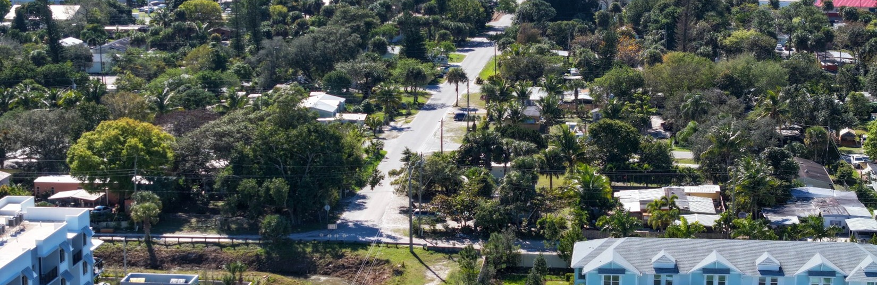
Project Development & Environment (PD&E) Study
Alternatives Public Workshop
Willoughby Boulevard
from State Road (S.R.) 714/Monterey Road to U.S. 1/S.R. 5/Federal Highway
Martin County, Florida
Florida Department Of Transportation
Financial Project ID: 419669-3-22-03
ETDM No: 14512
July 28, 2026, at 5:30 p.m. (Virtual Meeting)
July 29, 2026, at 5:30 p.m. (In-person Meeting)

Slide 2
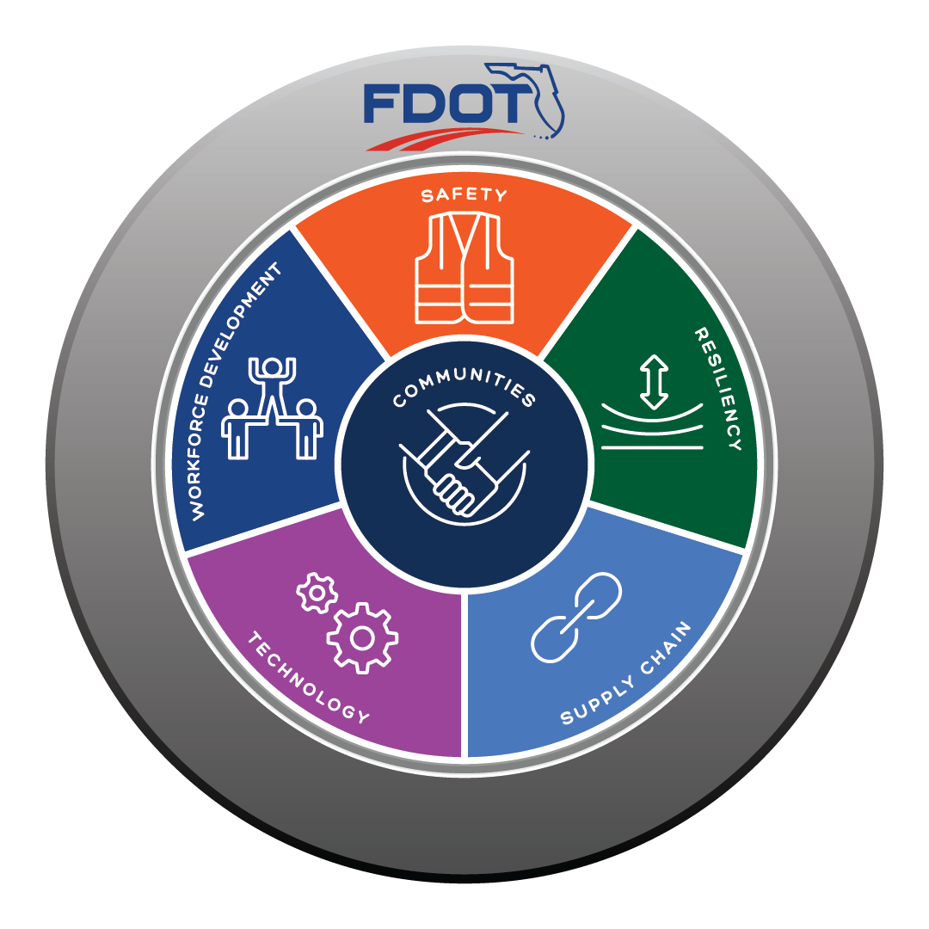
FDOT Compass
Community feedback is at the core of all we do. FDOT works with the public to balance their community vision with the community's transportation needs. This is routine on all our projects to ensure Florida's infrastructure is safe, resilient, and efficient for many years into the future.

Slide 3



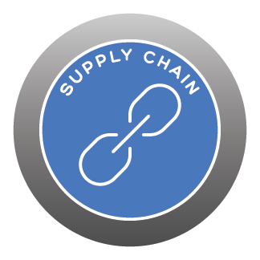
Project Benefits
Communities
Identified in Martin MPO’s Long Range Transportation Plan Needs Assessment list in 1994.
#12 on Martin MPO 2026 List of Project Priorities (LOPP)
Enhance mobility and ease of access between residential communities, businesses, and schools.
Strengthen network connections of existing sidewalks and bicycle lanes by constructing pedestrian facilities to address major gaps.
Reduce congestion and improve bicycle/pedestrian facilities.
Enhance emergency vehicle travel time.
Safety
Resiliency
Provide stormwater management that addresses future issues with water levels and groundwater conditions to operate effectively in the future.
Supply Chain
Improve traffic operations to accommodate the growing transportation demand for goods and services.
Increase network accessibility of existing and planned development to regional roadway system.

Slide 4

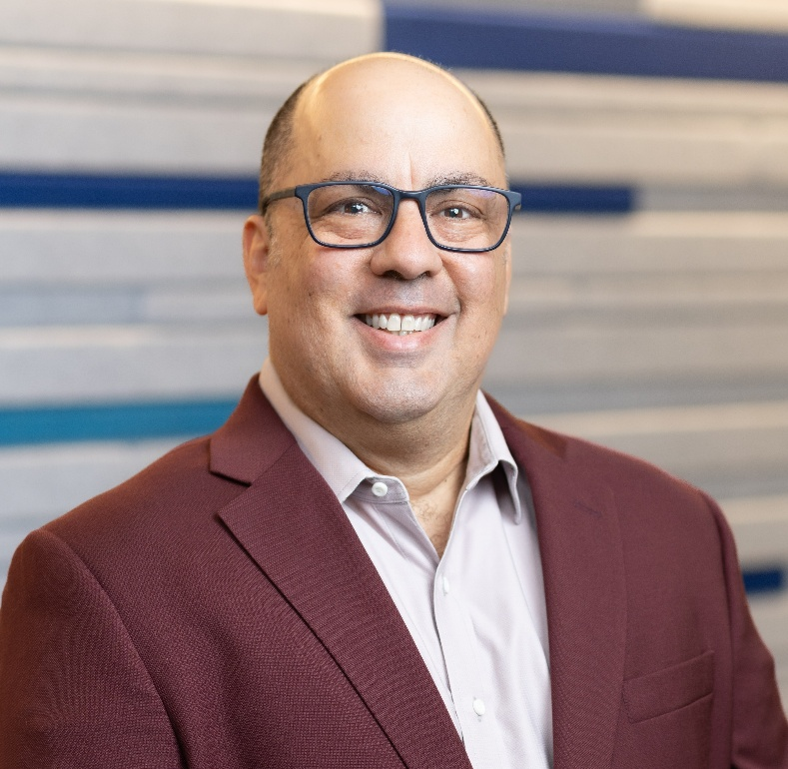
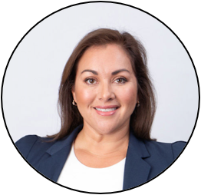
Project Team
Vanita Saini, P.E.
Project Manager
Florida Department of Transportation (FDOT) District 4
Chris Rizzolo, P.E.
Consultant Project Manager
AECOM
Monica Diaz
Principal
Infinite Source Communications Group

Slide 5
WE WELCOME ALL ELECTED OFFICIALS

Slide 6
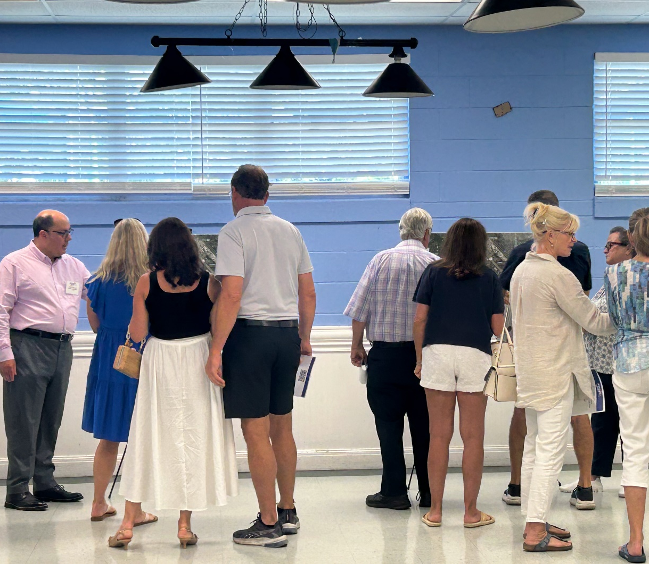
Meeting Format
Virtual:
Date: Tuesday, July 28, 2026
Time: 5:30 p.m.
Location: Microsoft Teams Webinar
In-Person:
Date: Wednesday, July 29, 2026
Time: 5:30 p.m.
Location: 10th Street Community Center 724 SE 10th Street, Stuart, FL 34994

Slide 7
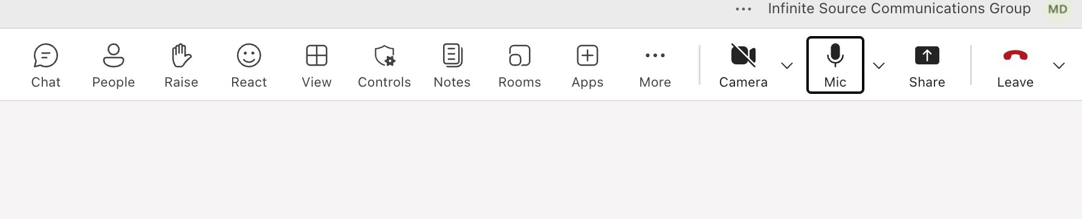
Rules of Engagement
This Public Workshop is being recorded.
If you experience technical difficulties, please contact 954-548-2754 so that a member of our technical support team may assist you.
All Virtual attendees will remain muted throughout the Meeting.
Virtual attendees are also welcome to submit any questions/comments using the Teams control panel at any time or use the “Raise Hand” button on your control panel and a member of our team will respond to/unmute you during the open discussion.
If you are participating via Telephone and have questions/comments, feel free to submit them to the FDOT Project Manager Vanita Saini, P.E., via email after the meeting and a response will be provided.

Slide 8

About Your Comments and Questions
All written comments are part of the Public Record.
You can submit comments and questions throughout the project.
All registrants will receive a link to the presentation recording.

Slide 9







Public Meeting - Public Notice
Property owner letters/tenant flyers
Emails to project contacts list
Newspaper
Florida Administrative Register
Social media
Project website

Slide 10
Title VI of the Civil Rights Act of 1964
The Florida Department of Transportation is required to comply with various non-discrimination laws and regulations, including Title VI of the Civil Rights Act of 1964. Public participation is solicited without regard to race, color, national origin, age, sex, religion, disability, or family status. Persons wishing to express concerns relative to FDOT compliance with Title VI may do so by contacting:
Sharon Singh Hagyan
District Four Title VI Coordinator
3400 West Commercial Boulevard
Fort Lauderdale, Florida 33309
(954) 777-4190
(866) 336-8435, Ext. 4190 (Toll Free)
sharon.singhhagyan@dot.state.fl.us
Lisa Bethancourt
State Title VI Coordinator
Florida Department of Transportation
Business Growth & Engagement Office
605 Suwannee St. MS 65
Tallahassee, FL 32399-0450
(850) 414-4742
(866) 374-3368, Ext. 4742 (Toll Free)
Lisa.Bethancourt@dot.state.fl.us

Slide 11
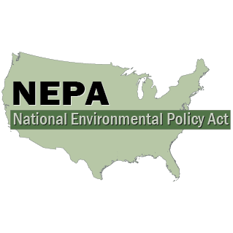
FDOT NEPA Assignment
The environmental review, consultation, and other actions required by applicable federal environmental laws for this project are being, or have been, carried out by the Florida Department of Transportation (FDOT) pursuant to 23 United States Code (U.S.C.) §327 and Memorandum of Understanding dated May 26, 2022, and executed by the Federal Highway Administration and FDOT.

Slide 12
Transportation Development Process
1
PLANNING
2
PROJECT DEVELOPMENT AND ENVIRONMENT (PD&E) STUDY
Why is a PD&E Study performed?
To determine the best alternative to address the purpose and need
To evaluate the potential environmental and social effects
To include public participation to help shape the project
To comply with federal, state, and local laws
During the PD&E Study:
The community will have several opportunities for input on the project
Project effects to the environment will be avoided or minimized
Coordination with federal, state and local agencies will occur
Project reports and plans will be available for public view
3
DESIGN
4
RIGHT OF WAY ACQUISITION
(IF NEEDED)
5
CONSTRUCTION
6
MAINTENANCE

Slide 13
PD&E Study Process
1
PLANNING
2
PROJECT DEVELOPMENT & ENVIRONMENT (PD&E) STUDY
Data Collection/
Initial Stakeholder Coordination
Develop
Alternatives
Alternatives Analysis - Engineering
Alternatives Analysis - Environmental
Final Documents
Area residents and businesses
Martin MPO
Martin County School Board
Martin County and City of Stuart
  Law Enforcement
  Fire Rescue
  Public Works
Purpose & Need
Stakeholder feedback
Feasibility
Traffic Evaluation
Safety Analysis
Roadway Analysis
Drainage/ Stormwater Management
Alternatives Public Workshop
Assess Potential Environmental Impacts
  Cultural
  Natural
  Physical
  Social
Alternatives Public Workshop
Determine Class of Action:
  Environmental Assessment (EA)
  Environmental Impact Statement (EIS)
Public Hearing
LDCA
3
DESIGN
4
RIGHT OF WAY ACQUISITION
(IF NEEDED)
5
CONSTRUCTION
6
MAINTENANCE
Continuous Public Engagement

Slide 14



Purpose and Need
Purpose
Improve roadway connection.
Add bicycle and pedestrian facilities.
Improve bicyclist safety.
Need
Provide an alternative route to alleviate traffic congestion within the project area.
Expand bicycle and pedestrian facilities in the project area.
Reduce bicycle crashes at S.R. 714/Willoughby Boulevard.
Objectives
Evaluate alternatives to alleviate traffic congestion by extending Willoughby Boulevard.
Improve bicycle and pedestrian connectivity.
Obtain Location and Design Concept Acceptance (LDCA) for a proposed alternative that meets the purpose and need.
Accommodate Population Growth & Travel Demand
Improve Connectivity
Enhance Mobility
Enhance Safety & Emergency Vehicle Travel Time

Slide 15
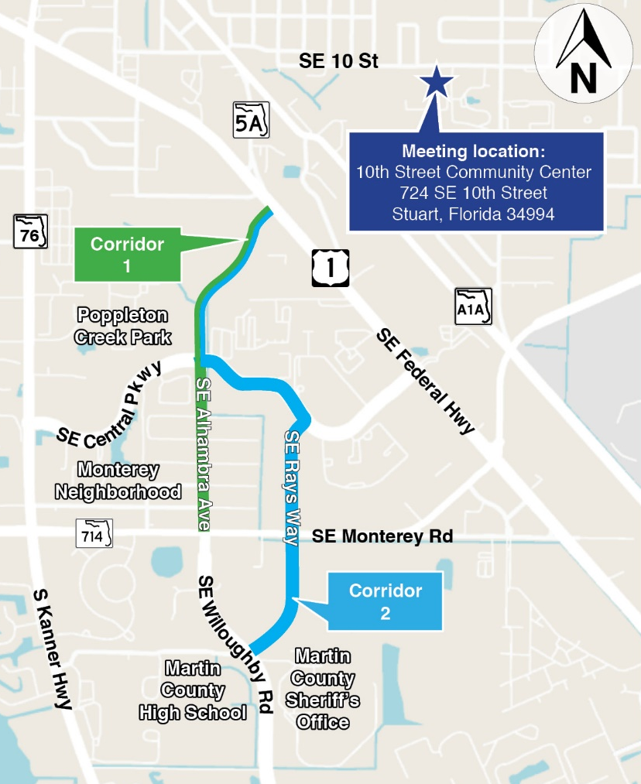


Project Location
FPID: 419669-3-22-03
ETDM#: 14512
Roadway: Willoughby Boulevard
RR Crossings: None
Project Study Limits: Willoughby Boulevard from State Road (S.R.) 714/Monterey Road to U.S. 1/S.R. 5/Federal Highway
County: Martin
City: Stuart
Project Scope
Extending Willoughby Boulevard from its northern terminus at S.R. 714/Monterey Road to an appropriate terminus at S.R. 5/U.S. 1/Federal Highway
San Jose St.
Corridor 1 (approximately 3/4 miles) | Reconstruct existing Alhambra Ave. (1/4 mile) Construct new roadway from San Jose St. to U.S. 1/S.R. 5/Federal Hwy. (1/2 mile)*
Corridor 2 (approximately 1-1/4 miles) | Construct new roadway from MCHS entrance to S.R. 714/Monterey Rd. (1/4 mile) Reconstruct existing Rays Way from S.R. 714/Monterey Rd. to Central Pkwy (1/4 mile) Reconstruct existing Central Pkwy. (1/4 mile) Construct new roadway from Central Pkwy. to U.S. 1/S.R. 5/Federal Highway (1/2 mile)*
*Right of way was established and dedicated in 2010

Slide 16
Area Projects and Previous Studies
Area Projects
Previous Studies
Willoughby Blvd. Corridor Feasibility Study Report from S.R. 714/Monterey Road to U.S. 1/Federal Highway (FPID: 419669-3)
Project Name | Project FPID | Project Type | Project Phase
S.R. 714/Monterey Rd. at FEC Railroad Crossing | 441636-2 | Railroad Crossing Improvements | PD&E Study¹
S.R. 714/Monterey Rd., C.R. 5A/Dixie Hwy., and Palm Beach Rd. | 444405-2 | Multimodal | Construction
S.R. 714/Monterey Rd. from Citrus Blvd. to SW Martin Downs Blvd. | 436870-1 | Widening | Construction Complete
Cove Rd. from S.R. 76/Kanner Hwy. to S.R. 5/U.S. 1 | 441700-1 | Widening | Design
C.R. 713 from I-95 to SW Martin Hwy. | 441699-1 | Widening | Design
¹ 2030 Construction Year

Slide 17
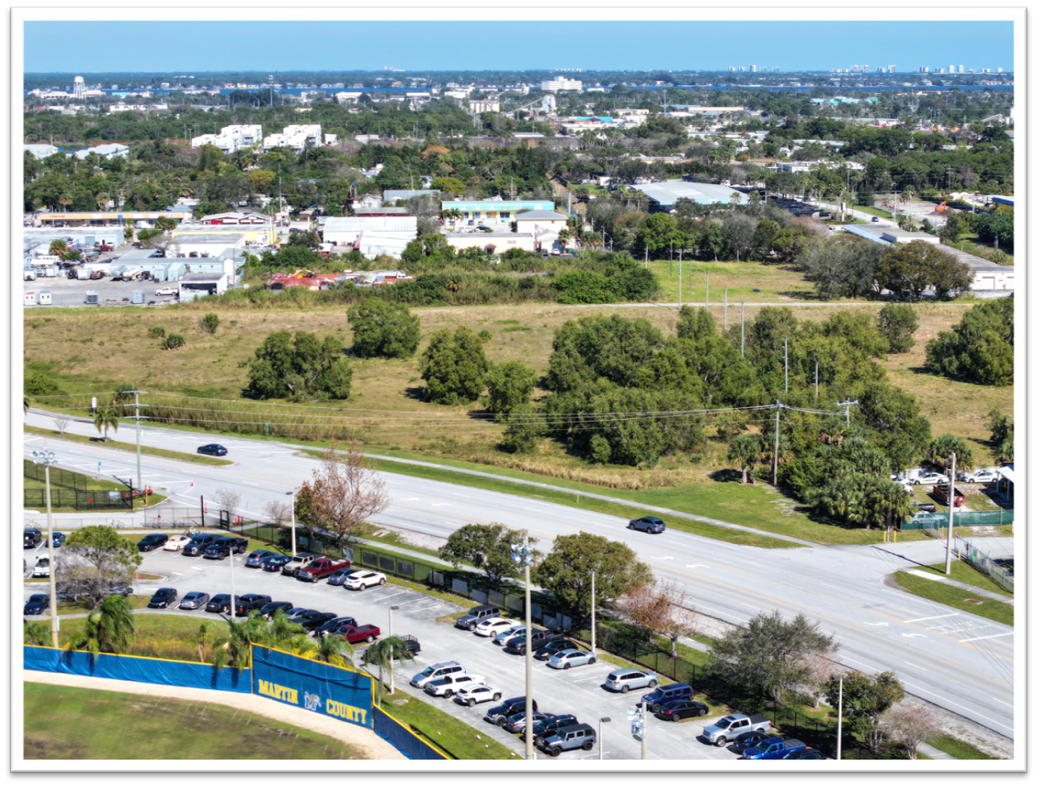
Existing Conditions – Roadway
Willoughby Boulevard
County road from Cove Rd. to S.R. 714/Monterey Rd.
Four lanes divided (two in each direction) from Pomeroy Rd. to S.R. 714/Monterey Rd.
Sidewalks on both sides
Posted speed limit: 45 mph
12 key intersections
Paved shoulders (no designated bike lanes/facilities)

Slide 18
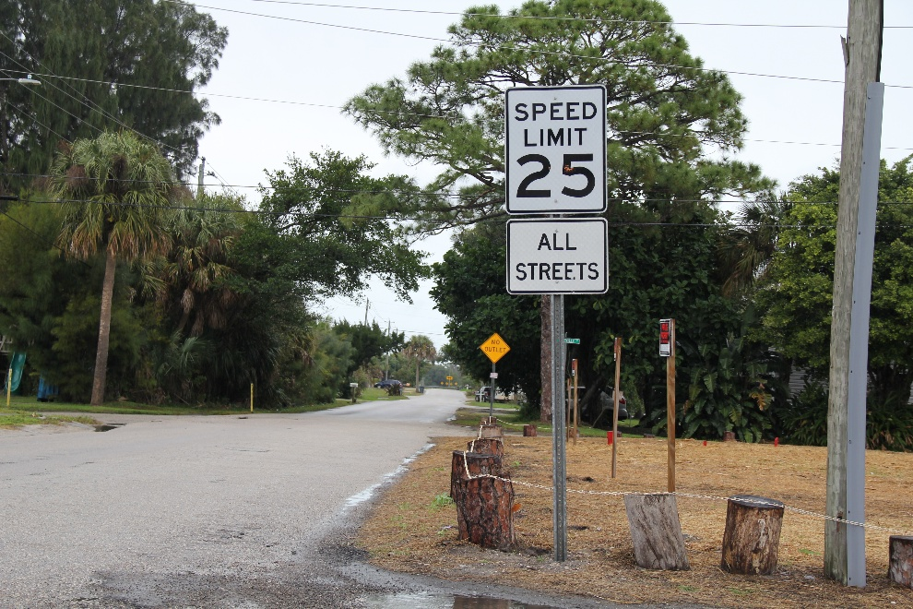
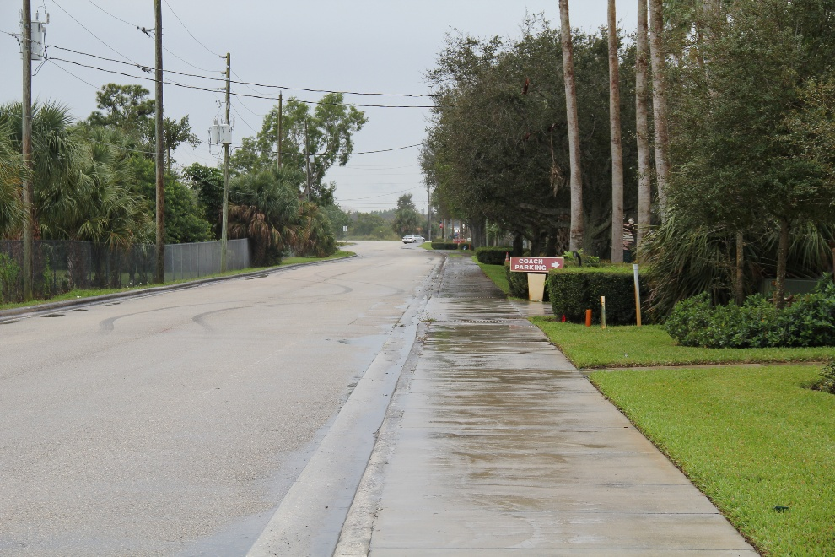
Existing Conditions – Roadway
Alhambra Avenue
County Road from S.R. 714/Monterey Rd. to San Jose St.
Two lanes undivided (one in each direction)
Sidewalk on west side from S.R. 714/Monterey Rd. to Seville St.
Posted Speed Limit: 25 mph.
No bicycle facilities
Rays Way
City Road from S.R. 714/Monterey Rd. to Central Pkwy.
Two lanes undivided (one in each direction)
Sidewalk on west side from S.R. 714/Monterey Rd. to Central Pkwy.
Posted Speed Limit: 25 mph
No bicycle facilities

Slide 19
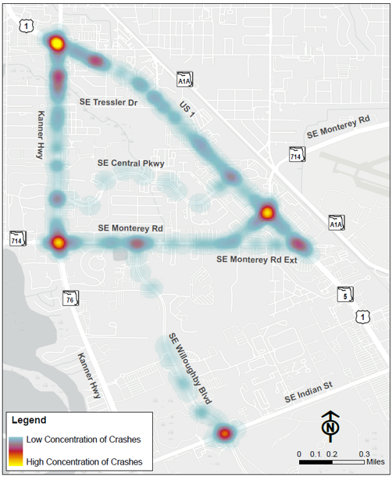
Vehicle Crash History
Crash Severity | 2019 | 2020 | 2021 | 2022 | 2023 | Total | Proportion
Fatal | 1 | 0 | 2 | 1 | 0 | 4 | 0.2%
Injury | 79 | 60 | 78 | 86 | 86 | 389 | 23.0%
PDO* | 262 | 213 | 237 | 290 | 300 | 1,302 | 76.8%
Total Crashes | 341 | 273 | 317 | 377 | 386 | 1,695 | 100.0%
U.S. 1
*Property Damage Only
Notes:
This slide summarizes crash trends within the study area over the five-year period from 2019 to 2023.
The data show that most crashes were property-damage-only crashes, while injury crashes represented about 23 percent of the total.
Four fatal crashes took place in this five year period, which highlights the need to improve safety and operations

Slide 20
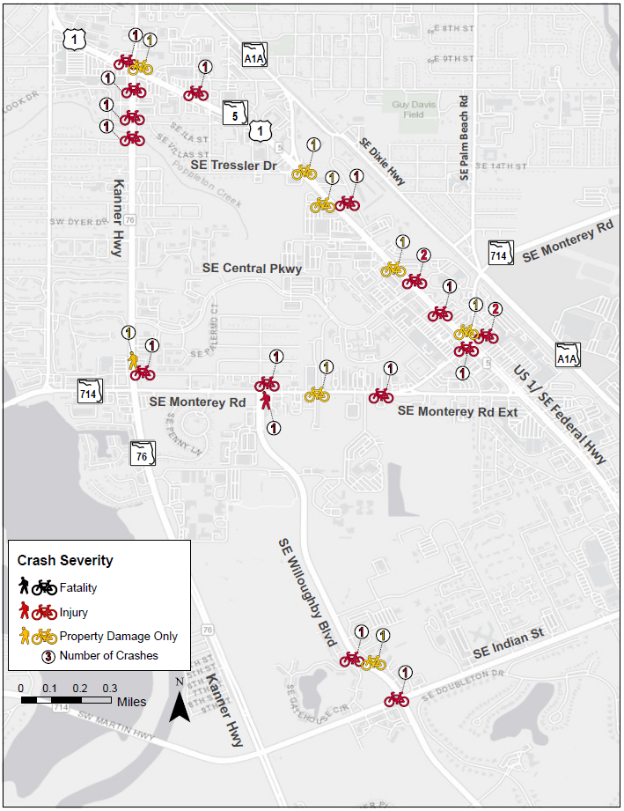
Bicycle & Pedestrian Crash History
Crash Severity | 2019 | 2020 | 2021 | 2022 | 2023 | Total | Proportion
Fatal | 0 | 0 | 0 | 0 | 0 | 0 | 0%
Injury | 2 | 3 | 7 | 6 | 0 | 18 | 69%
PDO* | 0 | 1 | 2 | 3 | 2 | 8 | 31%
Total Crashes | 2 | 4 | 9 | 9 | 2 | 26 | 100%
*Property Damage Only
Notes:
Looking at bicycle and pedestrian crashes, about 69% involved injuries. This indicates a higher travel risk for vulnerable users.
As part of this study, the team is considering opportunities to support safer and more comfortable travel for people walking and bicycling throughout the corridor

Slide 21
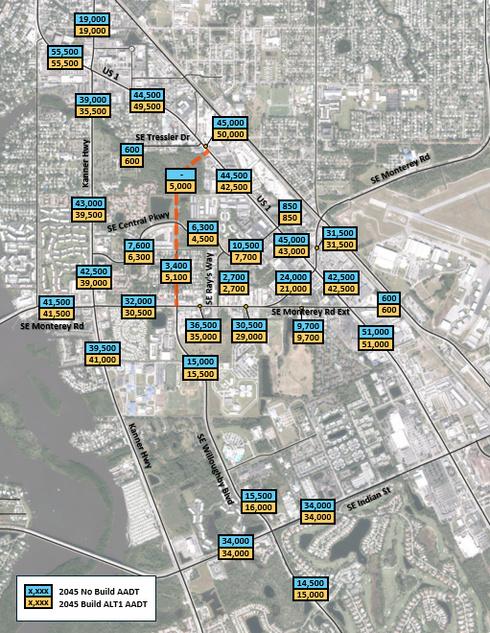
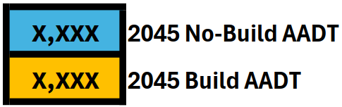
2045 Projected Traffic (Build and No-Build) – Corridor 1
Legend
Notes:
This slide show projected future traffic conditions for Corridor 1 alternative compared to the No-Build condition.
The No-Build condition represents what the roadway network could look like in the future if improvements beyond already committed projects are not added.

Slide 22
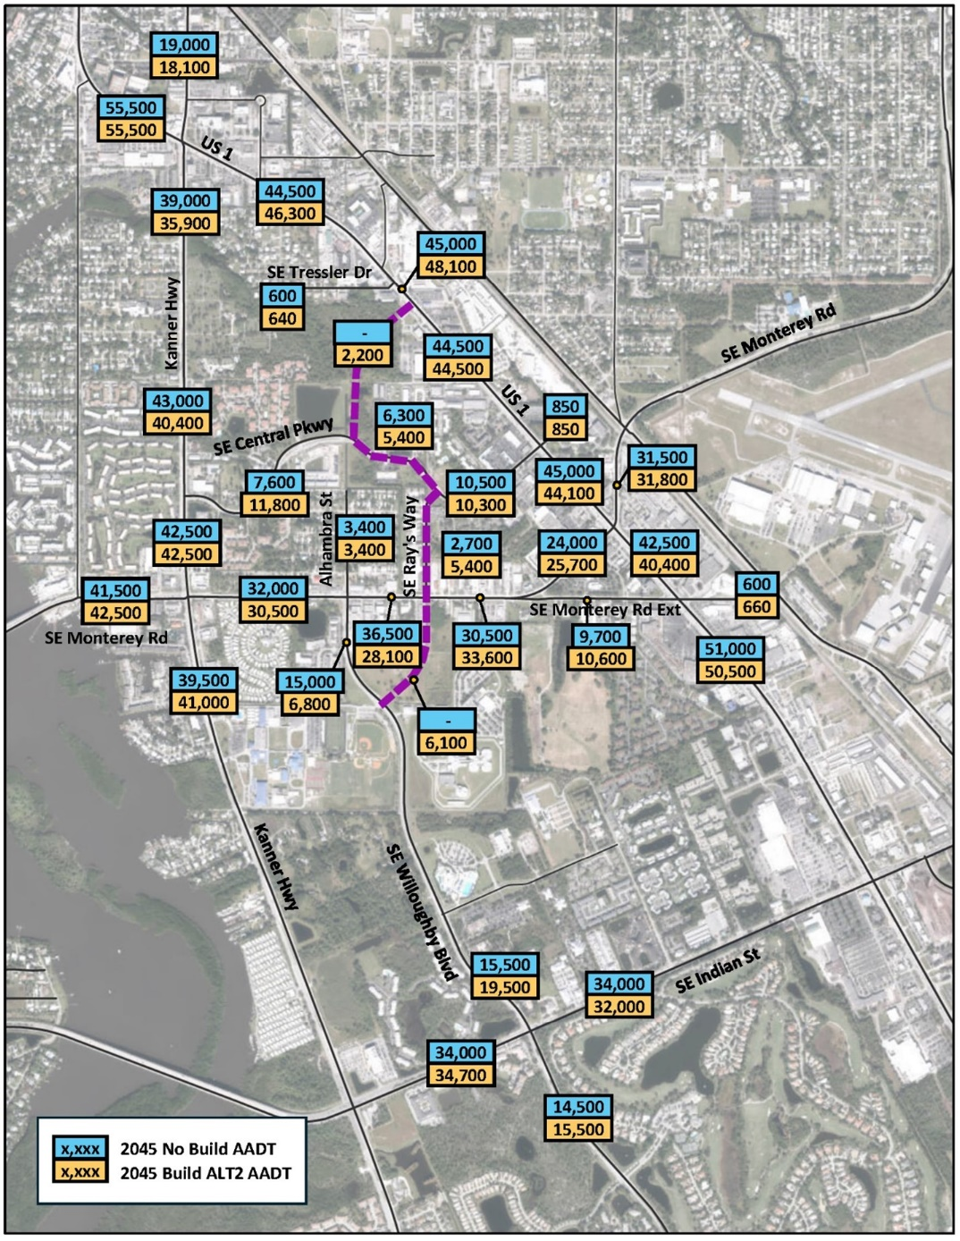
2045 Projected Traffic (Build and No-Build) – Corridor 2
Legend
Notes:
These slide show projected future traffic conditions for Corridor 2 alternative compared to the No-Build condition.
Both alternatives are being evaluated to understand how they may improve traffic flow, reduce congestion, and support future travel demand within the study area.

Slide 23
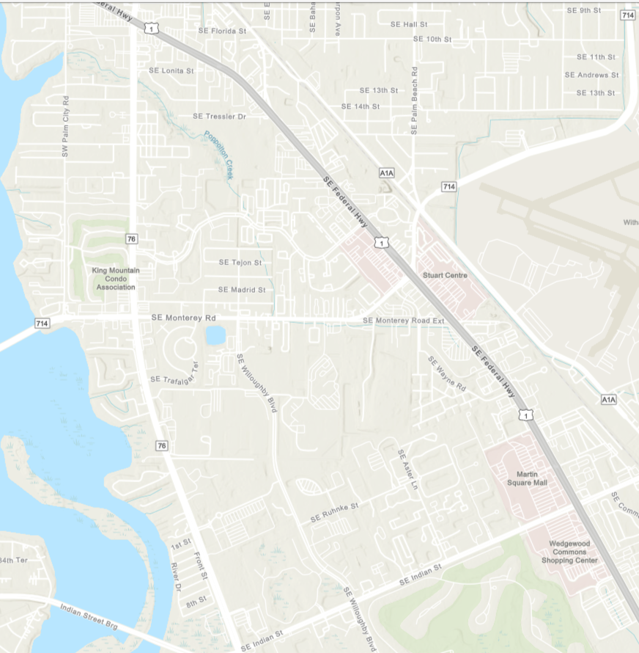


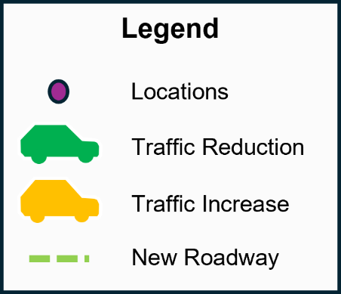
2045 No-Build vs. Existing Traffic Projection Comparison
17%
Kanner Highway
Increased congestion
17%
21%
Increased travel time
17%
SE Central Pkwy
117%
21%
SE Ray’s Way
13%
SE Monterey Road
Existing
No Build
16%
US 1
Willoughby Blvd
Legend
29%
Locations
SE Indian Street
Traffic Increase
Notes:
This is a comparison of future traffic operations between the No-Build condition and the Corridor 1 alternative.
Corridor 1 was developed to improve overall roadway operations and to provide an additional travel option through the corridor.
The traffic projections indicate that Corridor 1 may help distribute traffic more efficiently across the roadway network.
For residents and businesses, these improvements will support more reliable trips, improved access to surrounding destinations, and better overall mobility throughout the study area.

Slide 24
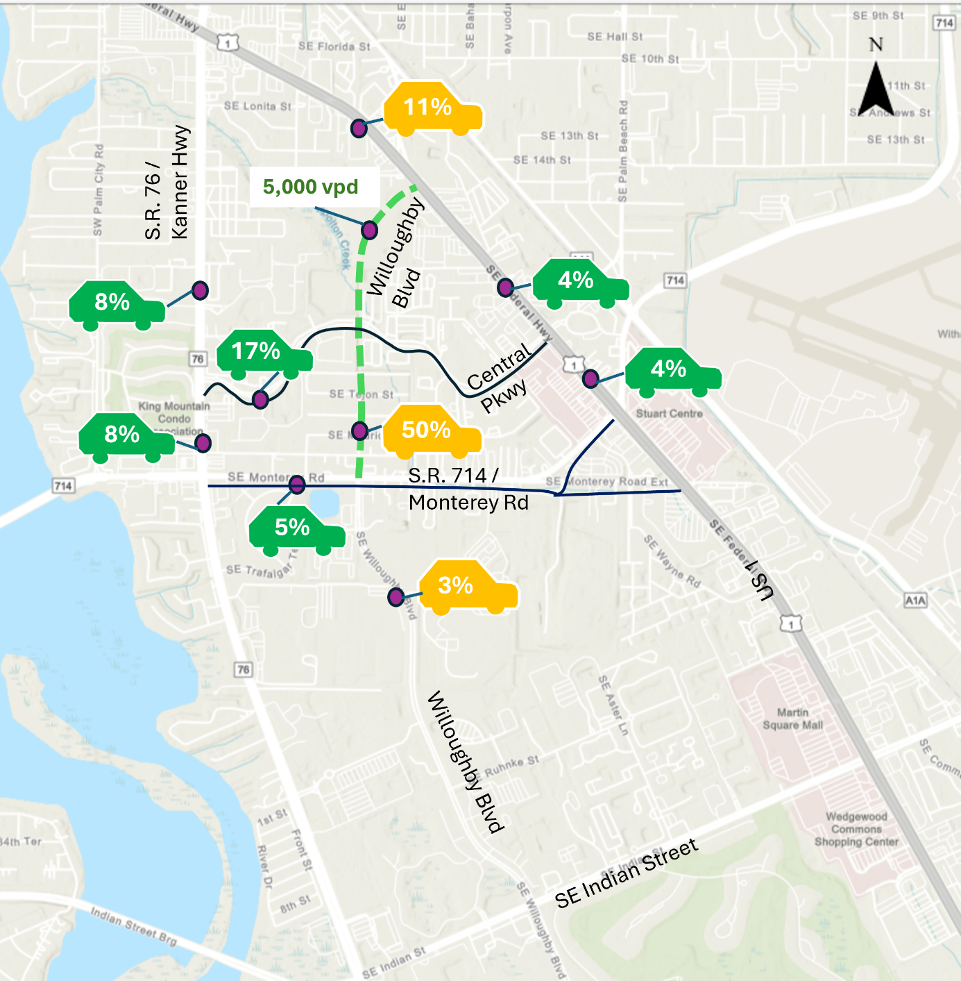


2045 No-Build vs. Corridor 1 Traffic Projection Comparison
Reduced congestion
Reduced travel time
Corridor 1
No Build
Notes:
This is a comparison of future traffic operations between the No-Build condition and the Corridor 1 alternative.
Corridor 1 was developed to improve overall roadway operations and to provide an additional travel option through the corridor.
The traffic projections indicate that Corridor 1 may help distribute traffic more efficiently across the roadway network.
For residents and businesses, these improvements will support more reliable trips, improved access to surrounding destinations, and better overall mobility throughout the study area.

Slide 25
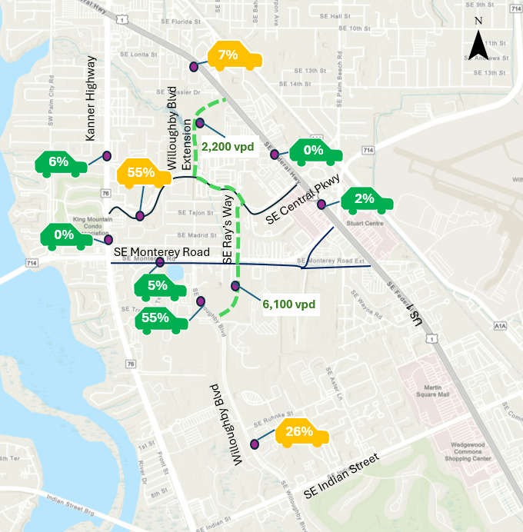
2045 No-Build vs. Corridor 2 Traffic Projection Comparison
Reduced congestion
Reduced travel time
Corridor 2
No Build
Notes:
Like Corridor 1, the Corridor 2 alternative is intended to address future traffic demand and improve traffic circulation within the study area.
While Corridor 1 and Corridor 2 perform somewhat differently, both alternatives demonstrate positive operational improvements when compared to the No-Build condition.

Slide 26
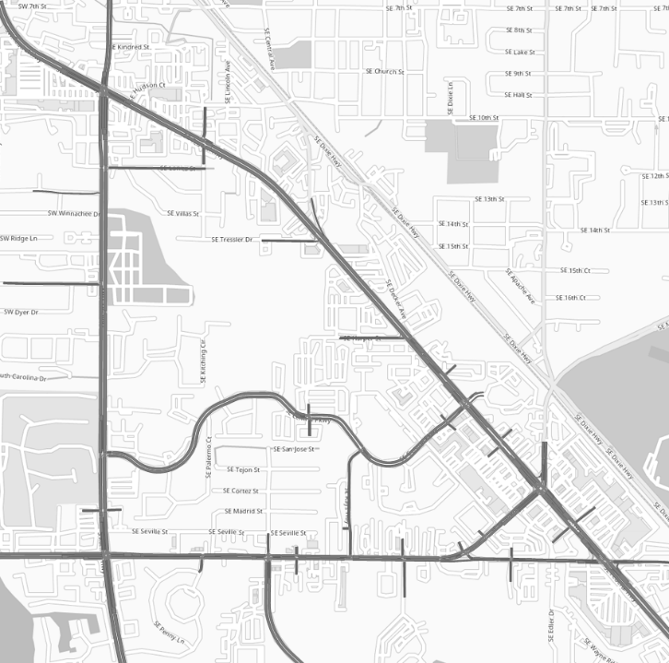
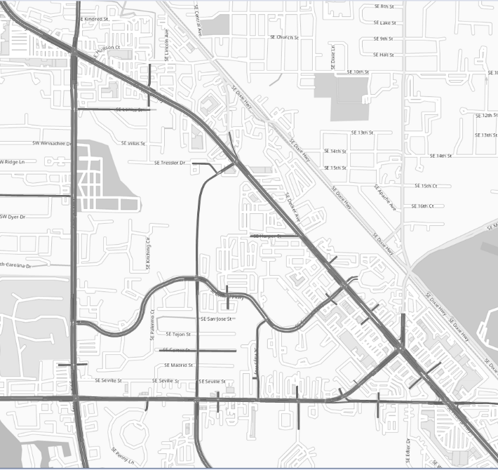
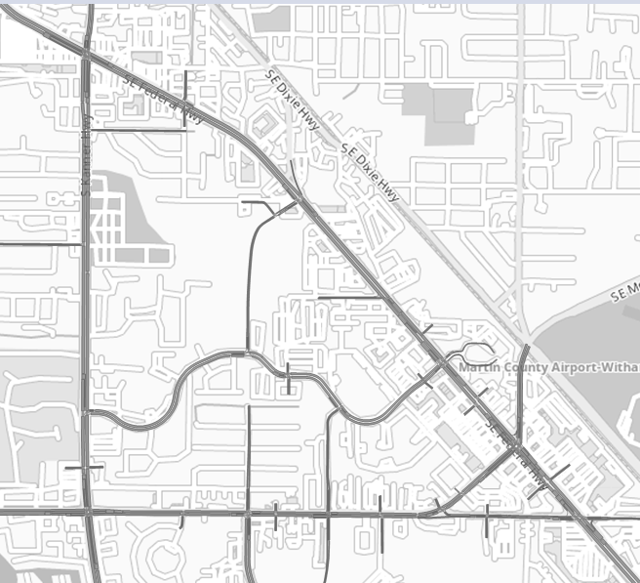


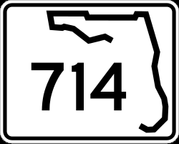
2045 No-Build, Corridor 1 and Corridor 2 Evening Peak Hour Travel Time Comparison
No-Build Alternative
No-Build vs. Corridor 1
No-Build vs. Corridor 2
Travel Time Reduction
Travel Time Reduction
37%
31%
Kanner Hwy
Kanner Hwy
Kanner Hwy
Willoughby Blvd
Willoughby Blvd
Monterey Rd
Monterey Rd
-30%
Monterey Rd
S.R. 714 / Willoughby Blvd. to S.R. 76 / U.S. 1 (New Corridor)
Notes:
The study team evaluated how both Corridors could improve mobility and traffic circulation within the roadway network.
For Corridor 1, the analysis shows an estimated 37 percent reduction in evening peak hour travel time compared to the No-Build condition.
Corridor 2 also demonstrates operational improvements, with an estimated 31 percent reduction in travel time compared to the No-Build condition.
These improvements suggest that both alternatives may help drivers move more efficiently through the corridor during busy travel periods.
This slide also demonstrates how additional roadway connectivity may help distribute traffic across multiple routes rather than concentrating traffic on a limited number of major corridors.

Slide 27
2045 No-Build, Corridor 1 and Corridor 2 Evening Peak Hour Travel Time Comparison
No-Build Alternative
No-Build vs. Corridor 1
No-Build vs. Corridor 2
Travel Time Reduction
Travel Time Reduction
27%
50%
Kanner Hwy
Kanner Hwy
S.R.76/Kanner Hwy
Willoughby Blvd.
Willoughby Blvd
Monterey Rd.
Monterey Rd.
S.R.714/Monterey Road
S.R. 714 / Willoughby Blvd. to S.R. 76 / U.S. 1 (Existing Corridor)
Legend
New Roadway
Notes:
This slide focuses on projected evening peak hour travel times along Kanner Hwy and Monterey Road roadway connections under both build alternatives.
For Corridor 1, the analysis indicates an approximate 8 percent reduction in travel time compared to the No-Build condition.
While this improvement is moderate than some of the other roadway segments evaluated in the study, it still represents a positive operational benefit for drivers using Willoughby Boulevard and surrounding intersections.
Corridor 2 shows projected improvement along this segment, with an estimated 43 percent reduction in travel time compared to the No-Build condition.
Overall, the findings shown on this slide indicate that both alternatives may improve future travel conditions, although the level of improvement varies depending on the roadway segment and alternative being evaluated.

Slide 28
2045 No-Build, Corridor 1 and Corridor 2 Evening Peak Hour Travel Time Comparison
No-Build Alternative
No-Build vs. Corridor 1
No-Build vs. Corridor 2
Travel Time Reduction
Travel Time Reduction
36%
33%
Kanner Hwy
Kanner Hwy
Kanner Hwy
Willoughby Blvd
Willoughby Blvd
Monterey Rd
Monterey Rd
Monterey Rd
S.R. 714 west of S.R. 76 to S.R. 76 / U.S. 1
Legend
New Roadway
Notes:
This slide presents projected evening peak hour travel time improvements along the Kanner Highway, traffic coming to/from SW Martin Downs Blvd. for both Corridor 1 and Corridor 2.
The study analysis shows that Corridor 1 may reduce travel times by approximately 36 percent compared to the No-Build condition.
Corridor 2 also shows an estimated 33 percent reduction in travel time along this corridor.
These findings suggest that both build alternatives may provide meaningful operational improvements and help address future congestion within the study area.

Slide 29
2045 Total Travel Time and Delay Comparative Results¹
22%
65%
User Benefits of the Build alternative were estimated over a 21-year project life span using the projected reduction in network travel time:
Corridor 1 User Benefit: $57 Million or $2.7 Million per year
Corridor 2 User Benefit: $50 Million or $2.3 Million per year
1. Daily statistics include the AM (7:00–11:00 AM) and PM (3:30–7:30 PM) peak periods. Total travel time (hours) and average delay (seconds) are network-wide statistics covering all roadways in the study area.
Notes:
This slide compares the Year 2045 traffic conditions for the No-Build alternative and two build corridors.
The analysis focuses on total travel time and average vehicle delay during the morning and evening peak periods across the study area.
Corridor 1 shows the greatest operational improvement, reducing total travel time by approximately 65 percent and lowering average delay by about 44 percent compared to the No-Build alternative.
Corridor 2 also improves travel conditions by reducing congestion and delay throughout the network.
The study also evaluated long-term user benefits over a 21-year project life span.
Corridor 1 is projected to provide approximately $57 million in travel time savings, while Corridor 2 is projected to provide about $50 million in user benefits.
These savings reflect reduced time spent in traffic and improved mobility for area residents and travelers.

Slide 30
Future Condition Safety Evaluation for S.E. Central Pkwy at S.R. 76/Kanner Hwy
+14%
-5%

Slide 31
Future Condition Safety Evaluation for S.E. Central Pkwy at U.S. 1
-11%
-7%

Slide 32
Future Condition Safety Evaluation for S.R. 714/S.E. Monterey Rd at S.R. 76/Kanner Hwy
-1%

Slide 33
Future Condition Safety Evaluation for S.R. 714/S.E. Monterey Rd at U.S. 1
-17%
-16%

Slide 34
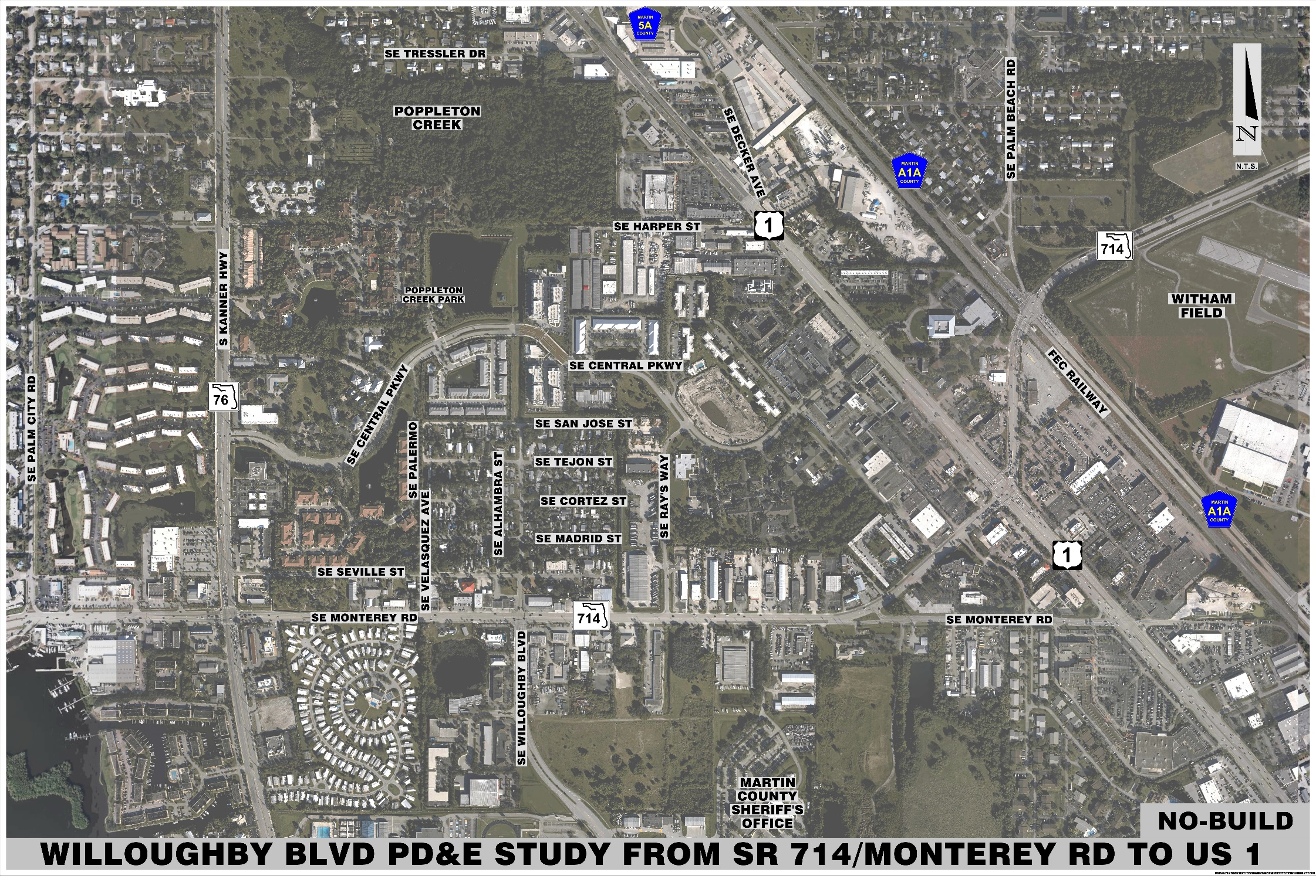
No-Build
No improvements
Previously Planned/Programmed projects in place
  S.R. 417 / FEC RR
  S.R. 76 / U.S. 1 Improvements

Slide 35
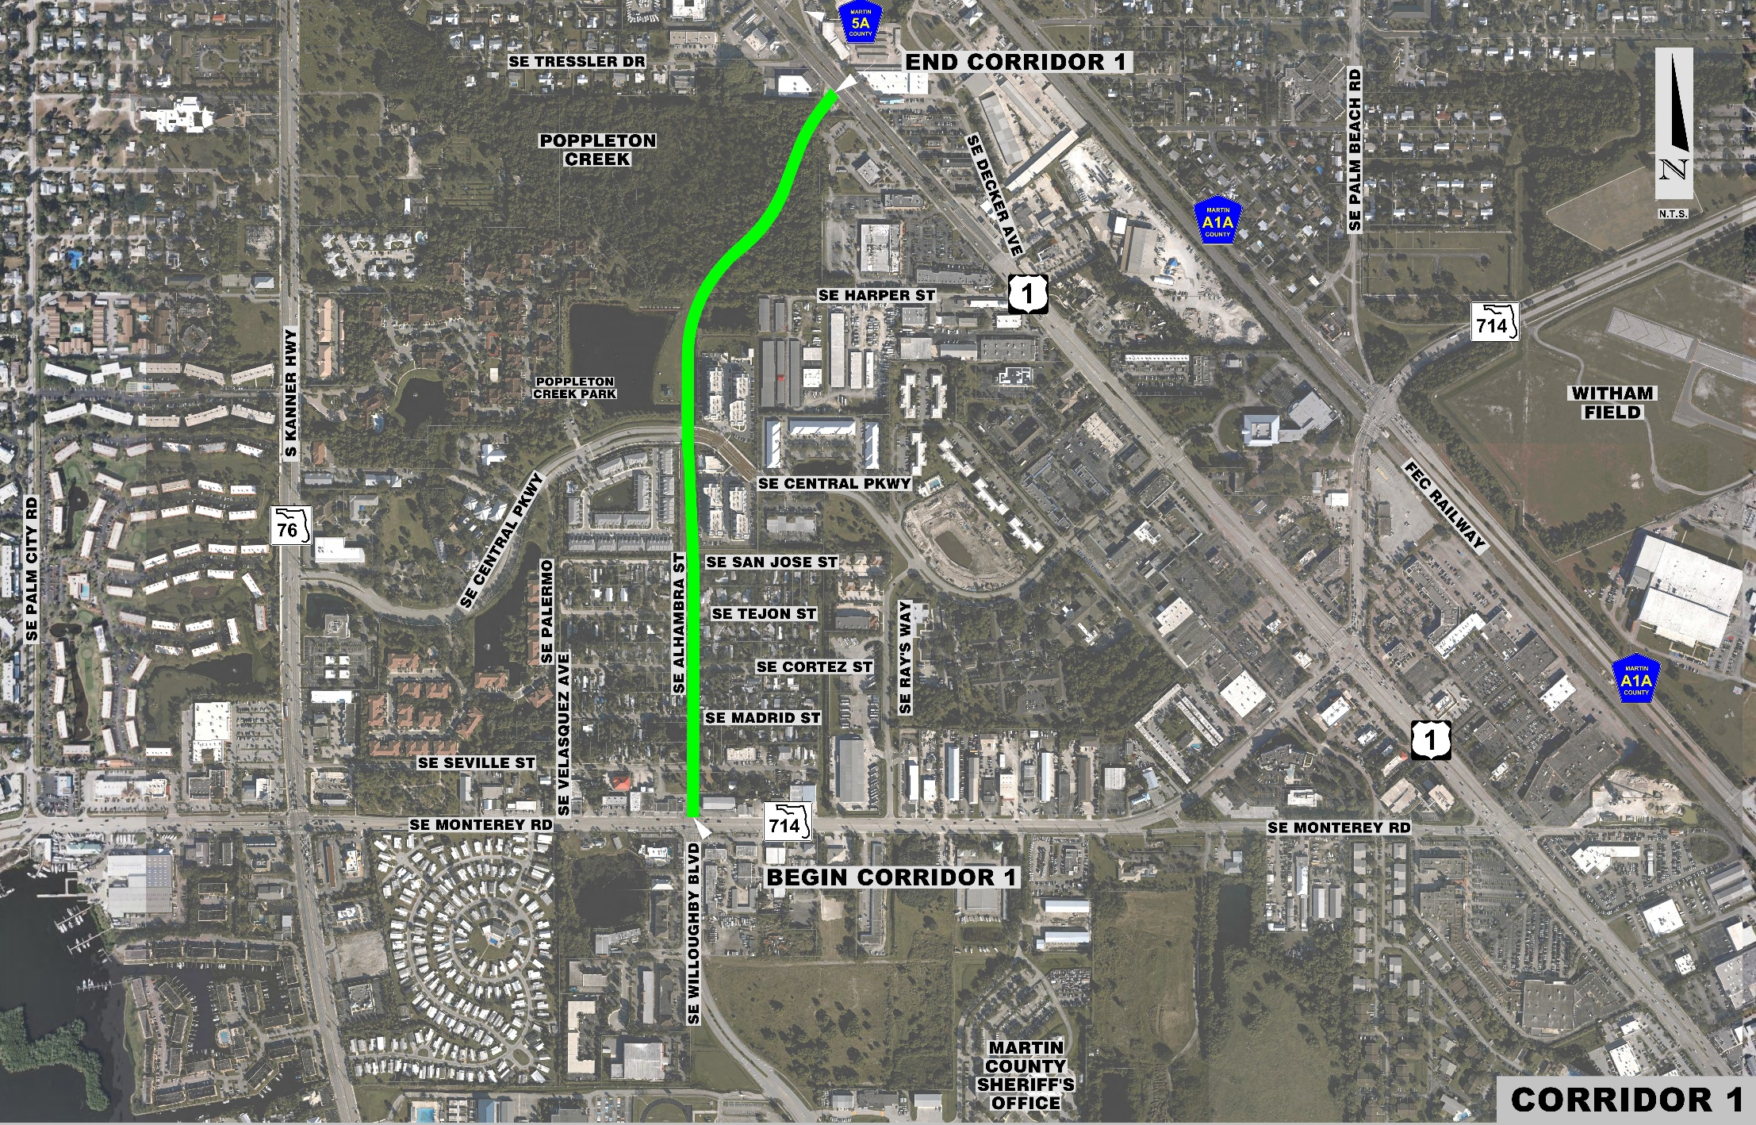
Corridor 1
Segment 1 – from S.R. 714 to San Jose St.
Segment 2 – from San Jose St. to Central Pkwy.
Segment 3 – from Central Pkwy. to U.S. 1
Segment 3
Segment 2
Segment 1

Slide 36
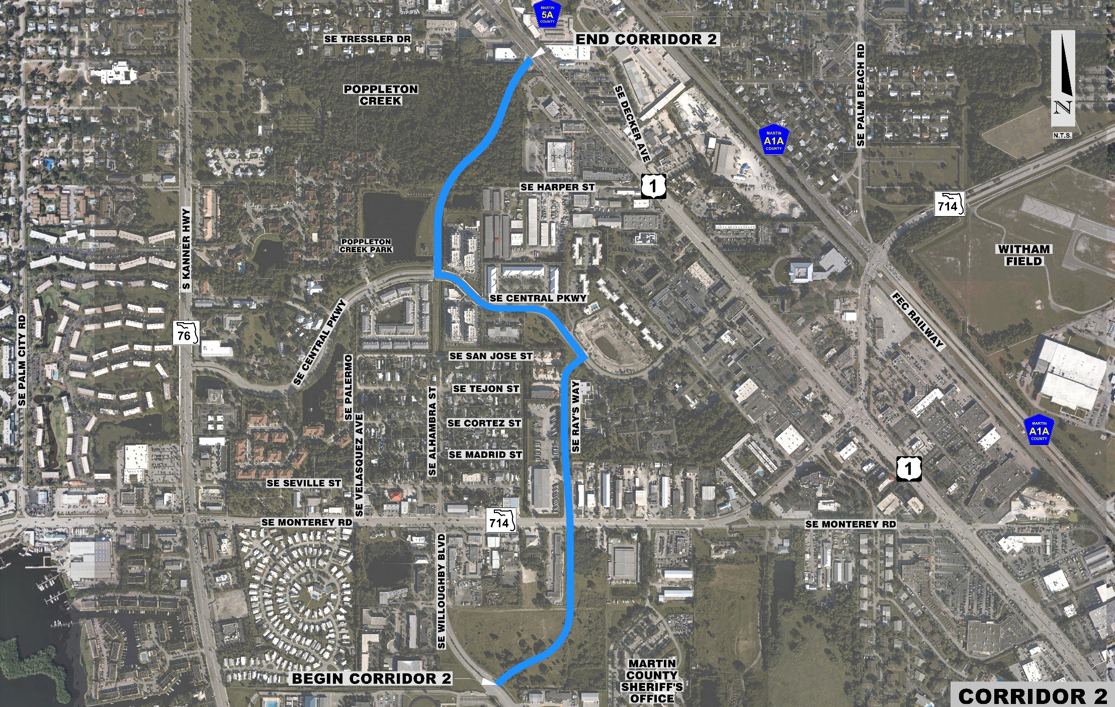
Corridor 2
Segment 1 – from Willoughby Blvd. to S.R. 714
Segment 2 – from Rays Way to Central Pkwy.
Existing Central Pkwy.
Segment 3 – from Central Pkwy. to U.S. 1
Segment 3
Segment 2
Segment 1

Slide 37
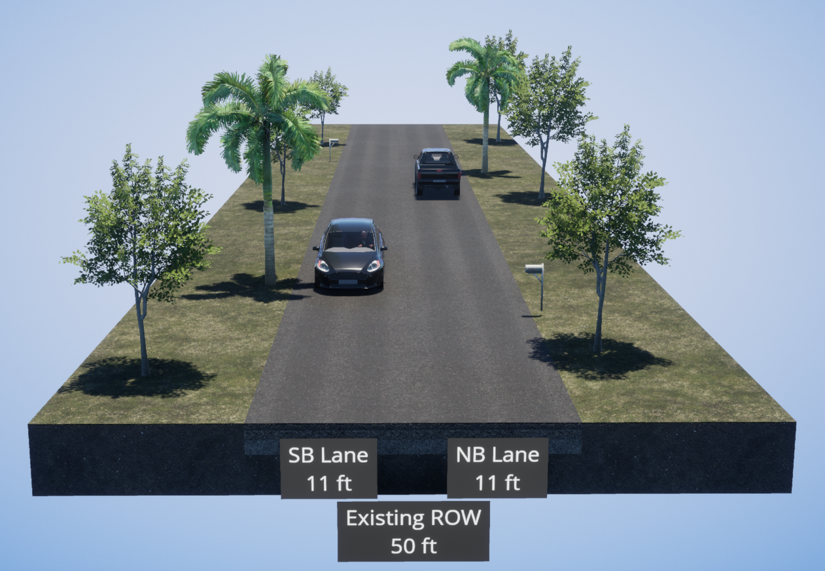
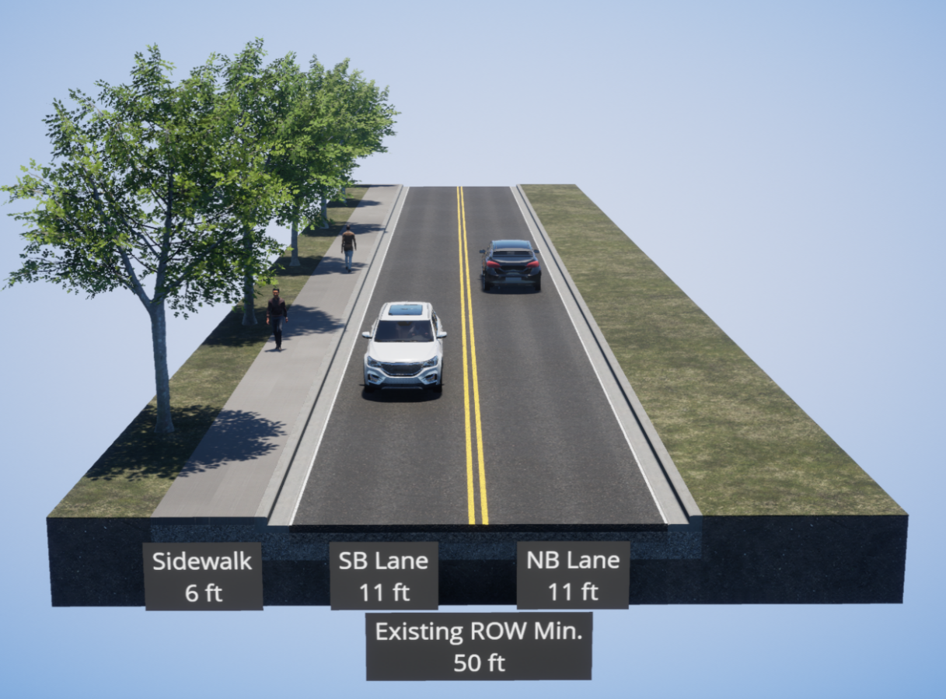
Existing Typical Sections – No-Build
Alhambra Avenue
Rays Way

Slide 38
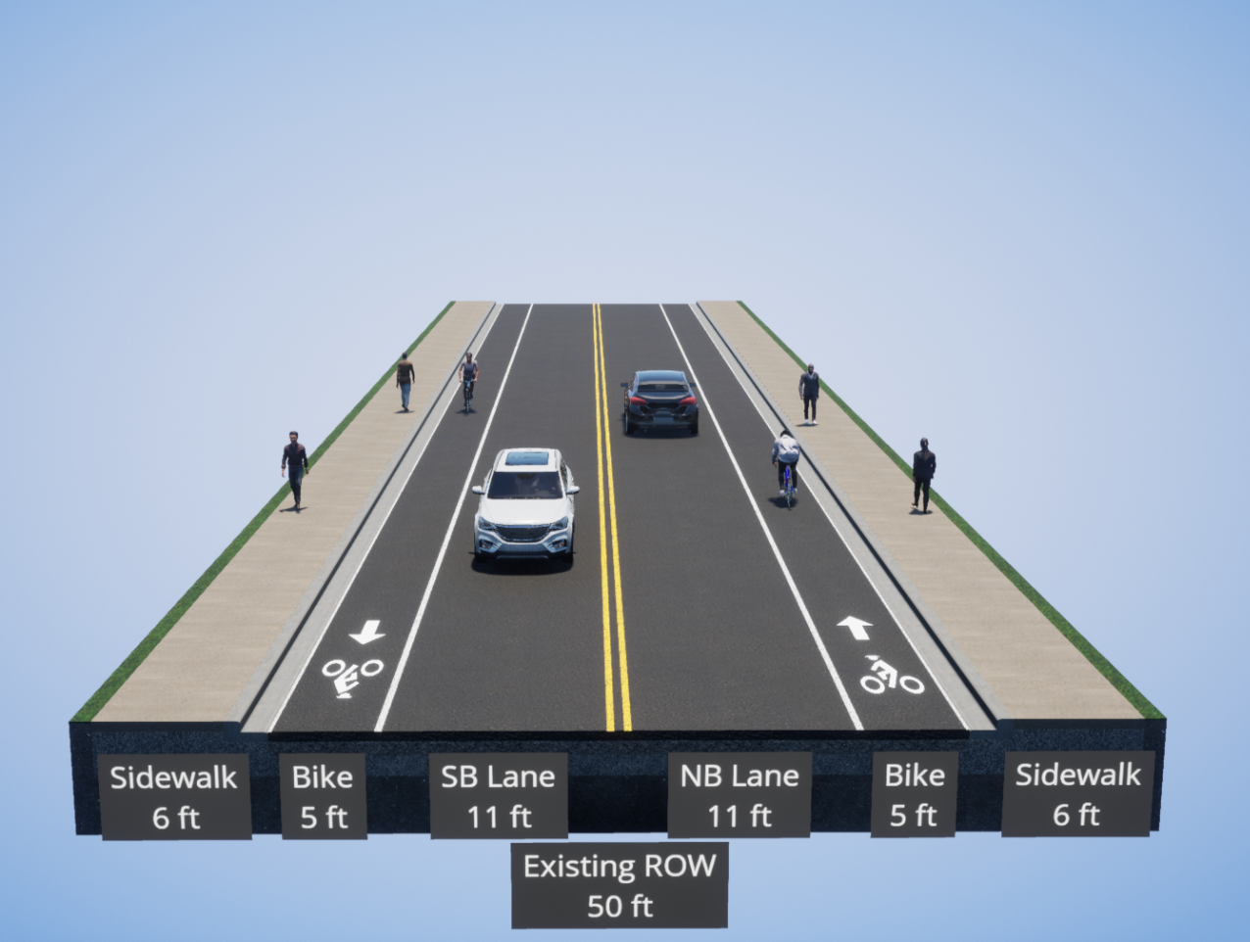
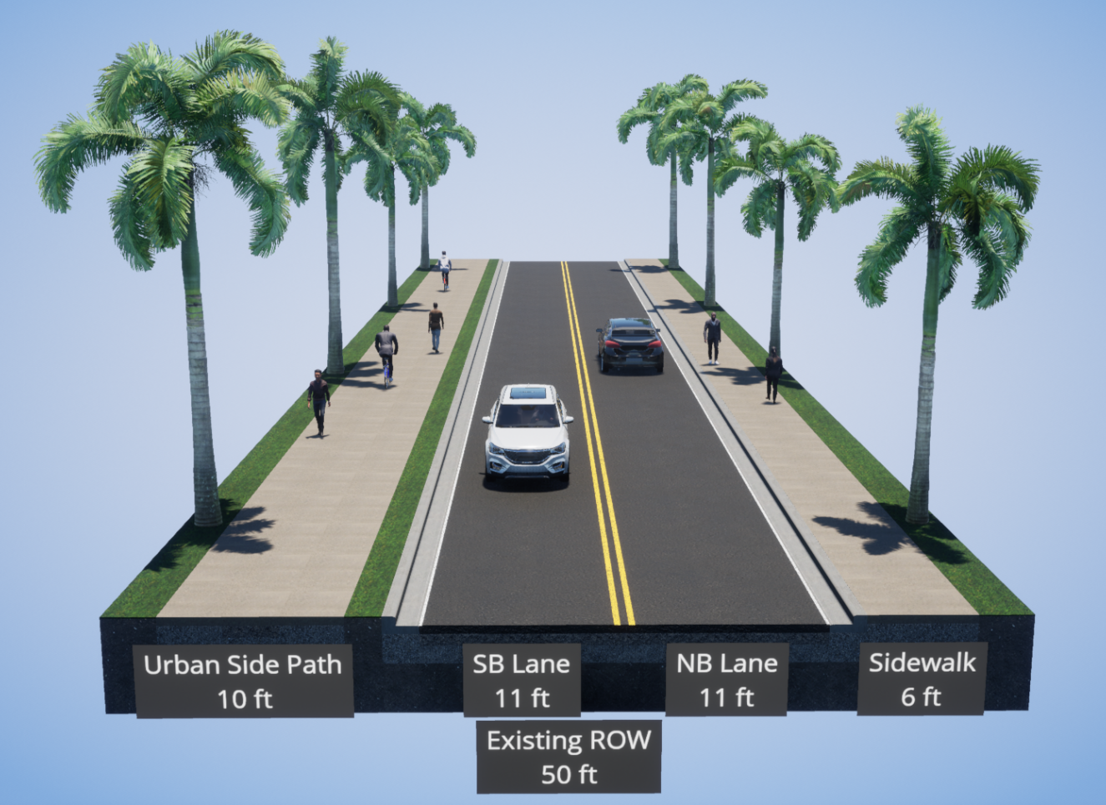
Typical Sections - Corridor 1, Segment 1
Alternative A
Alternative B

Slide 39
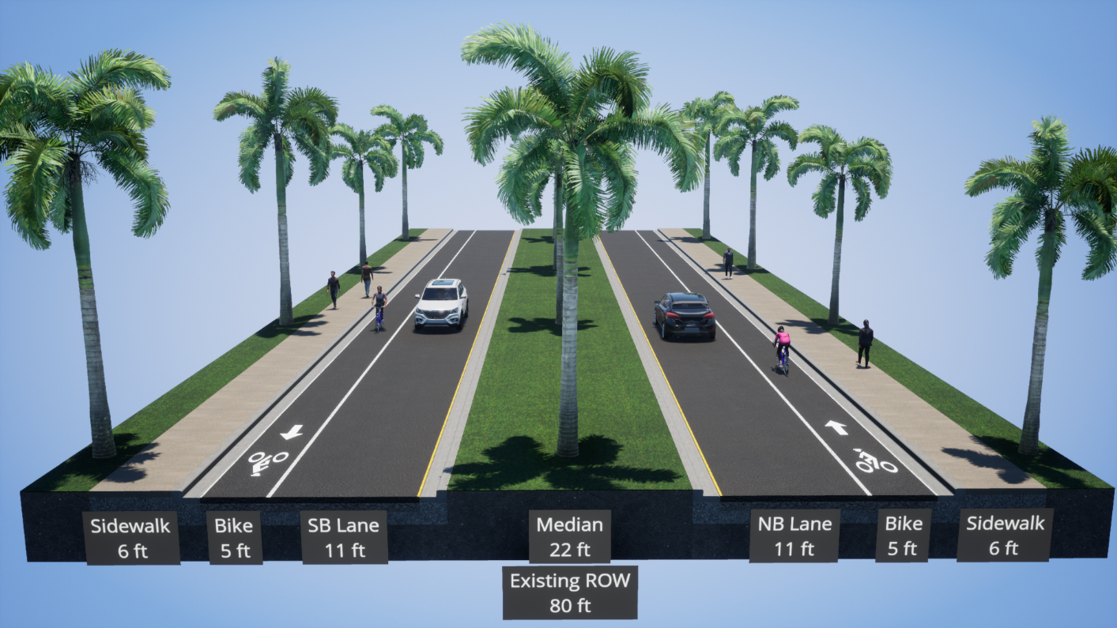
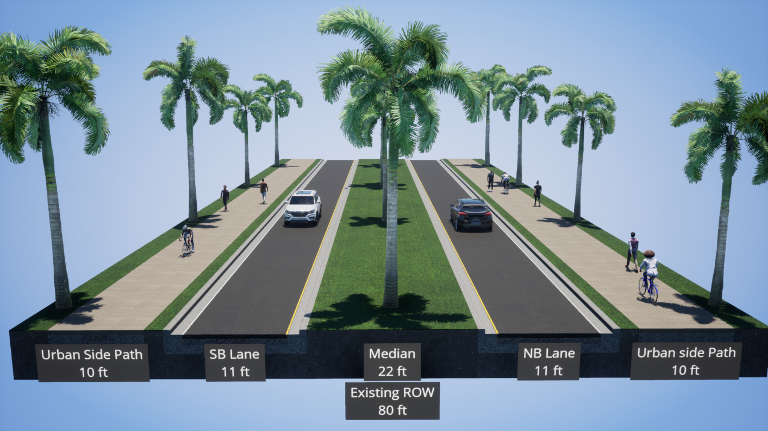
Typical Sections - Corridor 1, Segment 2
Alternative A
Alternative B

Slide 40
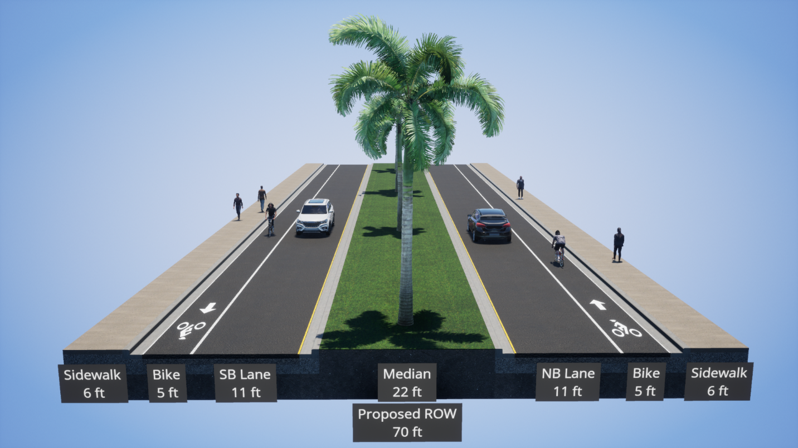
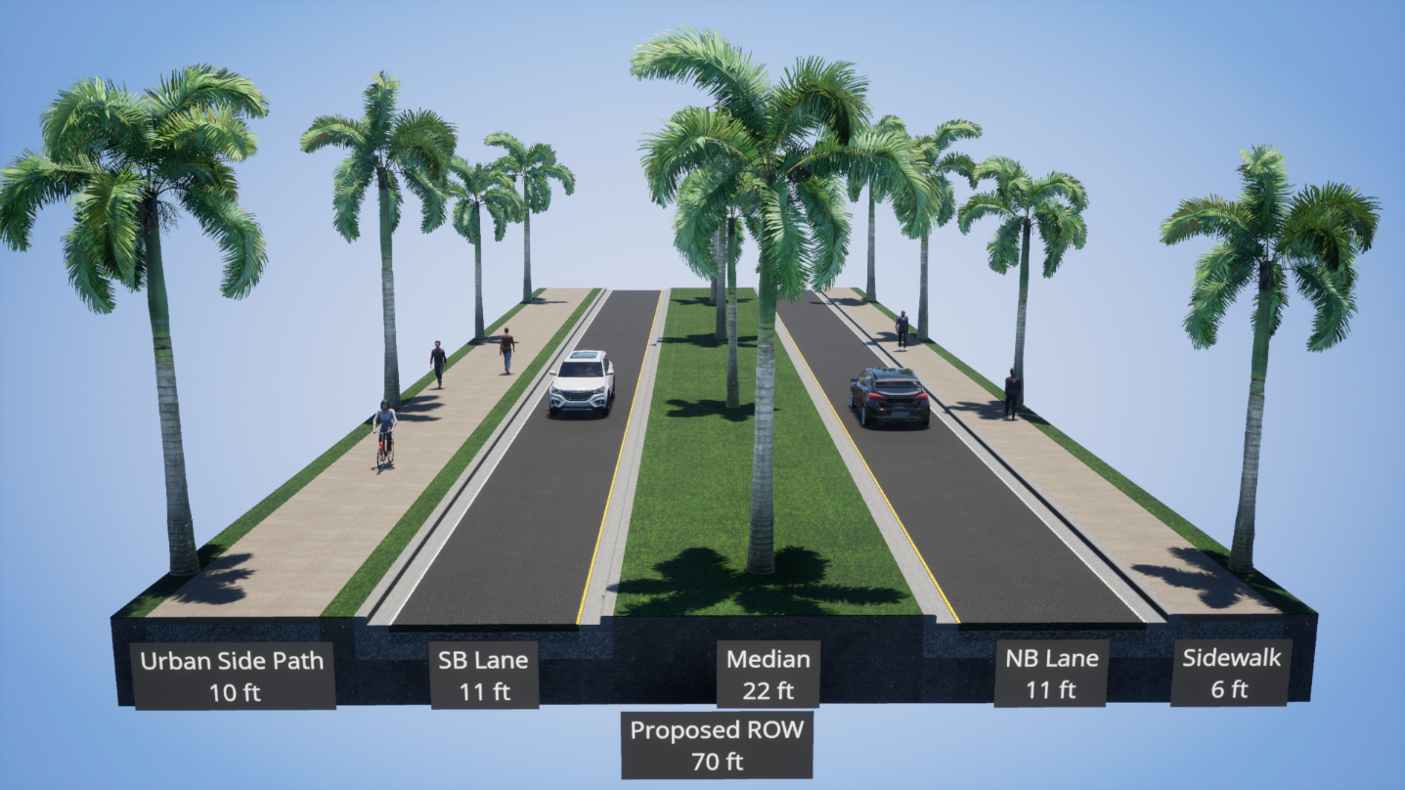
Typical Sections - Corridor 2, Segment 1
Alternative A
Alternative B

Slide 41
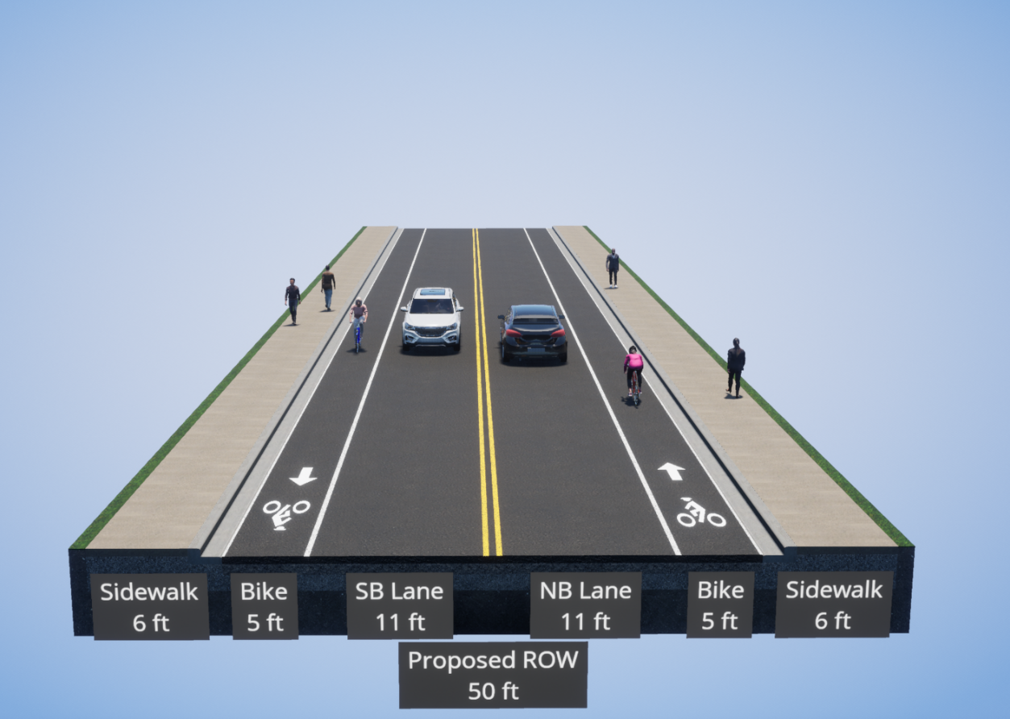

Typical Sections - Corridor 2, Segment 1
Alternative C
Alternative D

Slide 42
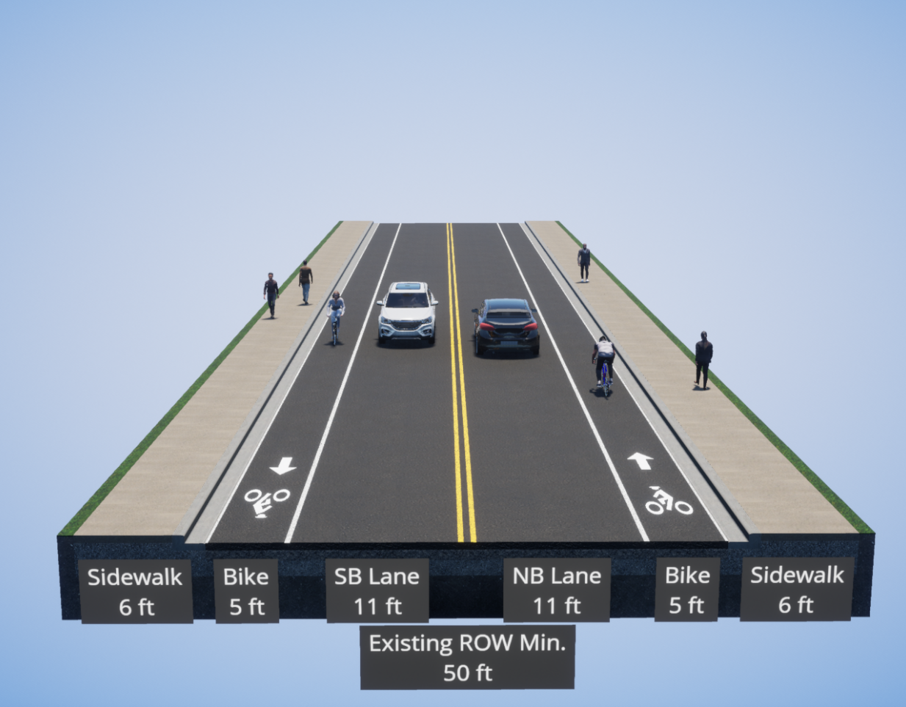

Typical Sections - Corridor 2, Segment 2
Alternative A
Alternative B

Slide 43
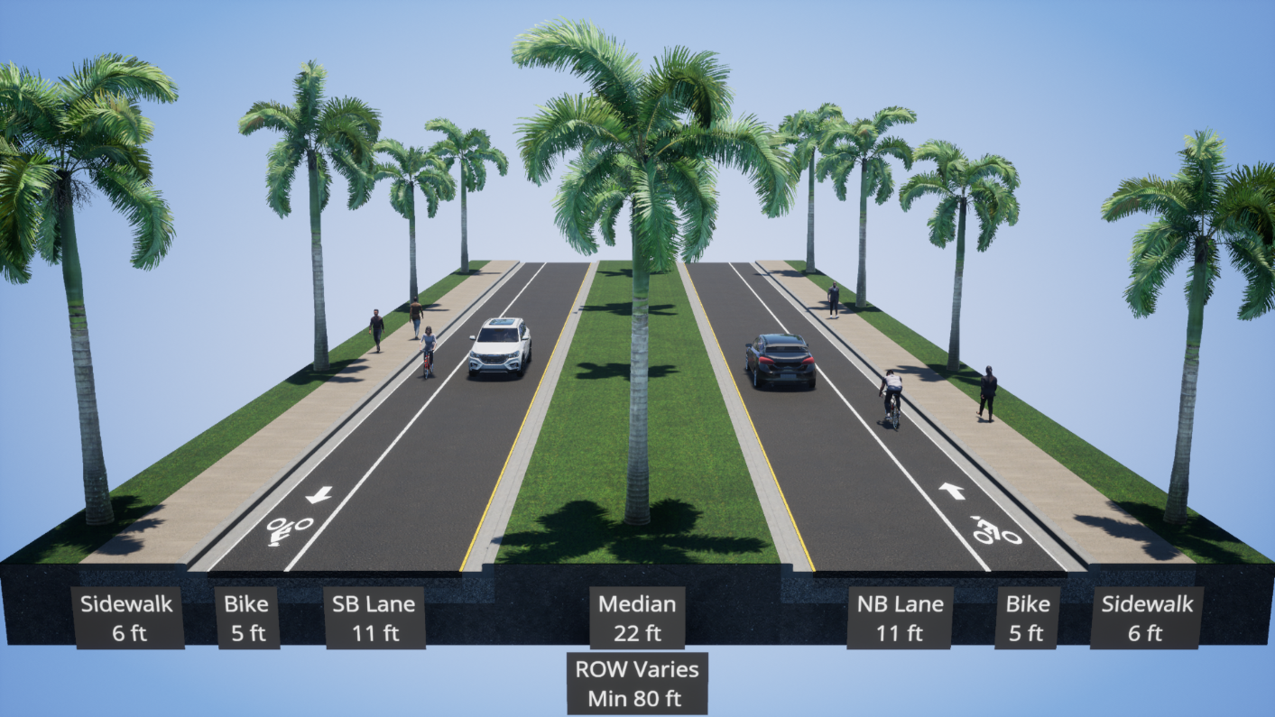
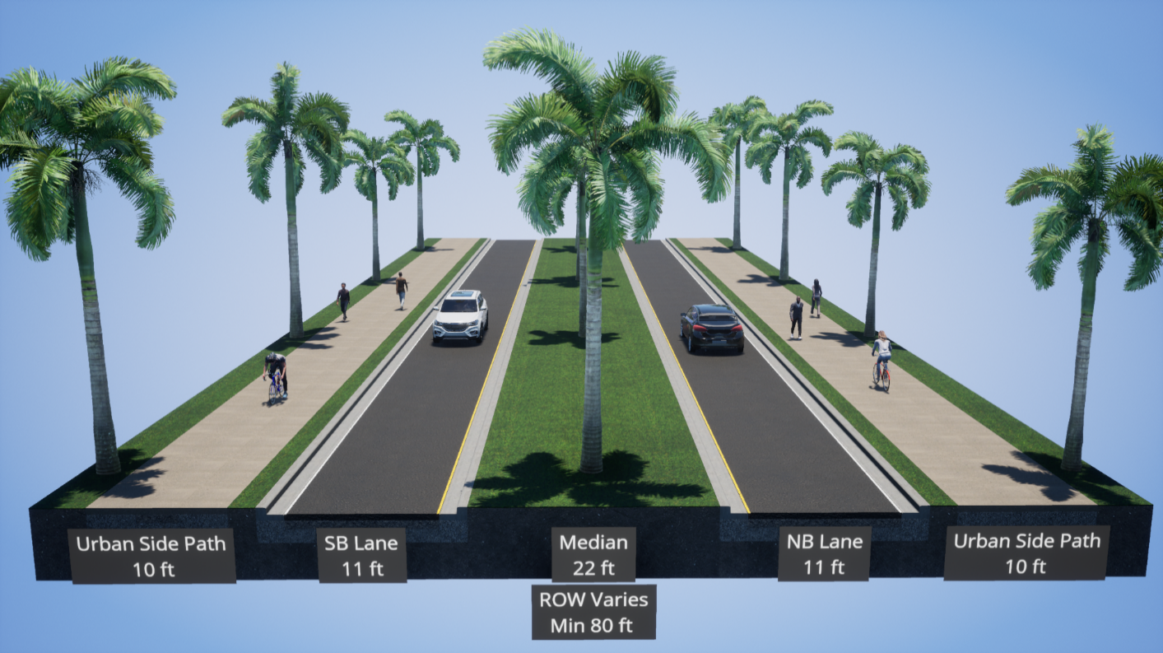
Typical Sections - Corridors 1 & 2, Segment 3
Alternative A
Alternative B

Slide 44
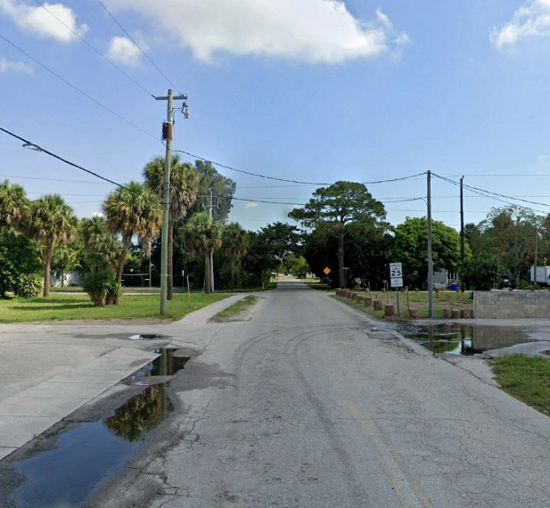
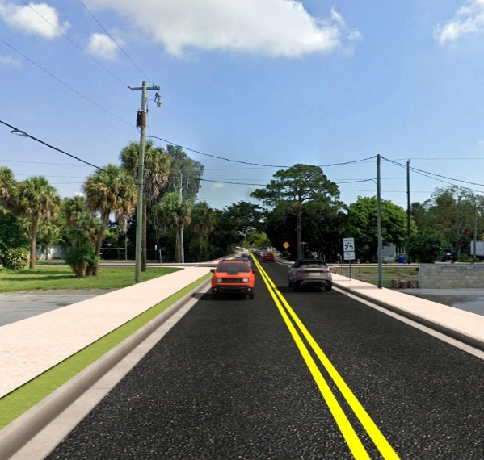
Corridor Build Renderings
Slide 44 – Corridors 1 & 2, looking north from Central Pkwy.
Slide 45 – Corridor 1, looking south from Central Pkwy.
Slide 46 – Corridor 1, looking north from San Jose St.
Slide 47 – Corridor 1, looking southeast from the Alhambra Ave. / Cortez St. intersection
Slide 48 – Corridor 1 – looking north from the S.R. 714 / Willoughby Blvd. intersection
Slide 49 – Corridor 1, looking south from San Jose St.
Slide 50 – Corridors 1 & 2, looking north at the U.S. 1 / Willoughby Blvd. intersection

Slide 45
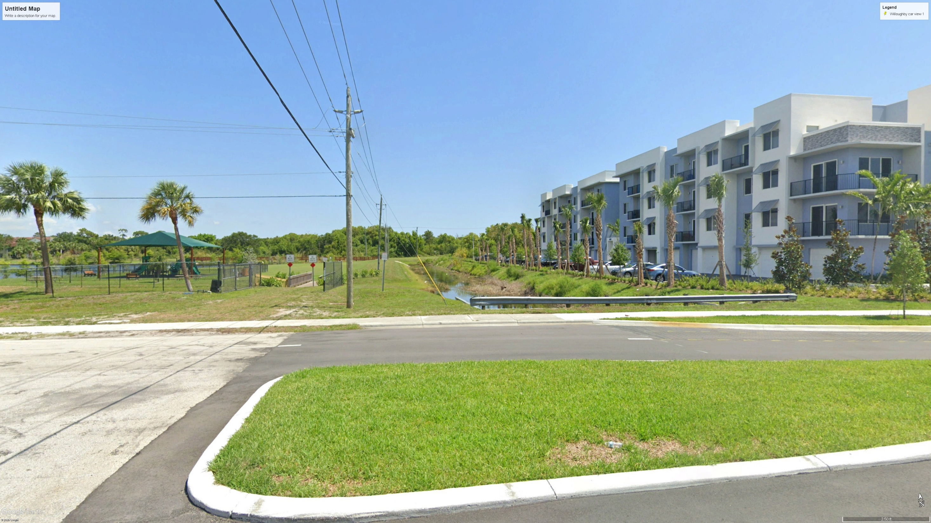
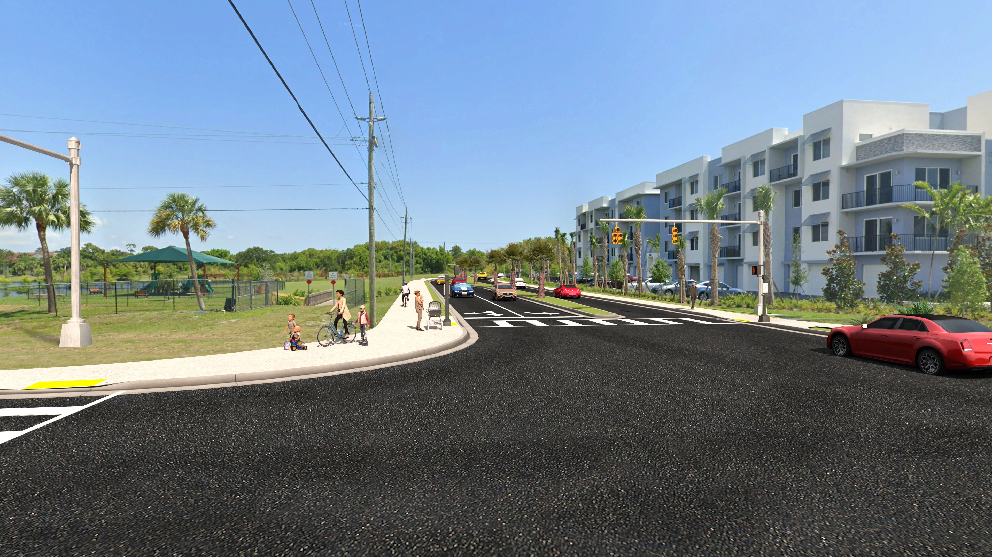
Central Parkway at Canal looking North – Existing / No-Build
Central Parkway at Willoughby Boulevard looking North – Build
Preliminary – Subject to Change

Slide 46
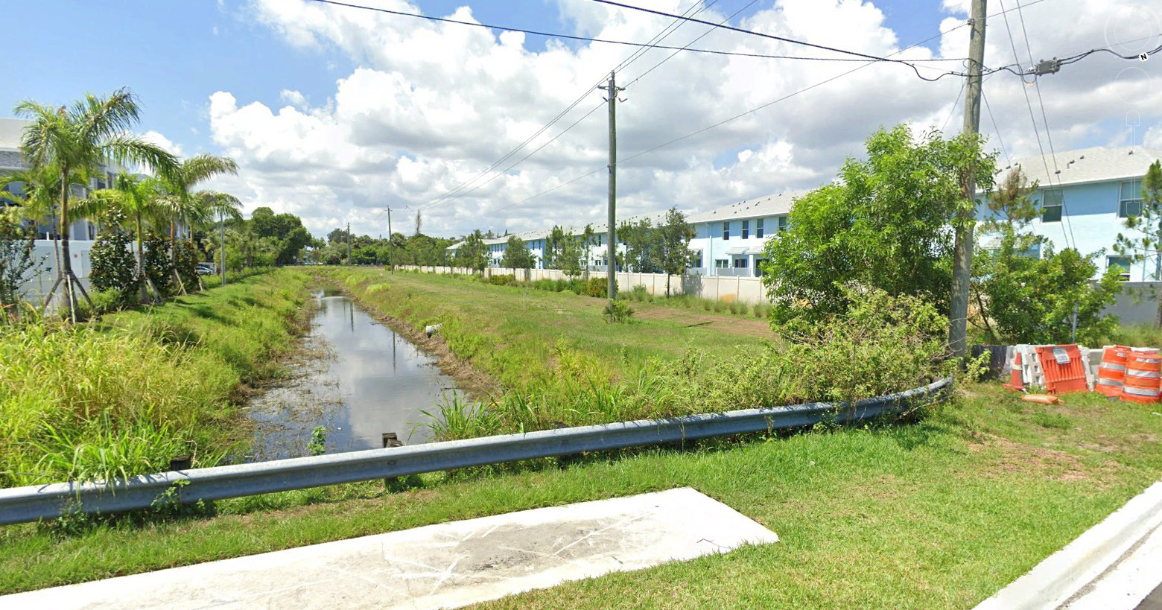
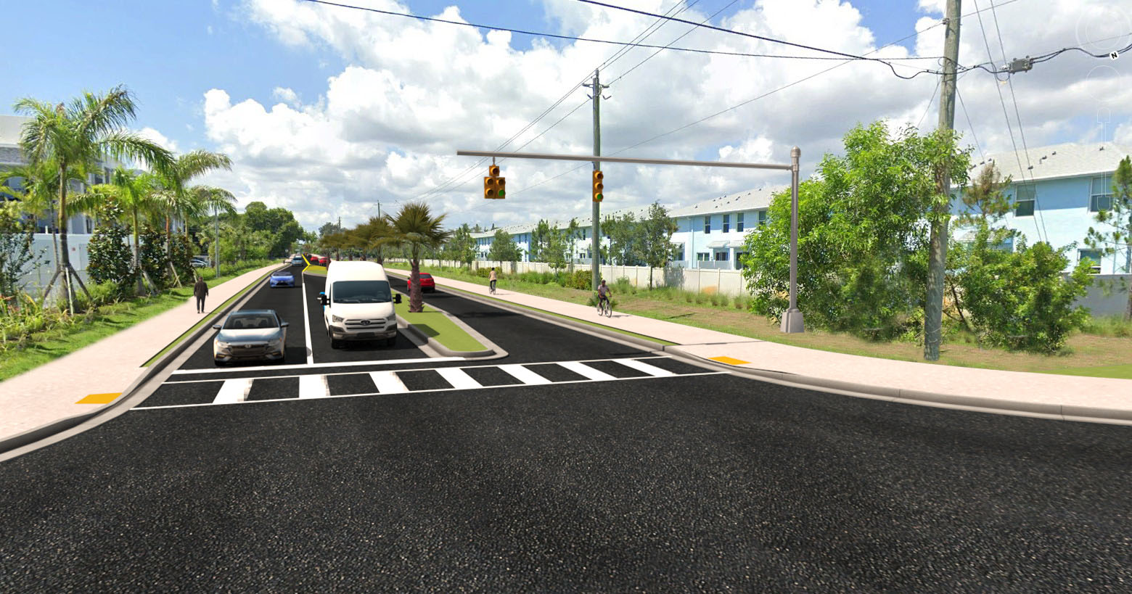
Central Parkway at Canal looking South – Existing / No-Build
Central Parkway at Willoughby Boulevard looking South – Build
Preliminary – Subject to Change

Slide 47
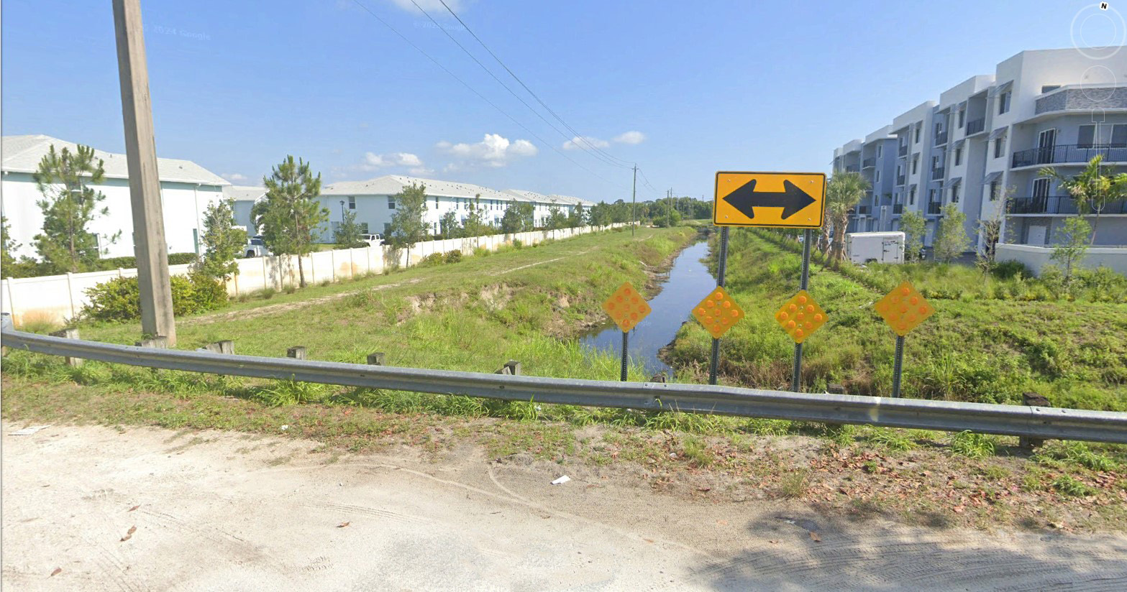
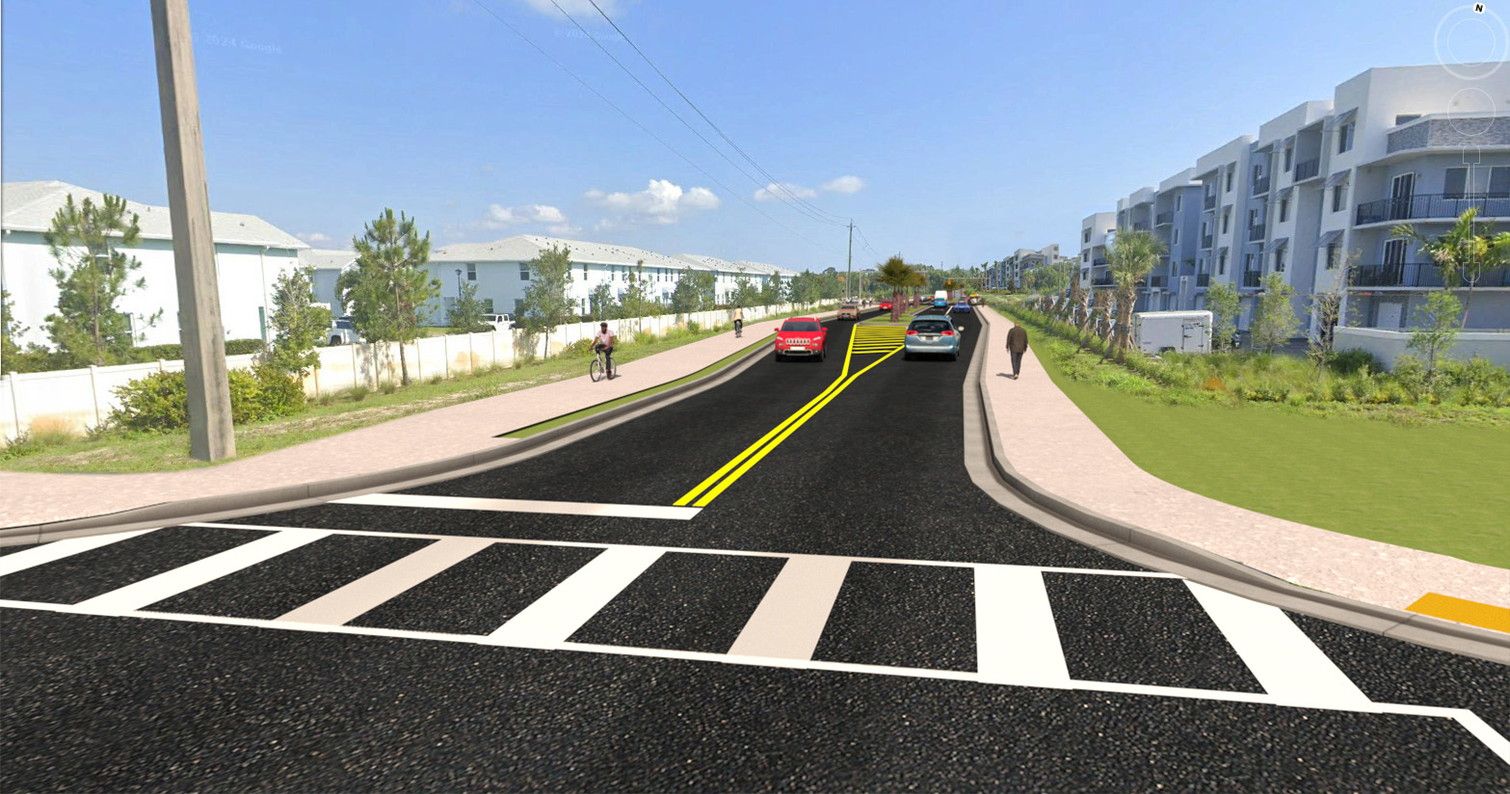
Alhambra Ave. at San Jose St. looking North – No-Build / Existing
Willoughby Blvd. at San Jose St. looking North – Build
Preliminary – Subject to Change

Slide 48
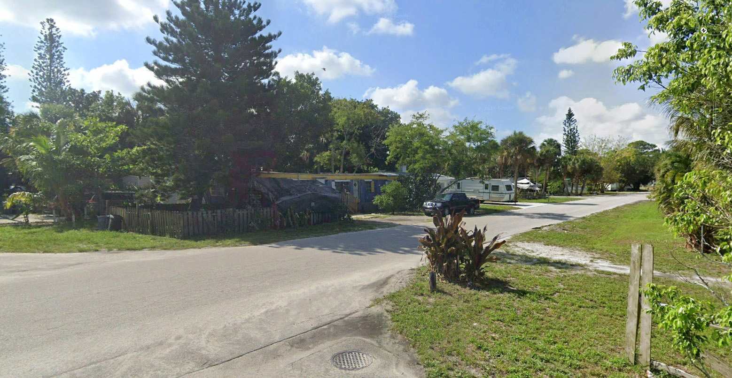
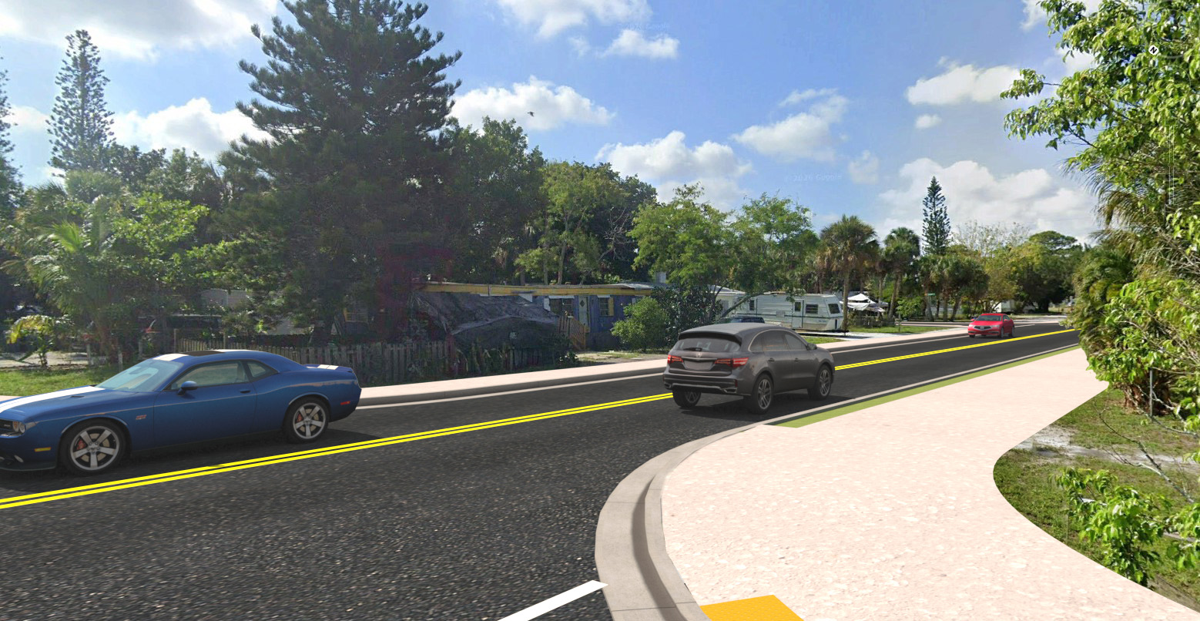
Cortez St. at Alhambra Ave. looking SE – Existing / No-Build
Cortez St. at Alhambra Ave. looking SE – Build
Preliminary – Subject to Change

Slide 49


Willoughby Boulevard at S.R. 714 looking North – Build
Alhambra Ave. at S.R. 714 looking North – Existing / No-Build
Preliminary – Subject to Change

Slide 50


Alhambra Ave. at San Jose St. looking South – No-Build / Existing
Willoughby Blvd. at San Jose St. looking South – Build
Preliminary – Subject to Change

Slide 51


U.S. 1 at Dixie Cutoff looking North – Existing / No-Build
U.S. 1 at Willoughby Blvd. looking North –Build
Preliminary – Subject to Change

Slide 52










Environmental
Key Project Issue
Natural
Cultural
Physical
Social & Economic
Protected Species and Habitat
Wetlands and Other Surface Waters
Essential Fish Habitat
Floodplains
Water Resources (Water Quality and Quantity)
Section 106 (NHPA)
Historic Sites/Districts
Archaeological Sites
Section 4(f)
Recreational Areas
Highway Traffic Noise
Air Quality
Contamination
Utilities and Railroads
Construction
Communities
Economic
Land Use Changes
Mobility
Aesthetic Effects
Relocation Potential
Required Agency Coordination
Notes:
For environmental, the PD&E Study team will conduct a comprehensive review and analysis of all the environmental topics including Natural including protected species and wetland resources, Cultural including Section 4(f) recreational resources, Physical including noise, air quality and contamination, and Social & Economic including community and right of way effects. Key project issues are highlighted in bold text. Efforts include coordination with the relevant environmental agencies having jurisdiction over components of the project.

Slide 53

Environmental Analysis – Natural Environment
Wetlands / Other Surface Waters
Poppleton Creek Watershed Project – Willoughby Blvd included in Phase IV
No impacts to Poppleton Creek, FDEP Pond, or existing treatment ponds
Existing canal east of park to be culverted
Potential impacts to remnant exotic-dominated wetland to be mitigated
Notes:
Within the limits of both corridors, impacts are anticipated to existing ditches and wetland resources. Mitigation will be proposed to compensate for any loss in functional value to wetland resources.

Slide 54

Environmental Analysis – Natural Environment
Protected Species / Habitat
Potential Fencing / Wildlife Crossing
Gopher Tortoise Relocation
Florida Bonneted Bat Survey Underway
FDACS Opportunity to Relocate State-listed Plants
Mitigation of Wood Stork Foraging Habitat
USFWS / FWC Coordination Initiated
Notes:
Both corridors are located within range of threatened and endangered species including the Florida bonneted bat, gopher tortoise, wading birds including the wood stork, and several state-listed plants. General and species-specific surveys have been completed for all species having the potential to occur. Conservation measures to avoid and/or minimize effects to protected species potentially including gopher tortoise relocation, fencing, creation of wood stork foraging habitat, and installation of a wildlife crossing for small mammals/reptiles are currently being evaluated and will be coordinated with the respective federal and state agencies.

Slide 55

Environmental Analysis
Ongoing Assessments – Cultural and Physical
Noise Study
Historic/Archaeological Assessment
Contamination Screening Evaluation
No relocations are anticipated
Notes:
Impact assessments are currently underway for all environmental topics including wetlands and protected species, noise impact modeling including evaluating potential abatement options, historic and archaeological resource assessments and contamination screening. Minor right of impacts may be required at certain locations; however, no relocations are anticipated.

Slide 56

Environmental Analysis
Ongoing Assessments – Cultural
Section 4(f) Analysis – publicly owned lands, parks
  No Direct Impacts
  Minimal Indirect Impacts with Mitigation (landscaping / fencing)
  Low Probability for Permanent Impact / Change of Use
Notes:
Evaluation of potential effects to Section 4(f) resources is currently underway for Poppleton Creek Park and two FDEP Office of Greenways and Trails multi-use trail opportunities (Atlantic Ridge Trail Corridor and Cross Country Trail 2). Currently, no direct impacts are anticipated to these resources. Mitigation for potential indirect effects relating to aesthetics and safety are currently being evaluated and may include such measures as landscaping and fencing.

Slide 57
Preliminary Evaluation Matrix – No-Build, Corridor 1, Corridor 2

Slide 58




Public Involvement
Public Meetings
Virtual Public Kick-off Meeting – June 25, 2025
In-Person Public Kick-off Meeting – June 26, 2025
Virtual Public Alternatives Meeting – July 28, 2026
In-Person Public Alternatives Meeting – July 29, 2026
Public Hearing – January 2028 (Tentative)
How to participate
Attend Public Meetings
Provide your input
Visit the project webpage:
Stakeholder Meetings
Elected Officials
Local Businesses
Local Neighborhoods
https://www.fdot.gov/projects/willoughbypde/

Slide 59


Project Website
We encourage you to be an active participant and stay involved throughout the entire project.
Visit the project website to learn more about the study and to provide feedback.
https://www.fdot.gov/projects/willoughbypde/

Slide 60

Public Involvement Schedule
PD&E Study Began: August 2024
Public Kick-Off Meeting: June 2025
Public Alternatives Meeting: July 2026
Public Hearing: January 2028 (tentative)
PD&E Study Complete: Anticipated August 2028
Design and Construction Funding Status: Unfunded
Willoughby Boulevard Extension from S.R. 714/Monterey Road to U.S. 1/ S.R. 5/Federal Highway
Public Involvement Schedule

Slide 61
Next Steps
Continue Public Involvement
Document Engineering and Environmental Analyses for Public Review
Select Preferred Alternative and Present at Public Hearing
FDOT Provides the opportunity and encourages the Public to give feedback throughout the project. Please provide any comments, questions, or concerns by mail, email, phone, or by visiting the project website. We welcome and encourage you to share your input throughout the duration of the project.
Public Involvement

Slide 62
Submitting Comments and Questions
Multiple ways to submit:
By submitting comments and questions in tonight’s meeting
By email to FDOT Project Manager
By U.S. mail to FDOT Project Manager
By phone, after the meeting
Project Website
https://www.fdot.gov/
projects/willoughbypde/
FDOT Project Manager Contact Information
Vanita Saini, P.E.
Florida Department of Transportation
3400 West Commercial Boulevard
Fort Lauderdale, Florida 33309
(954) 777-4468
Vanita.Saini@dot.state.fl.us

Slide 63
Rules of Engagement Reminders
If you experience technical difficulties, please contact 954-548-2754 so that a member of our technical support team may assist you.
All Virtual attendees will remain muted throughout the Meeting.
Virtual attendees are also welcome to submit any questions/comments using the Teams control panel at any time or use the “Raise Hand” button on your control panel and a member of our team will respond to/unmute you during the open discussion.
If you are participating via Telephone and have questions/comments, feel free to submit them to the FDOT Project Manager Vanita Saini, P.E., via email after the meeting and a response will be provided.

Slide 64
Thank you for participating!
Please submit your comments and questions
Project Website
FDOT Project Manager
Contact Information
https://www.fdot.gov/projects/willoughbypde/
Vanita Saini, P.E.
Florida Department of Transportation
3400 West Commercial Boulevard
Fort Lauderdale, Florida 33309
(954) 777-4468
Vanita.Saini@dot.state.fl.us

Slide 65
Thank you
for attending the
Alternatives Public Workshop for the
Willoughby Boulevard PD&E Study

