Slide 1
FDOT District Reviewer Training

Slide 2
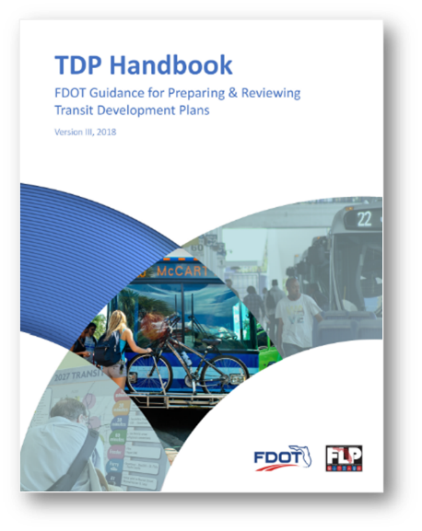
Agenda
Welcome and Introductions
TDP Components Overview and Issues
District Role and Responsibilities
Local Conditions
TDP Process and Adoption
Use of Adopted TDP
2018 TDP Handbook Part II
Summary and Closing

Slide 3
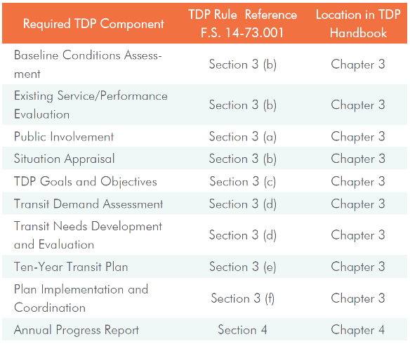
TDP Components
Discussion of
Morning Session
Purpose
Take-Aways
Relationships

Slide 4
District Role and Responsibilities
District Survey Feedback
PIP
Strategic Nature
Financing
Performance Measures
Relationship to Plans
Guidance
Involvement
Review and Approval
Use of TDP by FDOT

Slide 5
FDOT use of tdp
Florida Statutes / Administrative Code
Practical Local Use
Block Grant Funding
Public Participation
Data
Coordination
Communication
Strategic Planning
Public Engagement and Public Relations
Inter-Agency Coordination
Agency Business Plan and Team Mission
Project Priorities
Strategic Policies and Funding Development
Discretionary Grants

Slide 6
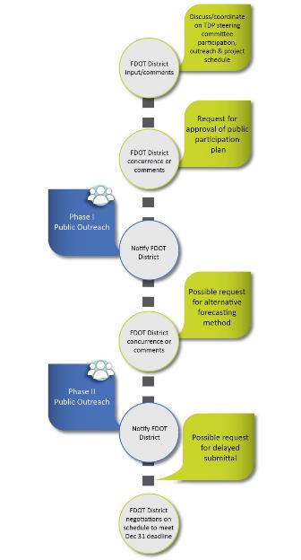
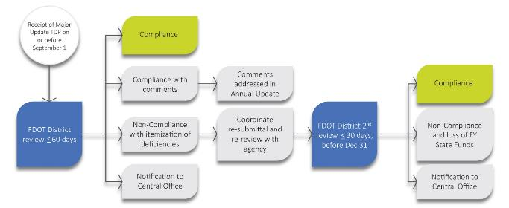
handBook Format & structure
PART II – Reviewers Guide
Chapter 1
Coordination with the Agencies
Pre-Submittal
During the TDP
Review Process & Timeline

Slide 7
Due Dates and Review timeline
District Interviews Input
Strategic Nature
FDOT Involvement
FDOT Approval Points
Compliance Issues

Slide 8
Key FDOT agency coordination
Initiate
TBEST
or Not
Reasons?
PIP
Approval

Slide 9
Reviewer’s Use of Guidebook Part I
Example One: Public Involvement
Requirements and Best Practices
Examples of Approach and Techniques
Reviewers use for Compliance and Comments
Refer to Guidebook
Page 40

Slide 10
Reviewer’s Use of Guidebook Part I
Example Two: 10 Year Plan
Requirements and Best Practices
Examples of Approach and Techniques
Reviewers use for Compliance and Comments
Refer to Guidebook Page 75
Refer to Guidebook Page 76

Slide 11
Reviewer’s Use of Guidebook Part I
Example Three:
Annual Progress Report
Requirements and Best Practices
Examples of Approach and Techniques
Reviewers use for Compliance and Comments
Refer to Guidebook Page 75
Refer to Guidebook Page 99

Slide 12
Scenarios
Scenario One
All 9 components presented
Basic public involvement effort, however no apparent involvement of MPO
Alternatives conducted, no service change alternative chosen
Lacking financial data beyond 5-years
Submitted on September 1st
No previous discussion with FDOT other than approval of PIP

Slide 13
Scenarios
Scenario Two
All 9 components presented
Public involvement engaging and creative
Alternatives conducted, significant improvements presented
Vague review of state, regional and local plans and policies for coordination with public transportation improvements
10-Year Plan beyond any reasonable ability to fund
Unrealistic assumption of future FDOT and FTA funding availability
Based upon a significant local funding initiative

Slide 14
Annual Report Scenario
Scenario Three
Clearly addresses lack of all progress and why
Complete revision of goals and objectives
Complete revision of not only 10th year of plan but also remaining 9 years
Major impact on addressing previously identified needs
Submitted on time

Slide 15
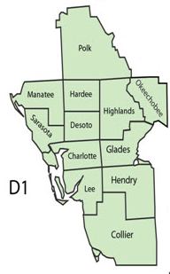
FDOT District One Transit Agencies
Year TDP DUE:
2018
Manatee County Area Transit (MCAT)
2019
Sarasota County Area Transit (SCAT)
Charlotte County Transit
2020
Collier Area Transit (CAT)
2021
LeeTran
2022
LAMTD/Citrus Connection
Highlands County (HRTPO)

Slide 16
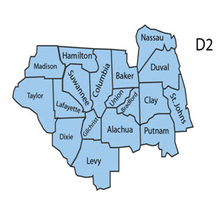
FDOT District TWO Transit Agencies
Year TDP DUE:
2018
None
2019
Jacksonville Transit Authority (JTA)
Gainesville Regional Transit System (RTS)
2020
None
2021
St. Johns County (Sunshine Bus Company)
2022
None

Slide 17
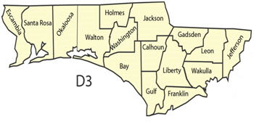
FDOT District THREE Transit Agencies
Year TDP DUE:
2022
None
2018
None
2019
None
2020
None
2021
Bay Town Trolley
Escambia County Area Transit (ECAT)
Okaloosa County (EC Rider)
Tallahassee (StarMetro)

Slide 18
FDOT District Four Transit Agencies
Year TDP DUE:
2018
Broward County Transit (BCT)
Indian River County (GoLine)
SFRTA (Tri-Rail)
2019
St. Lucie County (Treasure Coast Connector)
Martin County (MARTY)
2020
None
2021
Palm Beach County (Palm Tran)
2022
None

Slide 19
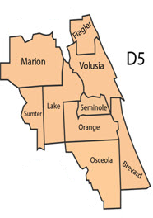
FDOT District FIVE Transit Agencies
Year TDP DUE:
2018
Lake County (LakeXpress)
2019
None
2020
Flagler County Public Transportation
2021
Volusia County (VOTRAN)
2022
Orlando (LYNX)
Space Coast Area Transit
Ocala/Marion County (SunTran)

Slide 20
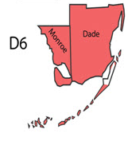
FDOT District SIX Transit Agencies
Year TDP DUE:
2018
None
2019
Key West Transit
Miami-Dade Transit
2020
None
2021
None
2022
None

Slide 21
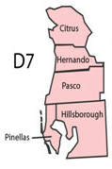
FDOT District SEVEN Transit Agencies
Year TDP DUE:
2018
Pasco County Public Transportation (PCPT)
2019
Hernando County (TheBus)
2020
Citrus County Transit
Pinellas Suncoast Transit Authority (PSTA)
2021
Hillsborough Area Regional Transit (HART)
2022
None

Slide 22
Review Checklist
PIP
Coordination
PIP
MPO / Workforce Development
Comment Due Limits

Slide 23
Review Checklist
Situation Analysis
Baseline
Demand Estimate
Performance
Comp Plans
Land Use
State, Regional, Local Influence Relationships
Agency Organization / Technology
TBEST
Peer and Trend, Surveys

Slide 24
Review Checklist
Goals & Objectives
Demand
Agency Vision, Mission, Goals
Monitoring of Progress
Alternatives Analysis
Opportunity for Review and Comment

Slide 25
Review Checklist
Transit Needs
/Alternatives
10 Year Plan
Implementation
Strategies
10 Year Program
Service Area and Level Of Service
Financing
Monitoring Program
Unfunded Needs

Slide 26
Review Checklist
Annual Update
Coordination
Monitor Progress
Discrepancies / Changes
Revisions / Updating
10th Year Adjustments
Updating of Priorities

Slide 27
Discussion
Process
Compliance / Comment
Major TDP
Annual TDP
Submittals
Extensions

Slide 28
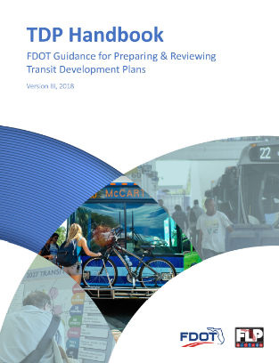
Additional Comments/Questions
Chris Wiglesworth
FDOT Transit Office
(850) 414‐4532
chris.wiglesworth@dot.state.fl.us
Ann Joslin
CUTR
(813) 974-9183
Joslin@cutr.usf.edu
Richard Dreyer
Tindale Oliver
(863) 533-8454
rdreyer@tindaleoliver.com

Slide 29
Training Schedule
FDOT Training Sessions
November 2018 - January 2019
One-day training – 9:00-3:00
Locations across Florida
One in each FDOT District
Audience
TDP preparer session: Transit/Planning Agencies
TDP reviewer session: FDOT District Offices
Can attend either or both

Slide 30
Training Schedule
FDOT Training Sessions
District 2 – November 8, 2018 Jacksonville
District 5 – November 16, 2018 Deland
District 4 – November 29, 2018 Ft. Lauderdale
District 6 – November 30, 2018 Miami
District 7 – January 9, 2019 Tampa
District 1 – January 22, 2019 Bartow
District 3 – January 24, 2019 Chipley

