Slide 1
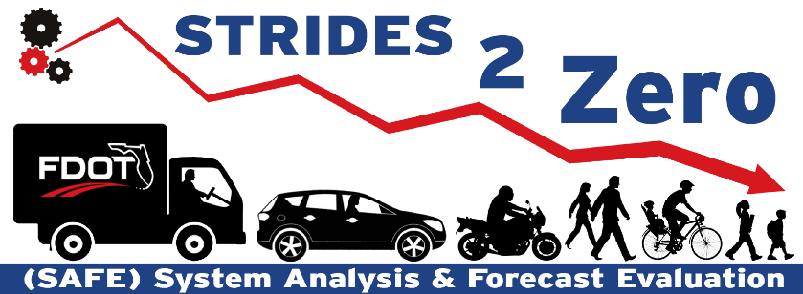
STRIDES 2 Zero
(SAFE)
District Safety Engineering Meeting
March 9, 2020
1
Notes:
STRIDES 2 Zero
State Traffic Roadway and Intersection Data Evaluation System 2020
SAFE
System Analysis and Forecast Evaluation
Date for DTOE meeting from One Note

Slide 2
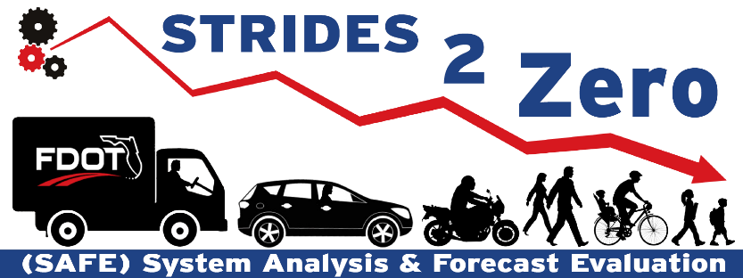
SAFE STRIDES 2 Zero Program
Leverage departmental data to evaluate safety & mobility for roadway facilities
In alignment with FDOT Vital Few Safety Initiative
  Targeted on reducing fatalities and severe injuries on state highway system (SHS)
Enhanced roadway network screening method
  Previous method: Hot spot analysis
  SS2Z program: Quantitative evaluation with Florida specific crash predictive tools
SAFE
System Analysis and Forecast Evaluation
STRIDES 2 Zero
State Traffic Roadway and Intersection Data Evaluation System 2020
SS2Z
SAFE STRIDES 2 Zero
2
Notes:
Question:
To the department, how valuable is it to identify intersections that have the most potential for safety improvements on an annual basis?
Use leading-edge scientific predictive methods to screen and identify candidate intersections that have the most potential for safety improvements.
Diagnose, identify and select engineering countermeasures that reduce fatal and severe injury crashes.
Emphasize the change from hot-spot analysis to predictive method.
Delete the last two bulletins
Monitor safety performance before and after implementing engineering countermeasures
Track and document SAFE STRIDES 2 Zero program to evaluate return on investment (ROI)

Slide 3
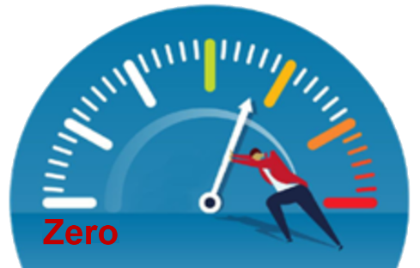
Annual SAFE Reporting Overview
KA: Fatal and Severe Injuries
11%
2020 SHS Signalized Intersection Candidates: 154 Sites
Fatalities
SHS Signalized Intersection
7-year Safety Trend:
21
Fatalities Per Year Increased
Total Observed KA Crashes per Year for Candidates:
349
Serious Injuries
89%
KA Crash Reduction with
SAFE Implementation:
16%
20-year Safety Improvement
Construction Cost Estimated:
$39.1 Million
$78.5 Million
Safety Benefit per Year:
5
SAFE Implementation:
Less Fatalities Per Year
24% Reduction of the Trend
$1.07 Billion Societal Savings Over 20-Year Design Life
Notes:
NPV = 1.034 Billion , 20 years, Societal KA Benefits – Construction = Net Societal Savings
(Societal KA Benefits do not include other savings due to BCO Benefits)
7 YR Trend = 20.929x+297.3
x=Year 1 to 7
154 Sites equals 1.8% of all signalized intersection on the State Highway System
Reduction of 5 lives are applied to the based condition 297.3.
21 Lives Trend is from CARS Signalized intersection based on internal data 2011-2017
We did not have data before 2011 that we were able to use for this analysis.
Using 2019 Signalized Intersection TEO Data
Construction Cost in an NPV from a 20-year design Life.
Future Analysis:
Initial Steps towards determining save cost implementation. Accuracy will increase with tracking of project after they are programmed and constructed, and calibrating benefit cost calculations will come from these values.
Redesign the slides - better way to present the information (deadline 3/13). Work with Laura.

Slide 4
Florida Roadway Safety Management
Safety projects for funding (2017-2019)
  HSIP
  HSID
  HSLD
No formal process for candidate selections
  Based on project B/C ratios
Beginning 2024
  Districts to fund their own projects to follow statutory requirements (pending)
SS2Z program to formalize and enhance roadway safety management
  Note: HSIP stands for Highway Safety Improvement Program
  HSID stands for Highway Safety Improvement for Intersection Crashes
  HSLD stands for Highway Safety Improvement for Lane Departure Crashes
  B/C stands for benefit/cost ratio
Notes:
Need to work – not sure whether it’s important.

Slide 5
What’s new in SAFE?
Florida specific safety performance functions (SPF) for network screening
  Intersections grouped based on context classification, number of legs and traffic control type
Data driven process for identifying safety projects
  Use extract, transfer and load (ETL) process to collect up-to-date crash and roadway data
  Identify counterpart sister intersections
Diverging from hot-spot to predictive safety analysis
  Maximize benefits for FDOT safety funding
Countermeasures are identified and selected
  Projects are preapproved for HSIP funding implementation
Candidate intersections (poor safety performance)
Counterpart sister intersections (good safety performance)
Definition

Slide 6

Methodology
FDOT Highway Safety Management Process
Develop SPFs using intersection traffic volumes, geometry
and crash data
Preliminary Diagnosis
Countermeasure Selection
Economic Appraisal
Calculate safety performance with
crash-predictive models
Network Screening
Project Prioritization
Annual Report
Identify candidate intersections and their counterpart sister intersections
Implementation
Safety Effectiveness Evaluation
6
Notes:
Florida HSMP methodology uses AASHTO HSM fundamentals.
Put the flowchart in the middle
Make HSM smaller
Create the flowchart
Include counterpart intersections under network screening
Pop out information for network screening
Emphasize the new method introduced to the HSM method – sister intersection selection

Slide 7
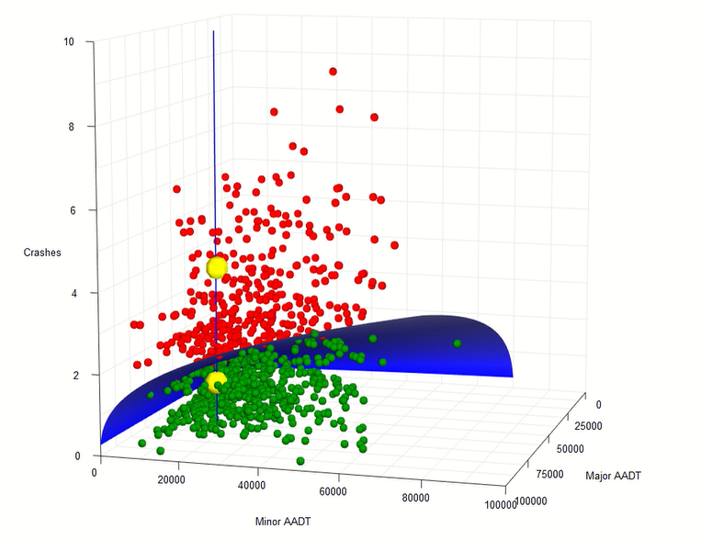
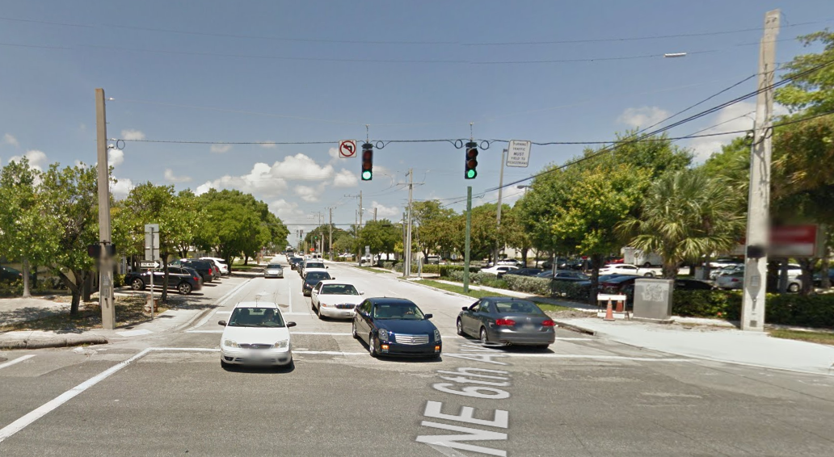
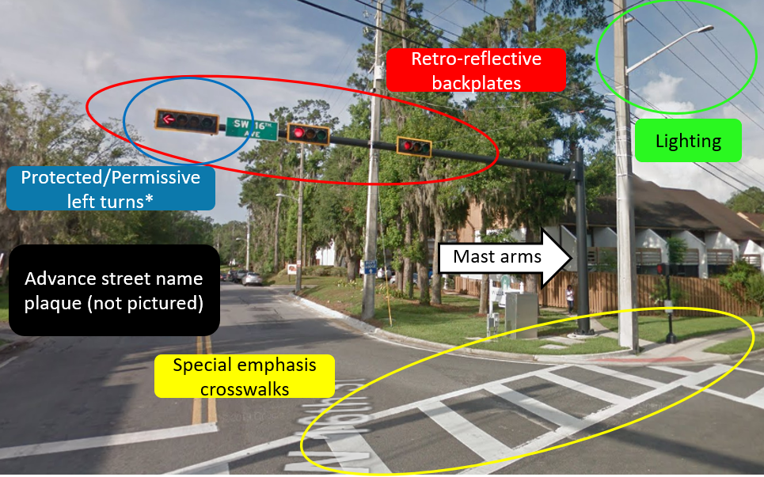
On-system C4 4-leg Signalized Intersections
Major AADT: 59,000
Minor AADT: 15,733
4 KA crashes
Major AADT: 55,332
Minor AADT: 15,733
1 KA crashes
Note: C4 stands for urban general
AADT stands for annual average daily traffic
Notes:
What the 3D curve surface mean?
Put horizontal first
Click on the point and pop out the intersection/fatal crashes
Draw line to show major/minor AADT for one intersection (add AADT data), intersection pictures/no fatal crashes/total crashes
Y-axis

Slide 8
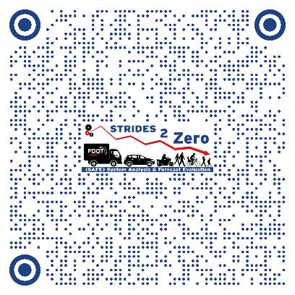
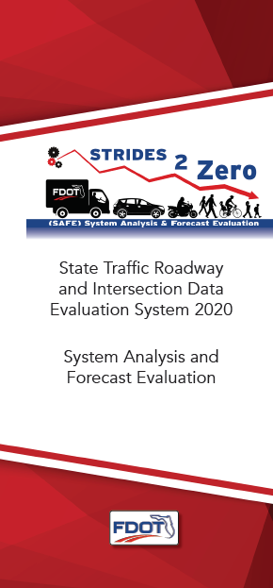
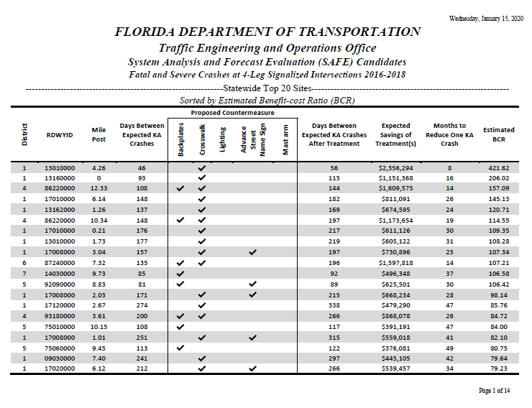
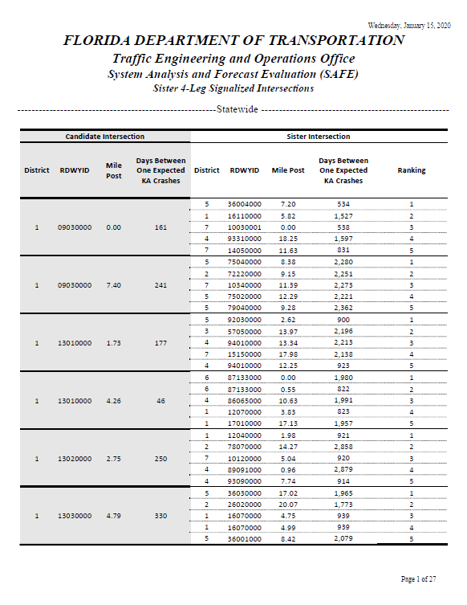
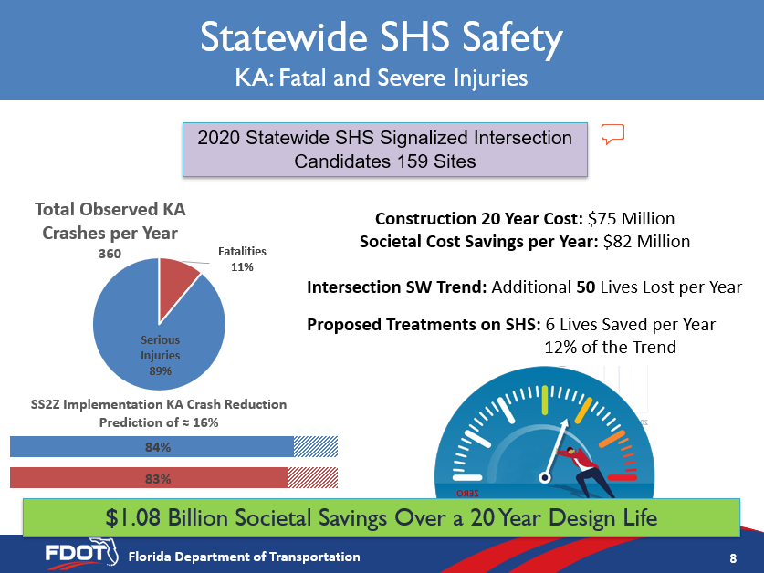
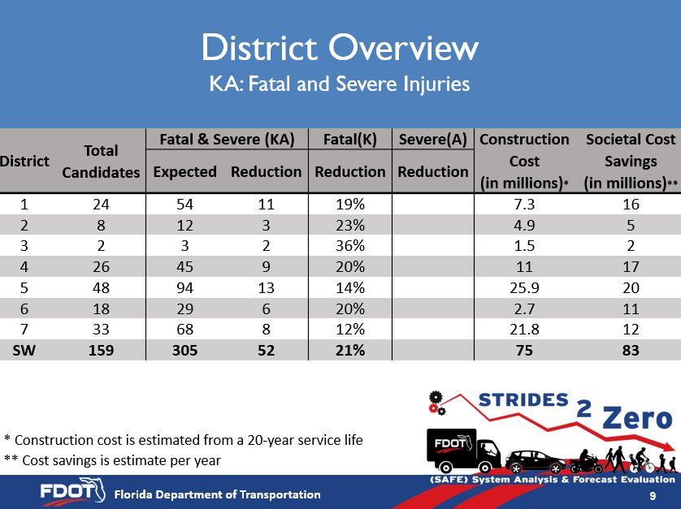
Description of the Report
SAFE Report at FDOT SharePoint site
  https://fdot.tips/38uVqkO
Locations
Proposed Countermeasure
Days/Months Between Expected Fatal and Severe Crashes
Benefit-Cost Ratio (BCR)
Comments
Sister Intersections
8

Slide 9
SAFE District Overview
SHS Signalized Intersection Fatal and Severe Injuries
District | Total Candidates | Fatal & Severe (KA) |  | Fatal (K) | Severe (A) | Construction Cost (in millions)* | Societal Cost Benefits (in millions)**
 |  | Expected | Reduction | Reduction | Reduction
1 | 22 | 50 | 10 | 19% | 19% | 5.0 | 14.6
2 | 8 | 12 | 3 | 22% | 23% | 2.5 | 4.5
3 | 2 | 3 | 1 | 36% | 36% | 0.9 | 1.8
4 | 26 | 45 | 9 | 19% | 19% | 5.8 | 16.2
5 | 47 | 93 | 13 | 13% | 13% | 12.5 | 19.3
6 | 18 | 29 | 6 | 19% | 19% | 1.1 | 10.5
7 | 31 | 64 | 8 | 12% | 12% | 11.3 | 11.6
SW | 154 | 296 | 50 | 16% | 16% | 39.1 | 78.5
K: Fatal Crashes A: Crashes with Severe Injuries * Construction cost is a 20-year estimate ** Cost savings is a per-year estimate
9

Slide 10
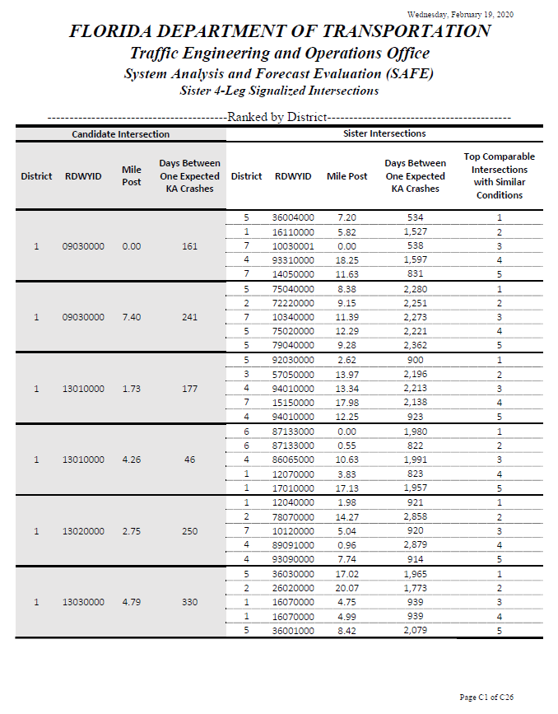
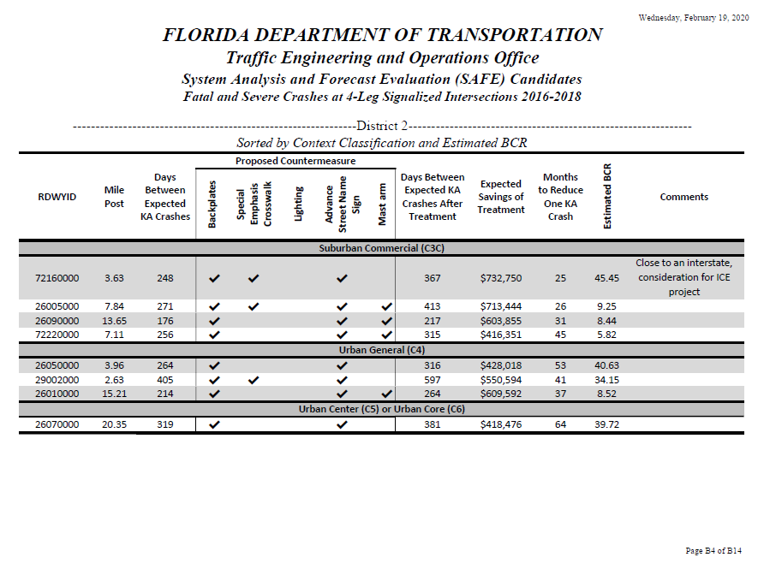
SS2Z SAFE Report
Include information for candidate intersections and their counterpart sisters
Notes:
Add one slide to show the report for sister intersections – page C26.

Slide 11
SS2Z Plan
2019
2020
2021-2025
STRIDES 2 Zero
ETL Process
Program Development
First SAFE Static Report with Proposed Candidates
Program Design and Development
ETL Development
Roadway Inventory Data Collection for New Countermeasures
Dynamic Reporting Mechanism Design and Development
Work Program Integration
Database Architecture Continued Development
Coordination with Partnerships and Research
Dynamic Reporting Development
Program Design and Continued Development
ETL Continued Development
Development of Florida-specific CMFs
Analysis and Incorporation of other Countermeasures
CAV Countermeasure Data
Database Architecture Continued Development
Continued Coordination with Partnerships and Research
Note:
CMF stands for crash modification factor
CAV stands for connected and automated vehicle
11

Slide 12



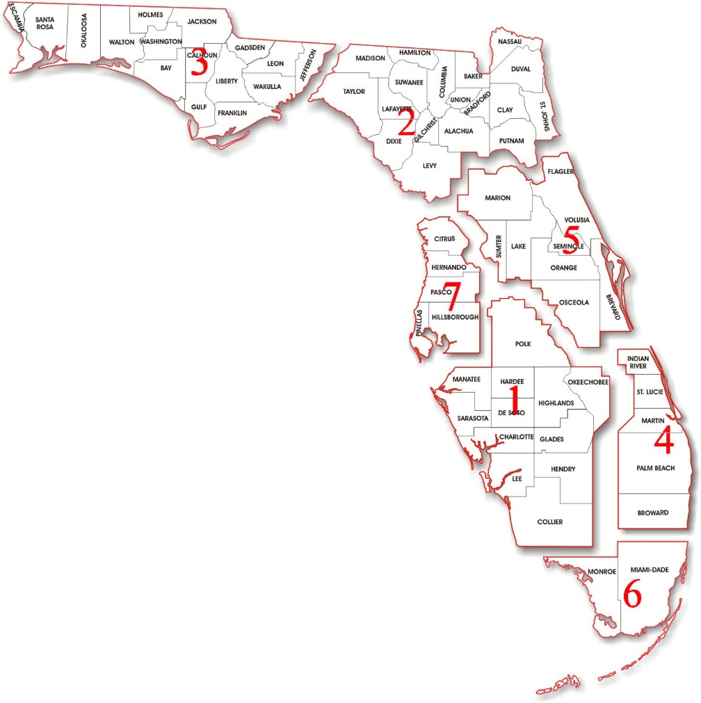











Growing Partnerships
12

Slide 13
Next Steps
Develop SPFs for roadway segments, midblock crosswalks and bicycle facilities
Expand the analysis to include the above facilities
Update SAFE annual report
Include more safety countermeasures when data is/are available
Develop new sub-programs for STRIDES 2 Zero to enhance the overall safety management process
Notes:
Add one slide to show the report for sister intersections – page C26.

Slide 14
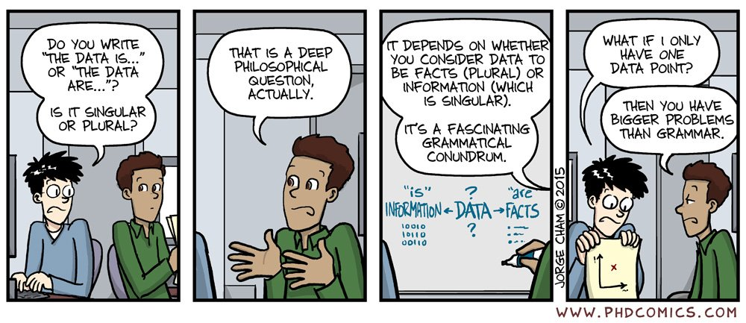
Questions?
Trey Tillander
850-410-5419
Alan El-Urfali
850-410-5416
Javier Ponce
850-410-5417
14

