Slide 1

STRIDES 2 Zero
(SAFE)
Executive Workshop
April 15, 2020
1
Notes:
STRIDES 2 Zero
State Traffic Roadway and Intersection Data Evaluation System 2020
SAFE
System Analysis and Forecast Evaluation

Slide 2
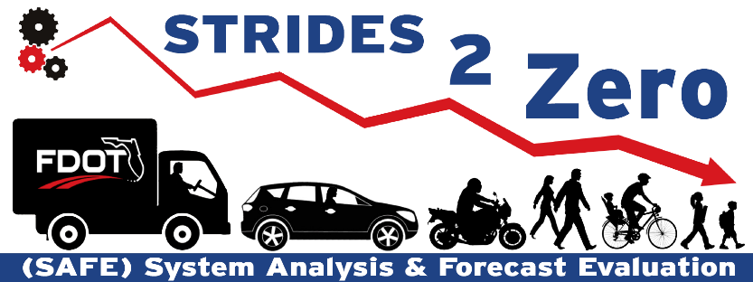
SAFE STRIDES 2 Zero Program
Leverages various data sources to enhance safety & mobility of the state highway system (SHS)
Aligns with three of the four Vital Few Safety Initiatives
  Enhancing safety
  Improving mobility
  Inspiring innovation with a predictive method of analyzing safety data
Enhances roadway network screening
  Previous method: Hot-spot analysis
  SS2Z program: Quantitative evaluation with Florida specific crash predictive analytics tools
SAFE
System Analysis and Forecast Evaluation
STRIDES 2 Zero
State Traffic Roadway and Intersection Data Evaluation System 2020
SS2Z
SAFE STRIDES 2 Zero
2
Notes:
Question:
To the department, how valuable is it to identify intersections that have the most potential for safety improvements on an annual basis?
Use leading-edge scientific predictive methods to screen and identify candidate intersections that have the most potential for safety improvements.
Diagnose, identify and select engineering countermeasures that reduce fatal and severe injury crashes.

Slide 3

Annual SAFE Reporting Overview
KA: Fatal and Severe Injuries
11%
2020 SHS Signalized Intersection Candidates: 154 Sites
Fatalities
SHS Signalized Intersection
7-year Safety Trend:
21
Fatalities Per Year Increased
Total Observed KA Crashes per Year for Candidates:
349
Serious Injuries
89%
KA Crash Reduction with
SAFE Implementation:
16%
Estimated Construction Cost:
$40.4 Million
$78.5 Million
Safety Benefit per Year:
5
SAFE Implementation:
Less Fatalities Per Year
24% Reduction of the Trend
$1.07 Billion Societal Savings Over 20-Year Design Life
Notes:
NPV = 1.07 Billion , 20 years, Societal KA Benefits – Construction = Net Societal Savings
(Societal KA Benefits do not include other savings due to BCO Benefits)
7 YR Trend = 20.929x+297.3
x=Year 1 to 7
154 Sites equals 1.8% of all signalized intersection on the State Highway System
Reduction of 5 lives are applied to the based condition 297.3.
21 Lives Trend is from CARS Signalized intersection based on internal data 2011-2017
We did not have data before 2011 that we were able to use for this analysis.
Using 2019 Signalized Intersection TEO Data
Construction Cost is in NPV from a 20-year design Life.
Design, MOT, CEI, Mobilization, Contingency (Maintenance not included)
Future Analysis:
Initial Steps towards determining save cost implementation. Accuracy will increase with tracking of project after they are programmed and constructed, and calibrating benefit cost calculations will come from these values.

Slide 4
Florida Roadway Safety Management
Federal safety funds categories (2017-2019)
  Highway Safety Improvement Program (HSIP)
  HSID
  HSLD
No formal process for candidate selections
  Based on project benefit-cost (B/C) ratios
Beginning 2024, Districts to fund safety projects following statutory requirements (pending)
SS2Z program to formalize and enhance roadway safety management
  Note: HSID stands for Highway Safety Improvement for Intersection Crashes
  HSLD stands for Highway Safety Improvement for Lane Departure Crashes

Slide 5
What’s new in SAFE?
Safety Performance Function (SPF) is an equation to calculate how many crashes are expected to occur, on average, for a selected roadway facility
Florida specific Safety Performance Functions (SPF) for network screening
  Intersections grouped based on context classification, number of legs, and traffic control type
Data driven process for identifying safety projects
  Identify counterpart sister intersections
Diverging from hot-spot to predictive safety analysis
  Maximize benefits for FDOT safety funding
Countermeasures are identified and selected
  Projects are pre-approved for HSIP funding implementation
Definition
Definition
Candidate Intersections (poor safety performance)
Counterpart Sister Intersections (good safety performance)

Slide 6

Methodology
FDOT Highway Safety Management Process
Develop SPFs using intersection traffic volumes, geometry,
and crash data
Preliminary Diagnosis
Countermeasure Selection
Economic Appraisal
Calculate safety performance with
crash predictive models
Network Screening
Project Prioritization
Annual Report
Identify candidate intersections and their counterpart sister intersections
Implementation
Safety Effectiveness Evaluation
6
Notes:
Florida HSMP methodology uses AASHTO HSM fundamentals.

Slide 7
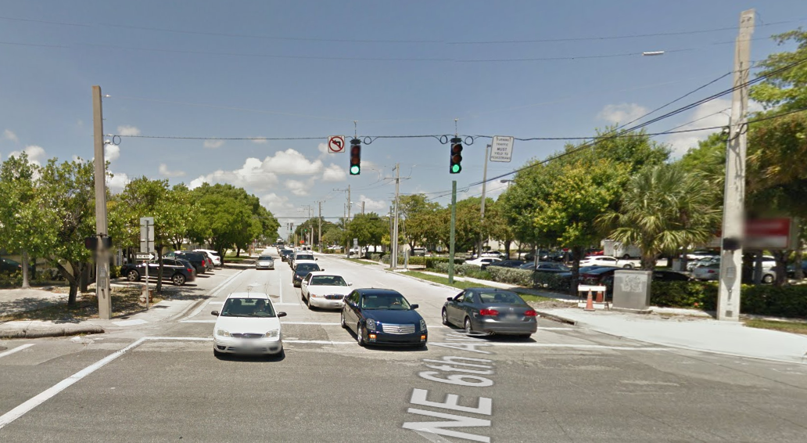
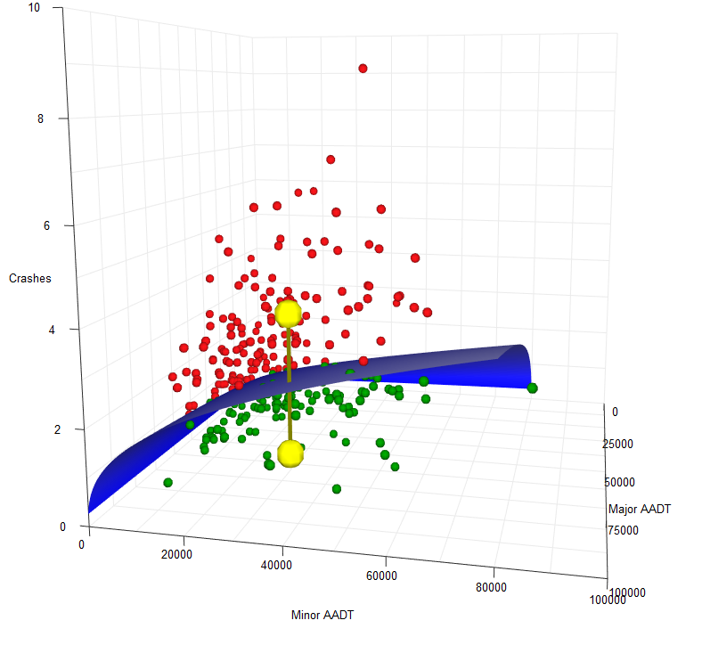
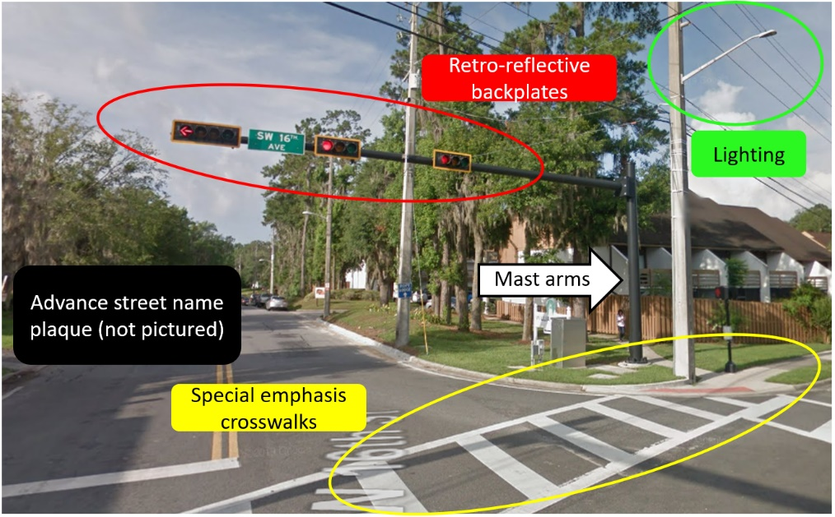
On-system C4 4-leg Signalized Intersections
Major AADT: 59,000
Minor AADT: 25,733
4 KA crashes
Major AADT: 55,332
Minor AADT: 25,733
1 KA crash
Note: C4 = Urban general
AADT = Annual average daily traffic
7

Slide 8
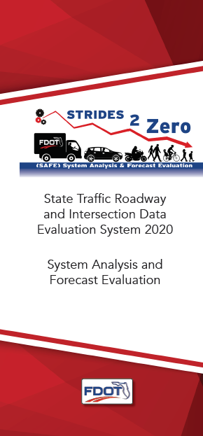
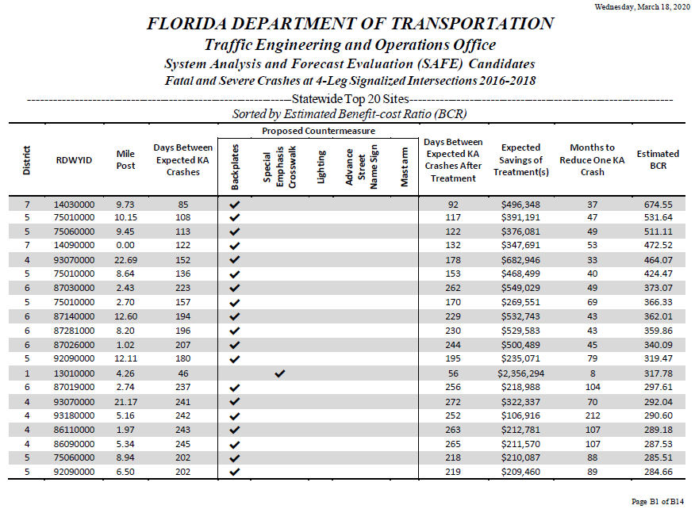
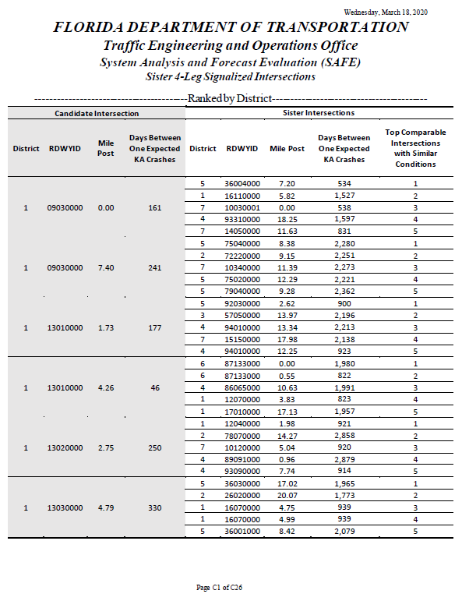
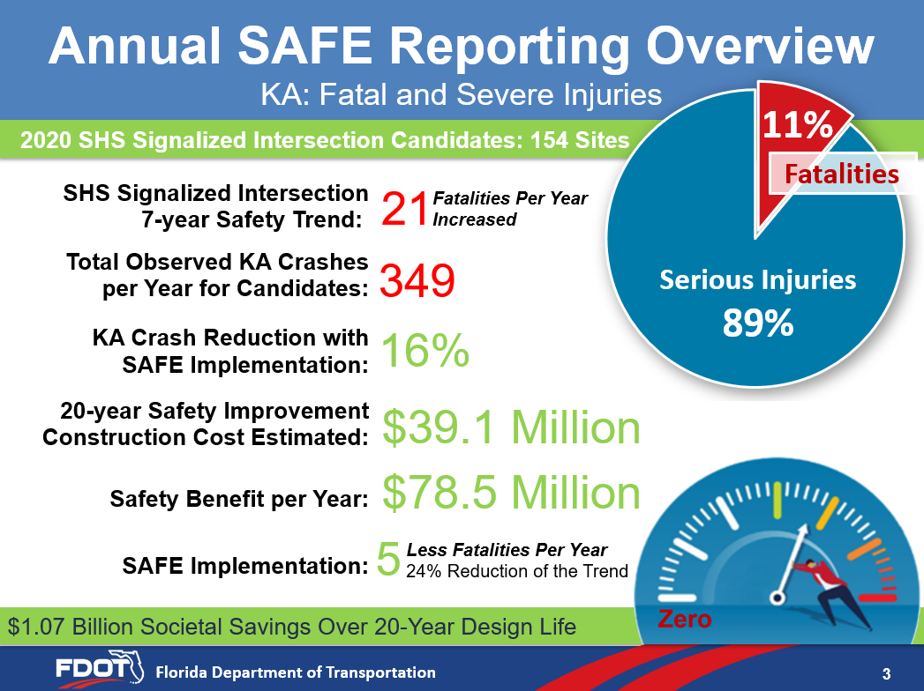
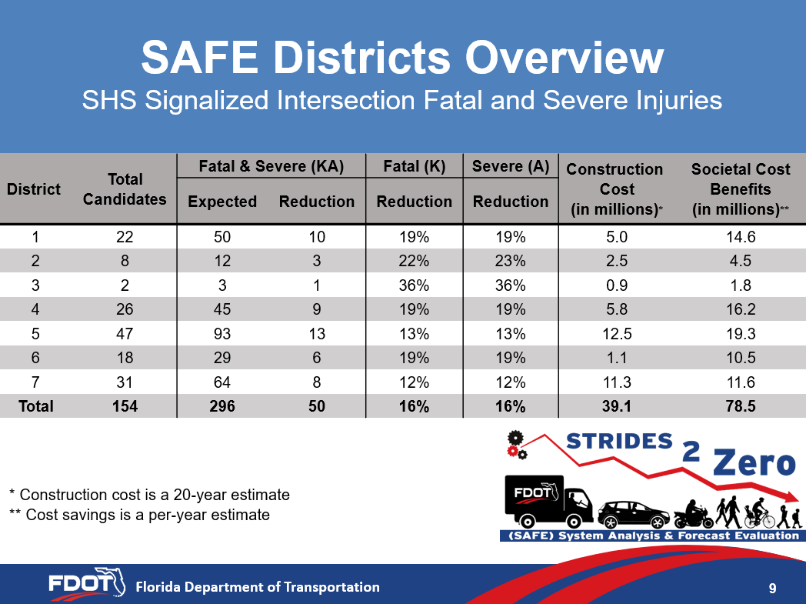

SAFE Report Contents
Priority locations
Proposed countermeasures
Days/months between expected fatal and severe injury crashes
Benefit-cost ratio (BCR)
Additional comments
Sister intersections
SAFE report available on the FDOT website
  https://bit.ly/2vmAezO
8

Slide 9
SAFE Districts Overview
SHS Signalized Intersection Fatal and Severe Injuries
District | Total Candidates | Fatal & Severe (KA) |  | Fatal (K) | Severe (A) | Construction Cost (in millions)* | Annual Societal Benefits (in millions)
 |  | Expected | Reduction | Reduction | Reduction
1 | 22 | 50 | 10 | 19% | 19% | 5.2 | 14.6
2 | 8 | 12 | 3 | 22% | 23% | 2.6 | 4.5
3 | 2 | 3 | 1 | 36% | 36% | 0.9 | 1.8
4 | 26 | 45 | 9 | 19% | 19% | 5.9 | 16.2
5 | 47 | 93 | 13 | 13% | 13% | 13.0 | 19.3
6 | 18 | 29 | 6 | 19% | 19% | 1.1 | 10.5
7 | 31 | 64 | 8 | 12% | 12% | 11.7 | 11.6
Total | 154 | 296 | 50 | 16% | 16% | 40.4 | 78.5
* Construction cost is NPV for a 20-year design life
9

Slide 10
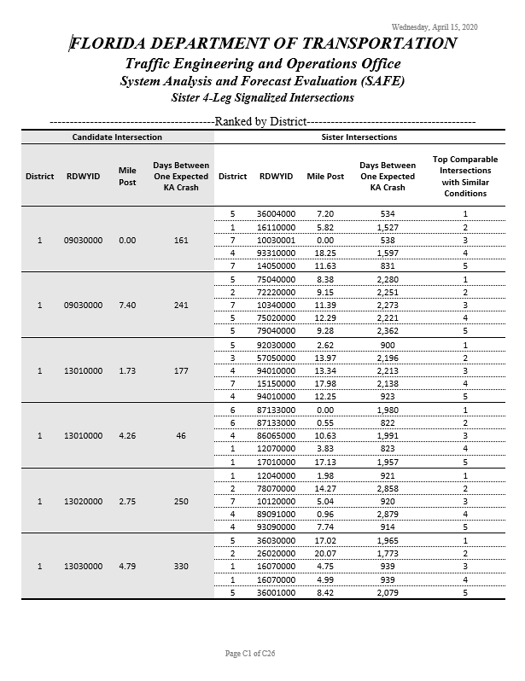
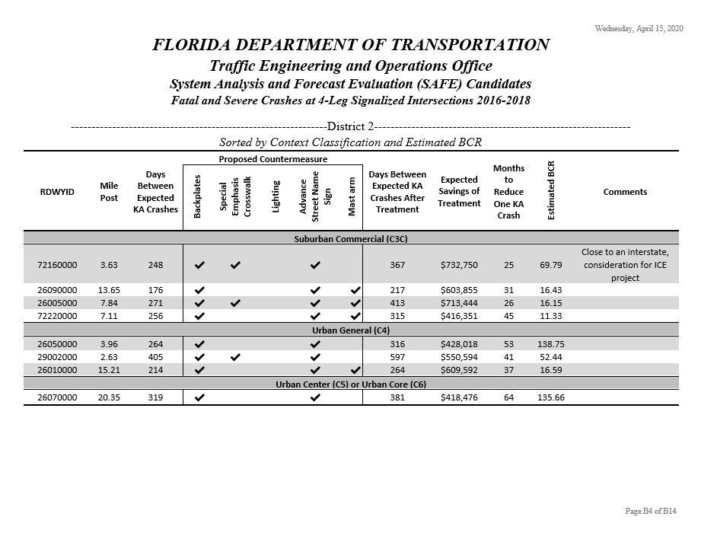
SS2Z SAFE Report Snapshot
Candidate intersections and counterpart sisters

Slide 11



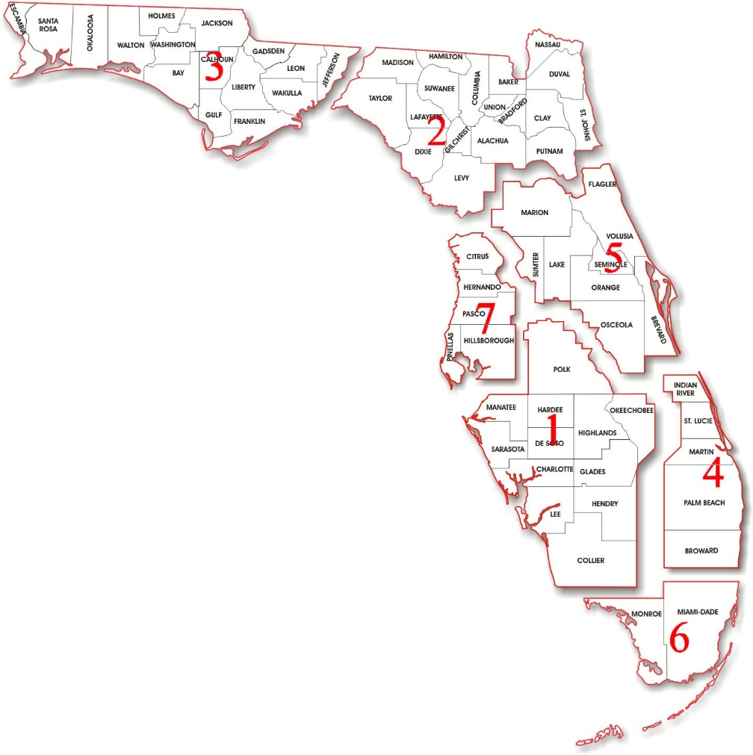











Growing Partnerships
11

Slide 12
SS2Z Next Steps
Develop SPFs for roadway segments, midblock crosswalks and bicycle facilities
Expand the analysis to include these facilities
Update SAFE Report annually (Dynamic Reporting)
Include more safety countermeasures when data is/are? available
Develop new sub-programs for STRIDES 2 Zero to enhance the overall safety management process
Notes:
Pending CO funding availability.

Slide 13
SS2Z 2020 Ask
  Districts, please use the SAFE 2020 Report to program and implement safety improvements at the listed intersections and provide feedback as to its usability
  Districts, please provide data for the missing intersections (i.e., local road AADTs, turn lanes, protective/permissive signal phasing, LPI, passive detection, etc.)
Notes:
Bottom Line Ask:
1: Start using the tool to implement projects. Districts to send CO feedback to improve the tool.
2: Refine the tool by getting more data from the Districts to improve and enhance reliability. Including additional countermeasures.

Slide 14
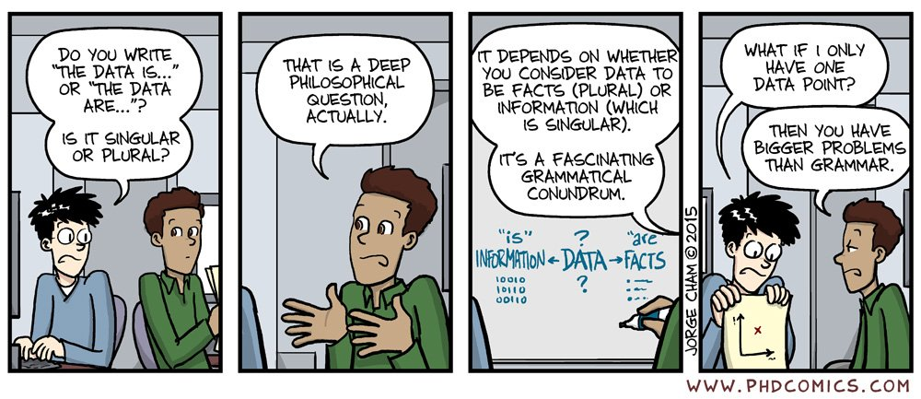
Questions?
Trey Tillander
850-410-5419
Alan El-Urfali
850-410-5416
Javier Ponce
850-410-5417
14

