Slide 1

STRIDES 2 Zero
(SAFE)
SW Traffic Services
and Studies Meeting
February 6, 2020
1
Notes:
STRIDES 2 Zero
State Traffic Roadway and Intersection Data Evaluation System 2020
SAFE
System Analysis and Forecast Evaluation

Slide 2
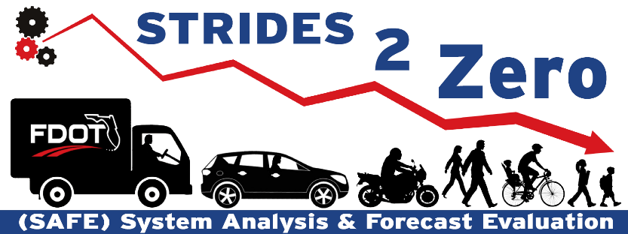
SAFE STRIDES 2 Zero Program
Leverage departmental data to evaluate safety and mobility for intersections and roadway segments
Enhance highway safety management network screening method from traditional hot spot analysis to quantitative evaluation with crash predictive tools
Monitor safety performance before and after implementing engineering countermeasures
Track and document SAFE STRIDES 2 Zero program to evaluate its return on investment (ROI)
SAFE
System Analysis and Forecast Evaluation
STRIDES 2 Zero
State Traffic Roadway and Intersection Data Evaluation System 2020
SS2Z
SAFE STRIDES 2 Zero
2

Slide 3

Methodology
FDOT Highway Safety Management Procedure
  Group intersections by context classification, traffic control type and number of legs
  Develop safety performance functions (SPF) with collected intersection and crash data
  Evaluate intersection safety performance using state-of-the-art crash predictive models
  Calculate highly reliable excess expected crash frequency with Empirical Bayesian (EB) method
  Identify candidate intersections with high potential for safety improvements and their sisters
  Propose engineering countermeasures for candidate intersections and rank them by benefit-cost ratio (BCR)
3

Slide 4
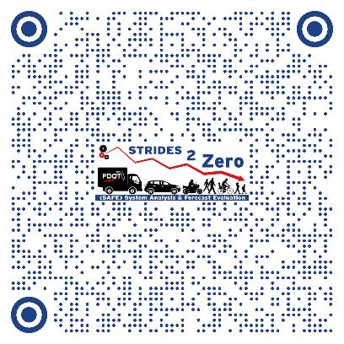
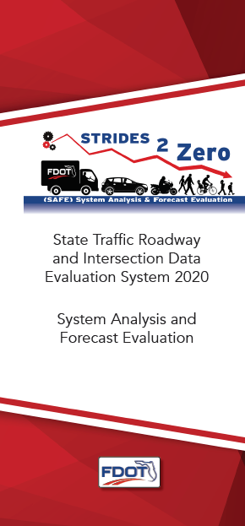
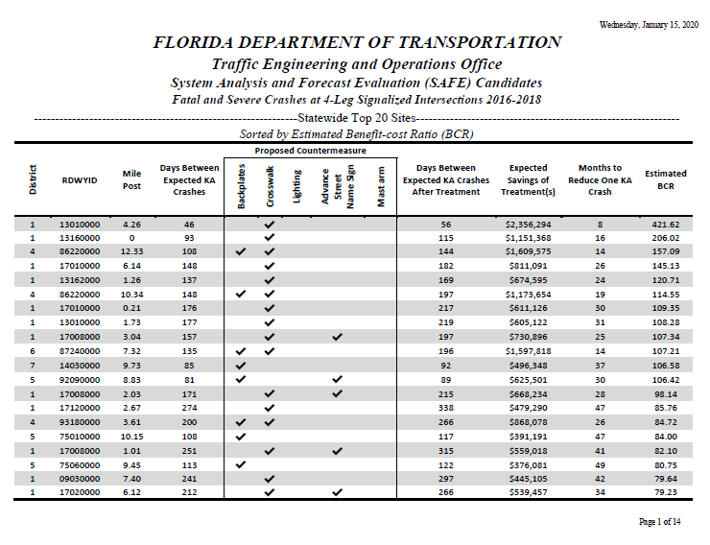
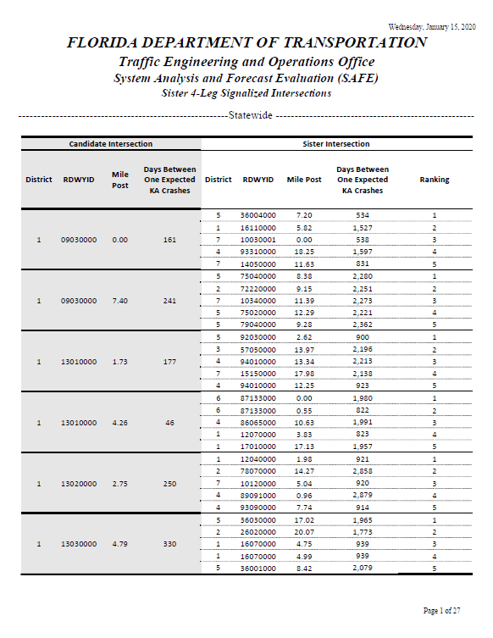
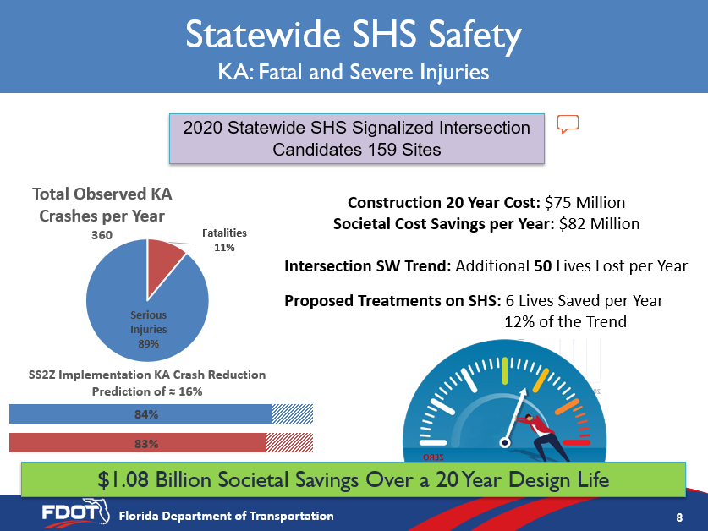
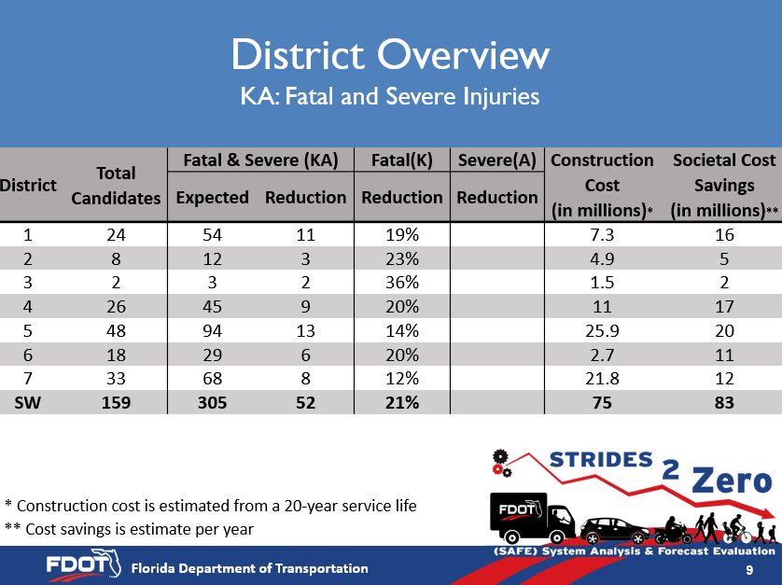
SAFE REPORT
SAFE Report at FDOT SharePoint site
  https://fdot.tips/38uVqkO
A SAFE program overview, including costs and benefits of the program, number of lives saved, and number of intersections for safety improvements
All candidate intersections with propose safety improvements and benefit cost ratio
All sister intersections for candidate to help identify contributing factors for poor safety performance
4

Slide 5
STRIDES 2 Zero Data Source
Exhibit A Intersection Database
  8,582 SHS traffic signals
CARS
  Crash data for 2016-2018
  Fatal and Severe Injury (KA) crashes only
Roadway Characteristic Inventory (RCI)
  Roadway context classification
Traffic Data Availability
  3,022 intersections available (blue)
  5,560 intersections needed
Data Collection Methods
  Desktop review
  Aerial analytics (AI)
  Lidar
  Districts efforts
Incomplete Data for Signalized Intersections
5
Notes:
AADT Minor 3022/8582
Total signalized intersection: 8565 (Exhibit A)+17 (maintained by D6)=8582

Slide 6

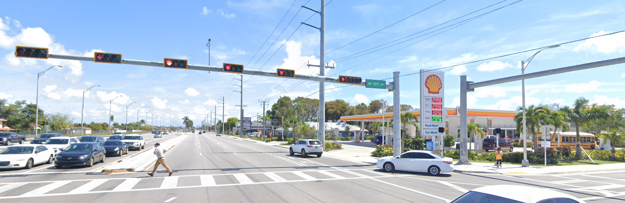
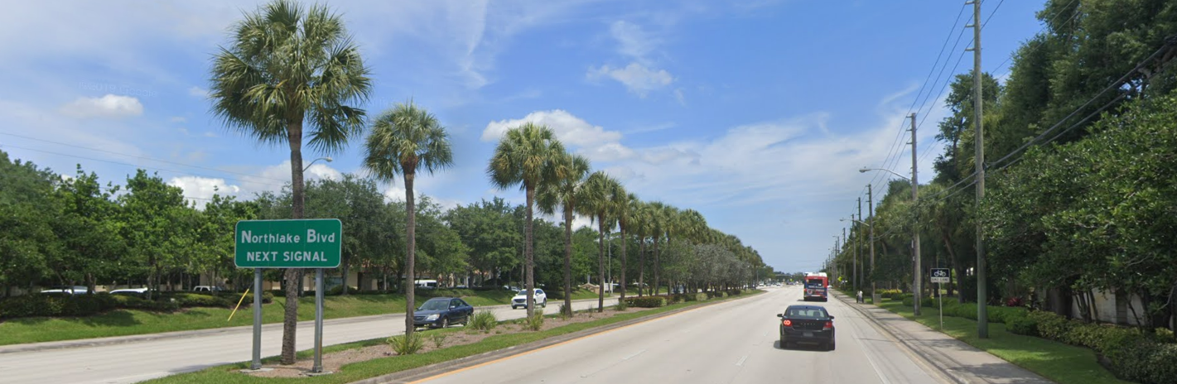
Safety Features
Desktop review
Retro-reflective backplates
Special emphasis crosswalks
Lighting
Protected/Permissive left-turn
Advance street name plaque
Mast arms
Retro-reflective backplates
Special emphasis crosswalks
Lighting
Protected/Permissive left-turn*
Advance street name plaque
6
Notes:
*Protected or Permissive left-turn lane was not used for 2020 SAFE analysis. Further data is needed for incorporation into the program.

Slide 7
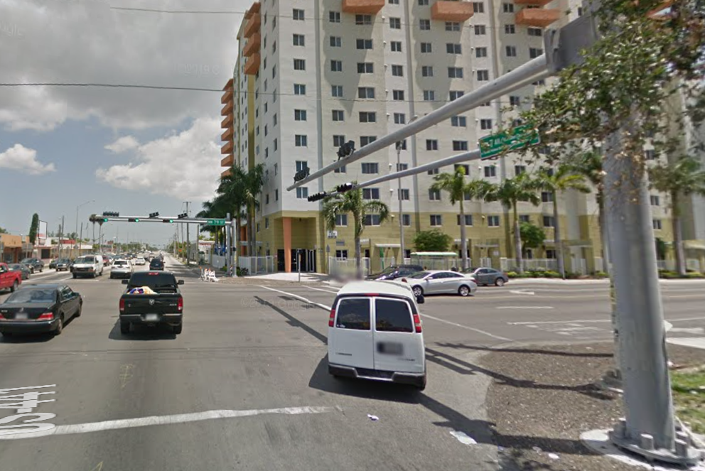
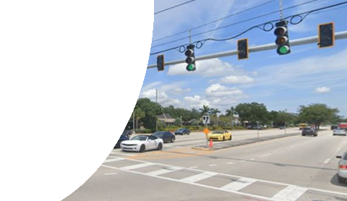
Data Sources for Safety Features
2019
  Desktop Review angle
2020 & Future
  FSU
    Aerial analytics (machine learning)
    Drone Traffic Studies Efforts
  UCF
    Context-based research efforts
    SPF variable significance
  Existing District Databases
    SharePoint site data
    Traffic Regulations
- Turn lanes
- Bike lanes
- Intersection
- Number of through lanes
- Midblock crosswalks
7

Slide 8

Annual SAFE Reporting Overview
KA: Fatal and Severe Injuries
2020 Signalized Intersection SHS Candidates 154 Sites
Total Candidate Observed KA
Crashes per Year
349
SAFE Implementation KA Crash Reduction ≈ 16%
20-year Safety Improvement
Construction Cost: $73.5 Million
Safety Benefit per Year: $78.5 Million
SAFE Implementation: 5 Fatalities Per Year Reduced
24% of the Trend
Current 7-year Signalized Intersection on SHS Safety Trend:
21 Fatalities per Year Increased
$1.03 Billion Societal Savings Over a 20-Year Design Life
Notes:
NPV = 1.034 Billion , 20 years, Societal KA Benefits – Construction = Net Societal Savings
(Societal KA Benefits do not include other savings due to BCO Benefits)
7 YR Trend = 20.929x+297.3
x=Year 1 to 7
154 Sites equals 1.8% of all signalized intersection on the State Highway System
Reduction of 5 lives are applied to the based condition 297.3.
21 Lives Trend is from CARS Signalized intersection based on internal data 2011-2017
We did not have data before 2011 that we were able to use for this analysis.
Using 2019 Signalized Intersection TEO Data
Construction Cost in an NPV from a 20-year design Life.
Future Analysis:
Initial Steps towards determining save cost implementation. Accuracy will increase with tracking of project after they are programmed and constructed, and calibrating benefit cost calculations will come from these values.

Slide 9
SAFE District Overview
SHS Signalized Intersection Fatal and Severe Injuries
District | Total Candidates | Fatal & Severe (KA) |  | Fatal (K) | Severe (A) | Construction Cost (in millions)* | Societal Cost Benefits (in millions)**
 |  | Expected | Reduction | Reduction | Reduction
1 | 22 | 50 | 10 | 19% | 19% | 7.1 | 14.6
2 | 8 | 12 | 3 | 22% | 23% | 4.9 | 4.5
3 | 2 | 3 | 1 | 36% | 36% | 1.5 | 1.8
4 | 26 | 45 | 9 | 19% | 19% | 11 | 16.2
5 | 47 | 93 | 13 | 13% | 13% | 24.7 | 19.3
6 | 18 | 29 | 6 | 19% | 19% | 2.6 | 10.5
7 | 31 | 64 | 8 | 12% | 12% | 21.7 | 11.6
SW | 154 | 296 | 50 | 16% | 16% | 73.5 | 78.5
K: Fatal Crashes A: Crashes with Severe Injuries * Construction cost is a 20-year estimate ** Cost savings is a per-year estimate
9

Slide 10
Evolution of Network Screening Process
Safety Network Screening List
  2,409 Intersections
  National wide HSM base condition model
  Static analysis
SAFE Network Screening List
  154 Intersections
  FL specific average condition model using HSM methodology
  Countermeasures Identified
  Contains 25% intersections not previously identified.
  SW Comparison with Sister Sites
  Automated dynamic algorithms using new and existing accessible databases for annual reports and ROI tracking
Notes:
Project level vs network screening level.

Slide 11
SS2Z Timeline
2019
2020
2021-2025
STRIDES 2 Zero
ETL Process
Program Development
First SAFE Static Report with Proposed Candidates
Program Design and Development
ETL Development
Roadway Inventory Data Collection for New Countermeasures
Dynamic Reporting Mechanism Design and Development
Work Program Integration
Database Architecture Continued Development
Coordination with Partnerships and Research
Dynamic Reporting Development
Program Design and Continued Development
ETL Continued Development
Development of Florida-specific CMFs
Analysis and Incorporation of other Countermeasures
CAV Countermeasure Data
Database Architecture Continued Development
Continued Coordination with Partnerships and Research
11

Slide 12
SS2Z Timeline
2019
STRIDES 2 Zero
Database architecture Design and Development
ETL Process
  CARS
  RCI
    Context Classification, AADT (Major, Minor)
  ARBM
    Number of Legs
  TSMCA Data
    Traffic Control Devices
  TEO Data
    Roadway Inventory Data Collection
Program Development
SAFE
12

Slide 13
SS2Z Timeline
2020
First SAFE Static Report with Proposed Candidates
Program Design and Development
SAFE; Ped Bike; School; Speed; RFSA
ETL Development
  District; RCI; Work Program; S4A
  DHSMV; Pavement Management; ARBM; Others
Roadway Inventory Data Collection for New Countermeasures
Working with our partnerships for new data collection efforts in order to gather new countermeasures on the SHS
Dynamic Reporting Mechanism Design and Development
Work Program Integration
Database Architecture Continued Development
Coordination with Partnerships and Research
13

Slide 14
SS2Z Timeline
2021-2025
2021-2025
Dynamic Reporting Development
Program Design and Continued Development
ETL Continued Development
Development of Florida-specific CMFs
Analysis and Incorporation of other Countermeasures
CAV Countermeasure Data
Database Architecture Continued Development
Continued Coordination with Partnerships and Research
14

Slide 15



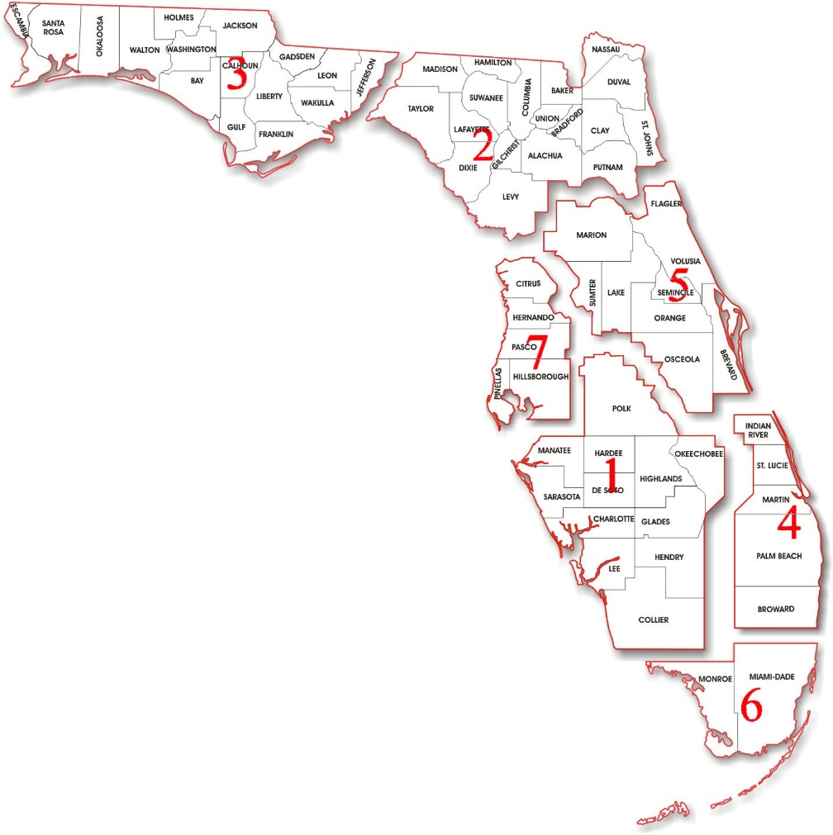











Growing Partnerships
15

Slide 16
Description of the Report
Locations
Proposed Countermeasure
Days or Months Between Expected Fatal and Severe Crashes
Benefit Cost Ratio (BCR)
Comments
Sister Intersections
16

Slide 17
District Assistance
What we ask of the Districts
  Input on presentation and report
  Assistance in acquiring the rest of the data
  Advice regarding:
    New CAV implementation
    Report countermeasures – are there any countermeasures that we are overlooking?
Anything to help us improve the SAFE STRIDES 2 Zero Program
17

Slide 18
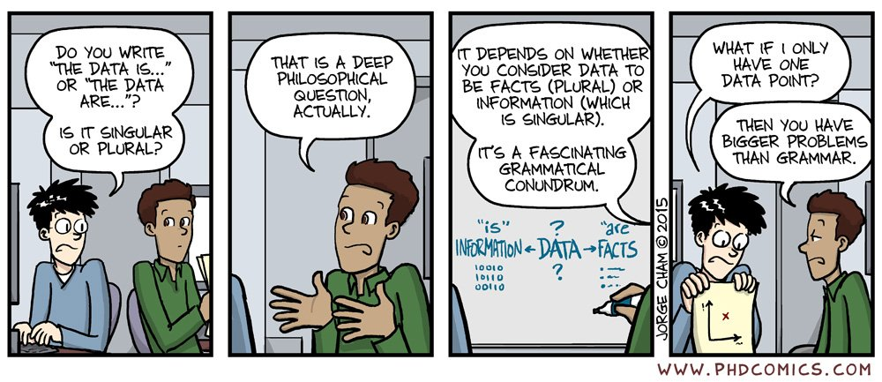
Questions?
Trey Tillander
850-410-5419
Alan El-Urfali
850-410-5416
Javier Ponce
850-410-5417
18

