Slide 1

How To Navigate In This Presentation
To move to the next slide or animation on the current slide, left click on your mouse OR go to the lower left corner of the slide and click on the “Next” button .
To go back to the previous slide, press the “backspace” key on your keyboard OR go to the lower left corner of the slide and click on the “Previous” button .
Slides with animations requiring additional clicks have an icon in their upper right corner.
A
Buttons In Lower Left Corner Of Slides:

Slide 2
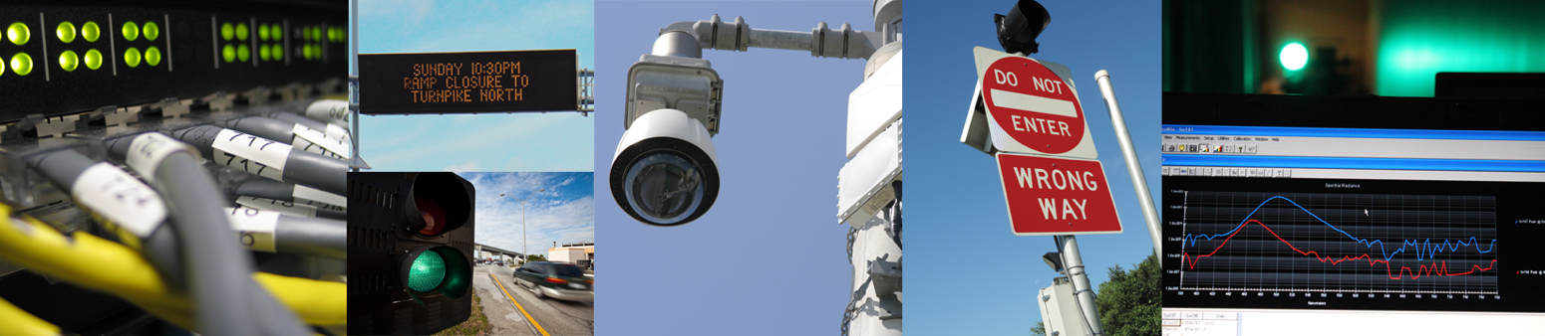
Approved Product List Process for the Traffic Engineering Research Laboratory
FDOT Traffic Engineering and Operations Office
Traffic Engineering Research Laboratory (TERL)
2612 Springhill Rd
Tallahassee, FL 32305
6/11/2026

Slide 3
Contents
PART 1: Legal Basis for Approved Product List (APL) Program
PART 2: Web Links to:
  APL Process
  Requirements Documents
PART 3: Three-Step APL Process (ONLY Certified Process)
PART 4: Completing APL Documentation: Compliance Matrices and Checklists for Lab Testing and External Standards
PART 5: Maintaining Impartiality

Slide 4
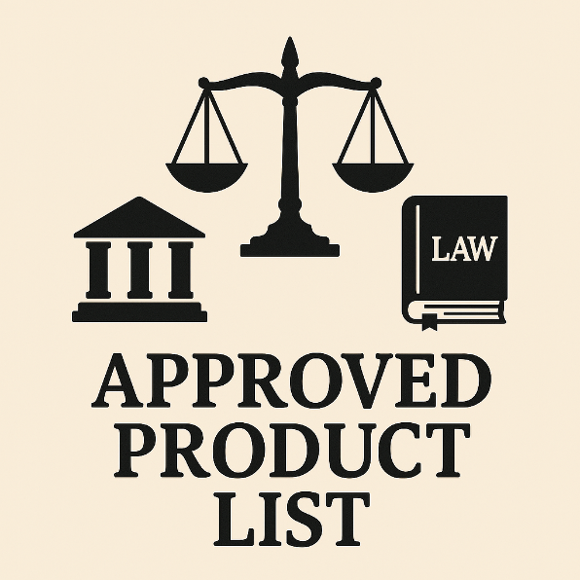
Part 1: Legal Basis for APL Program

Slide 5
Legal Basis For APL Program
State law gives the Florida Department of Transportation
the authority to certify traffic control products.
…………………………………………………………………………………………………………………………….
Vendors, manufacturers or contractors who intend to sell or install a transportation device within the State of Florida must follow the Department's approval process as outlined below. It shall be unlawful for any public body or official to purchase, or for anyone to sell, any traffic control signal or device unless it conforms with the manual and specifications published by the Department of Transportation and is certified to be of such conformance prior to sale.
…………………………………………………………………………………………………………………………….
– Excerpt from Florida Statute 316.0745

Slide 6
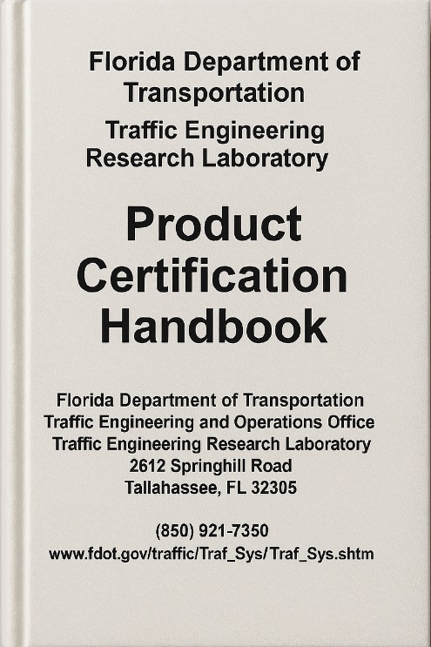
Part 2: Web Links to APL Process and Requirements Documents

Slide 7
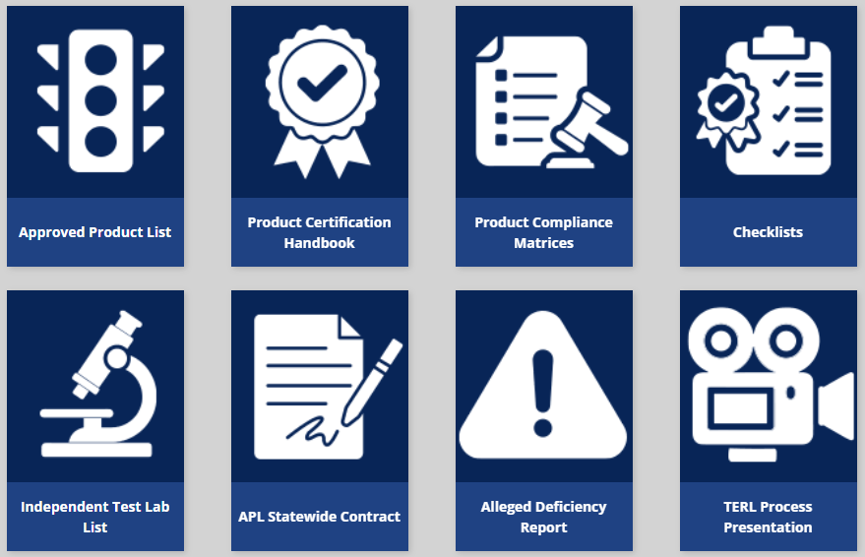
What Are The Important Web Links?

Slide 8
What Are The Important Web Links?
The Approved Product List (APL) includes traffic control products certified by TERL.

Slide 9
What Are The Important Web Links?
The Product Certification Handbook describes the TERL processes and requirements for listing products on the APL.

Slide 10
What Are The Important Web Links?
Product Compliance Matrices describe product requirements for listing on the APL. They are derived from Standard Specifications.

Slide 11
What Are The Important Web Links?
Checklists are referenced in product compliance matrices. They describe test lab, test lab reporting and external standard-based requirements for listing on the APL. They are derived from the Product Certification Handbook and external standards adopted by TERL (e.g., NEMA TS2).

Slide 12
What Are The Important Web Links?
The Independent Test Lab List contains third party test labs that have met requirements for test lab and test reporting, specified in Section 7 of the Product Certification Handbook. This list is provided for information only; there is NO requirement for selecting a test lab from this list.

Slide 13
What Are The Important Web Links?
The APL Statewide Contract includes a list of APL products that were competitively bid and awarded to the low bidder. This allows government agencies to purchase products without requesting multiple bids.

Slide 14
What Are The Important Web Links?
The Alleged Deficiency Report is a one-page form used to report alleged deficiencies of Section 316.0745, Florida Statute, product/quality management system standards or certification requirements.

Slide 15
What Are The Important Web Links?
The TERL Process Presentation is a short training slide show describing the TERL process for certifying and listing products on the APL.

Slide 16
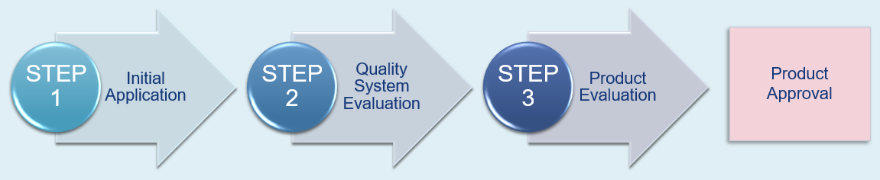
Part 3: Three-Step APL Process
(ONLY Certified Process)

Slide 17
How To Get A Product Listed On The APL
A
There are three sequential steps to get a product approved and listed on the APL:
This presentation summarizes the step process detailed in Section 3.2 of the Product Certification Handbook.
Initial Application
Quality System Evaluation
Product Evaluation
Product Approval
STEP 1
STEP 2
STEP 3

Slide 18
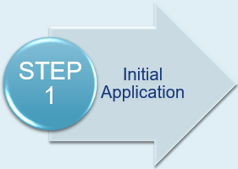
How To Get A Product Listed On The APL
A
The applicant must first submit product information via the Product Application Tracking and History (PATH) web site.
This includes a completed Request for Product Consideration (RFPC) Application.
If the product requires listing on the APL and the applicant is a new vendor, the applicant will be directed to proceed to STEP 2.
Existing vendors with specific changes to their accepted quality system (i.e., new manufacturing facility) will also be directed to STEP 2.

Slide 19
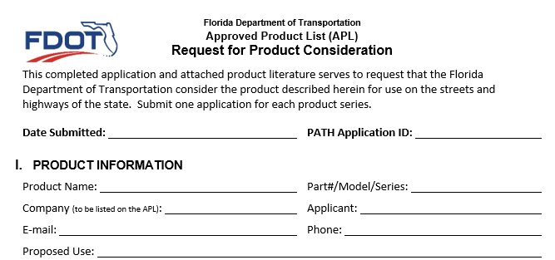
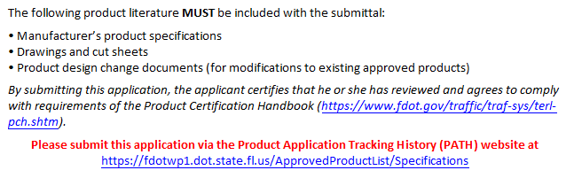
How To Get A Product Listed On The APL
A
STEP 1 consists of completing a one-page Request for Product Consideration Application and providing the product literature shown below.
This information is submitted via a portal (PATH) which requires an account.
The account instructions link is found on the TERL Product Approval Process page.

Slide 20
How To Get A Product Listed On The APL
TERL Response In STEP 1:
TERL sends an email, typically within 14 calendar days, indicating next step to follow if product is within scope of the APL.

Slide 21
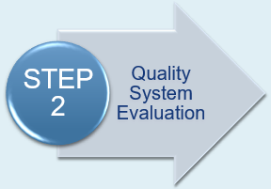
How To Get A Product Listed On The APL
A
The applicant is required to undergo an evaluation of their internal quality system based on the ISO 9001 Standard, as described in Section 5 of the Product Certification Handbook.
ISO 9001 certification is NOT required.
The applicant will be provided instructions that include the required quality system documentation to submit.
Upon acceptance of the quality system, the applicant will be directed to proceed to STEP 3.

Slide 22
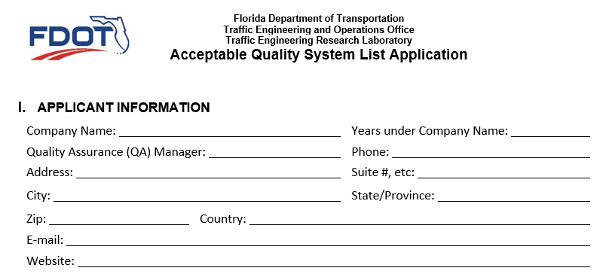
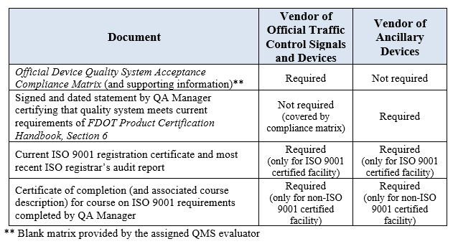
How To Get A Product Listed On The APL
A
STEP 2 consists of completing a three-page Acceptable Quality System List Application and providing the supporting information below.
Supporting Information:

Slide 23
How To Get A Product Listed On The APL
A
The supporting information depends on the type of product:
  Official traffic control signals and devices
  Ancillary devices
For more details, go to Section 4.2 of the Product Certification Handbook.
Compliance matrices will be explained later in this presentation.
Click here to find examples of course providers.

Slide 24
How To Get A Product Listed On The APL
TERL Response In STEP 2:
TERL sends an email, typically within 30 calendar days, with quality system evaluation findings to resolve (if any), or notification of quality system acceptance.

Slide 25
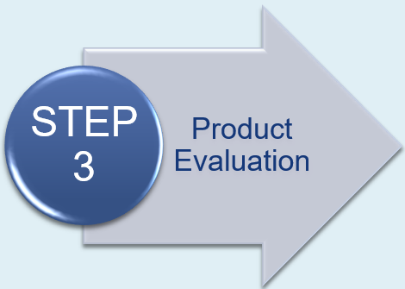
How To Get A Product Listed On The APL
A
STEP 3 occurs after successfully completing STEPS 1 & 2.
STEP 3 is subdivided in two sequential steps.
The applicant will first be directed to submit product documentation (STEP 3A, shown on next slide).
Product documentation is first reviewed for completeness.
Upon determination of completeness, the applicant will be directed to provide a representative sample of the product for evaluation (STEP 3B).
The product sample and documentation will then be evaluated.

Slide 26
How To Get A Product Listed On The APL
A
STEP 3 consists of providing the product documentation below (STEP 3A) and then a product sample (STEP 3B).
Compliance matrices will be explained later in this presentation.
PRODUCT DOCUMENTATION | ADDITIONAL DOCUMENTATION (as applicable)
Applicable product compliance matrices Third-party or first-party test data specified in matrices Testing laboratory/report and standards-based checklists Manufacturer’s product specifications Product drawings or cut sheets Parts list Assembly and installation instructions | Operation manual Troubleshooting and service manual Circuit board schematics or block diagrams
Test data refer to first or third party test lab reports that show compliance to external standards.

Slide 27
How To Get A Product Listed On The APL
TERL Response In STEP 3A:
TERL sends an email, typically within 14 calendar days, with results of documentation completeness review.
TERL Response In STEP 3B:
TERL sends an email, typically within 60 calendar days, with product evaluation report containing findings to resolve (if any), or notification via email of product approval.

Slide 28
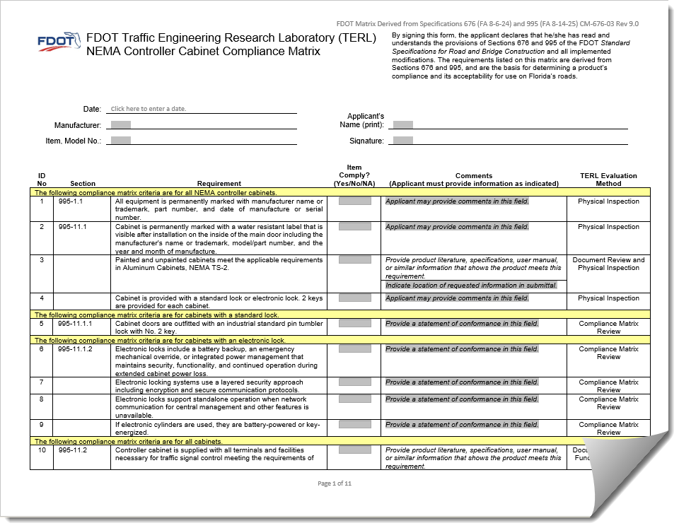
Part 4: Completing APL Documentation:
- Compliance Matrices
- Checklists for Lab Testing and External Standards

Slide 29
What Are The Two Types Of Compliance Matrices?
In STEP 1: No compliance matrix for this step
In STEP 2: Quality System Compliance Matrix
  E-mailed to the vendor (NOT available online)
  ONLY for vendors of official traffic control signals and devices
In STEP 3: Product Compliance Matrix
  Available online for download at: https://www.fdot.gov/traffic/traf-sys/product-specifications.shtm

Slide 30
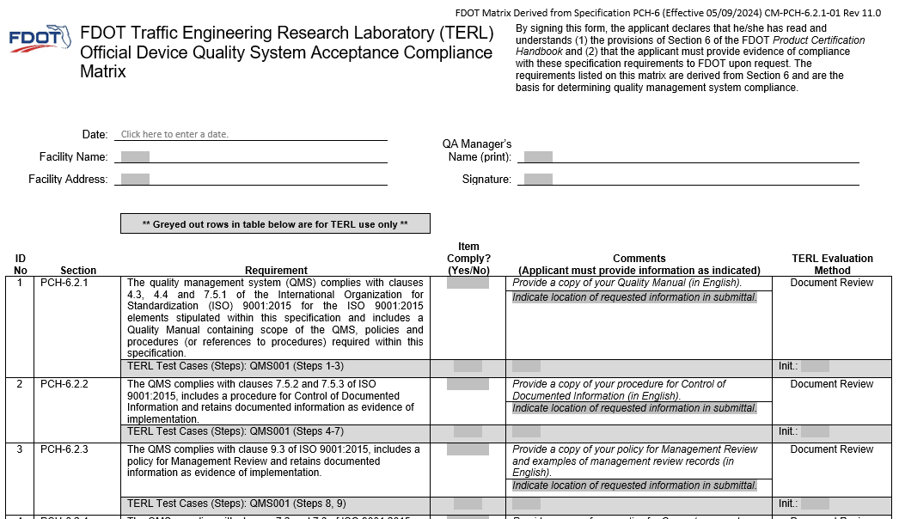
How To Complete A Quality System Compliance Matrix

Slide 31
How To Complete A Quality System Compliance Matrix
A
Facility Name/Address and QA Manager’s Name/Signature must match those in the Acceptable Quality System List Application.

Slide 32
How To Complete A Quality System Compliance Matrix
A
Complete the “Item Comply? (Yes/No)” column for each Requirement. If Requirement is not applicable, select “No” and add justification in the “Comments” column.
The “Comments” column specifies the documentation to be provided for each Requirement. For ease of review, replace the greyed-out text with text indicating the specific location of the documentation.

Slide 33
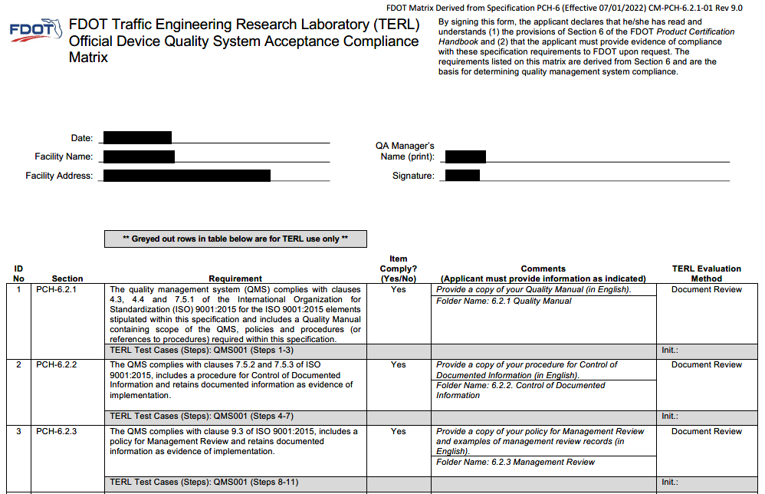
Good Example Of Completed Quality System Compliance Matrix
A

Slide 34
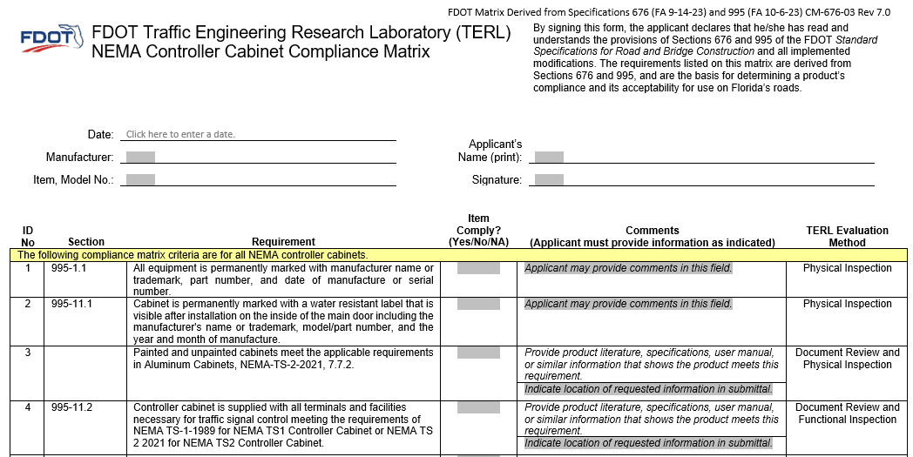
How To Complete A Product Compliance Matrix

Slide 35
How To Complete A Product Compliance Matrix
A
Manufacturer, Model No., and Applicant’s Name must match those in the PATH Application. Also, matrix must be signed.

Slide 36
How To Complete A Product Compliance Matrix
A
Complete the “Item Comply? (Yes/No/NA)” column for each Requirement. If Requirement is not met but is applicable, select “No” and add justification in the “Comments” column. If Requirement is not applicable, select “NA”.
The “Comments” column specifies the documentation to be provided for each Requirement. For ease of review, replace the greyed-out text with text indicating the specific location of the documentation.

Slide 37
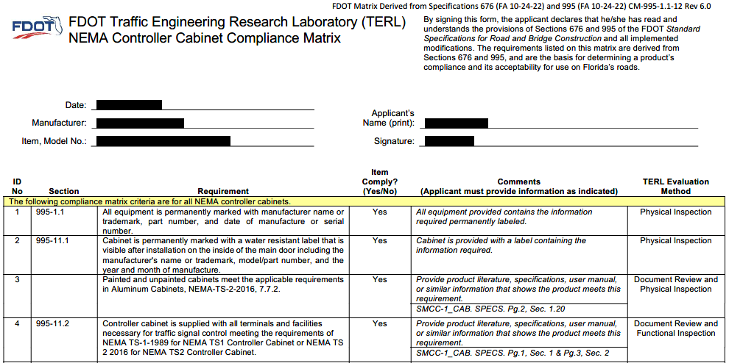
Good Example Of Completed Product Compliance Matrix
A

Slide 38
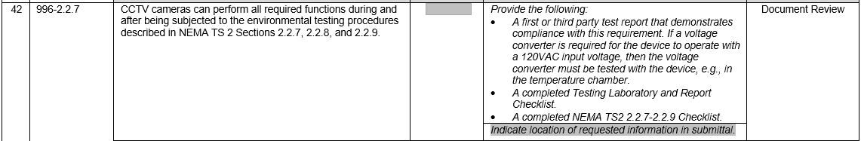
What To Do When A Test Lab Report Is Required
The “Comments” column in the product compliance matrix specifies, for example:
The type of test report required, first or third party
The additional components to be tested (e.g., voltage converter)
The test related checklists (2 required checklists in example below)

Slide 39
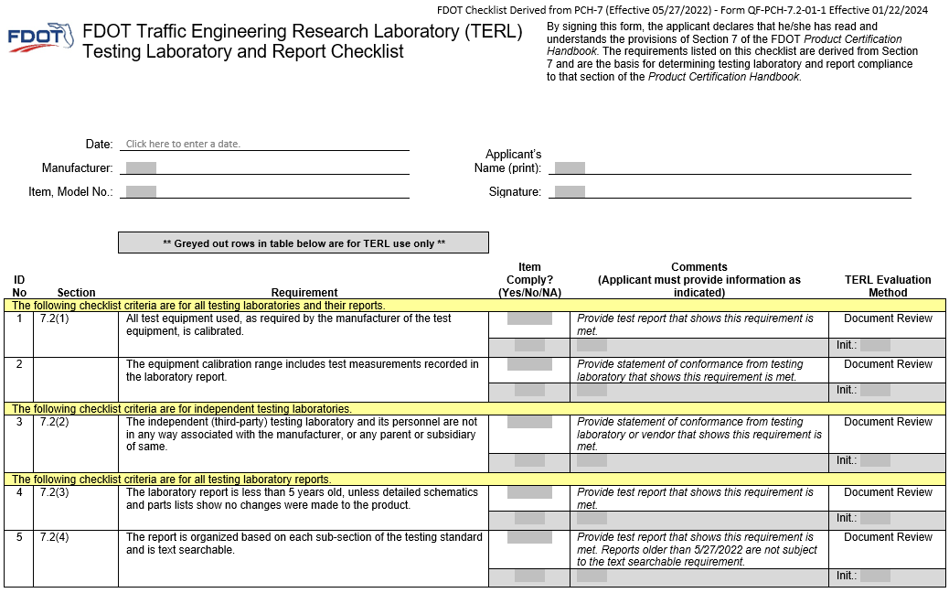
Testing Laboratory And Report Checklist
Checklist to be completed by applicant, NOT test lab.

Slide 40
Testing Laboratory And Report Checklist
A
Manufacturer, Model No., and Applicant’s Name must match those in the PATH Application. Also, checklist must be signed.

Slide 41
Testing Laboratory And Report Checklist
A
Complete the “Item Comply? (Yes/No/NA)” column for each Requirement. If Requirement is not met but is applicable, select “No”. If Requirement is not applicable, select “NA”.
The “Comments” column specifies the documentation to be provided for each Requirement.

Slide 42
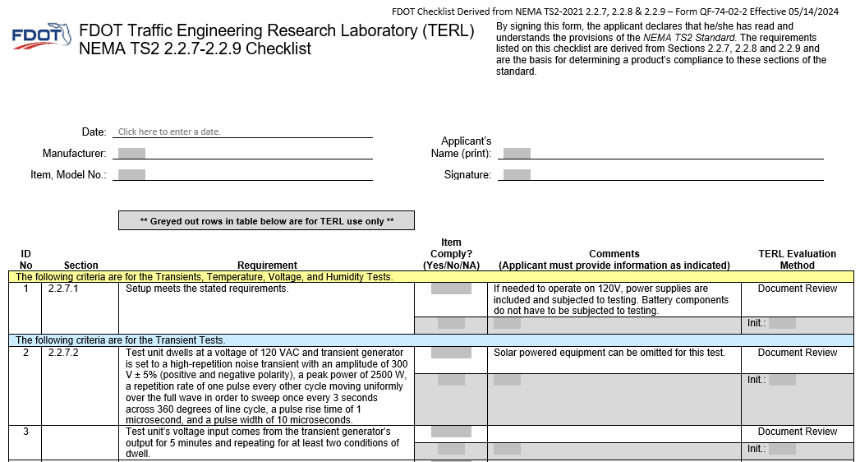
Example Of Checklist For NEMA TS2 2.2.7-2.2.9 Standard
Checklist to be completed by applicant, NOT test lab.

Slide 43
Example Of Checklist For NEMA TS2 2.2.7-2.2.9 Standard
Manufacturer, Model No., and Applicant’s Name must match those in the PATH Application. Also, checklist must be signed.

Slide 44
Example Of Checklist For NEMA TS2 2.2.7-2.2.9 Standard
Complete the “Item Comply? (Yes/No/NA)” column for each Requirement. If Requirement is not met but is applicable, select “No”. If Requirement is not applicable, select “NA”.
The “Comments” column includes supplemental information for the test.

Slide 45

Part 5: Maintaining Impartiality

Slide 46
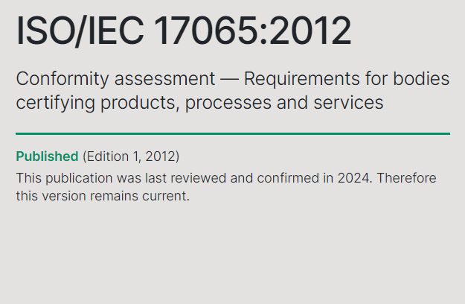
How TERL Maintains Impartiality
TERL has adopted the ISO 17065 Standard for conducting its product certification operations.
ISO: International Organization for Standardization

Slide 47
How TERL Maintains Impartiality
The ISO 17065 Standard includes impartiality requirements, such as:
  Applying the same certification requirements to each applicant without exception
  Processing applications on a first-in first-out basis
  Establishing an organizational structure allowing for independent review and decision-making regarding product certification

Slide 48
Product Certification Decision-Making Process
A
Quality System and Product Evaluations
TERL Quality System Evaluators
Independent Review of Evaluations
TERL Quality Assurance Manager
(Quality System)
Technical Product Certification Decision
TERL Manager
Director, Office of Materials
Administrative Product Certification Decision
Director, Office of Traffic Engineering and Operations
OR
OR
Designee
TERL Manager
(Product)
AND
AND
TERL Product Evaluators

Slide 49
Thank You For Watching This Presentation On The APL Process
If you have any questions, please read Section 3 of the Product Certification Handbook.

