Slide 1
WWD Event Handling (4700)
Tucker Brown

Slide 2
Current Functionality
SG allows a user to create WWD event from the Map directly and that will automatically activate a response plan.
SG allows a user to create an event as another datatype and then change it to a WWD event type.
No response plan is automatic in this case
SG allows a user to create an event from an alert
No response plan is automatic in this case
SG automatically creates an event and activates a response plan based on an incoming alert
Suggested and pre-defined plans supported

Slide 3
Issues Identified
Events that result in a crash are later found to be related to Wrong Way Driving but still maintain a crash event type
This includes other event types where you also need to signify a WWD event occurred.
Events that really are WWD events but don’t need automatic response plans.

Slide 4
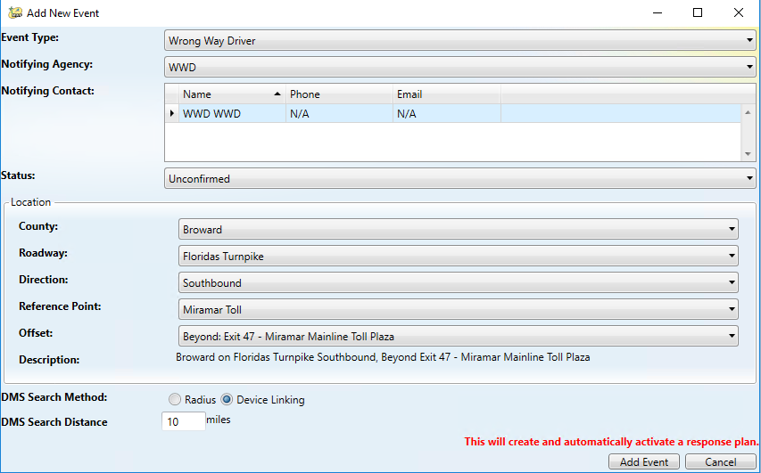
Proposed Changes
(Previously discussed) Have a checkbox (similar to Fire, HAZMAT, etc) to flag the event as WWD related
Would be set automatically for event with a WWD event type
Manually set for all other event types
Make the automatic response plan optional for Event created as WWD Events

Slide 5
QUESTIONS?

Slide 6
Modify Comments through Audit (4679)
Tucker Brown

Slide 7
Modifying Comments
Auditing allows adding new comments but not editing existing comments
Proposed change would allow existing comments to be editable
Would still have a Audit line added in the Event Chronology
JIRA issue says “Operator” comments, but would it be an issue if all comments were editable?

Slide 8
QUESTIONS?

Slide 9
Remove County Boundaries from Reporting (4677)
Tucker Brown

Slide 10
Current Functionality
When running a report between 2 points, the user is required to select the County, Roadway, and Direction before selecting the 2 points.
This prevents a user from selecting points in different counties
Also note, there is no current path for traversing EM locations along a roadway. This is currently done by giving all the locations defined for the county, roadway, and directions between the sort orders of the selected endpoints.

Slide 11
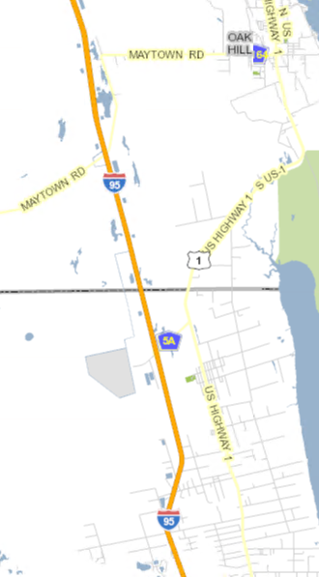
Option 1: Easiest
Have user configure the sort order of points along the roadway so that even across the county boundary, they are consecutive.
More time consuming for configuration but could be implemented with report template changes.

Slide 12
Option 2: Medium
Using a combination of sort orders and shape files, have the system figure out the order of the points on the roadway.
Updated for each configuration change
Less configuration, less user interaction
Possibility of errors in the generation

Slide 13
Option 3: Expensive (Long Term)
Change the Event Location schema to directly reference shape file data to tie it specifically to points
Pros
Easier to traverse a roadway
Easier to configure system initially (or add new roadways)
Would make this particular issue trivial
Cons
How to tie historical data to new locations
Less flexibility in the placement of locations
3rd Party Changes (FLATIS, other local software)

Slide 14
QUESTIONS?

