Slide 1
RISC in SunGuide
Tucker Brown

Slide 2
RISC Enhancement
Within JIRA there are multiple requests for RISC. There are multiple options ranging from:
Add a checkbox to say/indicate that an event is associated with RISC
Full RISC tracking and reporting in SunGuide
Does anyone need the ability to just have the checkbox?

Slide 3
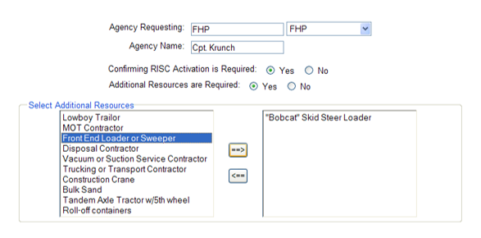
RISC Enhancement
Conceptually, here is the walkthrough for handling the RISC event:
RISC would be accessed from the event details window in the ribbon bar
Activating it would allow the user to put in a requesting agency and any equipment needed

Slide 4
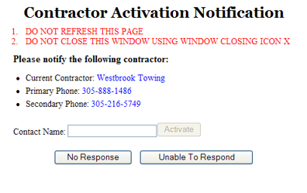
RISC Enhancement
At this point, an email would be sent to a configurable Email List
A pop up would appear to the user to show the next contractor to notify of the incident.
If the contact responds, the contact is noted and an email is sent.
If there is no response, they are unable to respond, or a pre-configured amount of time elapses, the next contractor’s information is displayed

Slide 5
RISC Enhancement
The dialog would allow the user to note the time of arrival for the RISC vehicles and equipment.
Once all equipment is ready, the Notice to Proceed is given, noting who authorized the NTP.
Can the ending criteria be that the operator unblocked the lanes in the event? (as opposed to checking it the RISC area)

Slide 6
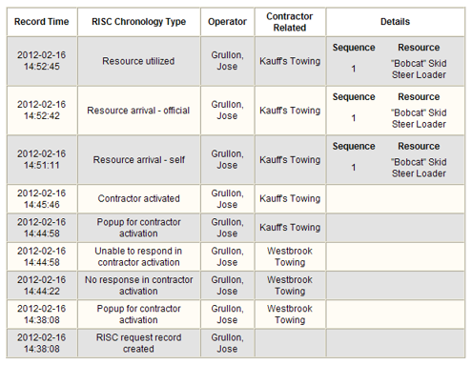
RISC Enhancement
The chronology will be a part of the EM Event Chronology but will have a comment type that will allow the RISC specific rows to be isolated.
These will be filtered and displayed in the RISC dialog
How searchable does the chronology need to be?
Do we need auditing?

Slide 7
RISC Enhancement
This is the D6 OTM installation workflow. Are there others that need to be considered?
Other fields that need to be tracked?
Things that might be made optional as a district would/could not use them?
Other considerations?

Slide 8
QUESTIONS?

Slide 9
Background Information SG- 4465
Tucker Brown

Slide 10
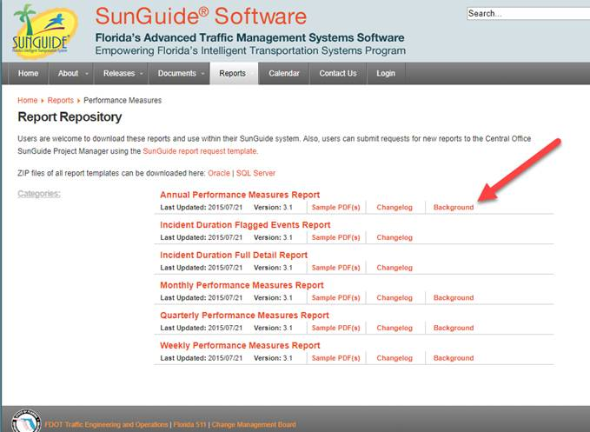
Reporting
On the http://sunguidesoftware.com/report-repository website, there is background information on some reports, but not all.
This information would explain the fields of the reports including formulas and calculations
We will be adding background information for all reports
Are there reports you would like to prioritize?

Slide 11
QUESTIONS?

