Slide 1
SunGuide Software Users Group Meeting
August 24, 2023

Slide 2
WELCOME
ATTENDEE ROLL CALL

Slide 3
SG-6780 - Echo(ISS) enhancement to read directional BIN
AJ Skillern

Slide 4
Current Behavior
Directional bin is currently read for Wavetronix devices and can detect a wrong way driver based on a volume in the opposite directional bin.
Only available for Wavetronix HD devices.

Slide 5
Enhancement Request
Get the directional information from the ISS devices (Echo) that are also on the APL.
9.0 Enhancement would allow it to be used by SunGuide in WWD Mainline Detection.

Slide 6
QUESTIONS?
COMMENTS?
SUPPORT?

Slide 7
SG-6773 - Treat TSS detectors as failing a poll cycle when no data is received
AJ Skillern

Slide 8
Current Behavior
When a detector is polled, the criteria for a successful poll is only that data is returned.
If a controller has lanes 1, 2, and 3, but the poll returns 4, 5, and 6, technically, this is still a successful poll.
Likewise, if response is a successful response, but has no lanes worth of data, it is still a valid response.

Slide 9
Enhancement Request
If no data is retrieved for any lane for a configurable number of poll cycles, treat this as an error state and update the Op Status of the device.
Configurable number of cycles (1 or more)
Could disable this functionality if set to 0?

Slide 10
QUESTIONS?
COMMENTS?
SUPPORT?

Slide 11
SG-6053 - Message Library - Automatically Select Correctly Sized Graphics
AJ Skillern

Slide 12
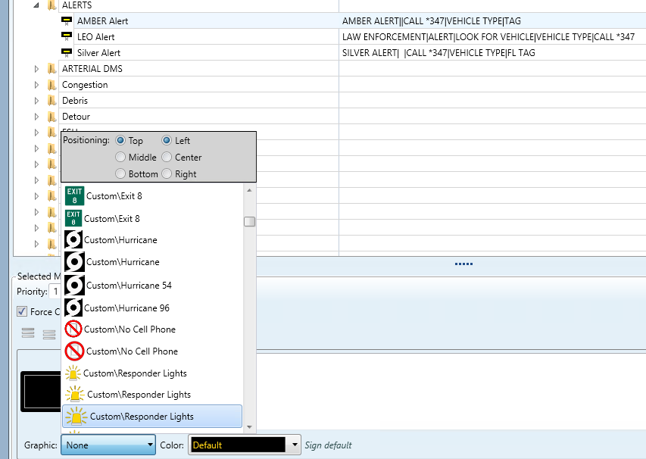
Current Behavior
When configuring DMS Library Messages, the size isn’t shown to the user.

Slide 13
Clarification
Should the system allow selecting a direct size at all?
Or
Should it allow selection of a graphic with no sizing, similar to the Add DMS Message?
Map would dynamically select size when applied to the sign.

Slide 14
QUESTIONS?
COMMENTS?
SUPPORT?

Slide 15
SunGuide DMS Graphics
SunGuide Software Team

Slide 16
DMS Graphics
Since 2010, the installer has included a set of graphics designed to be used on DMSs that support graphics.
176 graphics in two sizes (54 pixels high and 96 pixels high)
County Roads
FTE
Interstates
State Roads
Toll Roads
US Hwy
Warnings
Districts have asked us to provide missing shields.

Slide 17
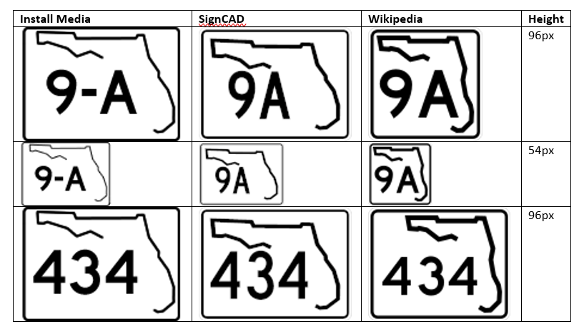
New Shields
Wikipedia is giving us the best results

Slide 18
Next Steps
Central Office will produce a new set of shields.
Existing shields will be replaced in order to ensure consistency.
We will not be creating new “Warnings” or event-type-specific graphics at this time.

Slide 19
District Needs
Re-packaging per district specifications
Additional sizes
County roads
Operationally useful graphics (non-shield)

Slide 20
QUESTIONS?
COMMENTS?

Slide 21
ANNOUNCEMENTS?
QUESTIONS?
COMMENTS?
ADJOURN.

