Slide 1
SunGuide Software Users Group Meeting
May 4, 2023

Slide 2
WELCOME
ATTENDEE ROLL CALL

Slide 3
SG-6517 - SAS Schedule Copying Dialog Behavior
Tucker Brown

Slide 4
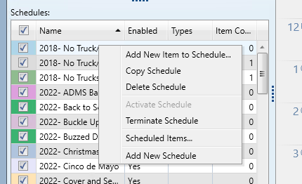
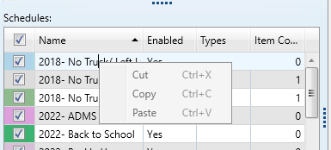
Current Behavior
When clicking in the SAS Schedule Name text box, different options may appear to the user based on whether the user has already selected the text.

Slide 5
Enhancement
Make the Name of the Schedule read-only.
Add a ‘Rename’ option to the context menu.
Would make all items in the Schedule box consistent, as they would all be read-only.
Pop up would always show the same options no matter how the user has selected the cell.

Slide 6
QUESTIONS?
COMMENTS?
SUPPORT?

Slide 7
SG-6497 - Removing Activity not Reflected in Chronology in Event Details
Tucker Brown

Slide 8
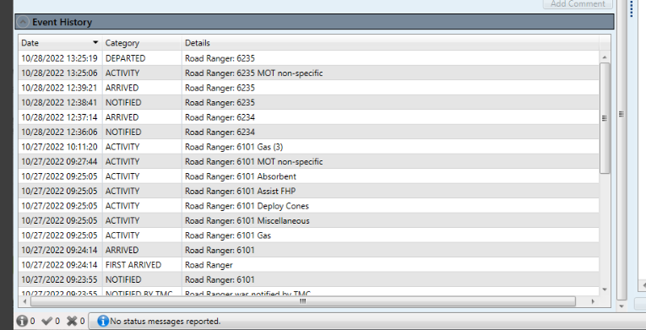
Current Behavior
When removing an activity for a Road Ranger, the inclusion of the original activity is not removed from the chronology.

Slide 9
Enhancement
For a live event, remove the original chronology entry entirely.
If auditing, remove the entry and display the audit entry in the chronology.

Slide 10
QUESTIONS?
COMMENTS?
SUPPORT?

Slide 11
SG-5927 - Make Disable PTZ a Filterable Camera Column
Tucker Brown

Slide 12
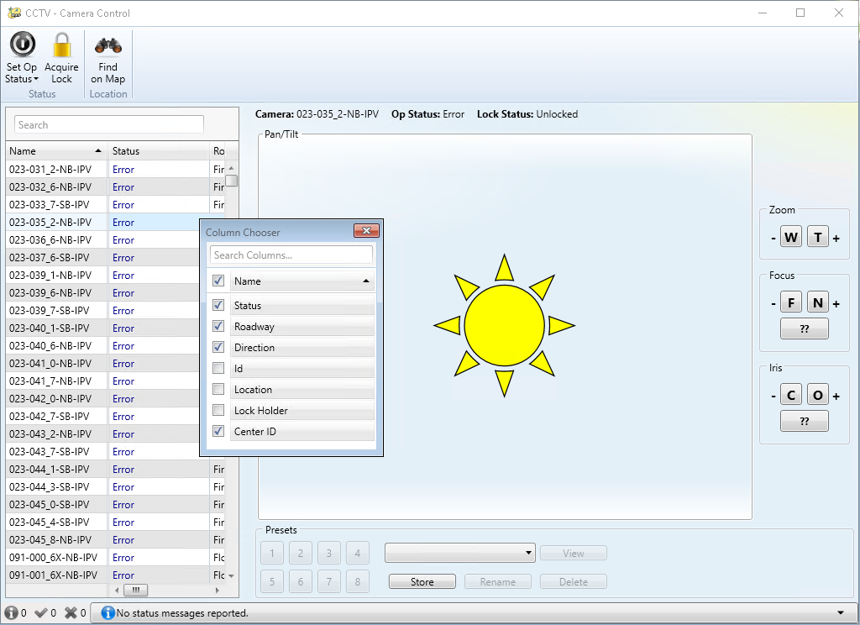
Enhancement
Add “PTZ” as an available column to the Camera Control dialog to allow filtering to only cameras the user could possibly control.

Slide 13
QUESTIONS?
COMMENTS?
SUPPORT?

Slide 14
SG-6109 - WWD Events Ignore Configured Radius for Event Type WWD
Tucker Brown

Slide 15
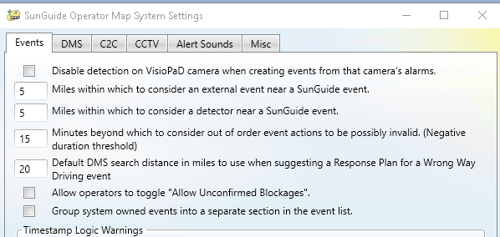
Current Behavior
When an event is created via the Event Creation dialog, the default search radius for finding DMSs for automatic response plans is pulled from the System Settings.

Slide 16
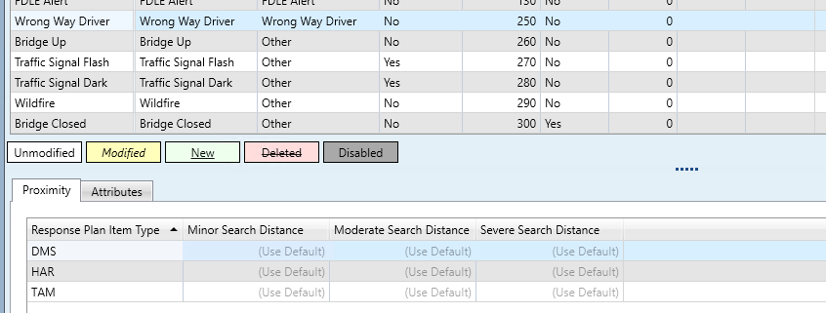
Current Behavior
When a response plan is created through the event, the system uses the configuration for response plans.

Slide 17
Enhancement
The system should sync these two values, and only use the one from the Event Types configuration dialog.
District suggested to used the ‘Minor Search Distance’ DMS value from Event Types configuration dialog.

Slide 18
QUESTIONS?
COMMENTS?
SUPPORT?

Slide 19
ANNOUNCEMENTS?
QUESTIONS?
COMMENTS?
ADJOURN.

