Slide 1
SunGuide Software Users Group Meeting
May 19, 2022

Slide 2
WELCOME
ATTENDEE ROLL CALL

Slide 3
SG-1053 – Add filter in reports for "Comment Type" and Comment keyword search & SG-4784 - Keyword search for Reports
Tucker Brown

Slide 4
Enhancement
Add a “comment type” filter to Reporting that could be added to reports.
Add the keyword filter and comment types filter to the Event Chronology report to search for specific words or phrases in the event chronology.

Slide 5
QUESTIONS?
COMMENTS?
SUPPORT?

Slide 6
SG-3391 – Running reports for C2C Links
Tucker Brown

Slide 7
Current Behavior and Enhancement
Current Behavior:
C2C link data is logged but a current set of reports doesn’t exist, as one of the main parameters for TSS reporting is detectors which C2C links do not have.
Enhancement:
Modify the Map to allow reports to run against specific C2C links in addition to TSS.

Slide 8
QUESTIONS?
COMMENTS?
SUPPORT?

Slide 9
SG-3822 – Add drop-down filters to Regional Floodgate Messages report to allow filtering by Floodgate slot/tree
Tucker Brown

Slide 10
Current Behavior and Enhancement
Current Behavior:
Reporting is available for Floodgate history but does not have parameters for specific floodgates (just time and keyword).
Enhancement:
Add additional parameters to reports for regional floodgate filtering.
Selected level of the Floodgate location will contain everything in the selected area.

Slide 11
QUESTIONS?
COMMENTS?
SUPPORT?

Slide 12
SG-5098 – Add driver name to traffic signal plan dropdown when configuring TCS plans
Tucker Brown

Slide 13
Current Behavior and Enhancement
Current Behavior:
Response plans contain the name of the traffic signal plan but not the driver (traffic signal system) the plan came from.
Enhancement:
Add the driver name to the response plan item.
Example (current): "US-17 Northbound - Default" "US-17 Northbound - Default“
Example (requested): "US-17 Northbound - Default (NaztecDriver_DUVAL)" "US-17 Northbound - Default (NaztecDriver_CLAY)"

Slide 14
QUESTIONS?
COMMENTS?
SUPPORT?

Slide 15
SG-5254 – ONVIF Focus command speed
Tucker Brown

Slide 16
Current Behavior and Enhancement
Current Behavior:
Certain ONVIF manufacturers have focus ranges from (-1 to 1), while others might be (-100 to 100).
Requests to focus are based on an algorithm that ends up with small steps.
Enhancement:
Retrieve the ONVIF range for the camera and scale it the same across all cameras, allowing for smoother focusing.

Slide 17
QUESTIONS?
COMMENTS?
SUPPORT?

Slide 18
SG-5009 – First-time post-install issue for users when not run with administrative privileges
Mark Dunthorn

Slide 19
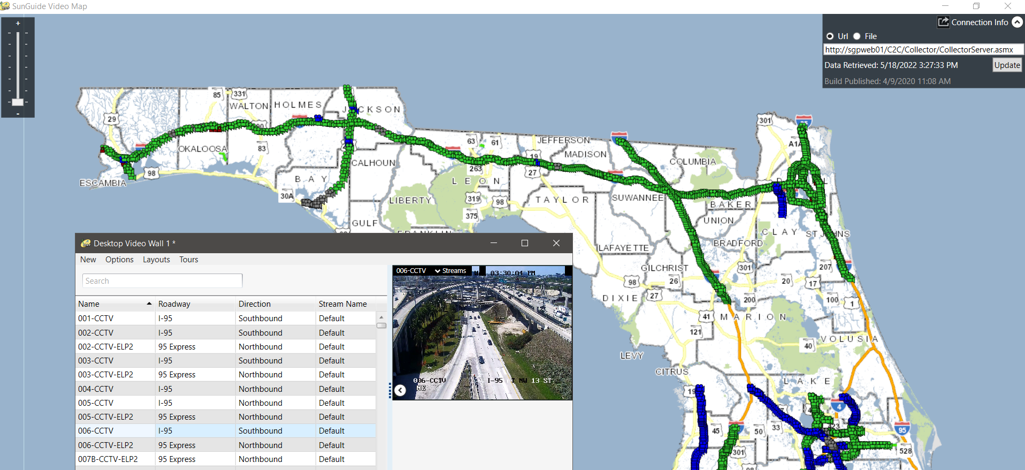
Current Behavior
C2C Video Map provides read-only access to district cameras statewide.
When deploying the C2C Video Map, you need administrative privileges.
Writes to Event Viewer, as it does not have access to Status Logger.

Slide 20
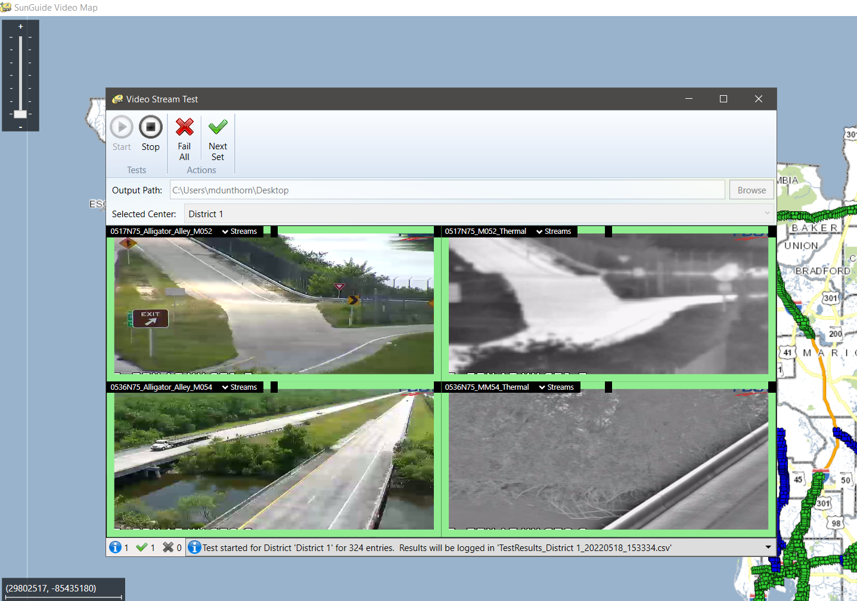
Usage
Used by the State EOC during activations.
Used by the FION team to monitor status of district cameras.

Slide 21
Enhancement and Discussion
Enhancement
Remove the need to run with administrative privileges so users are able to run upgrade installations.
Discussion
Any other use cases that we missed?

Slide 22
QUESTIONS?
COMMENTS?
SUPPORT?

Slide 23
ANNOUNCEMENTS?
QUESTIONS?
COMMENTS?
ADJOURN.

