Slide 1
SunGuide Software Users Group Meeting
February 8, 2024

Slide 2
WELCOME
ATTENDEE ROLL CALL
Christine Shafik, PE, PMP®, CPM, FCCM, FCCN, CGB
State CAV/STAMP/ML Engineer

Slide 3
SG-6906 – Blinking Event Alert Icons Obscure cameras, blink behavior sometimes annoying
Tucker Brown

Slide 4
Current Behavior & Enhancement
Current Behavior
Blinking alert icons can obscure cameras in the same area and make it difficult to verify the alert
Enhancement
Option 1: 9.0 introduces a concept of rubber band select and sending cameras to VOD
Option 2: Context menu item on the alert to open all cameras within some configured radius
Option 3: Attempt to layer the alerts under the cameras

Slide 5
QUESTIONS?
COMMENTS?

Slide 6
SG-6905 – Custom sort for Agencies on Event Details Responders
Tucker Brown

Slide 7
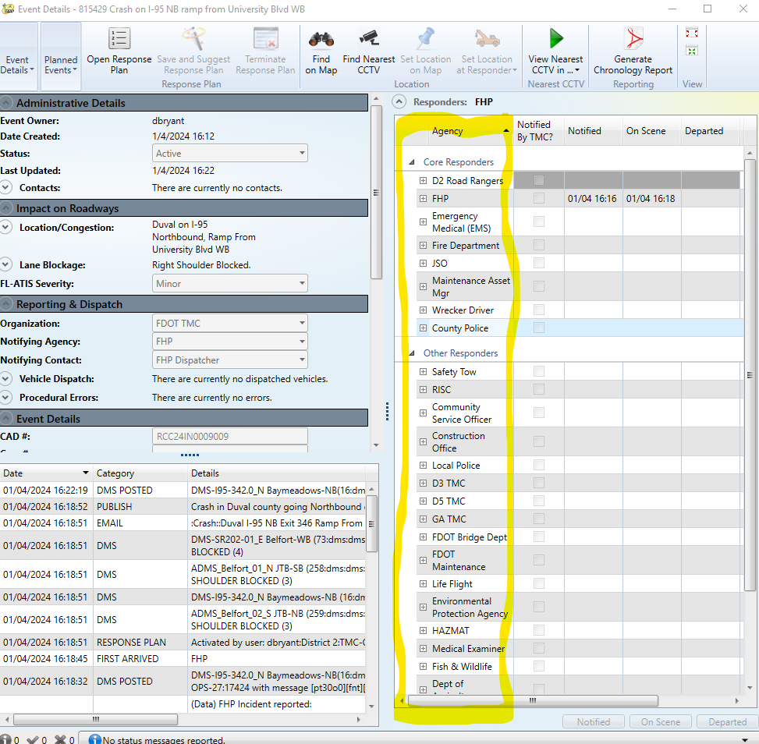
Current Behavior and Enhancement
Current Behavior
Sort order for the responder list is set at a global sort order for all operators, including the “Core Responders”
Enhancement
Allow users to override the order to a user selected order

Slide 8
QUESTIONS?
COMMENTS?

Slide 9
IVV Issue SGIVV-444 – Previous Association Not Accurate in Associate Alert to Existing Event
Tucker Brown

Slide 10
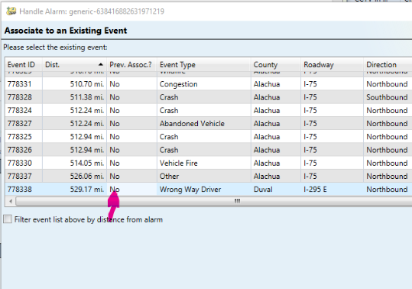
Current Behavior
Current Behavior
Only FHP monitors “updates” to events and would let users know previous association
Clarification
At this time, does the Generic Alert interface anticipate updates to its alerts and need similar handling?

Slide 11
QUESTIONS?
COMMENTS?

Slide 12
IVV Issue SGIVV-457 – LCS Messages are not Atomic
Tucker Brown

Slide 13
Current Behavior
Current Behavior
The system treats LCS as individual heads and those can have a graphics fail or succeed. If a set of 4 heads has a single head that fails, it does NOT remove the graphic from the other 3 heads.
Clarification
Should SG treat the SET of messages as a single message? Would cause NO signs to be posted in the case of a single head failure.

Slide 14
QUESTIONS?
COMMENTS?

Slide 15
SG-5989 – SunGuide Alert Viewer (Service Accounts)
Pete McGilvray, HNTB

Slide 16
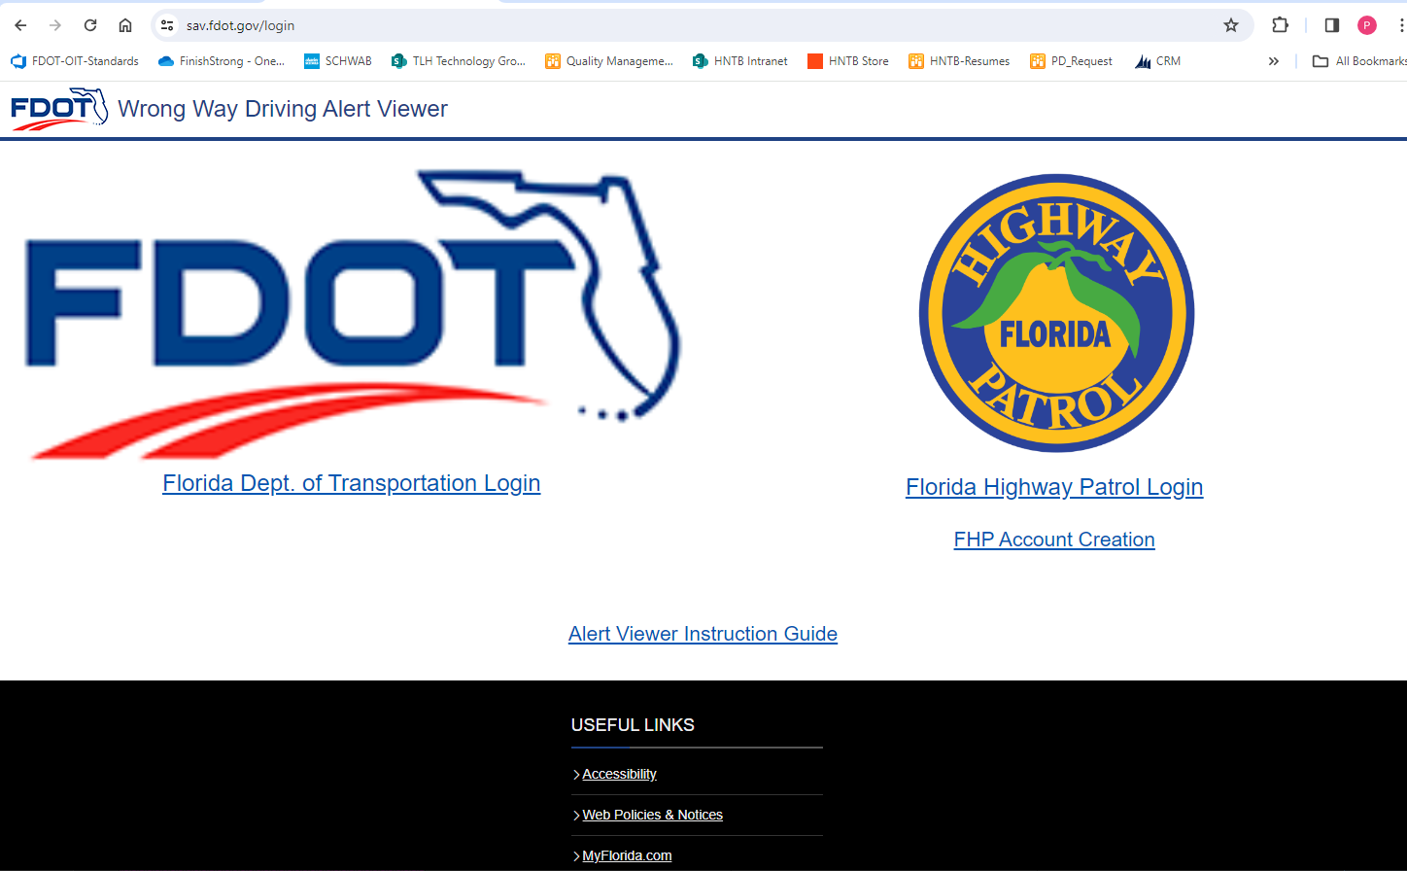
SunGuide Alert Viewer (SAV) – Wrong Way Driving
In Production
Accessible by authorized FDOT and FHP users
Service Account Creation
https://sav.fdot.gov/

Slide 17
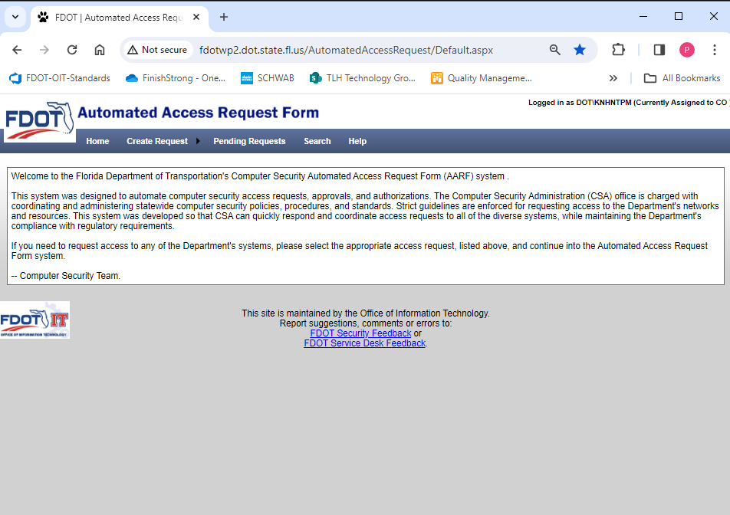
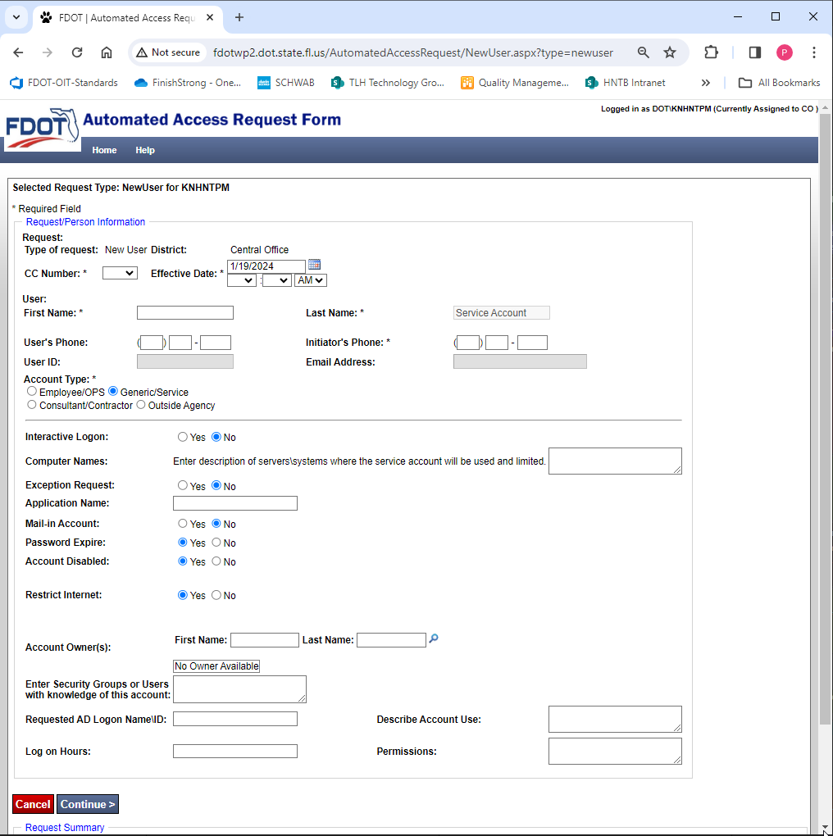
SAV – Service Accounts
Optional: May want if Co-Located with FHP
Needed if wanting SAV on Video Wall in TMC
Not tied to a specific person
Generic Accounts – owned by TMC
Authentication within the TMC
Service Account Creation occurs within AARF

Slide 18
SAV – Service Accounts – Process to Get One
Identify the person (or persons) who will be responsible for:
Owning account
Log into TMC resources as needed (after computer upgrade, power outage)
AARF – New Service Account
Created in the District
2nd Factor Authentication MUST be setup as the TMC Main Phone Number
Guide of AARF SAV Service selections available
If interested:
Contact:
Christine.Shafik@dot.state.fl.us and peter.mcgilvray@dot.state.fl.us by email and we will begin the coordination

Slide 19
QUESTIONS?
COMMENTS?

Slide 20
ANNOUNCEMENTS?
QUESTIONS?
COMMENTS?
ADJOURN.

