Slide 1
SunGuide Software Users Group Meeting
January 12, 2023

Slide 2
WELCOME
ATTENDEE ROLL CALL

Slide 3
SG-6519 - Filter Event Attributes from Event Type and Auto-Fill Attributes
Tucker Brown

Slide 4
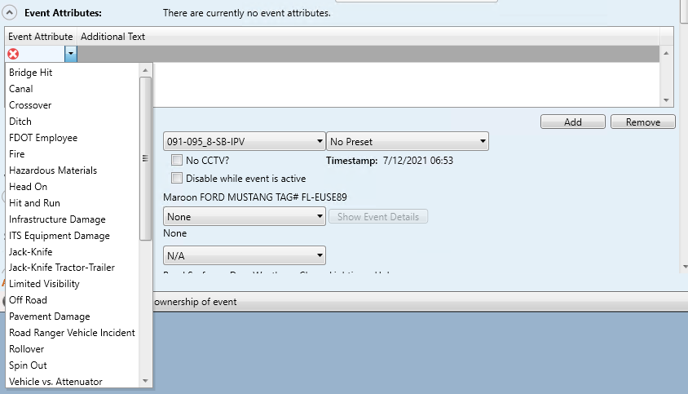
Current Behavior
Operators can add attributes from a full list of configured attributes.

Slide 5
Enhancements
Enhancement 1
Allow administrators to configure specific attributes available for each event type.
Should this be a whitelist or blacklist?
Filter the list of only those attributes when an event type is selected.
If no configuration is specified for the event type, all attributes would be available.
Enhancement 2
Users can type into the drop down to quickly find attributes.

Slide 6
QUESTIONS?
COMMENTS?
SUPPORT?

Slide 7
SG-6368 - Allow specifying a default subject for response plan emails
Tucker Brown

Slide 8
Current Behavior & Enhancement
Current Behavior
Default subject is not selected, and the user must select one.
Enhancement
Allow the default subject for an email to be configured.
Does this need to be just one? Or rules-based? If so, what criteria?
Users can still change the subject afterwards, if needed.

Slide 9
QUESTIONS?
COMMENTS?
SUPPORT?

Slide 10
SG-6365 - NWS Alerts full description
Tucker Brown

Slide 11
Current Behavior & Enhancement
Current Behavior
For NWS alerts, the system displays the type and subject of the alert, but does not contain the full description sent by NOAA.
Enhancement
Update the alert to include the full description.
Add the full description as part of the event chronology if the alert is made into a new event or associated to an event.

Slide 12
QUESTIONS?
COMMENTS?
SUPPORT?

Slide 13
SG-5877 - DMS Font Management Improvement
Tucker Brown

Slide 14
Current Behavior & Enhancement
Current Behavior
When setting a font on the sign, especially if changing one, it is necessary to run the auto-config to “Verify” the font.
Enhancement
The system should not require the administrator to re-verify any changes made to the sign. These should be automatically verified when the change is made.

Slide 15
QUESTIONS?
COMMENTS?
SUPPORT?

Slide 16
FYI: SG-6523 - Add Vehicle Alert Device status to C2C
Mark Dunthorn

Slide 17
Enhancement
Add a new data type to the C2C stream for Vehicle alert devices.
Feed should contain configuration information, including location.
Feed should contain current Op Status for the devices, including any Maintenance Mode settings.

Slide 18
QUESTIONS?
COMMENTS?

Slide 19
FYI: 2023 SunGuide Tile Set
Mark Dunthorn

Slide 20
Extraneous Hospital Icons
Files used to generate tiles have been updated.
Currently being tested at the TERL.
Now includes LabCorp, private practices.
Results in large number of Hospital icons that do not actually point to public health locations.
Possibly distracting in time-pressured scenarios.
Only appears at zoom levels 1 – 3.
Could this be an issue for Operations?

Slide 21
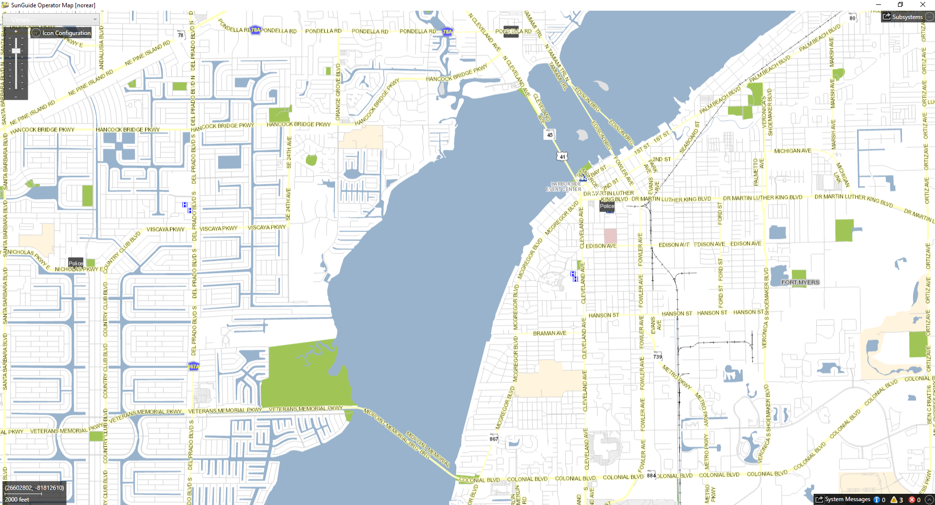
Current Tile Set

Slide 22
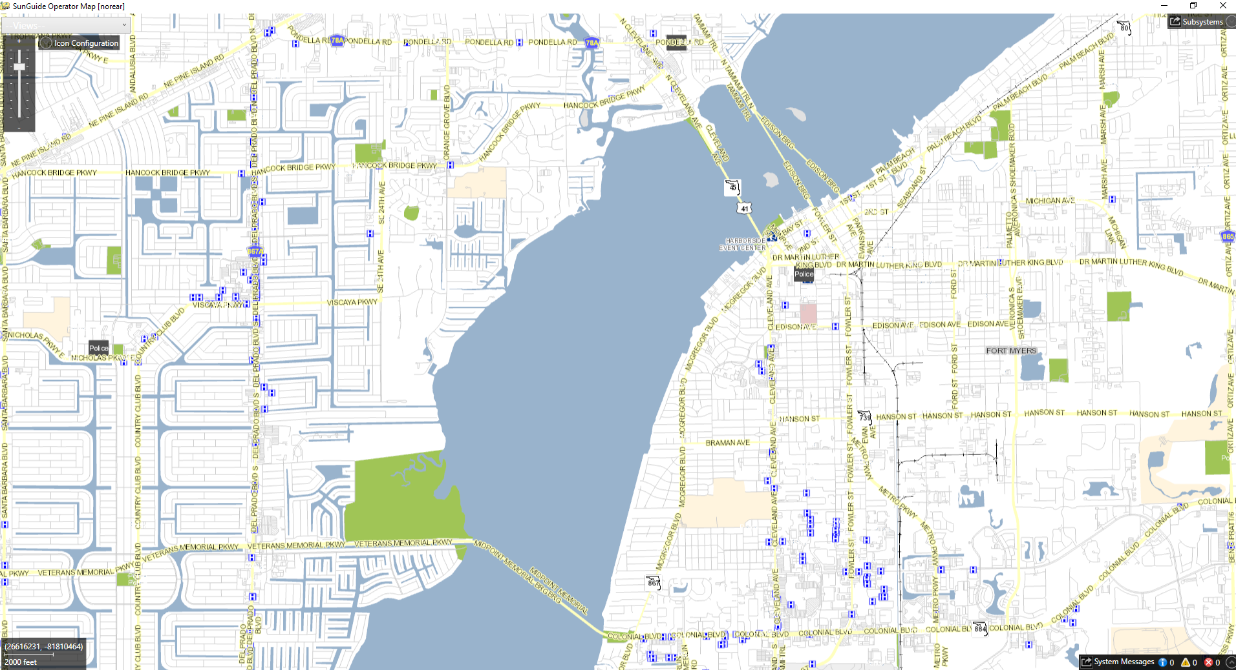
New Tile Set

Slide 23
QUESTIONS?
COMMENTS?

Slide 24
ANNOUNCEMENTS?
QUESTIONS?
COMMENTS?
ADJOURN.

