Slide 1
SunGuide Software Users Group Meeting
January 11, 2024

Slide 2
WELCOME
ATTENDEE ROLL CALL
Christine Shafik, PE, PMP®, CPM, FCCM, FCCN, CGB
State Connected Mobility & Technologies Engineer

Slide 3
SG-6898 – Close this Viewer button added to viewers
Tucker Brown

Slide 4
Current Behavior & Enhancement
Current Behavior
When closing a viewer in Video on Desktop, the user must right-click and select from the context menu.
When trying to close multiple viewers in a larger layout, this becomes tedious.
Enhancement
Add “X”s to the viewer to allow quick closure of the viewer.

Slide 5
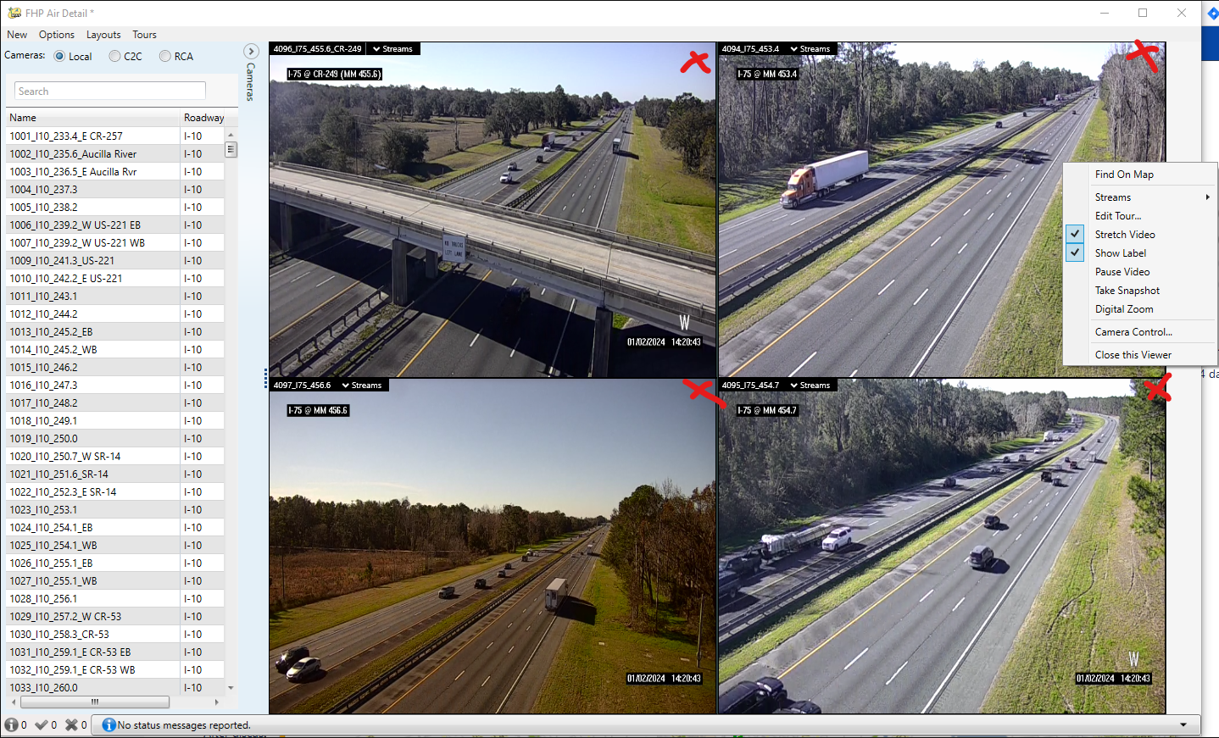
Enhancement

Slide 6
QUESTIONS?
COMMENTS?
SUPPORT?

Slide 7
SG-6872 – Support ONVIF wiper control
Tucker Brown

Slide 8
Current Behavior & Enhancement
Current Behavior
Wiper control is supported under the NTCIP driver only.
Enhancement
Add wiper control functionality for ONVIF cameras, as well.
Optional camera control features are being added to the TERL specification and would be tested as part of standard ONVIF camera testing in July 2025.

Slide 9
QUESTIONS?
COMMENTS?
SUPPORT?

Slide 10
SG-6796 – Stale Event Time
Tucker Brown

Slide 11
Current Behavior
The software supports reminders for “Stale” events.
“Stale” is a configurable amount of time between the last time a response plan was activated and the current time.

Slide 12
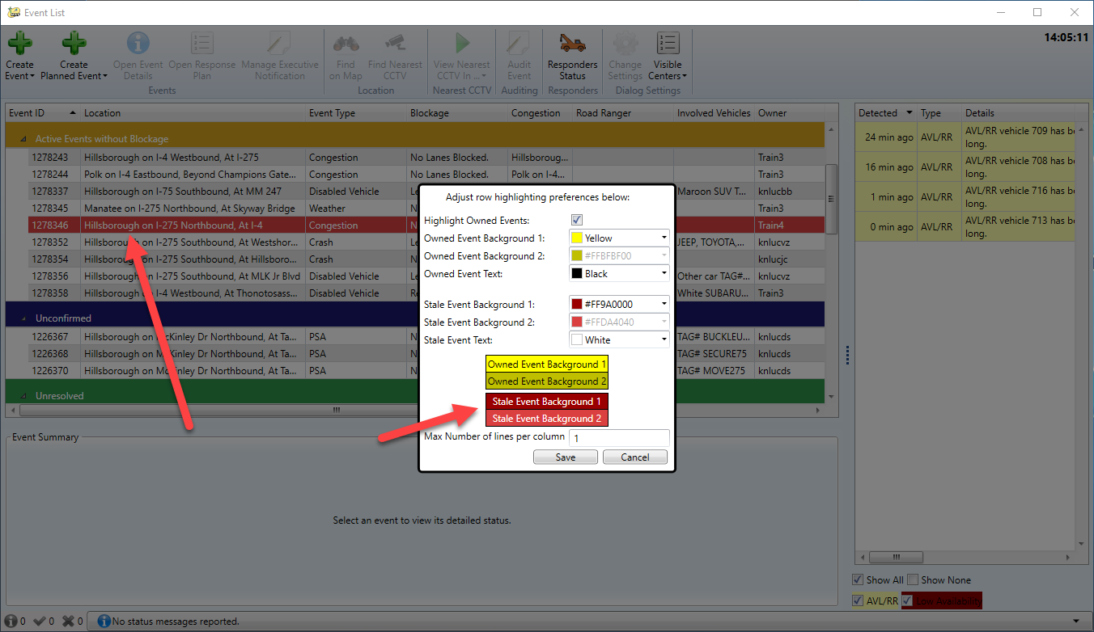
Current Behavior

Slide 13
Enhancement
A request was made for another reminder that would mark the event as “Stale” based on the created time until the current time.
This would be separate from the existing configuration and marking of the event in the Event List
Time span would be configurable per event type.
Software would use a different color for marking an event of this type in the event list.

Slide 14
QUESTIONS?
COMMENTS?
SUPPORT?

Slide 15
SG-6886 – Multi-Select Roadways for All Reports
Tucker Brown

Slide 16
Current Behavior & Enhancement
Current Behavior
When running a report, you can either select all roadways or filter to a single roadway.
Enhancement
Allow selection of multiple roadways as a filter.
When multiple roadways are selected, Direction, From Reference Point, and From Location should be Any.

Slide 17
QUESTIONS?
COMMENTS?
SUPPORT?

Slide 18
Support Issues Prioritization
Tucker Brown

Slide 19
Prioritization
Districts should have received a spreadsheet of currently open issues.
SwRI will be hitting support hard for the next 5 months.
Spreadsheet will be used to determine what order issues should be worked.
Please fill out and return with your priorities listed.

Slide 20
QUESTIONS?
COMMENTS?

Slide 21
ANNOUNCEMENTS?
QUESTIONS?
COMMENTS?
ADJOURN.

