Slide 1
SSUG 11/05/20
SunGuide Software Users Group | 11/05/20

Slide 2
SG-5468: DMS Removal Request
Tucker Brown

Slide 3
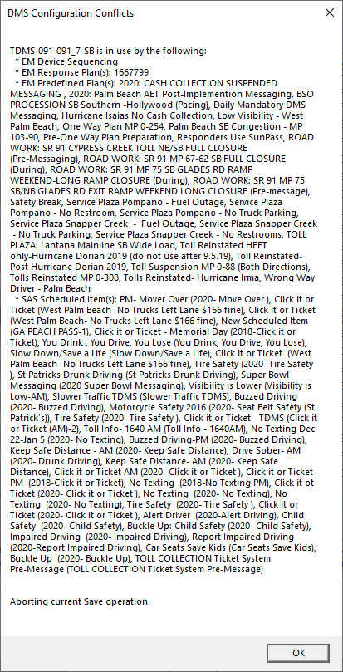
Issue and Proposed Change
When attempting to delete a DMS, the user is required to manually remove references to a DMS before deleting.
A list is provided but the list can be extensive.
Proposed Change
Add a mechanism to automatically remove references to a DMS.

Slide 4
QUESTIONS?

Slide 5
SG-3232: Associating FHP and TSS Alerts to Already Created Events
Tucker Brown

Slide 6
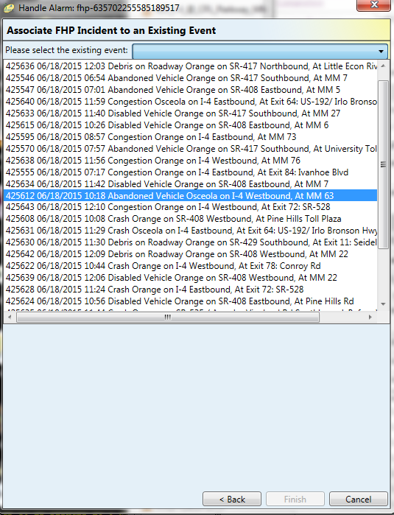
Current State
When picking an event to associate an alarm to, the event list presented is difficult to find the correct event.
Current:
Option to show “Nearby Events”
“Nearby” is in the System Settings.
Option to show all events
Include closed and non-lane blocking.
No sort filter applied.

Slide 7
Potential Changes
Numerical Sort?
Distance Sort?
Grid Layout for filtering?

Slide 8
QUESTIONS?

Slide 9
SG-2997: Visibility/Smoke weather condition
Tucker Brown

Slide 10
Issue and Proposed Change
Add “Smoke” as a statewide attribute.
Add either the full list of attributes or a subset of attributes to the message sent to 511.
511 can more reasonably inform the public.

Slide 11
QUESTIONS?

Slide 12
Database-specific changes
Tucker Brown

Slide 13
Current State
Districts have added custom indexes, constraints, and tables to the SunGuide database.
During an upgrade, custom changes can cause a failure in the upgrade scripts.
These are normally worked through by running the scripts against a test database, prior to upgrade.

Slide 14
Proposed Change
In order to better ensure an upgrade will be successful, it would be helpful to have all of the Districts’ database structure in sync.
Districts would be asked to run a query to give the current state of the database.
A report would be generated about differences between the Districts and a recommendation given on how to sync them.
Once completed, future database changes would need to be reported to Central Office to be included in the statewide structure.

Slide 15
QUESTIONS?

