Slide 1
SSUG 7-30-20
SunGuide Software Users Group | 7/30/20

Slide 2
SG-3203 - Microcom sensors for weather feeds
Mark Dunthorn

Slide 3
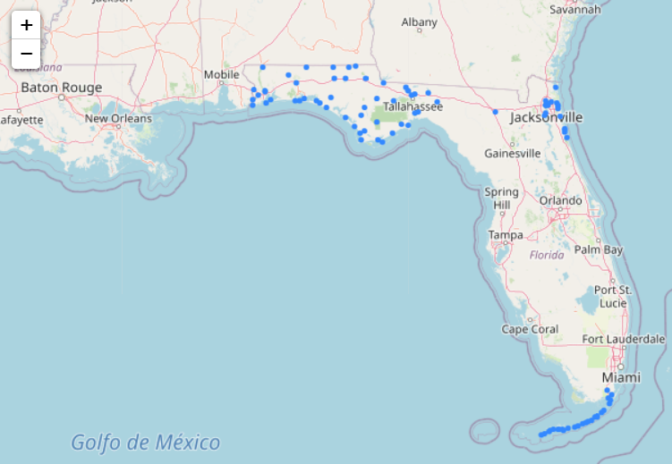
Current Situation
Weather sensor information available on ITS WAN
97 wind stations in D2, D3, and D6
Data can be viewed on web page

Slide 4
Proposed Enhancement
RWIS stations that report wind speed only?
Existing RWIS alarm functionality would work
Water level stations also available (Suwanee and Santa Fe Rivers only) – any interest?
Synchronize inventory with Microcom?

Slide 5
QUESTIONS?
SunGuide Software Users Group | 07/30/20

Slide 6
SG-3331 - Video on desktop CPU usage threshold is unreliable and does not reset once triggered
Tucker Brown

Slide 7
Current Situation
CPU usage “Warning” is not as helpful as it could be
Currently, the CPU usage is sampled and averaged over a minute (to avoid the temporary spikes).
If VOD closed, then immediately opened, sampling does not reset. Still averaging over the last minute which can lead operators to think it didn’t clear.

Slide 8
Proposed Enhancement
Instead of popping up, the alert could be embedded into the dialog as a warning, but not steal focus
Any suggestions on changing the threshold for showing an alert?
Currently, alert is based on 80% CPU averaged over 1 minute.

Slide 9
QUESTIONS?
SunGuide Software Users Group | 07/30/20

Slide 10
SG-5170 - Ability to filter Roadway in WAZE Alert (White/Black List per District)
Tucker Brown

Slide 11
Current Situation and Proposed Solution
The Waze process running at the TERL allows districts to whitelist the roadways where they would like to see alerts generated.
The system does not allow districts to pick which roadways where they DO NOT want to see alerts generated.
Proposed Enhancement
Allow a blacklist of roadways so certain roadways can be filtered out.
Districts would get to choose between a whitelist or a blacklist, but not both.

Slide 12
QUESTIONS?
SunGuide Software Users Group | 07/30/20

Slide 13
SG-5321, SG-5337, SG-5338 – DMS issues in 7.2 with fonts
Tucker Brown

Slide 14
Current Situation
Older signs with “NTCIP” support do not respond to the font queries/commands as expected
Issues have been identified with MarkIV, Adaptive, and ADDCO signs
As designed, the system requires NTCIP controllers to respond to these in order to work with SunGuide.

Slide 15
Proposed Enhancement
Add checkbox to DMS to “opt out” of the font functionality
Would revert back to using user-defined fonts and the sign would always use the default font assigned on the controller
Ability to set fonts would be restricted on these signs when editing, even though they are NTCIP.

Slide 16
QUESTIONS?
SunGuide Software Users Group | 07/30/20

