Slide 1
SSUG 7-16-20
SunGuide Software Users Group | 7/16/20

Slide 2
SG-5267 – Thru Lanes: Adding new Event Management Lane Type for Lane Mapping
Tucker Brown

Slide 3
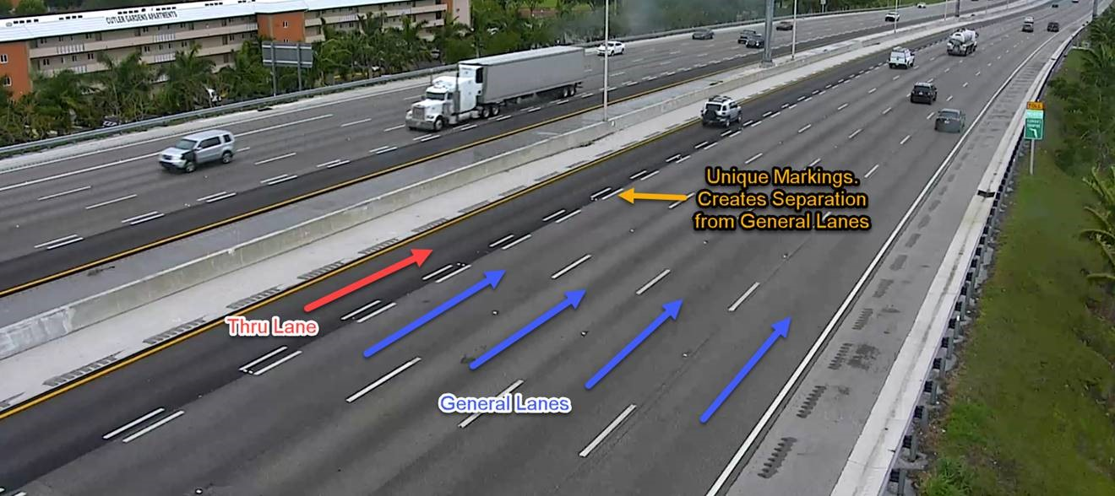
Proposed Enhancement
Issue: There are lanes that are not captured by the current list of lanes
Proposed Solution: Add “Thru Lanes” – Similar to Express Lanes without the Tolling.

Slide 4
QUESTIONS?
SunGuide Software Users Group | 07/16/20

Slide 5
SG-5278 BOS Blank Out Signs Integration
John Hope
SunGuide Software Users Group | 07/16/20

Slide 6
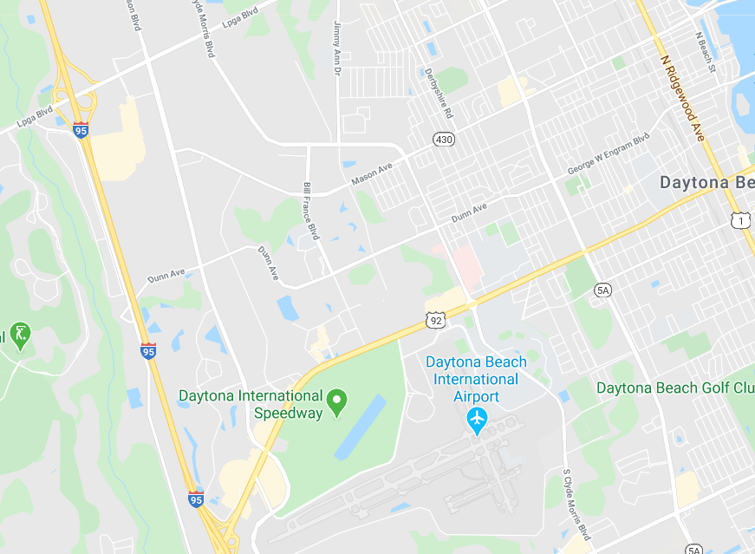
BOS
General purpose of BOS are to redirect traffic during planned or unplanned traffic events
X
SunGuide Software Users Group | 07/16/20

Slide 7
ITSIQA
Uses of BOS
Arterial route alternative routing
Coordinated activation of multiple BOS using SunGuide’s response plan functionality
Warnings to over-height vehicles approaching bridges
Automated activation to warn traveling public of potentially dangerous situations
Permit Application System (PAS) and FOX system can provide over-height vehicle information
Parking availability
Automatically/manually activate signs to direct incoming traffic to parking facilities
SunGuide Software Users Group | 07/16/20

Slide 8
ITSIQA
Changes in SunGuide
Communication with BOS devices
Configuration of BOS plans, which may also use beacons
Integration of PAS/FOX systems for over-height vehicle data
Integration into EM’s Response Generation
Additional Conceptual information available in
BOS Integration Document
SunGuide Software Users Group | 07/16/20

Slide 9
QUESTIONS?
John Hope
John.Hope@aecom.com
SunGuide Software Users Group | 07/16/20

Slide 10
SG-5251 Wrong Way Device – Incorrect images displayed in SunGuide with Alert
Tucker Brown

Slide 11
Proposed Enhancement
Issue: Only one alert can exist on a WWD device at any time. If another alert comes in, the images are overwritten with the newer ones but no new alert is generated.
Proposed Solutions
Option 1: Don’t overwrite the images and don’t allow multiple alerts from the same device at the same time
Reports wont show “all” alerts generated from the device.
Option 2: Allow multiple alerts from the same device
Would need to make the images unique filenames and store them
Has FOIA and storage implications

Slide 12
QUESTIONS?
SunGuide Software Users Group | 07/16/20

