Slide 1
SG-5300 - Access to district SunGuide data from the Central Office
Mark Dunthorn

Slide 2
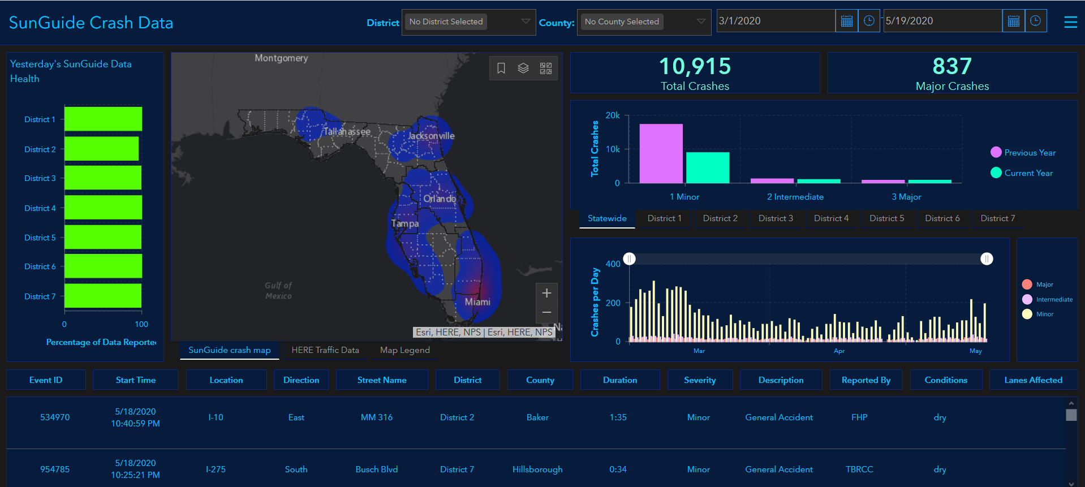
Central Office Data Requests
https://devgis.fdot.gov/arcgisportal/apps/MapSeries/index.html?appid=b58b0a3b7c454535ac95c2139fffc127

Slide 3
Central Office Needs
Access to current data
At least daily
Full data set
Complete event record, including data needed to derive performance measures

Slide 4
District Needs
Self-service
No impact on operations
Reflect event audits

Slide 5
QUESTIONS?

Slide 6
SG-5289 Proposed SunGuide Improvements
Renjan Joseph
SunGuide Software Users Group | 07/2/20

Slide 7
Proposed Sunguide Improvements
Enhance Reporting Capabilities
Custom Dashboard Generation

Slide 8
Background
Requests from management after major happenings like pandemic conditions, natural disasters, civil unrests etc.
The need for generating comparative plots with respect to volume, speed and incidents
Safety evaluations to identify segments of crash concentration

Slide 9
Enhancement to Volume Related Plots
Real-time volume plots by user definable stretch of a roadway
Historic volume plots with the flexibility to refine by:
a. User selectable roadway b. User selectable date range c. User selectable days d. User selectable time range within 24 hours

Slide 10
Enhancement to Volume Related Plots
e. User selectable roadway extends by:
Mile Marker/Mile Posts
County limits
City limits
RCI roadway ID
Single MVDS
Selectable combination of MVDS etc.
f. Comparative volume plots for same user selectable day/date/time ranges and roadway extends.

Slide 11
Enhancement to Volume Related Plots
Sample Volume Comparison Plot

Slide 12
Enhancement to Speed Related Plots
Real-time speed plots for user definable stretch of a roadway by lanes and by all lanes.
Historic Speed plots with the flexibility to refine by:
a. User selectable roadway b. User selectable date range c. User selectable days d. User selectable time range within 24 hours
e. User definable percentile speeds

Slide 13
Enhancement to Speed Related Plots
f. User selectable roadway extends by:
Mile Marker/Mile Posts
County limits
City limits
RCI roadway ID
Single MVDS
Selectable combination of MVDS etc.
g. Comparative speed plots for same user selectable day/date/time ranges and roadway extends.

Slide 14
Enhancement to Speed Related Plots
Sample Real-Time Speed Plot

Slide 15
Enhancement to Speed Related Plots
Sample Speed Comparison Plot

Slide 16
Enhancement to Incident Related Plots
Incident plots by type, level, user definable combination and total for:
a. User selectable roadway b. User selectable date range c. User selectable days d. User selectable time range within 24 hours

Slide 17
Enhancement to Incident Related Plots
e. User selectable roadway extends by:
Mile Marker/Mile Posts
County limits
City limits
RCI roadway ID
Single MVDS
Selectable combination of MVDS etc.
g. Comparative incident plots for same user selectable day/date/time ranges and roadway extends.

Slide 18
Enhancement to Incident Related Plots
Rank 0.5 mile stretches of user selectable extends of a roadway based on incident by type, level, user definable combination and total for safety evaluation and project initiatives.
Heat maps based on the same criteria above.

Slide 19
Enhancement to Incident Related Plots
Sample Incident Comparison Plot

Slide 20
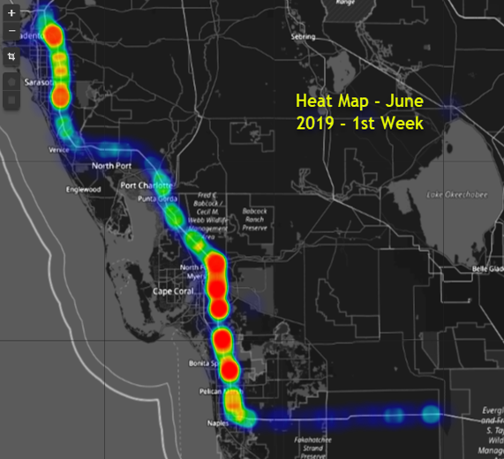
Enhancement to Incident Related Plots
Sample Incident Heatmap

Slide 21
QUESTIONS?
SunGuide Software Users Group | 07/2/20

Slide 22
SG-5293 Add a CCTV Field to the Executive Notification Email
Dee McTague

Slide 23
Management Request
Original request was to add a link to CCTV feeds in DIVAS during major events requiring Executive Notifications
Operations does not have access to DIVAS so addition of the CCTV number used to manage event was proposed
Currently, supervisors are adding the number manually
Request is to add a field and automatically add the CCTV number based on information entered in the SunGuide event

Slide 24
QUESTIONS?

Slide 25
SG-5278 BOS Blank Out Signs Integration
John Hope
SunGuide Software Users Group | 07/2/20

Slide 26
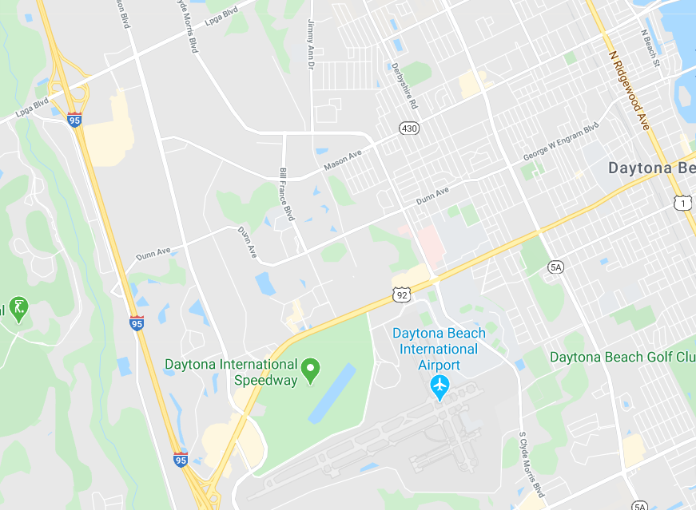
BOS
General purpose of BOS are to redirect traffic during planned or unplanned traffic events
X
SunGuide Software Users Group | 07/2/20

Slide 27
ITSIQA
Uses of BOS
Arterial route alternative routing
Coordinated activation of multiple BOS using SunGuide’s response plan functionality
Warnings to over-height vehicles approaching bridges
Automated activation to warn traveling public of potentially dangerous situations
Permit Application System (PAS) and FOX system can provide over-height vehicle information
Parking availability
Automatically/manually activate signs to direct incoming traffic to parking facilities
SunGuide Software Users Group | 07/2/20

Slide 28
ITSIQA
Changes in SunGuide
Communication with BOS devices
Configuration of BOS plans, which may also use beacons
Integration of PAS/FOX systems for over-height vehicle data
Integration into EM’s Response Generation
Additional Conceptual information available in
BOS Integration Document
SunGuide Software Users Group | 07/2/20

Slide 29
QUESTIONS?
John Hope
John.Hope@aecom.com
SunGuide Software Users Group | 07/2/20

