Slide 1
SSUG 6-18-20
SunGuide Software Users Group | 5/21/20

Slide 2
SG-4089 - Enhancement to allow multiple links to be combined as one for travel time calculations
Previously discussed at 11/7/2019 SSUG
SunGuide Software Users Group | 6/18/20

Slide 3
ITSIQA Intelligent Transportation Systems Integration Quality and Analysis
John Hope
SunGuide Software Users Group | 6/18/20

Slide 4
ITSIQA
Developed by District 5
Designed to:
Integrate multiple sources from SunGuide and C2C into a standard format
Flag possible issues with traffic detectors and generate trouble tickets via MIMS
Assign quality values to integrated data and merge data according to quality values
Generate trusted travel time, speed, occupancy, and volume data
Push traffic data via C2C and travel time messages to SunGuide
SunGuide Software Users Group | 6/18/20

Slide 5
ITSIQA
SunGuide Software Users Group | 6/18/20

Slide 6
ITSIQA Data Inputs
Other Districts
HERE Data
SunGuide
Other Agencies
Databus
Center-to-Center
SunGuide
Interface
C2C
Interface
WAZE
WAZE
Interface
Traffic Data
Miovision
ITSIQA
Turning Movement Count Interface
Turning Movement Count Data
Gridsmart
ATSPM

Slide 7
ITSIQA
SunGuide Detector Analysis
Performs specific checks on incoming data once/minute
Check must fail for a configurable number of minutes to be triggered
Checks reduce reported quality value for detector
Some checks trigger a MIMS ticket
SunGuide Software Users Group | 6/18/20

Slide 8
ITSIQA
SunGuide Detector Analysis, pg1
Max Volume: Volume > threshold
Max Occupancy: Occupancy > threshold
Lane Speed Differential: Difference in Speed Between Lanes > Threshold
Max Speed: Speed Per Lane > Speed Threshold + Speed Limit
Min Speed: Speed Per Lane < Threshold
SunGuide Software Users Group | 6/18/20

Slide 9
ITSIQA
SunGuide Detector Analysis, pg2
Inconsistent Values: Four different checks that compare volume, speed, and occupancy against each other
Sequential Volumes: Same volume reported X minutes
Duplicate Values: Same volume, speed, or occupancy reported for multiple lanes
Directional Check: Is detector reading correct direction of travel?
SunGuide Software Users Group | 6/18/20

Slide 10
ITSIQA
SunGuide Detector Analysis, pg3
Reported Lanes Count: Reported number of lanes doesn’t match configuration
AADT Check: Reported daily volume < or > % of expected daily volumes
Communication Failed: Detector stops reporting
SunGuide Software Users Group | 6/18/20

Slide 11
ITSIQA Data Outputs
SunGuide
Databus
ITSIQA
DMS Message Data
SunGuide
Interface
Travel Time Generator
C2C
Interface
Center-to-Center
Traffic Link Data
Traffic Per Lane Data
Other Districts or Agencies or External Systems
Traffic Classification Data
System Output
Traffic Super Link Data
Turning Movement Count Data

Slide 12
ITSIQA Benefits
Quicker response to detector issues / failures
Adds intelligence to the selection / calculation of all available traffic data
Standardizes reporting of roadway link information
Uses FDOT CO’s All Roads Base Map
Handles “heavy lifting” of data consolidation from multiple external systems
Significantly reduces amount of processing within SunGuide, especially load on Operator Map
SunGuide Software Users Group | 6/18/20

Slide 13
QUESTIONS?
John Hope
John.Hope@aecom.com
SunGuide Software Users Group | 6/18/20

Slide 14
4209 – Use Polyline instead of single point for road closures
Tucker Brown

Slide 15
Issue Status
Issue: WAZE is unable to put road closures into their feed with a line including, at a minimum, the start and end point of the closure.
This issue was previously discussed at a SSUG in April 2018.

Slide 16
Proposed Enhancement
User selects start and end point from dialog just like setting a congestion head and tail right now.
Option 1: System automatically detects the configured locations between these two points and uses those to define midpoints between the start and end points.
This is better now as the sort orders on the location should allow easy selection without the use of GIS files
To make a cleaner line, suggests the use of only before, at, and beyond locations (no ramps).
Option 2: User selects a set of points between the start and end point
More manual process but the user would have better control of the midpoint selection.
Option 3: Allow both of these and allow the user to choose which one to apply.

Slide 17
Proposed Enhancement
List of included locations
Because a closure may effect multiple on ramps, it would be desirable to include a list of affected locations
List can be built from the list of locations between the start and end points, including ramps.
List would initially include all locations but could be modified by the user.
Does it ONLY need to be the on-ramps?
List would be included in the event sent to 511.

Slide 18
QUESTIONS?
SunGuide Software Users Group | 6/18/20

Slide 19
SG-5289 Sunguide Dashboard Generation and Reporting Enhancement
Renjan Joseph
SunGuide Software Users Group | 6/18/20

Slide 20
Proposed Sunguide Improvements
Enhance Reporting Capabilities
Custom Dashboard Generation

Slide 21
Background
Requests from management after major happenings like pandemic conditions, natural disasters, civil unrests etc.
The need for generating comparative plots with respect to volume, speed and incidents
Safety evaluations to identify segments of crash concentration

Slide 22
Enhancement to Volume Related Plots
Real-time volume plots by user definable stretch of a roadway
Historic volume plots with the flexibility to refine by:
a. User selectable roadway b. User selectable date range c. User selectable days d. User selectable time range within 24 hours

Slide 23
Enhancement to Volume Related Plots
e. User selectable roadway extends by:
Mile Marker/Mile Posts
County limits
City limits
RCI roadway ID
Single MVDS
Selectable combination of MVDS etc.
f. Comparative volume plots for same user selectable day/date/time ranges and roadway extends.

Slide 24
Enhancement to Volume Related Plots
Sample Volume Comparison Plot

Slide 25
Enhancement to Speed Related Plots
Real-time speed plots for user definable stretch of a roadway by lanes and by all lanes.
Historic Speed plots with the flexibility to refine by:
a. User selectable roadway b. User selectable date range c. User selectable days d. User selectable time range within 24 hours
e. User definable percentile speeds

Slide 26
Enhancement to Speed Related Plots
f. User selectable roadway extends by:
Mile Marker/Mile Posts
County limits
City limits
RCI roadway ID
Single MVDS
Selectable combination of MVDS etc.
g. Comparative speed plots for same user selectable day/date/time ranges and roadway extends.

Slide 27
Enhancement to Speed Related Plots
Sample Real-Time Speed Plot

Slide 28
Enhancement to Speed Related Plots
Sample Speed Comparison Plot

Slide 29
Enhancement to Incident Related Plots
Incident plots by type, level, user definable combination and total for:
a. User selectable roadway b. User selectable date range c. User selectable days d. User selectable time range within 24 hours

Slide 30
Enhancement to Incident Related Plots
e. User selectable roadway extends by:
Mile Marker/Mile Posts
County limits
City limits
RCI roadway ID
Single MVDS
Selectable combination of MVDS etc.
g. Comparative incident plots for same user selectable day/date/time ranges and roadway extends.

Slide 31
Enhancement to Incident Related Plots
Rank 0.5 mile stretches of user selectable extends of a roadway based on incident by type, level, user definable combination and total for safety evaluation and project initiatives.
Heat maps based on the same criteria above.

Slide 32
Enhancement to Incident Related Plots
Sample Incident Comparison Plot

Slide 33
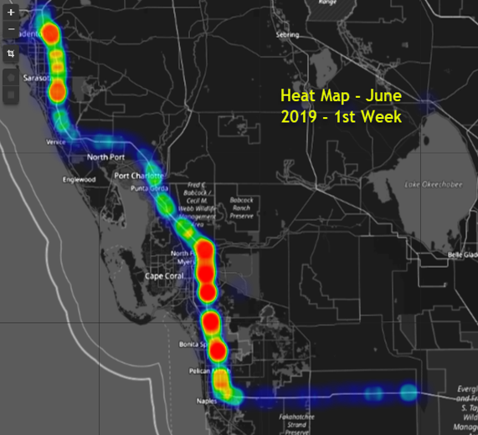
Enhancement to Incident Related Plots
Sample Incident Heatmap

Slide 34
QUESTIONS?
SunGuide Software Users Group | 6/18/20

Slide 35
SG-5300 - Access to district SunGuide data from the Central Office
Mark Dunthorn

Slide 36
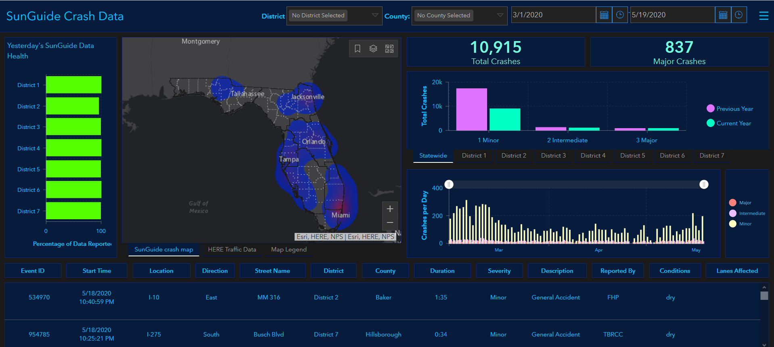
Central Office Data Requests
https://devgis.fdot.gov/arcgisportal/apps/MapSeries/index.html?appid=b58b0a3b7c454535ac95c2139fffc127

Slide 37
Central Office Needs
Access to current data
At least daily
Full data set
Complete event record, including data needed to derive performance measures

Slide 38
District Needs
Self-service
No impact on operations
Reflect event audits

Slide 39
QUESTIONS?

