Slide 1
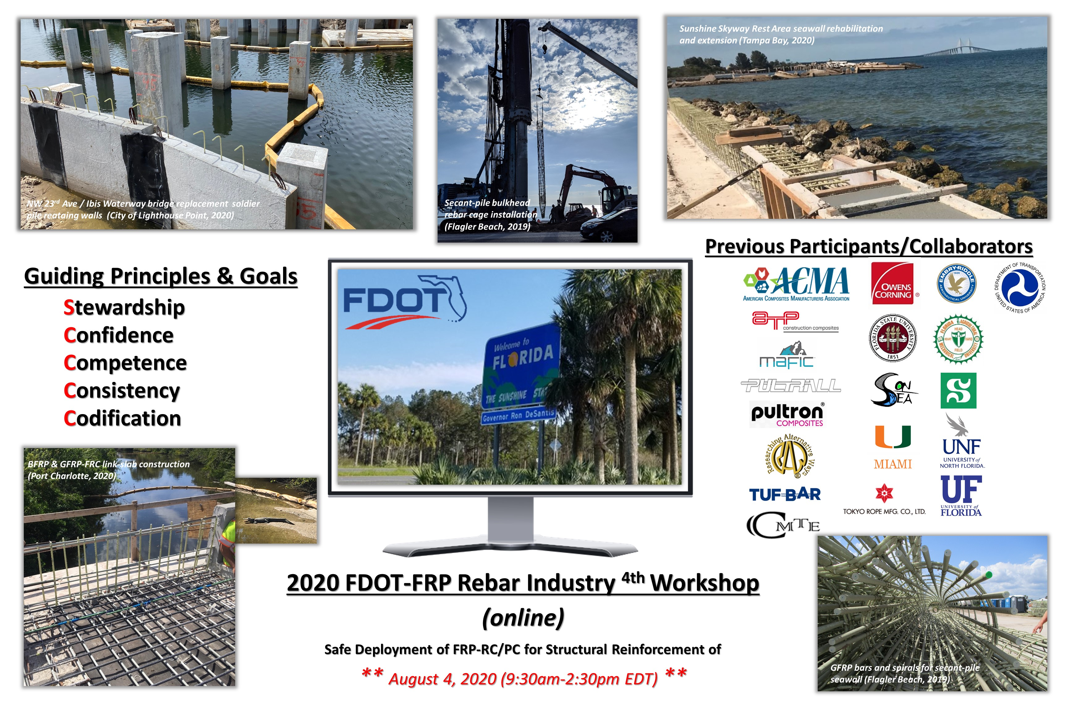
Workshop Outline

Slide 2

Announcement
Following up on a successful FRP-RC Workshops initiated in Daytona Beach in 2016, then at the Florida Turnpike Enterprise HQ in 2017 & 2018, and in continual support of FDOT’s Invitation to Innovation initiative for Fiber Reinforced Polymer (FRP) Reinforcing Bars and Strands, FDOT’s State Structures Design Office is hosting the 4th FRP-Reinforced Concrete Workshop to be held again at the Florida Turnpike Headquarters in Orlando, Florida. The workshop is critical for advancing the practical implementation of design and material criteria to get the most benefit from these newer materials. The workshop aim is to collaborate with design practitioners, FRP Industry producers and academia for FDOT structural items of interest.
The workshop will be held virtually due to the current COVID-19 pandamic using the GoToMeeting platform, with no registration fee.
Industry attendees are encouraged to review the previous workshop webpages and the distributed Strategic Workplan that has been updated since the 2018 Workshop:
  2016 1st Workshop webpage link
  2017 2nd Workshop webpage link
  2018 3rd Workshop webpage link

Slide 3
GoToMeeting (for remote Attendees)
4th FDOT/FRP Industry Reinforced/Prestressed Concrete Workshop (Part A)
Tue, Aug 4, 2020 9:30 AM - 12:00 PM (EDT)
https://global.gotomeeting.com/join/360067229
You can also dial in using your phone. United States: +1 (786) 535-3211
Access Code: 360-067-229
4th FDOT/FRP Industry Reinforced/Prestressed Concrete Workshop (Part B)
Tue, Aug 4, 2020 1:15 PM - 2:45 PM (EDT)
https://global.gotomeeting.com/join/412187349
You can also dial in using your phone. United States: +1 (872) 240-3412
Access Code: 412-187-349

Slide 4
Agenda - Part A
9:30 - 9:45am: Welcome and Introduction of topics
Objective of Workshop
Deliverables from Workshop
9:45 – 10:55: Presentations – Current State of Activity
Design (Vasconcelos)
  FDOT FRP-RC/PC Design implementation status & needs
Durability and Endurance Testing (Knight & Fallaha)
  FDOT Materials Office update on durability focused research projects
  Endurance Testing needs
Construction (Nolan)
  FDOT Construction related issue from recent projects & needs
Other State DOT activity (Hartman)
Standards/Specifications
  ASTM D7957-17 potential updates for mechanical property improvement (Gremel)
  ACI Committee 440 related activities (Nanni)
Rebar Industry (Busel)
  ACMA FRP-RMC update Imagine Act progress
International perspectives (Benmokrane & Ferrier)
*** Coffee Break (5 mins) ***
11:00 - noon: Next Level of Activities based on Needs – Moderated Discussion
Bar Properties (Strategic Workplan Item #3)
  FDOT 2021 proposed increase in Elastic Modulus and Tensile design limits for FDOT Specification 932-3
  What to do about Bent Bars, at least for the intermediate future?
Project level testing
  How much and how to pay for it?
Barriers to seamless deployment
  Lifting hardware, couplers, splicing, replacement of damaged bars
Noon - 1:15pm: Lunch

Slide 5
Agenda - Part B
1:15 - 2:15pm FRP Industry Discussion - Strategic Workplan Items and Roadmap Planning
(moderated session)
Endurance Limits, Characteristic Curves and Testing (Strategic Workplan Items #1 & #2)
Refine FDOT Workplan Priorities for expanded FRP deployment opportunities –
Review remaining Strategic Workplan items:
  Establishing Consistency
  Increasing Material Property Qualification Thresholds and Design Limits (see Part A)
  Cost Estimating
    OC initiative for ACMA FRP-RMC
    FDOT SDG Chapter 9 update
  Bar Bends
    Complex Shapes
    FDOT Index D21310
  Minimum Bar Sizes for Design Elements
  Life-Cycle Cost Guidance
  Minimum Concrete Class
  Shear Resistance
Synergies with AASHTO COBS T-6 Strategic Plan to accelerate progress
EDC-6 (2021-2022) Any potential for FRP-RC?
Establish how FRP Manufacturing Industry can effectively contribute to advancing efforts (a & b)
2:15 - 2:30pm Future Workshops and Action Items (Nolan)
Action Item Summary
Future Workshop opportunities and suggestions:
  5th FDOT-FRP RC/PC Industry Workshop (dates & location/delivery format)
  FRP-RC/PC Designer Training (August 2020)
  TRB 2020 Workshop ABK10/AFF80 (January 2021)
  3rd International Workshop on FRP-RC, University of Sherbrooke (August 2021)
Closing Statements

Slide 6

Adjourn - Thanks for tuning in !
FRP Reduces Back Injuries! Put It Down!!

