Slide 1
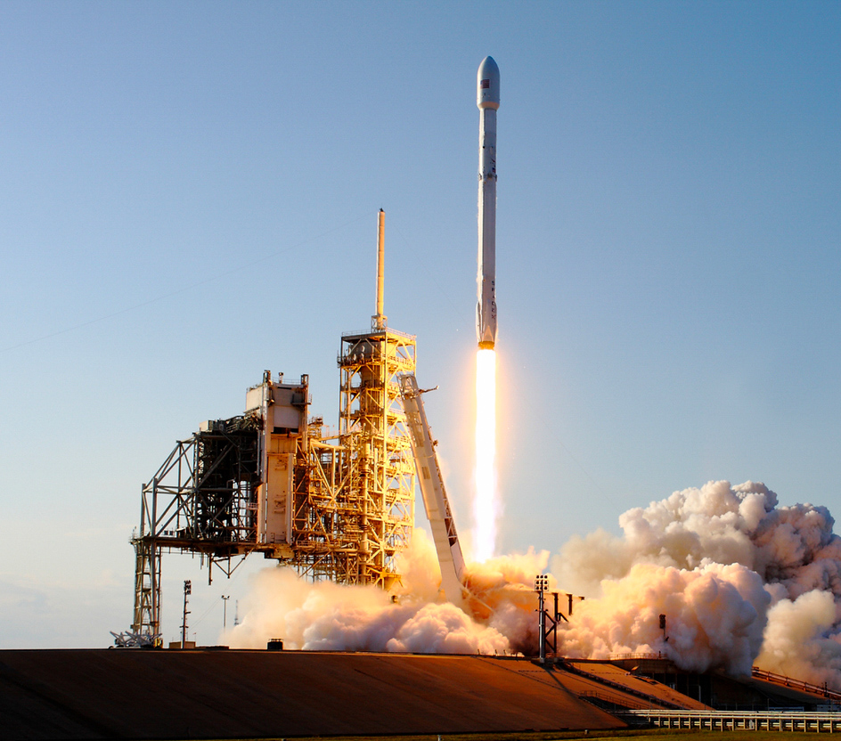
Spaceport Office
Mission: Deploy the Department’s work program to attract and support long-term commercial aerospace industry through the Spaceport Improvement Program, advance the Department’s Mission & Vision and collaborate with Space Florida to make Florida the ‘Place For Space.’
Core Function: Partner with Space Florida to allocate available funding
Manager
Spaceport Office
Wayne Lambert
Program Coordinator
Spaceport Office
Wayne Lambert

Slide 2
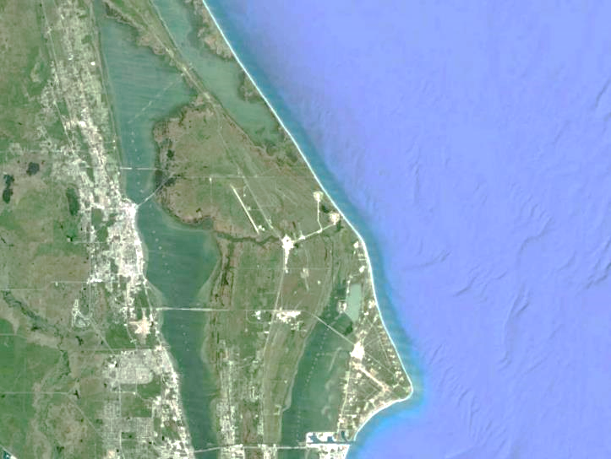
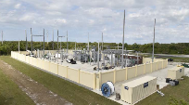
Spaceport Improvement Program
FY12-22
34 Major Projects
2575+ Direct Jobs
$312.7M+ State
$1.43B+ Private
$1.7B+ Total
LC39A Commercial Heavy Lift Complex $32M
LC41 Crew & Vulcan Upgrades $17M
LC40 Launch Capacity $20M
LLF
KSC
New Commercial Power / Helium Pipeline Extension $20M
Comm. Crew & Cargo Processing Facility $20M
KSC
CCAFS
Exploration
Park $10M
Orbital Processing Facility 1 $9M
LC-46
$5M
LC36 Commercial Orbital Launch Site $43M

Slide 3
Spaceport Office Key Partners

