Slide 1
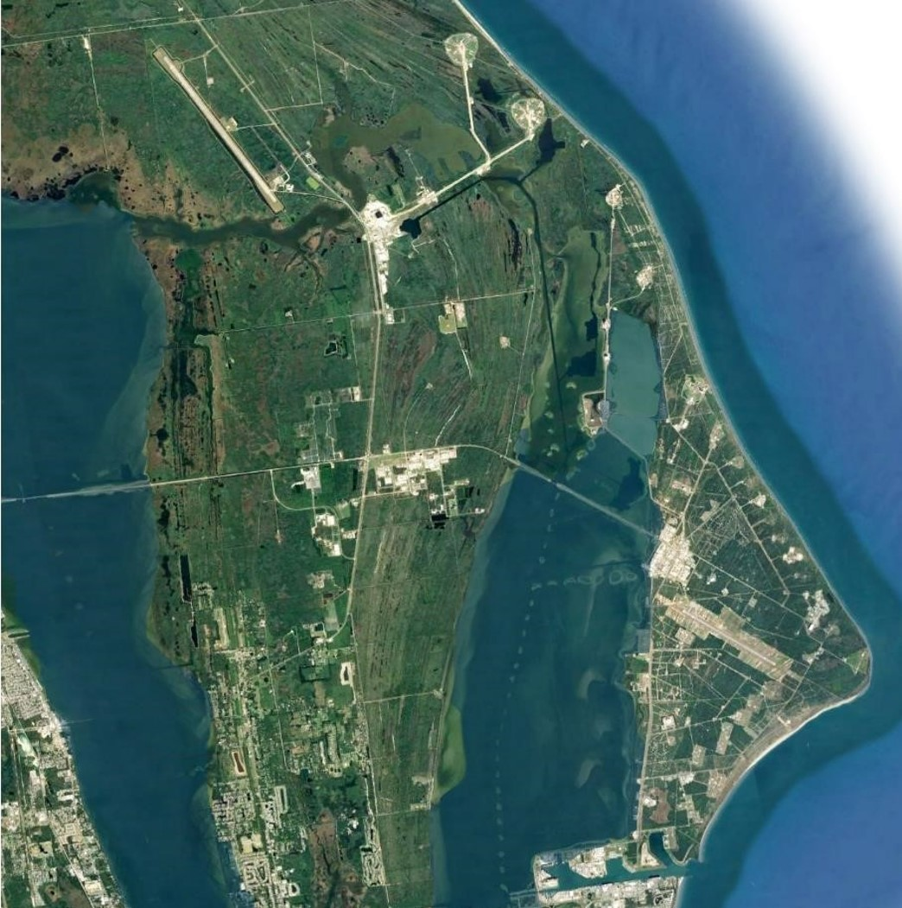
ACTIVE SIP INFRASTRUCTURE GRANT PROJECTS
1
Roberts Road Corridor Development
Cecil Spaceport
16
Spaceport LLF East Area Development
3
9
2
6
2
8
14
3
Cecil Spaceport Infrastructure Improvements
15
15
4
Aerospace Manufacturing Facility
5
Launch Complex 20 Improvements
7
19
6
Next Gen Space Vehicle Launch Site Infrastructure
7
CCS Power Improvements Ph 2: Saturn Substation
15
8
LLF Airfield Improvements
18
9
Cecil Spaceport Utility Corridor
6
15
1
18
10
Area 57 West Facility Improvements
11
CCS Commercial Growth Wastewater System Improvements
5
Astronaut Training Facility
12
12
4
13
Composites Assembly Facility
13
17
11
14
Satellite Payload Processing Facility at the LLF
Space Coast Regional Spaceport
19
15
Spaceport Transportation & Energy Common Use, Phase 1
16
Spacecraft Manufacturing & Operations Center at the LLF
10
17
Space Coast Spaceport Access Roadway
18
Spaceport Commodities Pipelines Extension
Ori==
Processing & Range
19
CCS On-Site Liquified Natural Gas Generation
Common Use
Horizontal Launch & Landing Improvements
Vertical Launch Improvements

