Slide 1
Florida’s Turnpike Enterprise
Innovative Stormwater Success Stories
January 2021

Slide 2
Projects
Constructed Already:
Winding Waters Natural Area Boardwalk and Trail: Palm Beach County (MP 104 to 106)
406110-1: Wildwood Interchange, Sumter County
441309-1: Turkey Lake Service Plaza Tandem Truck Staging Lot (MP 263), Orange County
Under Construction:
405270-1: Suncoast Parkway 2 SR 589 from US 98 to Grover Cleveland Blvd, Hernando/Citrus County
440293-1: Resurface SR 91 MP 260-265 (Pervious Pavement TPK Headquarter Parking), Orange County
435784-1/435785-1: Widen SR 91 from SR 50 Minneola, Orange/Lake County
Under Planning/Design:
440897-2: Central Polk Parkway from Polk Parkway to US 17, Polk County
442212-1 PD&E (Originally 406150-1 Design): I-595 to Wiles, Broward County

Slide 3
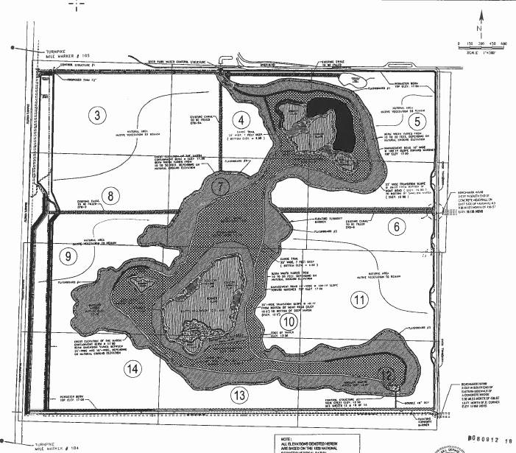
Winding Waters Natural Area Boardwalk and Trail: Palm Beach County (MP 104 to 106)
County approached Florida’s Turnpike Enterprise requesting to use a strip of land owned by Florida’s Turnpike Enterprise for conveyance of their proposed project.
Turnpike requested, in exchange, that their project treat and attenuate all runoff from all future projects for the 2 miles of roadway that drains to them.
This saves the Turnpike several acres of land for current design projects.

Slide 4
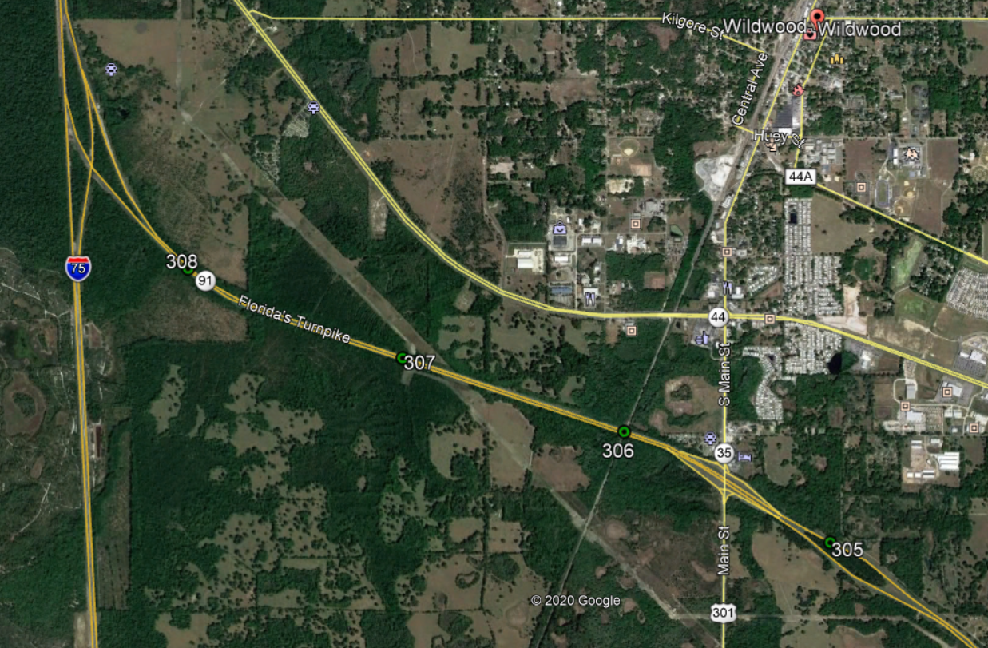
406110-1: Wildwood Interchange, Sumter County
The southern basin included approximately 15 acres of additional pavement
Bifurcation area south of US 301 provides necessary compensation treatment by adding a weir to the outfall cross drain
Avoided additional R/W and wetland impacts by utilizing this area already owned by FDOT
Ditch blocks were added to help attenuate and control any point discharges offsite
Project
location
Bifurcation Area

Slide 5
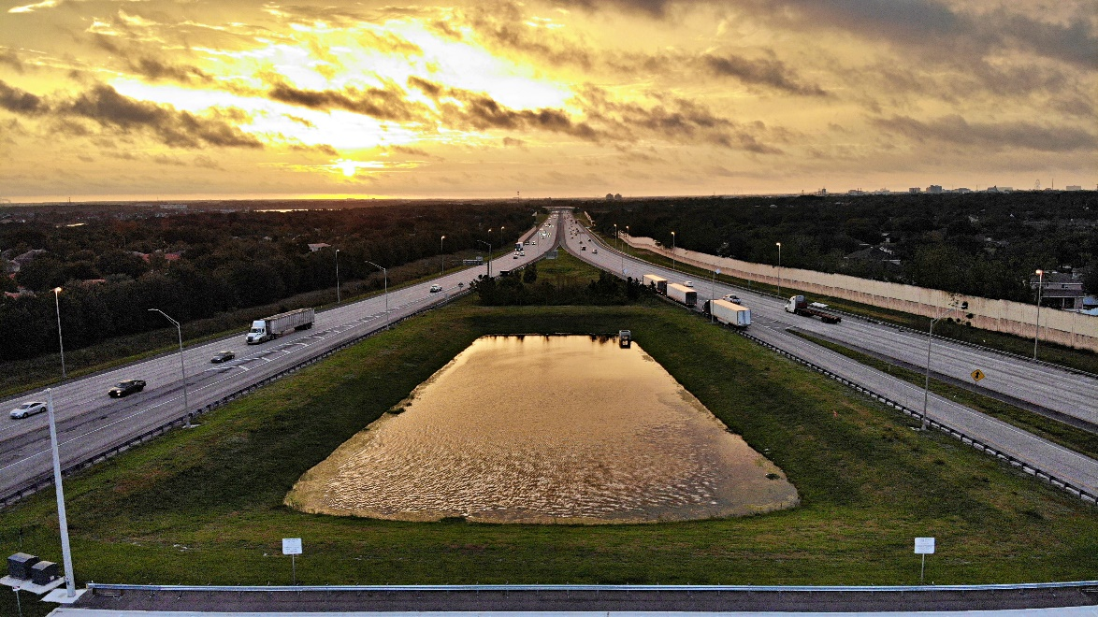
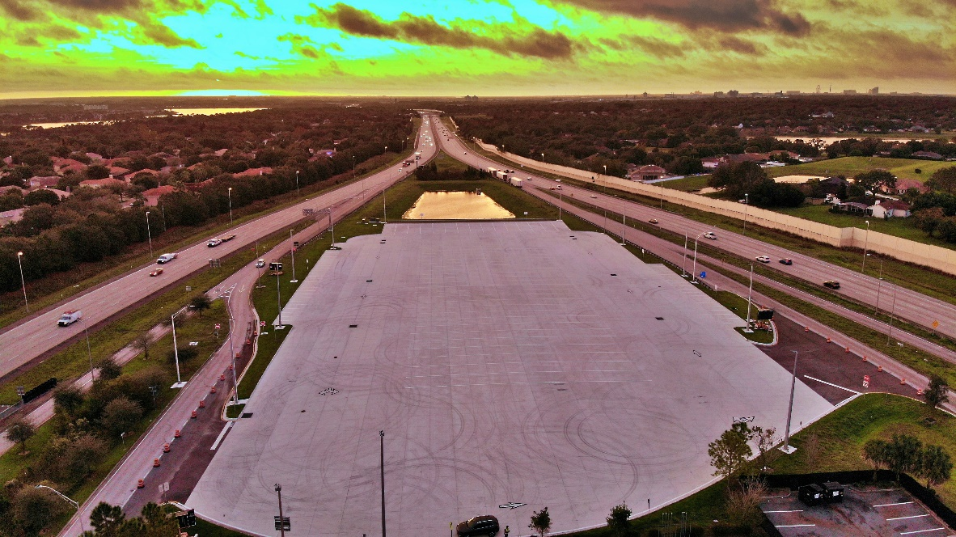
441309-1: Turkey Lake Service Plaza Tandem Truck Staging Lot, Orange County
A pond was required to be significantly filled in to accommodate the tandem truck parking
Additional capacity was found in an existing pond east of the project due to a lower SHWL than originally permitted (stormwater was conveyed to this pond)
Avoided offsite R/W purchase to account for the additional impervious/replace lost volume
Existing: Constructed:

Slide 6
441309-1: Turkey Lake Service Plaza Tandem Truck Staging Lot, Orange County
Parking
Existing Pond

Slide 7
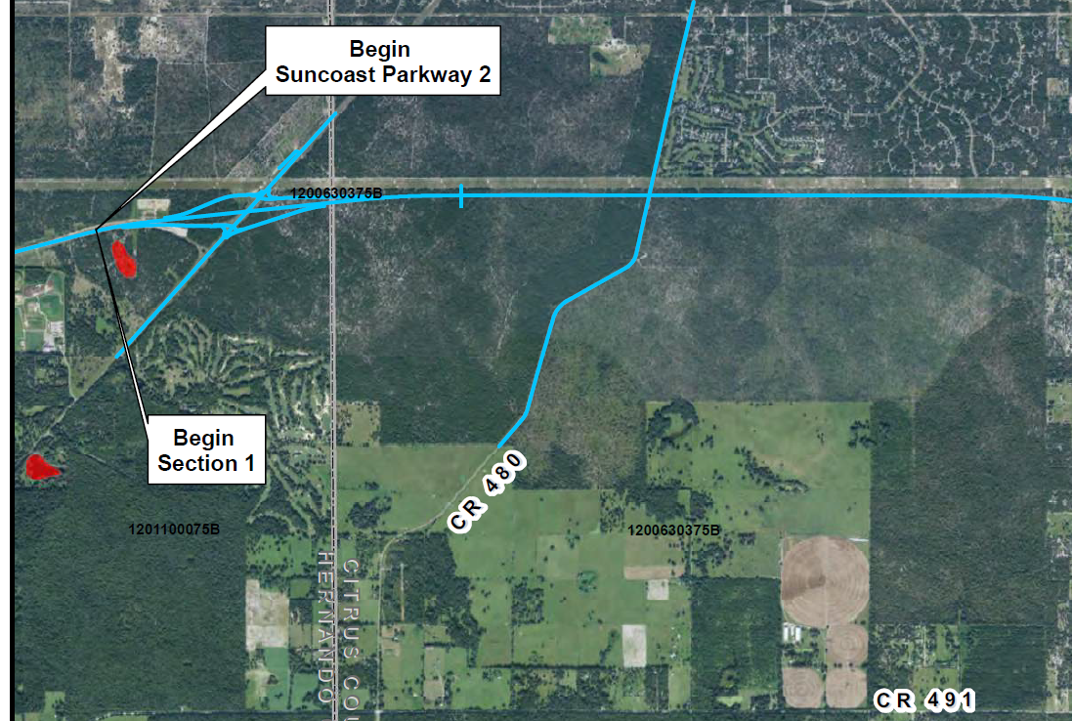
405270-1: Suncoast Parkway 2, Hernando/Citrus County
No stormwater facilities were constructed within the Withlacoochee State Forest Lands (DEP agreement) to avoid additional impacts to this land
Stormwater through this area flows to existing depression areas after receiving pre-treatment within the roadway R/W (collecting debris and controlling point discharges)
Velocities to state lands were kept to below 3 feet per second
N

Slide 8
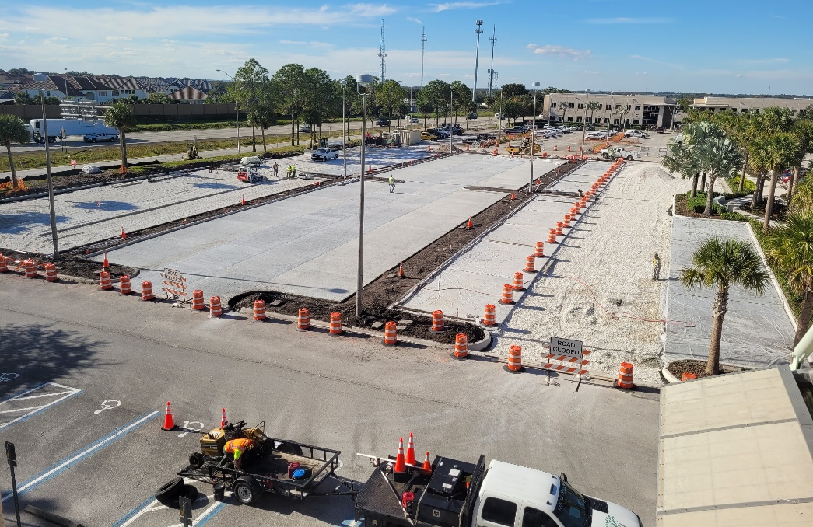
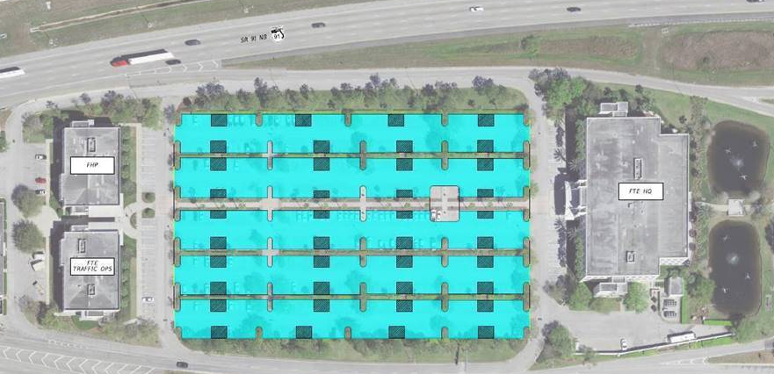
440293-1: Resurface SR 91 MP 260-265, Orange County
3.6 acres of pervious concrete is being installed at Turnpike Headquarters
Will improve water quality and reduce stormwater volume needs for a future widening of SR 91
The reservoir underneath will allow rainwater to slowly percolate
New tree vaults below the pervious concrete will allow the trees to receive additional hydration, allowing them to continue to grow while reducing the overall irrigation needs

Slide 9
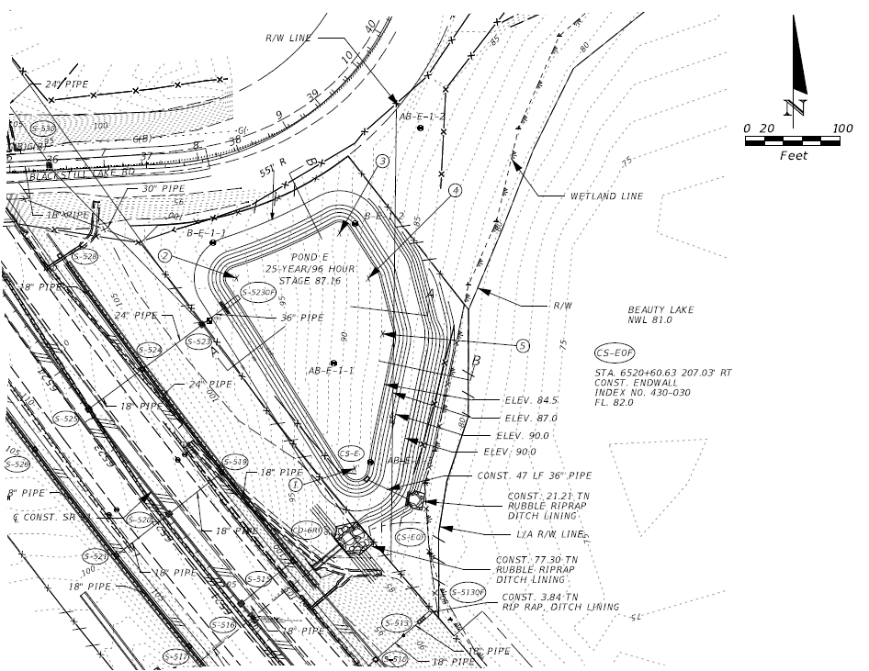
435784-1/435785-1: Widen SR 91 from SR 50 Minneola, Orange/Lake County
Beauty Lake had no previous owner and is being acquired by FDOT to provide additional stormwater needs for this project. This allowed a smaller R/W take for Pond E that drains to Beauty Lake.
Pond E

Slide 10
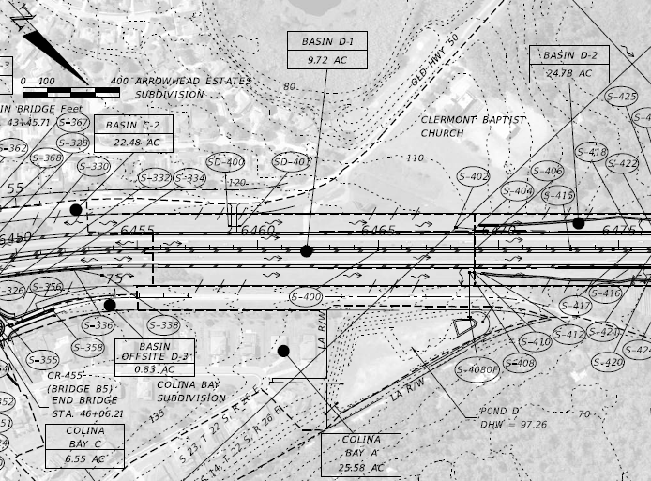
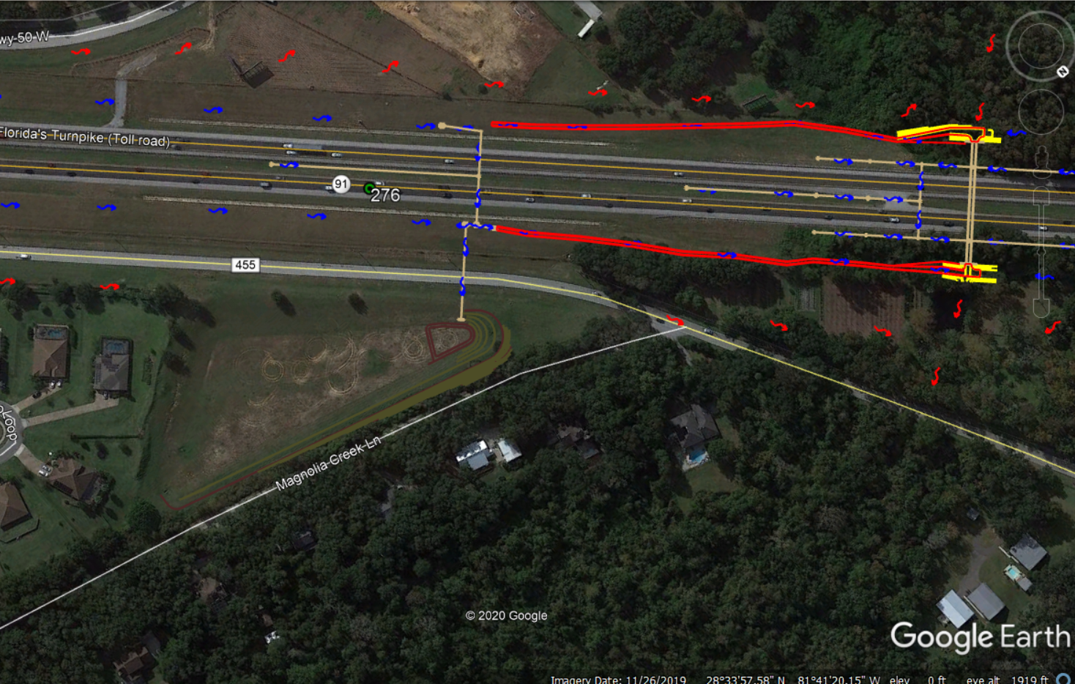
435784-1/435785-1: Widen SR 91 from SR 50 Minneola, Orange/Lake County
Existing Colina Bay Pond (Pond D) has excess capacity
It was originally designed to be a closed basin but the existing drainage pattern was able to be reestablished prior to the pond construction to reestablish an open basin

Slide 11
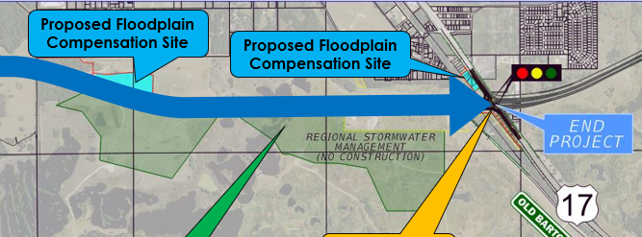
440897-2: Central Polk Parkway from Polk Parkway to US 17, Polk County
Impacts to a Development of Regional Impact (DRI) are already planned due to the new roadway alignment
FDOT will be purchasing the entire DRI and removing cattle and agricultural activities from the site
The net nutrient removal benefit will demonstrate the traditional pond requirements will be met or exceeded
Will reduce R/W impacts for the project and overall maintenance needs to maintain a new stormwater management facility

Slide 12
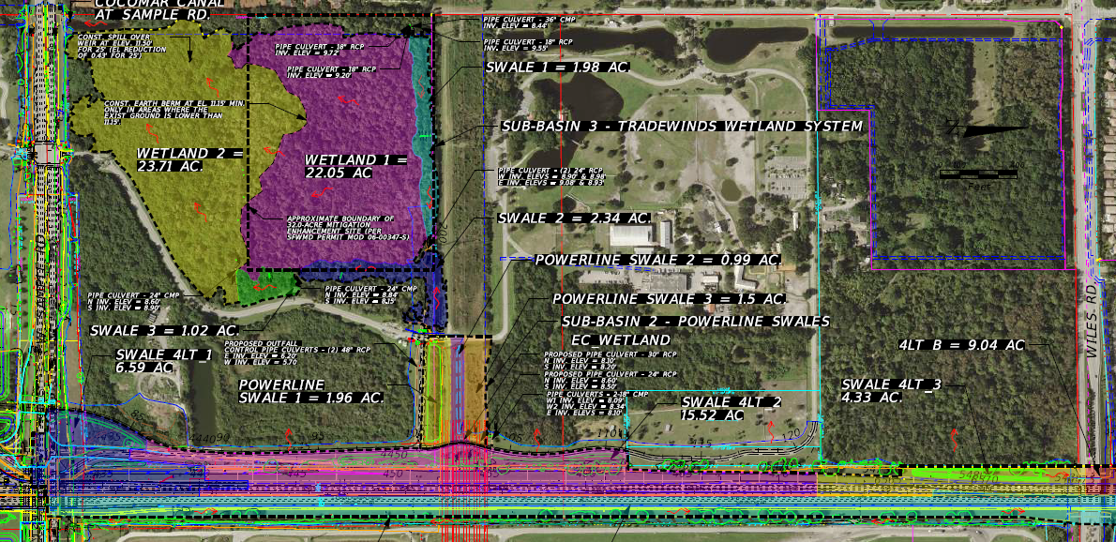
442212-1 PD&E (Originally 406150-1 Design): I-595 to Wiles, Broward County
Widening of SR 91 was under design from Atlantic to Wiles
Planned to send stormwater (pre-treated) to a wetland to reduce pond R/W impacts and in turn hydrate a wetland in need of water
Project was placed on hold and is now back in the PD&E phase

