Slide 1

Guide for Review and Assessment of Local Mobility Plans:
A Proposed Practice
Final Report | BDK84 TWO#977-02
March 2010
Center for Urban Transportation Research
University of South Florida

Slide 2
FDOT’s Role in Growth Management
2005 Growth Management Legislation
2008 Legislation - Reduce Greenhouse Gases
2009 Community Renewal Act

Slide 3
FDOT’s Current Role
Comprehensive plans, CPAs, EARs, and EAR-based CPAs
Within TCEAs
  focus on local land use and transportation strategies to support and fund mobility, including alternative modes - mobility plans
  no authority to review CPAs for compliance with level of service standards
  local governments not required to consult with FDOT on impacts or mitigation to the SIS
Outside of DULA TCEAs
  review CPAs and proposed DRIs to ensure LOS standards are achieved and maintained - mitigation of impacts may be required
  local governments must adopt FDOT LOS standards for the SIS
Notes:
The reviewing agencies (e.g. FDOT, DCA) no longer have authority to review future land use plan amendments in TCEAs for compliance with the requirement to “achieve and maintain level of service standards for transportation.” In dense urban land areas designated as transportation concurrency exception areas, local governments are therefore no longer required to consult with FDOT on impacts or mitigation to the SIS.

Slide 4
Mobility
Assessment
Guide

Slide 5
Guide
Detailed instructions for use of template
Description of Categories, Elements, and Criteria
“Notes” describe how each Criterion may be addressed in the plan

Slide 6
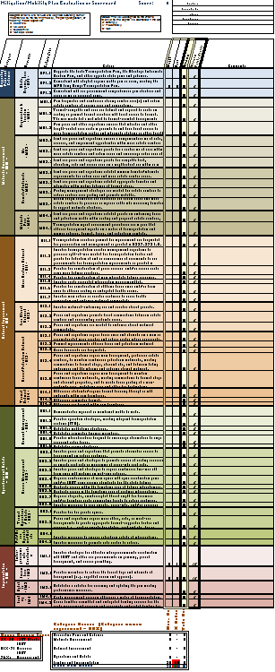
Mobility
Assessment
Template

Slide 7
Template Purpose
To assist in review and/or development of
  local government mobility plans
  related plans
    corridor management plans
    long-term concurrency management system plans
    other SIS impact mitigation plans
Plan must address transportation system deficiencies
  based on an analysis of existing conditions
  specific community planning objectives

Slide 8
Template Overview
Category - indicates the overall category
Elements - breaks down each category into core elements
Criteria Code – a code number for each criterion to aid in cross referencing
Criteria – states each specific criterion
Weight – reviewer assigns weight to each criterion
  importance to maintaining mobility, mitigating congestion, or meeting modal objectives
  determined jointly by the preparer and reviewer based on Existing Conditions Analysis
Value – reviewer enters value based on how the plan advances the criterion
  Local government may identify desired value in the application along with supporting info
  use the locally-assigned value or assign a different value per staff report
Score – spreadsheet computes the score of each criterion by multiplying the Weight by the Value assigned
  Each Category, at a minimum, must achieve 50% of the Maximum Points Available
Maximum Points Available - maximum points that can be achieved – a benchmark
  Assigned Weight x Maximum Value
Comments – staff comments related to the criterion

Slide 9
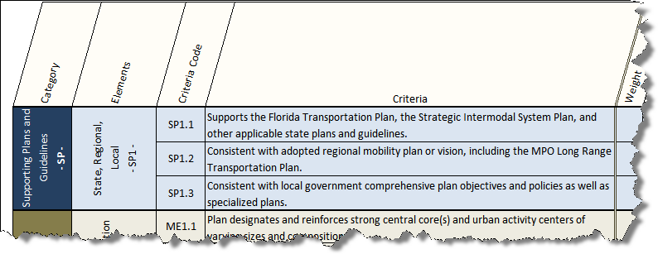
The “Category” field groups related elements together.
Notice the code “SP.” It is used to describe all criteria that fall within this particular category.

Slide 10
The “Elements” field breaks each category into core elements.
Notice that all elements are denoted by the code for their category, followed by consecutive numbering.

Slide 11
The “Criteria Code” field uniquely identifies each criteria.
Each criteria is assigned a consecutively numbered code to aid in cross referencing.

Slide 12
The “Criteria” field includes specific items to look for in the assessment.

Slide 13
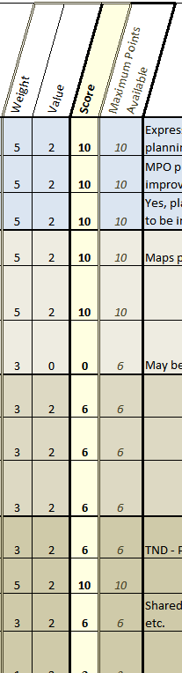
Weight: Criteria are ranked and weighted according to their importance to maintaining mobility, mitigating congestion, or meeting modal objectives
5: Essential
3: Valuable
1: Supportive
0: Not applicable
Criteria considered essential are assigned a weight of 5. If the criteria are valuable or supportive, a 3 or 1 would be assigned.
Values are assigned based on these guidelines:
Value: The value assigned to the criteria relative to the degree it is addressed in the plan
2: Strongly
1: Moderately
0: Not

Slide 14
The Score for each criteria is equal to the Weight multiplied by the Value for each criteria.
x
=
x
=
x
=
Score = Weight x Value
x
=
x
=
x
=
The Maximum Points Available for each criteria is equal to the Weight multiplied by the highest Value possible, being “2”.
x
=
x
=
x
=
x
=
Max Points Available = Weight x 2
x
=
x
=

Slide 15
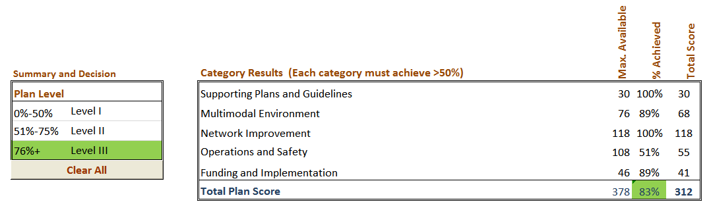
All category scores are compiled into a table at the bottom of the template. This is used to determine the overall score, as a percentage, for the plan.
The percent achieved for each category must
equal or exceed 50%.
The score is then compared to Plan Levels.
In this example, the score is above 76% and therefore the plan is at Level III and would merit FDOT approval and implementation support.

