Slide 1
Florida’s Truck Parking Availability System (TPAS)

Slide 2
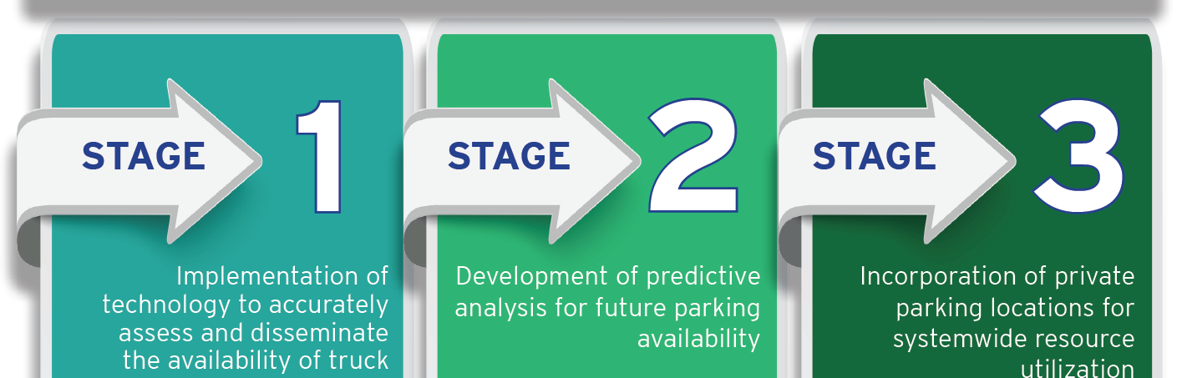
TPAS Program Delivery
Three-stage approach to statewide comprehensive truck parking solution
Notes:
SCRIPT:
TPAS project will be delivered in three stages:
Stage 1: Implementation of technology to accurately assess and disseminate the availability of truck parking.
This stage was completed through a series of design‐build projects led by FDOT Districts to deploy TPAS system at FDOT facilities (rest areas, welcome centers, and weigh stations).
The system will provide real‐time truck parking information along interstates.
TPAS will detect parking availability through sensors embedded in the parking areas as well as through vehicle detection counters.
The information will be aggregated through the existing Intelligent Transportation Systems (ITS) fiber optic network at each of the District Regional Transportation Management Centers (RTMC).
The truck parking information will be disseminated to the public via roadside signs, FL 511, and third‐party data feeds such as Data Integration and Video Aggregation System (DIVAS).
Stage 2: Development of predictive analysis for future parking availability.
This stage will follow immediately after the Stage 1 completion and once adequate parking data is aggregated from the system.
As statistically sufficient data is aggregated, algorithms will predict parking availability based on trends in parking utilization.
This information will be made available through data feeds
This information will allow motor carrier operators to carry out educated trip logistics planning to optimize safe and efficient freight movement throughout Florida.
Stage 3: Incorporation of private parking locations for systemwide resource utilization.
This stage will involve private party (such as gas stations with truck parking at exists) parking information integration.
Public‐private partnerships may be leveraged to deploy technology at private system parking facilities.
Private parking data will then be aggregated and disseminated along with public parking information to provide full system availability.
Predictive analysis is provided to commercial vehicle operators and dispatchers, maximizing use of the parking network.

Slide 3
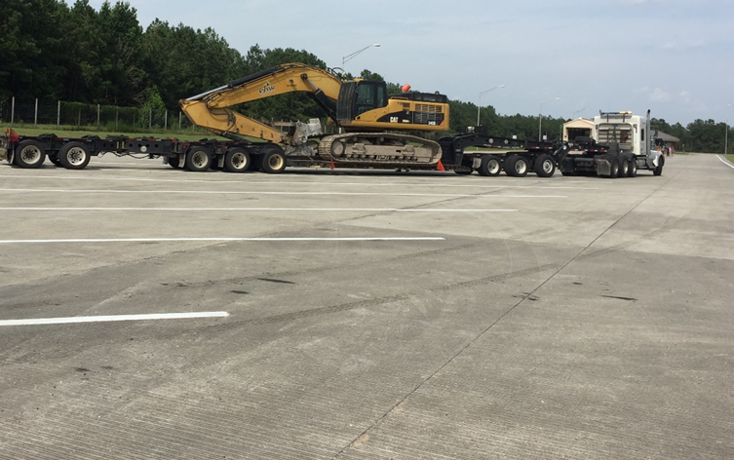
FDOT Research - FIU
Part 1:
Determine current supply and demand of public parking
Parking use unbalanced, some over-utilized while others under-utilized
Part 2:
Assess technology to improve parking management
Provide advanced notification of parking availability
Two pilot projects
Leon (in-pavement Sensors)
St. Johns County (ingress/egress counts with MVDS)
Notes:
SCRIPT:
FDOT Completed a two-part research project to study Truck Parking:
Determine the supply and demand of public truck parking across the State.
Limited initial source data
Duration of individual parking session
Peak time
Over-crowding evident by parking on ramp shoulders, especially in urban areas
FIU Research on Supply/Demand Indicated that:
Parking use is unbalanced, some over-utilized while others under-utilized
Baseline truck parking data based on FIU research report
Categorized study areas based on level of truck parking capacity problem
Low, medium, high
Based unavailability of parking resulted in overparking, pass-through due to no parkin
Assess technology to improve parking management
Provide advanced notification of parking availability
Part 2 involved deploying a pilot project to assess the technology to improve parking management. The part 2 tested use of individual in‐pavement sensors technology to detect presence and occupancy.
FIU‐FDOT research also included an assessment of technology that can be used to improve truck parking management at rest areas in Florida and deployment of a pilot project to test implementation. The vehicle detection technology chosen for the pilot project at the Leon County rest areas (eastbound and westbound) on I‐10 features wireless ground sensors, which detect the presence of a vehicle as it comes to a stop above it.

Slide 4
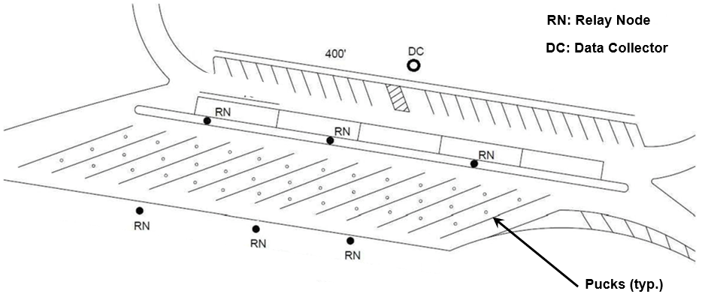
FDOT Pilot Project - Leon County
Location: I-10; Leon County; FDOT District 3
Assess technology to improve parking management
In-pavement sensors to detect presence and occupancy
Leon County Truck Parking
Notes:
SCRIPT:
Leon County on I‐10 (in‐pavement sensors) and
Space‐by‐Space detection
Applicable at mixed use facilities such as rest areas and welcome centers.
Mixed use‐ facilities use trucks, recreational vehicles, passenger cars
In‐pavement “pucks” will collect and automatically provide high accuracy truck parking event data
“Pucks” will communicate parking events wirelessly with “relay node”.
““relay node” will communicate parking events wirelessly with “data collectors”.
Both “pucks” and “relay node” are battery powered and “data collector” is regular commercial power.
The parking data is communicated to RTMC through Data collector.
Using In‐pavement sensor will result in limited RTMC operator involvement.
The truck parking management system for commercial motor vehicles should have the following items based on FIU research:
The system must accurately and reliably “know” whether a parking area is full, and if it is not full, the number of spaces remaining.
The system must include the capability to archive data, so that historical information on parking occupancy can be assembled and monitored.
The system must forecast space availability for approaching drivers at a micro‐level by combining the real‐time parking space occupancy information with the historical parking trend information.

Slide 5
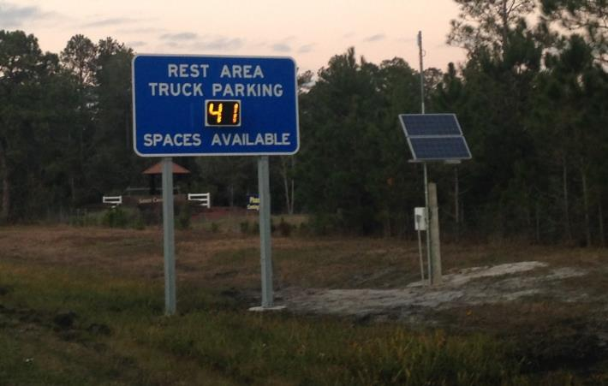
FDOT Pilot Project - St. Johns County
Location: I-95, St. Johns County, FDOT District 2
Project used MVDS sensors to count trucks at ingress/egress of truck parking lot
Provide advanced notification of truck parking availability
MVDS
MVDS
Pilot TPAS Sign on I-95 in St. Johns County
St. Johns County Truck Parking
Notes:
SCRIPT:
St. Johns County (ingress/egress counts with MVDS)
Ingress/Egress Monitoring
Microwave Vehicle Detection Systems (MVDS) at each Ingress and egress point of a truck only parking lot.
One Closed Circuit Television (CCTV) for parking verification
One static sign with variable message panel to display number of parking spots available.
Pilot TPAS static sign on I‐95 in St. Johns County shown here. In all subsequent TPAS installations each sign meets MUTCD guidelines on white color letter color on embedded DMSs.
Applicable at primary truck parking only facilities (weigh stations)

Slide 6
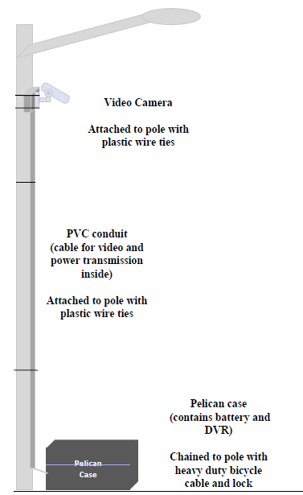
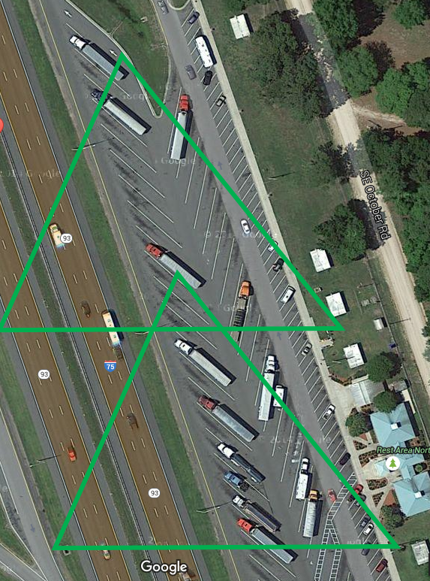
FDOT Research - UF
Evaluation of in-ground sensors to examine their capabilities
Tested four different vendors
Ground-truth data through video logs
Three products listed on Innovative Products List (IPL)
Video Camera Mounting Details
Notes:
SCRIPT:
In 2016 a commercial truck parking detection technology evaluation research work funded by FDOT was conducted by the University of Florida at two rest areas to test multiple in‐ground sensors.
The research project examines technology capabilities and integration with existing infrastructure.
The research tested the performance of available technology at two rest areas in Columbia County, I‐75, to further define the parameters of the new WDS deployment.
Four vendors participated in the evaluation process. All vendor technologies supported wireless detection system (WDS).
Ground‐truth in‐ground sensor vendor data verified through video logs.
Three (3) vendors were selected for inclusion on the Innovative Product List (IPL) based on performance of sensors.
Those selected for IPL were SensIT, Sensys and CivicSmart. This slide shows two SensIT inground sensors and related above ground devices.
SensIT uses magnetic and infrared detection while both the Sensys and CivicSmart use microwave radar.
Both methods involve sensors which are placed in or under the monitored parking spaces.
These sensors communicate wirelessly with an electronic “relay node” then to a “Data collector” or directly to a data collector.
The ‘Data Collector’ aggregates the information and relays it to a central location.
For study purposes, this location was a company server, but in TPAS deployment, the information would be sent to SunGuide® to make it accessible to users of the SunGuide® app.

Slide 7
FDOT Research - UF
Performance Accuracy Requirements
Turnover Accuracy – 90%
Occupancy Accuracy – 95%
Detection system test conducted over two 15-hour (6:00 pm to 9:00 am) sessions
Developmental Specification 660
Notes:
SCRIPT:
The study resulted in the establishment of a Developmental Specification 660 outlining the requirements of the WDS for use in deployment documents
Each detection system must be tested to meet the following Developmental Specification 660 accuracy minimum performance requirements, conducted over two 15‐hour (6:00p.m. to 9:00 a.m.) sessions.
Truck parking Turnover Accuracy – 90%
Truck parking Occupancy Accuracy – 95%

Slide 8
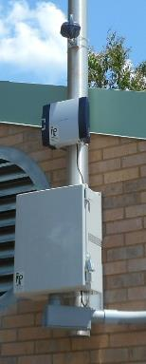
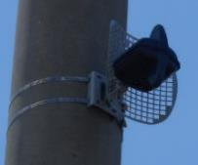
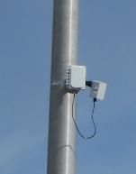
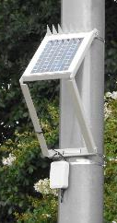
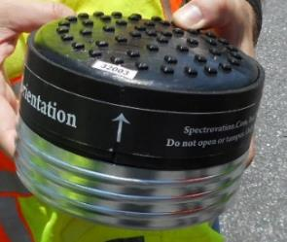
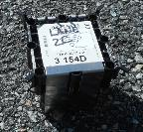
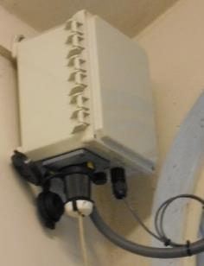
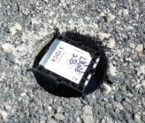
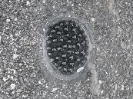
Florida TPAS - Detection Devices
SensIT
Sensys
CivicSmart
Notes:
SCRIPT:
Three (3) vendors were selected for inclusion on the Innovative Product List (IPL) based on performance of sensors.
Those selected for IPL were SensIT, Sensys and CivicSmart. This slide shows two SensIT inground sensors and related above ground devices.
SensIT uses magnetic and infrared detection while both the Sensys and CivicSmart use microwave radar.
Both methods involve sensors which are placed in or under the monitored parking spaces.
These sensors communicate wirelessly with an electronic “relay node” then to a “Data collector” or directly to a data collector.
The ‘Data Collector’ aggregates the information and relays it to a central location.

Slide 9
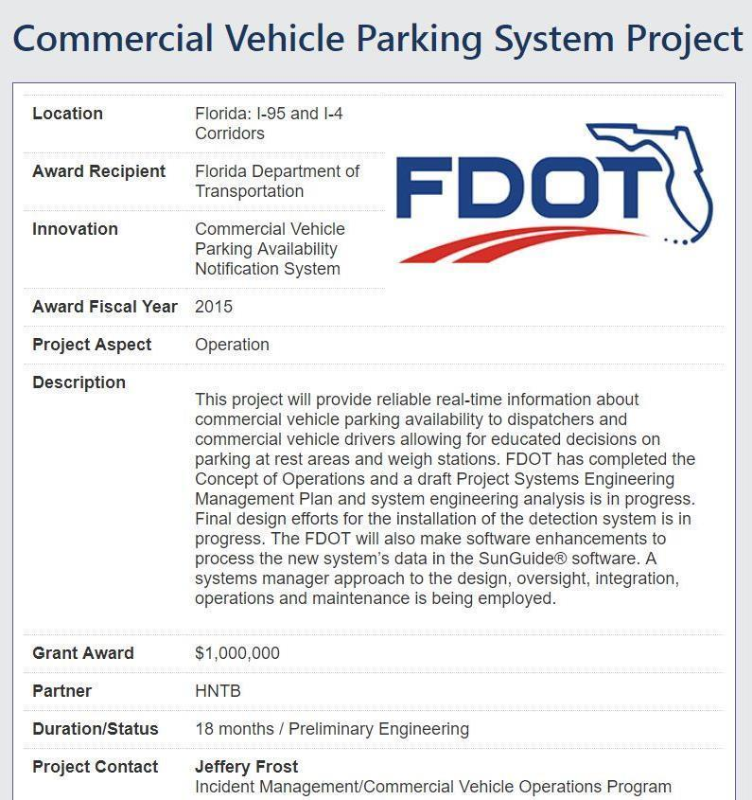
Federal Grants
FDOT Received two (2) federal grants to support statewide implementation:
Federal AID: $ 1 Million
FASTLANE: ~ $11 Million
Notes:
SCRIPT:
FDOT received two federal grants for this project.
As discussed earlier, the Federal Accelerated Innovation Deployment (AID) grant supported the initial statewide study and technology evaluations. The Federal AID grant award was $1.0M.
FDOT applied for the second grant in 2016 under FAST Act (FASTLANE) that brought nearly $11 M (10.7M) in federal funding for the statewide deployment on public facilities along interstates. This grant award catapulted the project from pilot to systemic deployment. This project formally named as Truck Parking Availability System or TPAS.

Slide 10
Deployment Mechanism
Notes:
SCRIPT:
Deployment conducted in phases by Districts using Design‐Build process. FDOT Central Office and its consultant is serving as the System Engineer developing and overseeing deployment of all seven phases.
Some districts used low‐bid design build while some preferred adjusted score design‐ build process.
Note the vendors included in the UF study and FDOT IPL list were selected for deployments. Design‐Build firms chose the technology vendor.
To date, each technology has been successfully tested.
Each one, however, will be closely monitored for the long-term effectiveness, reliability, maintenance, and life cycle issues.

Slide 11
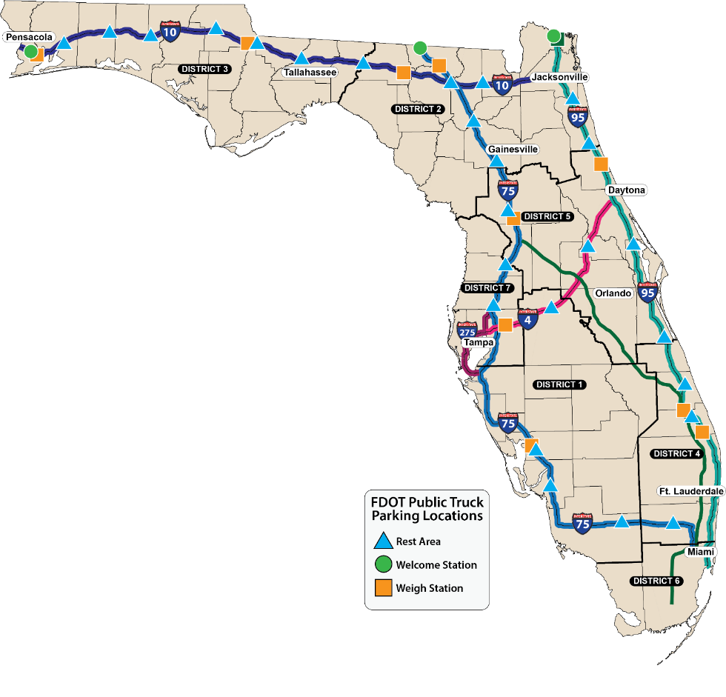
TPAS Initial Locations
45 Rest Areas
20 Weigh Stations
3 Welcome Centers
4 Corridors: I-95, I-4, I-75, I-10,
3 Welcome Centers
20 Weigh Stations
45 Rest Areas
Truck Parking Sites Located in
FDOT Districts: 1, 2, 3, 4, 5, and 7
Number of Truck Parking Spaces Monitored | 2,352
Wireless Detection System (WDS) | 1,875
Microwave Vehicle Detection System (MVDS) | 477
Notes:
SCRIPT:
Due to on-going or planned construction, the initial deployment did not cover all public parking facilities. The initial deployment included:
45 rest areas, 20 weigh stations, and three (3) welcome centers.
TPAS deployment on all these public truck parking lots will be operational by the end of calendar year 2019.
A total of 2,352 +/- truck parking spaces will be monitored using TPAS system. Out of which, 1,875 will be instrumented with the Wireless Detection System (WDS) and 477 spaces will be monitored using the Microwave Vehicle Detection System (MVDS).

Slide 12
TPAS Supplemental Locations
6 Additional Rest Areas:
I-10 EB Suwannee County
I-10 WB Columbia County
I-75 SB Hillsborough County
I-75 NB Hillsborough County
I-275 SB Pinellas County
I-275 NB Manatee County
3 Corridors: I-75, I-10, I-275
6 Rest Areas
Truck Parking Sites Located in FDOT Districts: 1, 2, and 7
Notes:
SCRIPT:
The supplemental deployment is occurring in conjunction with, or following, the rest area reconstruction projects.
The I-10 projects are scheduled for FY 2020
The I-75 projects are underway and in various stages of construction or procurement.
The I-275 projects are in conceptual development.

Slide 13
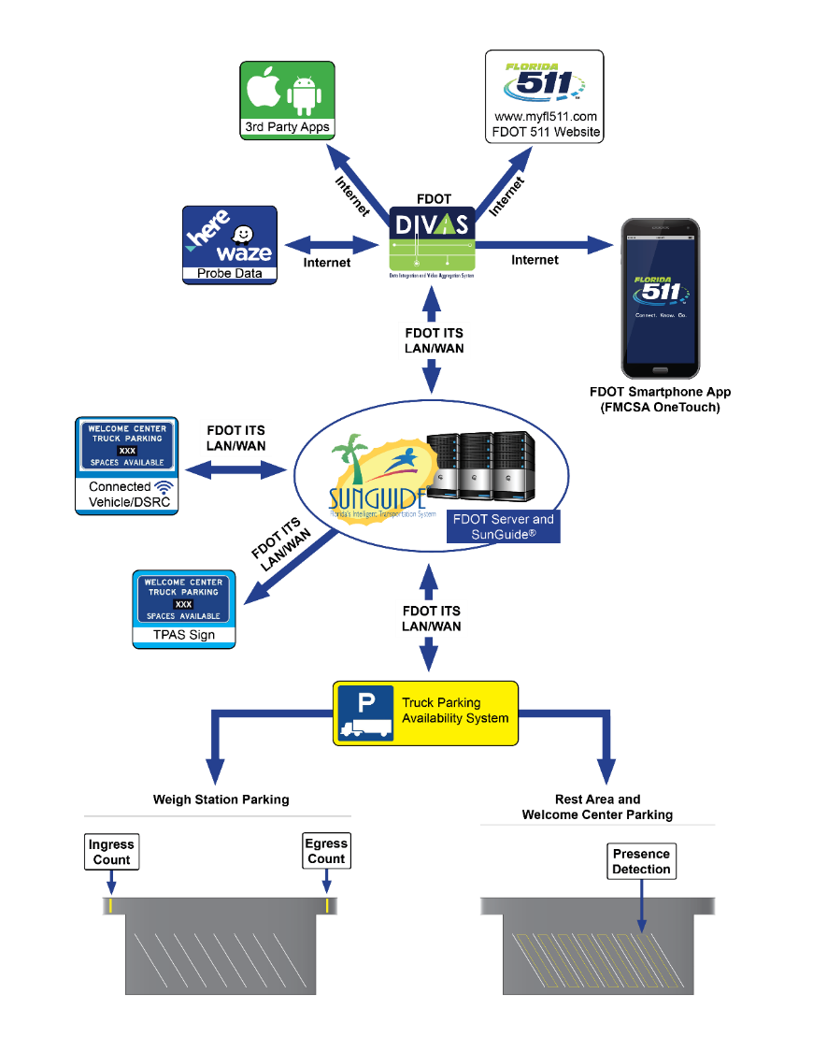
TPAS Architecture
Data Collection
Through TPAS sensors
Data Communications
Existing ITS SICN
Data Collection, Processing, and Storage
RTMC using SunGuide® system
Data Dissemination
Embedded roadside Dynamic Message Sign (DMS)
Connected Vehicle - Future
Data Integration and Video Aggregation System (DIVAS)
Florida 511, 3rd Party Apps, Waze
Notes:
SCRIPT:
The TPAS architecture consists of field technologies, communications to Regional Transportation Management Centers (RTMCs), data collection-processing-storage, and data dissemination.
The data communications is done using existing ITS communication network to transmit field parking data to RTMCs.
The data collection, processing, and storage process takes place at RTMCs via SunGuide® central system software server.
The data dissemination to truckers is done using roadside signs, FL 511, and DMS. Future enhancements may include connected vehicle technology and data dissemination for third-party use via FDOT’s Data Integration and Video Aggregation System (DIVAS).

Slide 14
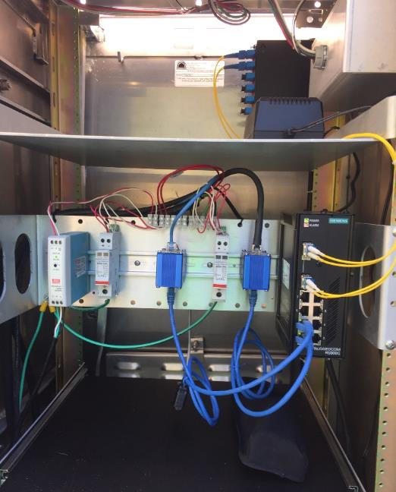
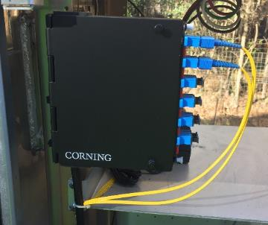
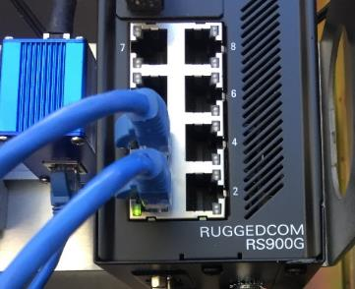
TPAS Integration
Fiber Patch Panel
TPAS device communication integration with existing ITS communication network
Minimal interruption to existing ITS infrastructure and RTMC operations
No fiber splices allowed to existing ITS fiber network
Connect to available ports in existing MFES Switch in ITS cabinet
Existing fiber network is untouched
TPAS Device Power
Reduce additional utility bills
Use of Existing ITS service drops where feasible
Connect to existing ITS cabinet to draw power for TPAS sign
NO UPS and/or solar power provided to the TPAS cabinets
Available ports in MFES Switch
FDOT EXISTING ITS CABINET
Notes:
SCRIPT:
TPAS device communication integration with existing ITS communication network
TPAS project integration plans is designed to have Minimal interruption to existing ITS infrastructure and ITS RTMC operations
No fiber splices allowed to exist in the ITS fiber network in almost all districts. Only at District 3 are fiber splices are allowed to exist in the ITS network.
A new TPAS ITS Field Cabinet with power supply, Managed Field Ethernet Switch (MFES), fiber connection to an existing switch (MFES) inside an existing ITS cabinet, conduit, pull boxes, splice boxes, and all other equipment necessary to connect rest area, welcome center and weigh station presence detection and CCTV to SunGuide®.
Existing fiber network is untouched, even patch panel is untouched at in the existing cabinet. All the existing ITS splice canisters and splice trey are not disturbed.
TPAS infrastructure interface with existing ITS infrastructure at pull boxes and cabinets but connect at only in the cabinet
TPAS Device Power Plans:
TPAS power source is designed to reduce additional electric utility bills.
New TPAS devices use of Existing ITS service drops where feasible
TPAS sign connect and draw power from existing ITS cabinet. TPAS sign located near existing ITS device to make this connection feasible.
TPAS system is non-critical ITS system.
TPAS system will not have UPS.
Solar power is not provided to the TPAS cabinets. This reduced maintenance issues and ITS operation and maintenance personal to maintain multiple types of power system.

Slide 15
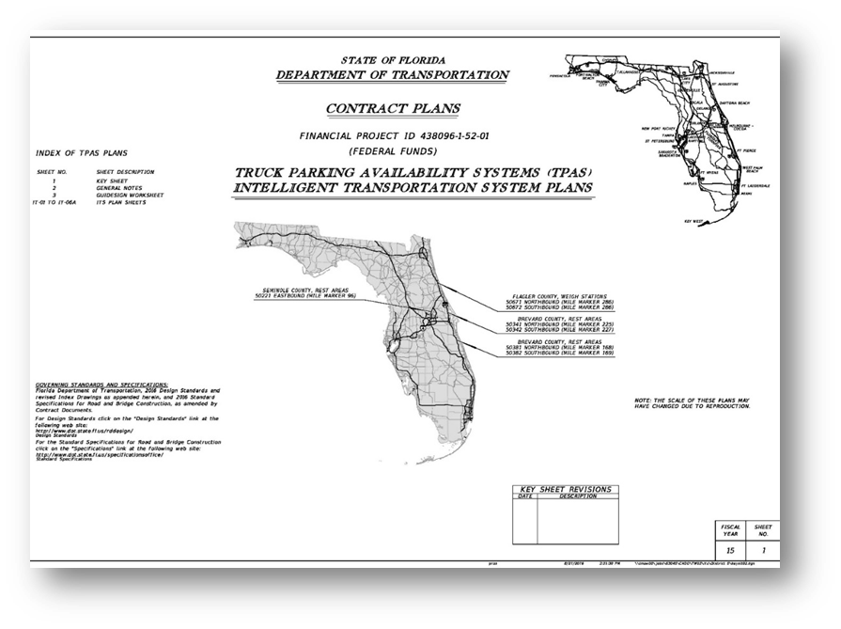
TPAS Concept Plans and Guide Sign
Concept Plans Development
For each Design Build Project
Identified TPAS Sign location
TPAS system integration details
Guide Sign Worksheets
Rest Area, Welcome Center and Weigh Station TPAS Signs
TPAS Sign Placed Inside Rest Area to Guide Trucks Towards Available Parking Rows
XXX
XXX
XXX
XXX
XXX
Notes:
SCRIPT:
Guide Sign Worksheets:
Standard Guide sign worksheets were developed for Rest Area, Welcome Center and Weigh Station TPAS signs.
The guide signs are developed to meet MUTCD guidelines and include full color embedded DMS.
The guide signs went through approval from FHWA.
Additional internal TPAS Signs were placed inside Rest areas to guide trucks towards available parking. This was due to a lack of internal circulation. Without these signs,
If a truck choses a full row and misses an available truck parking spot, they would have to exit the parking location and travel to the next location.
The internal sign directs the drivers to the appropriate row with available parking
Sponsorship Sign
FDOT worked with FHWA to secure sponsorship approval to support on‐going maintenance funding. Currently FDOT in the process of procuring a vendor for the sponsorship signs.
Each TPAS sign may have a supplemental sponsorship sign, these sponsorship signs will be installed in the future.
The TPAS supplemental sponsorship sign will have a maximum width of six (6) feet and a height of four (4) feet.
The TPAS Sign is designed with all sign support structures to allow for the future installation.
Supplemental sponsorship sign is located immediately below the bottom of the proposed sign.
Supplemental sponsorship sign right-justified with the proposed sign.
FHWA approved FDOT’s supplemental sponsorship sign with TPAS sign for all public truck parking locations.

Slide 16
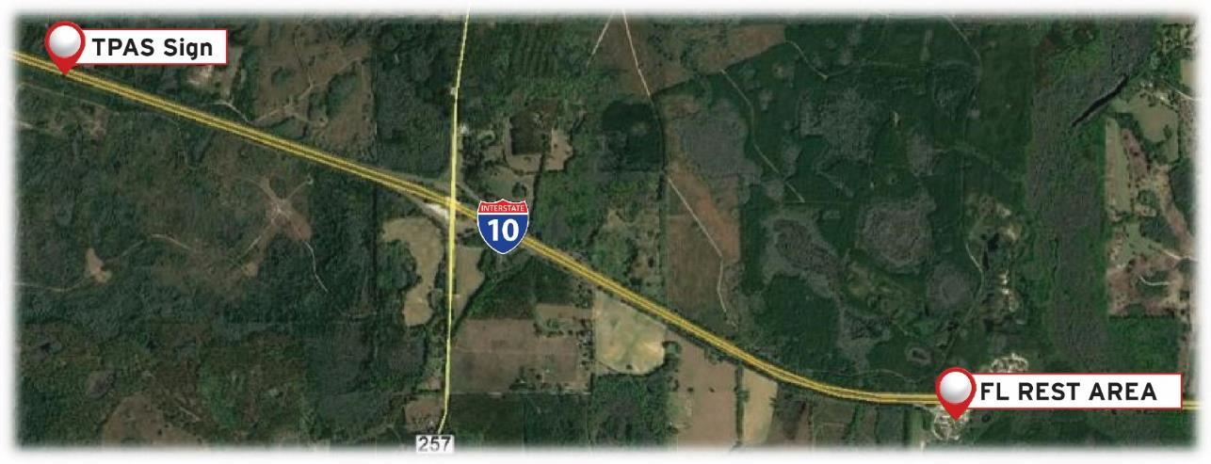
Information Dissemination - Signs
Criteria used for roadside signs
Two to three miles upstream of the parking facility preferably prior to an upstream exit ramp for better decision-making
Manual of Uniform Traffic Control Devices (MUTCD) compliant
Near existing ITS communication and power source
Near an existing CCTV for message verification
Notes:
SCRIPT:
TPAS truck parking signs were placed at two to three miles upstream of the parking facility, preferably upstream of and interchange for decision making.
Road sign static signs proposed with embedded DMS.
Signs will be placed per MUTCD requirements along with the panel design for better readability.
SunGuide software will be used to display available truck parking numbers on roadside TPAS signs.
TPAS sign will be placed near existing ITS infrastructure to connect to ITS communications and power.
TPAS signs will be placed near an existing CCTV for message verification.

Slide 17
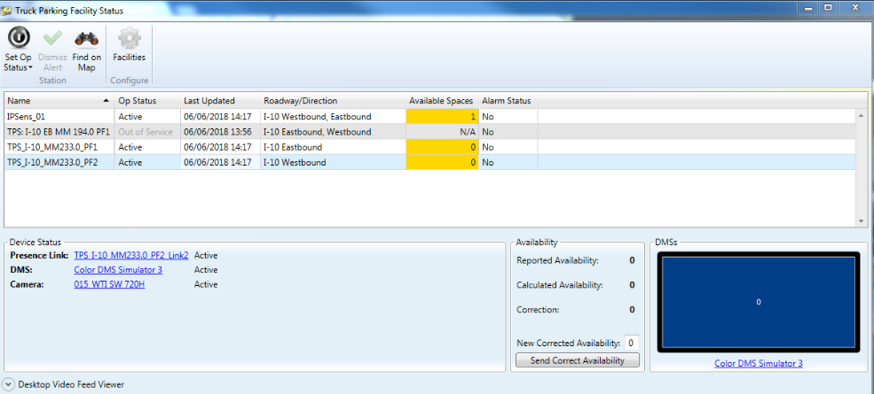
TPAS SunGuide® Interface
TPAS SunGuide® Interface
Each in-ground sensor vendor
Mock set up at Traffic Engineering Research Lab (TERL)
Interface Control Document (ICD) using TPAS ConOps Companion
In-ground sensor data interface with SunGuide® is adopted during mock set up
SunGuide® Release 7.0
Display truck parking availability
at rest areas and weigh stations
Truck parking availability posted on DMS signs
Notes:
SCRIPT:
To facilitate the development of the SunGuide® software interface with the proposed TPAS, each vendor provided a mock setup at TERL that includes the parking sensors, repeaters, access point, servers, hardware and mounting equipment as well all software.
This mock set up is provided within 30 days of the D‐B project execution.
The vendor provided software support to aid in the development of the SunGuide® software interface.
The each inground sensor vendor submitted an interface control document (ICD) detailing how the truck parking availability system interfaces with external FDOT systems.
These external FDOT systems include
SunGuide® software
Existing fiber optic network
Wireless interface
All media-to-media conversions
Detector software and interface with the FDOT District Network Management Software (NMS)
Each ICD contains protocol information used by the SunGuide® software team to communicate with the truck parking availability system /devices.
SunGuide® Release 7.0
Display truck parking availability at rest areas and weigh stations
Truck parking availability posted on DMS signs

Slide 18
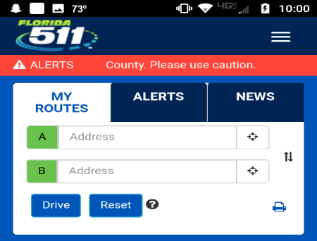
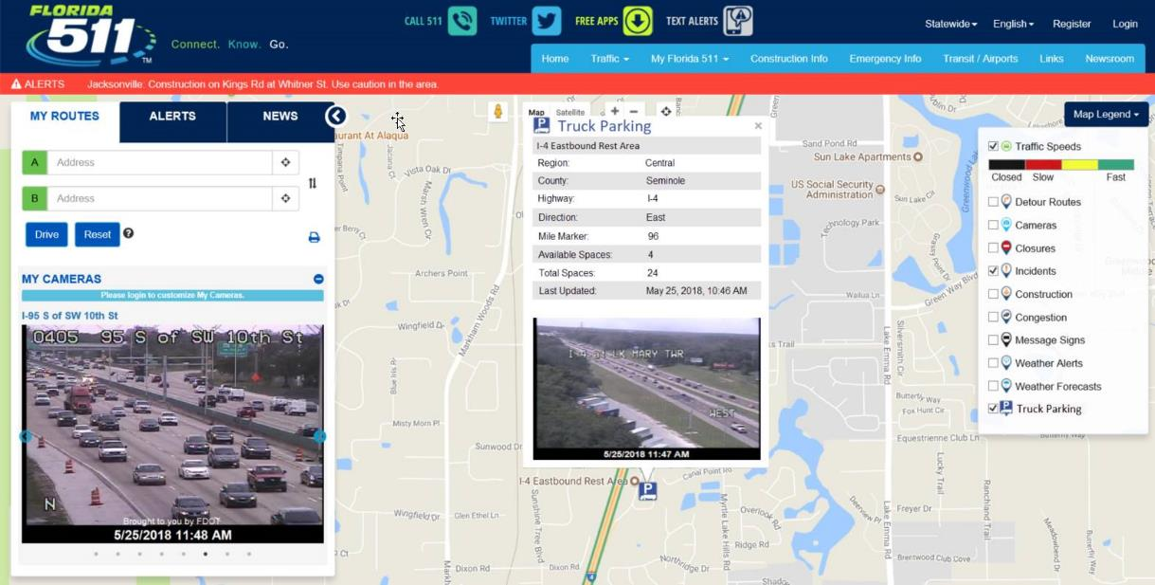
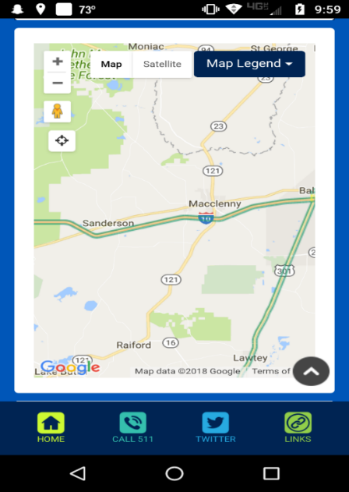
Information Dissemination - FL511
Notes:
SCRIPT:
TPAS uses FL 511 to disseminate truck parking information messages via FL 511 website and smartphone application.
Above two picture show
FL 511 Website Truck Parking Facility Map and Detailed View, and
FL 511 Mobile App Truck Parking Facilities List View
It’s crucial that truckers know ahead of time the available parking spaces they should come to expect at Public Parking Facilities in order to plan their trip in advance.
SunGuide® system will be used for recording, storing, and analyzing truck parking data, and in turn use the data to predict parking spaces at any time of day.

Slide 19
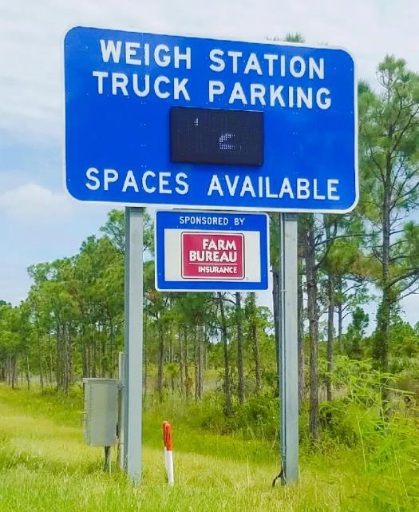
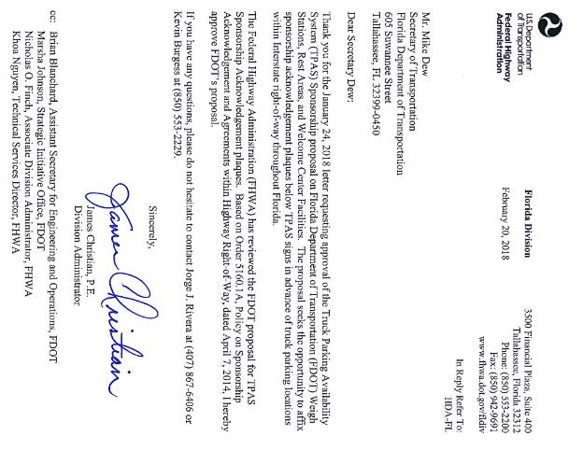
TPAS Sponsorship Sign
TPAS Supplemental Sponsorship Sign
6‘ X 4’ Size of the Supplemental Sponsorship Sign
Supplemental Sign located right justified below TPAS Sign
FDOT received FHWA Approval
Supplemental Sponsorship Sign
TPAS Sign Cabinet
Notes:
SCRIPT:
FDOT worked with FHWA to secure sponsorship approval to support on‐going maintenance funding. Currently FDOT is in the process of procuring a vendor for the sponsorship signs.
Each TPAS sign will have a supplemental sponsorship sign, these sponsorship signs will be installed in near future.
The TPAS sign supplemental sponsorship sign will have a width of six (6) feet and a height of four (4) feet.
The TPAS Sign is designed with all sign support structures to allow for the future installation.
Supplemental sponsorship sign is located immediately below the bottom of the proposed sign.
Supplemental sponsorship sign right-justified with the proposed sign.
For supplemental sponsorship sign, FDOT requested FHWA for approval.
FHWA acknowledged and approved the FDOT supplemental sponsorship sign.
FHWA approved FDOT’s supplemental sponsorship sign with TPAS sign for all public truck parking location.

Slide 20
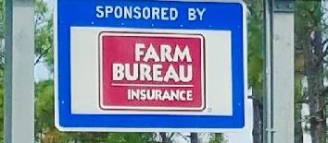
Lessons Learned
Design:
Internal Parking Layout – Additional Directional Signs
API for Interface with other states
Power service for remote sign locations
Systems Engineering documents with well-defined validation
Include future sponsorship opportunity in signpost design
Construction:
Let by Districts due to funding resulted in different vendors
Early coordination with other projects
Single oversight team from concept through construction
FUTURE SUPPLEMENTAL SIGN
Notes:
SCRIPT:
Internal Parking Layout – Additional Directional Signs
API for Interface with other states
Power service for remote sign locations
Systems Engineering documents with well-defined validation
Include future sponsorship opportunity in signpost design
Led by Districts due to funding resulted in different vendors
Early coordination with other projects
Single oversight team from concept through construction

Slide 21
Lessons Learned
Weigh station parking perception by truck drivers
Open/Closed signs at weigh stations causing confusion
No baseline truck parking data at facilities before TPAS deployment
Data sharing protocols between Districts and Central Office
Notes:
SCRIPT:
Weigh station parking perception by truck drivers – afraid of enforcement while parked at comfort station
Open/Closed signs at weigh stations causing confusion – if weigh station is closed, is truck parking open or closed?
Not collecting truck parking data at rest areas before TPAS deployment
Protocol not in place to share truck parking event data from district to central office

Slide 22
Questions?
Marie Tucker
Commercial Vehicle
Operations Manager
(850) 410-5619
Marie.Tucker@dot.state.fl.us
Additional TPAS Information:
www.floridatruckinginfo.com
22

