Slide 1
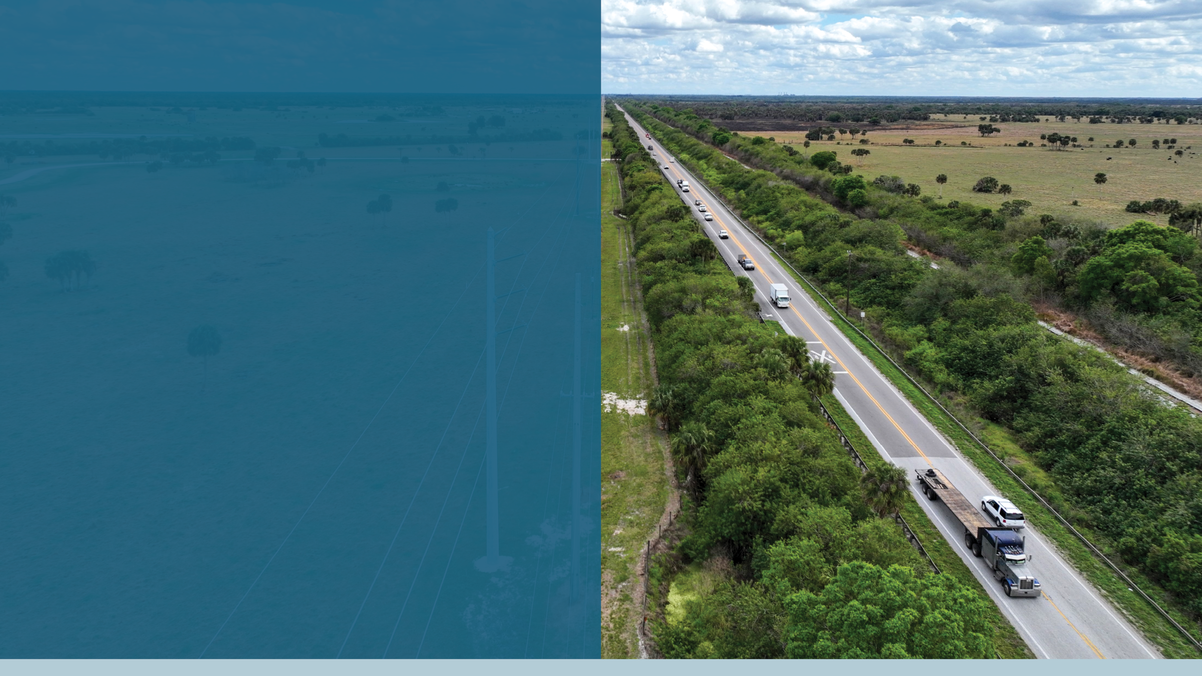


^{STATE ROAD (SR) 710}
^{PROJECTS UPDATE}
^{Martin Metropolitan}
^{Planning Organization}
APRIL 21, 2025 – POLICY BOARD MEETING
FINANCIAL PROJECT IDENTIFICATION NUMBERS:
447555-1, 447555-2, 453333-3 (Go Together) 453333-2, 453333-1, and 453333-4 Martin and Okeechobee Counties
Florida Department of Transportation

Slide 2


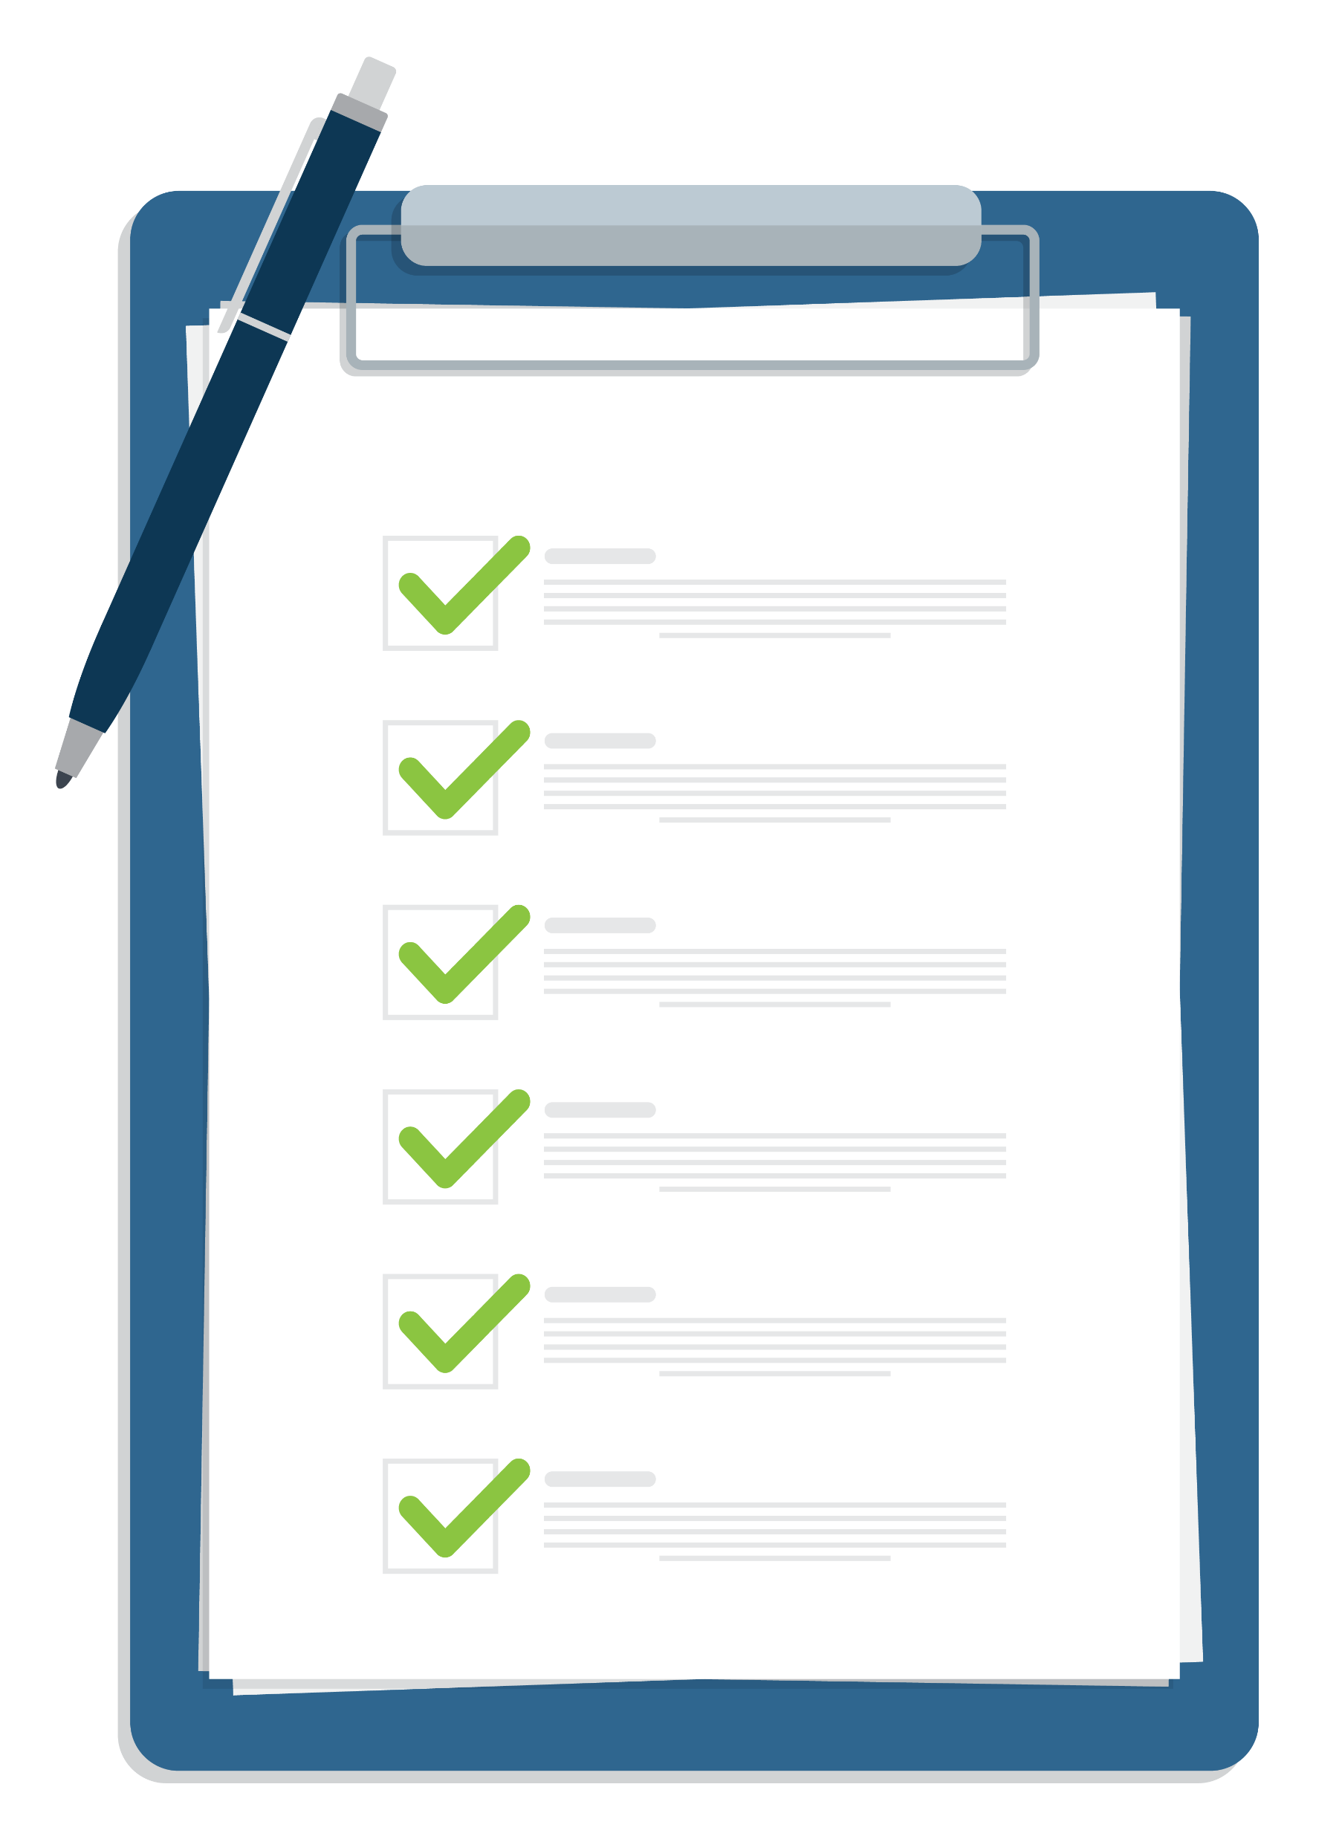



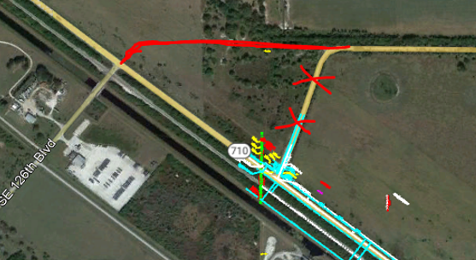
Agenda
Corridor Overview
Project Goals
Existing Conditions
Proposed Improvements by Segment
  Challenges
  Key Stakeholder
  Coordination
  Project Schedule
2
Notes:
Corridor Overview (common)
Existing Conditions
Project Goals
FPID Number 1 -

Slide 3


FDOT Compass
Transportation Project Development Process
We Are Here
Planning
PD&E
Design
Right-Of-Way
Construction
Existing Conditions
Needs Assessment
Work Program
Purpose & Need
Alternatives Analysis
Environmental Studies
Documentation
Detailed design
Construction Plans
Cost Estimates
Permits
Appraisal
Negotiations
Acquisition
Build and Deliver
3

Slide 4
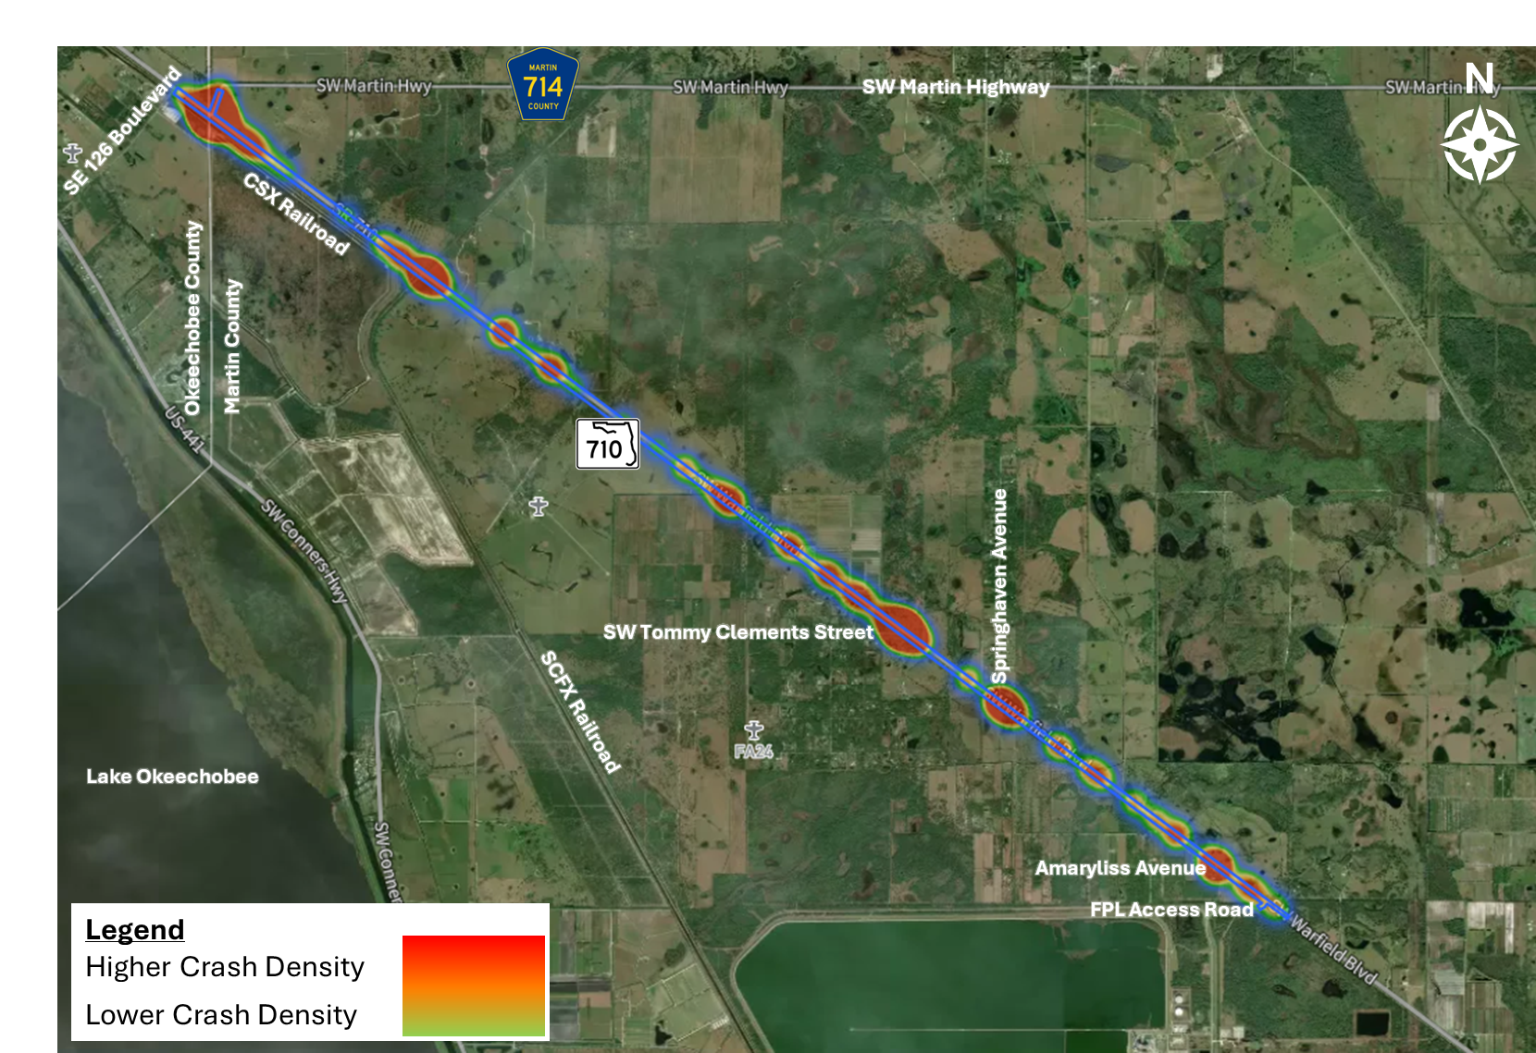


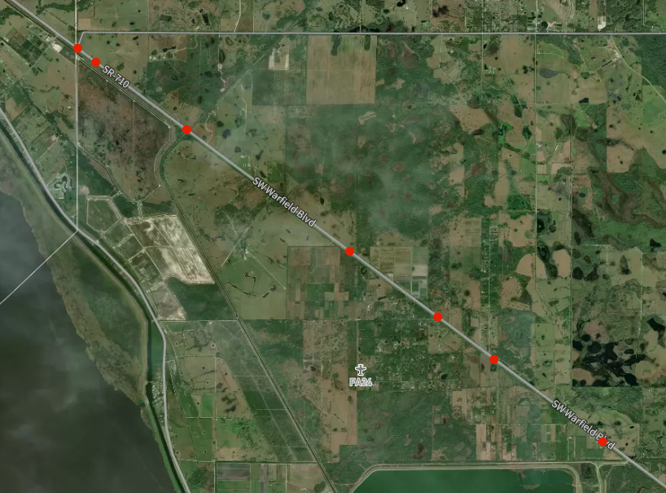
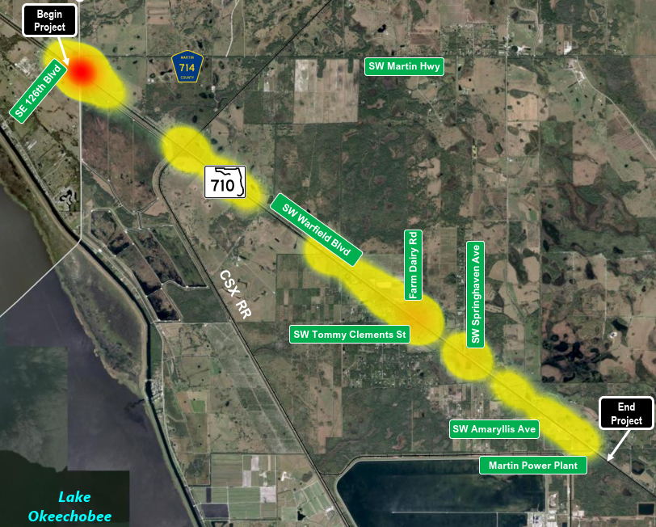

Traffic and Safety
Traffic Volumes
Truck % : 8% to 18%
Level of Service Target C (Outside Urbanized Area)
Currently exceeds target
Crashes
 | 2023
Peak Hour | 790
AADT | 9,400
Fatal Crash Locations
Crash Analysis
139 crashes (2019 – 2023)
  High crashes of 34 in 2021 and 2023
  7 fatal crashes, 38 injury crashes (9 serious)
  5 fatal involved trucks, 3 were head-on
  ABOVE IS FOR –2 ONLY, GODFREY TO UPDATE TO ADD IN -1
4

Slide 5






Proposed Goals
Proposed Improvements:
  Enhance mobility, safety, emergency access, and truck movement
  Enhance Strategic Intermodal System (SIS) connectivity in the region
  Connect SR 70 and Port of Palm Beachs
INCREASE CAPACITY
  From 2-lane undivided to a 4-lane divided facility
IMPROVE INTERSECTION
  Intersection realignment between Martin Highway and
  SE 126th Boulevard which will include adding a traffic signal
ACCOMMODATE TRAFFIC
  Intersection design will accommodate heavy truck traffic
PROVIDE SAFETY
  Address Safety Concerns
LOWER FATALITY RATE
  Eliminate fatalities (Target Zero) along SR 710
5

Slide 6
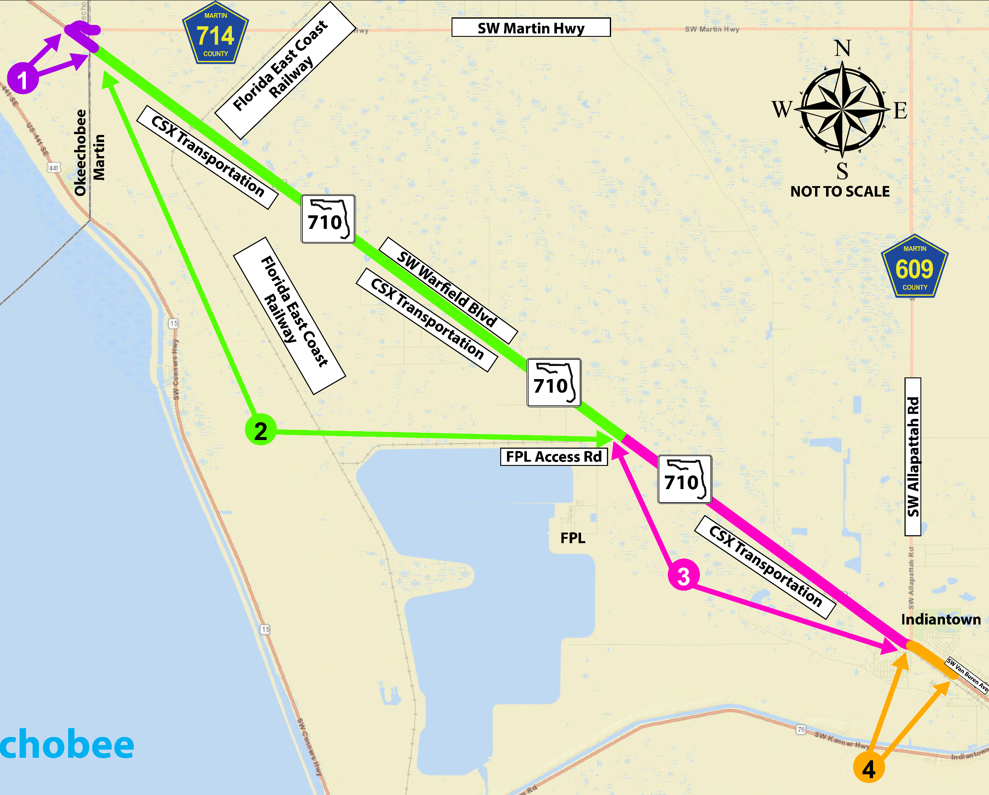
Corridor Overview
SR 710 from west of SE 126th Boulevard to Van Buren Avenue
Approximately 17.7 miles
Okeechobee and Martin Counties
Broken out into 4 segments
MAP LEGEND
1
Realignment of SW Martin Hwy/CR 714 to Intersect with SE 126th Blvd and SR 710. Add Lanes & Reconstruct SR 710 from West of SE 126th Blvd to Okeechobee/Martin County Line – Okeechobee County
2
Add Lanes & Reconstruct SR 710 from Okeechobee /
Martin County Line to FPL Access Rd – Martin County
3
Add Lanes & Construct SR 710 from FPL Access Rd to Allapattah Rd – Martin County
4
Add Lanes & Construct SR 710 from CR 609/Allapattah Rd to Van Buren Ave – Martin County
Lake Okeechobee
6

Slide 7


Looking Back
FDOT Completed
PD&E Study
Safety Study
Design commence for all segments
2011
2021
2024
Major Challenges
High Construction Cost
High Utility Relocation Cost
Stakeholder Challenges
Right-of-way Impact Cost
7

Slide 8
1
Realignment of SW Martin Hwy/CR 714 to Intersect with SE 126th Blvd and SR 710
Financial Project Identification Number (FPID) #: 447555-1 and -2
Realignment of SW Martin Hwy/CR 714 to Intersect with SE 126th Blvd and SR 710
Add Signal
FPID #: 453333-3
SR 710 from west of SE 126th Blvd to E of CR 714/SW Martin Hwy
8
Realignment of SW Martin Hwy/CR 714 to Intersect with SE 126th Blvd and SR 710
Add Lanes & Reconstruct SR 710 from West of SE 126th Blvd to Okeechobee/Martin County Line – Okeechobee County
Notes:
The purple portion highlighted on the screen covers FPID’s 447555-1, -2 & 453333-3 within both Okeechobee and Martin Counties. The proposed improvements include Realignment of SW Martin Hwy/CR 714 to Intersect with SE 126th Blvd and SR 710. Add Lanes & Reconstruct SR 710 from West of SE 126th Blvd to Okeechobee/Martin County Line

Slide 9

1
Corridor Schedule for Segment
June
2024
Realignment of SW Martin Hwy/CR 714
to Intersect with SE 126th Blvd and SR 710
4th Quarter
2025
2nd Quarter
2026
Design Starts
Initial Plans
Public Information Meeting
4th Quarter
2026
* Construction is currently funded for fiscal year 2030
4th Quarter
2028
Right-of-Way
Starts
3rd Quarter
2029*
Final Plans
Construction
Letting
Project schedule is subject to change.
PD&E Study for I-95 Widening from South of High Meadow Avenue to SR-70/Okeechobee Road | FM No. 422681-5-22-02 / 422681-6-22-02 | Ad No. 25442/43
9
9
* Construction Letting is currently funded for fiscal year 2030.
Notes:
These Design Segments are currently ongoing
Right-of-Way is scheduled for 2026
Utility Relocation is scheduled for 2029
Construction is scheduled for FY 2030

Slide 10
2
SR 710 from CR 714 to Martin FPL Power Plan Rd
FPID: 453333-2
SR 710 from Okeechobee/Martin County Line to FPL Access Rd
9.771 miles
10
Notes:
We going to focus on the -2 segment. _2 extends from Okeechobee/Martin County Line to FPL Access Rd within Martin County

Slide 11
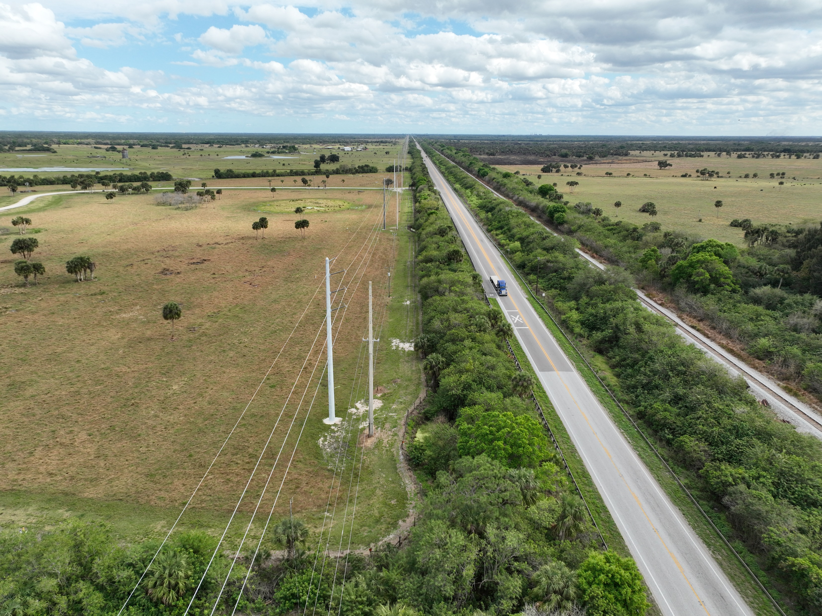





Existing Conditions
SR 710/SW Warfield Blvd is an existing two-lane (one lane in each direction), undivided, east/west roadway
Posted speed limit: 60 mph
Functional classification: Rural Principal Arterial
FPL TRANSMISSION
FPL DISTRIBUTION (To be replaced with new transmission poles)
GAS MAIN
Fiber
GAS MAIN
11

Slide 12




Key Stakeholder Coordination
South Florida Water Management District (SFWMD)
  Joint Agency Meeting to discuss permit criteria
FEC Railway
  Met to discuss impacts of future rail improvements
CSX Transportation
  Met to discuss right-of-way impacts
FPL Transmission
  Disposition of easement and potential impacts
Martin County
  Construction & Maintenance Agreement
12

Slide 13
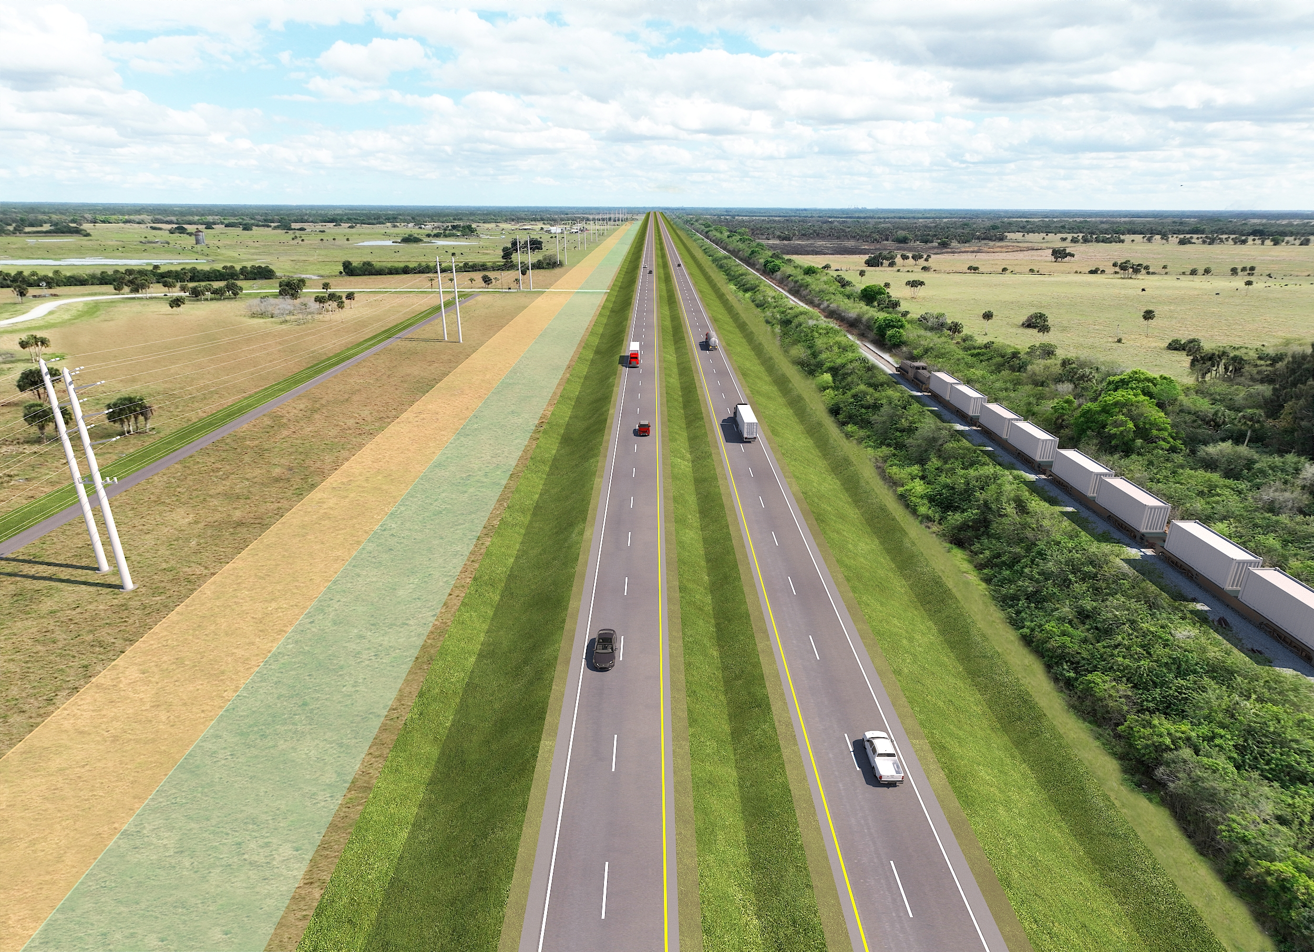
PD&E Typical Section
CHALLENGES
FPL Transmission Relocation
  Time consuming process
  Escalated costs
Right-of Way Needs
  276.560 ac
  3 Business Relocations
65 MPH/4-lane Divided/SIS Rural Principal Arterial
  C-2 Context Classification
  Class 3 Access
Shared Use Path (SUP) and Interceptor Ditch
3
1
2
3
2
Eastbound
Westbound
1
3
40 FT
40 FT
100 FT
50’
50’
40’
(2) 12’
MEDIAN
(2) 12’
40’
VARIES 100’ – 200’
SUP
& INTERCEPTOR DITCH
RELOCATION EASEMENT
EXIST EASEMENT
EXIST EASEMENT
BORDER
LANES
LANES
BORDER
CSX R/W
12’ SHLD.
(5’ PAVED)
12’
SHLD.
(4’ PAVED)
12’ SHLD.
(5’ PAVED)
13
Notes:
Big picture; FDOT R/W290

Slide 14
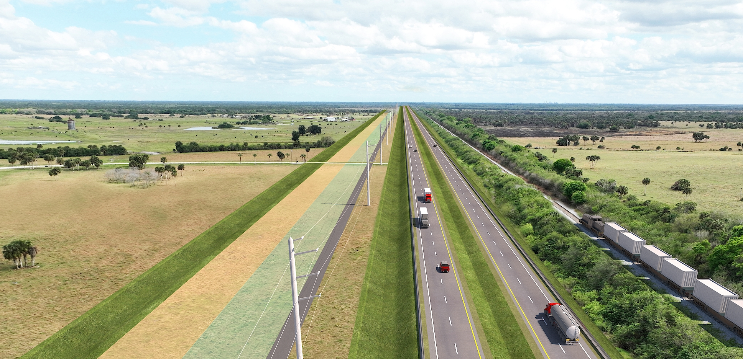
Proposed Typical Section
Convert Exist 2-lane 2-way to New EB Roadway
Avoid reconstruction
Reduce new Impervious Area
Keep Exist Cross Drains
Dry Swale in FDOT R/W
Avoid FPL Relocation
BENEFITS
Avoid FPL relocation
No business relocations anticipated
Reduce construction costs
Reduce stormwater treatment
Reduce wetland impacts
REFINEMENTS
1
2
3
Westbound
Eastbound
2
3
1
40 FT
VARIES 100’ – 200’
40’
50’
(2) 12’
MEDIAN
(2) 12’
CSX R/W
50’
20’
25’ – 30’
40’
5’ -40’
INTERCEPTOR DITCH
EXIST EASEMENT
EXIST EASEMENT
SUP
BORDER
LANES
LANES
BORDER
12’ SHLD.
(5’ PAVED)
12’
SHLD.
(4’ PAVED)
12’ SHLD.
(5’ PAVED)
Notes:
Reduced FDOT 196’

Slide 15
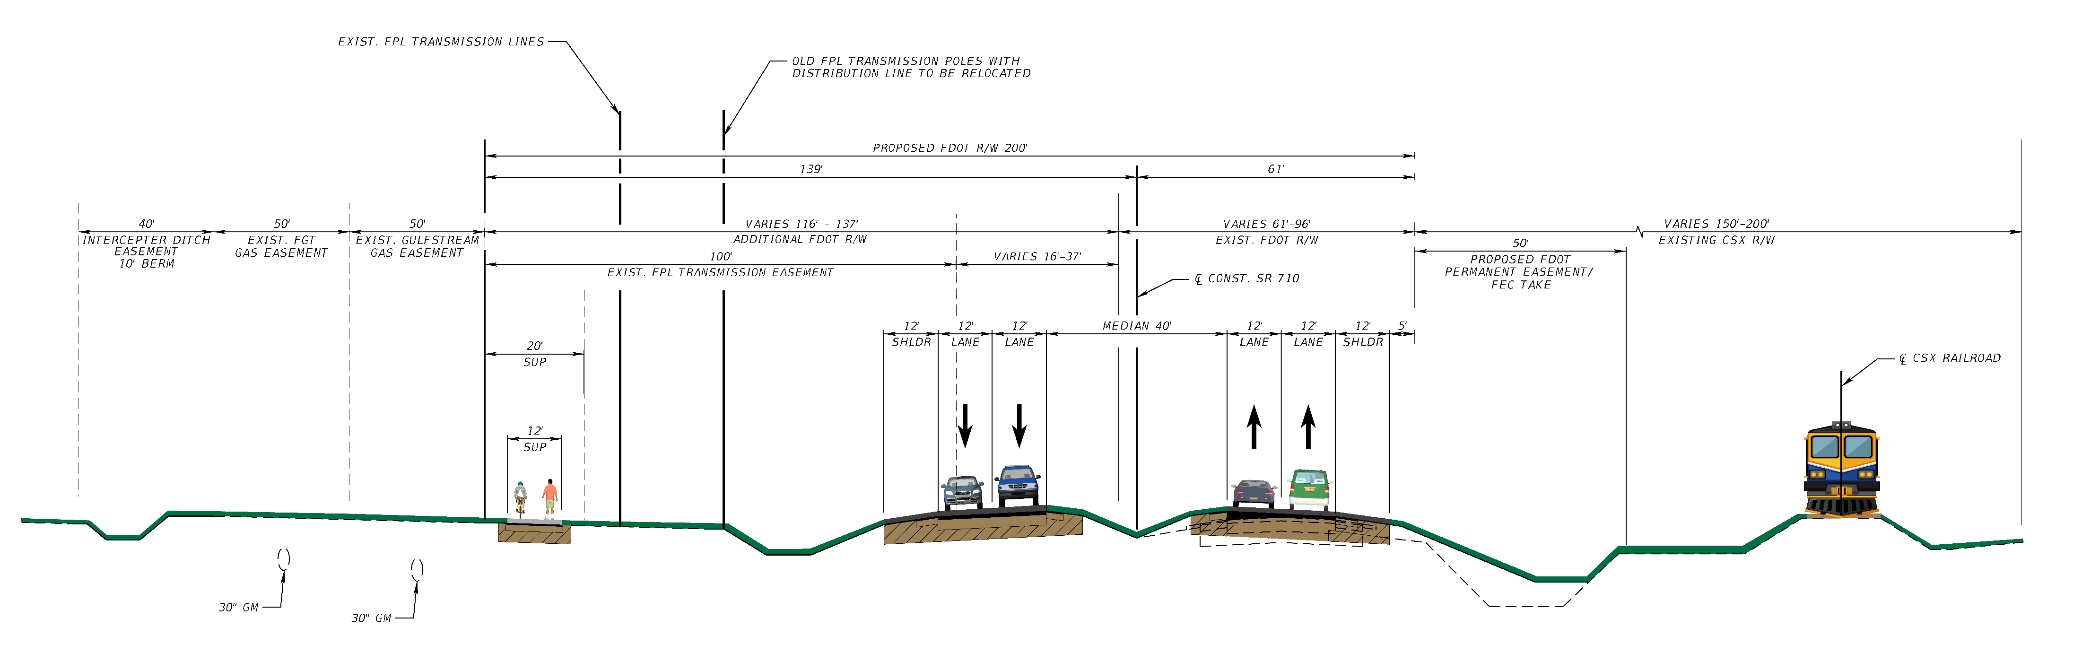
Proposed Typical Section
Stakeholder coordination
    High construction costs
    Construction & Maintenance Agreements:
      Interceptor ditch
      Shared use path
      Frontage road
EXISTING FDOT R/W
NEW FDOT R/W
Challenges:
FPL EASEMENT (Subordination of FPL Transmission to FDOT)
CSX R/W OF INTEREST TO FDOT
INTERCEPTOR DITCH CONSTRUCTION AND MAINTENANCE EASEMENT
15
Notes:
Four Lanes Divided Roadway (Two Lanes in each direction)​
65 mph Design Speed​
Strategic Intermodal System (SIS)​
Rural Principal Arterial​
C-2 Context Classification

Slide 16
2
Corridor Schedule for Segment
June
2024
SR 710 from CR 714 to FPL Access Rd
4th Quarter
2025
Design Starts
4th Quarter
2026
Initial Plans
1st Quarter
2027
1st Public Info Meeting
Right-of-Way
Starts
4th Quarter
2028
Utility Relocation Starts
* Construction is currently not funded
3rd Quarter
2029
2nd Public Info Meeting
2nd Quarter
2030
Final Plans
3rd Quarter 2030*
Construction Letting
Project schedule is subject to change.
PD&E Study for I-95 Widening from South of High Meadow Avenue to SR-70/Okeechobee Road | FM No. 422681-5-22-02 / 422681-6-22-02 | Ad No. 25442/43
* Construction Letting is currently funded for fiscal year 2030.
Notes:
2 public meetings: before R/W and after R/W: combine between -1 and -2
^{Utility relocation starts}

Slide 17
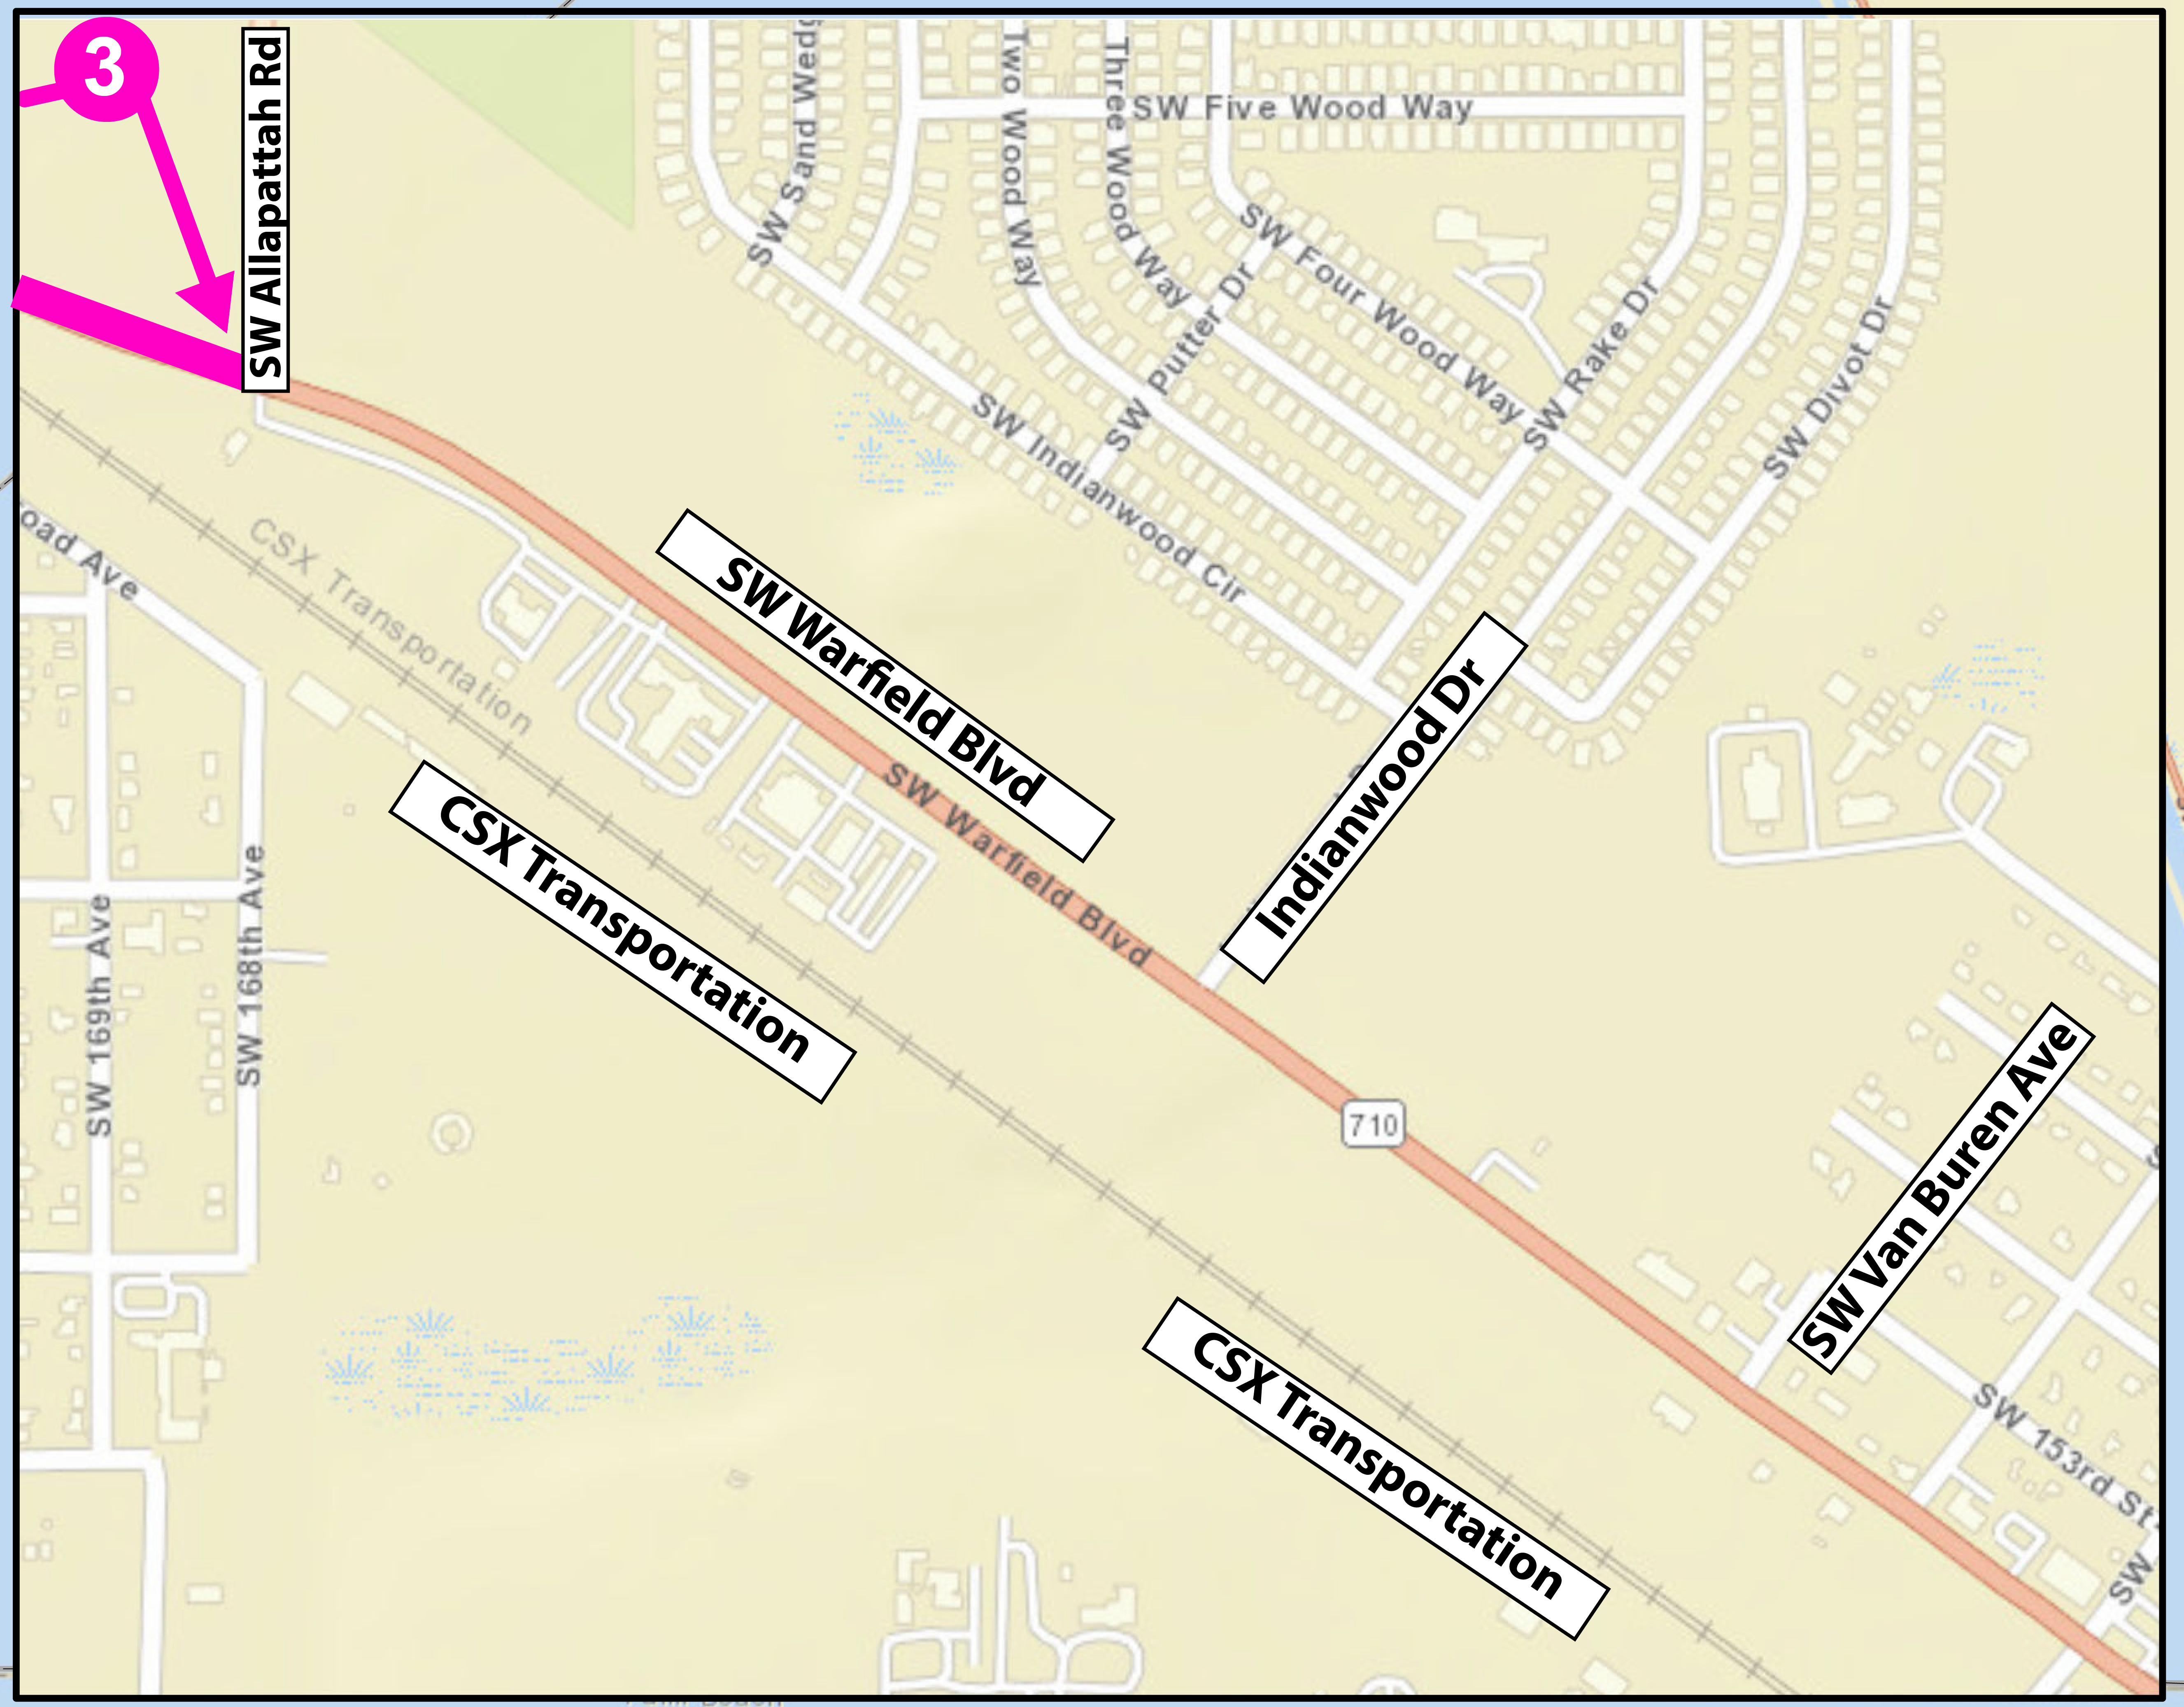
3
SR 710 from FPL Access Rd to Allapattah Rd
FPID: 453333-1
SR 710 from FPL Access Rd to Allapattah Rd
5.201 miles
17
Notes:
We going to focus on the -2 segment. _2 extends from Okeechobee/Martin County Line to FPL Access Rd within Martin County

Slide 18
3
Corridor Schedule for Segment
May
2024
SR 710 from FPL Access Rd to Allapattah Rd
4th Quarter
2025
4th Quarter
2026
Design Starts
Initial Plans
Public Information Meeting
1st Quarter
2027
Right-of-Way
Starts
* Construction is currently not funded
3rd Quarter
2030
1st Quarter 2031*
Final Plans
Construction
Letting
Project schedule is subject to change.
PD&E Study for I-95 Widening from South of High Meadow Avenue to SR-70/Okeechobee Road | FM No. 422681-5-22-02 / 422681-6-22-02 | Ad No. 25442/43
18
18
* Construction Letting is currently funded for fiscal year 2030.
Notes:
Appraisal date?

Slide 19
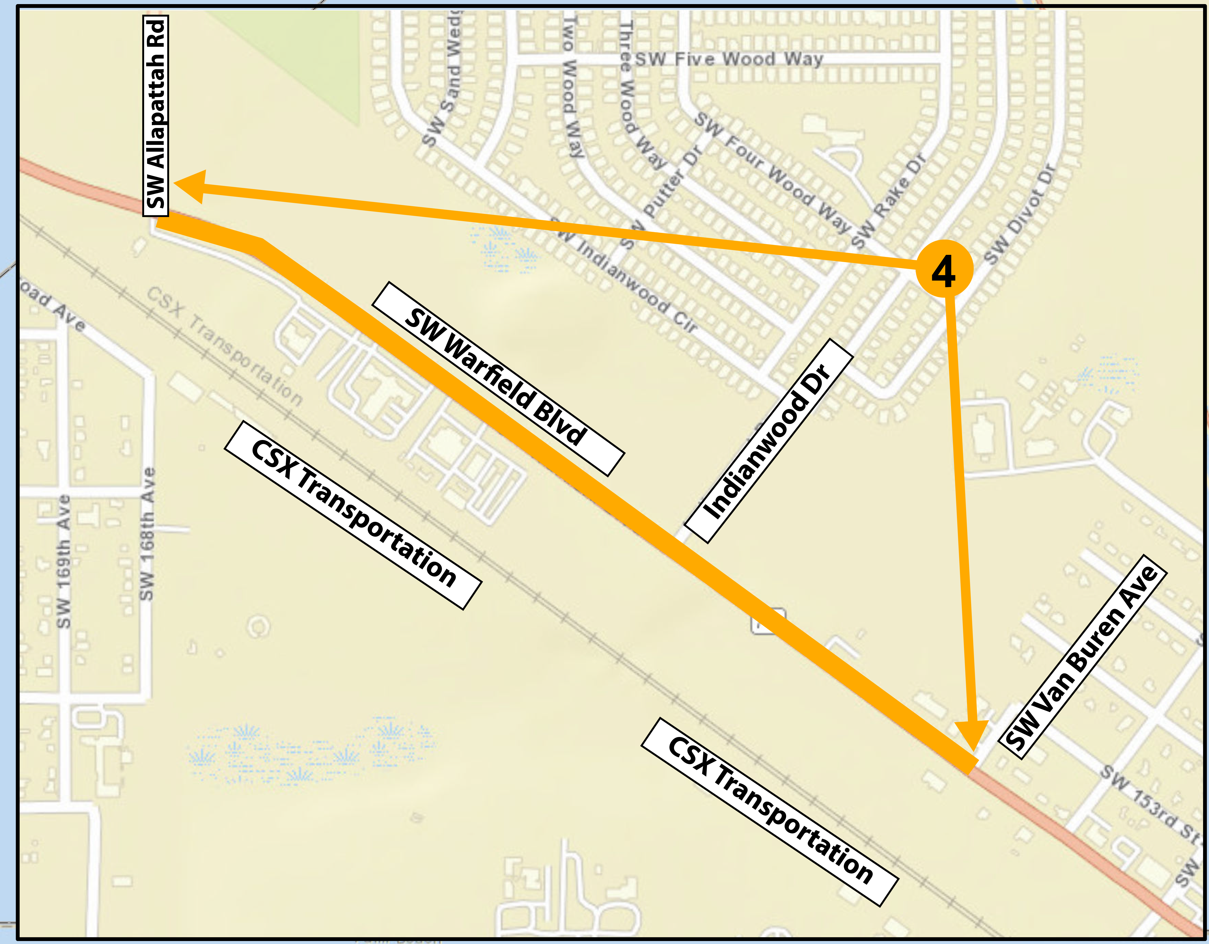
4
SR 710 from CR 609/Allapattah Rd to Van Buren Ave
FPID: 453333-4
SR 710 from CR 609/Allapattah Rd to Van Buren
0.770 miles
19
Notes:
We going to focus on the -2 segment. _2 extends from Okeechobee/Martin County Line to FPL Access Rd within Martin County

Slide 20
4
Corridor Schedule for Segment
May
2024
SR 710 from CR 609/Allapattah Rd to Van Buren Ave
4th Quarter
2025
1st Quarter
2027
Design Starts
Initial Plans
Public Information Meeting
1st Quarter
2027
Right-of-Way
Starts
* Construction is currently not funded
3rd Quarter
2027
July 2029*
Final Plans
Construction
Letting
Project schedule is subject to change.
PD&E Study for I-95 Widening from South of High Meadow Avenue to SR-70/Okeechobee Road | FM No. 422681-5-22-02 / 422681-6-22-02 | Ad No. 25442/43
20
20
* Construction Letting is currently funded for fiscal year 2030.
Notes:
Appraisal date?

Slide 21

National Distracted Driving Awareness Month
21

Slide 22


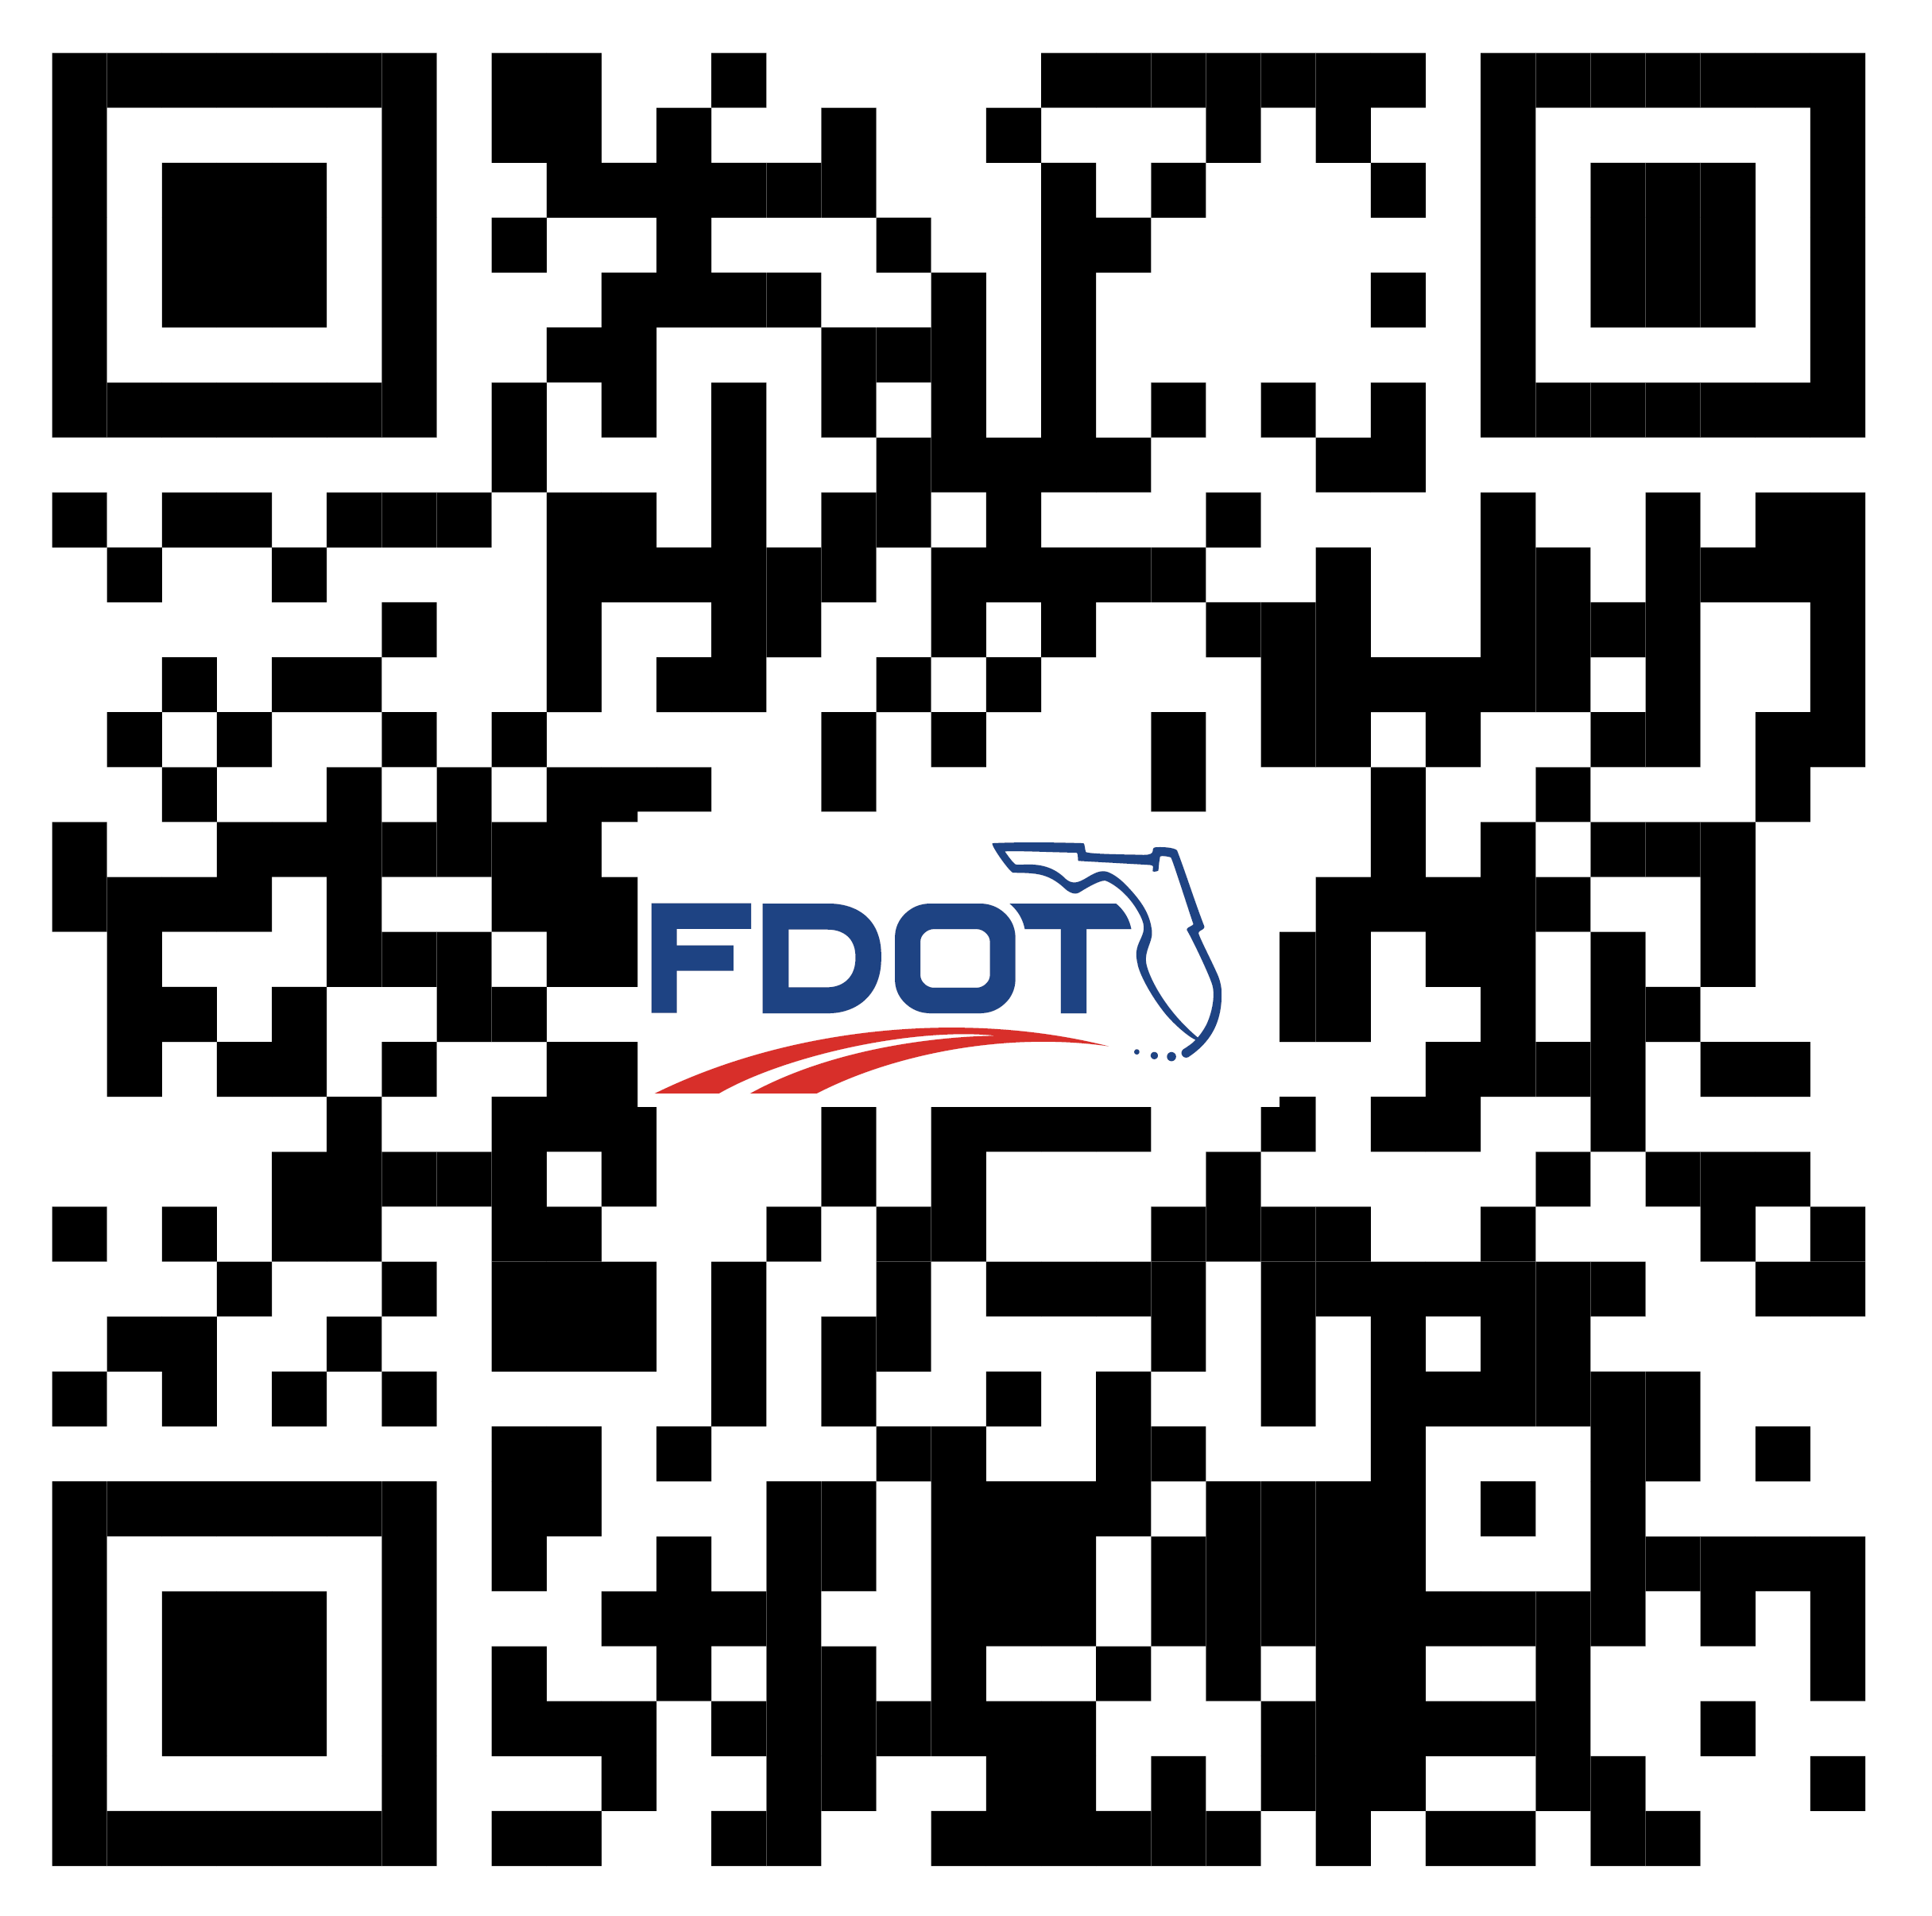
Contact Information
Robert Lopes, P.E.
Florida Department of Transportation (FDOT) Project Manager
FDOT District Four
3400 West Commercial Boulevard
Fort Lauderdale, FL 33309
robert.lopes@dot.state.fl.us
(954) 777-4425
Scan the QR Code to visit the project website at
https://www.d4fdot.com/tcfdot/sr_710_projects.asp for more information about this project or to sign up to be on the mailing list.
22

Slide 23
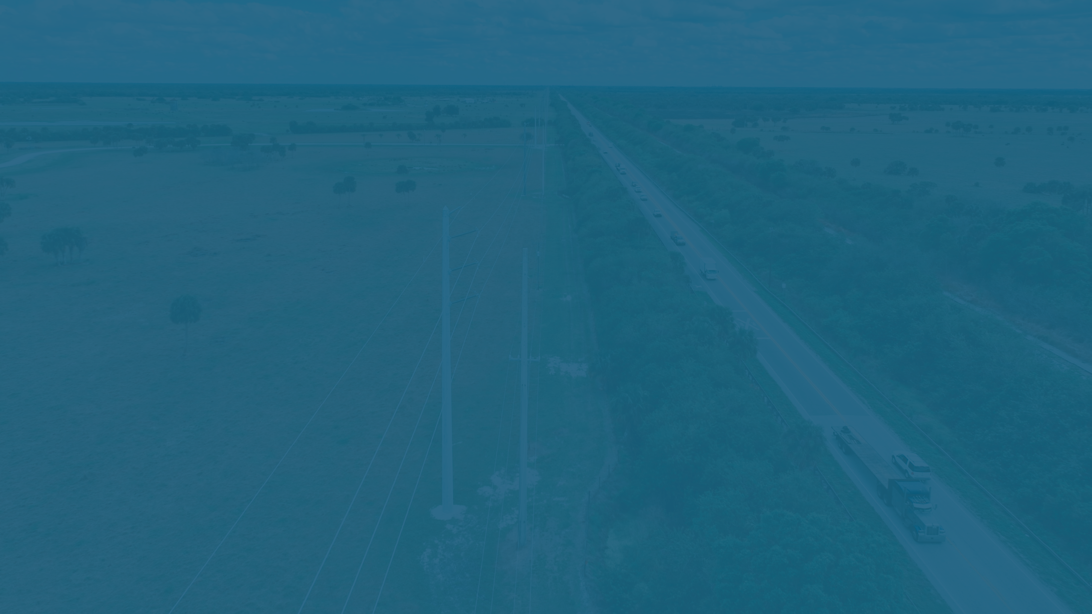

Questions / Comments
23

Slide 24
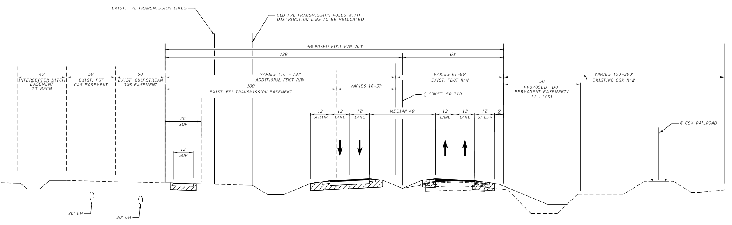
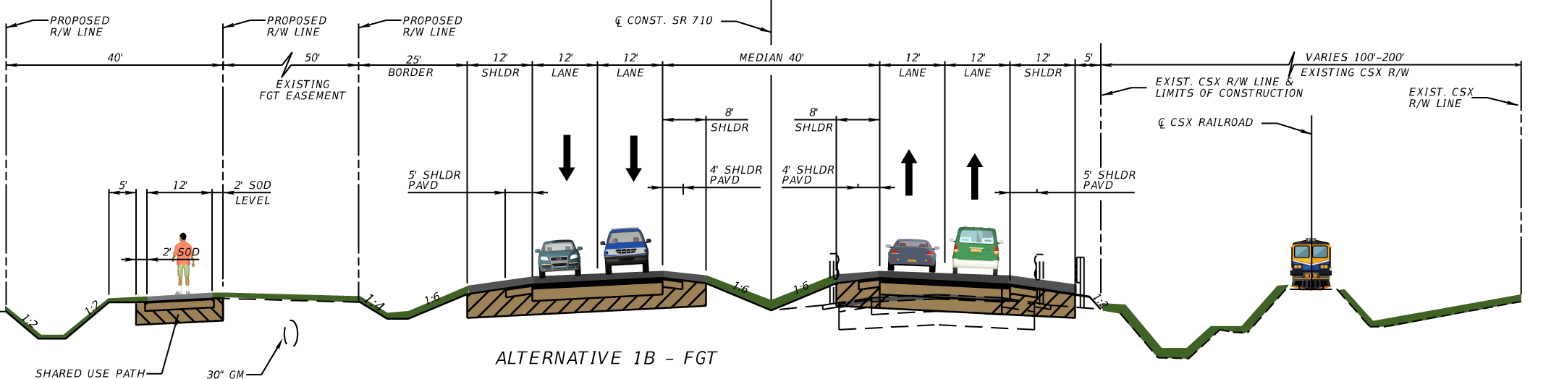
Proposed Typical Section
Stakeholder coordination
    High construction costs
    Construction & Maintenance Agreements:
      Interceptor ditch
      Shared use path
      Frontage road
EXISTING FDOT R/W
NEW FDOT R/W
Challenges:
FPL EASEMENT (Subordination of FPL Transmission to FDOT)
CSX R/W OF INTEREST TO FDOT
INTERCEPTOR DITCH CONSTRUCTION AND MAINTENANCE EASEMENT
24
Notes:
Four Lanes Divided Roadway (Two Lanes in each direction)​
65 mph Design Speed​
Strategic Intermodal System (SIS)​
Rural Principal Arterial​
C-2 Context Classification

