Slide 1
PSEE Utility Module
Overview for FDOT Staff
Presented by District Utility Staff

Slide 2
Purpose of the Utility Module
1 stop shop for Utility Staff – Inside and outside of the Department
Dashboard view for quick referencing
Assist in the sharing of utility documents internally and externally
Reminder alerts that attention/action is needed
Historical documents
Notes:
The purpose of the utility module in PSEE affects not just FDOT employees. This is the first module in PSEE that allows collaboration between FDOT and the industry staff. This module is a 1 stop shot for all parties. There is built in security to maintain the integrity of industry documents while being easy to use. It has a dashboard view for each area of the utility process. The utility module also assists in sharing of documents to the entire team and will be available for historical needs. This module also brought about another first in the form of reminder alerts that an item needs attention or an action performed. This is a feature every modules has needed but could not get.

Slide 3
Functional Areas
Viewing only
  Dashboard/Assignments
  PSM Scheduling
  OSP Permits
Input and View
  Plans
  Utility Work Schedule
  Agreements
  Invoices
  Subordinations
  Address Book
Notes:
The utility module is broken down by the functional areas related to the utility process. Some of these areas are for viewing information only. This will include the Dashboard/Assignment, PSM Scheduling and the OSP Permits areas. The other areas involve inputting data, documents and workflows for approval/response. This will include the Plans, Utility Work Schedule, Agreements, Invoices, Subordinations, and Address Book. We will cover each of these areas in depth through this presentation. The development of this Utility Module is almost like 8 modules in one compared to the rest of the application.

Slide 4
2 ways to get the work done
Project Level
  All functional areas for 1 specific project at a time
System Level
  Many projects for 1 functional area at a time
  Dashboard found at this level
Notes:
For those who are not familiar with PSEE, there are 2 ways to work. Its an option for everyone. There is the ability to work at a project level. This means you can work at multiple functional areas for ONE specific project at a time. OR there is the ability to work at a system level. This allows the option to work in one functional area for MANY projects at a time. There is not a right or wrong choice. Each of you will find your preference. And you will find your preference may changed depending on your needs.
It is important to remember the UAO representatives only work at the system level. They do not view at a project level.

Slide 5
WORKING AT A PROJECT LEVEL
Notes:
The first part of this overview will be at a project level. Think of that project that is near and dear to your heart. ☺ Go ahead and type that project into PSEE and open the Utility Module.
Again - It is important to remember the UAO representatives only work at the system level. They do not view at a project level.

Slide 6
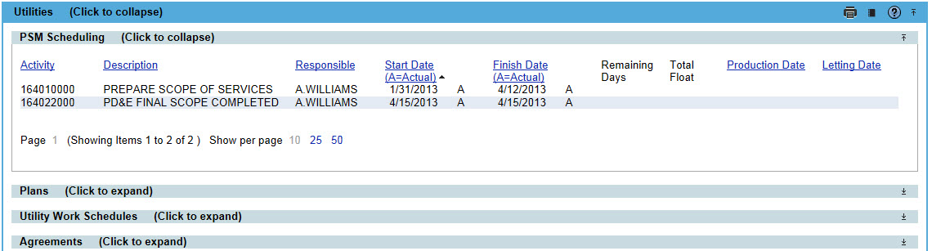
Project Level – PSM Scheduling
Activity | Description
205****** | Phase 56 Encumbrance
113****** | Roadway Plans
126****** | Utility Relocation
204****** | Production Date
228****** | Submit Utility Data
264****** | Utility Contact
265****** | Utility Pre-Design Conf
266****** | Utilities Certified
280****** | Letting Date
283****** | Open Design Build Bid
289****** | LAP Letting
851****** | Utility Depend Time to Prj Mgr
View Only – Changes are made in the Scheduling Module
As always – Blue headers mean the column is sortable
Filter to only a select group of activities that related to Utilities
Notes:
The first functional area is the PSM Scheduling. PSM stands for Project Schedule Management. It was the original software/database for the production project schedule. This is a filtered view of the PSM module in PSEE. The activities are filtered to just those that relate to or impact the Utility area. Included is a list of the activities. These activities can not be updated here. If that is part of your responsibility, you will need to do so in the Scheduling Module.

Slide 7
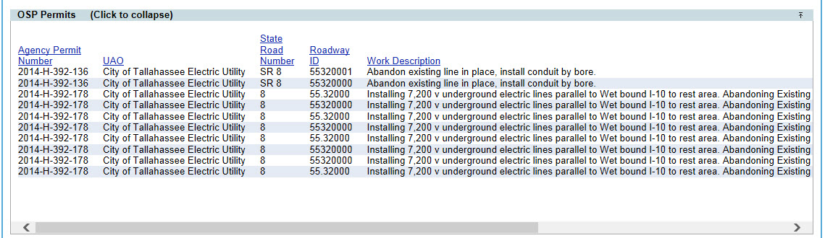
Project Level – OSP Permits
View only. PSEE users cannot update any data in the OSP Permit area.
  Information from the One-Stop Permitting (OSP) application.
The OSP Permit entries display most of the fields in OSP.
Currently going through an upgrade. When completed, this module will receive an upgrade.
Notes:
Just like the PSM area, the One-Stop Permitting (OSP) area is a view only. If you are required to log into OSP and enter data, you will continue to do that. This area is more for quick referencing or for those who don’t have log in privileges in OSP. You can find the status of permits or the description of the work to be done.
The OSP application is currently undergoing modifications. We hope to see the re-release of this application within the next year. Once the update is complete, PSEE will be updated as well to reflect the improvements.

Slide 8
FUNCTIONAL AREA
PROCESS OVERVIEW
User Creates Entry
Attach Documents
Add Reviewer(s) Assignment
PSEE sends email to Reviewer(s)
Reviewer(s) opens their Dashboard
Reviewer sends email to Utility Coordinator with their response.
Utility Coordinator opens entry and respective Reviewer
Reviewer attaches document(s) to entry & type details in the description
Response includes documents?
YES
NO
Utility Coordinator reviews attachment(s) and comments.
Response Acceptable?
Utility Coordinator updates Assignment Status to Complete
YES
NO
Utility Coordinator contacts the review who responded.
Notes:
This is a high level flow chart of how the creation and response for each functional area work.
To ensure the Utility PM/Coordinator received all the emails pertaining to the entries/responses, it is important for them to either:
subscribe to the projects they are responsible for to ensure they receive all emails pertaining to entries, or
Include themselves as an FYI on each entry.
A quick walkthrough of the process begins with a user creating the entry. They click “Create an Entry” and complete at least the required fields. Required fields are denoted with a triangle warning symbol next to them. While on this entry screen, the PM can attach the document(s). Documents must be upload 1 at a time. This is a EDMS restriction not a PSEE restriction. If more than one document is needed, the PM will add the first document and click save. Then view the entry to continue adding the remaining documents. Once ALL documents are loaded, reviewer(s) will be added. These reviewers can be assignment reviewers (meaning they have an action to perform) or FYI reviewers (meaning they are just being made aware). They can be FDOT staff, Consultants or UAO reps. The assignment for reviewers does require the entry of a due date. The due date controls the distribution of the reminder notifications which will be discussed later.
When reviewers are added and the entry is saved, PSEE send an email to each of the reviewers listed as well as the Utility Coordinator. The reviewer(s) will open their dashboard and click view on the entry they need to review. If there response is accompanied by a document they will attach the document.
It is important to not combined multiple documents into one. This requires others to perform extra steps to separate. It was told to the UAOs the same.

Slide 9
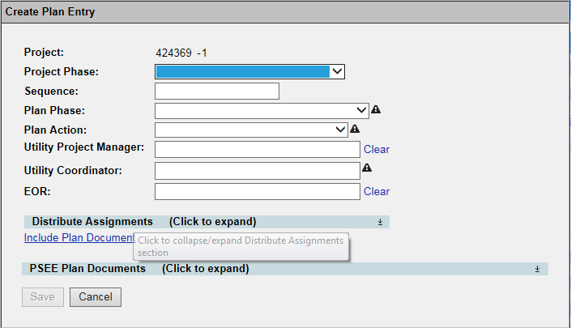
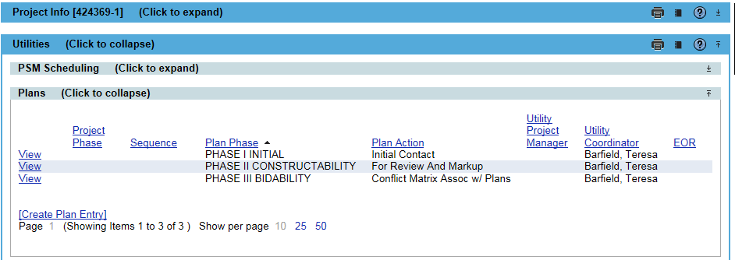
Project Level – Plans
Entry creation for each plan phase.
Attach documents such Plans, Utility Contact Letters, Utility Markups, Conflict Matrix.
Assignments to FDOT staff and UAO reps in the same entry.
Tracking of who, what and when information sharing.
Notes:
The Plans Functional area allows user to create entries for each Plans Reviews. Theses entries can be used to create assignments with UAOs and FDOT staff. The entries can contain items such as initial contact letters, request to review plans and request for markups. However this is not the limitations of this area. This area hold potential for researching prior phase submittals for comparison with latter or final phase submittals. Also the ability to search the final design submittal years later when its time for the next project.
UAOs, when assigned, will be able to respond by attaching a document such as their markups. The assignments for each UAO and/or FDOT staff can be tracked as to the status of responses.

Slide 10
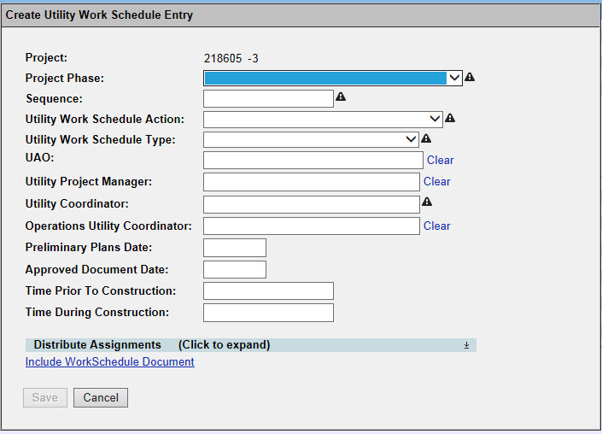
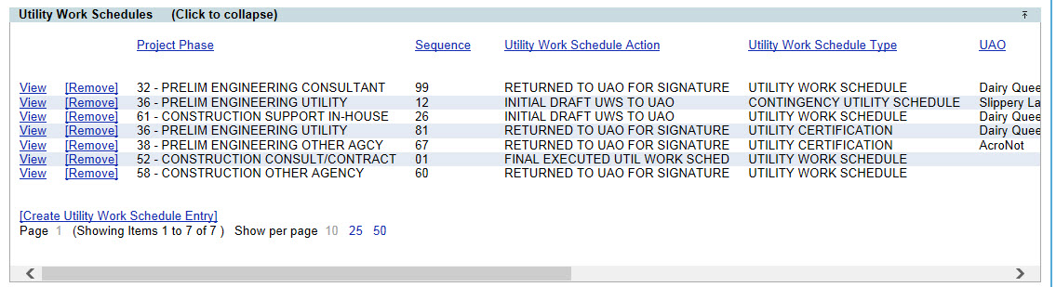
Project Level – Utility Work Schedules (UWS)
Allows a user to create assignments for both UAOs and FDOT staff to review Utility Work Schedules.
Once a Utility Work Schedules (UWS) is complete, assignments can be created for the UAO, EOR and DUA/E to sign off.
  Users will be able to provide certifications through this functional area as well.
UAOs will be able to respond to assignments by attaching their documents.
  These assignments can be tracked by UAO until all responses are received.
Notes:
The Utility Work Schedule (UWS) Functional area allows user to create entries for UAO to respond with their Work Schedules and Certifications.
Also a neat feature added here is a reminder email that there is work to be completed PRIOR to construction. When a UAO responds to an assignment and indicates that there is work to be done prior and during construction, the FDOT Utility Coordinator will input those days into this module. PSEE will automatically send the UAO Representative associated, Operations Utility Coordinator and the Utility Coordinator an email to reminder of the work to be completed prior to construction. The system rule to send the email is to add the number of days the UAO stated is needed PLUS 60 calendar days and then back up that many days from the letting date. FOR EXAMPLE: UAO needs 45 days. So the email will be sent 105 days BEFORE the Letting Date. Because there could have been several months/years between the submittal of the UWS and this reminder, this feature serves several purposes. (1) Maybe there is a need to pull permits or acquire materials before the work can. (2) Maybe the UAO representative is no longer with the Utility Company. Now the FDOT Utility Coordinator is also reminded to confirm the UAO is correct and update if not. (3) If the Letting Date in the FDOT Project Schedule is delayed or advanced, the reminder is sent at the correct time. This date is not based on a date set years ago but rather the most current and up to date schedule.
UAOs when assigned will be able to respond by attaching a document such as their markups. The assignments for each UAO and/or FDOT staff can be tracked as to the status of responses.

Slide 11
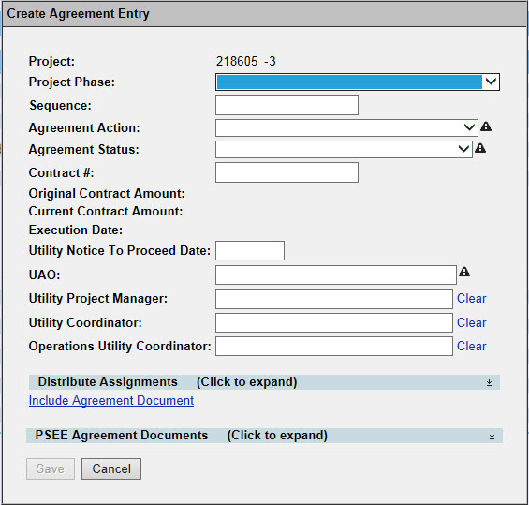
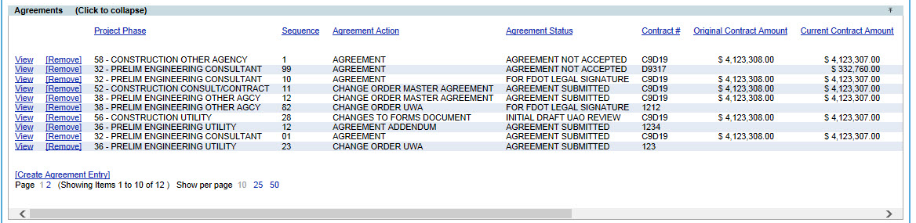
Project Level – Agreements
Allows an entry to create and track Agreement and the Review Assignments of both UAOs and FDOT staff
Once Agreements are ready for execution, assignments can be created for the UAO, DUA/E, Legal and Management to sign off.
  Users will be able to provide certifications through this functional area as well.
UAOs will be able to respond to assignments by attaching a document.
  These assignments can be tracked by UAO until all responses are received
Notes:
The Agreement area allows a user to create entries for UAO, Consultant or FDOT staff to track Utility Agreements. Also there is opportunity to search and view existing/previous entries. This area is 1 Utility Company to 1 Agreement entry relationship.
Slightly more security than the UWS, the only UAO users who can search and see the agreement area are those who are assigned as reviewers or FYI.
When you do search for information, there are fields of information displayed in addition to the search fields at the top. When entered by FDOT Utility Coordinator, the Utility Notice to Proceed date will appear. Also once a Contract # is associated to an Agreement, the Current Contract Amount and the Contract Execution Date are visible. This information is pulled from the FDOT system used for contract management and payment. Again I want to stress UAO Representatives can only see information for entries where they have an assignment.

Slide 12
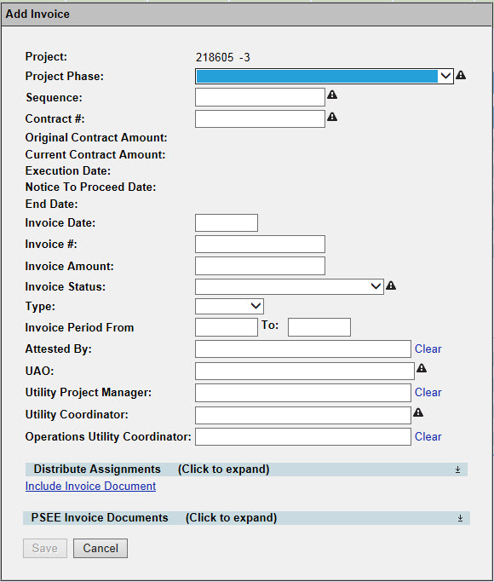
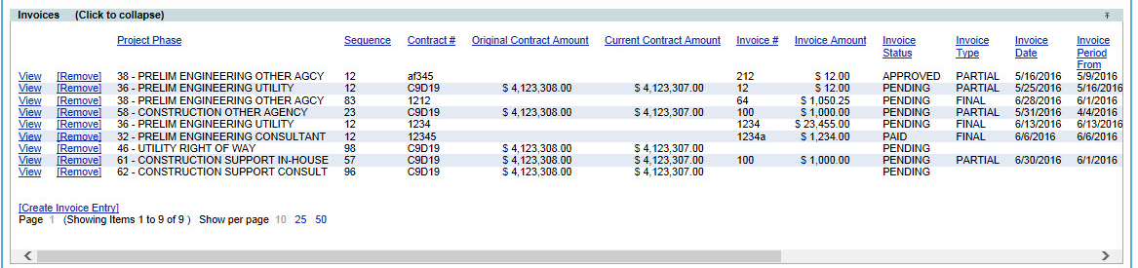
Project Level – Invoices
Allows a user to create assignments for both UAOs and FDOT staff to review Invoices.
Once Invoices are ready for submittal, assignments can be created for the UAO and DUA/E. This includes returning invoices for corrections, and alerting a UAO that an invoice has been processed for payment.
  This also includes being able to route an invoice for review to multiple FDOT staff if applicable.
Notes:
The Invoices area allows a place to request, submit and store Utility Invoicing. There is also the opportunity to search and view existing/previous entries. . This area is 1 Utility Company to a Invoice entry relationship.
Just as the security in the Agreements area, the only UAO users who can search and see the agreement area are those who are assigned as reviewers or FYI.
When you do search for information, there are fields of information displayed in addition to the search fields at the top. When entered by FDOT Utility Coordinator, the Utility Notice to Proceed date will appear. Also the Contract #, the Current Contract Amount, the Contract Execution Date and the End Date of the contract are visible. This information is pulled from the FDOT system used for contract management and payment.
As stated at the beginning of this presentation, the only way a UAO Representative can upload documents in this system is through an assignment. UAO representatives can not create assignments. It is understood that makes this area a little tricky as the UAO is usually the one beginning the invoicing process. As a way to facilitate this part, it was recommended to FDOT staff to create an entry and assignment as soon as a contract number is given. This assignment will most likely have a due date of 60 days prior to the contract end date and is be MANY years down the road. The assignment will stay on Assignee’s Dashboard at the bottom. As the due date gets closer, the assignment will move up the list of ‘to dos’. This was recommended for several reasons. (1) It gives an assignment to respond to when the UAO Representative is ready to invoice. If it a partial invoice, the FDOT Utility Coordinator can update the type to partial and then create an new assignment for the UAO Representative to respond with either another partial or the final invoice, which ever is applicable. (2) Maybe the UAO representative is no longer with the Utility Company. Now the FDOT Utility Coordinator is also reminded to confirm the UAO is correct and update if not. (3) This also is a chance to remind the UAO Representative to invoice. (4) If more time is needed, this gives the FDOT Utility Coordinator time to request an extension BEFORE the contract expires. Again this was a recommendation. If the district(s) does not create these assignments ahead of time, the UAO Representative will simply email or snail mail the invoice to FDOT.

Slide 13
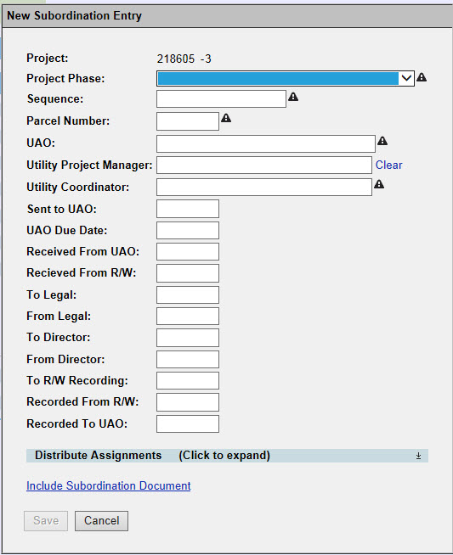
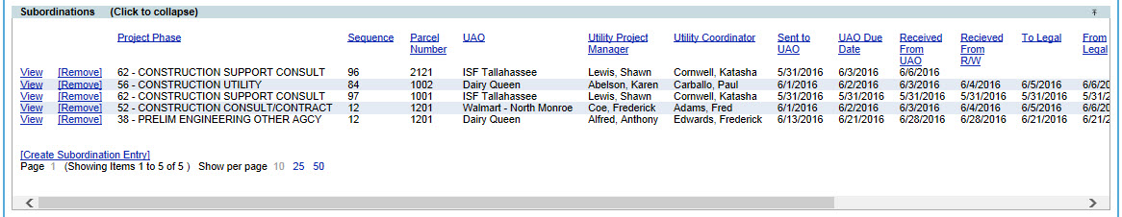
Project Level – Subordinations
Allows a user to create assignments for both UAOs and FDOT staff to review Subordinations.
Once Subordinations are ready for execution, assignments can be created for the UAO, DUA/E, Legal and Management to sign off.
  This includes returning Subordinations for corrections, and alerting a UAO that Subordinations have been recorded. This also includes being able to route Subordinations for review to multiple FDOT staff if applicable.
Notes:
The Subordination area allows to request, submit and store of Utility Subordinations. There is also the opportunity to search and view existing entries. This area is 1 Utility Company to a Invoice entry relationship.
Just as the security in the Agreements area, the only UAO users who can search and see the agreement area are those who are assigned as reviewers or FYI.
While developing this area, it was found statewide the districts used all of the date fields EXCEPT the to and from Director. Some districts use this area while some districts have that time lumped in with the time the Subordination is in the Legal office. This is because the Legal staff is responsible for routing the document through the Director’s office.
It was also determined that each subordination entry will have a minimum of 2 documents attached. The first document will be the blank Subordination that is sent for the UAO Representative to sign. The instructions will be something similar to “Please print and return a hardcopy with your original signature.” The second document will be the final recorded Subordination that is sent to the UAO Representative for their records. This will be a scanned copy with the OR Book and Page information. There could be additional document but these 2 will be the normal. There will not necessarily be an assignment for the UAO Representative to respond to through this area. The UAO Representative’s assignment status will be updated when FDOT receives the signed hardcopy.

Slide 14
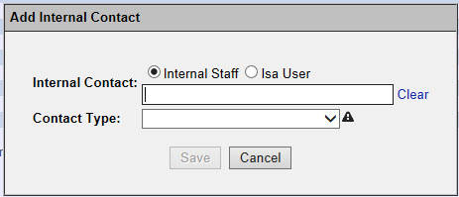
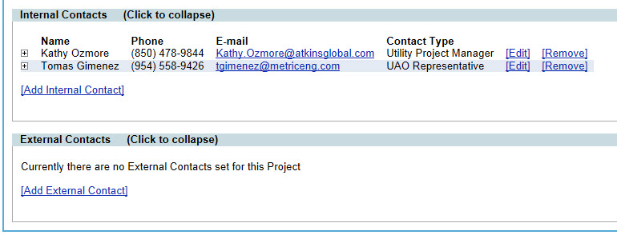
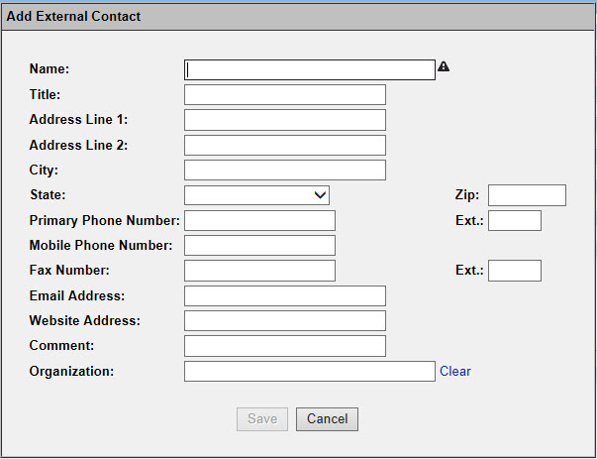
Project Level – Address Book
Allows contact information to be added about people or organizations that are involved with a project.
There are 3 types of contacts to search:
  Internal users are those who have a user-id. This could include consultants who work for the department.
  Isa Users are those who log in with an Internet Subscriber Account. This will be Utility Representatives.
  External users are those who do not have access to log into PSEE. This will be users who do not have an ISA account but their contact information is associated. This could also include the overall company information for the UAO(s) on the project.
Notes:
The address book function area allows the opportunity assign a user to a project as well as search and view people or organizations who have been identified as being associated to one or more projects.
There are 3 types of contacts to search:
Internal users are those who have a user-id. This could include consultants who work for the department.
Isa Users are those who log in with an Internet Subscriber Account. This will be Utility Representatives.
External users are those who do not have access to log into PSEE. This will be users who do not have an ISA account but their contact information is associated. This could also include the overall company information for the UAO(s) on the project.
You will be able to view the email, phone and address of the contact. The email address will be clickable to automatically open a new email message.

Slide 15
WORKING AT A SYSTEM LEVEL
Notes:
Users can work at a system level. Again this means 1 functional area for MANY projects.

Slide 16
System Level â€“ Overview
Dashboard found here
Same ability to create new entries
Search across the application
Search results are exportable
Notes:
At a system level is where the Utility Dashboard is found. This is the list of pending assignments for a user.
Also at a system level, users with the privilege(s) can create entries. The difference will be the project number (Item / Item Segment) will NOT be prepopulated.
Searches for information already in the system are available at the system level and are exportable to Excel.

Slide 17
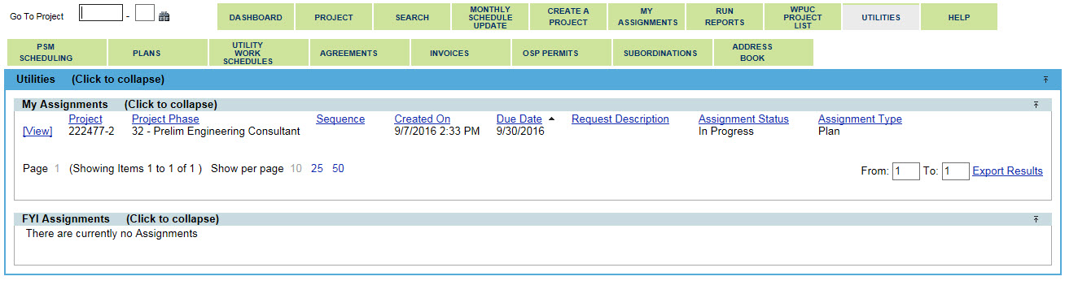
Dashboard – My Assignments
Notes:
The dashboard is the first screen that appears. Listed here will be any assignments for you. Also any items you have been FYIed on. You will notice your name in the top corner with an icon for your user profile.
There is a tab for each functional area. To return to the Dashboard after you navigate to another area, just click on the Utility tab in the top line. Also there is a help tab.
As you move through the functional areas, you will be able to see the repetition and consistency in design. This was specifically designed to lessen the amount a user had to change from area to area.

Slide 18
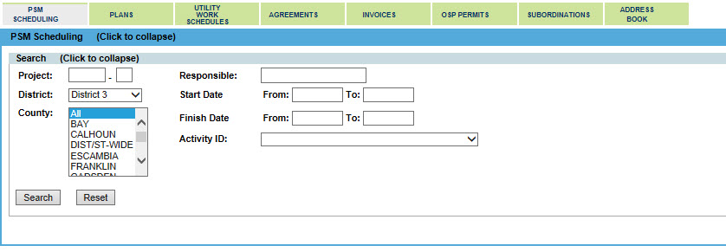
System Level - PSM
Notes:
Beginning with the easy tabs, the first functional area is the PSM Scheduling. This area is a filtered view of the Project Schedule Management or PSM system. The activities are filtered to just those that relate to or impact the Utility area. Included in the slide is a list of the activities. These activities numbers are standard for FDOT however the descriptions of them may vary from district to district. These activities can not be updated here.
Searches can be performed for a few or as many filters.
Reminder the activities are limited to those related to the Utility process. This will pull scheduling information from the dawn of time.
Make sure to click the “RESET” button to clear search criteria. The number of results displayed can be 10, 25 or 50. Also results can be exported. There is a limit of 500 results per export. If there are more than 500. Export 1 to 500 THEN 501 to 1000, etc.

Slide 19
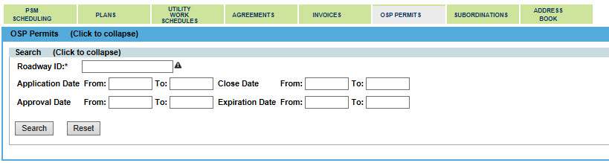
System Level - OSP
Notes:
Just like the PSM area, the One-Stop Permitting (OSP) area is a view only. If you are required to log into OSP and enter data, you will continue to do that. This area is more for quick referencing or for those who don’t have log in privileges in OSP. You can find the status of permits or the description of the work to be done.
The OSP application is currently undergoing modifications. We hope to see the re-release of this application within the next year. Once the update is complete, PSEE will be updated as well to reflect the improvements.
Make sure to click the “RESET” button to clear search criteria. The number of results displayed can be 10, 25 or 50. Also results can be exported. There is a limit of 500 results per export. If there are more than 500. Export 1 to 500 THEN 501 to 1000, etc.

Slide 20
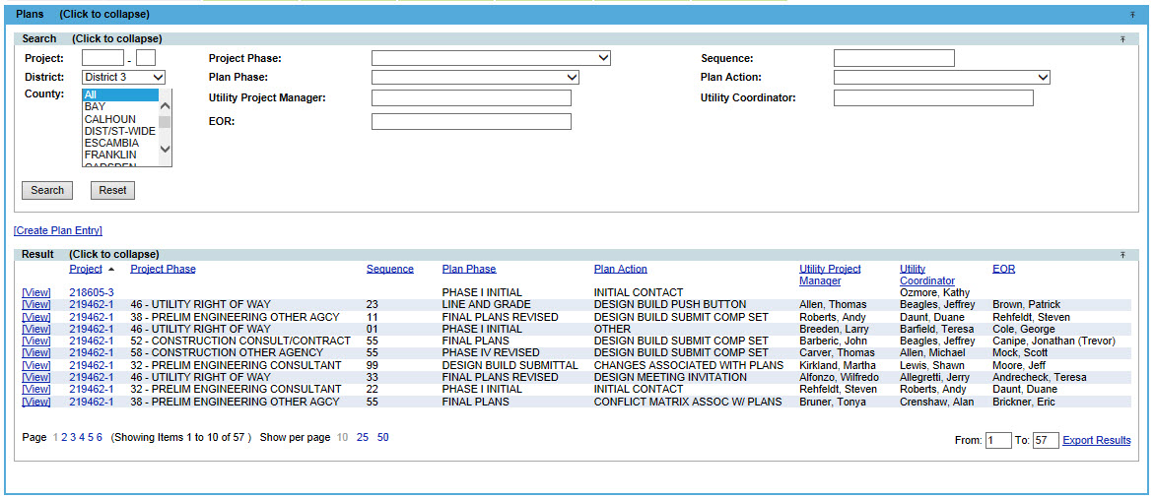
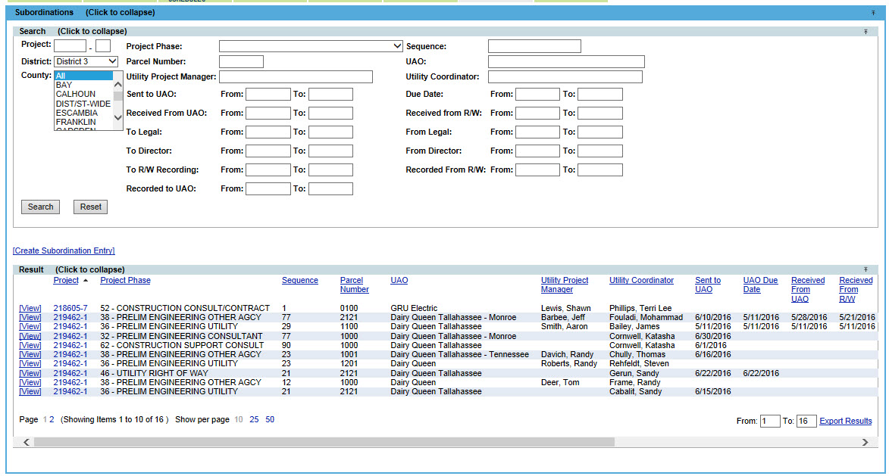
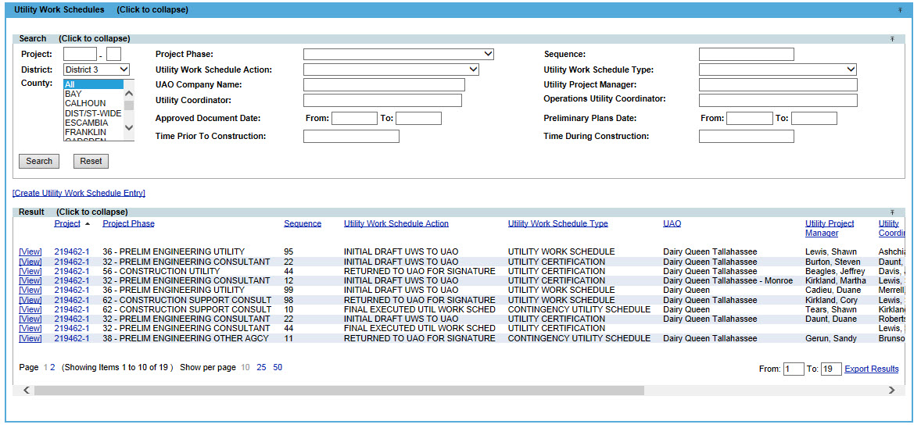
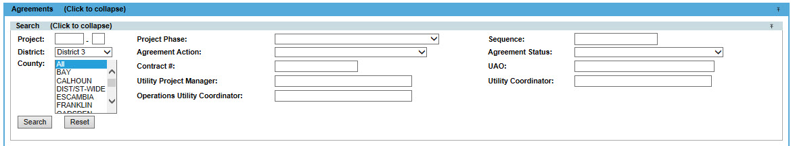
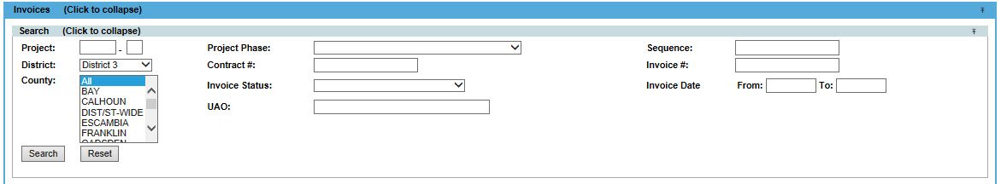
System Level – Plans, Work Schedules, Agreements, Invoicing and Subordinations
Notes:
The Functional areas of Plans, Agreements, Invoicing, and Subordinations at the system level are mostly for the UAO Representatives or for searching capabilities. Users with the privileges can also create entries at the system level. The Project numbers in the search results are hyperlinks to the project level. Included here is a screenshot of each functional area.
You will notice these comments apply to all areas and will be repeated throughout this presentations. Make sure to click the “RESET” button to clear search criteria. The number of results displayed can be 10, 25 or 50. Also results can be exported. There is a limit of 500 results per export. If there are more than 500. Export 1 to 500 THEN 501 to 1000, etc.

Slide 21
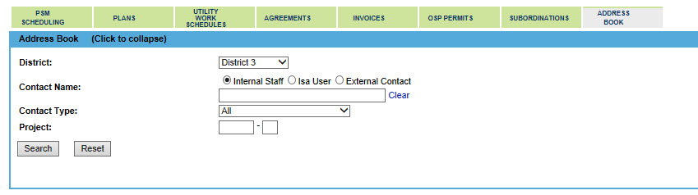
System Level – Address Book
Notes:
The address book function area allows the opportunity assign a user to a project as well as search and view people or organizations who have been identified as being associated to one or more projects.
There are 3 types of contacts to search:
Internal users are those who have a user-id. This could include consultants who work for the department.
Isa Users are those who log in with an Internet Subscriber Account. This will be Utility Representatives.
External users are those who do not have access to log into PSEE. This will be users who do not have an ISA account but their contact information is associated. This could also include the overall company information for the UAO(s) on the project.
You will be able to view the email, phone and address of the contact. The email address will be clickable to automatically open a new email message.

Slide 22
Working As an Admin
Notes:
The Utility Module also is the first module to have Functional Admins. This means we gave admin rights to the Utility module to Utility Experts in each district.
Utility Admins have 3 responsibilities:
Grant privileges to FDOT users and Consultants who do work on FDOT’s behalf.
Maintain the contact information for Utility Companies that partner with FDOT.
Maintain the association between UAO Representatives who sign up with ISA accounts and the Utility Company they work for.
The Utility Admins are also the first contact for UAO Representatives and other users of the Utility Module.

Slide 23

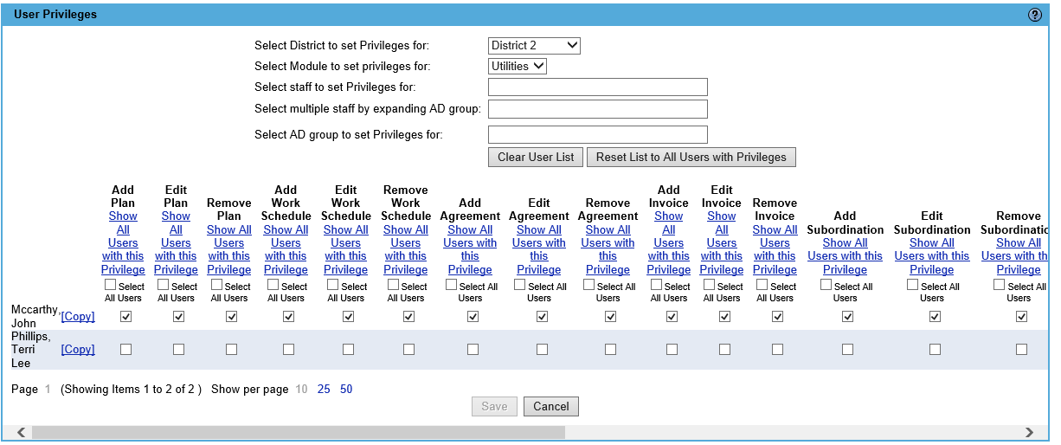
Granting Privileges
Notes:
If you are a Utility Admin, the title and a wrench icon will be next to your name in the top right corner.
To Grant Privileges, the Admin will click on the wrench to open the User Privilege screen. The screen will be defaulted to the district and the module they can assign in.
There are a few ways to select users that require privileges. The options are individual users and by AD group.
By individual user: Enter the first or last name of the user that requires privilege(s). As you type, a list will appear with all potential matches. Select the correct person.
By AD Group: Enter the name of AD group that contains the user(s) who require privilege(s). As you type, a list will appear with all potential matches. Select the correct group.
The selected person’s current privileges for the utility module will display. A check indicates the person has privilege to perform an action; a blank box indicates they cannot perform the action.
Select and deselect the privileges you would like the selected user to have. An explanation of each of these privileges is in the help document.

Slide 24
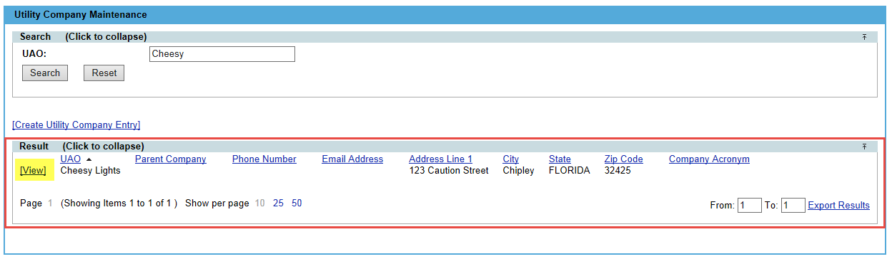
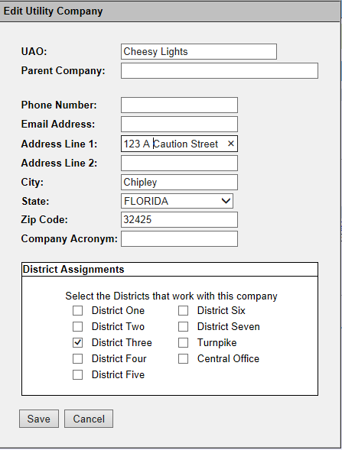
UAO Maintenance (1 of 2)
Notes:
Users who have been granted the Privilege “Manage Utility Company” are known as Utility Administrators and will have the wrench tool available. A number of activities within PSEE involve the use a UAO. A UAO must be established in PSEE before UAO Representatives can be associated and before assignments can be made.
NOTE: If you are more than a Utility Administrator, you will need to select “Utility Company Maintenance” from the Admin Menu.
Before the Utility module was released, an initial list of Utility Companies currently partnering with FDOT was loaded. However there may be new companies added. There is an ability to add “Create Utility Company Entry” or modify existing Utility Companies.

Slide 25
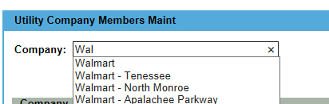
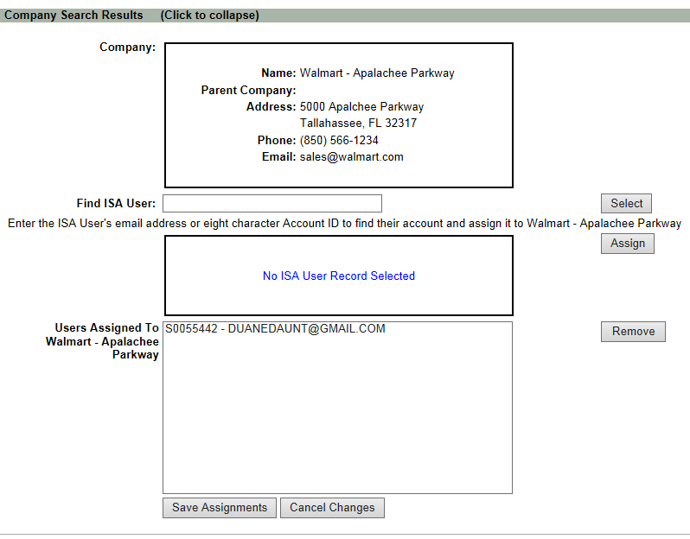
UAO Maintenance (2 of 2)
Notes:
Once the Utility Admin reviews and approves the ISA user’s request for access to PSEE, the external user will need to be associated with a utility within PSEE. When the external user is associated with a Utility Company they are then referred to as a UAO Representative. When a UAO Representative is not longer part of a Utility Company, they will also need to be unassociated.
The association action is performed by accessing the Utility Company Members Maint page. Access to the UAO Maintenance Page is available based on privileges granted.
External user access is limited to the dashboard and functional area summary pages. External users will not have access to the project detail page and will have limited create functions within the application. These activities include viewing data for the projects related to their UAO or projects which they are assigned as a Reviewer or FYI. UAO representatives will also inherit the privilege to add a document and its description as a response to their assignment.
NOTE: External users will be allowed to be associated to multiple UAOs and thus see information related to those UAOs. External users can have more than one ISA account.

Slide 26
COMMON QUESTIONS
Notes:
To keep you informed, the following questions may apply to both from UAO Representatives and FDOT users. This will be helpful incase a UAO representative was to ask you questions. They were given a training session very similar but as it relates to their screens. It is posted on the Utility Internet site. To distinguish between the two, FDOT’s training slideshow has a blue background and the UAO’s training slideshow has a green background.
IF you have any questions, Shawn Lewis is the Central Office contact for Utility Module. Or you can contact Dianne Perkins or Erica Hewett who are the FACs for ProjectSuite.

Slide 27
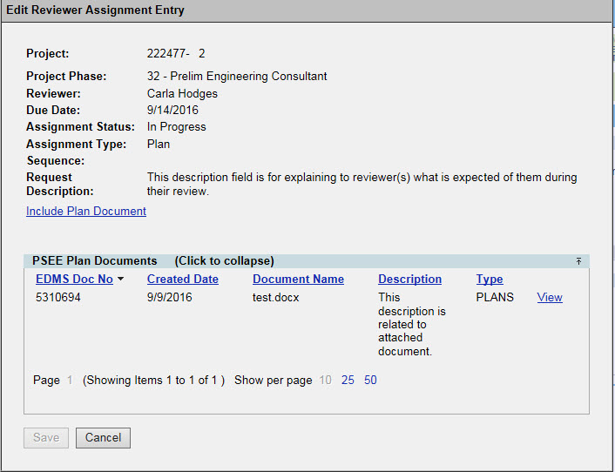
How do I respond to an Assignment?
Notes:
When an assignment appears in the dashboard, click view to open the entry. Read the Request Description for instructions left for the reviewer(s). Open attached documents, if any, as needed for reviewing. Within the module, a response can only be made if you have a document to include.
Click Include … Document link. Use the description area as your email body if you need to leave extra information.

Slide 28

What if I have no document to attach as a response to my assignment?
Notes:
If your response does not require a document to be included, it should be emailed to the Utility PM / Utility Coordinator. They can attach your email when they close your review assignment.

Slide 29
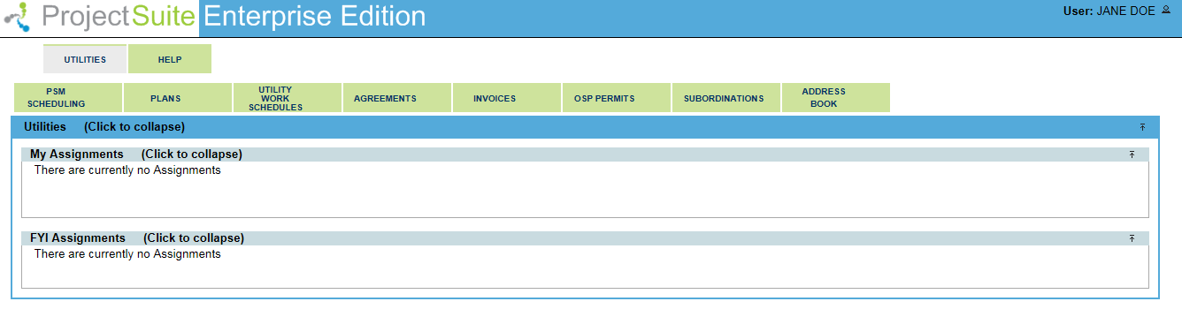
What is different between what I can see and what a UAO Rep can see?
Notes:
There are several differences between FDOT view and UAO representatives (ISA account holders). UAO reps will be using the internet site to log in.
UAO reps can not see:
anything at a project level. They only work at system level.
ONLY the Utility button on the system toolbar.
Create…..entry. They can not be granted those privileges.
UAO reps can see
Search results for projects they are associated to. For example: If Jane Doe’s company doesn’t not have projects associated in Bay Count and she search for all plan entries in Bay county; her results will be zero.
Assignments they are included in.
Help documents for UAO’s only.

Slide 30
Who do I contact if I don’t have the privilege to perform a necessary action?
District | Utility Admins
1 | Deborah Barnhill
2 | John Mccarthy, Terri Lee Phillips
3 | Jonathan Harris, Traci Adkison, Teresa Barfield, Rachel Healey, John MacDonald, Kathy Ozmore
4 | Eugene Khashper, Juliet Ashbourne, Tim Brock, Kadian Mclean
5 | Staci Nester, Marlon Bates, Megan Owens
6 | Ozzie Sanchez
7 | No one???
TP | No one???
Utility FAC - Shawn Lewis
District PSEE Admins – Located at the bottom of your PSEE Screen
PSEE FACs - Dianne Perkins or Erica Hewett

