Slide 1
ProjectSuite Enterprise Edition (PSEE)
Florida Department of
TRANSPORTATION
Setting Utility User Profile
Notes:
Welcome.

Slide 2
User Profile
Signature
Delegates
Privileges & Notifications
Notification Subscriptions
User Settings
Search Profile Management
Florida Department of Transportation
Notes:
There are 7 topics under User Profile. These include setting up a signature, selecting delegates, requesting privileges, establishing notification types, choosing projects for notification subscriptions, updating the users settings, and management of search profiles.
The user profile is displayed next to the user’s name in the top right corner.

Slide 3
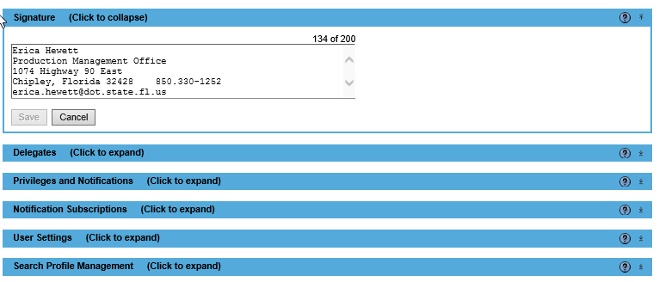
Signature
Florida Department of Transportation
Notes:
The signature box is simply a text box. The signature entered will be used on emails the system generates on your behalf. Please keep this area short and simple. Do not use images or emojis.

Slide 4
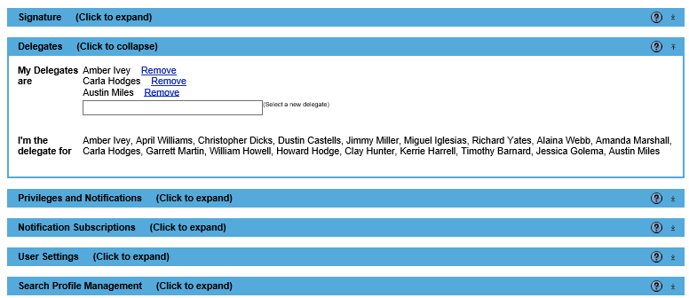
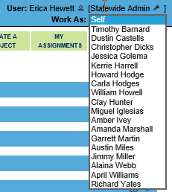
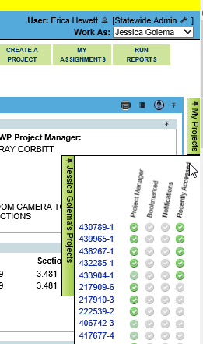
Delegates
Florida Department of Transportation
Notes:
Delegates are those co-workers or staff who can work on your behalf. When you work as someone, you inherit their permission. The exception being no one can inherit the Admin privileges.
The Delegates section list who is a delegate for you. To add a person, type their name in the search box. To remove someone, just click Remove. Others receive an email each time you add or remove them.
Also displayed is everyone who has added you as a delegate. Who have no control of who adds you nor can you remove your name from their list. Simply don’t work as that person.
At the project level, if you are a delegate for someone else there will be a “Work As” dropdown. Select the name from this list. You will inherit their dashboard list and the “My Projects” list.
A person who is a delegate inherits privileges NOT notifications.

Slide 5
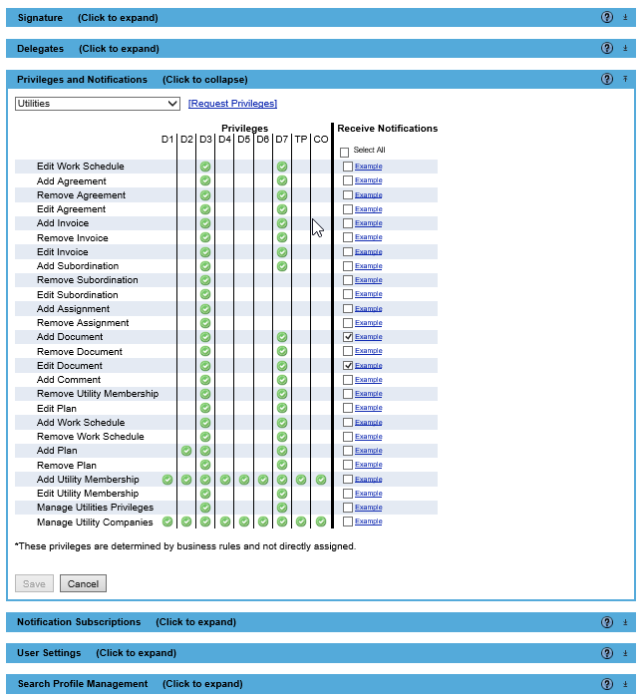
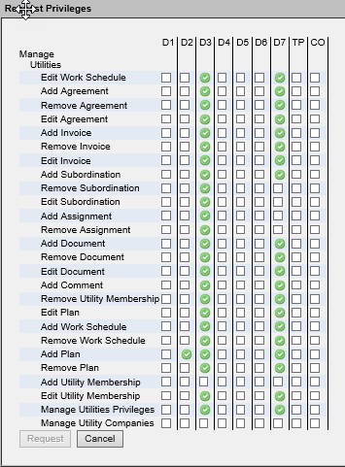
Privileges and Notifications
Florida Department of Transportation
Notes:
The Privileges and Notifications module covers two purposes.
First is the privileges. The privileges allows a user to do an action not access projects. Any user can see and search projects from any district. The green circle with a checkmark indicates that privilege has been granted to a user. If additional privileges are needed, select the appropriate module title from the dropdown. Then click Request Privileges. A dialog box will open. Click in the box for the privileges under the appropriate district, then click the “Request” button. An email will be sent to the District ProjectSuite Admins, District Utility Admins and the State ProjectSuite Admins alerting them to the need to assign privileges. The District Utility Admin will review the request and may contact the user for additional information or explanation if request will not be fulfilled.
The second purpose is for selecting what kind of emails a user would like to see. Each privilege is an action that generates an email. Users click in the box to choose an emails type. If unsure what an email is, there is an example of each by selecting the example link. For all Utility Staff, it is recommended you select notifications for Add Document and Edit Document. This is the only way you will know if a UAO uploads or edits an upload for an assignment. The other notification can be selected at your discretion.
Setting up notifications is a 2-step process. This was step one.

Slide 6
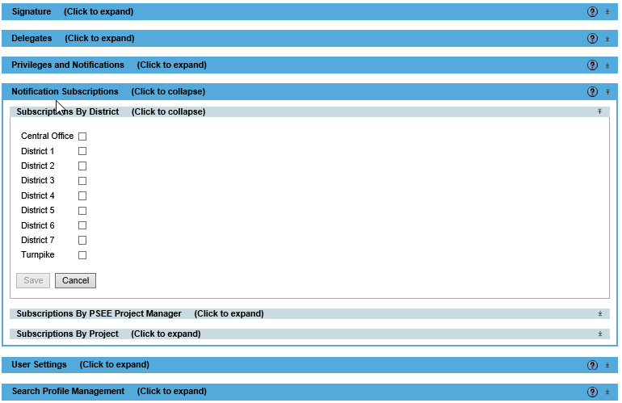
Notification Subscription
Florida Department of Transportation
Notes:
Notification Subscription is part 2 of the 2-step process. Subscriptions can be by district, project manager or project. The easiest selection is to receive all of a particular email for the entire district. Do NOT choose this. If you think subscribing by district is the best choice, contact the District Admin or a FAC to discuss. There is a huge benefit to those who use this option. However that group of users is very small. If selected unnecessarily it can cause email overload very quickly.
Next could be by project manager. This is most commonly used by Supervisors or Managers. Subscribing this way means a user will only get an email if the project manager is John Smith. This subscription is used by the Design office mostly.

Slide 7
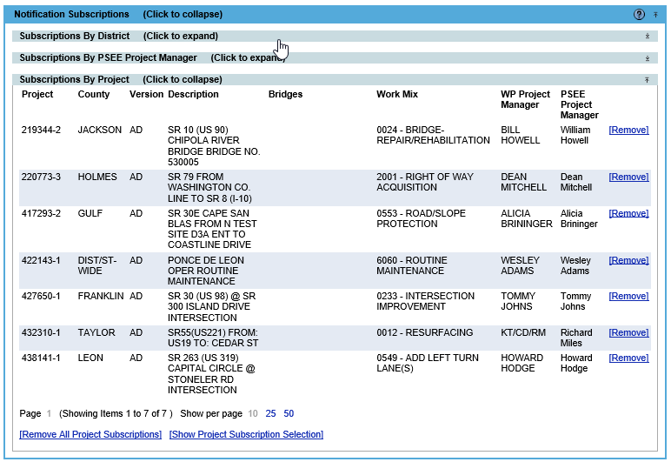
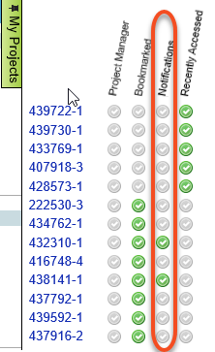
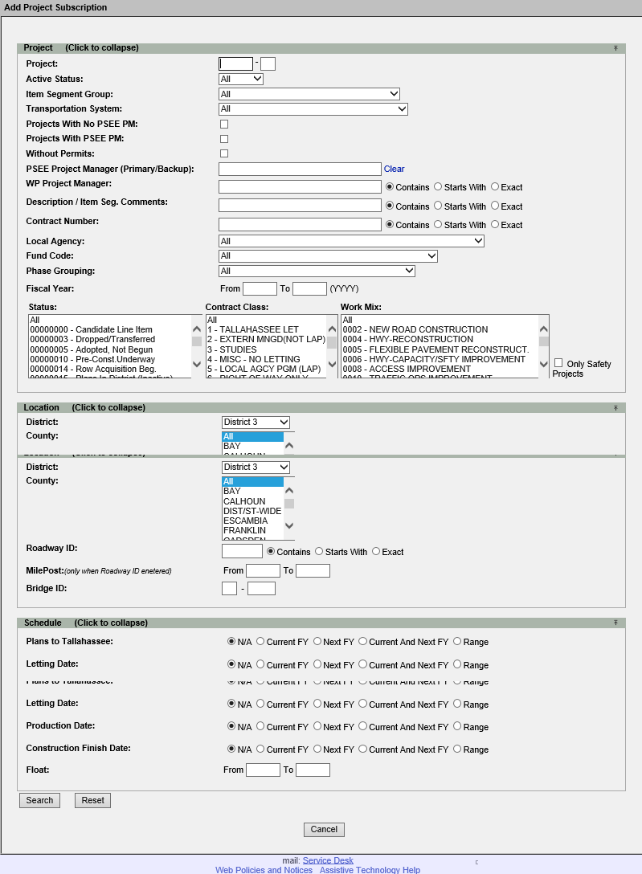
Notification Subscription
Florida Department of Transportation
Notes:
Lastly is by project. This means the subscription could be ANY project in the State of Florida. This is the most commonly used method. There are two ways to locate the projects.
First is to use the “Show Project Subscription Selection”. The search box opens and the user filters the criteria. The only problems is when the results appear only one at a time can be selected. This means if 5 projects need a subscription, the user must search the criteria 5 times. Also this selection method is only for notifications.
The second way is a the project level. Go to the project and open “My Project” list. Click on the gray checkmark circle in the Bookmark and Notification columns for the project to turn it green. The project is now subscribed to and bookmarked. The bookmarking holds the project to your “My Project” list for quicker access. When the subscription is no longer need, simply uncheck the bookmark and notification columns to stop the emails. I feel this way is much easier to manage.

Slide 8
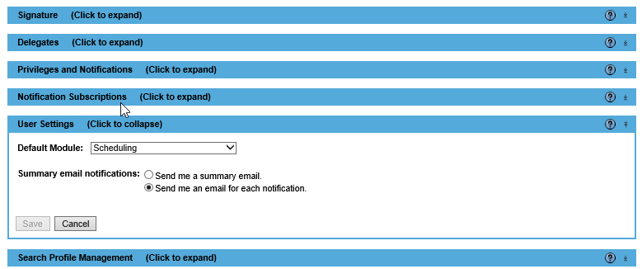
User Settings
Florida Department of Transportation
Notes:
The User Settings module allows the selection of one default module. The means when ProjectSuite is opened the Project Info module PLUS the default module will automatically open. It is recommended the Utility staff select Utility as their default module.
Also in the module, users can decide if they want their notifications to be delivered as they occur or in a summary email once a day. My recommendation is to leave it as an email for each notification.

Slide 9
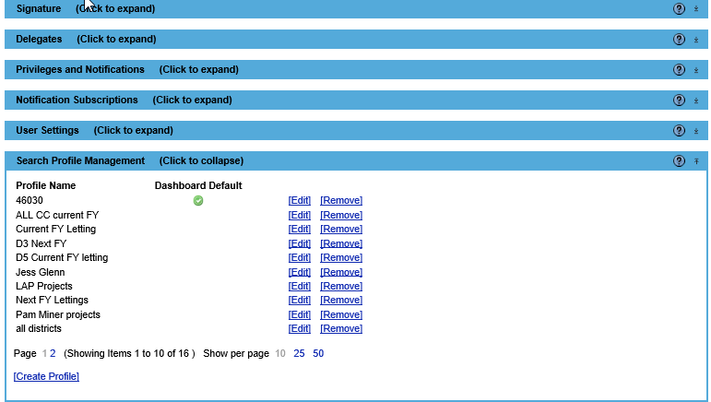
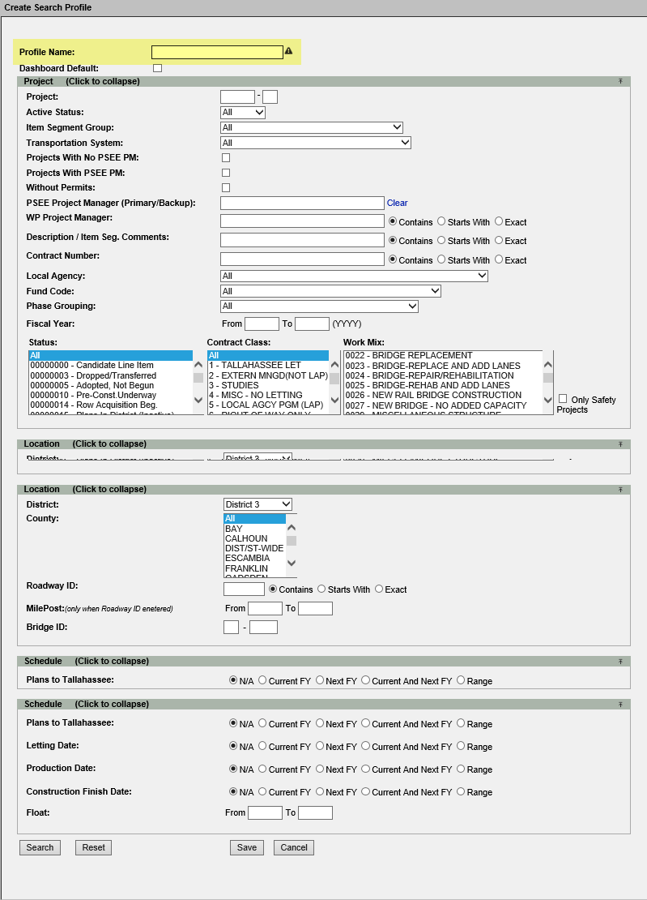
Search Profile Management
Florida Department of Transportation
Notes:
The last module of the user profile is the Search Profile Management. Sometimes there are searches a user does over and over. Maybe they are done once a quarter or every week. This area allows the search to be saved and automatically updated. Every saved search also becomes a dashboard tab. There can only be one default dashboard.
A common saved search is “This fiscal year lettings”. When saved this saved search will be different on June 30th and July 1st. Why? Because the Fiscal year changed. Another common saved search “Projects currently assigned to John Smith”. This list will change every time John Smith is added to or removed from project as the Project Manager.
Click create profile to set up a new saved search. The given the search a unique name and select the filter criteria. It is a good practice to actually run the search before actually saving. This helps confirm the filter criteria was selected correctly. If a profile needs deleted, click remove.
I am not sure this is useful at this time to the Utility Staff. However if you would like more information or assistance in setting up a search profile, give your District Admin or FAC a call.

Slide 10
PSEE Utility Functional Application Coordinator – Shawn Lewis
PSEE Functional Application Coordinators - Dianne Perkins and Erica Hewett
Florida Department of Transportation

