Slide 1
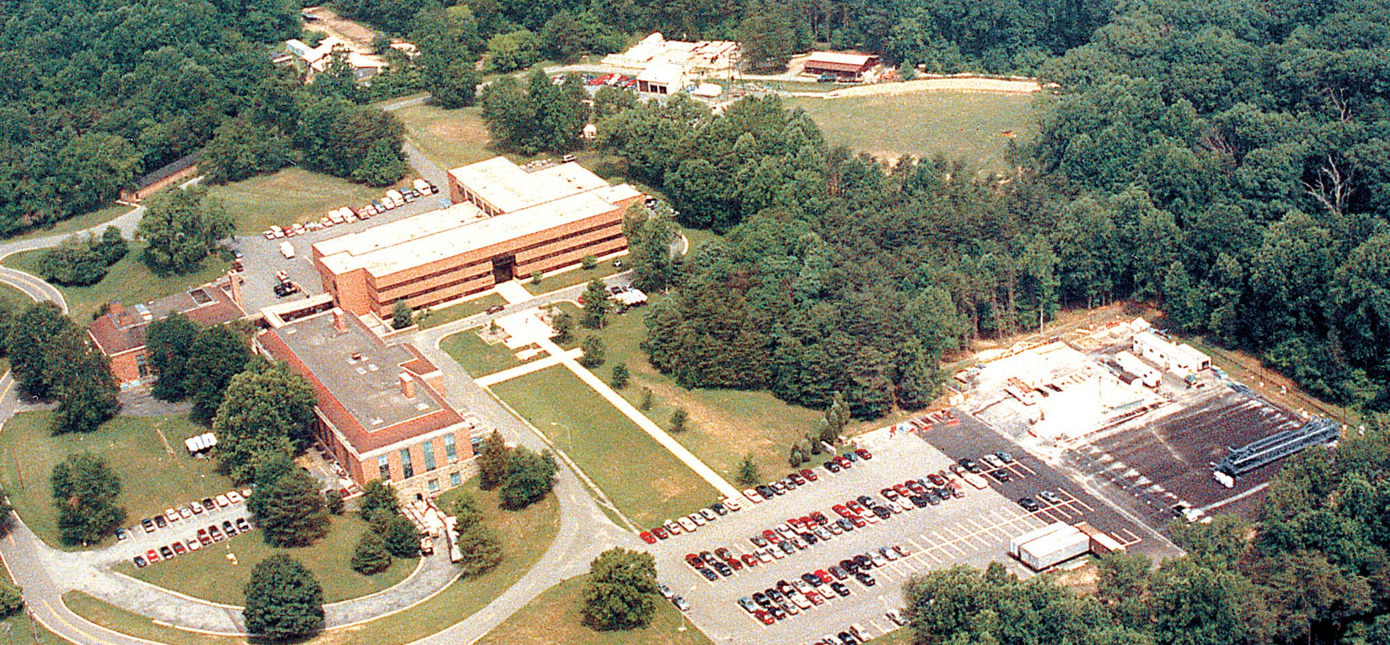
Welcome
Notes:
Welcome to the Federal Highway Administration’s Turner-Fairbank Highway Research Center ...(next slide)

Slide 2
Federal Highway Administration
Analysis of Construction QA on Locally Administered Federal-aid Projects
Introduction By:
Richard B. Duval, P.E., FHWA
Presented by:
Sidney Scott, P.E., Hill International
Leslie A. Myers McCarthy, Ph.D., P.E.
Notes:
Richard
Read Title – Introduce myself
Thank you to all states and LPA that participated in surveys and interviews and provided data
Thank you to Sid Scott and Linda Konrath at Hill International
Thank you to Dr. Leslie Myers McCarthy of Villanova University.

Slide 3
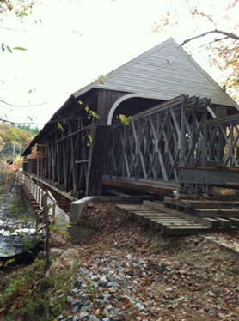
Topics Covered Today
Background/Introduction
Purpose of Study
Approach
Findings
Recommendations
Blair Covered Bridge Historic Reconstruction, Town of Campton, NH
Notes:
Richard
Background/Introduction – Richard
Purpose of Study – Richard
Approach – Sid Scott
Findings – Dr. Leslie McCarthy and Sid Scott
Recommendations Sid Scott

Slide 4
Background
FHWA and OIG National Reviews of LPA projects 2006-2011
  State QA Oversight and guidelines vary considerably
  Extreme variance in construction QA practices among LPAs
  Significant instances of deficient or lack of documentation, frequency of testing, or other issues related to 23 CFR 637 QA requirements
Notes:
Richard
Background - What prompted FHWA to do this research?
An increasing number of Federal-aid highway projects are being administered by Local Public Agencies (LPAs). It was estimated that LPA projects account for approximately 20 percent of the Federal-aid program.
Which prompted FHWA in 2006 to conduct a national review of locally administered projects and in 2009-2011 the department OIG to conduct an additional review. Revealed shortcomings
The objectives of the review were to “Assess the administration, oversight and stewardship of local public agency Federal-aid projects” and to identify areas for improvement. Findings from the program review included:
State QA Oversight and guidelines vary considerably
Extreme variance in construction QA practices among LPAs
Significant instances of deficient or lack of documentation, frequency of testing, or other issues related to 23 CFR 637 QA requirements
Bottom Line - There are extreme differences and risks exist in the LPA Federal-aid project activities
Federal-aid program guidance to LPAs could be improved

Slide 5
23 CFR637 applies to all projects on the NHS
637.201 Purpose. To prescribe policies, procedures, and guidelines to assure the quality of materials and construction in all Federal-aid highway projects on the National Highway System.
This has become a significant issue in a number of States with the expansion of the NHS under MAP-21. For instance, California has 400 LPA’s that have NHS routes where they can administer projects.
Notes:
Richard
That 23 CFR637 Subpart B applies to all projects on the NHS. Cal trans has 400 LPA w/NHS and NC has very few…depends on state
An LPA, viewed in Federal regulations as a sub-recipient of Federal funds, must demonstrate to the DOT that it has adequate project delivery systems and sufficient accounting controls to properly manage Federal funds. Once approved or certified by the DOT to administer Federal-aid projects, an LPA may assume various project responsibilities, including:
• Project selection
• Location and design
• Utility and railroad agreements
• Standard consulting engineering agreements
• Environmental documentation
• Plans, specifications, and estimates
• Advertisement, award, and execution of construction contracts
• Construction administration
• Construction quality assurance, including material testing and testing personnel
We continue to have Division Office staff that assume that 23 CFR637 does not apply to projects that a LPA administers.

Slide 6
Purpose of Study
Investigate current construction QA practices for LPA Projects
Identify risks or challenges, and existing effective practices that mitigate challenges
Recommend best practice improvements in Construction QA for LPA projects
Notes:
Richard
The general objectives of this research were to:
• Document current QA practices used on locally administered Federal-aid projects from DOT and LPA perspectives to include material sampling and testing, as well as inspection practices.
• Identify specific issues or areas of weakness in QA practices form both DOT and LPA perspectives.
• Identify existing successful practices that could be applied to generally improve construction QA across the full spectrum of locally administered projects.
The scope of the study covered various types, sizes, and scopes of transportation projects delivered by LPAs, focusing on the construction and close-out phases.

Slide 7
Approach to Research & Data Collection
Comprehensive investigation of current construction QA practices for LPA Projects
  Content analysis of literature including process audits, prior research, and current SHA QA procedures for LPA projects
  National SHA/LPA survey of construction QA practices on LPA projects
  In-depth interviews of selected cross-section of State and Local agencies
Notes:
SID
Content analysis of Literature focused on prior challenges (from process reviews), current practices (from DOT QA procedures for LPA projects)
Survey/Interviews designed to identified QA challenges and risks and potential best practices from both DOT and LPA perspectives (large and small)

Slide 8
Approach to Analysis
Content analysis of Literature
  prior FHWA/SHA process reviews and state LPA guidance manuals
Identify construction QA risks or challenges
  DOT and LPA perspectives through survey and selected interviews
Prioritize risks/issues based on likelihood and impact
Identify practices that mitigate risks
Notes:
SID
Steps in analysis
Content analysis of literature
Through survey and interviews, identify risk issues and prioritize based on likelihood and perceived impacts
Identify best practices that mitigate risks
Make final recommendations re best practices

Slide 9
Content Analysis of Literature
Process audits by FHWA Division offices and State DOTs
Past and ongoing research related to LPAs
State DOT guidance manuals and QA procedures for LPA projects
EDC-2 and 3 Guidance
FHWA –DOT Stewardship and Oversight agreements
Notes:
SID
For Content analysis, we reviewed a number of different types of documents:
FHWA division office and selected state process reviews revealed recurring or significant issues related to compliance with Federal-aid requirements occurring over last 10 years 2002-2012
Recently published research conducted by Dr. Leslie McCarthy included NCHRP Synthesis Reports 414 “Effective Practices for Delivery of Small Scale Federal-aid Projects,” and more recent 2013 NCHRP Synthesis Report 442, “Practices and Performance Measures for LPA Federally Funded Highway Projects,” addressed in part statistics re QA practices and LPA project oversight
State DOT guidance manuals and QA procedures for LPA projects
FHWA EDC 2 and 3 guidance
FHWA Stewardship and Oversight Agreements
Also AASHTO 2013 Sub on Construction LPA Oversight Survey Results

Slide 10
Findings from Prior Process Reviews
Process and PMIT reviews by FHWA Division offices and State DOTs
  Documentation
  Training
  Guidance manuals
  Oversight by State DOTs
  QA by LPAs
  Specifications
Notes:
SID
Level of documentation varies and is sometimes missing, or not sufficient or not updated (e.g a log summary of testing frequencies, certifications, records of testing calibration, resolution of failed tests)
QA Training - District personnel and LPAs were not attending or unaware of training available. Also, LPAs could not afford to send staff to get trained or certified for testing or do not have the right staff.
Guidance manuals – Some DOTs lacked guidance to assist LPAs with QA inspection and testing. Others directed LPAs to use the state construction/materials manuals, which may be too rigorous for non-complex LPA projects or irrelevant to specialized construction.
DOT oversight is extremely variable by region or district in each state due to insufficient staff

Slide 11
Findings from DOT/LPA Guidance Manuals
Content analysis of state LPA guidance manuals, specifications
  Guidance in state LPA manuals varies considerably, in particular guidance for construction QA
  Most LPAs use DOT std. specifications for QA but some agencies maintain LPA-specific specifications
Notes:
SID
We performed content analysis of Guidance manuals
Significant variability in content
Some Focused on Preconstruction activities
Other on construction – materials testing and inspection
Some published separate guides for testing and inspection of LPA projects
Very few addressed CFR requirements (only GDOT specifically addressed the requirements of a QA program per 23 CFR 637)

Slide 12
Stewardship Agreements
Agreements were reviewed and rated in terms of the quantity and quality of guidance (good, limited, vague)
Information related to materials QA and construction oversight and the LPA program only included in about one-third of the S&O agreements
Agreements lacked specific requirements for LPAs specifically for materials QA and construction oversight
Notes:
SID
We were looking for anything specific to construction and materials QA, related to LPAs

Slide 13
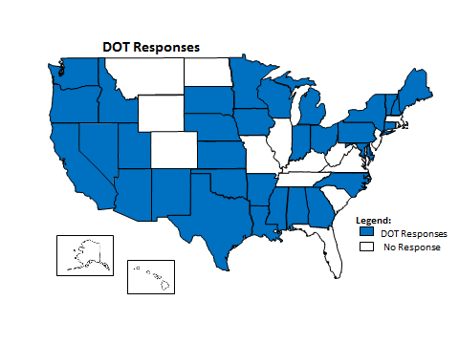
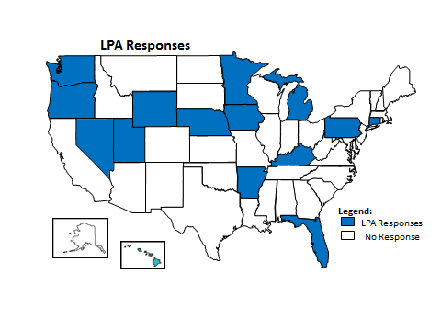
Surveys
Notes:
LESLIE
High degree of interest particularly among DOTs reflected in survey response.
DOT response rate of 69% (34 state DOTs and Dist. of Columbia).
LPAs 33 agencies from 14 states responded to survey.

Slide 14
Survey Findings – DOT perspective
Construction QA risks/issues
  Lack of QA documentation
  Insufficient sampling and testing frequency
  lack of or insufficient inspection
  Lack of material/personnel certifications
  Insufficient communication
  Turnover of LPA staff
Few reported instances of poor quality on LPA projects
Notes:
LESLIE
Findings were generally consistent with FHWA/SHA audits and process reviews – most findings involved administrative issues
One reported instance of re-work required for aggregate base that didn’t meet QA requirements
Another example involved lack of weld test reports for an LPA pedestrian bridge that resulted in rework (cost) to retest & certify welds

Slide 15
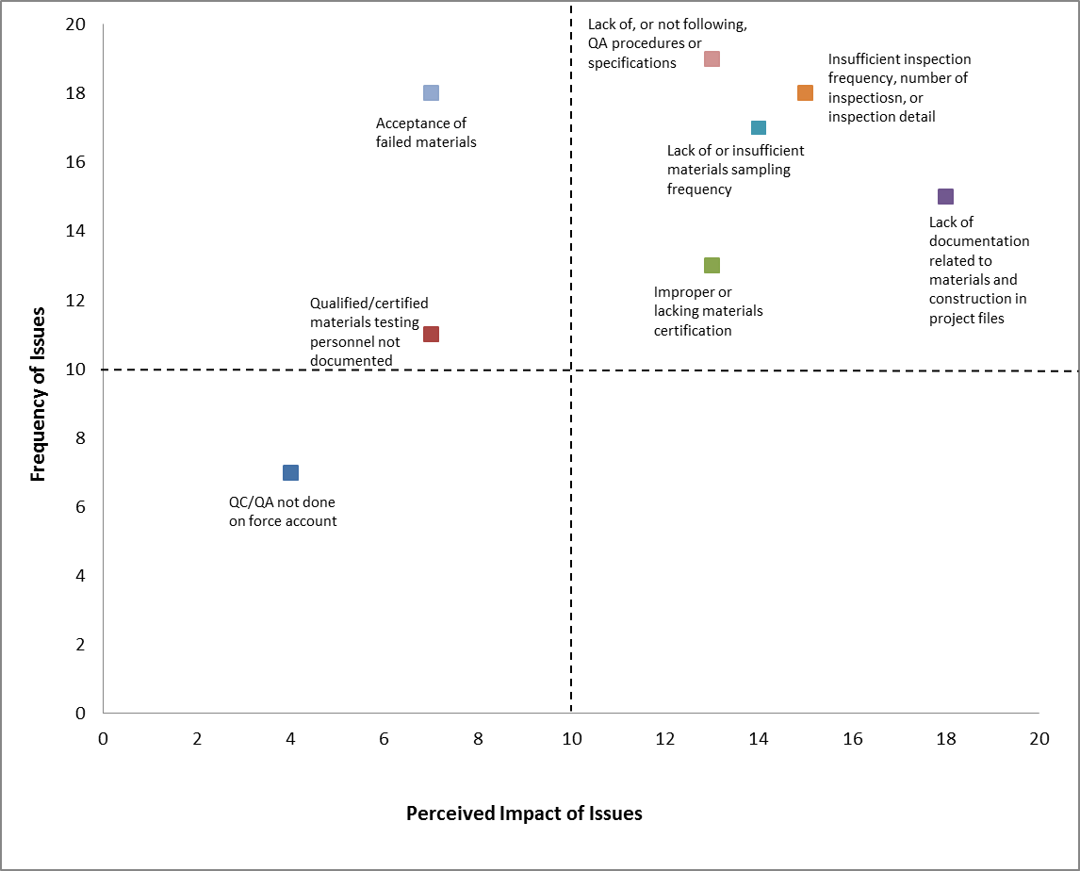
DOT
Findings
Impacts
Minimal
Minor
Moderate
Significant
Notes:
LESLIE
Risks/issues were rated in terms of reported frequency and severity of impact
Biggest reported impact to an LPA project was loss of federal funding
Other significant risk issues were lack of documentation, non-conforming sampling and inspection frequency, and lack of or improper materials certifications

Slide 16
Survey Findings – LPA Perspective
Construction QA risks/issues
  Cost of construction QA
  Inconsistent DOT oversight
  Use of consultants for QA oversight
  DOT one-size-fits-all standard specifications and manuals
  Access to training
LPA perspectives vary based on size of local agency program, and project types.
Notes:
LESLIE

Slide 17
Interviews
DOTs
  Caltrans
  FDOT
  Ohio DOT
  Oregon DOT
  Maine DOT
  Missouri DOT
  NHDOT
  PennDOT
  VDOT
  WisDOT
  WSDOT
LPAs
  City of Ormond Beach, Volusia County, City of Lakeland, Hillsborough County, City of Tampa, FL
  Town of Allenstown, Town of Campton, City of Claremont, NH
  Allegheny County, PA
  City of Richmond, Fairfax County, VA
  Saulk County, Waukesha County, WI
Notes:
LESLIE
Interviewed cross-section of DOTs and LPAs with large and small programs.
Research panel provided input re selection of States to interview (11 states in all were interviewed)
DOTs assisted team with interviews of selected LPAs in FL, VA, NH, and WI. A total of 13 LPAs were interviewed.
Interviews were conducted in-person and by conference call
Purpose of interviews:
(1) Collect general programmatic information from DOT and LPA staff regarding program size, project types, and current QA practices, (2) obtain more insight into both program deficiencies and best practices that could be used to resolve these issues, and (3) gather and develop detailed case studies examples to support these findings if possible.

Slide 18
Interview Findings – Larger DOTS
Delegate greater responsibility to LPAs for QA administration
Assign dedicated DOT management staff to LPA programs
Provide certification and training programs (in conjunction with FHWA LPA guidance) to assist LPAs with QA and Federal-aid requirements.
Use a tiered approach to QA oversight depending on LPA capabilities or certification standards obtained by the LPA.
Develop and maintain LPA-specific manuals, specifications, and guidelines tailored to LPA projects.
Notes:
LESLIE
DOTs reported that even for the larger state programs, most LPA projects are less than $1M involving sidewalks, culverts, streetscapes, or small interchanges or bridge rehabilitation. Less frequently, LPAs have major projects, bridge or other signature projects, that require greater levels of funding, resources, and QA oversight

Slide 19
Interview Findings –Smaller DOTS
DOT staffs typically are more directly involved in QA oversight for LPA projects,
May provide staff for periodic inspection, verification and acceptance testing, and Independent Assurance (IA).
Typically require that LPAs essentially adhere to the same QA requirements as for state DOT Federal-aid projects using the DOT standard specifications and QA manuals.
Notes:
LESLIE
Smaller DOT programs more directly oversee LPA projects
Use same standards and QA requirements for DOT and LPA projects (smaller LPAs also support this approach)

Slide 20
Interview Findings – DOT Issues
Wide range of LPA certification processes
Inconsistency in DOT staff performing QA oversight.
Lack of understanding of LPAs regarding QA testing and documentation required for acceptance of work.
Less experienced or untrained consultant staff hired by LPAs
More guidance for DOT/LPA staff handling non-compliance issues
Lack of consistent communication among all the parties.
Notes:
LESLIE
A broad range of certification practices ranging from a simple self-assessment form or viewing training videos to more rigorous, multi-step interviews and efforts to assign the LPA cradle-to-grave project responsibility. More standardization and clarity is needed.
Inconsistency of DOT staff performing QA oversight at Central office or Districts – DOT shortage of staff or lack of dedicated staff is a factor
LPA staff may not be qualified for certain discipline areas, and do not follow procedures or perform the right numbers of tests
Lack of consistent communication among all the parties involved in a project including LPA, DOT District oversight staff, and FHWA.

Slide 21
Interview Findings – LPAs
Most LPAs, large and small, use consultants at some level to perform CEI services and QA testing on LPA projects. The consultants used were quite often former DOT employees with the same qualifications/certifications to perform the inspection and testing as for DOT projects.
Several LPAs reported that the level of effort for construction management was the same regardless of the type of Federal-aid project.
Notes:
LESLIE
The local agencies interviewed included Counties, Cities, and Towns.
The LPAs ranged from small towns with minimal in-house staff that occasionally entered into a Federal-aid project as part of a Federal-aid improvement program (i.e. safety enhancement and accessibility, safe routes to school, urban construction, scenic trails, etc.) to large Cities or County LPAs with significant capital construction programs, using LPA standard specifications, and employing in-house engineering and construction staff.

Slide 22
Interview Findings - LPA Issues
General high Cost of QA for federally-funded LPA projects.
Project close-out and paperwork (i.e. justifying non-conformance reporting) far too long and costly.
One size fits all DOT QA or LPA specifications not flexible or fully applicable to certain projects,
Inconsistent training or QA training not available,
Lack of consistency from DOT QA oversight and management staff.
Difficulty with sorting out project funding and getting reimbursement for Federal-aid projects.
Notes:
LESLIE
Several LPAs interviewed reported high cost of QA. The perception was that LPA has limited control over QA oversight costs.
One example of the added costs related to compliance with QA and other Federal-aid requirements provided by an LPA was for a 2-1/2 mile ARRA paving project where one half of the project used local funds and the other one half included federal funds. Though the two sections used the same design, specifications and contractor, the cost for the federally funded portion was 100% higher, in part due to the required use of a consultant contract to provide management and oversight.
It was reported several times by DOTs and LPAs alike that the use of consultants has in some cases added to the costs of CEI for LPA projects because of the consultant tendency to use full-time staff or add scope.
DOT QA or LPA specifications are in some cases not fully applicable to certain projects, particularly City or Town projects with different design or construction-related standards. The City specifications are more than adequate for most types of City projects.

Slide 23
Interview Findings
DOTs and LPAs both reported that there was a low frequency of failing or non-compliant materials,
Larger challenge was adherence to administrative paperwork and QA recordkeeping requirements for federal-aid projects.
Notes:
LESLIE
Examples of non-conformance were primarily missing test reports in the files, missing documents for close-out, and fewer tests taken or material certifications than required. There were a reported few cases of non-compliant or failing materials but low frequency and not considered a significant risk by either DOTs or LPAs.

Slide 24
Findings – Best Practices
DOT
  Improved communications
  Training
  LPA Certification programs
  LPA Manuals and Guidelines
  Management consultants
  Risk-based QA based on project type/purpose or criticality
LPA
  Improved communications
  Training
  LPA Certification programs*
  LPA-tailored specifications and QA requirements*
  On-call consultants
  Dedicated DOT staff
*Smaller LPAs prefer use of DOT specifications and dedicated DOT staff to manage QA for LPA projects.
Notes:
SID
Several agencies, DOT and LPAs, pointed to greater or consistent use of project walkthroughs, and preconstruction or pre-paving meetings to define QA requirements, commitments and responsibilities, early action items, and milestones. It was also recommended that preconstruction meetings should be followed by periodic or quarterly coordination meetings to assess progress, raise issues, and develop solutions.
Training was mentioned repeatedly as a best practice. DOTs and LPAs also noted that the high level of turnover at LPAs limits the effectiveness of periodic in-person training. One LPA suggested that the general training on LPA contract administration should be supplemented with more specific targeted training related to use of electronic systems and forms, and QA inspection and testing for specific project types or elements. Web-based training was suggested as an alternative or supplementary measure. The initial investment in online training could be costly, but would save the cost of classroom training.
DOTs cited the development of specific LPA guidelines and manuals for administration of LPA projects is a best practice that has reduced the frequency of issues related to quality or non-compliance with QA. Team noted significant differences in the content and depth of the information, particularly related to construction administration and QA. The most effective manuals were those that included detailed guidance on construction QA and documentation requirements.
DOTS noted that developing a risk-based or flexible approach to QA oversight based on the criticality of the project or the work or materials would provide for a rational way to optimize DOT resources.
The use of consultants was viewed as a best practice by some agencies but is controversial - not supported by all the LPA respondents. A DOT implemented a relatively unique approach to the administration of LPA projects through its Management Consultant (MC) program. This program allowed the DOT to outsource the management of its LPA program by District without delegating its QA oversight.
Larger LPAs want more flexible QA requirements based on project characteristics/purpose. Smaller LPAs prefer that DOT specs/standards be used
Practices need to be tailored to size/experience of LPA and project type

Slide 25
Recommendations
Improved communication
  Pre-design walkthroughs
  Preconstruction meetings
  Direct and frequent communication during projects
  Community of practice or stakeholder meetings
    Improve understanding of federal-aid requirements
    Communicate new issues and lessons-learned
    Improve consistency of QA administration
    Clarify roles and responsibilities for QA
Notes:
SID
Different levels of communication during project lifecycle
Extension of partnering concepts
Stakeholder committee/Community of Practice - EDC 2/3 promoted

Slide 26
Recommendations
Training
  Dedicated funding (accessible to DOT and LPA staff)
  Web-based
  Shorter modules
  QA topics
  Case studies of issues and lessons-learned
Notes:
LESLIE
Training be parceled out in shorter segments (less than one hour in length) to keep each module concise, but also be in-depth and focused on current challenges. The most effective way to do this would be to make some of the training segments web-based, similar to the FHWA Federal Aid Essentials training series.
Consider developing additional videos within the topic area of quality assurance, but to address the most frequently observed or most significantly impacted topics uncovered as part of the review. These topics include: system-based and project-based IA programs; estimation techniques for the cost of construction engineering, including the CEI and testing consultants; importance and impact of materials sampling frequency; daily construction records for LPA projects; construction dispute resolution for LPA projects; and, managing materials testing subcontracts.

Slide 27
Recommendations
LPA-specific Specifications, Manuals and Guidelines
  Add guidance on construction QA and administration
  Use statewide LPA manual to promote consistent construction QA administration across all districts and projects
  Use LPA-tailored specifications to adapt construction QA to project purpose/type
    Smaller quantities
    City standards
    Rural projects
Notes:
LESLIE
DOTs should develop and maintain LPA-specific Guidance Manuals or LPA Project Delivery Manuals, which covers all of the LAP project types and includes sections that specifically address quality assurance in construction.
The study findings revealed that the state DOTs who generated LPA-specific materials and construction specifications that are more suitable to fit a particular LPA project purpose found it to be a worthwhile investment and had less instances of nonparticipation as a result. Furthermore, tailoring state DOT specifications to be more relevant for local projects would eliminate the frustration reported by some LPAs regarding a one size fits all approach to DOT specifications for LPA projects.

Slide 28
Recommendations
Use of Consultants
  Management consultants (hired by DOT) for oversight when DOT does not have sufficient resources to dedicate staff to LPA projects
    DOT must retain responsibility for oversight of program
    Avoid actual or perceived conflict of interest between different levels of consultants
  On-call Consultants (hired by LPA or DOT) for construction QA
    On-call to control QA cost
    Certified QA inspectors and/or testing firms
Notes:
LESLIE
For a state DOT that does not have adequate staff to cover the number of LPA projects active at any given time, consider hiring of Management Consultants (MC) to help ensure that Federal-aid QA requirements are met for the QA activities related to the program. However, if a state DOT elects to procure the help of MCs, it is critical that the state DOT maintain responsibility and oversight of the LPA program and use program reviews or audits at a specified frequency to ensure that there is consistent oversight and no conflict of interest between different levels of Consultants involved in the overall LPA program.
For smaller LPAs that require the use of on-call consultants for construction inspection and testing, the DOT should establish a DOT-based Open End Consultant Contract to be available to the small “one project” LPAs. The OE Consultant performs project management and QA. This process is suggested for projects costing under $1.0 million. These consultants should also be trained, and certified to perform QA inspection and testing.

Slide 29
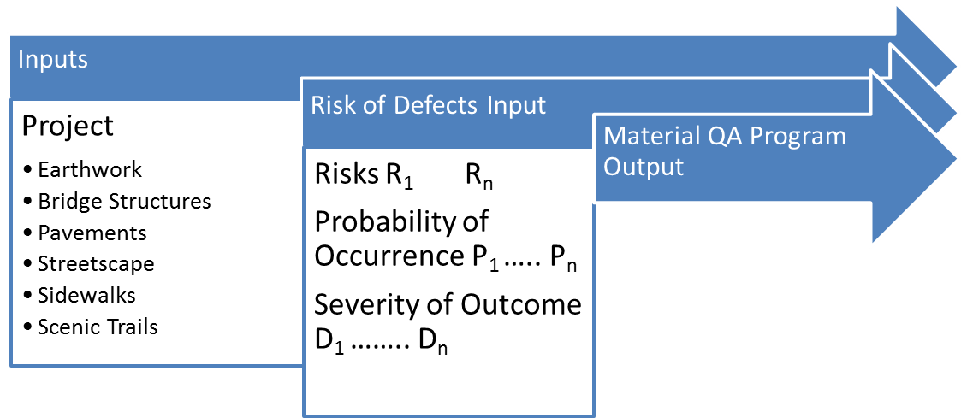
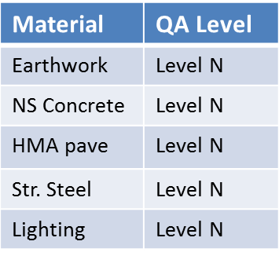
Recommendations
Flexible or risk-based approach to construction QA
Notes:
SID
Tiered or levels of QA oversight based on criticality of work
More QA resources (inspection and testing) to more critical work and fewer resources to less critical
Criticality defined in terms of safety, cost of replacement or re-work, or impact to public (user)

Slide 30
Recommendations
Certification program for LPAs
  Applicable to LPAs with more internal resources
    Promotes local ownership of quality
    More efficient use of DOT/LPA resources
    DOT still performs oversight (periodic audits, IA, etc.)
  Can structure as a tiered program with key elements
    Conditional certification (Tier 1)
    Demonstration projects
    Full certification (Tier 2)
    Re-certification
Notes:
SID
This was part of EDC2 initiative
Based on the findings of this study, a need exists for further clarity in defining what the criteria for LPA certification should be (particularly for QA) and for this information to be deployed consistently through national guidance from FHWA. The WSDOT certification program is a good model to consider as a starting point for wider adoption.

Slide 31
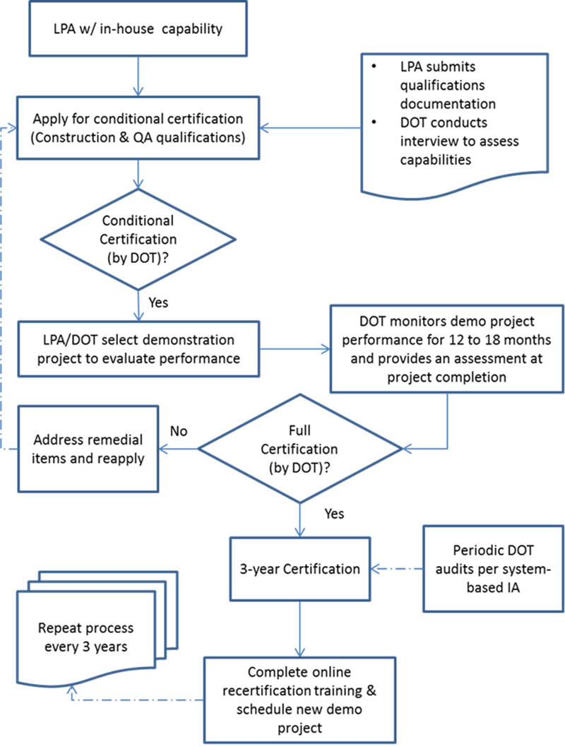

Example LPA
Certification
Process
Notes:
LESLIE
An example of a proposed 2-step or tiered process for certification is illustrated in this slide. As a first step, the LPA would submit its qualifications with the required documentation. The DOT would then conduct an interview with LPA staff to review past performance, current in-house staff, QA and construction inspection capabilities, and knowledge of federal and state requirements. Given that the results of the interview are acceptable, the DOT will conditionally certify the LPA (e.g. Tier 1). The DOT and LPA would then select an appropriate demonstration project for the LPA to administer on a trial basis.
The DOT would then monitor the demonstration project for its duration (12 to 18 months are assumed). At completion, the DOT will assess the performance of the LPA and either approve the LPA for full certification or provide a list of remedial actions for the LPA to address to reapply for certification. With full LPA certification, the DOT would be required to conduct periodic audits and/or system-based IA as part of its stewardship responsibilities. This means that DOT should revisit stewardship agreements to address LPA projects and materials QA fro LPAs.
With certification, it is recommended that a periodic recertification program be established to address potential staff turnover or training new staff. The recertification process should include mandatory periodic (e.g., every three years) training that the LPA engineering and/or public works staff should attend. It is also recommended that the recertification training be recorded in an online format (accessible online such as through an LTAP or a university’s distance learning), due to the scheduling challenges or travel restrictions often experienced by local staff. The DOT will still be encouraged to hold their routine random audits on the large agencies that are certified and would ideally maintain a system-based IA program.

Slide 32
FHWA-DOT Stewardship Agreements
Review existing FHWA-DOT partnership agreements for consistency with advancements or changes made regarding:
  Implementation of a LPA certification program (either partial or full);
  System-based IA as part of a DOT’s stewardship responsibilities to the LPA program;
  Implementation of LPA-specific standards or construction & materials specifications.
Notes:
LESLIE
In conclusion, might also want to revisit FHWA stewardship agreements. FHWA Division Offices should consider reassessing the current version of their S&O agreements to place more emphasis on the areas of materials QA and construction oversight, particularly as they related to local agencies.
Implementation of a LPA certification such as the one in the example in the previous slide may mean that it might be a good idea for the FHWA-DOT stewardship agreements to be revisited if a DOT adopts a certification model such as the one presented herein

Slide 33
Summary
Approach to construction QA should consider LPA program and project profile
Flexible (tiered) approach to QA with strategies to Optimize QA:
  LPA-tailored Specifications and Manuals
  Certification program
  Risk-based QA based on project type/purpose and criticality of work
FHWA-led committee of stakeholders (state and local) to explore how construction QA can be optimized in context of current regulations
Notes:
In summary, a flexible approach based on LPA, project profile/risk is recommended.
Stakeholder partnering will continue to be promoted into EDC-3 - stakeholder committees including representatives from State Transportation Agencies, LPAs, and FHWA. The purpose of the committee is to improve communication to serve as a platform to launch training and process improvements in Federal-aid project delivery.

Slide 34
Any Questions?
Contact: Richard Duval
Richard.Duval@dot.gov
202-493-3365
Thanks for your time and interest!
Notes:
Thanks for participating in our webinar. Any questions? ...(next slide)

Slide 35

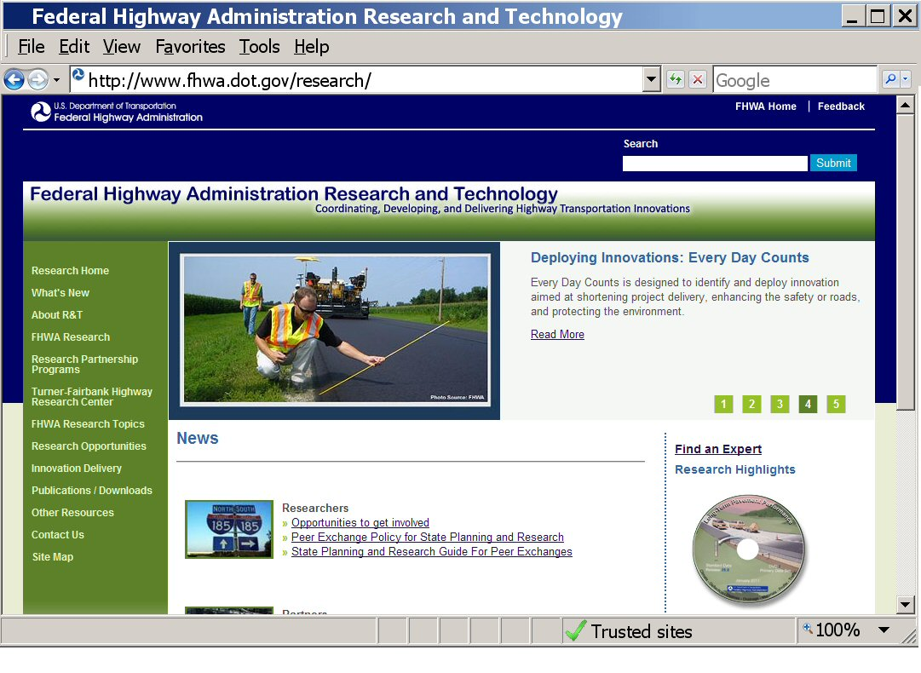
Visit us at
www.fhwa.dot.gov/research
Notes:
Visit our Web site for information about our national research programs, experts, laboratories, and the research projects...(next slide)

Slide 36


Want new updates and document links delivered to you wherever?
  http://www.fhwa.dot.gov/research/whatsnew/tfhrcrss.xml
Scan it. Click it. Connect.
Notes:
If you prefer that updates and new publication links are delivered to you...via mobile, electronic pads, notebooks, or your computer browser, you may subscribe to our RSS Feed....and to make it easy for you, we are providing a quick response code (in center of this slide), so you can have immediate access. (...PAUSE A MOMENT) Or, you can subscribe on our Web site under “What’s New.” ...(next slide)

