Slide 1
Communication Strategy and Plan

Slide 2
Content
Communication Strategy
Introduction
Communication Strategy
Communication Importance
Communication Objectives
Guiding Principles
WPII Stakeholders
Communication Development and Delivery
Communication Intake Process
WPII Communication Channel Overview
Communication Roles and Responsibilities
Risks and Issues
Success Factors
Communication Plan
Introduction
Communication Needs Assessment
Communication Plan and Schedule
Communication Delivery
2

Slide 3
Introduction
WPII is a high-priority of the Department and provides an opportunity for the agency to innovate and streamline its financial systems and processes. The WPII solution will:
Optimize business processes
Modernize outdated technology
Reduce redundancy, increase efficiency, and mitigate risks
Ensuring the WPII Solution is executed effectively and efficiently requires commitment throughout the Department. To help facilitate this, a Communication Strategy will be deployed to:
Keep stakeholders informed of the nature, progress and outcomes of the WPII solution
Drive a communication connection among stakeholders
Help WPII Liaisons fill the information gap for their teams in their respective districts and prepare them for change
Improve and inform stakeholder engagement across FDOT’s Districts, Central Office, and Turnpike
3

Slide 4
Communication Strategy
The Communication Strategy will help build stakeholder awareness, understanding, acceptance, and commitment to the WPII project via consistent, frequent, and highly targeted communications
The primary objectives of the Strategy are to:
Create awareness and understanding of the WPII project (who, what, where, when & why) among all stakeholders
Coordinate communication content and timing across all FDOT
Provide WPII stakeholders with context for the change and the road ahead
Promote involvement by providing opportunities for key stakeholder groups to contribute feedback/input
Engage WPII stakeholders in meaningful and varied ways by not relying solely on written communications, such as emails
4

Slide 5
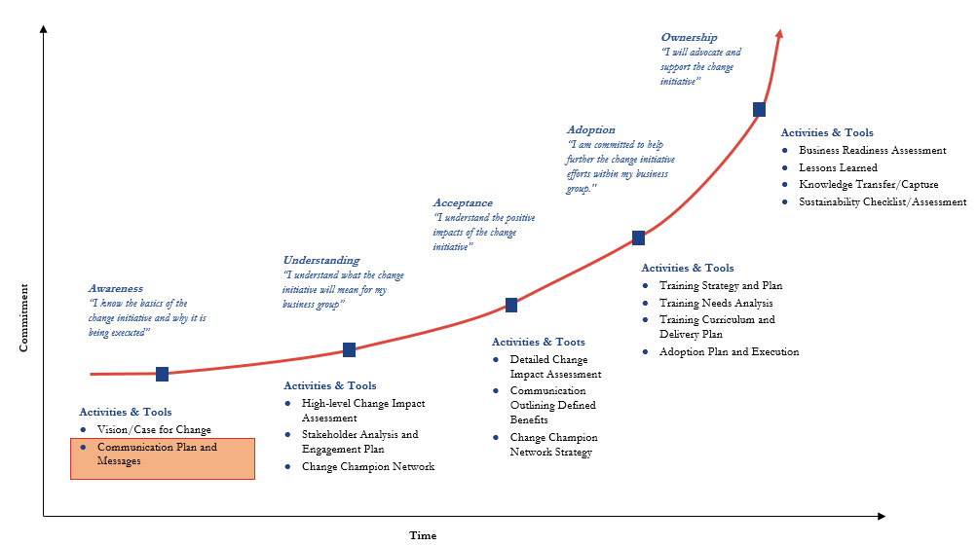
Communication Strategy: Commitment Curve
Once implemented, the Communication Strategy will guide WPII stakeholders through the commitment curve quickly and effectively with the use of targeted communications
5

Slide 6
Communication Importance
Effective communication strategies and stakeholder engagement is critical to the success of the WPII project
1
Why does WPII need a communication strategy?
2
What is the benefit of this communication strategy?
3
How will the communication strategy and plan help?
WPII requires effective messaging throughout the Department. Stakeholder communication is a critical part of the implementation because it provides:
Better understanding of the project and project objectives
A transparent connection and relationship with all WPII stakeholders
Support for a culture of open communication and transparency
The communication strategy articulates a set of activities at every step of the project for optimal stakeholder management. It provides:
Alignment of the project objectives and the organizational priorities
Alignment with the project messaging across all workstreams
Adequate stakeholder identification
The proper planning, integration and monitoring of the project steps
Inclusion of change management activities to ensure people’s transition journey
An established communications strategy and plan supports cross work stream alignment with:
A well executed plan to engage with all stakeholders and align communications with the wider project strategy
A communication strategy to help FDOT realize benefits sooner by articulating the “what's in it for me” to all stakeholders
A communication calendar to maintain and manage communications throughout the project lifecycle
6

Slide 7
Communication Objectives
The purpose of this document is to present the Communication Strategy and Plan that will support WPII design and deployment. The WPII Communications Plan has three main objectives:
1
2
3
Inform and engage
Strengthen understanding and build commitment
Support OCM needs of the project
Ensure the stakeholders’ understanding of the WPII project and ensure buy-in for change
Raise awareness around the need for change across the Department districts which will facilitate a smooth transition to future state
Engage stakeholders and keep momentum around the financial transformation at every phase of the project from design to deployment
7

Slide 8
Guiding Principles
Communications Guiding Principles will help keep communications targeted and relevant during the project lifecycle
1
Leverage existing communication channels to deliver WPII project communications whenever possible (e.g., WPII Communications Site, Newsletter, Project Meetings)
2
Create clear, consistent project messaging that directly links to the WPII Project Objectives and Case for Change
3
Tailor communications to target audience needs
4
Establish communication channels that facilitate a two-way communication
(e.g., face-to-face meetings, surveys, WPII Liaison meetings)
5
Make communications frequent and timely, balanced with proper pacing to retain stakeholder interest
6
Ensure ample preparation time for more complex communications that require input from the project team
8

Slide 9
WPII Stakeholders
WPII Stakeholders have been identified and categorized into three specific groups. Additional groups may be identified throughout the project lifecycle
Stakeholder Group | Types of Communication
Legislative Stakeholders Governor’s office, state legislature and other Florida Government bodies interested in the outcomes provided by WPII | Project updates Status and progress
WPII Project Team The project team is accountable for overall design, delivery and execution of the WPII Solution | Project updates that describe the ‘what’ and ‘why’ of the change and information on upcoming tasks/initiatives Targeted communications explaining how each group and individual will be prepared and supported in advance of the change General program information (e.g., SharePoint, FAQ) Leadership messaging Engagement events
WPII Liaisons FDOT District, Central Office, and Turnpike leads involved with and/or impacted by the implementation of the WPII solution | WPII project updates that describe the ‘what’ and ‘why’ of the change and information on upcoming events/initiatives Targeted communications explaining how each group/district and individual will be prepared and supported in advance of the change General project information (e.g., SharePoint, FAQ)
FDOT Stakeholders Agencies or organizations outside of the WPII Project team that require project information (e.g., contracted & non-contracted providers) | Project updates that describe the ‘what’ and ‘why of the change, and information on upcoming events/initiatives
9

Slide 10
Communication Development and Delivery
WPII Project Communications will be developed and delivered in the following steps
Step 1
Identify and segment audience groups
Step 2
Review and Identify appropriate communication channels
Step 3
Communications
Strategy
Develop project phase key messages around themes of awareness, understanding, adoption, ownership
Step 4
Create tactical communications plan to target audiences and assess effectiveness of channels
Communications
Plan
10

Slide 11
Communication Intake Process and Criteria
Determine | Develop | Distribute
Provide content/submit request
for project communications
Develop and submit materials
Distribute materials to identified Points of Contact(s) for the targeted stakeholders
Determine if communication is in scope
Review and approve materials
Cascade materials to targeted audiences
If out of scope, notify requester or escalate to appropriate group (i.e. business track)
If in scope, plan communication materials, target stakeholders, etc.
Assess existing communication channels and feedback mechanism i.e. SharePoint, Work sessions, e-mail, newsletter etc.
Provide additional content, if necessary
11

Slide 12
WPII Communication Channel Overview
Multiple channels will be used to deliver key WPII project messages to stakeholder groups. Channels will be selected based on the scope, content, and key messages of a communication task
In-Person Communications | Push/Pull
WPII Work Sessions (Small) Selected project sub-team meetings (Large) District visits workshops MST and/or Executive Sponsors updates PMT updates Formal training classes Agile system demonstrations ThinkTank sessions WPII Liaison Meeting WPII OCM Team Meetings | WPII Newsletters PM status reports Other misc.: Metrics/reports WPII Project Frequently Asked Questions FAQs WPII Shared Mailbox (announcements, upcoming meetings invitations etc.) GoTo Meeting Training Liaison Meeting System Demonstrations Conference Room Pilots Day in the Life Walkthrough WPII SharePoint site
12

Slide 13
Communication Roles and Responsibilities
 | Roles & Responsibilities
WPII OCM Communications Lead | Filter communication requests from different stakeholder groups and determine if request is in scope Determine stakeholder communication needs and revise Communications Plan accordingly Plan, prepare, and deliver communication materials Evaluate communication effectiveness and revise Communications Plan accordingly Liaise with Project Manager to provide updates on overall workstream project plan and status Ensure up to date information for communication artifacts on SharePoint
OCM Team | Provide content for communication materials, if applicable Provide regular input to the Communication Plan phase by phase Assist with communication needs assessment Leading practice recommendations on communications rollout and expertise
WPII Liaisons | Submit requests for communication materials Review and provide feedback on communication materials, when applicable, particularly for end-user communication activities that involve or impact their respective groups Provide regular input to the Communication Plan phase by phase Cascade communication materials, when applicable
PMO, Business, Technical, CGI, and OCM Tracks Leads | Provide regular input and content to the Communication Plan by phase or product increment Review and provide feedback on communication materials to Communication Lead, when applicable, particularly for end-user communication activities that involve or impact the project Disseminate communication materials to target stakeholders, when applicable
OCM Trans Tech Manager | Review/approve Communications Strategy & Plan Provide content for communication materials, particularly leadership messaging Review and provide feedback to communication materials, when applicable Disseminate communication materials to target stakeholders, when applicable
WPII OCM Admin | Report out on Communications Plan rollout Ensure expectations are universally understood across the project team and stakeholders Provide front line support and guidance on communication content and relevance Deliver initial level of review on drafted communications
13

Slide 14
Risks and Issues
Below are some risks associated with the Communication Strategy, as well as proactive actions to avoid the need for mitigation.
Communication Risks and Issues | Proactive Actions | Activities
Lack of prioritization on communications (Approval, execution, and delivery) | Meet with Project Track Leads and Communication Lead once a month to review Communication Plan and establish rules of engagement and messaging for executing communications activities | To note and review action items or raise risks on RAID log Change Fatigue Identification activities (i.e.. Communication saturation, mixed messaging, etc.)
Lack of formalized integration between Communication and other WPII Teams | Meet with other Project Teams weekly via PMT meeting to review communications activities and ensure alignment amongst the Project Tracks As appropriate, meet with individual or project track leaders to ensure communication messaging is aligned | Review integration among WPII teams and note possible escalation to WPII leadership Ensure all WPII project communications are aligned and delivered to the appropriate groups
Lack of sufficient bandwidth for Communication deliverables | Identify communications points of contact amongst the various project tracks to support communications activities | Prioritize message and assign appropriate resource to develop and deliver project communications
Communication activities not modified as needed based on WPII project developments | Meet with Project Track Leads and Communication Lead once a month to review Communication Plan and establish rules of engagement and messaging for executing communications activities | Update communication plan activities in collaboration with Communications lead and other WPII teams Collaborate, when appropriate, with system development teams to align to in-flight activities
14

Slide 15
Success Factors
Success Factor | Measurement Tools
Ability to accurately explain the purpose, objectives, and expected outcomes of the WPII project: goal is for awareness and understanding among all WPII stakeholders | Surveys Stakeholder Interviews (WPII Liaisons, SME’s, etc.)
Fulfilled call-to-action for stakeholder support and engagement: goal is to create acceptance and commitment from WPII leaders and FDOT employees, and external constituents | Qualitative/Quantitative Survey(s) Focus groups and stakeholder interviews using numerical ratings or verbal judgements of preferences
Established two-way communication: goal is for FDOT employees to have their questions answered, and to understand why, how and when things are going to change and what they have to do to keep up | Qualitative and quantitative surveys Focus groups and stakeholder interviews using numerical ratings or verbal judgements of preferences Needs assessment
Acquired acceptance of the change from employees: goal is for employees, and other audiences, to acknowledge acceptance of changes and expectations of them | Surveys Focus groups and stakeholder interviews using numerical ratings or verbal judgements of preferences
15

Slide 16
Communication Plan
16

Slide 17
Communication Plan: Introduction
The Communication Plan is a living document, which will contain the detailed information necessary to execute the Communication Strategy as broken out by project phase. Additionally, the communications plan will:
1
Align with the phases of the Commitment Curve: awareness, understanding, acceptance, and ownership/commitment
2
Support the Communication Strategy and overall Business Engagement & Readiness (e.g., Stakeholder Management, Change Management strategies)
3
Remain flexible to changing project priorities, direction, and implementation timelines to best provide up to date and relevant messaging to FDOT stakeholders
4
Define specific communications needs and project messages for impacted stakeholders, both internal and external
5
Disseminate project information strategically and proactively to drive the agency toward understanding and accepting the planned change
6
Support and enable two way feedback to ensure stakeholder and end-user concerns are heard and prioritized by the project team
17

Slide 18
Communication Needs Assessment
A Communication Needs Assessment will be conducted following the initial stakeholder impact assessment conducted by the OCM team (FDOT, EY and CGI). The needs assessment will be completed with a single point of contact (SPOC) for each stakeholder group and will help plan and design communication messaging, channels, and schedule.
1
2
3
4
5
Understand the context
Undertake Assessment
Plan the Communication
Deliver
Evaluate Effectiveness
Identify
Key Stakeholders
Single Point of Contact
Diagnose
Impacts
Communication Needs
Design
Communication Messaging
Channels (new or existing)
Schedule
Deliver
Communication via appropriate channel according to schedule
Sustain
Evaluate/measure success and evolve the messaging and approach
18

Slide 19
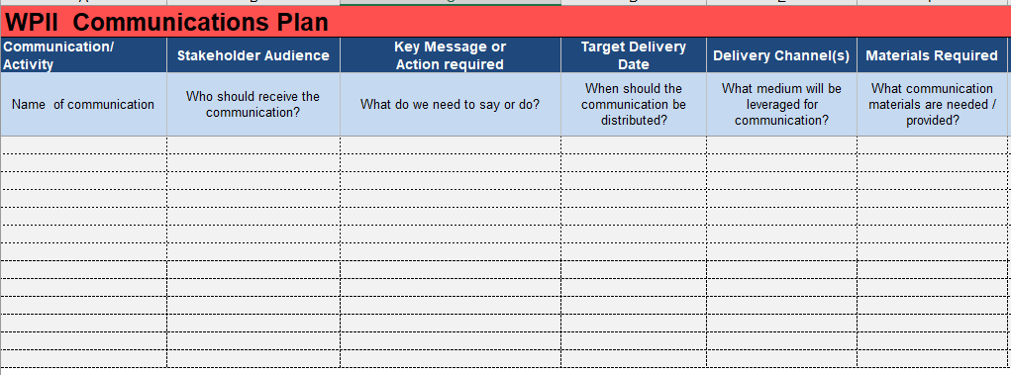
Communication Plan and Schedule
Based on the Communication Needs Assessment, the Plan will be tailored to stakeholders and adjusted based on feedback. It will be organized into two sections:
The Communication Plan specifies the event, audience, message, content provider, channel, timing & frequency, results, status, etc.
It is used to execute the communication plan and track progress
The Communication Calendar illustrates when each event is to be delivered, the intention of the communication and the channel that will be leveraged
It is also useful for aligning the sequence of communications with the implementation plan
ILLUSTRATIVE
ILLUSTRATIVE
19

Slide 20
Communication Delivery
Targeted and timely push and pull communications will deliver and receive relevant information to and from the right people at the right time, and broaden involvement. In-Person and Push/Pull Communications will include the following:
Communication | Audience | Purpose/Key Messages | Frequency
WPII Newsletter | Project Team WPII Liaisons District Leads | Project Updates Critical business decisions Accomplishments Leadership Msgs. | As needed
WPII Communications SharePoint
WPII PMO update Project Mgmt. Track Business Track Technical Track OCM Track | Program Team Vendors | Project Updates Risks and Issues Next Steps | Weekly
WPII OCM Meeting | OCM Team (FDOT,EY.CGI) | OCM Updates Accomplishments Critical Project Decisions | Weekly
WPII Liaisons Meetings | WPII Liaisons WPII Project team WPII Trans-Tech OCM Manager | Project Updates Alignment on Project Priorities Critical Business Decisions | Bi-weekly
20

