Slide 1
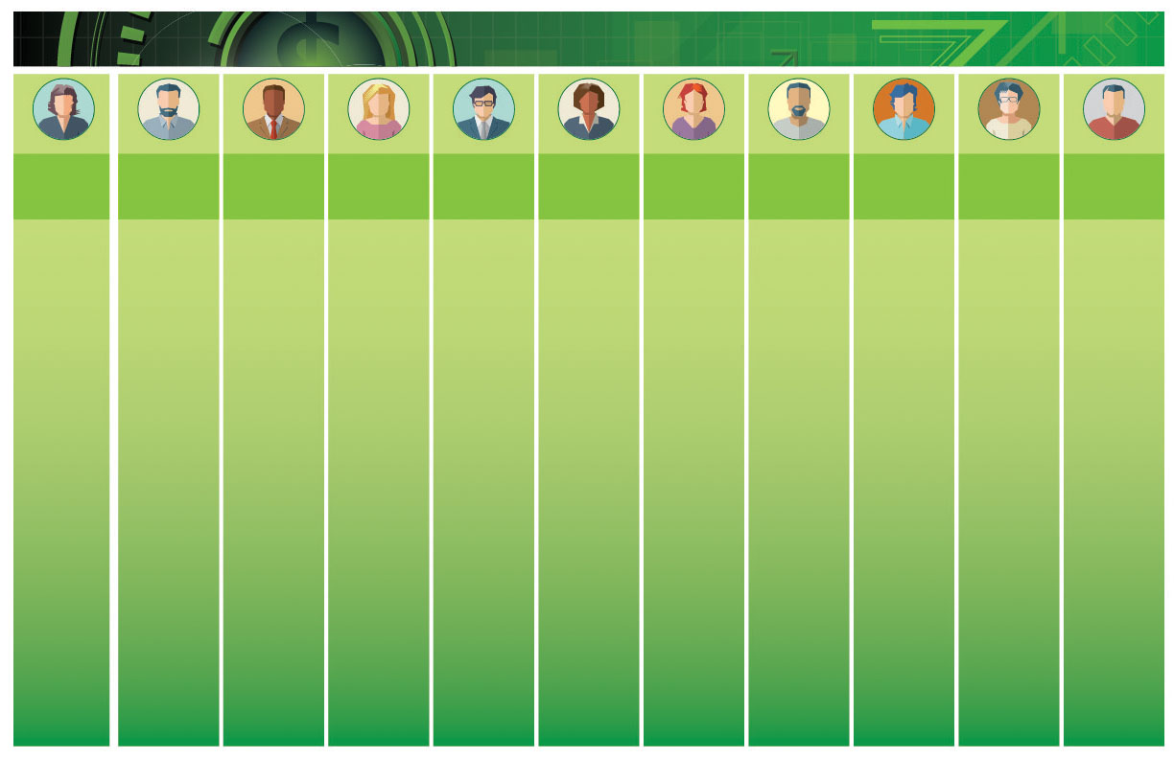
Executive
Project Sponsor (EPS)
Executive Steering Team (EST)
Management Steering Team (MST)
Project Management Team (PMT)
Functional Coordinators
Organizational Change Management (OCM)
Project Management Office
(PMO)
Key Sponsors
Sponsors
WPII Liaison
Change Agent
Accountable for success of the Project.
Ensure project meets documented scope, budget, and schedule.
Approve all deliverables for payment.
Approve any material Scope, Budget, and Schedule Variance via the Change Control process in consultation with the Management Steering Team.
Ensure cross -functional FDOT alignment.
Participate in review meetings and provides guidance and direction to the Project Team.
Serve as a champion of the Project within the Department.
Makes final decision regarding scope and Phase Gate Go/No Go passage if Key Sponsors cannot come to an agreement.
Resolve any issues escalated to Governance Tier 3 for resolution.
Participate in Executive Steering Team / Management Steering Team Review Meetings.
Provide guidance and direction to the Project Team.
Support time commitments of the Functional Coordinators and Subject Matter Experts.
Provide support to the Project Director and Project Team.
Review and accept or reject Vendor deliverables.
Resolve any issues escalated to Governance Tier 2 for resolution; and
Participate in Review Meetings and provide guidance and direction to the Project Team.
Serve as champions of the Project within the Department.
Participate in Project Status Meetings and provide guidance for the daily operations of the Project that do not require Governance.
Approve Task Work Orders (TWOs);
Inform Management Steering Team members of items that may impact the Project.
*Key Functional Coordinators drive design of overall future state business processes and ensure forward progress, stakeholder input is reviewed and incorporated where necessary, and functional planning requirements are met.
Define processes and functional content for FDOT.
Engage Subject Matter Expertise.
Provide status updates to the Project Management Team.
Serve as Process Visionaries for business area.
Coordinate activities and ensure appropriate participation.
Prepare functional project communications.
Review work products with project teams.
Recommend course of action on items under consideration.
Champion OCM activities associated with Project to the Department to drive the success of the project.
Create, manage, and implement OCM plan and associated plans to WPII network and Stakeholders.
Coordinate Central Office, Turnpike, and District Change Networks.
Identify and develop project management methodology, best practices, standards and templates per the PMI PMBOK standards.
Monitor and control compliance with project management standards, policies, procedures, and templates.
Coordinate project communication and meetings.
Coach, mentor, and train project team members on the project processes.
Ensure documented scope meets the needs of respective areas and, as a team, for FDOT.
Provide guidance on overall scope and project direction.
Support time commitments of the Liaisons, Change Agents, Functional Coordinators (FCs), and Subject Matter Experts (SMEs).
Approve project scope artifacts for respective area.
Approve passage through Phase Gates (Go/No Go).
Serve as champions for the Project within the Department.
Serve as champions of the Project within the Department.
Ensure respective area's participation in project activities, communications and information sharing, and feedback processes.
Coordinate reviews, feedback, and sign offs for future state business processes and other project deliverables for respective area.
Provide internal perspective, accurate information, and current status of the project.
Serve as key representative of future-state design concepts.
Explain intent of anticipated features and feasibility of design with local subject matter expertise and answer questions from respective area.
Serve as the single point of contact between respective area and project team.
Communicate with Stakeholder Group.
Liaise and coordinate project activities, communications and information sharing, and feedback between Stakeholder Group and WPII Liaison.
Advocate for the Project within Stakeholder Group.
Identify and manage concerns within Stakeholder Group.
Serve as coach for Stakeholders.

