Slide 1
High Level Change Impact Assessment SAMPLE

Slide 2
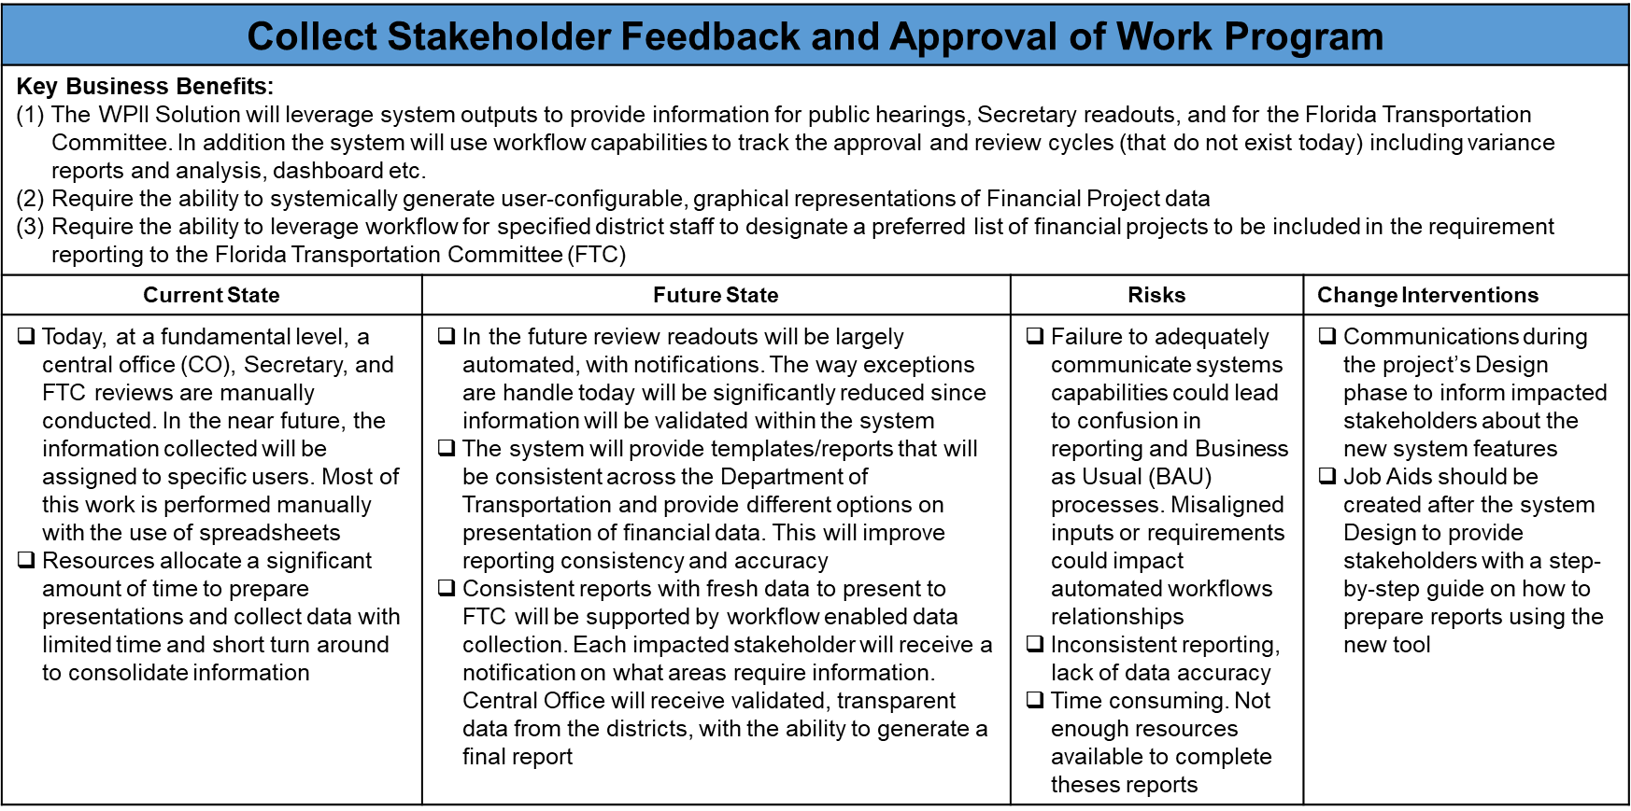
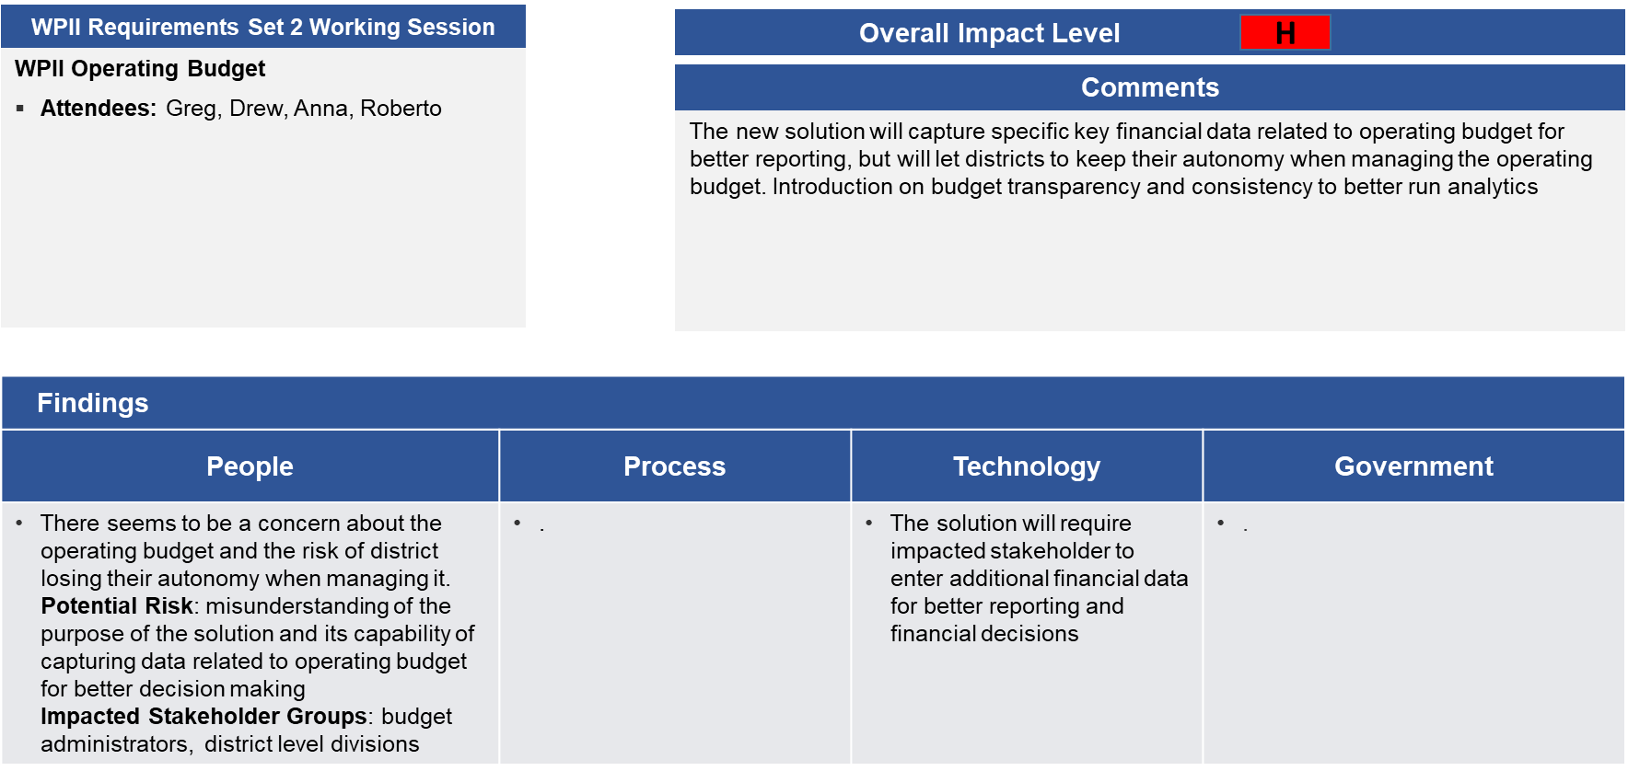
Sub-Function & Specific Topic Change Impacts
Below are the two methods in which high level change impacts are being captured for the current requirements phase:
Example
Example
Sub-Function Impact Assessment
Captures impacts by relevant requirements, broken out by sub function
Collected during requirements sessions
Includes high level views of Business Benefits, Current State, Future State, Risks if Not Mitigated, and Potential OCM Interventions
Impacts to be validated against SME’s and Systems Integrator prior to development of Training, Communications, or Readiness Plan
Identified requirements represent a sample of captured items to illustrate identified impacts
High Level Impact Assessment (Specific Topics)
Captures impacts raised by or discussed with project team that may comprise multiple requirements across various sub-functions
May also include impacts from a specific sub-function identified to be highly disruptive or impactful to FDOT
Collected during requirements sessions and/or dedicated conversations with project SME’s
Addresses initial impressions of impacts to People, Process, Technology, and Government
Impacts to be validated against SME’s and Systems Integrator prior to development of Training, Communications, or Readiness Plan

Slide 3
Sub-Function Change Impacts Summary
Based on requirements sessions attended between 8/12/19 –9/6/19, the following is a summary of the types of change impacts discussed to date. Anticipated approaches for mitigating those impacts are included as well, which will be further assessed as requirements gathering proceeds
Sub-Function
Anticipated Impact and Approaches for Mitigation
Collect Stakeholder Feedback and Approval of Work Program
Submit Legislative Budget Report
Submit Legislative Budget Report
Establish Candidate Project Through Unique Project Identifier
Communication: Job Aids to inform District Work Program Staff, District Leadership, and Central Office Work Program Staff about new system features
Stakeholder Engagement: Involvement of key FDOT resources to participate in designing the system to incorporate the Budget toolbox into the new WPII solution
Training: Training content should be developed during the Build phase for budget coordinators, requestors program area (L2 Group), district level, and divisions budget issues approvers
Communications: Draft messages to Work Program staff/program management staff about the historical data process after the SI is finished designing the system

Slide 4
Sub-Function Change Impacts Summary (Cont.)
Sub-Function
Anticipated Impact and Approaches for Mitigation
Manage GAA Impact
Stakeholder Engagement: Roadshow that includes a prototype while designing the system for budget coordinators and cost center managers
Manage Project Resources
Communications: Draft messages prior to the system Build phase to inform project managers, Work Program analysts, and other stakeholders about the system notifications and the governance structure
Procure Contract Resources
Stakeholder Engagement: Prior to designing the system, workshops may be held with SME’s (contract manager, contract arbiters, project managers, etc.) to determine how new data hierarchy and rollups drive current activities
Manage Contract
Communications: Job Aids could be created after system Build detailing new workflows
Close Contract
Stakeholder Engagement: Focused group discussions may be held with contract management and finance accounting SME’s to determine practices regarding automated/batch uploads to the State Financial Management System

Slide 5
High-level Sub-Function Change Impacts
Collect Stakeholder Feedback and Approval of Work Program
Key Business Benefits: The WPII Solution will leverage system outputs to provide information for public hearings, Secretary readouts, and for the Florida Transportation Commission (FTC). In addition, the system will use workflow capabilities to track approval and review cycles that do not exist today, including variance reports and analysis, dashboard etc. Req. 5654-5658 Require the ability to systemically generate user-configurable, graphical representations of Financial Project data and leverage workflow for specified district staff to designate a preferred list of financial projects to be included in the requirement reporting to the Florida Transportation Commission (FTC) Req. 5660
Current State | Future State | Risks | Change Interventions
Today, at a fundamental level, central office (CO), Secretary, and FTC reviews are manually conducted. In the near future, the information collected will be assigned to specific users. Most of this work is performed manually with the use of spreadsheets Resources allocate a significant amount of time to prepare presentations and collect data with limited time and short turn around to consolidate information | In the future review readouts will be largely automated, with notifications. The way exceptions are handled today will be significantly reduced since information will be validated within the system The system will provide templates/reports that will be consistent across the Department of Transportation and provide different options on presentation of financial data. This will improve reporting consistency and accuracy. In addition, consistent reports with fresh data to present to the FTC will be supported by workflow enabled data collection. Each impacted stakeholder will receive a notification on what areas require information. Central Office will receive validated, transparent data from the districts with the ability to generate a final report | Failure to adequately communicate system capabilities could lead to confusion in reporting and Business as Usual (BAU) processes. Misaligned inputs or requirements could impact automated workflows Inconsistent reporting and lack of data accuracy could impact available resources to complete reports due to time consuming activities | Communications prior to designing the system to inform District Work Program Staff, District Leadership, and Central Office Work Program Staff about the new system features Job Aids should be created prior to system Build to provide District Work Program Staff, District leadership, and other stakeholders with a step-by-step guide on how to prepare reports using the new tool

Slide 6
High-level Sub-Function Change Impacts
Collect Stakeholder Feedback and Approval of Work Program (Cont.)
Key Business Benefits: The WPII Solution will enable workflow functionality to request and approve the Department's Capital Plan of Project (i.e., Work Program) in totality for the purposes of legislative budget request submission Req. 5881-5883
Current State | Future State | Risks | Change Interventions
The approval process is largely ceremonial now and occurs outside of a system | Instead of high-volume, fragmented data and presentations, system generated readouts and dashboards will be made available to support the approval process. The Secretary will be able to evaluate fresh data from integrated systems and provide his/her digital signature, generating a letter of approval. This process will also introduce several new layers of approvals prior to final sign-off | All the system capabilities will be performed in the new solution, requiring new elements of review and sign off. Failure to adequately communicate systems capabilities could lead to confusion | Communications (one pager) prior to the system Build phase to inform impacted stakeholders about the new approval process. In addition, supporting training may be included for key sign-off providers on their new responsibilities during the Build phase

Slide 7
High-level Sub-Function Change Impacts
Submit Legislative Budget Report
Key Business Benefits: The WPII solution will capture key financial data related to operating budget for better reporting and decision making Req. 5909-5922 Require the ability to generate actions for specified users within the budgeting function, designating the appropriate system, and enabling the correct permissions. This workflow will be supported by systemic actions, notifications triggers, accessible document library, report generation, and data analysis. Current state, these actions are performed today by an MS Excel based tool called “Clearing House“ Req. 5891-5908
Current State | Future State | Risks | Change Interventions
Budget toolbox is currently housed in SharePoint and needs to be moved over to the new solution (system integrator) All department budget needs are currently processed manually within an MC Excel based tool called “Clearing House” | All the toolbox capabilities will be performed in the new WPII Solution The WPII solution will incorporate all functionalities provided by “Clearing House”, as well as introduce new capabilities based on transparent, validated data | Failing to adequately communicate the new system functionality can create confusion among users If not addressed, it might cause confusion and unnecessary work | Involvement of key FDOT resources to participate in designing the system to incorporate the Budget toolbox into the new WPII solution Training should be developed during the Build phase for budget coordinators, requestors program area (L2 Group), district level, and divisions budget issues approvers. In addition, training delivery should be conducted during the initial sprints

Slide 8
High-level Sub-Function Change Impacts
Establish Candidate Project Through Unique Project Identifier
Key Business Benefits: The WPII solution will have the ability to systematically track and present to the users the history of changes to all Financial Project data attributes. Historical elements will include: all value, new value, prior data value, user ID, and Timestamp. Req. 0197, 6008 The WPII solution will provide users with the ability to restrict designated user groups from systematically modifying selected financial attributes (limit read-only access) Req. 6011, 0260
Current State | Future State | Risks | Change Interventions
Current state, only financial changes are captured but there is not enough information around project scope changes (who, when, and why). Users do not have enough information to do forensic analysis Restrictions to modify financial attributes are locked manually and are very rudimentary. Some users misinterpret the data shown (i.e. data that is used for analysis/ financial projections) | Capturing historical information of the project will be intuitive and user friendly based on system design (i.e. if the project scope is changed). The system will provide context around the who, when and why Automated system notifications will let users know when access is restricted to modify/view financial attributes (i.e. external consultants with no need to access that information) These features will only let designated users view/modify data | Failing to adequately track historical elements can prevent accurate forensic analysis of changes to financial project data Confusion around data shown by the system and the ability of unauthorized users to change key financial attributes | Communications to Work Program staff/program management staff prior to the Build phase to completed with the system integrator Prior to the Build phase, communications to Work Program staff/program management staff and other impacted resources (i.e. external consultants) should be executed with the system integrator

Slide 9
High-level Sub-Function Change Impacts
Manage GAA Impact
Key Business Benefits: The WPII solution will have the ability to systematically validate that amounts and budget structure posted in Master Allocation Tables at a summary level (i.e. Organizational Level 1) are consistent with amounts and budget structure as provided in LAS/PBS specified column. This feature will enable transparency and provide users with the ability to generate report and perform data analysis. Req. 6027
Current State | Future State | Risks | Change Interventions
Current state, this function is performed in an Excel macro file. Manual activities such as emails and phone conversations dictate much of this workflow. Significant process improvement opportunities exist if these activities are integrated into the tool. A high degree of forensic analysis is conducted to determine how the budget is allocated into different projects. Data analysis is complex due to the required amount of manual intervention. There is a high degree of stakeholder concern over the lack of autonomy and the need to dispose the budget as required by the district | Validation of the information will occur systematically as opposed to manually. In addition, reports and budget dashboard will be created for better traceability of the budget use | Lack of accountability and possible misuse of the budget | Roadshow that includes a prototype while designing the system for budget coordinators and cost center managers. In the meantime, budget coordinators should participate in the requirement sessions to provide their input and get their buy-in

Slide 10
High-level Sub-Function Change Impacts
Manage Project Resources
Key Business Benefits: The WPII solution will implement automated workflows to augment CEI, O&M report, and financial project correlation processes. In addition, governance will be introduced into financial transaction processes, including automated system enabled “hard stops”, to best support leading practice finance accounting requirements. Req. 8225, 8226, (OLD) 8232, Req. 8200 Manual interface points will be set up to ensure a level of oversight and quality control over automated processes before finance accounting results and data are uploaded to the State Financial Management System. Req. (OLD) 8232, 8233
Current State | Future State | Risks | Change Interventions
WP staff adjusting programmed amounts on CEI phases are prompted manually to begin workflow activities. Similarly, governance around running the O&M report is entirely manual and typically occurs at the end of the workflow Finance accounting processes are often reliant on manual intervention and quality control, usually occurring at the end of workflows and processes | The WPII solution will enable automated flags and alerts to begin workflow activities, as well as introduce governance at the beginning of select processes to ensure compliance. Select users will have oversight and signoff over automated processes enabling bulk upload of finance data to state accounting systems The WPII solution will introduce automation and integration with key systems to support process and workflow governance occurring further upstream to best capture errors and prompt corrections prior to finalization or submission | Failing to adequately communicate the new system functionality can create confusion among users. Likewise, it might cause confusion, quality control issues, and rework In addition, unprepared users may be unable to initiate or complete key Business As Usual (BAU) activities | Communications when designing the system to inform project managers, Work Program analysts, and other stakeholders about the system notifications and the governance structure. Job Aids should be created after designing the system to provide a step-by-step guide on new O&M governance End to End Walkthroughs on automation within key systems can be conducted with project managers for buy-in

Slide 11
High-level Sub-Function Change Impacts
Procure Contract Resources
Key Business Benefits: The WPII solution will house key contract documents within the system for easy access by users, reducing the number of “screens” needed to navigate. Req. 8441, 8442 Design / Build project designations will be enabled at various levels of the new data hierarchy, enabling more granular reporting. Req. 8448 Automated system governance will be introduced to support finance accounting processes. Req. 8452
Current State | Future State | Risks | Change Interventions
Contract documents are stored in Contract and Financial Management (CFM), which requires users to manually navigate systems to access this information Design / Build designations are enabled at the Financial Project level, currently the most granular level of reporting enabled Current state, quality control and governance largely occurs downstream within processes or “after the fact”. This requires significant rework to address issues | Contract documents will be stored within the WPII solution for easy access As additional data hierarchy and granularity is introduced, Design / Build attributes will be able to be applied to different designations within the new data structure Enhanced governance and system supported workflow will help support data integrity and drive down manual errors | Lack of knowledge around where key documents are stored could lead to rework or pulling incorrect documentation Confusion around data attributes within the new hierarchy could lead to misaligned reporting and readouts Implementation of new process controls could disrupt BAU activities if appropriate users are unaware of new responsibilities or required actions | Prior to designing the system, workshops may be held with SME’s (contract manager, contract arbiters, project managers, etc.) to determine how new data hierarchy and rollups drive current activities Interviews could be held with contract managers and arbiters SME’s to determine which documents will be most useful for easy access Job Aids detailing new automation and governance points could be provided to key stakeholders

Slide 12
High-level Sub-Function Change Impacts
Manage Contract
Key Business Benefits: The WPII solution will enable systemic workflow and notification capabilities to limit manual interaction with value add data. Req. MC0004, 0005, 0019, 0020,0024 Enable expanded justification narrative capabilities to include context around contract management actions. Req. MC0010 Introduce near real-time data integration around allocation and funding consumption data. General
Current State | Future State | Risks | Change Interventions
Processes regarding Contract Management are highly manual, reliant on disparate systems, and workflows are largely managed via email Contract Management roles are largely determined by manual process (who is sent what email, reads what report) and therefore lack critical context information Data refresh is a lengthy process requiring SME hours, batch uploads, and mapping between separate systems | Workflow functionality within the system will ensure that specific, dedicated users are routed the appropriate work tasks Role based user bands will help align processes, outputs, and system generated notifications to ensure users have access to relevant data System integration and standardized data models / formatting will cut down on time to validate data between systems | Failing to adequately communicate the new system functionality could result in inefficient processes that don’t take advantage of new capabilities Lack of clarity around role expectations could lead to end users receiving task notifications for items they cannot complete Unfamiliarity with new data presentation or refresh capabilities could negatively impact reporting | Job Aids could be created after system Build detailing new workflows Prior to designing the system, workshops could be held with contract managers to discuss which user roles should receive which alerts Prior to system build, workshops may be held across various FDOT departments to determine impacts from easier access to aligned data and “single source of truth” repositories

Slide 13
High-level Sub-Function Change Impacts
Close Contract
Key Business Benefits: The WPII solution will enable systemic workflow and notification capabilities to limit manual interaction with value add data. Req. CC0001, 0002, 0007, 0014, 0015, 0017 Enable user based notifications regarding contract change status based on data attributes. Req. CC0002, 0008, 0010, 0021 Introduce business rules that, once established, automate “check the box” style activities within the system. Req. CC0020
Current State | Future State | Risks | Change Interventions
End of life contracts are predominately processed in a fragmented and manual fashion, reliant on disparate systems and email notifications for progress through a workflow At times, changes to a contract status can go unrecognized or miscommunicated. This results in rework and disruption There is a high amount of manual interaction with contract data, increasing risk of errors | Systemic workflow will be employed to ensure correct system users are primarily interacting with contract data at the proper place within the workflow Role based notifications will alert users when actions need to be taken or contract statuses have changed “Check the box” style activities will be automated where possible to ensure the smooth passage of contracts and contract closures downstream | Unfamiliar users may not realize why their user permissions do not allow them access to different parts of the workflow Misunderstanding regarding system notifications could lead to key tasks remaining incomplete If not properly communicated, automated functionality may lack the proper level of user oversight | Prior to designing the system, workshops could be held with contract managers and arbiters to align users to automated workflow points Focused group discussions may be held with contract management and finance accounting SME’s to determine practices regarding automated/batch uploads to the State Financial Management System Job Aids could be delivered detailing how processes are automated

Slide 14
Change Impact Summary: Specific Topics
Current Observations
Based on early requirement gathering sessions, the WPII implementation will have large scale change impacts from both additional system functionality and changes to mindset and culture that must be addressed.
High Level Assessment
Change management activities should be considered prior to designing the system to ensure that stakeholders are engaged in a productive way that does not contribute to unease or concern with the WPII solution
Introduction of a new data hierarchical structure will have significant impacts across data reporting and analysis, as it will open up new reporting, forecasting, and simulation capabilities
Current state reports will have to be mapped to the new hierarchy and any new reports or readouts will have to take it into account. Significant stakeholder education will need to take place within FDOT to both understand the new hierarchy and take advantage of it’s capabilities.
This stakeholder education may expand to stakeholders outside FDOT using FDOT data.
Changes to how the operating budget is managed must be discussed with care and consideration prior to system implementation. It is possible that varied locations (Districts, Turnpike) might perceive a loss of autonomy, which could lead to dissatisfaction with WPII
Conversations and working sessions regarding managing the operating budget should be had in advance of designing the system to emphasize the additional capabilities that will be introduced.
District stakeholders should be involved and have a level of comfort interacting with both the project team and technology development teams to ensure their concerns are part of the solution
Adoption of user based role permissions will be a system driven requirement that will have an impact on culture / mindset. In an integrated solution, user activities are limited by level of access and permissions. This will be a large change from current state, where the presence of largely manual processes and fragmented systems mean users have a high degree of autonomy interacting with FDOT data, processes, and functions.
Business value of user based role permissions and data integrity should be key topics of messaging on this subject.
Desired user bands and capabilities should be discussed via workshop or ThinkTank-style sessions prior to designing the system to determine ideal-state capabilities broken out by user function to validate against system capabilities in a Fit-Gap analysis.
Managing budget allocation today is highly manual, subject to error, and lacking in standardization. This includes some Districts having the ability to manually load financial data into accounting systems. Adjustments to this processes will have far reaching impacts between all Districts.
Additional capabilities from the WPII solution should be demonstrated to stakeholders via activities such as end to end walkthroughs or working sessions.
Messaging can emphasize topics such as time savings from leveraging an integrated system and driving down rework thanks to better supported data integrity and governance.
User defined editing of data around financial projects is a sensitive area, given the amount of capabilities and data access current users have within the system. While the current state enables a high degree of flexibility, it also introduces risk regarding data integrity.
Stakeholder education around the budgeting function will be a key activity to emphasize data integrity and collaboration between the budgeting functions between Districts and Central Office.
This will help bridge the gap between current and future state understanding.
The introduction of the “Three Box Rule” for project funding will be a net new concept supported by new functionality for all FDOT users. This will require change management support - not just regarding training and communications, but also demonstrating the value and clarifying the benefits for all impacted by this change
Change management activities will focus on introducing the “Three Box Rule” as a concept, as well as explaining the system capabilities supporting it.
As this is a net new capability, stakeholder education will focus on the business value derived from this process and how it integrates into existing budget activities.

Slide 15
Introduction of New Hierarchical Structure
WPII Requirements Session
WPII Develop the Work Program Attendees: NA Potential Risk: Misunderstanding of the new hierarchical structure Impacted Stakeholder Groups: Work Program Staff, all FDOT Districts, District Secretaries, and other stakeholders
Overall Impact Level
High
Comments
The introduction of a new hierarchical structure will incorporate a transportation initiative (i.e. SunRail) that will break down into individual project initiatives (e.g. new railway grade crossings). This will further break down into work program item, item segment, phase, and project sequence. Change Intervention: Once the hierarchical structure is designed by the business, roadshows and meetings with all impacted stakeholders should be conducted
Findings
People | Process | Technology | Government
Today there is only one level, which is financial project. There is not a more granular hierarchical structure Stakeholders used to a single breakdown of data will now be exposed to data at different levels and initiatives | The new hierarchy is necessary to avoid activities and misalignments within the department A more detailed data hierarchy will add additional detail to new and existing reports, which could impact dashboards, readouts, and executive summaries | A new data hierarchy will impact how data is delivered, consumed, and processed by the new system The new hierarchy will need to be taken into account when validating / remediating existing reports and data feeds | Any legislature or Secretary readouts or reports will need to take the new hierarchy into account Stakeholder education should be considered regarding new reports or reporting capabilities

Slide 16
Managing the Operating Budget
WPII Requirements Session
WPII Develop the Work Program Attendees: Greg Patterson, Anna Suhrweir, Linda Glass Johnson, Leslie Wetherell, Drew Evers, Roberto Vicevich Potential Risk: Misunderstanding of the tool objectives and capabilities Impacted Stakeholder Groups: Work Program Staff, all FDOT Districts, District Secretaries, and other stakeholders
Overall Impact Level
High
Comments
The new solution will capture key financial data related to operating budget for better reporting, but will allow districts to keep their autonomy when managing the operating budget. Introduction of budget transparency and consistency will enable more accurate analytics and forecasting. Change Intervention: Prior to the Design phase, meetings with all impacted stakeholders should be conducted to explain the capabilities of the tool and the autonomy that district will still have when managing the operating budget
Findings
People | Process | Technology | Government
There seems to be a concern about the operating budget and the risk of Districts losing their autonomy when managing it Introducing transparency into a disparate and fragmented process could elevate risks and issues that previously went unrecognized | Large scale process changes can be anticipated once new system capabilities are introduced into the budgeting process These changes will likely impact Turnpike, Central Office, and Districts | The solution will require impacted stakeholders to enter additional financial data for better reporting and financial decisions | A cleaner, more transparent budgeting process will support legislature and Secretary reporting capabilities

Slide 17
Adoption of User Based Role Permissions
WPII Requirements Session
WPII Develop / Deliver the Work Program Attendees: Greg Patterson, Lisa Evans Potential Risk: Incorrectly aligned user capability bands restricting needed access Impacted Stakeholder Groups: All system users within FDOT
Overall Impact Level
High
Comments
The introduction of role based user permissions will represent a major change for FDOT system users. Current state, system permissions are largely open to various stakeholders. Workflows and processes are driven by who accesses what, since access is largely unrestricted. Future state, workflow and automation capabilities within the solution will dictate which users have access to certain information and actions within the system. Change Intervention: After designing the system, workshops should be held to discuss end-to-end processes across FDOT and validate user roles against system capabilities.
Findings
People | Process | Technology | Government
The introduction of User Based Role Permissions will drive a cultural shift within FDOT. OCM will need to mitigate feelings of restricted autonomy and unnecessary oversight Stakeholders who are used to expansive system and data access today will need to be deliberately engaged to build buy-in and support | New processes will have to take into account that not all users will have access to the full suite of system capabilities and data, based on their role Key processes will have to be explored and discussed to make sure there are no gaps in user capabilities | While designing the system, flexibility will need to be programmed within the system to ensure overrides or expedited access can be enabled Development teams will need to work with end users to determine appropriate user bands | Any roles interacting with Legislature or Secretary level reports, readouts, or activities will need to have their access vetted end-to-end prior to these activities Any data access permissions outside of FDOT for audit or government transparency should be discussed early on with technology development teams

Slide 18
Managing GAA Impact: Budget Allocation
WPII Requirements Session
WPII Develop the Work Program Attendees: Greg Patterson, Anna Suhrweir, Linda Glass Johnson, Leslie Wetherell, Drew Evers, Roberto Vicevich Potential Risk: Misunderstanding of the capabilities of the new solution and its capability analyzing data and updating FLAIR and Palm Impacted Stakeholder Groups: Work Program Staff
Overall Impact Level
High
Comments
A standardized method of loading budget allocation and distributing between organizational units will be introduced. Today, some districts have the ability to manually load into FLAIR or send a script to a controller. In the future, the new WPII solution will introduce governance to any information uploaded into FLAIR or Palm. It will be processed in the new system, which will then provide the results and provide better transparency. FDOT needs to make sure they have the tools to effectively perform zero base budget initiative. Today it cannot be done since there is not enough insights on budget allocation. Change Intervention: Roadshows, product demos, and meetings with impacted stakeholders during the design phase of the project.
Findings
People | Process | Technology | Government
Users will have to load all the information in the new solution first, instead of PALM or Flair. |  | The system will require impacted stakeholder to allocate budget distribution between organizational units

Slide 19
Program a Project: “User defined” Edits
WPII Requirements Session
WPII Develop the Work Program Attendees: Greg Patterson, Anna Suhrweir, Linda Glass Johnson, Leslie Wetherell, Drew Evers, Roberto Vicevich Potential Risk: Misunderstanding of the capabilities of the new solution and concern about the flexibility to perform this task Impacted Stakeholder Groups: Work Program Staff/Managers
Overall Impact Level
High
Comments
The ability to change data/edit (change the association) for a Financial Project (i.e. Ability to edit the user-defined value for ROI) is a current concern, especially for District 3. Users not only want to define, but also have edit permission. Right now, most data for super user access can be added/modified without any type of restriction. Other users want to add/edit defined fields. There is a high degree of concern around reaction if this functionality is eliminated, as well as general perception of infringing on users flexibility and autonomy. Change Intervention: Communications to inform stakeholders on the importance of data quality and integrity during the Design phase of the project.
Findings
People | Process | Technology | Government
The system will add more structure and more rigid rules to reinforce data condition and correct user behaviors. There is a concern among users that discretional edits might be eliminated. But (communications needed for this group |  | The system will provide a request to bypass of this rule, but only if enough justification is provided.

Slide 20
Program a Project - Three Box Rule
WPII Requirements Session
WPII Program a Project Attendees: NA Potential Risk: Misunderstanding of the purpose of the three box rule and its benefits Impacted Stakeholder Groups: Work program staff, executives, new district secretaries
Overall Impact Level
High
Comments
Introduction of the “Three Box Rule” and the purpose of each “box” (contingency, reserve, and target) for project funding will be new to all impacted stakeholders. Today, there is only one “box” where funding for projects are allocated. Feedback indicated that some users don’t want to have three separate box codes since they don’t see the value in it and don’t understand how it is used today. Change Intervention: Once the box rule is finalized by the business, roadshows with graphics and meetings with impacted stakeholders to explain box purpose, cash forecasting, and legislature reporting
Findings
People | Process | Technology | Government
This is a new concept to a lot of users and will require further communications to get buy-in.

Slide 21
Appendix

Slide 22
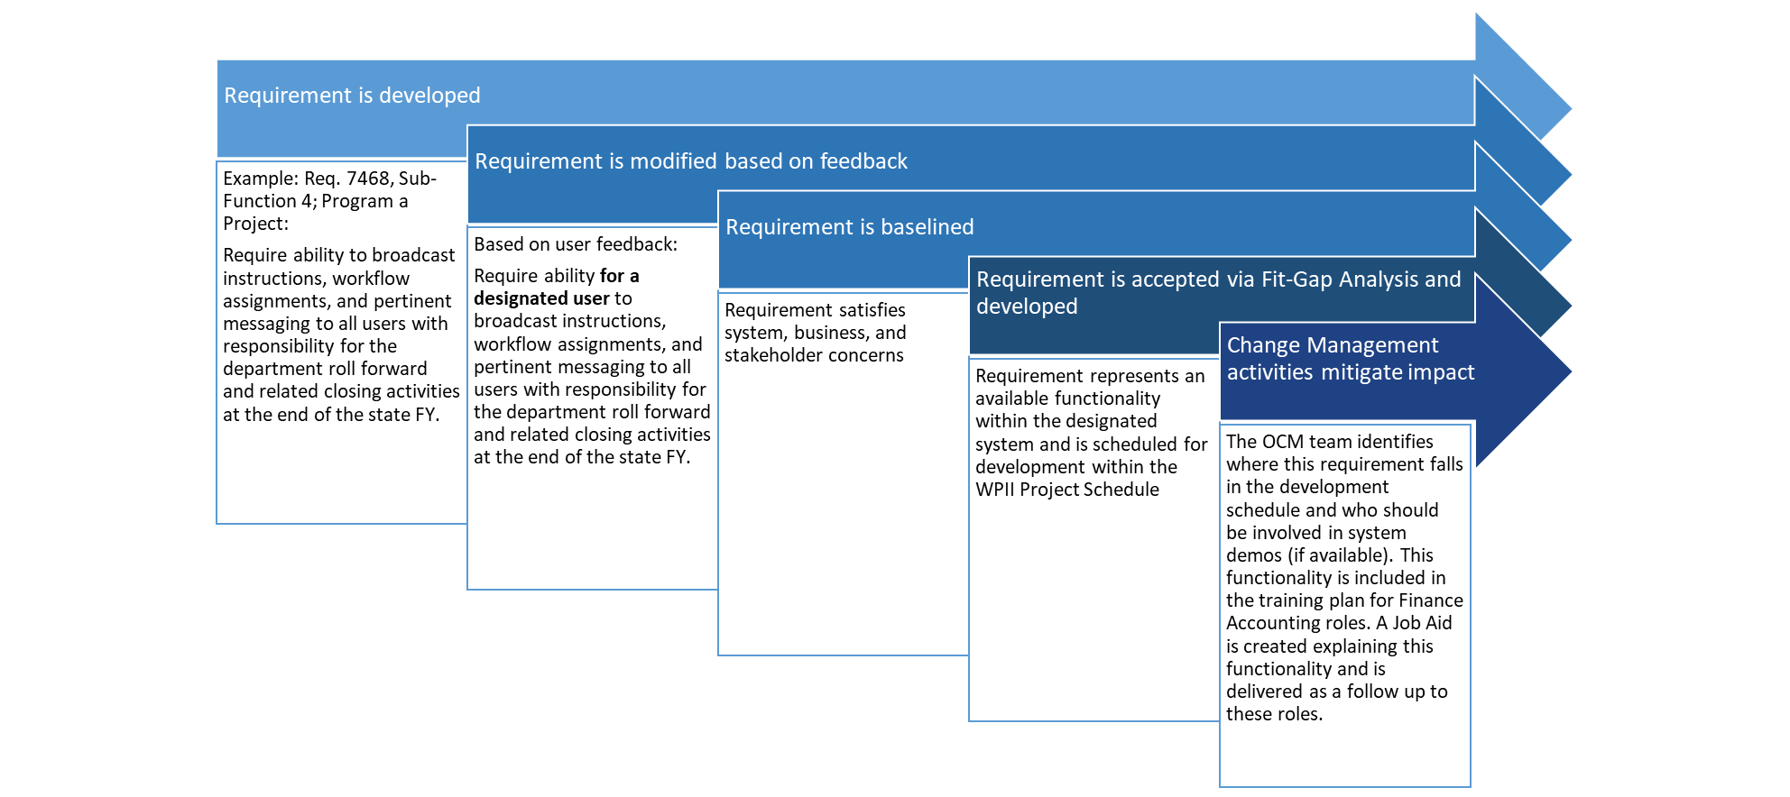
High Level Process Overlay
Discover
-High level change impacts are captured in requirements gathering sessions
- High level impacts are discussed with WPII team
Solve
- Entering the Fit-Gap analysis, a holistic view of OCM change impacts will be provided for baselined requirements
- These impacts will be modified as requirements either fall out during the Fit-Gap analysis or adapt to system capabilities
- Entering the Design phase, identified impacts and desired functionality will map to their relevant development items
Execute
- Entering the Build phase, identified impacts and desired functionality will be aligned to the Build schedule
Validate
- As requirements are further defined and established within each sub-function, the OCM team will ensure impacts are relevant to any requirement changes or modifications
- Desired functionality, impacts and business value will be tracked and mapped to confirmed requirements within each Sub-Function
- As these items are developed, they will be tracked by the OCM team
- Change impacts map to specific trainings and communications in the Training, Communications, and Readiness Plan

Slide 23
Change Impact Categorization
Change by Degree
High Impact | Medium Impact | Low Impact
Magnitude of the change is very extensive (i.e., large numbers of employees will be impacted and will require extensive education or communications efforts) | Magnitude of the change is medium (i.e., small to medium sized audiences will require some communications or education effort) | Nature of the change is fairly simple and/or the number of employees impacted is small
Complexity of the change management tools required to address the change is high (e.g., extensive job redesign is required, the creation of complex education materials or media such as web-based education is required) | Change management tools required to address the impacts are not overly complex (e.g., targeted communications, knowledge-based education materials, updated job descriptions) | Change management tools required to address the impacts are fairly simple (i.e., general communications)
Frequency of activity is high (e.g. activity is performed on a daily/weekly basis) | Frequency of activity is medium (e.g. activity is performed on a monthly basis) | Frequency of activity is low (e.g. activity is performed on a yearly basis)
Need for stakeholder buy-in among critical user groups is high | Need for stakeholder buy-in among critical user groups is medium (i.e., impacted employees will not be excited about pending change, but will likely follow the direction of leadership with little to no resistance) | Need for stakeholder buy-in among critical user groups is very low (i.e., impacted employees will be excited about pending change or will not consider it significant enough to generate anxiety)
Type of Change
People – Where a task/ activity has been added to/ taken away from a particular role
Process - Where the order of tasks/ activities is changed, or the activities described in the process are different from today
Technology - When the activities described in the process are performed using a technology different from that used today
Government - When a change impacts legislature readouts, internal FDOT policy, rules/regulations, or required reports

