Slide 1
Consultant Invoice Transmittal System (CITS)
Project Manager Overview

Slide 2

What you will learn:
Gaining Access to CITS
Proper Invoice processing
How CITS relates to Consultant Contracting
Contract Navigation
Scheduling and Tables

Slide 3


CITS Statistics
Statewide roll-out 7/02
Currently over 2000 total users, including
819 corporate ID’s from over 600 different firms
Nearly 2300 active contracts
Over 1500 invoices are paid each month
totaling over $75 million

Slide 4
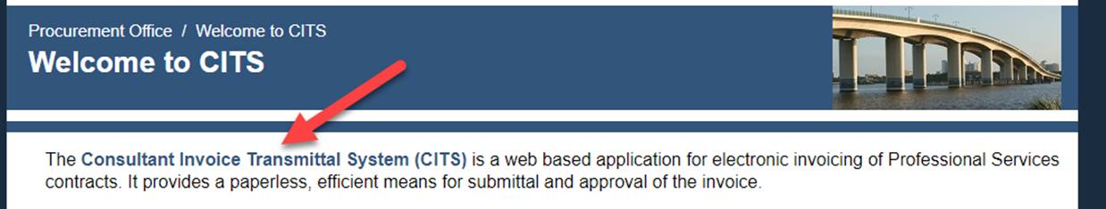
Getting Started
All users of the CITS system must have a Mainframe RACF Account and Password and System User Authorization (note attached link)
https://www.fdot.gov/procurement/Welcome-to-CITS.shtm

Slide 5
CITS Access – Consultants who need to invoice

Slide 6
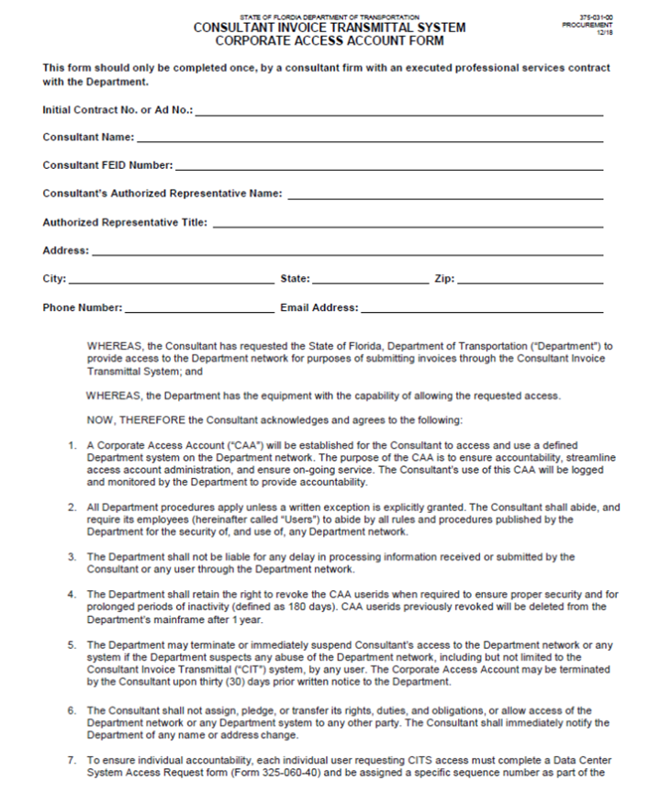
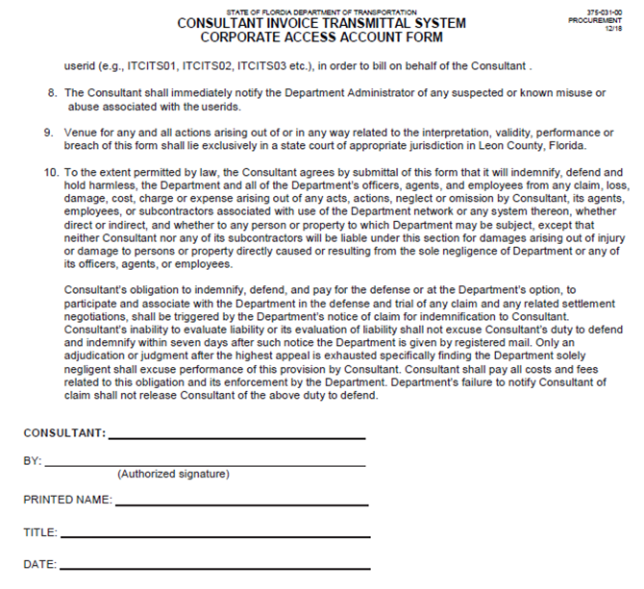
Corporate Access Agreement
In order for the firm to gain access to CITS, they will need to complete the Corporate Access Agreement.
https://na2.docusign.net/Member/PowerFormSigning.aspx?PowerFormId=bb72f079-728c-4e10-b3d0-f8606f2d311c

Slide 7
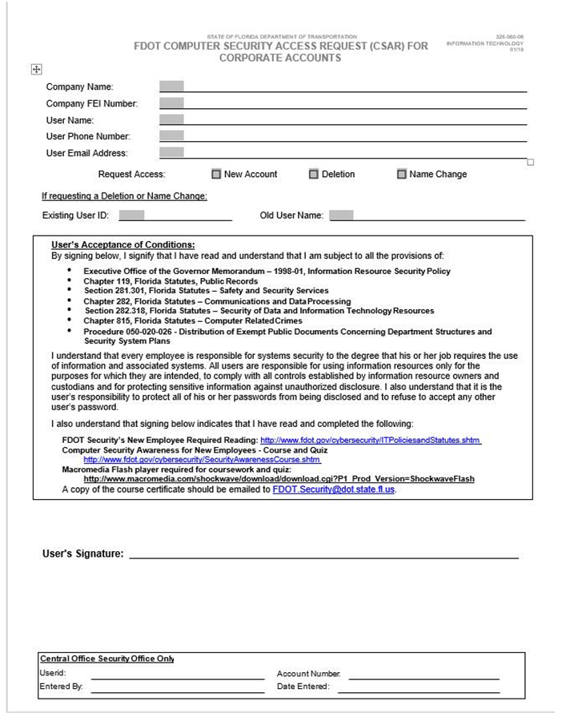
Individual Access Agreement (For Consultants who invoice)
An individual can gain access to CITS through completing the Security Access form.
https://na2.docusign.net/Member/PowerFormSigning.aspx?PowerFormId=c41e2a43-545b-4694-a1d5-8fc22339d2d3
Each user must read the policies and procedures found at the following link: https://www.fdot.gov/cybersecurity/ITPoliciesandStatutes.shtm
Each user must take the “Technology Resource Awareness Certification Kit” course referenced on the Computer Security website located at the following web address: http://wbt.dot.state.fl.us/ois/CSATRACKWBT/TRACKcbt.htm
Transmit a pdf copy of the signed Computer Security Awareness Certification form to the following e-mail address and indicate in the e-mail that it is for requesting access to CITS:
FDOT.Security@dot.state.fl.us

Slide 8
CITS Access – FDOT users

Slide 9
FDOT Project Manager’s Access
FDOT Project Managers will need to complete an AARF Request once for their userID.
A CITS Authorization Form, Form No. 350-030-10, is required per each project that the Project Manager is anticipated to be an invoice reviewer.
Helpful tip:
http://infonet.dot.state.fl.us/procurement/professional/forms.htm

Slide 10
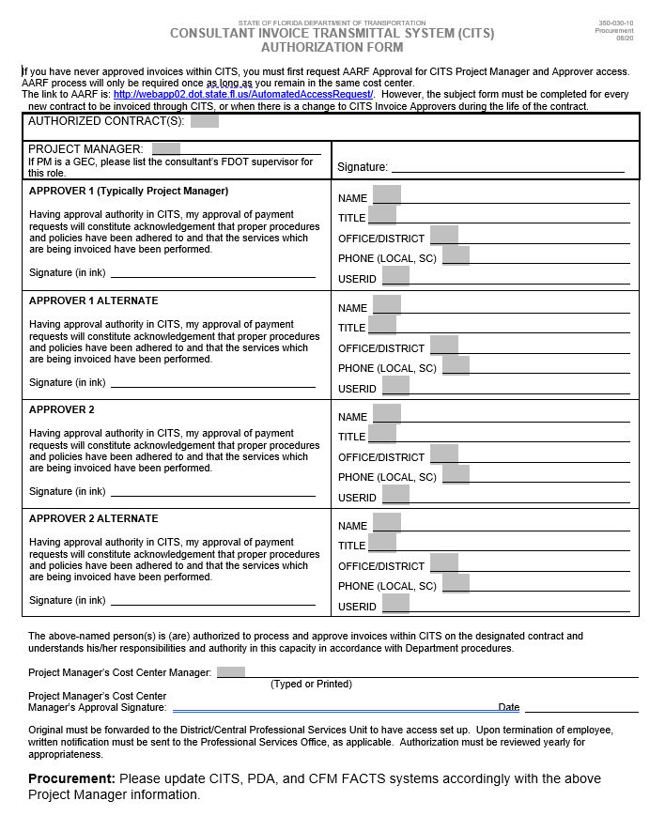
CITS Authorization Form, Form No. 350-030-10

Slide 11
Contract Status
Once contract documents are executed, Professional Services staff enters information into CITS
Note: Contract will be in suspended status during this process. Consultants cannot invoice during this time.
Financial Services Reviews contract to ensure accuracy prior to locking down for Consultant Invoicing

Slide 12
Invoice Status
Consultant enters and submits invoice in CITS and submits all supporting documentation to Project Management in the preferred format…
Invoice status: Prime
Project Management reviews and approves, or rejects for payment ensuring work effort is complete..
Invoice status: Primary or Secondary Reviewer
Financial Services audits and approves or rejects invoice for payment
Invoice status: Financial Services
Invoice status: Paid
Department of Financial Services (DFS) cuts voucher

Slide 13
Invoice
Financial Services
Primary
Secondary
or
or
Primary Alternate
Secondary Alternate

Slide 14
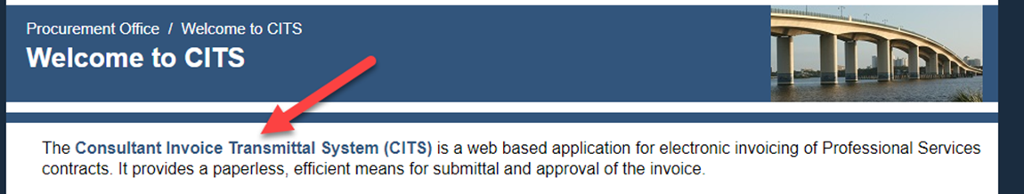
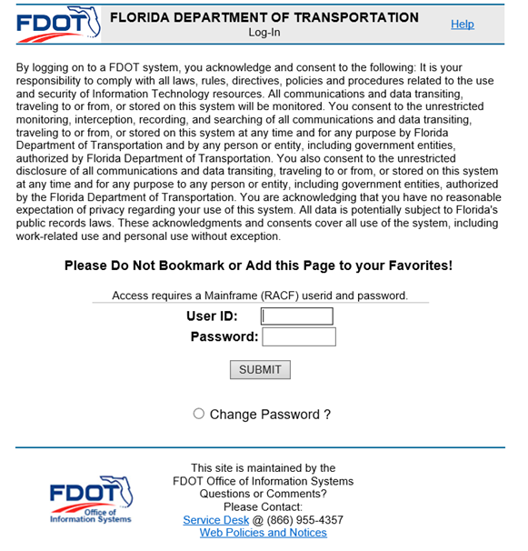
Logging Into CITS
https://www.fdot.gov/procurement/Welcome-to-CITS.shtm
Log in using your mainframe
user ID and password

Slide 15
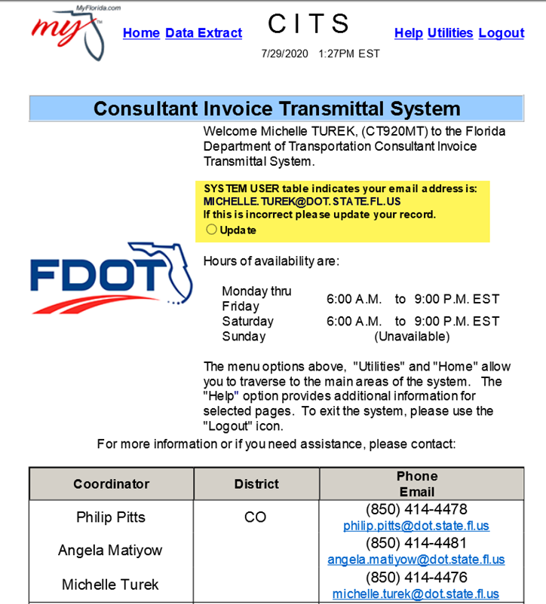
Welcome Page
From the Welcome Page click HOME
You should also update your Email
address from here if needed.

Slide 16

Reviewing Invoices in CITS
Remember CITS is only a method or process of invoice review, it is not the procedure
All invoices must be approved in compliance with Florida Statutes 112.061, 215.422,and 338.251 as well as Florida Administrative Code, Chapters 14-51, and 14B
https://www.fdot.gov/procurement/ProfessionalServicesReports.shtm

Slide 17
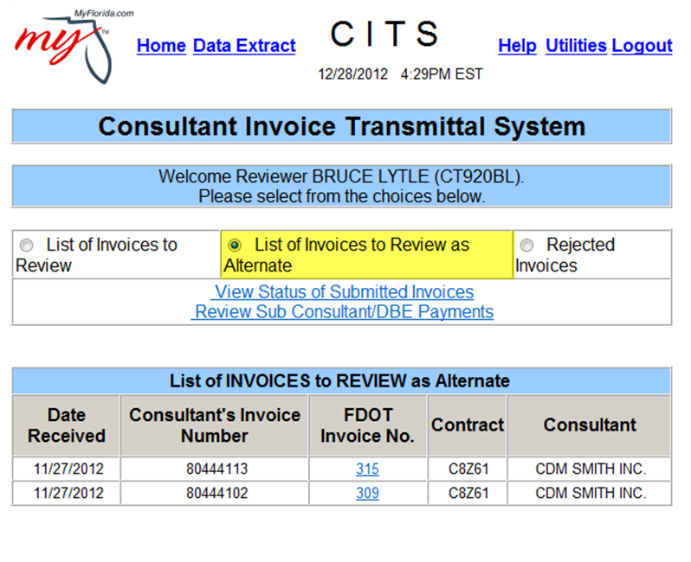
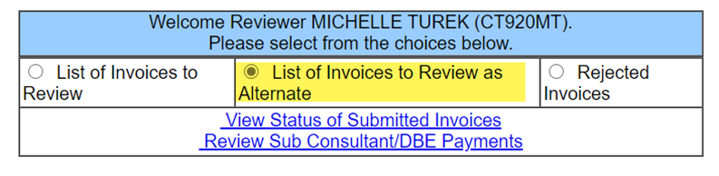
Invoice Reviewer Home Page
Select the Home Icon on the top.
Select an invoice for review by clicking
the underlined, hyperlinked invoice number;
this will take you to the Invoice Review Form
Note: If you are an Alternate Reviewer, click
the radio button labeled “List Invoices to
Review as Alternate”

Slide 18
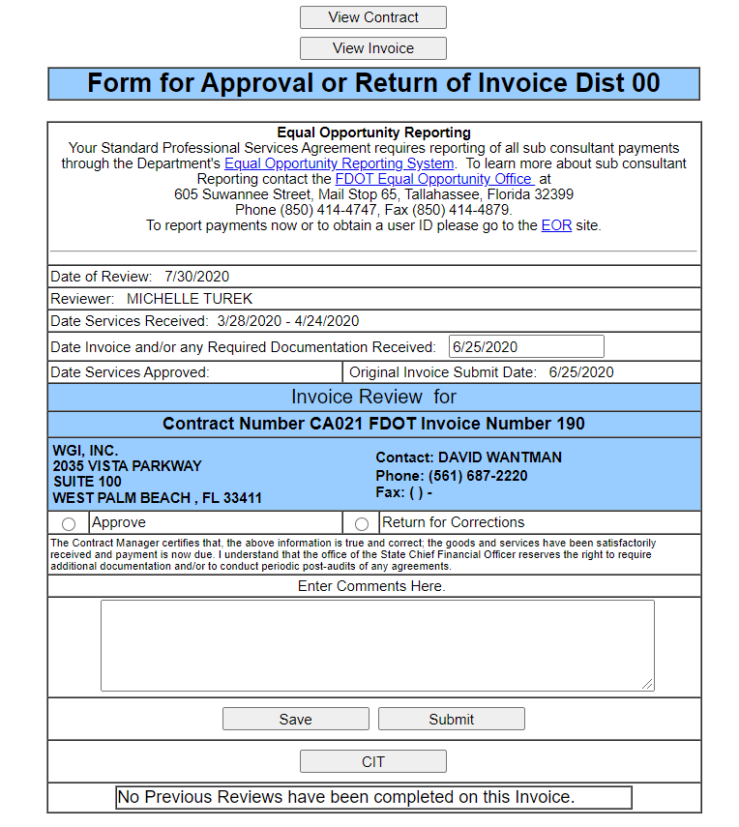
Invoice Review Form
Click “View Invoice” to open a new window
and review the invoice document
If there are questions concerning the Contract,
click “View Contract”. This will open a new window,
or switch the Invoice View to Contract View

Slide 19
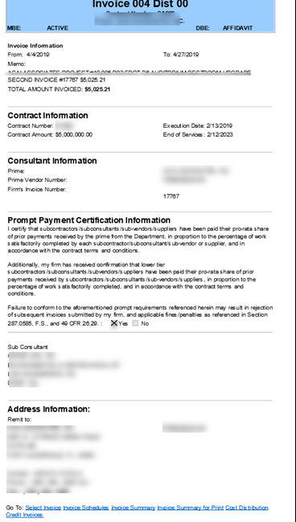
Main Invoice Page
All basic information concerning the
invoice is available on the Main Invoice Page
Please ensure the Prompt Payment Certification
Information section is completed with a
Y checkbox
To view the invoice detail, click
“Invoice Summary for Print “
http://infonet.dot.state.fl.us/procurement/professional/CITS_FAQ.htm

Slide 20
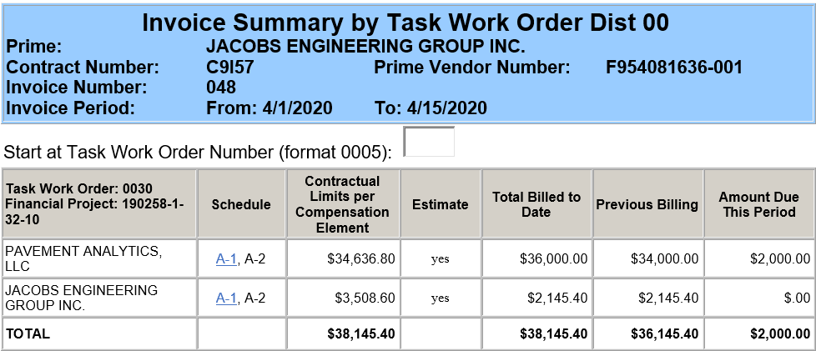
Invoice Summary Page
Charges are broken out by Task, Financial Project and Compensation element
Click the underlined, hyperlinked Schedule number to view detail of charges

Slide 21
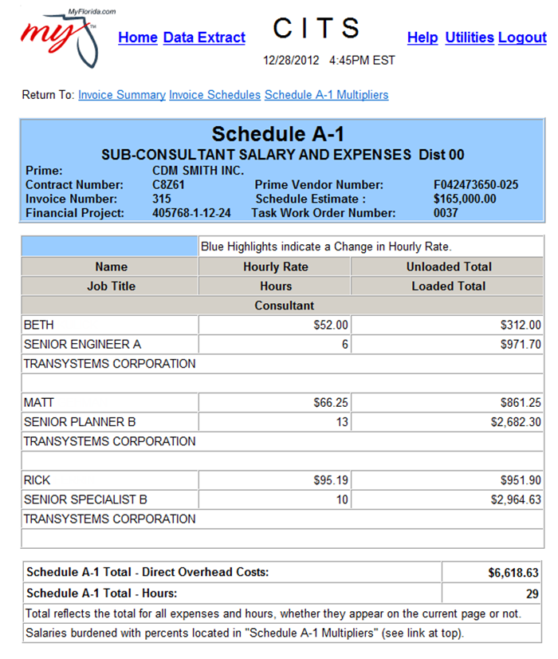
Invoice Schedules
The Invoice Schedule Pages give a
complete break down of all Schedule
charges for this invoice.
Review the information, return to the
Invoice Summary and proceed to the next
schedule, until the entire invoice has been
reviewed.

Slide 22
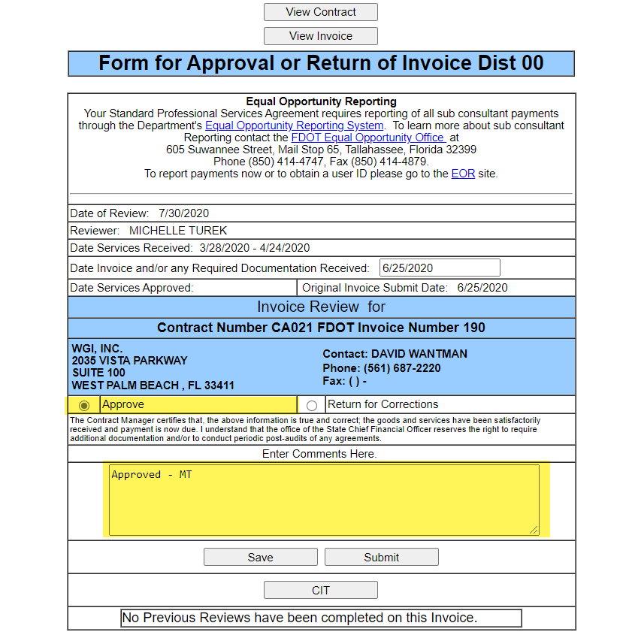
Invoice Review Form
Once the entire invoice has been
reviewed at the detail level, it may be:
  Approved
  Rejected
NOTE: A comment is required for
any invoice being rejected.
Select the radio button of the desired
action and click submit.

Slide 23
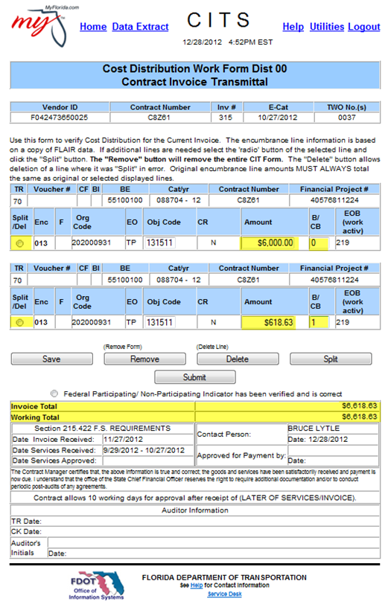
Cost Distribution Work Form
Approving the invoice automatically
generate the Cost Distribution Work form (CIT)

Slide 24
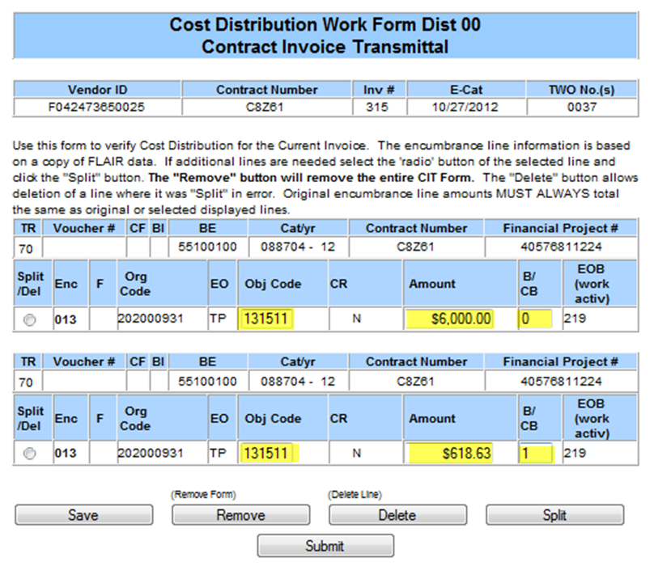
Cost Distribution Work Form
CITS uses oldest money first to pay all invoices
The invoice reviewer may adjust object codes,
line amounts and the B/CB indicator only

Slide 25
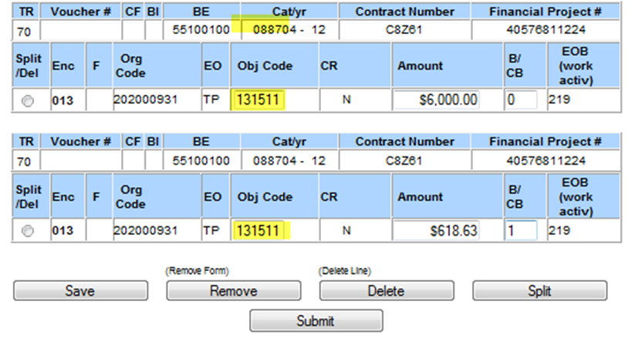
Cost Object Codes
Object Codes are determined by the Encumbrance line.
Most of the time, only charges relating to travel will require an Object Code Adjustment
CITS will not allow an object to be used, that has not been associated to the Financial Project
https://fldot.sharepoint.com/sites/FDOT-OOC/DOO/FLAIRCodes/SitePages/Home.aspx

Slide 26
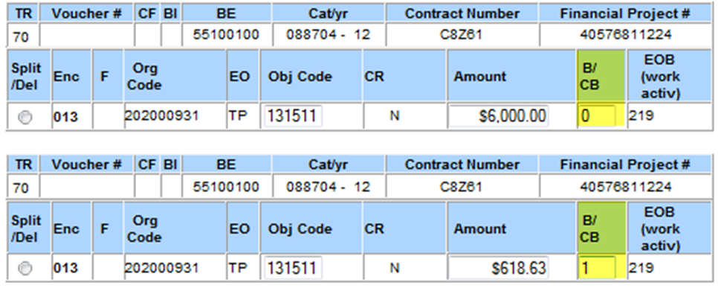
B/CB Billing Indicator
The B/CB indicator states whether or not these charges are “Federally Participating” or “Non-participating”
Only special circumstances will require an adjustment to this indicator

Slide 27
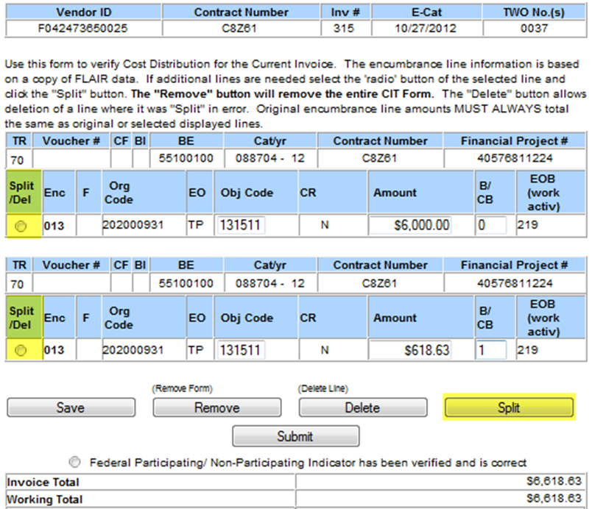
Splitting CIT Lines
CIT lines may need to be “Split” if the
charges should hit multiple Object
codes or if some charges are non-participating
To split a line, simply select the radio
button and click “Split”

Slide 28
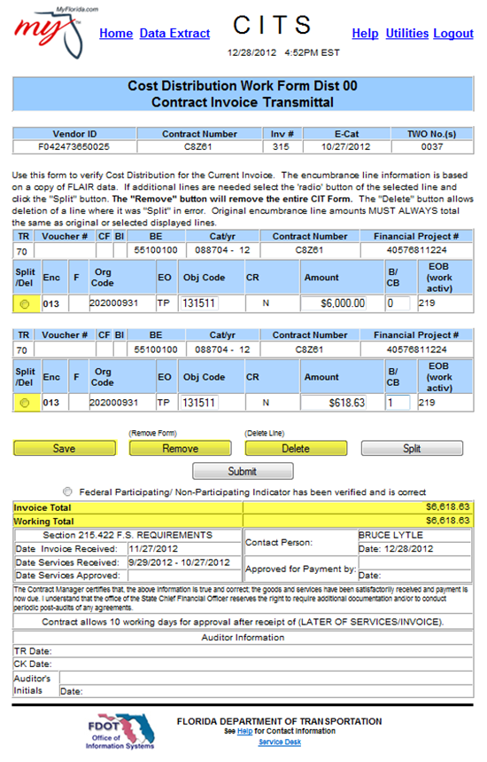
Cost Distribution Work Form
SAVE: Allows the user to save the
work form, exit and return later.
REMOVE: Completely removes the
CIT Form so the user may start over.
DELETE: Deletes a select line from
the CIT Form. Remember the Working Total
and Invoice Total must equal.

Slide 29
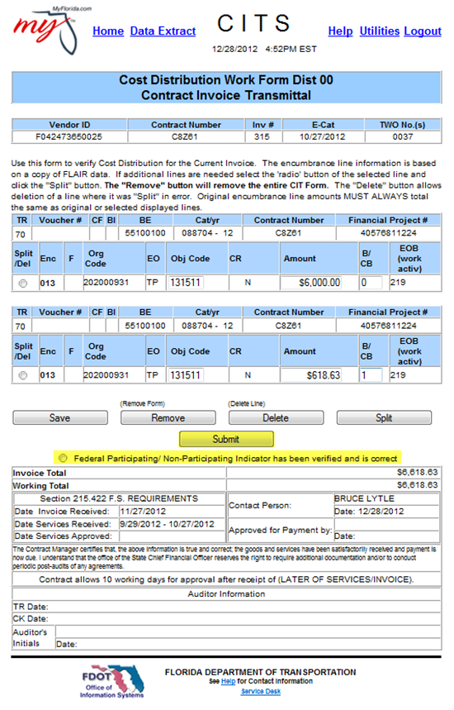
Cost Distribution Work Form
Prior to submittal of the CIT Form,
the invoice reviewer must click a radio
button indicating that the Federal
Participation indicator (B/CB) has been verified.
Submit sends the invoice to the
next level for review.

Slide 30
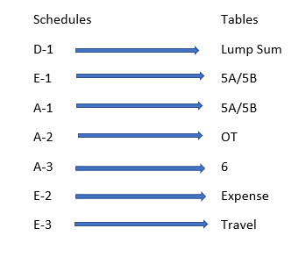
Invoice Schedule Detail
Schedule D-1 / LS, Percent Complete
Schedule E-1 / LS, Companion to A-1
Schedule A-1 / LA, From 5A & 5B
Schedule A-3 / LA or LS, Defined Rates
Schedule E-2 / LA, Direct Expenses
Schedule E-3 / LA, Travel Expenses

Slide 31
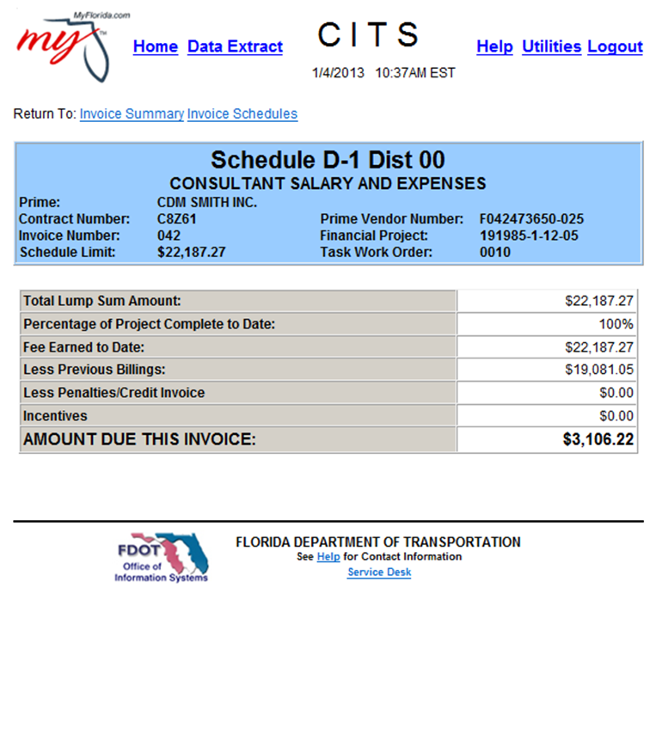
Schedule D-1
Calculates by % complete of services (LS-2)
or at completion of Services (LS-1).
Schedule always calculates against
current expense limit.
“FINAL” does not automatically
pay remaining balance.
Notes:
Remember: when schedule amount changes the previous % complete always changes: 60% of $100,000= 30% of $200,000 or 75% of $80,000

Slide 32
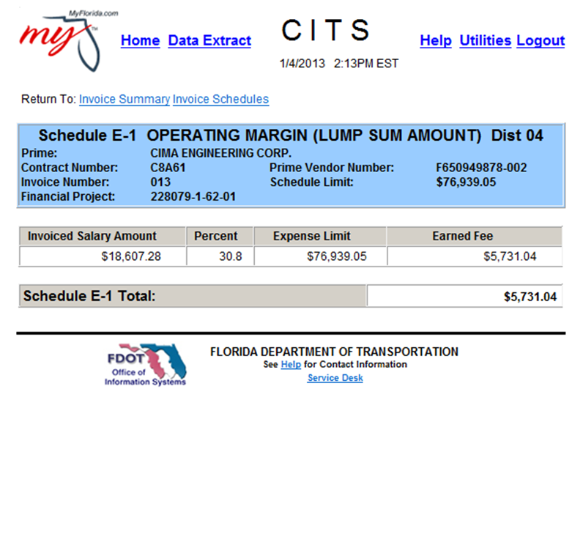
Schedule E-1
Most versatile of all schedules
Automatically calculates when
accessed - requires no input
Must be accessed after each
time Schedule A-1 is adjusted
Pays remaining schedule
balance on “FINAL” invoice

Slide 33
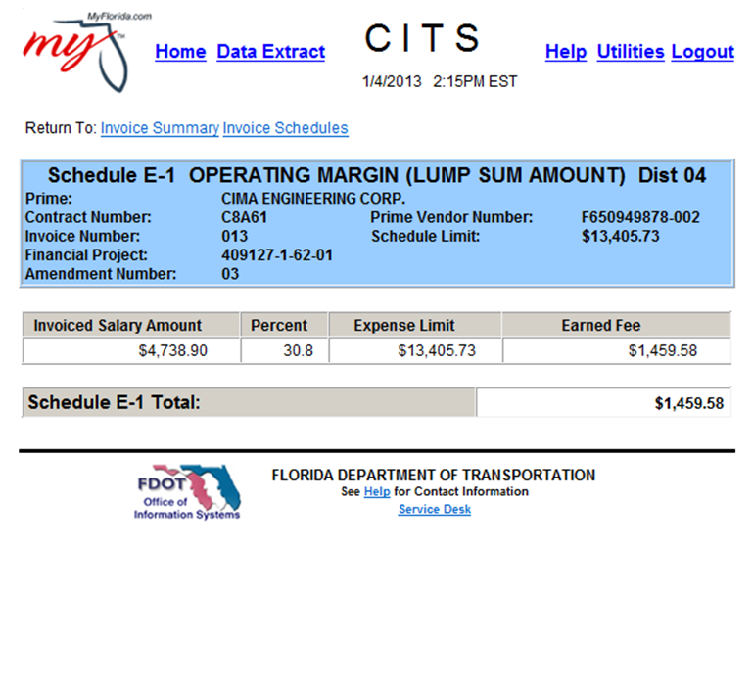
Schedule E-1
Means of calculation include:
  Total amount as a single initial payment
  Total amount spread over first two invoices
  Proportional to salaries
  Percentage of total salary dollars
  Percentage of raw salary dollars
  Uses rates from Table 4

Slide 34
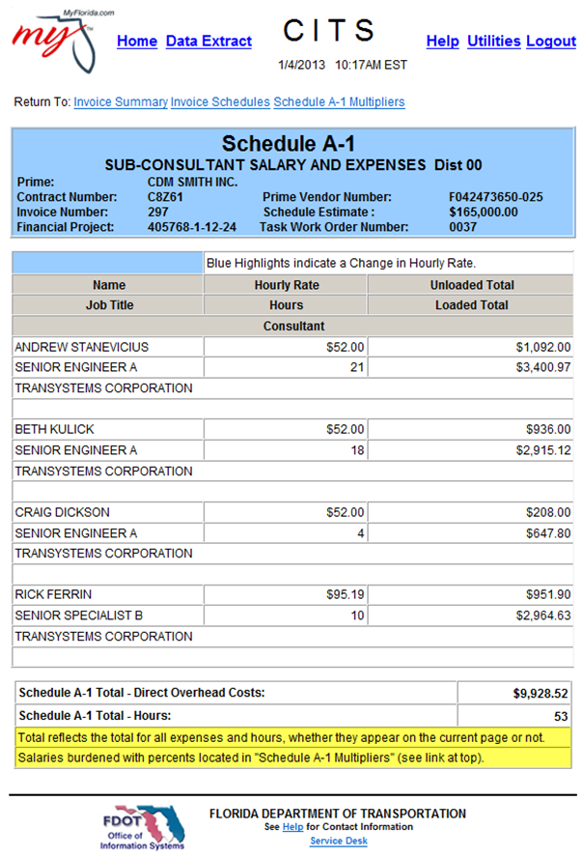
Schedule A-1
Calculates based upon multiplying
percentages in Table 5A and unloaded
salary rates (actual rates) in Table 5B
The consultant simply selects the position,
enters the appropriate hours, and CITS
performs all necessary calculations
The “NAME” field must be populated
for each entry

Slide 35
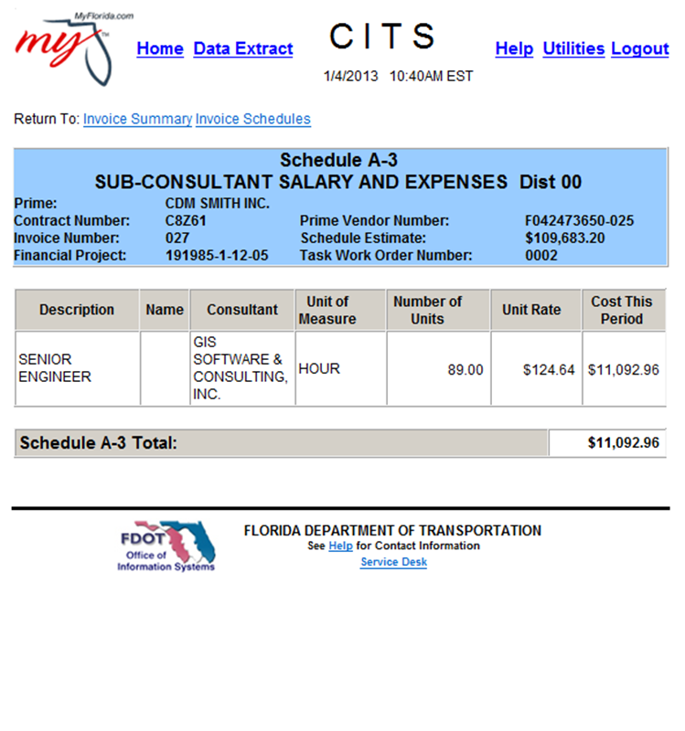
Schedule A-3
Calculates based upon rates in
contract Table 6
No multiplying percentages will be
applied to these rates
“Name/Description” field is not systematically
required but must be input, or financial services
may reject the invoice

Slide 36
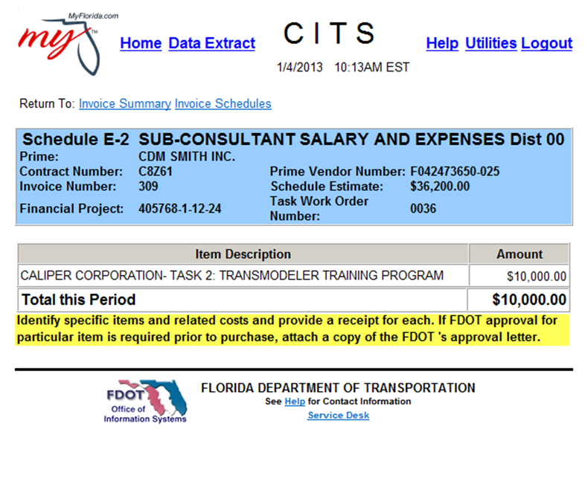
Schedule E-2
Used to invoice for approved direct expenses
Description and amount are only required fields
Every item invoiced in this schedule must be
accompanied by proper documentation
Travel expenses should not be invoiced using
this schedule

Slide 37
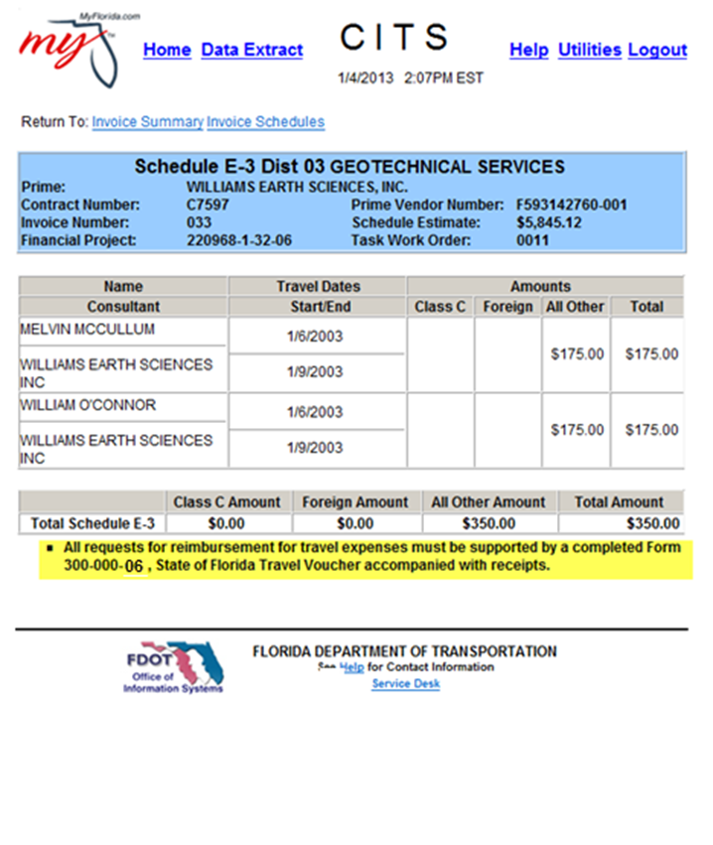
Schedule E-3
Used to invoice for authorized travel
expenses
“Name”, “Consultant”, “Start Date”,
and “End Date” are all required fields
For each individual listed in Schedule
E-3 a corresponding Contractor Travel
form 300-000-06 must be submitted prior to
payment

Slide 38
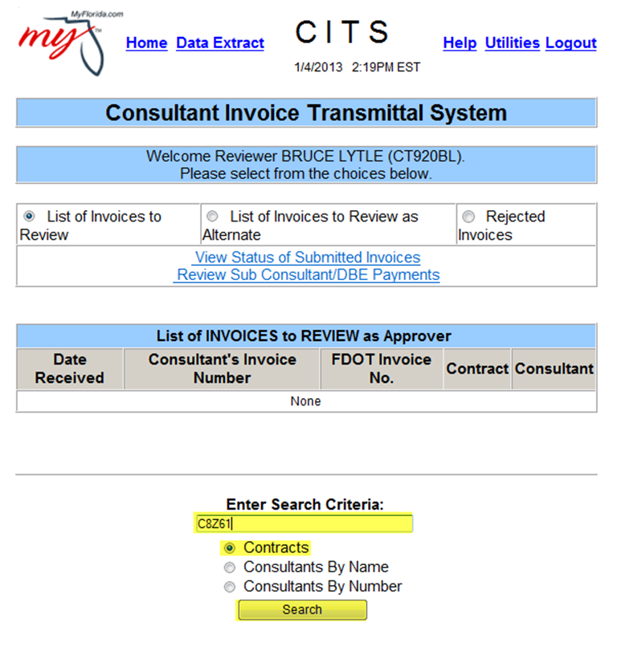
Viewing CITS Contracts
Enter the Contract Number under
the Search Criteria with no dashes
Click “Search”

Slide 39
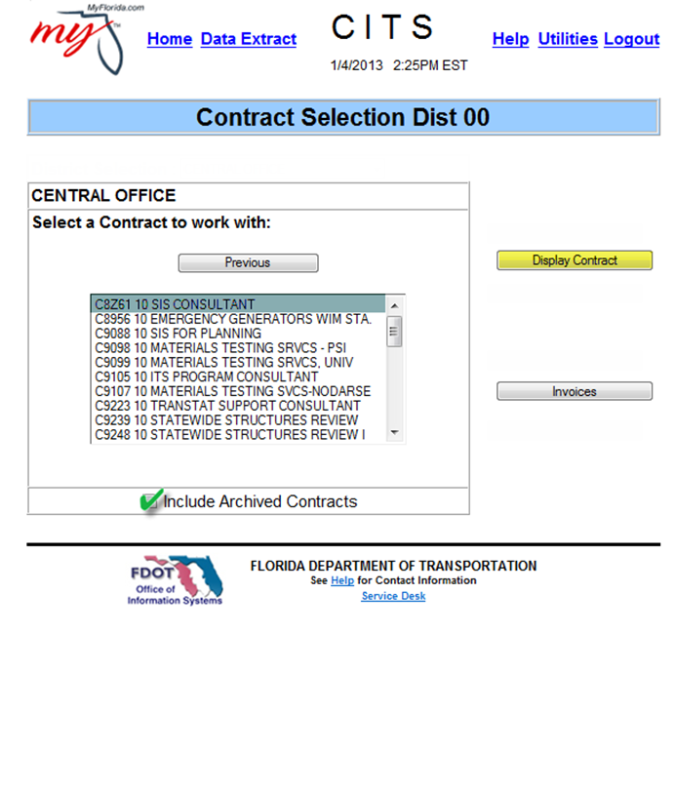
Viewing CITS Contracts
Highlight the desired contract
and click “Display Contract”
If the contract is closed,
check the “Include Archived Contracts” box

Slide 40
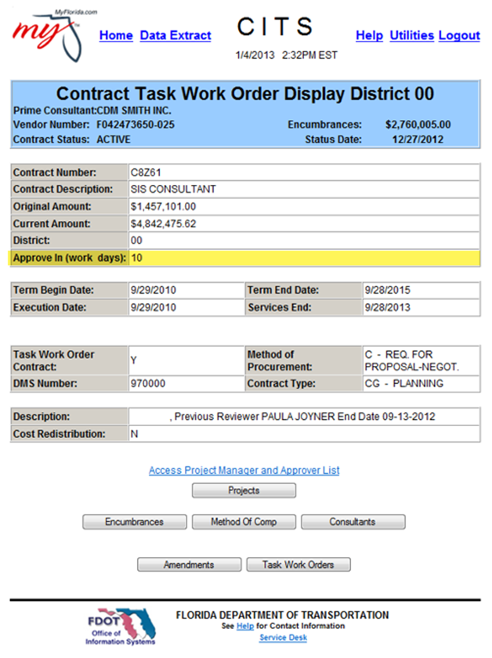
Contract Display
All general Contract information may
be viewed on the Contract Display Page
Note: Please be sure to pay attention to
how many days you have to approve an
invoice per contract language [Refer to
Exhibit B, Method of Compensation,
Section 3.0]

Slide 41
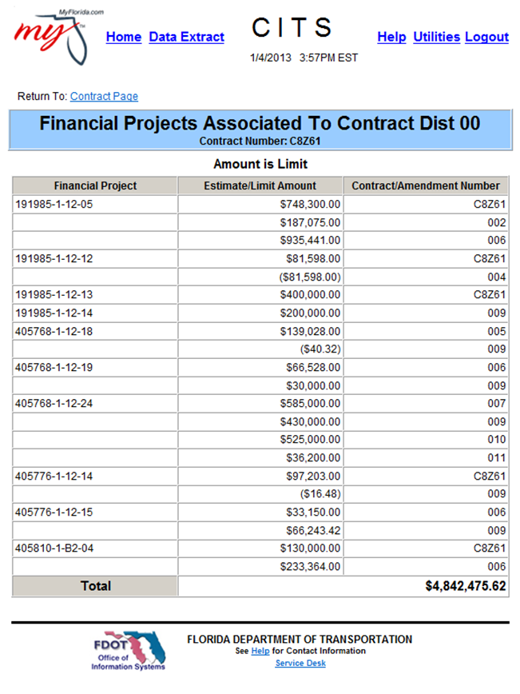
Projects Page
Displays all Financial Projects and their
encumbered amount associated to the contract.

Slide 42
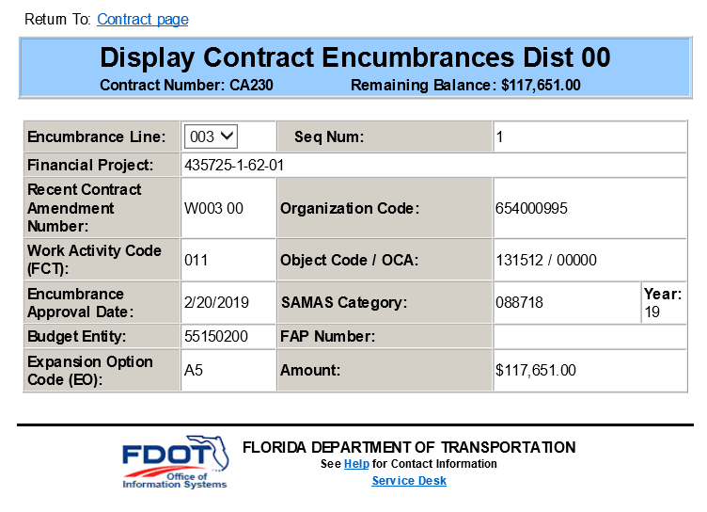
Encumbrance Page
Displays all Encumbrance lines that
are associated to both the Financial Projects and Contract. It will only display encumbrance lines that still have funds available.

Slide 43
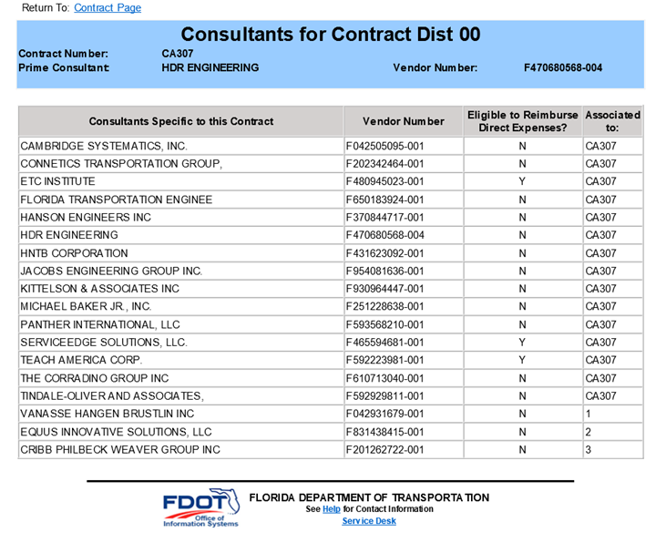
Consultant Page
Displays the Prime and sub consultants
that are associated to the Contract
Shows if they were on original contract
or added by amendment
Also shows whether the firm is eligible to
be reimbursed for actual direct expenses

Slide 44
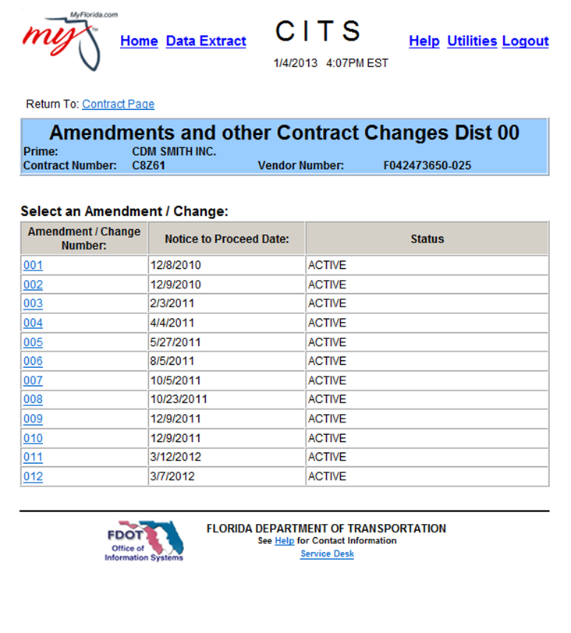
View All Amendments Page
Displays all amendments that have
been associated to the selected contract
To view the details of the amendment
click the underlined hyperlinked number

Slide 45
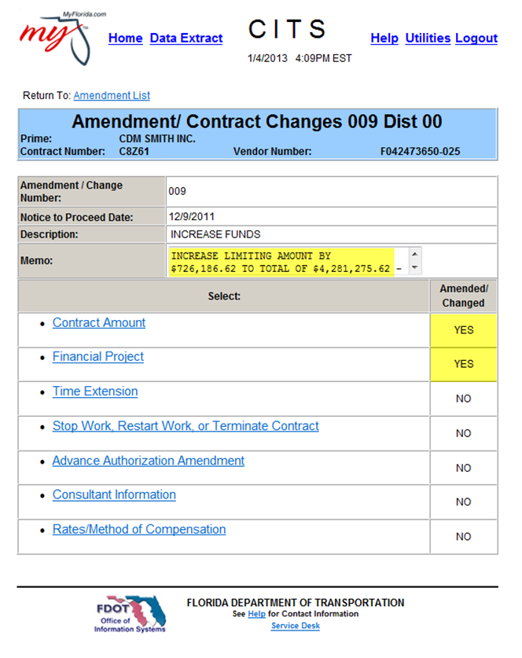
Amendment Main Menu
Gives an overview of the purpose
of the amendment
Displays all actions that were taken
on the selected amendment

Slide 46
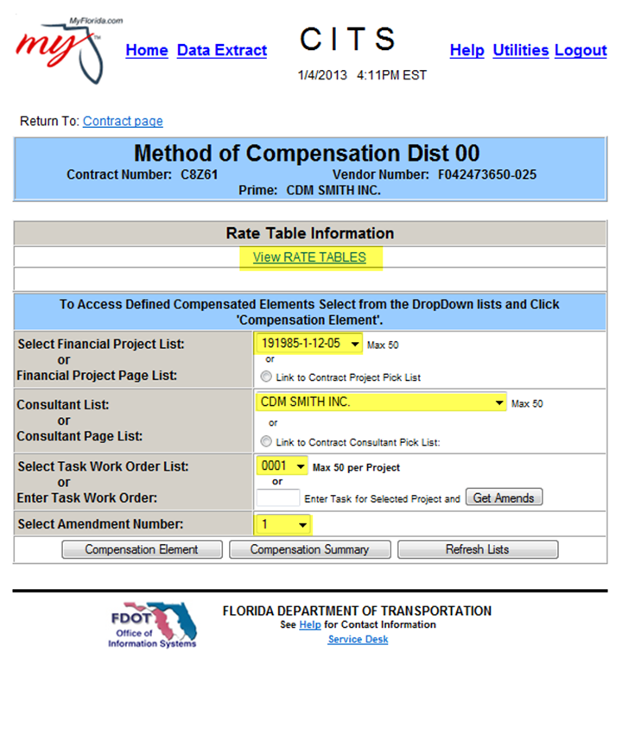
Method of Compensation Page
Allows the user to view specific
Contract Tables or Compensation detail

Slide 47
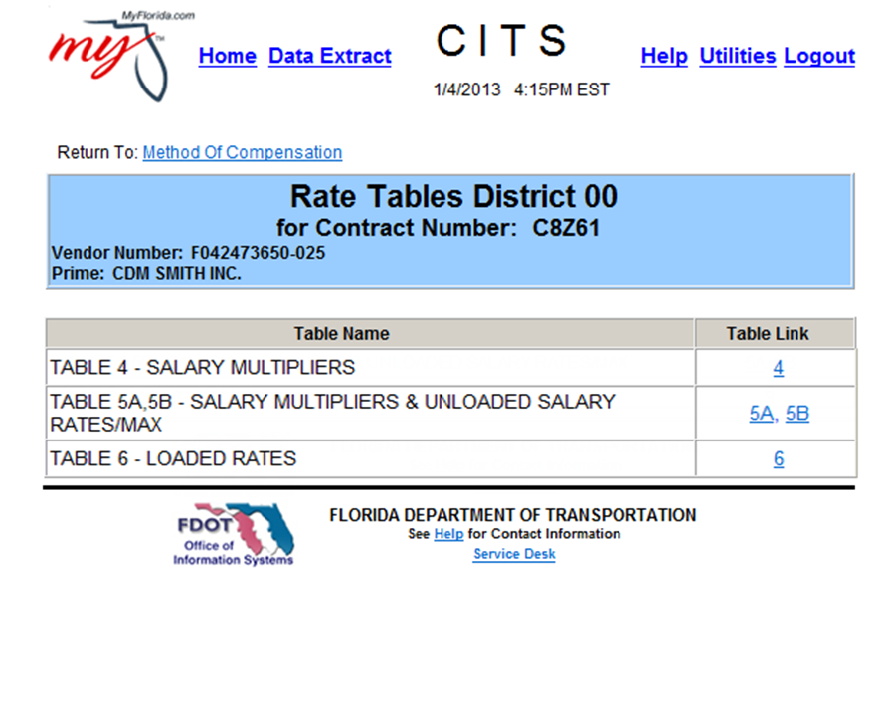
View Rate Tables
Allows the user to view specific contract rate tables
Click on Underlined Table Link

Slide 48
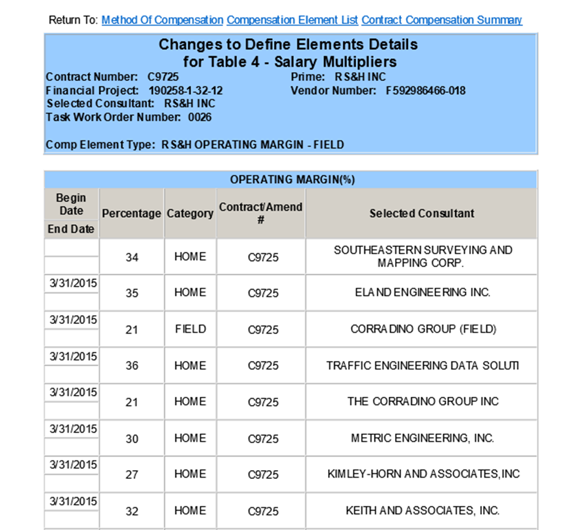
Contract Rate Tables
Each Rate Table consist of:
  Description
  Amount
    (% in Table 4)
  Consultant
  Effective Dates
  Amendment or Contract Number

Slide 49

Table 4
Consist of Independent Multipliers
Rates are applied to Table 5 rates through
Schedule E-1

Slide 50
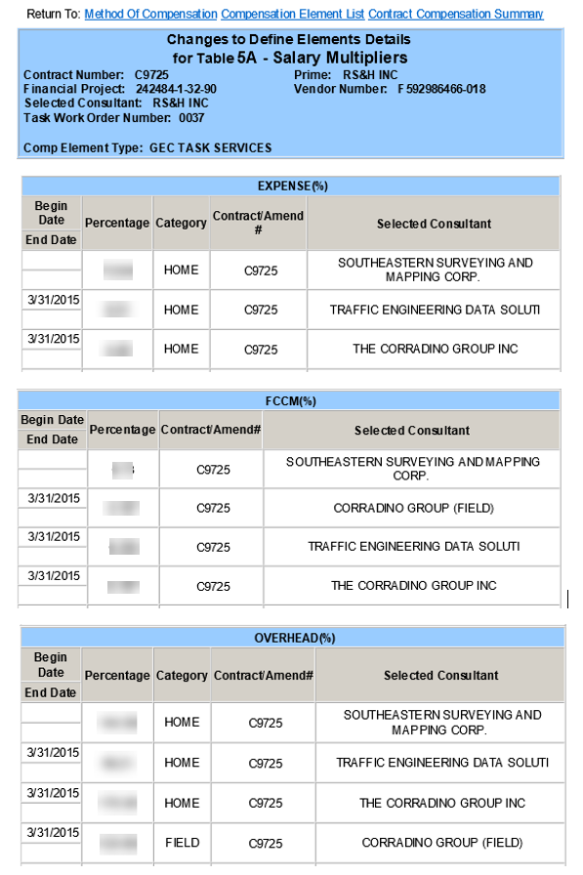
Table 5A
Percentages to be applied to Unloaded Salary
rates (Table 5B)
Calculated through Schedule A-1

Slide 51
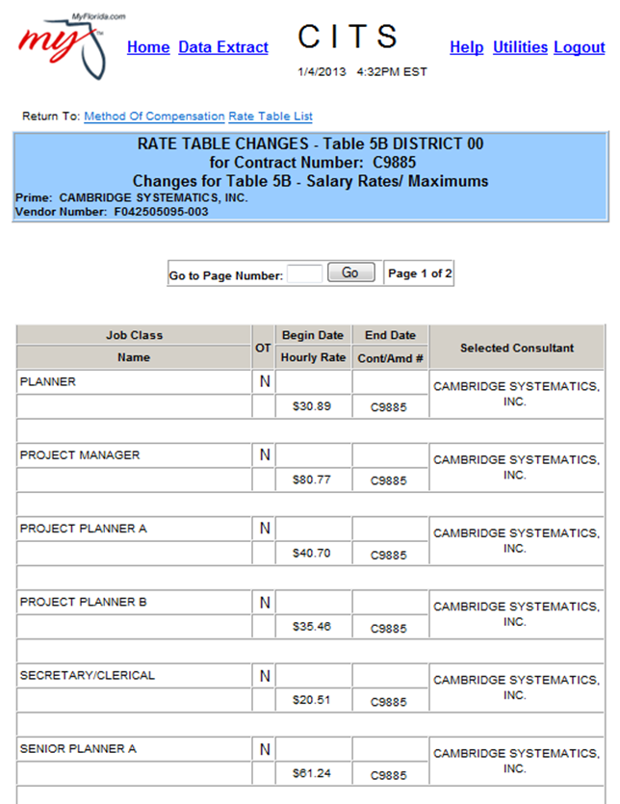
Table 5B
Unloaded, unburdened Salary Rates
Burdened with Percentages
in Table 5A
Calculated on Schedule A-1

Slide 52
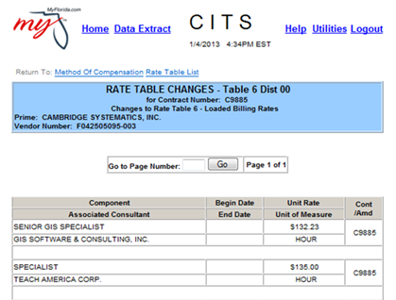
Table 6
Defined, loaded, fully burdened rates
for salaries, items or units
Calculated on Schedule A-3

Slide 53
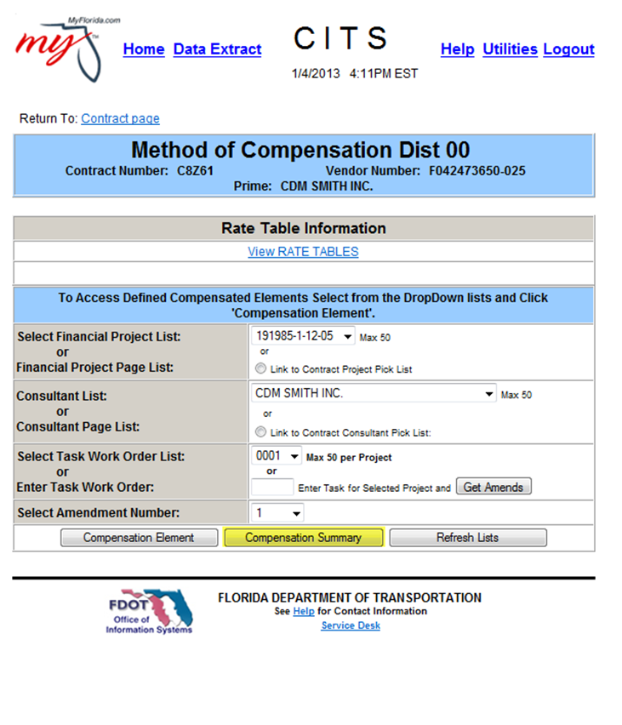
Contract Compensation Summary
Access through the Compensation Summary Button

Slide 54
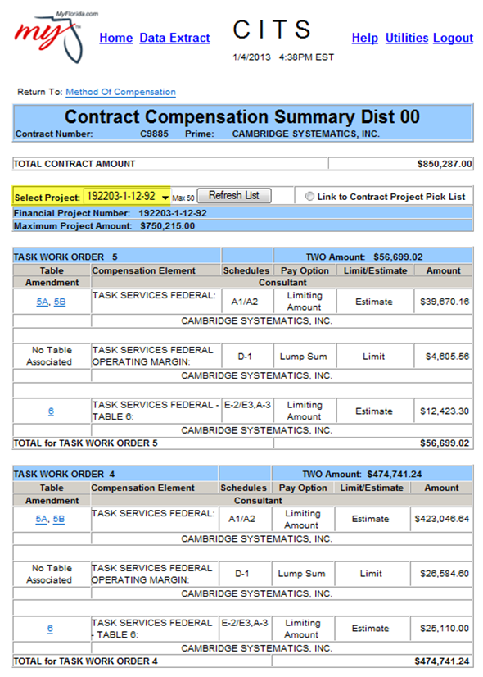
Contract Compensation Summary
Displays what is in the contract Method of
Compensation

Slide 55
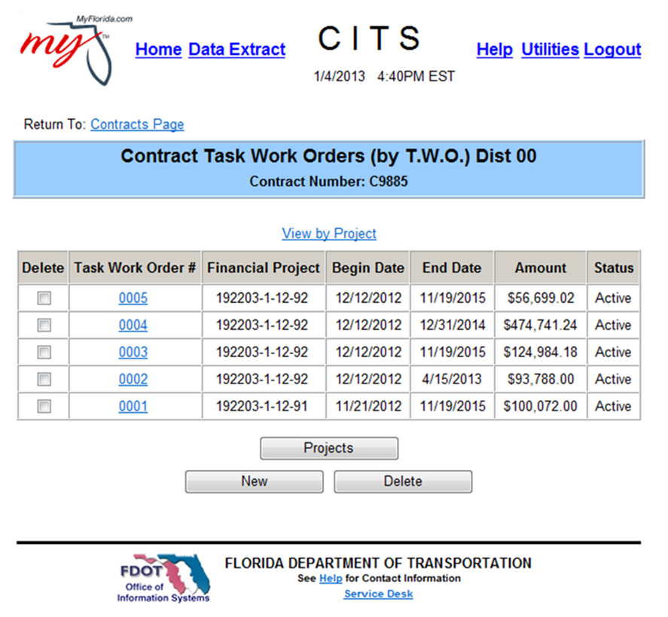
Contract TWO’s Page
Displays all Task Work Orders
Associated to the contract
Displays FP#, Service Periods,
Amount and Status
Use “View by Project” to
Displays specific FP#

Slide 56
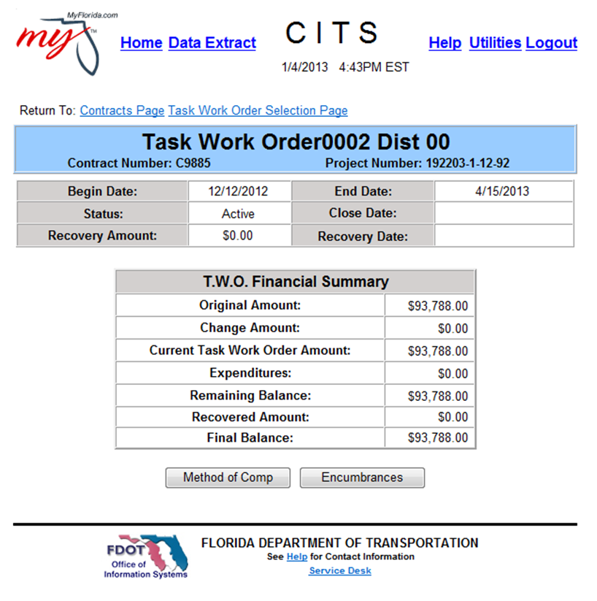
TWO Display Page
Displays TWO Amounts, history,
and vital dates

Slide 57
Important Information
CITS Logon
https://www.fdot.gov/procurement/Welcome-to-CITS.shtm
Information Security
https://www.fdot.gov/cybersecurity/types-of-access
FDOT Procurement
http://www.fdot.gov/procurement/
FDOT Professional Services Intranet Site
http://infonet.dot.state.fl.us/procurement/
Equal Opportunity Office
http://www.fdot.gov/equalopportunity
Michelle Turek
CITS Statewide Coordinator
Michelle.Turek@dot.state.fl.us
850-414-4476

Slide 58
What you have learned:
Gaining Access to CITS
Proper Invoice processing
How CITS relates to Consultant Contracting
Contract Navigation
Scheduling and Tables

Slide 59
Quick References

Slide 60
METHODS OF PAYMENT
LS/LA | Method of Compensation | Method of Comp Table(s) | Invoice Schedule(s)
LS-1 | at completion of all services/at completion of task | N/A | D-1
LS-2 | % of completion of all services | N/A | D-1
LS-3 | at completion of defined tasks or mileposts NOT AVAILABLE FOR CONTRACTS EXECUTED AFTER 7/1/2004 | 2 | D-3
LS-4 | % of completion of defined tasks or mileposts NOT AVAILABLE FOR CONTRACTS EXECUTED AFTER 7/1/2004 | 2 | D-3
LS-5 | at completion of mileposts within defined tasks NOT AVAILABLE FOR CONTRACTS EXECUTED AFTER 7/1/2004 | 3 | D-2
LS-6 | bill at defined unit rate, balance at end | 6 | A-3
LS-7 | at beginning of contract NOT AVAILABLE FOR CONTRACTS EXECUTED AFTER 7/1/2004 | N/A | E-1
LS-8 | at beginning of contract, spread over 1st 2 invoices NOT AVAILABLE FOR CONTRACTS EXECUTED AFTER 7/1/2004 | N/A | E-1
LS-9 | proportional to salary related costs, balance at end (expenses) NOT RECOMMENDED; PROBLEMS ENCOUNTERED WHEN SUPPLEMENTING | 5A/5B | E-1
LS-10 | % of salary related costs, balance at end (operating margin) NOT AVAILABLE FOR CONTRACTS EXECUTED AFTER 10/2003 | 4 | E-1
LS-11 | % if salary related costs, balance at end (fccm%) NOT AVAILABLE FOR CONTRACTS EXECUTED AFTER 7/1/2004 | 4 | E-1
LS-12 | % of direct salary costs, balance at end (operating margin/operating margin plus CDAF % or expense %) | 4 | E-1
LA-1 | actual salary rates CURRENT POLICY IS NOT TO COMPENSATE BASED ON ACTUAL RATES ALLOWING INCREASES | 5A | A-1/A-2
LA-2 | actual salary rates subject to class limits NOT ALLOWABLE FOR CONTRACTS EXECUTED AFTER 10/2003 | 5A/5B | A-1/A-2
LA-3 | defined salary rates per each class/person (contract rates) | 5A/5B | A-1/A-2
LA-4 | defined loaded rates for each class/person/unit of work | 6 | A-3
LA-5 | actual expenditures | 6 Must have Table 6 in CITS in order to bill | E-2/E-3, A-3
LA-6 | % of salary related costs NOT AVAILABLE FOR CONTRACTS EXECUTED AFTER 10/2003 | 4 | E-1
LA-7 | rate per hour/day/month NO LONGER AVAILABLE. SAME AS LA-4. | 6 | A-3

