Slide 1
Invoice Training for Project Managers

Slide 2
Standard Professional Services Agreement
Non-Lump Sum CEI
    Project Managers are advised to look at Exhibit B, Method of Compensation, Section 2.2.
Loaded Labor Rates- (LA-4)
Subject to the established limiting amount, the Consultant will be compensated for these services based on the rates provided in Table 6 of Section 5.0. No additional multipliers will be applied to these rates. For units of work, payment for such services will be based on approved units incurred during the billing period. For labor rates, payment for such services shall be based on approved time incurred during the billing period. No additional multipliers shall be applied to these rates. The following firms loaded labor rates are inclusive of Contract Duration Adjustment Factor:
XYZ Corporation
ABC Corp
Miscellaneous Direct Expenses- LA-5
Subject to the established limiting amount, only the following subconsultant firms are approved to receive compensation for itemized miscellaneous direct expenses when authorized and when properly supported by evidence of costs incurred: ABC LLC . For travel expenses, state travel vouchers must be submitted. For authorized direct expenses with rates established in Table 6 of Section 5.0, compensation will be at those rates without further support.

Slide 3
Standard Professional Services Agreement
Lump Sum CEI
    Project Managers are advised to look at Exhibit B, Method of Compensation, Section 2.2.
(LS-2) The Consultant will receive progress payments for services based on the percentage of services that have been completed and accepted by the Department during the billing period.
Limiting Amount/Cost Reimbursement Elements
For the following elements which are established as reimbursables, the Department will compensate the Consultant, subject to the total established limiting amount, for all reasonable, allocable and allowable costs incurred in the categories defined below. The reasonableness, allocability and allowability of compensation sought under this Agreement is expressly made subject to the terms of this Agreement; Federal Acquisition Regulations; and any pertinent Federal and State Law.
Loaded Labor Rates- (LA-4)
Rates for Specialty Services and/or Contract Renegotiation
Subject to the established limiting amount, the Consultant will be compensated for specialty services or contract renegotiation (when applicable), in accordance with the rates provided in Table 6 of Section 5.0. For units of work, payment for such services will be based on approved units incurred during the billing period. For labor rates, payment for such services shall be based on approved time incurred during the billing period. No additional multipliers shall be applied to these rates. The following firms loaded labor rates are inclusive of Contract Duration Adjustment Factor: (Reminder: Leave blank if CDAF does not apply on this contract).

Slide 4
Miscellaneous Direct Expenses
Authorized rates established in Table 6 of the contract.
Firms that can be reimbursed for miscellaneous direct expenses through the contract are listed in the Method of Compensation Section 2.2 Details of Compensation Miscellaneous Direct Expenses LA-5.
  Miscellaneous direct expenses must be authorized and properly supported by evidence of costs incurred.
The Prime Consultant may be compensated for the separate miscellaneous direct expense purchase of the Tangible Personal Property if such expenses are identified under Section 2.1 of the contract, properly supported by evidence of costs incurred.
  Approval must be obtained from Central Office Audit Rate Manager for tangible assets.

Slide 5
Field Office Direct Expenses
Miscellaneous Direct Expenses for Field Office Rent and Utilities - LA-5
Subject to the established limiting amount, only the following firm(s) is/are approved to receive compensation for itemized direct expenses associated with field office rent, utilities (excluding phone services), field office set-up/mobilization and de-mobilization costs only, when authorized and when properly supported by evidence of costs incurred: list firms here . Utility costs to be reimbursed as a direct project cost are: electricity, water, natural gas, sewer, internet service, trash pick-up, and hook-up fees associated with the aforementioned utilities. Field office set-up/mobilization and de-mobilization charges involved with transporting the trailer to and from the job site may also be reimbursed. Sales tax shall only be reimbursed as allowed in accordance with Florida law. Other than the allowable expenses listed above; no other LA5 expenses are authorized for reimbursement for the firms. Utility costs associated with phone services will not be reimbursed as a direct project charge. Charges for furniture, supplies, insurance, cleaning, and equipment (including fax, copier, computer, and phone equipment), and all phone services are included in the direct expense percentage and are not compensated as an itemized expense directly on the contract.

Slide 6
Field Office Direct Expenses
Must be included on the contract and explicitly listed on the contract that the firms are eligible to receive field office direct expenses.
What may be reimbursed?
Direct expenses associated with field office rent, utilities, field office set-up/mobilization and de-mobilization costs; only when authorized and when properly supported by evidence of costs.
  Utility costs may include electricity, water, natural gas, sewer, internet connection (e.g., non-mobile DSL or cable lines), trash pick-up, and hook-up fees associated with the aforementioned utilities.
  Field office set-up/mobilization and de-mobilization charges involved with transporting the trailer to and from the job site may also be reimbursed.
  Charges for furniture, supplies, insurance, cleaning, and equipment (including fax, copier, computer, and phone equipment) are included in the direct expense percentage and are not compensated as an itemized expense directly on the contract.

Slide 7
What may be reimbursed (cont’)
For purposes of reimbursement, field office lease agreement duration must align with the construction contract length provided in the original project schedule by the Department. In instances of voluntary contract acceleration, when the project is ending prior to the original approved field office lease expiration, the Department may reimburse the lease break/early termination fee or the original lease cost (remaining contract months), whichever is the lesser cost to FDOT. Documentation of the change in contract time, as approved by the FDOT Project Manager, shall be provided to the Department, including supporting documentation of change of contract terms with the Lessor of the field office.
Also, in the event of voluntary contract acceleration, utility costs such as electricity, water, natural gas, sewer, internet connection (e.g., non-mobile DSL or cable lines), and trash pick-up should be terminated early, and shall not be compensated by the Department beyond the modified contract time.

Slide 8
Field Office Direct Expenses FAQ
Would paying for a “Moving Company” to move furniture and equipment to the field office be acceptable?
  No, however, the costs should be reimbursed through the direct expense rate.
Are deposits allowed to be reimbursed?
  Deposits cannot be reimbursed. These costs are “pre-paid” costs and generally returned at a specified date.
Are security services/costs considered “utility” costs for actual reimbursement?
  No, the costs for security should be included in the direct expense rate cost pool and will not be reimbursed on the contract as an itemized expense.

Slide 9
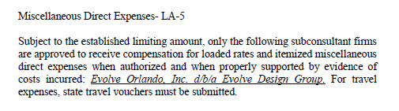
How to audit travel expenses?
Must be supported by evidence of costs incurred.

Slide 10
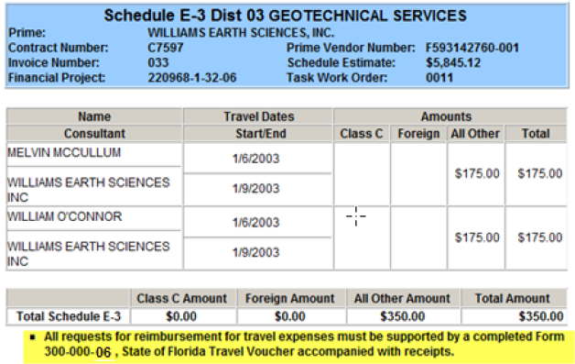
How to audit travel expenses?

Slide 11
How to audit travel expenses?
If the firm does not have a direct expense rate and are eligible for direct expenses on the contract they can bill for travel expenses that have been approved by the Project Manager and that meet the following criteria.
  Unit rates used to compute travel costs may not exceed those authorized for State employee travel in accordance with Section 112.061, F.S. Air fare must be based on coach rates with reasonable advance purchase and costs for rental cars must be based on the use of compact cars, unless otherwise justified and approved by the Department. Mileage for private vehicles must be at the state rate. The Disbursement Operations Handbook, is available on the Department’s Office of Comptroller (OOC) Sharepoint site.
  https://fldot.sharepoint.com/sites/FDOT-OOC-DOO/SitePages/Travel-System-Access.aspx
  *Training is geared towards FDOT Employees but rates and allowability rules still apply
  https://fldot.sharepoint.com/sites/FDOT-OOC-DOO/HBDocuments/Forms/AllItems.aspx?id=%2Fsites%2FFDOT%2DOOC%2DDOO%2FHBDocuments%2FDisbursement%20Handbook%20for%20Employees%20and%20Managers%2Epdf&parent=%2Fsites%2FFDOT%2DOOC%2DDOO%2FHBDocuments
  https://www.leg.state.fl.us/STATUTES/index.cfm?App_mode=Display_Statute&Search_String=&URL=0100-0199/0112/Sections/0112.061.html
  For travel expenses, state travel forms must be submitted.
    Contractor Travel Form, 300-000-06
      https://pdl.fdot.gov/api/form/downloadAttachment/10980349

Slide 12
How to audit travel expenses?
  If firm does not have direct expense rate and is eligible to be reimbursed directly on the contract -
Example of allowable: Commercial Coach Flights, Hotel Rooms up to $225/night (not including taxes – refer to below CFO memo as rate may change), Meals/Per Diem https://www.myfloridacfo.com/division/aa/memo
Examples of disallowed: Food for Conference, First Class Flights, rental car upgrades without business justification.

Slide 13
Required documentation
Documents to substantiate payments and keep in your file
  Receipts for utility costs such as electricity, water, natural gas, sewer, internet connection (e.g., non-mobile DSL or cable lines), trash pick-up, and hook-up fees associated with the aforementioned utilities.
  Receipts for field office set-up/mobilization and de-mobilization charges involved with transporting the trailer to and from the job site.
  Receipts for the field office trailer or field office building lease.
  Receipts for any “extraordinary” expenses, “extraordinary” expenses in the contract must first be approved by Central Office Audit Administrator; Jon Cook.
  Travel forms for reimbursable preapproved travel (when no direct expense rate).
  If quotes are received in advance during negotiation to support the costs, such as monthly utility fees, and field office monthly lease, these costs can be added in Table 6 as monthly unit rates, and won’t require submittal of backup documentation to support the charges for the expenses with the invoices each month.

Slide 14
Invoice timing required for payment of invoice per contract
Based on contract language found in the method of compensation section 3.0 Invoice Procedure : “The Department will render a decision on the acceptability of services within ____ working days of receipt of either the services, invoice, or progress report, whichever is later.”
  The number of working days will be specified in the contract. Typically 5 or 10 days.
  The invoice must be approved or rejected by the Project Manager.
If approved, the invoice will then go to Financial Services where it has an additional 5 days to be approved.
Once Financial Services approval is met, the invoice is submitted electronically and is processed through Electronic Estimates Disbursement (EED).
Lastly, the invoice is approved by the Department of Financial Services (10 days to approve) and funds are disbursed to the consultant.

Slide 15
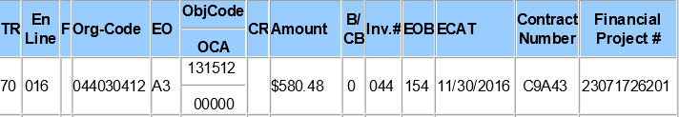
Federal Participating Indicator
In CITS, a B/CB (Current Billing) indicator of “0” indicates federal participating, and “1” non-participating.

Slide 16
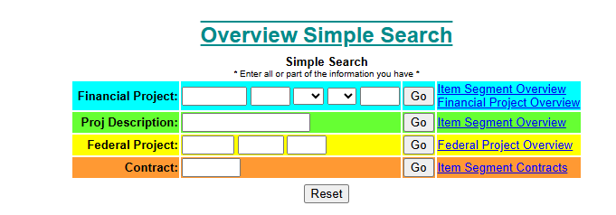
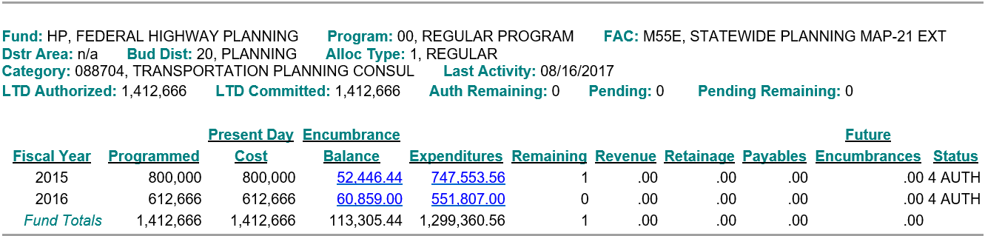
Federal participating vs non-participating on invoices
To check for financial project correlation to federal participating – the work program SharePoint site for project search.

Slide 17
Appropriate dates in invoices
The Consultant will be eligible for progress payments under this agreement at monthly intervals or when individual tasks or mileposts defined in this agreement are completed or reached.
Date invoice and/or any required documentation received should reflect the last date all required documents are received.

Slide 18
Thank you for participating
If you have any questions, please contact us by phone or e-mail.
  Procurement Office
    Angela Matiyow for contract questions
      Angela.matiyow@dot.state.fl.us
    Annita Varela for CITS questions
      Fdot.cits@dot.state.fl.us
  Construction Office
  Ryan Buck
    Ryan.Buck@dot.state.fl.us
  Office of Comptroller
    Dewayne Baxley
      Dewayne.Baxley@dot.state.fl.us
    For questions regarding travel expenses and allowable charges contact Dooqas@dot.state.fl.us

