Slide 1


Doing Business with
FDOT Professional Services
Florida Department of
TRANSPORTATION
Florida Department of Transportation

Slide 2
Professional Services
Section 287.055 (the Consultants' Competitive Negotiation Act) and Section 337.105, Florida Statutes, require procurement of professional services by competitive negotiation. The process, as mandated by statute and Rule 14-75, Florida Administrative Code, involves a prequalification process, advertisement, and competitive selection of professional services consultants based on qualifications, followed by negotiations to establish a fair, competitive and reasonable fee for the desired services.
A number of types of work have been established for which professional consultants are frequently used. Consultants desiring to compete for contracts in these standard types of work for professional services are required to renew their prequalification annually. Information on prequalification is available on the Prequalification website. Prequalification is coordinated through the Professional Services Qualification Administrator.
A listing of currently Prequalified Consultants is available on the Procurement website.
Florida Department of Transportation

Slide 3
Professional Services
Per Section 287.055, F.S., Professional Services can include, but is not limited to, the following:
Structural or Roadway Design
Architectural Services
Landscape Architectural Services
Geotechnical Services
Survey Services
Aerial Photogrammetry
Transportation Statistics
Bridge Inspection
Construction, Engineering, and Inspection (CEI)
Drainage Design
Value Engineering Design
Project Development & Environmental Studies (PD&E)
Intermodal Services (Planning)
Right-of-way Services
Services that require signing and sealing of design plans; engineering calculations or engineering judgment
Florida Department of Transportation

Slide 4
Getting Started
Firms seeking to work on FDOT Professional Services project must register with MyFloridaMarketPlace (MFMP), the State of Florida's vendor registration system.
All firms performing work for Professional Services contracts are required to be prequalified for any work they perform that is defined by Rule 14-75, F.A.C., regardless of whether they are working as a prime or a subconsultant.
Rule 14-75, F.A.C., establishes 16 work groups, broken down into 55 work types. Firms should review the descriptions and requirements of each work type prior to submitting for prequalification.
Florida Department of Transportation

Slide 5
Professional Services Work Types
Group 2 - Project Development and Environmental
(PD&E) Studies
Group 3 - Highway Design – Roadway
3.1 - Minor Highway Design
3.2 - Major Highway Design
3.3 - Controlled Access Highway Design
Group 4 - Highway Design – Bridges
4.1.1 - Miscellaneous Structures
4.1.2 - Minor Bridge Design
4.2.1 - Major Bridge Design - Concrete
4.2.2 - Major Bridge Design - Steel
4.2.3 - Major Bridge Design - Segmental
4.3.1 - Complex Bridge Design - Concrete
4.3.2 - Complex Bridge Design - Steel
4.4 - Movable Span Bridge Design
Group 5 - Bridge Inspection
5.1 - Conventional Bridge Inspection
5.2 - Movable Bridge Inspection
5.3 - Complex Bridge Inspection
5.4 - Bridge Load Rating
Group 6 - Traffic Engineering and Operations Studies
6.1 - Traffic Engineering Studies
6.2 - Traffic Signal Timing
6.3.1 - Intelligent Transportation Systems Analysis and Design
6.3.2 - Intelligent Transportation Systems Implementation
6.3.3 - Intelligent Transportation Traffic Engineering Systems Communications
6.3.4 - Intelligent Transportation Systems Software Development
Group 7 - Traffic Operations Design
7.1 - Signing, Pavement Marking and Channelization
7.2 - Lighting
7.3 - Signalization
Group 8 - Survey and Mapping
8.1 - Control Surveying
8.2 - Design, Right of Way & Construction Surveying
8.3 - Photogrammetric Mapping
8.4 - Right of Way Mapping
Group 9 - Soil Exploration, Material Testing and Foundations
9.1 - Soil Exploration
9.2 - Geotechnical Classification Laboratory Testing
9.3 - Highway Materials Testing
9.4.1 - Standard Foundation Studies
9.4.2 - Non-Redundant Drilled Shaft Bridge Foundation Studies
9.5 - Geotechnical Specialty Laboratory Testing
Group 10 - Construction Engineering Inspection
10.1 - Roadway Construction Engineering Inspection
10.3 - Construction Materials Inspection
10.4 - Minor Bridge & Miscellaneous Structures CEI
10.5.1 - Major Bridge CEI - Concrete
10.5.2 - Major Bridge CEI - Steel
10.5.3 - Major Bridge CEI - Segmental
10.6.1 - Complex Bridge CEI - Concrete
10.6.2 - Complex Bridge CEI - Steel
10.7 - Movable Span Bridge CEI
Group 11 - Engineering Contract Administration and Management
Group 13 – Planning
13.3 - Policy Planning
13.4- Systems Planning
13.5 - Subarea/Corridor Planning
13.6 - Land Planning/Engineering
13.7 - Transportation Statistics
Group 14 – Architect
Group 15 - Landscape Architect
Group 24 - Acquisition Relocation Assistance
Group 25 - Right of Way Clearing and Leasing
Florida Department of Transportation

Slide 6
Prequalification
Firm Registration
Corporations, Limited Liability Companies (LLCs), and Limited Partnerships are required to register with the Florida Department of State Division of Corporations. Individuals are not required to register.
Certificate of Authorization
Based on the type of work your firm performs, the firm may need to obtain a Certificate of Authorization (COA) from one or more Florida licensure Boards. Architecture, Engineering, Landscape Architecture, and Real Estate, and some Planning firms will need to obtain this from the Florida Department of Business and Professional Regulation (DBPR). Surveying and Mapping firms will need to obtain the COA from the Florida Department of Agriculture and Consumer Services (DACS).
Florida Department of Transportation

Slide 7
Prequalification
Professional Liability Insurance
All firms are required to obtain current professional liability insurance (PLI) for the firm. The name on the proof of insurance must match the firm’s name as the firm is registered with the Florida Division of Corporations. Proof of PLI can be provided to the Department through one of the following methods:
Submittal of a current certificate of PLI
Submittal of an unequivocal commitment letter from an insurance company
Florida Department of Transportation

Slide 8
Prequalification
Level of Qualification
Firms may prequalify at two different levels. Different documentation is required for qualification at each level.
Minor Level – Limits firms to perform less than $1,000,000 worth of work per project. Qualification at the minor level does not require any additional documentation, but firms can elect to submit a Self-Certification of Accounting System and Reimbursement Rates form. This is not required for qualification at the minor level, but this information will ultimately be required for contracting with the Department.
Unlimited Level – Firms can perform any amount of work per project, including $1,000,000 or more. Qualification at the unlimited level requires the firm to submit an annual overhead audit performed by an independent CPA for the most recent fiscal year and a signed Contractor Cost Certification.
Florida Department of Transportation

Slide 9
Prequalification
Request for Qualification Package for Professional Consultants
All firms seeking qualification must complete and submit a signed copy of the Request for Qualification Package for Professional Consultants application form. Instructions for the Prequalification Form are provided for additional information.
Resumes
Firms will need to gather resume information for each qualifying individual as it pertains to each work type they are being used to qualify for. Sample resumes are available. Although these were assembled with specific work types in mind, they provide an excellent basis for constructing resumes for all work types.
Florida Department of Transportation

Slide 10
Prequalification
Additional information on the Professional Services Prequalification process, including a detailed checklist for firms seeking qualification for the first time, is available on the Procurement website at https://www.fdot.gov/procurement/prequalification-applications.shtm/resume-guidance.
Florida Department of Transportation

Slide 11
Pursuing Professional Services Projects
Announcements regarding projects requiring professional services may be viewed at the Professional Services Advertisements link of this web site.
Planned Consultant Projects
Current Professional Services Advertisements
Professional Services Selection Results (Shortlisted, Final Selections)
Florida Department of Transportation

Slide 12
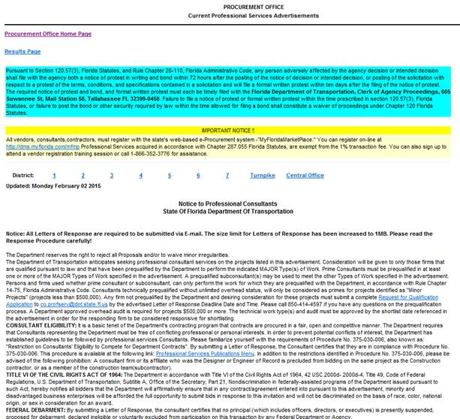
Pursuing Professional Services Projects
It is imperative that you read and understand the advertisement boilerplate, which precedes the actual advertisements on the Advertisements page.
Florida Department of Transportation

Slide 13
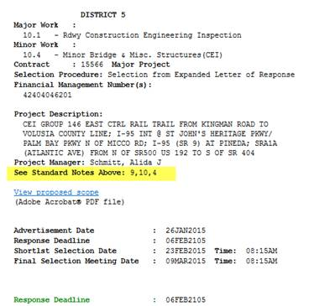
Pursuing Professional Services Projects
Be sure to carefully review any standard notes that are identified in the advertisement. Standard Notes are found in the boilerplate language above the advertisements.
Florida Department of Transportation

Slide 14
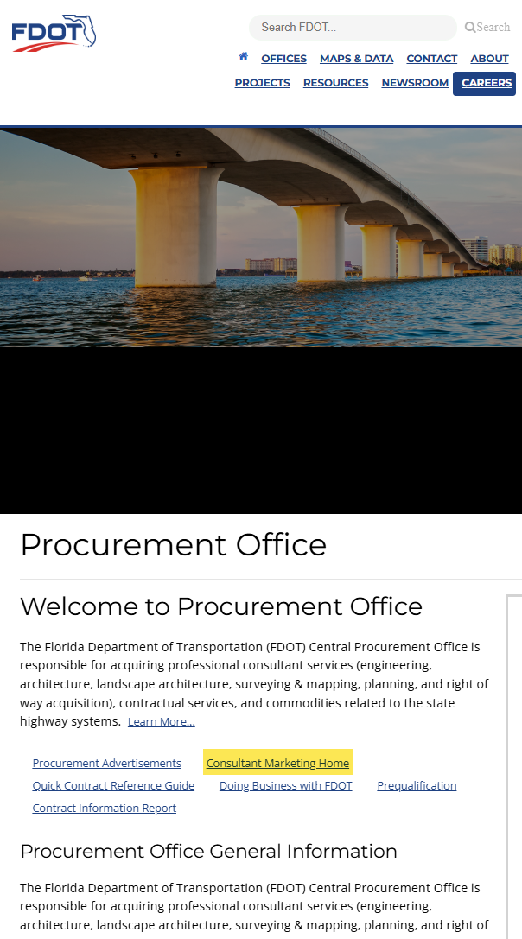
Pursuing Professional Services Projects
Information on upcoming Professional Services projects is available on the Consultant Acquisition Plan Report.
To view this report, visit the Procurement website and select Consultant Marketing from the column on the left.
Florida Department of Transportation

Slide 15
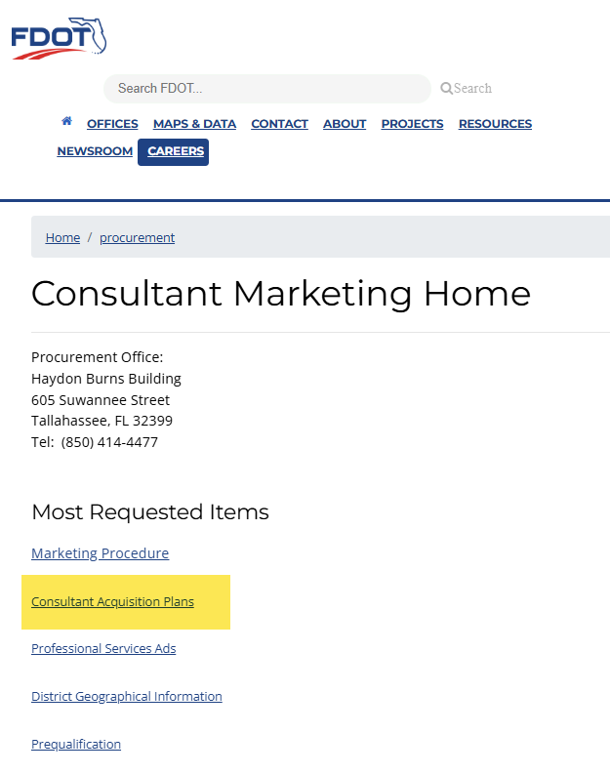
Pursuing Professional Services Projects
On the Consultant Marketing Home page, select Consultant Acquisition Plans from the column on the left.
Florida Department of Transportation

Slide 16
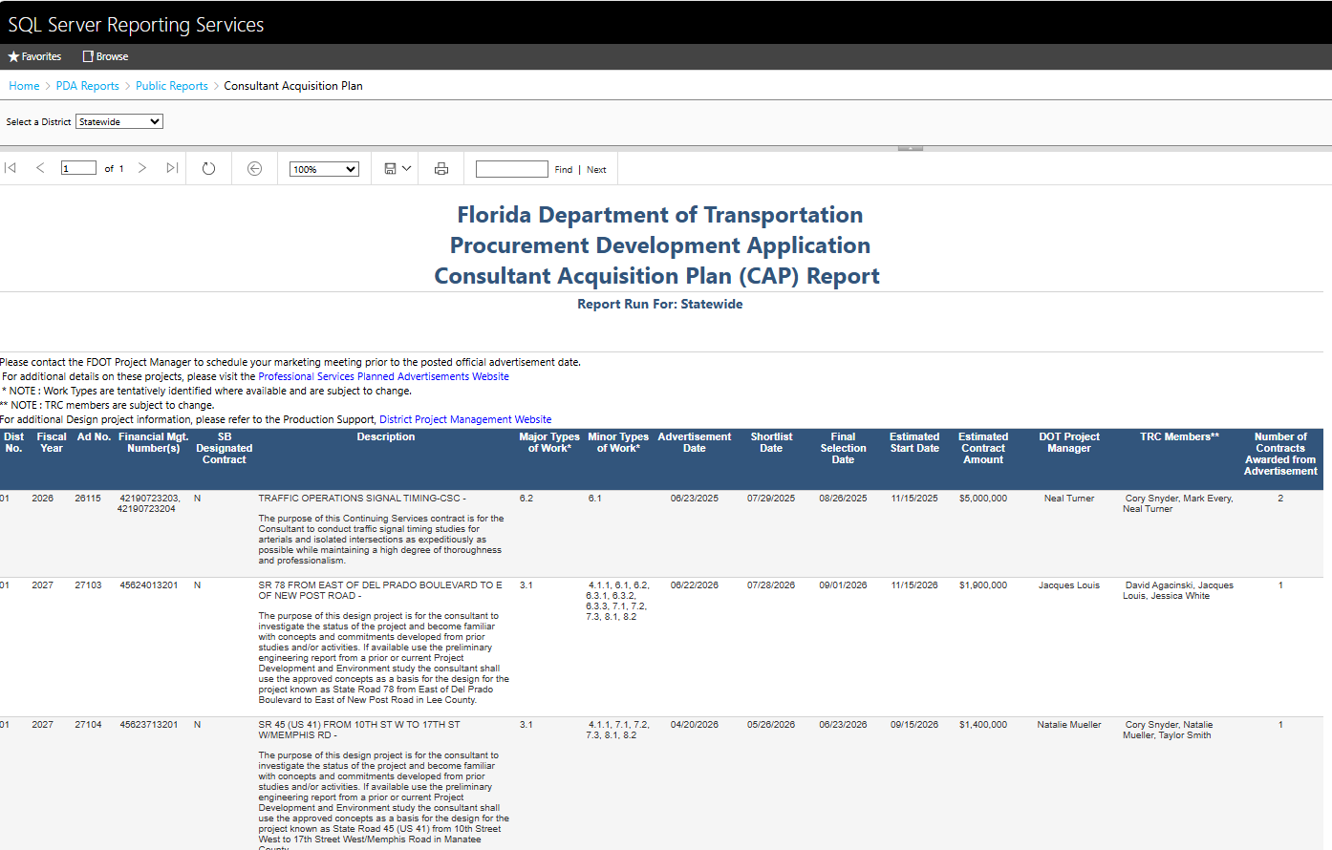
Pursuing Professional Services Projects
Sample Consultant Acquisition Plan Report
Florida Department of Transportation

Slide 17
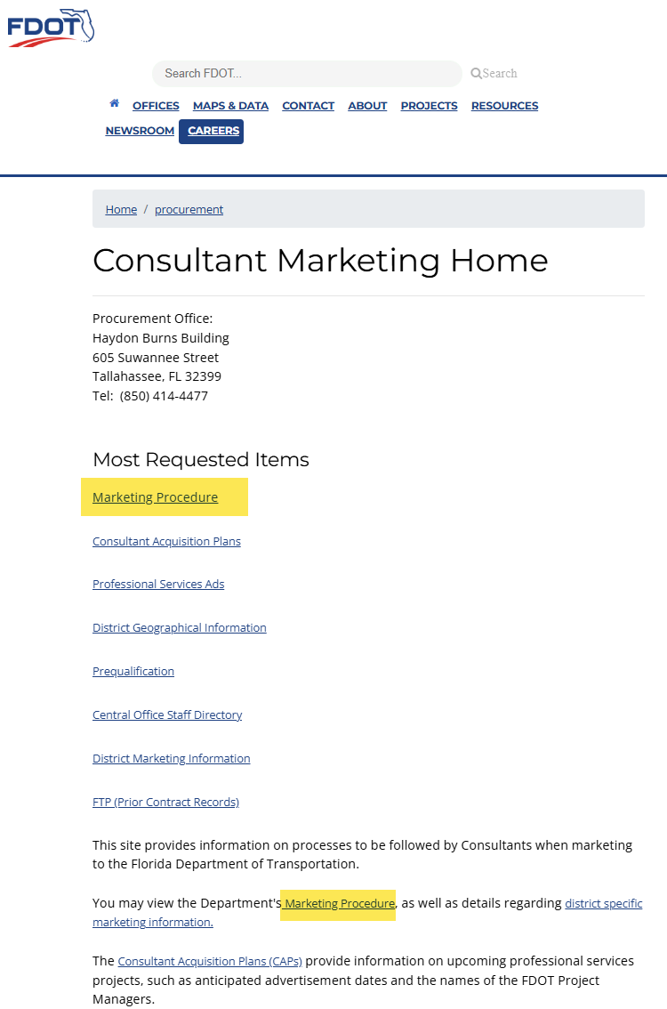
Pursuing Professional Services Projects
On the Consultant Marketing Home page, you can also access the Consultant Marketing Procedure by selecting either Marketing Procedure link.
Florida Department of Transportation

Slide 18
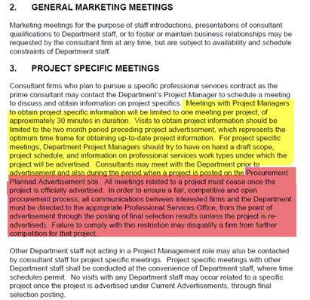
Pursuing Professional Services Projects
Consultant Marketing Procedure Excerpt
Florida Department of Transportation

Slide 19
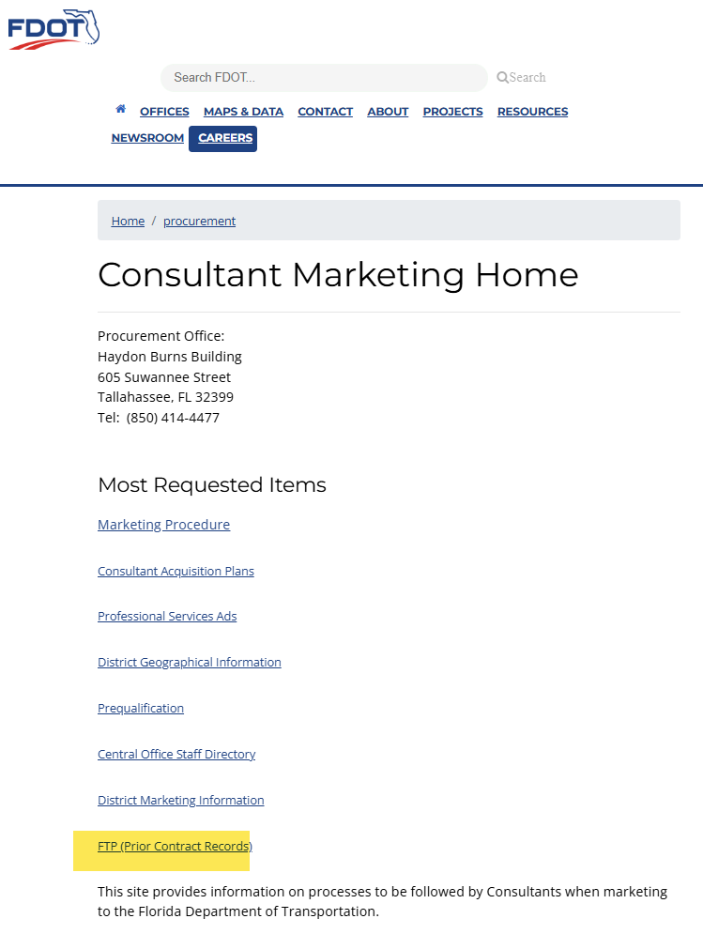
Pursuing Professional Services Projects
The Consultant Marketing Home page also includes a link to File Transfer Protocol (FTP) Sites.
Each district is responsible for maintaining their own FTP site, which contains past project information, such as letters of response, technical proposals, and final selection packages.
This information is also available on the Florida Accountability Contract Tracking System (FACTS) public search site.
Florida Department of Transportation

Slide 20
Small Business
Please visit the Department’s Small Business website for information on the Department’s Small Business Size Standards.
To see a listing of Small Businesses, please visit the Small Business site.
If you wish to be included in the Small Business listing for Professional Services or the Small Business listing for Construction, Maintenance and Other Contractual Services Firms, please visit the Small Business site for more information.
Florida Department of Transportation

Slide 21
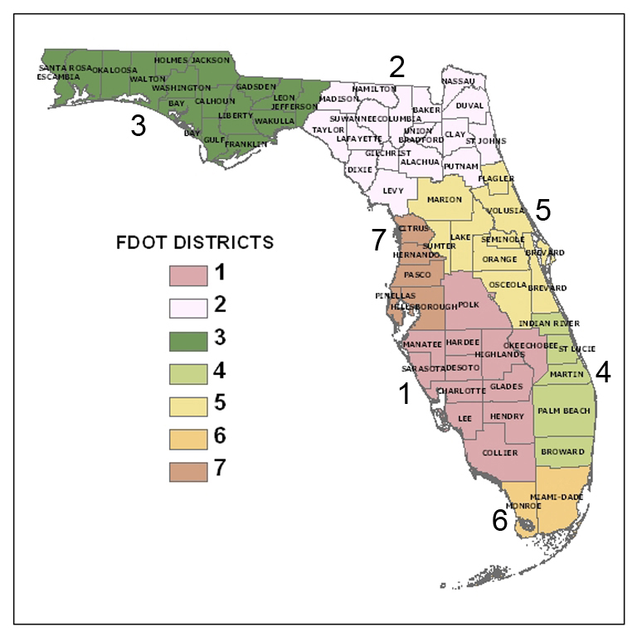
Contacts
Procurement Office http://www. fdot.gov/procurement/contacts.shtm
Florida Department of Transportation

