Slide 1

Doing Business with FDOT
Florida Department of
TRANSPORTATION

Slide 2

Quick Links
Quick Reference
Getting Started
Define Your Business
Small Business
Vendor One-Stop Quick Links
Florida Department of Transportation

Slide 3
Quick Reference
Contract Type | Examples | Advertisements | Prequalification Information | 1% transaction fee required? | Contacts
Professional Services | Engineering (including design), Architecture, Surveying & Mapping, Landscape Architecture, Planning, and Right of Way Services | Planned Projects and Current Advertisements | Professional Services Prequalification | No | Procurement Office
Commodities/ Contractual Services | Supplies, materials, goods, merchandise, equipment/IT consulting services, management consulting, environmental services, temporary staffing services | MyFlorida Market Place advertisements | No prequalification required | Yes | Procurement Office
Construction | Roadway Construction, Bridge Construction | Construction Letting and Project Information | Contracts Administration Prequalification | No | Contracts Administration Office
Maintenance | Right of way mowing, asset maintenance | Construction Letting and Project Information | No prequalification required | No | Contracts Administration Office
Design-Build |  | Planned Projects and Current Advertisements | Professional Services & Contracts Administration | No | Construction Office and Contracts Administration
Product Evaluation | Traffic Maintenance items – barricades, barriers, cones, sheeting | None | Approved Product List (APL) | No | State Materials Office
Florida Department of Transportation

Slide 4
Getting Started
Registration in MyFloridaMarketPlace and the Vendor Bid System
MyFloridaMarketPlace (MFMP) is the State of Florida's vendor registration system.
In addition to being registered in MFMP, you will also need to register for electronic notification of bidding opportunities in the Vendor Information Portal. To be properly notified of bidding opportunities, it is important that the commodity codes used to describe your products / services are inclusive and that the proper choices are selected for notification purposes.
Florida Department of Transportation

Slide 5
Define Your Business
In order for your company to do business with the Florida Department of Transportation, you must first identify the type of work your company performs and which FDOT office manages that type of work. This will help determine how your firm will need to proceed in order to begin working with the Department.
  Procurement Office
    Professional Services
    Commodities/Contractual Services
  Contracts Administration
    Construction Services
    Maintenance Services
    Design Build
  Specifications and Estimates
    Product Evaluation
Florida Department of Transportation

Slide 6
Procurement Office
Professional Services
including but not limited to the following:
Structural or Roadway Design
Architectural Services
Landscape Architectural Services
Geotechnical Services
Survey & Mapping Services
Aerial Photogrammetry
Transportation Statistics (planning)
Bridge Inspection
Construction, Engineering, and Inspection (CEI)
Drainage Design
Value Engineering
Project Development & Environmental Studies (PD&E)
Planning
Right-of-way Services
Services that require signing and sealing of design plans; engineering calculations or engineering judgment
Commodities /Contractual Services
including but not limited to the following:
Vehicles & Parts
Computer Equip., Software
Communications Equip.
Bulk Gasoline, Diesel
Office Furniture, Supplies
Tools – Handheld & Power
Laboratory & Safety Supplies
Management Consulting
Janitorial Services
Environmental Services
Lawn Maintenance Services
Pest Control Services
Security Guard Services
Temporary Staffing Services
Financial/Auditing Services
IT Services
Florida Department of Transportation

Slide 7
Professional Services
Section 287.055, F.S., the Consultants' Competitive Negotiation Act, requires procurement of professional services by competitive negotiation. The professional services procurement process may also be used for right-of-way services (337.107, F.S.) and planning services (337.1075, F.S.). Professional services procurement, as mandated by statute and Rule 14-75, Florida Administrative, involves a prequalification process, advertisement, and competitive selection of professional services consultants based on qualifications, followed by negotiations to establish a fair, competitive and reasonable fee for the desired services.
A number of standard types of work have been established for frequently used professional services (56 standard work types). Consultants are required to prequalify in order to pursue advertised professional services projects, and to renew their prequalification on an annual basis. Information on prequalification, including downloadable checklists of all required items, is available on the Prequalification website. Prequalification is coordinated through the Professional Services Qualification Administrator.
A listing of currently Prequalified Consultants is available on the Procurement website.
Return to Contract Types
Florida Department of Transportation

Slide 8
Professional Services Work Types
Group 2 - Project Development and Environmental
(PD&E) Studies
Group 3 - Highway Design – Roadway
3.1 - Minor Highway Design
3.2 - Major Highway Design
3.3 - Controlled Access Highway Design
Group 4 - Highway Design – Bridges
4.1.1 - Miscellaneous Structures
4.1.2 - Minor Bridge Design
4.2.1 - Major Bridge Design - Concrete
4.2.2 - Major Bridge Design - Steel
4.2.3 - Major Bridge Design - Segmental
4.3.1 - Complex Bridge Design - Concrete
4.3.2 - Complex Bridge Design - Steel
4.4 - Movable Span Bridge Design
Group 5 - Bridge Inspection
5.1 - Conventional Bridge Inspection
5.2 - Movable Bridge Inspection
5.3 - Complex Bridge Inspection
5.4 - Bridge Load Rating
Group 6 - Traffic Engineering and Operations Studies
6.1 - Traffic Engineering Studies
6.2 - Traffic Signal Timing
6.3.1 - Intelligent Transportation Systems Analysis and Design
6.3.2 - Intelligent Transportation Systems Implementation
6.3.3 - Intelligent Transportation Traffic Engineering Systems Communications
6.3.4 - Intelligent Transportation Systems Software Development
Group 7 - Traffic Operations Design
7.1 - Signing, Pavement Marking and Channelization
7.2 - Lighting
7.3 - Signalization
Group 8 - Survey and Mapping
8.1 - Control Surveying
8.2 - Design, Right of Way & Construction Surveying
8.3 - Photogrammetric Mapping
8.4 - Right of Way Mapping
Group 9 - Soil Exploration, Material Testing and Foundations
9.1 - Soil Exploration
9.2 - Geotechnical Classification Laboratory Testing
9.3 - Highway Materials Testing
9.4.1 - Standard Foundation Studies
9.4.2 - Non-Redundant Drilled Shaft Bridge Foundation Studies
9.5 - Geotechnical Specialty Laboratory Testing
Group 10 - Construction Engineering Inspection
10.1 - Roadway Construction Engineering Inspection
10.3 - Construction Materials Inspection
10.4 - Minor Bridge & Miscellaneous Structures CEI
10.5.1 - Major Bridge CEI - Concrete
10.5.2 - Major Bridge CEI - Steel
10.5.3 - Major Bridge CEI - Segmental
10.6.1 - Complex Bridge CEI - Concrete
10.6.2 - Complex Bridge CEI - Steel
10.7 - Movable Span Bridge CEI
Group 11 - Engineering Contract Administration and Management
Group 13 – Planning
13.3 - Policy Planning
13.4- Systems Planning
13.5 - Subarea/Corridor Planning
13.6 - Land Planning/Engineering
13.7 - Transportation Statistics
Group 14 – Architect
Group 15 - Landscape Architect
Group 21 - Acquisition, Negotiation, Closing, and Order of Taking
Group 24 - Acquisition Relocation Assistance
Group 25 - Right of Way Clearing and Leasing
Florida Department of Transportation

Slide 9
Professional Services
Announcements regarding projects requiring professional services may be viewed at the following links:
Planned Professional Services Advertisements
Current Professional Services Advertisements
Professional Services Selection Results (Shortlisted, Final Selections)
All Advertisements
These announcements require prequalification with the Department. Firms must follow instructions listed in the advertisement when responding.
Professional services contracts procured in accordance with Section 287.055 Florida Statutes are not subject to the 1% MyFloridaMarketPlace transaction fee, pursuant to Rule 60A-1.032, Florida Administrative Code.
Return to Contract Types
Florida Department of Transportation

Slide 10
Commodities/Contractual Services
Section 287.057, Florida Statutes, and Rule 60A, Florida Administrative Code, requires state agencies to acquire commodities and contractual services, in excess of Category Two ($35,000), by competitive sealed bids, request for proposals or by competitive negotiations, unless specifically exempted. These processes require a competitive selection based on either the lowest responsive bid (Invitation to Bid - ITB) or the most advantageous responsive proposal/price (Request for Proposals - RFP), or a "best value" determination (Invitation to Negotiate - ITN).
Criteria for evaluation of bids, proposals, or replies are set forth in the ITB, RFP or ITN package. In accordance with Rule 60A-1.031, Florida Administrative Code, all purchasing actions involving commodities and contractual services procured under Section 287.057 Florida Statutes are subject to a 1% MyFloridaMarketPlace Transaction Fee.
Return to Contract Types
Florida Department of Transportation

Slide 11
Commodities/Contractual Services
Types of commodities acquired may include; aggregates, barricades, computer hardware and software, electrical supplies, fencing, forms, gas, grass, hardware, heavy equipment, herbicides, janitorial supplies, laboratory equipment, maintenance supplies, nuclear gauges, office supplies and furniture, paint, reflective sheeting, roadway materials, safety products, survey instruments and supplies, tools, tolls equipment, uniforms, and vertical lift platform trucks.
Types of contractual services acquired may include: accounting, asbestos surveys & abatement, auditing, banking, building maintenance, communications, courier, environmental, equipment maintenance, hardware/software development & maintenance, janitorial, landscaping, legal, management, moving, pest control, public outreach, research, right of way appraisal, security, temporary help, training, video, and wildlife research. There is no pre-qualification required for proposing/bidding on these services, however, minimum qualifications may be specified in the bid or proposal package and will need to be demonstrated in the vendor response.
Return to Contract Types
Florida Department of Transportation

Slide 12
Commodities/Contractual Services
The Department utilizes the Department of Management Services(DMS) vendor list to notify vendors of advertised projects. Application to be included on this vendor list may be obtained by calling DMS at (850) 487-4634 or to register online, go to the on-line Vendor Registration web page.
Formal procurement of commodities and contractual services are advertised in the Vendor Bid System located on MyFlorida.com.
Return to Contract Types
Florida Department of Transportation

Slide 13
Contracts Administration Office
Construction & Maintenance
including but not limited to the following:
Bridge Painting
Computerized Traffic Control
Debris Removal
Drainage
Electrical Work
Fencing
Flexible Paving
Grading
Grassing, Seeding and Sodding
Guardrail
Hot In Place Resurfacing
Intelligence Transportation Systems
Landscaping
Bridge Construction
Pavement Marking
Roadway Paving
Roadway Signing
Traffic Signal
Includes Design Build work
Curbs
Asphalt repairs
Soundwalls
Concrete specialty work
Dredging
Drill shaft
Driveways
Fiber optic sables
Foundation drilling
Gutters
Handrails
Joint Specialty Work
Sidewalks
Structural Steel Cleaning and Painting
Sinkhole Remediation & Stabilization
Traffic Separators
Tree Removal and Trimming
Underground Utilities
Return to Contract Types
Florida Department of Transportation

Slide 14
Construction Services
The Department procures construction services such as roadway and bridge construction. These services are acquired in accordance with Section 337.11 Florida Statutes. Construction advertisement and qualification information can be found on the Office of Contracts Administration Home Page. From the Contracts Administration homepage you can also access Construction letting and project information. The Contracts Administration Office is responsible for advertising and awarding road and bridge construction projects.
All procurements under Section 337.11 Florida Statutes are not subject to the 1% MyFloridaMarketPlace Transaction Fee, pursuant to Rule 60A-1.032, Florida Administrative Code.
Return to Contract Types
Florida Department of Transportation

Slide 15
Maintenance Services
Maintenance services are generally defined as services associated with the maintenance and operation of roadways, structures, and rest areas. Some examples include right-of-way mowing, and asset maintenance. Maintenance service procurements for the Department of Transportation are also authorized under Florida Statute 337.11. Maintenance advertisements and qualification information can be found on the Office of Contracts Administration Home Page. From the Contracts Administration homepage you can also access Maintenance letting and project information. Acquisition of these services is also coordinated by the Contracts Administration Office.
All procurements under Section 337.11 Florida Statutes are not subject to the 1% MyFloridaMarketPlace Transaction Fee, pursuant to Rule 60A-1.032, Florida Administrative Code.
Return to Contract Types
Florida Department of Transportation

Slide 16
Design-Build
Design-Build combines into a single contract the design, construction, and in certain cases the construction engineering and inspection and acceptance requirements for a project, all in accordance with standard Florida Department of Transportation criteria, specifications, and contract administration practices. These projects allow the contractor to participate in the design in an effort to reduce costs and expedite construction. Contractors and Consultants interested in these projects will find information on these procurements on the Design-Build web page. Design-Build contracting is authorized under Section 337.11, Florida Statutes.
Return to Contract Types
Florida Department of Transportation

Slide 17
Specifications & Estimates Office
FDOT uses many products and services in the course of a road or bridge construction or maintenance project. The requirements for these products and services are identified in the Standard Specifications for Road and Bridge Construction Manual.
FDOT does not purchase these items directly. FDOT requires the Contractors to purchase these products and services meeting the manual requirements. The Approved Product List identifies the products that have been approved for use by the Florida Department of Transportation for use on State and Federal Highways. The products are listed by the Specification, Structures or Design Index reference that identifies the product usage or material requirements. Where applicable, cross-references are provided so that usage and material requirements are easily identified.
FDOT will limit the Contractor’s purchase and use of products and materials that require pre-approval to items listed on the APL, effective at the time of placement.
Further information on product evaluation can be found on the Program Management office, Specifications website.
Return to Contract Types
Florida Department of Transportation

Slide 18
Small Business
Please visit the Department’s Small Business website for information on the Department’s Small Business Size Standards.
To see a listing of Small Businesses, please visit the Small Business site.
If you wish to be included in the Small Business listing for Professional Services or the Small Business listing for Construction, Maintenance and Other Contractual Services Firms, please visit the Small Business site for more information.
Florida Department of Transportation

Slide 19
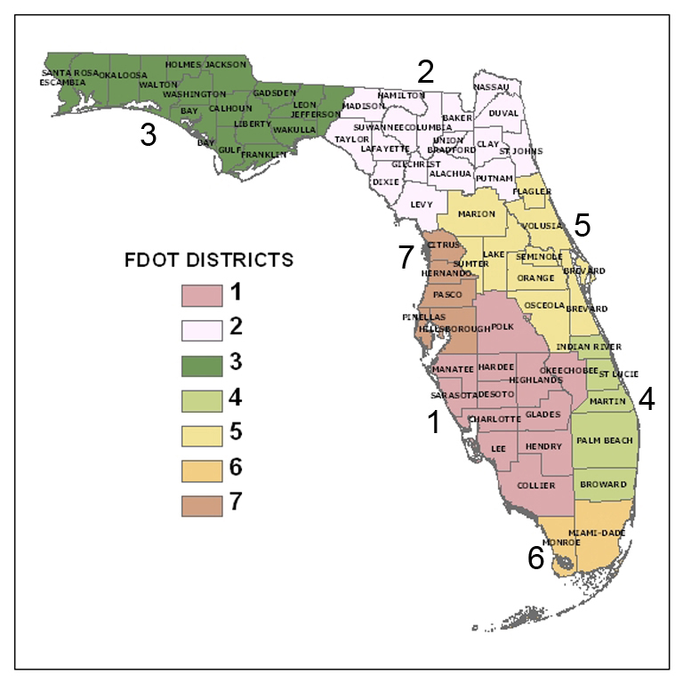
Contacts
Procurement Office http://www.fdot.gov/procurement/contacts.shtm
Contracts Administration Office
http://www.fdot.gov/contracts/staff.shtm
State Materials Office
https://www.fdot.gov/materials
Florida Department of Transportation

