Slide 1


GEC
INDUSTRY FORUM
DISTRICT SIX

Slide 2

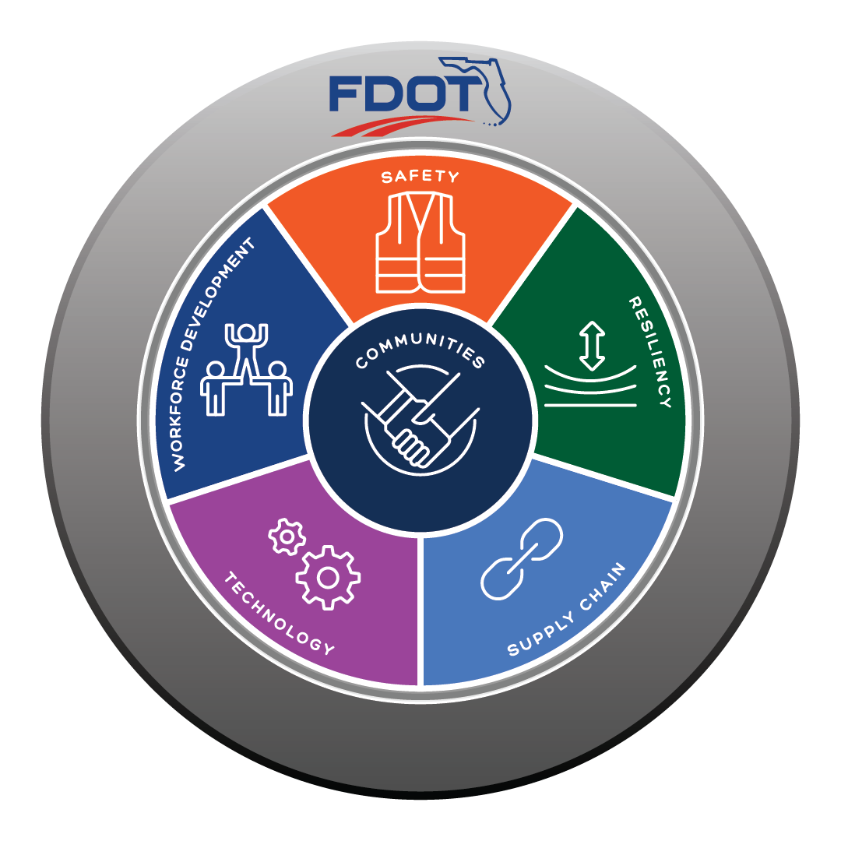
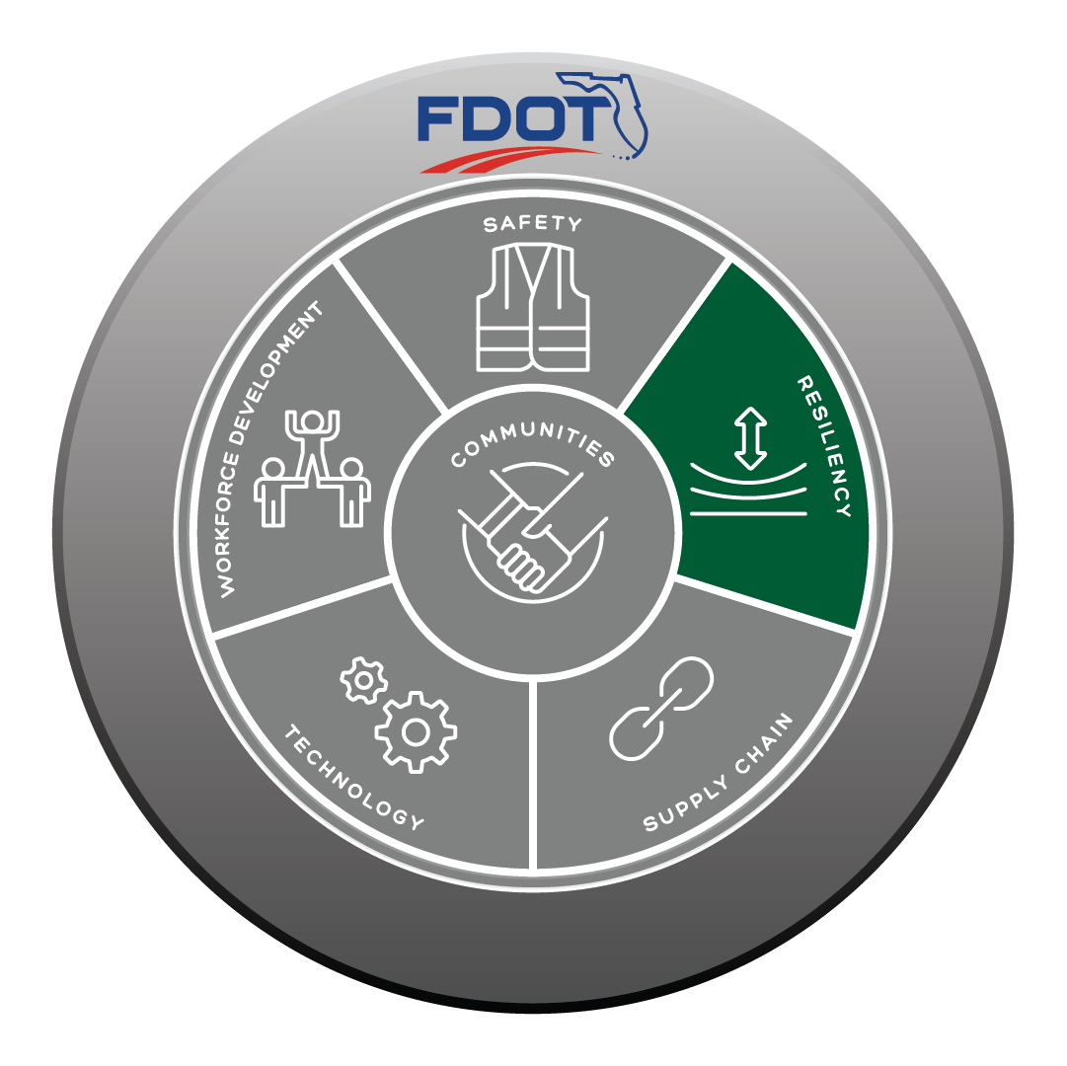

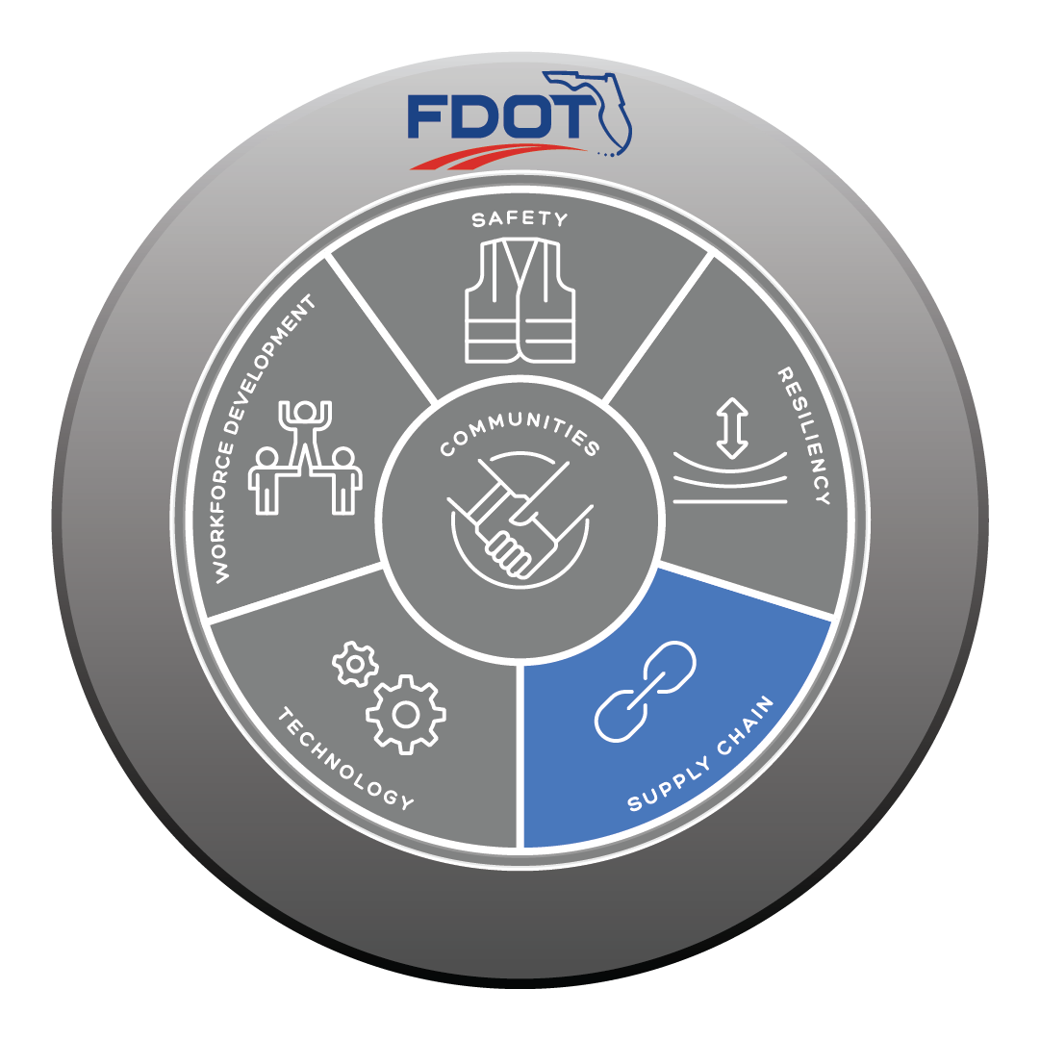
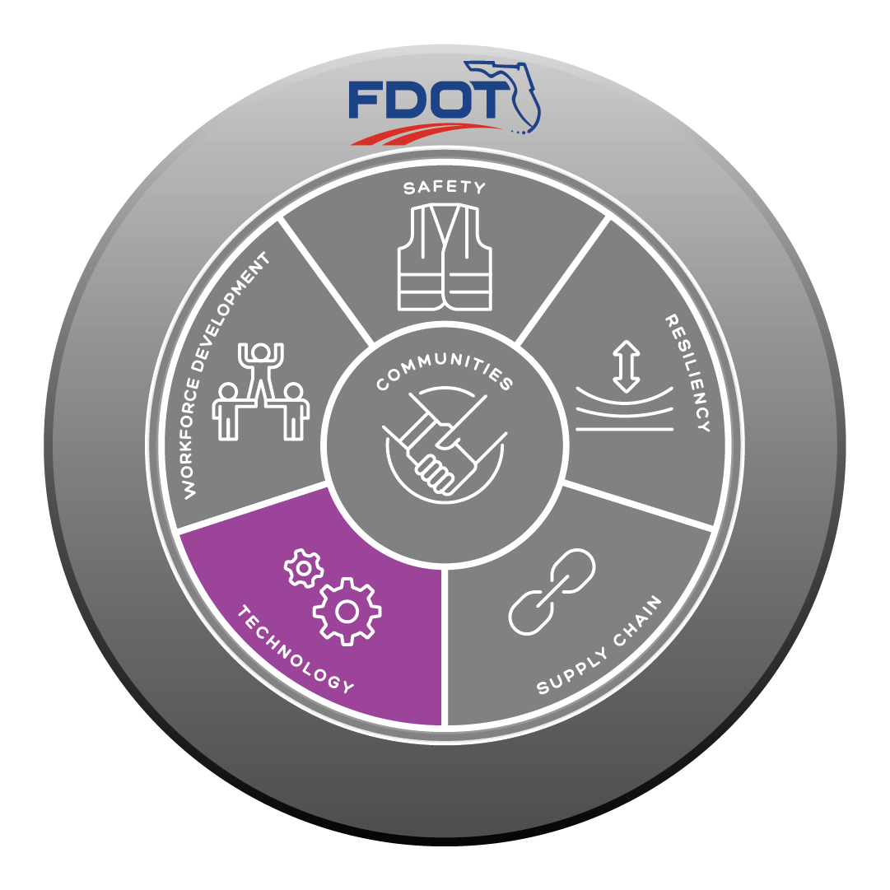

Daniel Iglesias, P.E.
Director of Transportation Development

Slide 3
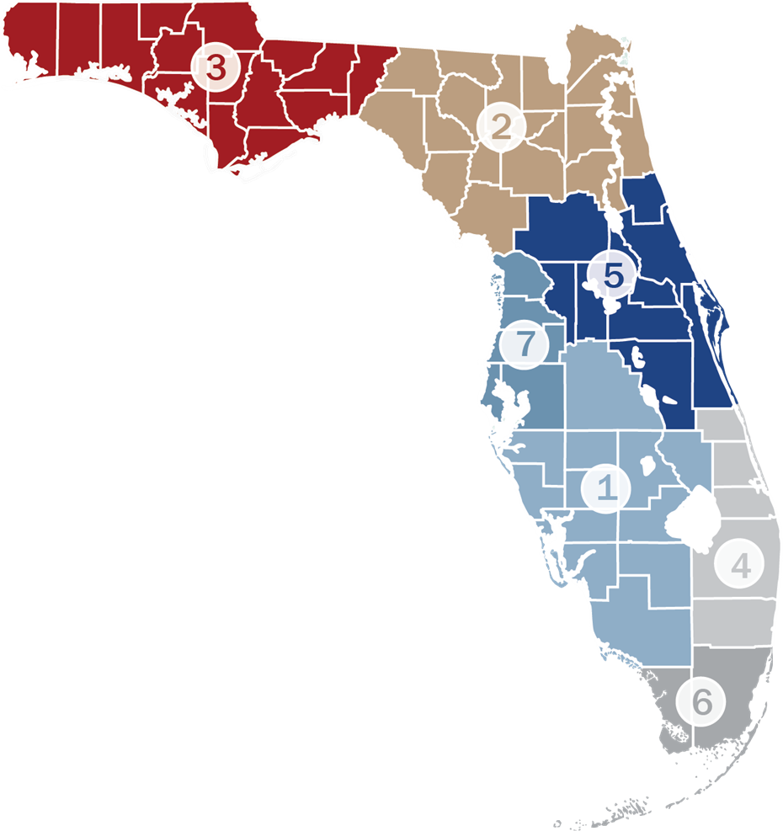
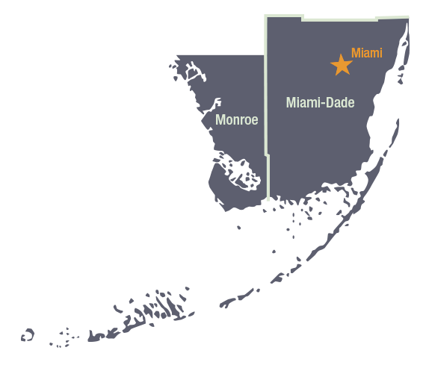
General Engineering Consultant (GEC) in District 6
Support for the Transportation Development Division
5 - year Contracts (Two Contracts)
Task Driven Contract
FDOT Project Manager: Felix Hernandez, P.E.
Staff Augmentation
Plan and Permit Reviews

Slide 4
GEC History in District 6
C8286: CSA
C8288: KCI
C8W42: HDR
C9007: KCI
C9015: AECOM
C9J67: HDR
C9J68: AECOM
2002
2010
2015
(Current Contracts)
CA933: HDR
CA934: Gannett Fleming
(New Contracts)
25650
25651
2020
2025

Slide 5
Transportation Development Support Needs
Design
Right of
Way
Program
Management
Traffic
Operations
Transportation
Development
Maintenance
Planning
&
Development
Modal
Development

Slide 6
Core GEC Support
Staff Augmentation
Plan Reviews
In-house Support
Phase Reviews
Technical Services
Serve as Technical Consultant
Expected to at District Office
Permit Reviews
Landscape Reviews

Slide 7
Contract Management
Open communication and timely response to requests from the Department
Expectations
Ability to provide experienced staff resources for multiple disciplines in a timely manner
Methods to track and manage multiple open tasks including control of funds

Slide 8
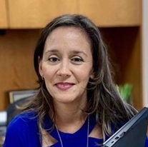
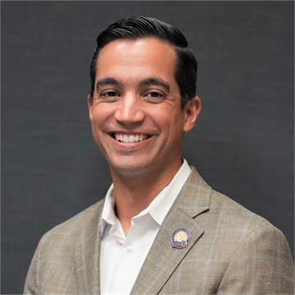
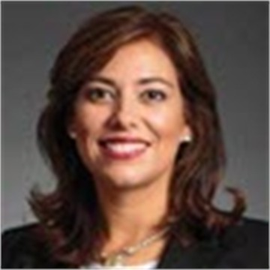
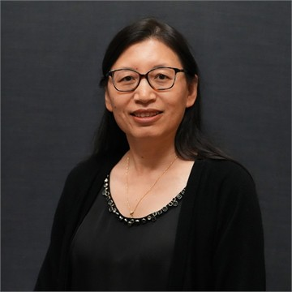
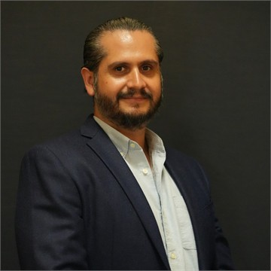
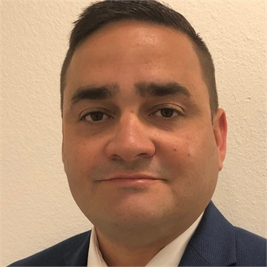
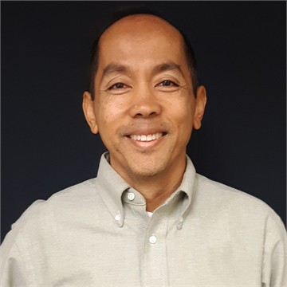
Design
Design
Karina Fuentes, P.E.
Internal Design
Raymond Valido, P.E.
Consultant Management
Judy Solaun-Gonzalez, P.E.
Structures
Hailing Zhang, P.E.
Design Support
Felix Hernandez, P.E.
Surveying and Mapping
Victor M Marrero, PSM
Drainage
Nathan Pulido, P.E.
Engineering Design Support
CADD support including 3D Modeling
Project Management
RFP Preparation
Technical Experts
Structural Design / Review Support
Structural Plans Preparation Support
Utility Coordination Support
GIS Support
Plans and Permit Reviews
Surveying services & Support
Mapping Services Support
Drainage Design/Review Support
Environmental Permitting Support
Drainage Complaint Resolution Support

Slide 9
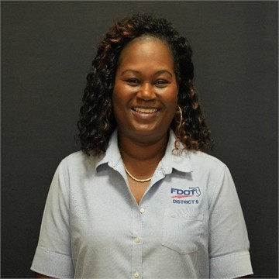
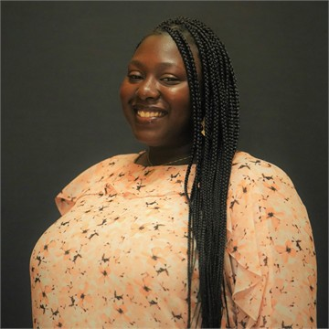
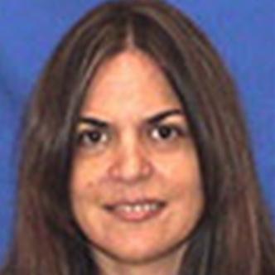
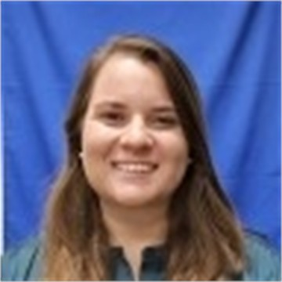
Program Management Support
Program Management
Antonette Adams
Production Manager
Austania Moss, MPA
Plans, Specifications, and Estimates Engineer
Vivian Lemus, P.E.
Local Program Administrator Jessica Beck-Galindo, MPA
Project Scheduling and Analysis
Production Dashboard Development
Production Management Reporting
Data Analytics
Specifications Package Preparation and Review
Construction Cost Development and Updates
Construction Plans Review
TSP and MSP Review
LAP Certification Coordination
Procurement Review and Oversight
Coordinate CST Plans Reviews and PS&E Packages
Process Reimbursement and Close-out

Slide 10
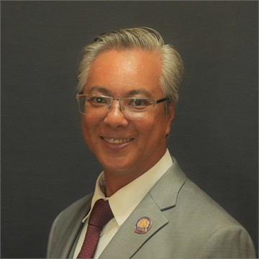
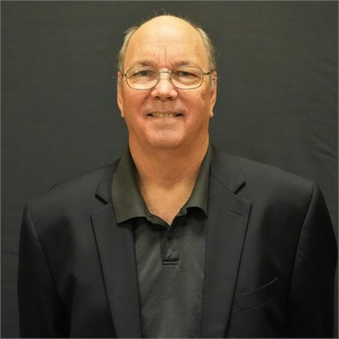
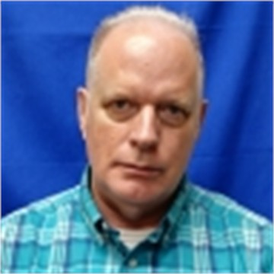
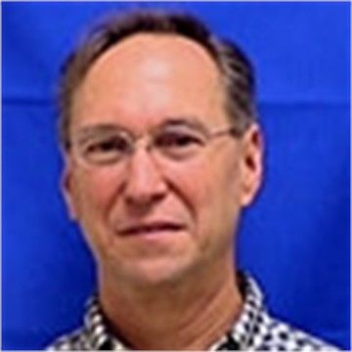
Planning & Environmental Management Support
PLEMO
Dat Huynh, P.E.
Transportation Planning
Kenneth Jeffries
Project Development
Mark Plass, P.E.
Environmental Management
Steven Craig James, RLA
Mobility Planning
Scope Refinement Team support
Project Development support
SIS program support
Concept Development support
Environmental Support Services
Subject Matter Expert
Corridor Planning
SIS Programming
Travel Demand Modeling
Bike/Ped Support
Data collection (RCI/TCI)
MPO Liaison support

Slide 11
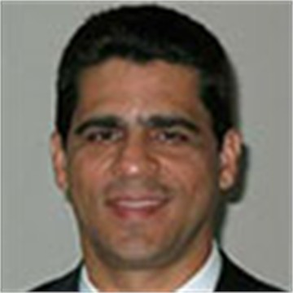
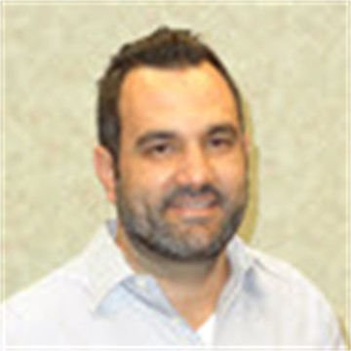
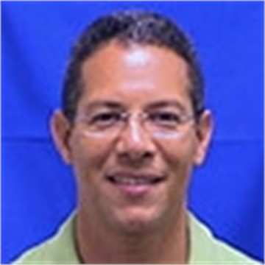
Transportation Operations
Director of Transportation Operations
Rudy Garcia, P.E
Maintenance
Renato Marrero, P.E.
Traffic Operations
Omar Meitin, P.E.
Permit Reviews
Engineering Assessments
Software Development
Push Button Contract Management Support
Traffic Study Reviews
Smart Work Zone Analysis & TCCP Development
Support for Statewide Safety Implementation Initiatives

Slide 12
Procurement Schedule
AD #25650 & 25651
October 28
January 14
May 30
Industry Forum
Shortlist Selection
Contract Execution
Project Advertisement
Final Selection
December 2
February 24

Slide 13
At Advertisement
Close Date:
  Letter of Response (LOR)
  Prime must be pre-qualified for Major Work Type 11.0 – Engineering Contract Admin. and Management
SELECTION
METHOD
Shortlisted Firms:
Interviews
Organizational Chart with Key Positions
Resumes:
  Project/Contract Manager
  Key Positions in Each Office: Design, Program Management, PLEMO

Slide 14



Central Office:
District 4:
Leslie Wetherell, P.E. (Design)
District 6:
Tim Lattner, P.E. (Office of Construction)
Felix Hernandez, P.E. (Design)
TECHNICAL REVIEW COMMITTEE
(TRC) MEMEBERS
*Subject to Change

Slide 15

CONFLICT OF INTEREST
  Refer to Conflict of Interest Procedure for Department Contracts procedure # 375-030-006.
  Providing services required on the GEC may cause ineligibility for the consultant (Prime and/or Sub) to pursue other Department contracts or phases of a project.
  GEC Consultant/Subconsultant has the responsibility to disclose any potential conflict of interest.
    Recuse themselves
    Request a determination on eligibility from the District Secretary
  If any assigned staff is required to perform a duty that would create a conflict of interest on a project, the Consultant shall provide alternate resources.
  If alternate resources are required, there is no guarantee the originally assigned staff will continue working on the assigned task work order.

Slide 16
QUESTIONS
?
Contact information:
  Project Manager: Felix Hernandez, P.E.
    Phone #: 305-470-5274
    Email: Felix.Hernandez@dot.state.fl.us
  Procurement Manager: Melanie Moreno
    Phone #: 305-470-5112
    Email: Melanie.Moreno@dot.state.fl.us

