Slide 1
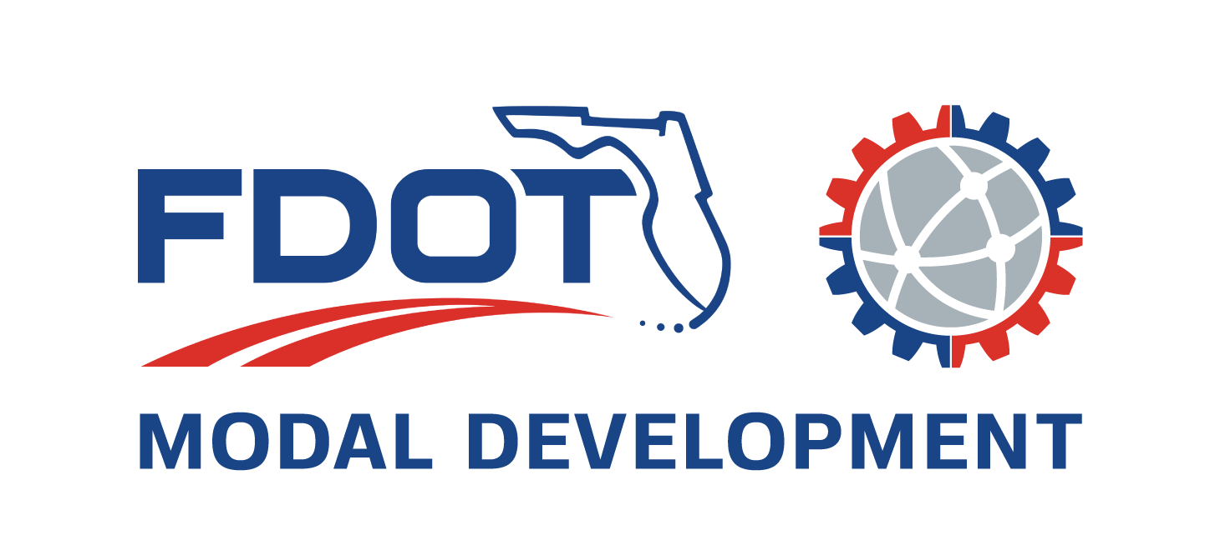
DISTRICTWIDE INSPECTION SERVICES CONTRACTS
INDUSTRY FORUM
448151-1-12-01 Ad #24675
448150-1-12-01 Ad #24676
December 11, 2023
Notes:
Good Morning
Welcome to the Modal Development Districtwide Inspection Services Contracts Industry Forum
I am Dionne Richardson and I am the PM for Ad #24675 and this is Raymond Freeman he will be the PM for Ad #24676, which will be advertised next month.

Slide 2
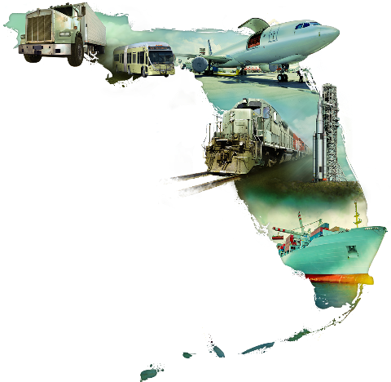
Office Overview
Manage aviation and seaports capital improvement grant programs in collaboration with local partners.
Manage transit grant programs in collaboration with local partners.
Coordinate/prepare SMART Program studies/initiatives in partnership with Miami-Dade County.
Manage rail safety and rehabilitation initiatives in partnership with rail service providers.
Manage freight initiatives in collaboration with trucking community and other stakeholders.
Serve as a technical resource for partner agencies (all modes).
Provide systems safety oversight and compliance reviews (all modes).
Federal grant opportunity coordination.
Notes:
Before we begin just a quick overview of the Modal Development Office
Manage aviation and seaports CIP grants in collaboration with local partners.
Manage transit grants program also with local partners.
Coordinate/prepare SMART Program studies in partnership with Miami-Dade County.
Manage rail safety and rehabilitation initiatives in partnership with rail service providers.
Manage freight initiatives in collaboration with trucking community and other stakeholders.
Serve as a technical resource for partner agencies (all modes).
Provide systems safety oversight and compliance reviews (all modes).
Federal grant opportunity coordination.

Slide 3
Office Overview Continues
Fast Facts:
Manages over $500M in grants and other funding for our transportation partners, over the five-year Work Program
8 public-use aviation facilities, including 2 commercial service airports and one seaplane base
2 deep-water-ports
3 railroad companies, including the South Florida Rail Corridor (SFRC)
57 transit agencies, including Miami-Dade Transit, the largest transit agency in Florida, municipal transit systems, and Section 5310 agencies.
Notes:
Manages over $500M in grants and funding for our transportation partners, over a five-year period
8 public-use aviation facilities, including 2 commercial service airports and one seaplane base
2 deep-water-ports
3 railroad companies, including the South Florida Rail Corridor (SFRC)
57 transit agencies, including Miami-Dade Transit, the largest transit agency in Florida, municipal transit systems, and Section 5310 agencies.

Slide 4
Contract Services Overview
These contracts involves:
Vehicle inspections
Compliance monitoring and reviews
Agency support services
Project site visits
Multimodal inventories
Systems safety plans
Rail complaint resolution
Construction railroad site administration
Monitoring Reports
Notes:
These contracts involves:
Transit triennial and biennial vehicles inspections
Compliance monitoring and reviews – for all agencies
Agency support services
Which includes technical and training support
Project site visits – for aviation, seaport and intermodal projects
Multimodal inventories
Such as transit vehicles, park and ride lots, RR signals and crossings
Systems safety plans – transit systems safety plans
Rail complaint resolution
Construction railroad site administration
Monitoring Report – for all activities mentioned

Slide 5
Method of Procurement
Letter of Response
Interviews

Slide 6
Procurement Schedule – Ad # 24675 (Dionne)
Milestone | Date
Advertisement | 12/18/2023
LORs due in PSU from Consultants | 01/08/2024
Reviewer Longlist Meeting | 01/23/2024
Shortlist Selection Meeting | 01/29/2024
Interviews | 02/15/2024
Final Selection Meeting | 03/04/2024
Contract executed | 04/30/2024

Slide 7
Procurement Schedule – Ad # 24676 (Raymond)
Milestone | Date
Advertisement | 01/22/2024
LORs due in PSU from Consultants | 02/05/2024
Reviewer Longlist Meeting | 02/20/2024
Shortlist Selection Meeting | 02/26/2024
Interviews | 03/13/2024
Final Selection Meeting | 04/01/2024
Contract executed | 05/31/2024

Slide 8
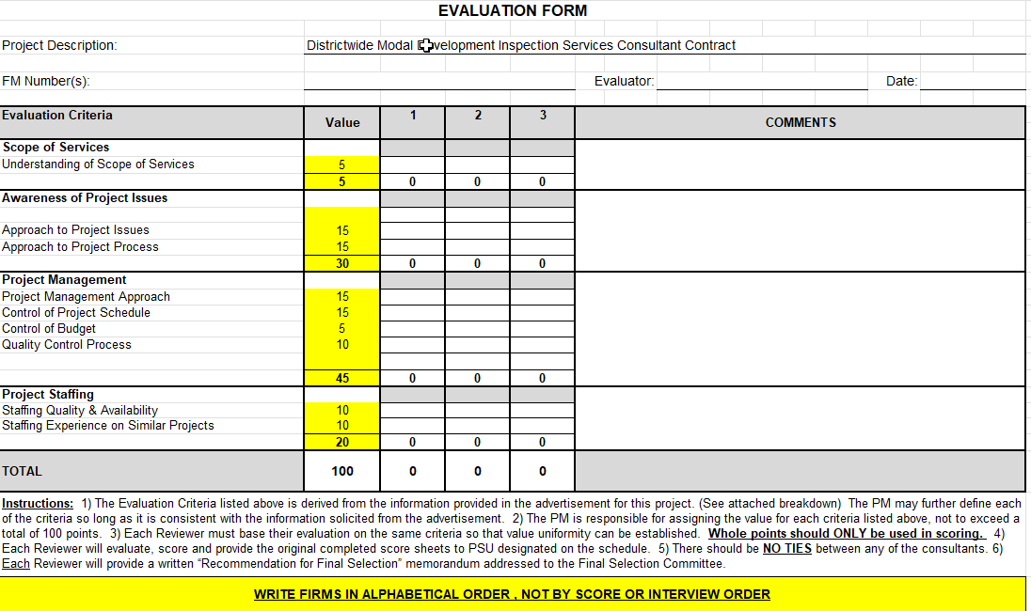
Evaluation Criteria

Slide 9
TRC Members – Ad# 24675
Dionne Richardson – Modal Development Office – Project Manager
Raymond Freeman – Modal Development Office
Johanna Hernandez – Design Office
Notes:
These contracts involves:
Transit vehicles inspections
Small, medium and large agencies
Compliance monitoring and reviews
Agency support services
Which includes training and technical support
Project site visits
Multimodal inventories
Such as transit vehicles, park and ride lots, RR signals and crossings
Systems safety plans
Rail complaint resolution
Construction railroad site administration
Reporting

Slide 10
TRC Members – Ad# 24676
Raymond Freeman – Modal Development Office– Project Manager
Dionne Richardson – Modal Development Office
Johanna Hernandez – Design Office
Notes:
These contracts involves:
Transit vehicles inspections
Small, medium and large agencies
Compliance monitoring and reviews
Agency support services
Which includes training and technical support
Project site visits
Multimodal inventories
Such as transit vehicles, park and ride lots, RR signals and crossings
Systems safety plans
Rail complaint resolution
Construction railroad site administration
Reporting

Slide 11
Notes:
Before we end, I would like to highlight the Department’s strategic initiatives which includes
Safety, workforce development, technology, a robust supply chain, resiliency and communities at the center.

Slide 12
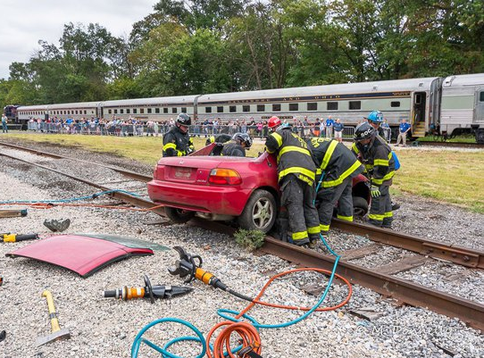
Be Rail Safe
DON’T STOP ON TRACKS!

Slide 13
Questions?
Notes:
Thank you for the opportunity to present to you today.
What questions do you have?

Slide 14
Question and Answers
Will it be a different focus? Will it be focused more on aviation, transit, etc between both contracts?
Same scope for both contracts. Only different is that the projects will be advertised at different times
Raymond’s project will tentatively be advertised as Dionne’s project will be shortlisted
Will the scopes be similar or different?
The scopes will be identical.
Both are 5 year contracts?
Yes, 5 year contracts for $2.5 million each contract
Usually these contracts are related to grants. Any freight studies to be included in this contract?
Freight is related to a standalone contract.
If a freight grant is granted, it will be a seaport or an aviation.

