Slide 1
FPID 456242-1-32-01
Ad # 27124
RRR and Safety
SR 70 FROM EAST OF SR 45 (US 41) TO WEST OF TARA BOULEVARD
Procuring Project Manager
Wadeana Beveridge, Phone No. 863-519-2482
Design Project Manager
Richard (Mose) Howard, PE, Phone No. 863-519-2374

Slide 2
Important CAP Dates
Advertisement: July 3, 2026
  Contact ceases with all FDOT staff (except PSU)
Procurement Method: Presentations
  Response Deadline: August 3, 2026
  Shortlist Selection: August 25, 2026
  Presentations: September 10, 2026
  Final Selection: September 22, 2026
No contact until 72 hours after final selection

Slide 3
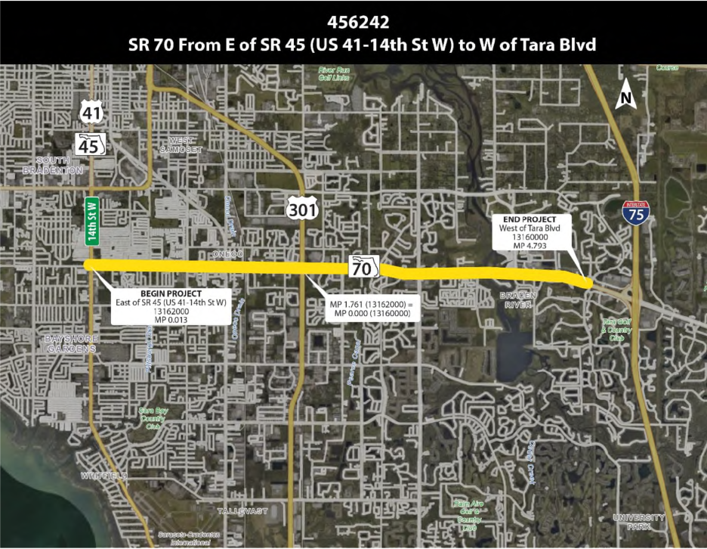
FPID:456242-1 is the RRR and Safety project that ties in with lighting project FPID 455188-1.

Slide 4
Project Overview
Scope is still under FDOT review and the below is subject to change
  RRR
    Milling and Resurfacing
    Reduction of Turning Radii at Side Streets (see ASR)
    Hardened Centerlines with Ramp Reconstruction (where needed)
    Sidewalk Cracking
    Separation of Shared Ramps
    Providing three (3) PHBs with Speed Tables (SR45(US41) to 9th St E)
    Other Minor Improvements

Slide 5
Anticipated Work Groups
Major Work Type: 3.1 Minor Highway Design
  4.1.1 Miscellaneous Structures
  6.2 Traffic Signal Timing
  6.3.1 ITS Analysis and Design
  7.1 Signing, Pavement Marking, and Channelization
  7.3 Signalization

Slide 6
Funding
Design
  $2.51M
  FY 2027
Construction
  $32.15M
  FY 2029

Slide 7
Documents
Located on PSU’s FTP site
  Draft 4P Technical Scope
      Not yet finalized
  Approved Typical Section Package
      Not yet finalized
  Safety Study
  When available
      Final 4P Scope
      Scope of Services
      Final TSP

Slide 8
Technical Review Committee (TRC)
Wadeana Beveridge
Xiaoxue (Snow) Peng, PE
Kim Abate

Slide 9
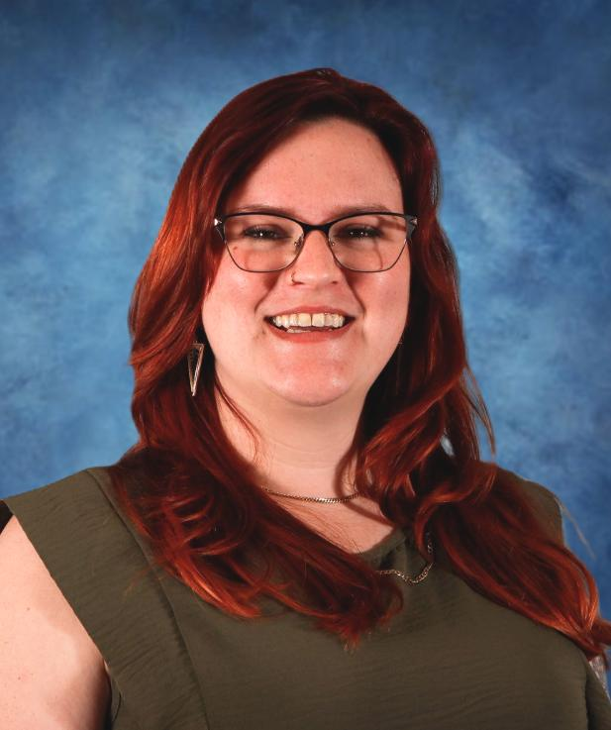
TRC: Wadeana Beveridge
Project Manager III
Florida Dept. of Transportation (FDOT)
  Project Management
Previous Work: FDOH
  3.5 years
Contact Information:
  (863) 519-2482
  Wadeana.Beveridge@dot.state.fl.us
Concerns: Attention to detail, Exceptional Communication, Innovation in Design
What I am looking for: A concise and logical approach that will produce a final product which will benefit all stakeholders.

Slide 10
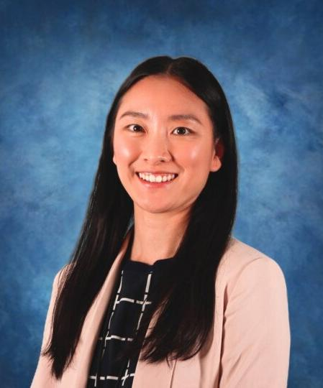
TRC: Xiaoxue (Snow) Peng, P.E.,
Traffic Design Engineer II
Florida Dept. of Transportation (FDOT)
  3+ years
Previous Work: 8.5 years with CTDOT
  5.5 years Traffic Engineer
  0.5 years of Bridge Design
  2 Years of Project Administration/ADA Engineer
Contact Information:
  (863) 519-2528
  xiaoxue.peng@dot.state.fl.us
Concerns: Attention to detail, use engineering judgment and knowledge to maximize transportation safety improvements, and ensure all designs comply with the latest standard.
What I am looking for: For the firm to show their Problem-solving skills.

Slide 11
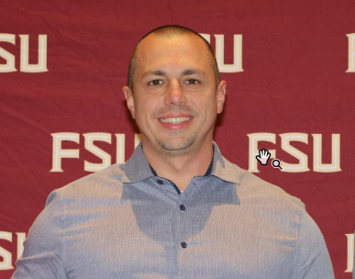
TRC: Kimberly Abate
Roadway Designer IV
Florida Dept. of Transportation (FDOT)
  7 years
Previous Work: FDOT
  Roadway Design
  Corridors Program Office
  (Project Manager – Design/PD&E)
Contact Information:
  (863) 519-2424
  Kimberly.Abate@dot.state.fl.us
Concerns: Communication and Safety
What I am looking for: Demonstration of good engineering judgment to provide innovative solutions to design issues
Notes:
.

Slide 12
Suggestions for the Letter of Interest
  Listen to the TRC.
  Use of graphics should add value to the letter.
  TRC prints in black and white, so colors may not be correctly represented.
  This TRC prefers a two-column format.
  If you reference a specific project, please include contact information.
  Check for grammatical errors and accuracy of information. It is a direct reflection on your QC abilities.

Slide 13
TRC Considerations for LOR
Please address the following topics in your letter:
Please share your team's experience with a similar suburban context classification setting. Discuss one challenge you faced and how you overcame it.
List 3 specific items in the scope that you would recommend be improved and why?
Discuss your approach to MOT along this corridor.
Discuss your approach to PIO.

Slide 14
The Letter
Do:
  Listen to the TRC.
  Use a two-column format.
  Check for grammatical errors. It is a direct reflection on your QC abilities.
Don’t:
  Don’t use excessive graphics and pictures.
  Don’t use multiple colors throughout the text. We print black and white.
  Don’t assume just because the TRC has worked with you in the past that we will take your past work into consideration. The only way to be fair is to read every letter like we’ve never met you. If it’s not in the letter, it won’t be taken into consideration when shortlisting.

Slide 15
Meetings are being held on:
May 18, 2026
June 24, 2026
June 25, 2026
This is your time to ask questions and gain clarification, so please be prepared to ask the TRC questions.
If you would like to schedule your 20-minute marketing meeting, please use the following link:
https://outlook.office365.com/book/D1TRCMarketingMeetings@fldot.onmicrosoft.com/s/IxRSovLpD0yZUvlDj5l68Q2?ismsaljsauthenabled

