Slide 1
444634-3-32-01
Ad # 27123
Widening Project:
SR 72 from E of Proctor Rd to E of Lorraine Rd
Sarasota County
Project Manager:
Amber Albritton
863-519-2668

Slide 2
Important CAP Dates:
Advertisement: February 13, 2026
      Contact shall cease with all FDOT staff (except PSU)
Presentations: April 9, 2026
Final Selection: April 28, 2026

Slide 3
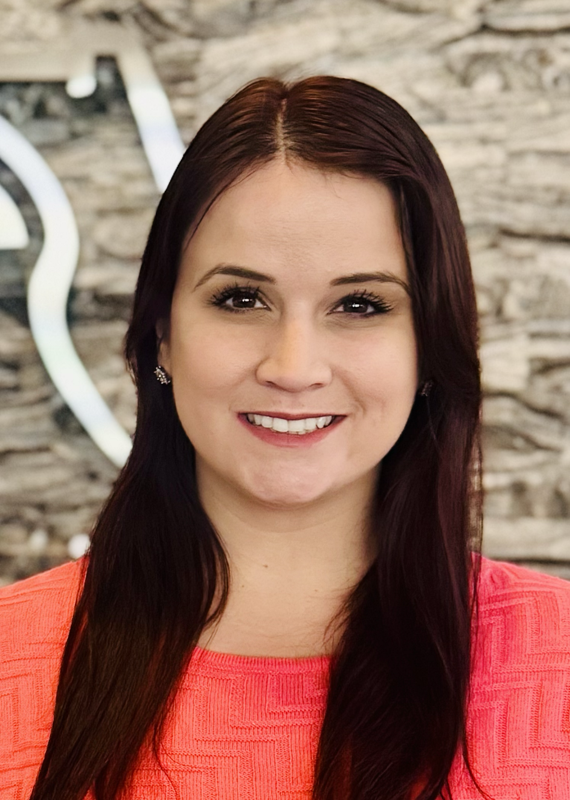
TRC: Amber Albritton
Project Manager III
2 Years with FDOT
  Project Management
Contact Information:
  863-519-2668
  Amber.Albritton@dot.state.fl.us

Slide 4
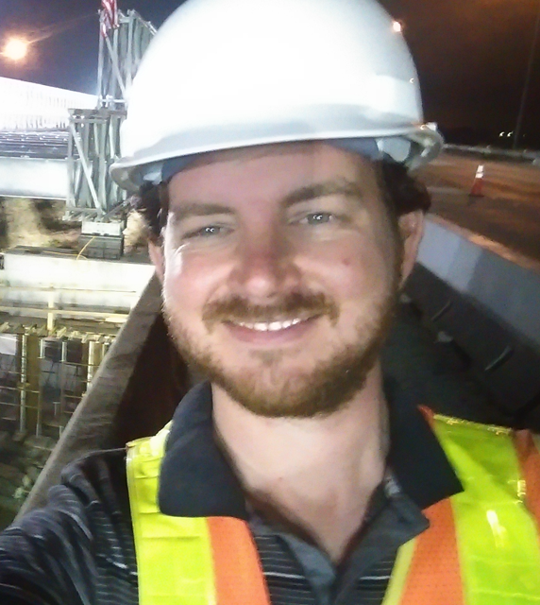
TRC: Joel Hobbs, PE
Project Management Engineer Supervisor III
13 Years with FDOT
  PE Training Program
  Construction
  Maintenance
  In-House Roadway Design
  Project Management
Contact Information:
  863-519-2376
  Joel.Hobbs@dot.state.fl.us

Slide 5
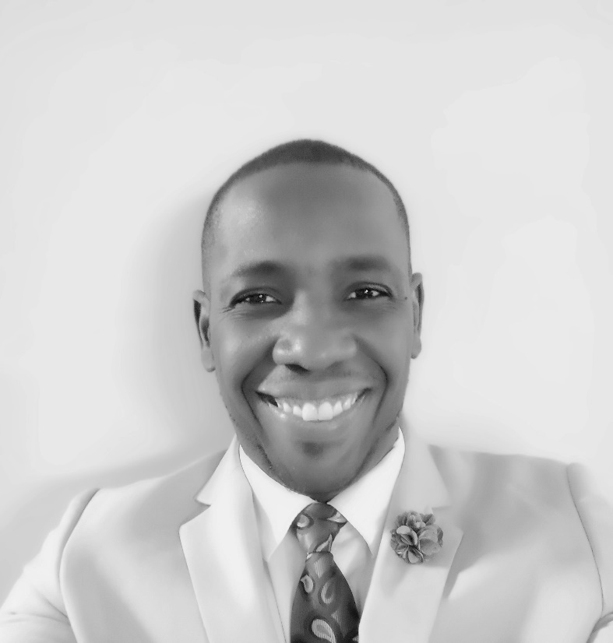
TRC: Jimmy Vilcé , PE
Project Development Manager
10 Years with FDOT
  Project Management
  Maintenance
  Permits
  Traffic Design
  Project Development & Environment
Contact Information:
  863-519-2293
  Jimmy.Vilce@dot.state.fl.us

Slide 6
Funding:
Design:
  $3,590,000 funded in FY2027
  ROW:
  $11,000,000 funded in FY2029
Construction:
  $42,000,000 funded in FY2099

Slide 7
Project Work Types
Major Work Type:
    3.2 Major Highway Design
Minor Work Type:
  2.0 - PD&E Studies
  3.1 Minor Highway Design
  6.1 - Traffic Engineering Studies
  7.1 - Signing, Pavement Marking and Channelization
  7.2 - Lighting
  7.3 - Signalization
  8.1 - Control Surveying
  8.2 - Design, Right of Way & Construction Surveying
  8.3 - Photogrammetric Mapping
  8.4 - Right of Way Mapping
  9.1 - Soil Exploration
  9.2 - Geotechnical Classification Laboratory Testing
  9.3 - Highway Materials Testing
  9.4.1 - Standard Foundation Studies
  15.0 - Landscape Architect

Slide 8
Discussion Points for LOR
Discuss any Maintenance of Traffic issues or challenges.
Discuss utility challenges and solutions to prevent relocation.
This will be a more compressed schedule than a typical project. How do you plan to aggressively address the schedule to both stay on track and keep the Right of Way funds from rolling?

Slide 9
The Letter
Don’t:
  Don’t use excessive graphics and pictures.
  Don’t assume letters will be printed in color, so colors may not be correctly represented
  Don’t assume just because the TRC may have worked with you in the past that we will take your past work into consideration. Make the letter count. The TRC will not consider any information outside of the letter.
  Don’t contact any external agencies/stakeholders outside of FDOT. This project is “no call” until told otherwise.
Do:
  Listen to the TRC.
  Use a two-column format.
  Check for grammatical errors. This is a direct reflection of your QC abilities.
  Provide name and contact information for all project references.

Slide 10
Meetings are being held on:
Friday, January 30 10:00 AM – 3:00 PM
Wednesday, February 4 from 8:00 AM – 3:00 PM
Wednesday, February 11 from 1:00 PM – 3:00 PM
Thursday, February 12 from 9:00 AM – 2:30 PM
***This time is for YOU to ask questions and get clarification. Information contained in this PowerPoint will not be repeated by the TRC.***
Please contact Amber Albritton at amber.albritton@dot.state.fl.us if you have any additional questions.
We invite you to schedule a 20-minute marketing meeting via the following link:
https://outlook.office365.com/book/D1TRCMarketingMeetings@fldot.onmicrosoft.com/s/piIX3VH_Skij6TgiZ-OJMg2?ismsaljsauthenabled

