Slide 1

456252-1-32-01
Ad # 27122
RRR Project:
SR 600 (US 92) from E of Churchill Ave to S of Main St
Polk County
Project Manager:
Amber Albritton
863-519-2668

Slide 2
Important CAP Dates:
Advertisement: April 17, 2026
  Contact ceases with all FDOT staff (except PSU)
Interviews: June 12, 2026
Final Selection: June 30, 2026

Slide 3
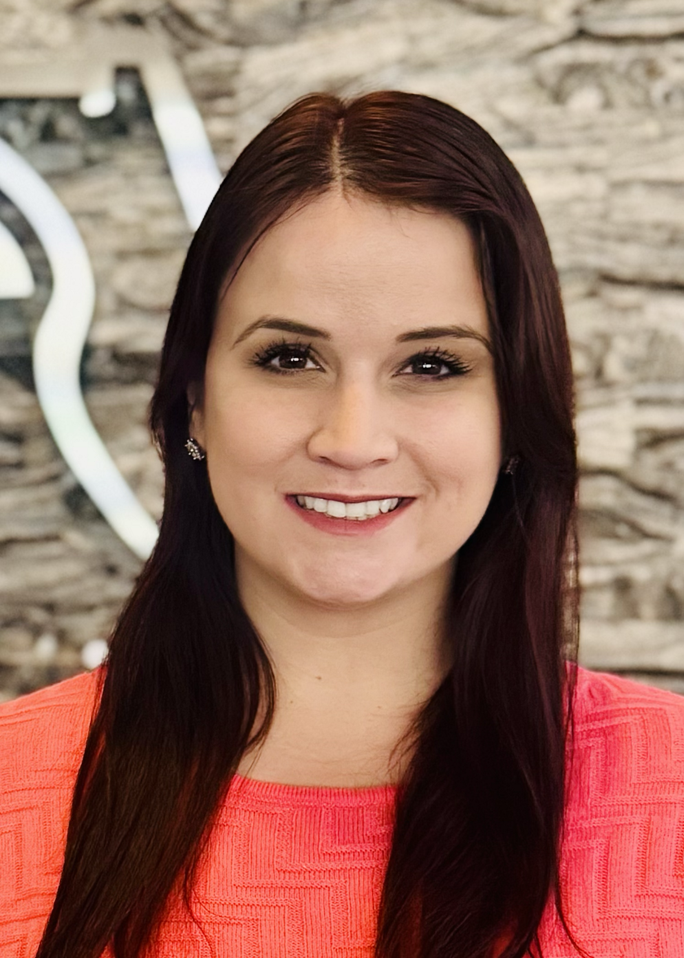
TRC: Amber Albritton
Project Manager III
2 Years with FDOT
  Project Management
Contact Information:
  863-519-2668
  Amber.Albritton@dot.state.fl.us

Slide 4
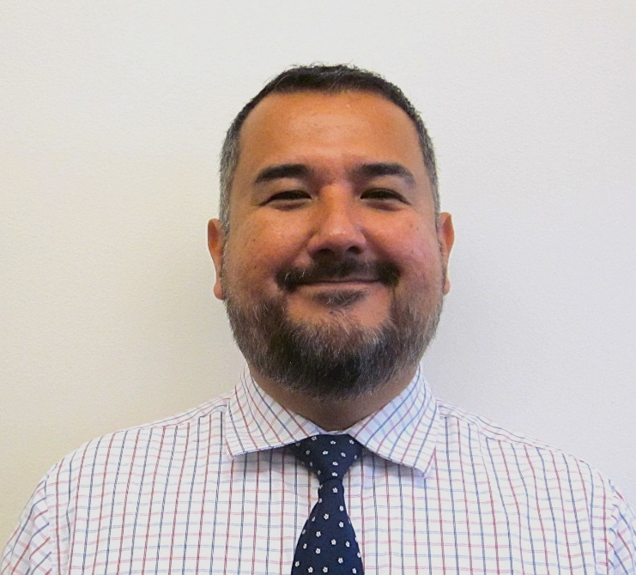
TRC: Roberto Gomez
Traffic Design Engineer II
0.5 Year with FDOT
  Traffic Design – 0.5 year
Contact Information:
  863-519-2368
  Roberto.Gomez@dot.state.fl.us

Slide 5
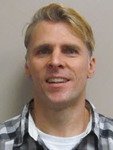
TRC: Randy Lachler, PE
Roadway Engineer I
27 years with FDOT
  P.E. Trainee Program – 4 years
  Structures – 2 years
  Roadway Design – 21 years
Contact Information:
  863-519-2548
  Randy.Lachler@dot.state.fl.us

Slide 6
Funding:
Design:
  $825,000 funded in FY27
  ROW:
  No ROW required
Construction:
  $7.5M funded in FY29

Slide 7
Consultant Responsibilities
Major Work Type: 3.1 Minor Highway Design
  4.1.1 Miscellaneous Structures
  6.1 Traffic Engineering Studies
  6.2 Traffic Signal Timing
  6.3.1 ITS Analysis and Design
  6.3.2 ITS Implementation
  6.3.3 ITS Traffic Engineering Systems Communications
  7.1 Signing, Pavement Marking & Channelization
  7.2 Lighting
  7.3 Signalization
  8.1 Control Surveying
  8.2 Design, Right of Way, & Construction Surveying

Slide 8
Major Scope Items
Milling and resurfacing SR 600 (US 92) from E of Churchill Ave to S of Main St
  Milling depth of 3 1/2”, resurfaced with 2” SP 12.5 and 1.5” FC 12.5
      Subject to change based on pavement cores
Updated Signalization
  Mast arm and signal replacements
Sidewalk
  Reconstructing curb ramps and replacing sidewalk that is broken and not ADA compliant
Updated Intersection Lighting
Drainage Repairs

Slide 9
TRC Considerations for LOR
Please address the following topics in your letter:
Discuss your approach to drainage on this project and where the replacement of curb would provide a drainage/maintenance benefit.
Discuss pedestrian safety in this corridor - concerns and suggestions for improvements.
Describe concerns and possible improvements for the freight trucks utilizing this corridor.

Slide 10
The Letter
Don’t:
  Don’t use excessive graphics and pictures.
  Don’t use multiple colors throughout the text. We print black and white.
  Don’t assume just because the TRC has worked with you in the past that we will take your past work into consideration. The only way to be fair is to read every letter like we’ve never met you. If it’s not in the letter, it won’t be taken into consideration when shortlisting.
  Don’t contact anyone regarding this project except FDOT. This project is “no call” until told otherwise.
Do:
  Listen to the TRC.
  Use a two-column format.
  Check for grammatical errors. If you can’t QC a letter, how do we expect you to QC plans?

Slide 11
Meetings are being held on:
Monday, April 6th from 9:00am-3:00pm
Tuesday, April 7th from 9:00am-3:00pm
Monday, April 13th from 1:00pm-3:30pm
Wednesday, April 15th from 9:00am-12:00pm
This time is for you to ask questions and get clarification on the project and expectations. We do not use anything shared in the Marketing Meetings to evaluate firms.
If you would like to schedule your
20-minute marketing meeting, please do so here: https://outlook.office365.com/book/D1TRCMarketingMeetings@fldot.onmicrosoft.com/s/O2hm__ihDE2-0LfHgkdLuA2?ismsaljsauthenabled

