Slide 1
FPID 451022-1-32-01
Ad # 27121
RRR and Safety
SR 684 (US 41) FROM 30TH ST W TO N OF 41ST AVE E
Project Manager
Wadeana Beveridge, Phone No. 863-519-2482

Slide 2
Important CAP Dates
Advertisement: August 7, 2026
  Contact ceases with all FDOT staff (except PSU)
Procurement Method: Presentations
  Response Deadline: August 24, 2026
  Shortlist Selection: September 15, 2026
  Presentations: October 1, 2026
  Final Selection: October 20, 2026
No contact until 72 hours after final selection

Slide 3
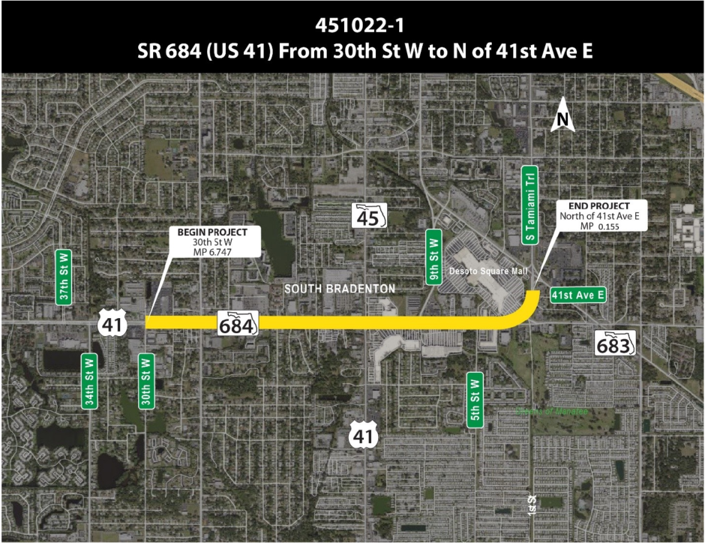
FPID:451022-1 is the RRR and Safety project

Slide 4
Project Overview
RRR
    Milling and Resurfacing
    Hardened Centerlines with Ramp Reconstruction (where needed)
    Sidewalk Cracking
    Separation of Shared Ramps
    Safety Improvements
    Other Minor Improvements

Slide 5
Anticipated Work Groups
Major Work Type: 3.1 Minor Highway Design
  4.1.1 Miscellaneous Structures
  6.2 Traffic Signal Timing
  6.3.1 ITS Analysis and Design
  7.1 Signing, Pavement Marking, and Channelization
  7.3 Signalization

Slide 6
Funding
Design
  $1.1M
  FY 2027
Construction
  $13.9M
  FY 2029

Slide 7
Documents
Located on PSU’s FTP site
  4P Technical Scope
  Approved Typical Section Package
  Scope of Services
    Uploaded when available

Slide 8
Technical Review Committee (TRC)
Wadeana Beveridge
David Walters
Sherry Mitchem

Slide 9
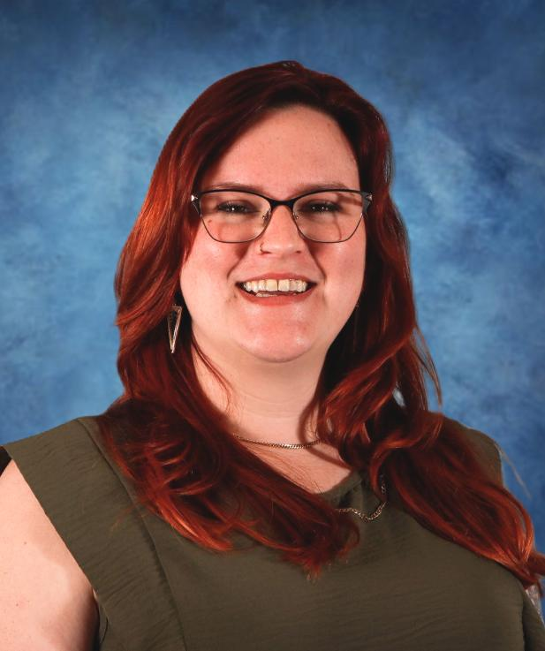
TRC: Wadeana Beveridge
Project Manager III
Florida Dept. of Transportation (FDOT)
  Project Management
Previous Work: FDOH
  3.5 years
Contact Information:
  (863) 519-2482
  Wadeana.Beveridge@dot.state.fl.us
Concerns: Attention to detail, Exceptional Communication, Innovation in Design
What I am looking for: A concise and logical approach that will produce a final product which will benefit all stakeholders.

Slide 10
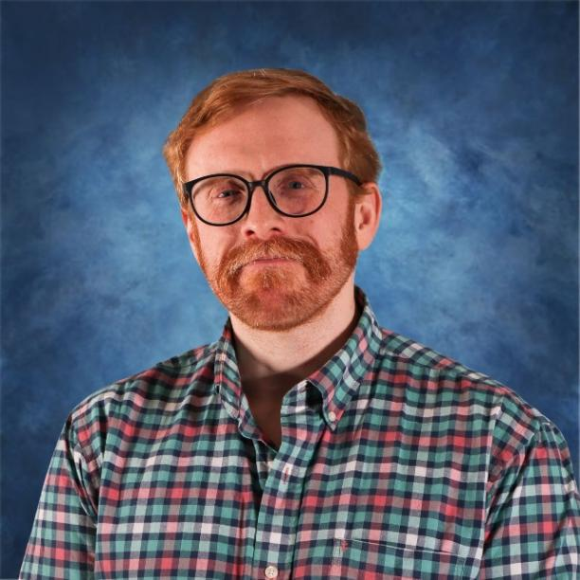
TRC: David Walters, Roadway Designer IV
FDOT – Sep 2023
  Roadway Design – 2.5 years
  CADD Background
Contact Information:
  (863) 519-2398
  David.Walters@dot.state.fl.us
Important to me: Clean and organized plans, attention paid to detail, adherence to design standards, clear and unambiguous communication.

Slide 11
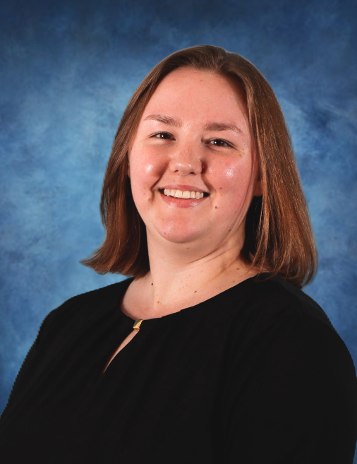
TRC: Sherry Mitchem, Traffic Designer IV
4 Years with FDOT
  Traffic Design – 4 years
Contact Information:
  863-519-2583
  Sherry.Mitchem@dot.state.fl.us
Important to me: Clear cross‑discipline communication, well‑documented design decisions, and proactive planning to avoid common issues.

Slide 12
Suggestions for the Letter of Interest
  Listen to the TRC.
  Use of graphics should add value to the letter.
  TRC prints in black and white, so colors may not be correctly represented.
  This TRC prefers a two-column format.
  If you reference a specific project, please include contact information.
  Check for grammatical errors and accuracy of information. It is a direct reflection on your QC abilities.

Slide 13
TRC Considerations for LOR
Please address the following topics in your letter:
If the signal at 5th St W were to be reconstructed, what are the three main design challenges you expect to face and how would you overcome them?
How can you mitigate the issues pedestrians and bicyclists face along this corridor?
What would be your approach to public outreach on this project?

Slide 14
The Letter
Do:
  Listen to the TRC.
  Use a two-column format.
  Check for grammatical errors. It is a direct reflection on your QC abilities.
Don’t:
  Don’t use excessive graphics and pictures.
  Don’t use multiple colors throughout the text. We print black and white.
  Don’t assume just because the TRC has worked with you in the past that we will take your past work into consideration. The only way to be fair is to read every letter like we’ve never met you. If it’s not in the letter, it won’t be taken into consideration when shortlisting.

Slide 15
Meetings are being held on:
June 29, 2026
June 30, 2026
July 13, 2026
This is your time to ask questions and gain clarification, so please be prepared to ask the TRC questions.
If you would like to schedule your 20-minute marketing meeting, please use the following link:
https://outlook.office365.com/book/D1TRCMarketingMeetings@fldot.onmicrosoft.com/s/Lrw4LAMfikyyBM5miDs56Q2?ismsaljsauthenabled

