Slide 1

449049-1-32-01
Ad # 27107
RIGID PAVEMENT RECONSTRUCTION:
SR546(US92)(MEMORIAL BLVD) FROM WABASH AVE TO WEST OF E GARY DR
Polk County
Project Manager:
Marie Carvajal
863-519-2669

Slide 2
Important CAP Dates:
Advertisement: May 22, 2026
Contact ceases with all FDOT staff (except PSU)
Response Deadline for LOR: June 9,2026
Shortlist Meeting: June 30,2026
Presentations: July 21, 2026
Final Selection: August 4, 2026

Slide 3
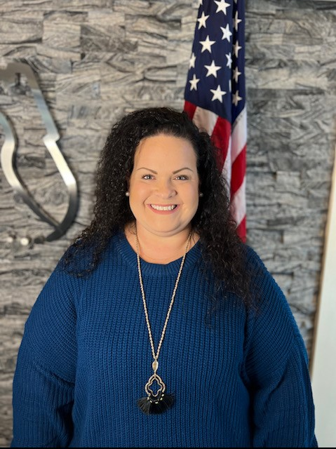
TRC: Marie Carvajal, Design Project Manager IV
6 Years with FDOT
  Procurement – 3 years
  Project Management – 3 years
Contact Information:
  863-519-2669
  Marie.Carvajal@dot.state.fl.us

Slide 4
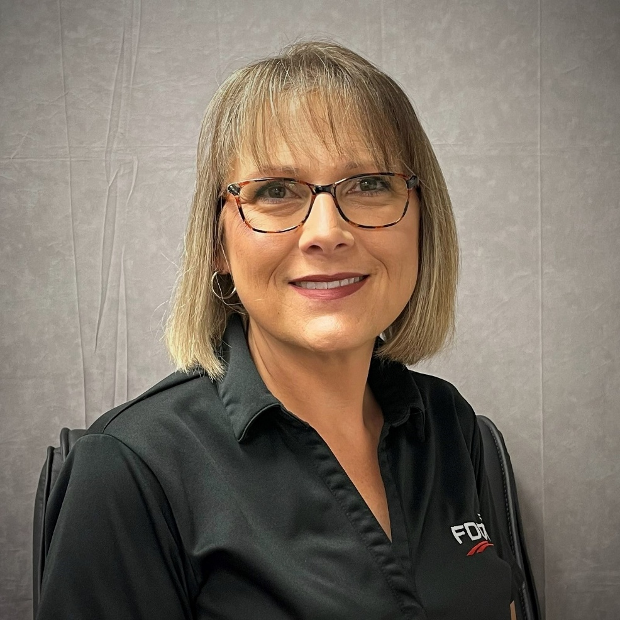
Design TRC: Tracy Padula
21 years with FDOT
Contact Information:
Tracy.padula@dot.state.fl.us
863-532-0272

Slide 5
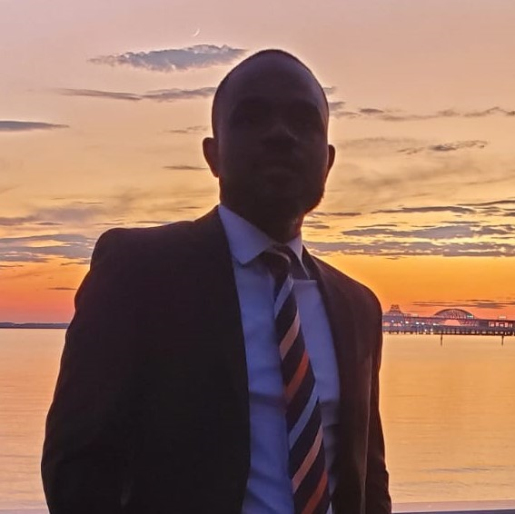
Design TRC: Samuel St. Hilaire
8 years with FDOT
Contact Information:
sam.sthilaire@dot.state.fl.us
863-519-2554

Slide 6
Funding:
Design:$6,750,000
  ROW:
  No anticipated ROW required
Construction:
  Not Funded

Slide 7
Consultant Responsibilities
Major Work Type: 3.2 Major Highway Design
  3.1 Minor Highway Design
  4.1.1 Miscellaneous Structure
  7.1 Signing, Pavement Marking & Channelization
  7.2 Lighting
  7.3 Signalization
  8.1 Control Surveying
  9.2 Geotechnical Classification Lab Testing

Slide 8
Major Scope Items
Removal and reconstruction of the existing concrete pavement mainline, turn lanes, shoulders, curb and gutter, shoulder gutter, traffic separators and concrete medians.
Reconstructing guardrails and to meet current FDM standards.
Providing hardened centerlines where viable.
Updating signals and lighting per the current criteria.
Updating signing and pavement markings.
Access Management implementation of directional median openings along SR 546.
Safety improvements
Rail Coordination (pier protection for Bridge No. 160068 SR 546 over the CSX railroad)
Analyze drainage
Utilities
SUE

Slide 9
TRC Considerations for LOR
Instead of listing specific topics we want you to cover, we ask you answer the following questions in your letter:
What key considerations and why would you follow when performing a lifecycle cost analysis comparing concrete replacement vs. asphalt overlay or full-depth asphalt reconstruction?
Can you share one experience working on similar projects and the key factors used to make the decision on concrete vs. asphalt and what were the outcomes.
What team, are you proposing and have you work together on similar projects?
Please discuss what traffic control impacts you would expect with this concrete reconstruction and how they may differ from asphalt.

Slide 10
The Letter
Don’t:
  Don’t use excessive graphics and pictures.
  Don’t use multiple colors throughout the text. We print black and white.
  Don’t assume just because the TRC has worked with you in the past that we will take your past work into consideration. The only way to be fair is to read every letter like we’ve never met you. If it’s not in the letter, it won’t be taken into consideration when shortlisting.
  Don’t contact anyone regarding this project except FDOT. This project is “no call” until told otherwise.
Do:
  Listen to your TRC.
  This TRC prefers a two-column format.
  Check for grammatical errors. If you can’t QC a letter, how do we expect you to QC plans?

Slide 11
Meetings are being held on:
Wednesday May13th from 9:00 am-4:00pm
Thursday May 14th from 8:00 am-12:00pm
Wednesday, May 20th from 8:00 am-12:00pm
***This time is for YOU to ask questions and get clarification, so information contained in this PowerPoint will not be repeated by the TRC.***
If you would like to schedule your
20-minute marketing meeting, please go to:
D1 Project Management Ads

