Slide 1
FPID 456237-1-32-01
Ad # 27104
Resurfacing Project
SR 45 (US 41) FROM 10TH ST W TO 17TH ST W/MEMPHIS RD
Manatee County
Design Project Manager:
Natalie Mueller
863-519-2837

Slide 2
Important CAP Dates:
Advertisement: April 20th, 2026
  Contact ceases with all FDOT staff (except PSU) on April 17th, 2026
Presentations: June 11th, 2026
Final Selection: June 23rd, 2026

Slide 3
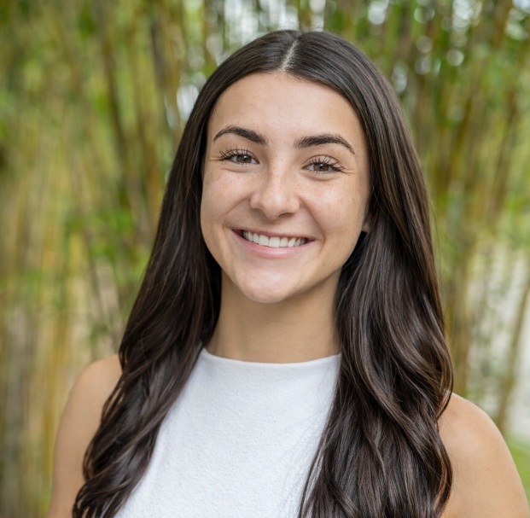
TRC: Natalie Mueller, Project Manager III
6 months with FDOT
  Project Management
Contact Information:
  863-519-2837
  Natalie.Mueller@dot.state.fl.us

Slide 4
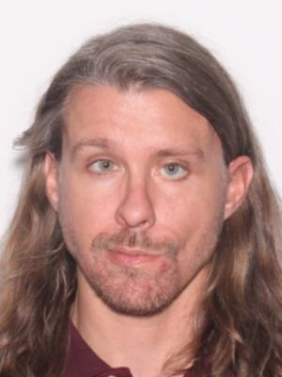
TRC: Taylor Smith, District Pavement Evaluation Engineer
4 years 2 months with FDOT
  D1 Materials
Contact Information:
  863-519-4221
  Taylor.Smith@dot.state.fl.us

Slide 5
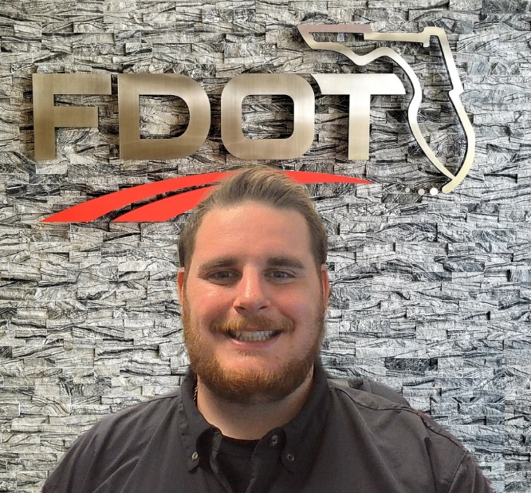
TRC: Cory Snyder, FMS/AMS Specialist IV
2 years 10 months with FDOT
  Manatee County Satellite Traffic Management Center
Contact Information:
  239-240-7925
  Cory.Snyder@dot.state.fl.us

Slide 6
Funding:
Design:
  $1.4M funded in FY27
  ROW:
  No ROW expected
Construction:
  $11.2M programmed in FY29

Slide 7
Consultant Responsibilities
Major Work Type: 3.1 Minor Highway Design
Minor Work Type(s):
  4.1.1 Miscellaneous Structures
  7.1 Signing, Pavement Marking & Channelization
  7.2 Lighting
  7.3 Signalization
  8.1 Control Surveying
  8.2 Design, Right-of-Way & Construction Surveying

Slide 8
Major Scope Items
Milling and resurfacing of the existing roadway mainline and any side street connections
Replace guardrail, end anchorage, and guardrail transition to rigid barrier along the NB approaches of the Green Bridge, if needed
Update 8 signals for FDM requirements and partial replacement of signal at Manatee Ave
Adding crosswalks at the approaches of signalized intersections

Slide 9
TRC Considerations
  Explain your team’s structures experience with bridge joint replacement, application of sealant, and removal of pavement markings.
  Explain your approach to coordinating with multiple maintaining agencies for signal detection and MOT.
  What do you foresee being the biggest challenge with this specific project and explain your plan to mitigate it?

Slide 10
Dos and Don’ts for LOR
Don’t:
  Don’t use multiple colors throughout the text. We print in black and white.
  Don’t assume just because the TRC has worked with you in the past that we will take your past work into consideration. The only way to be fair is to read every letter like we’ve never met you. If it’s not in the letter, it won’t be taken into consideration when shortlisting.
Do:
  Listen to your TRC considerations.
  This TRC prefers a two-column format.

Slide 11
https://outlook.office365.com/book/D1TRCMarketingMeetings@fldot.onmicrosoft.com/s/QeH3BvVwg0uTYZBRiwWulg2?ismsaljsauthenabled
This time is for you to ask questions and get clarification, so the information contained in this presentation will not be repeated by the TRC.
If you would like to schedule your
20-minute marketing meeting, please use the bookings link on the Advertisement (link below).

