Slide 1
451026-1-32-01 Ad # 25111 RRR Project: SR 45 (US 41) FROM N OF MAGELLAN DR TO N OF 63RD AVE W Manatee County
Project Manager:
Marie Carvajal
863-519-2669

Slide 2
Important CAP Dates:
Advertisement: June 21, 2024
Contact ceases with all FDOT staff (except PSU)
Interviews: August 21, 2024
Final Selection: September 3, 2024

Slide 3
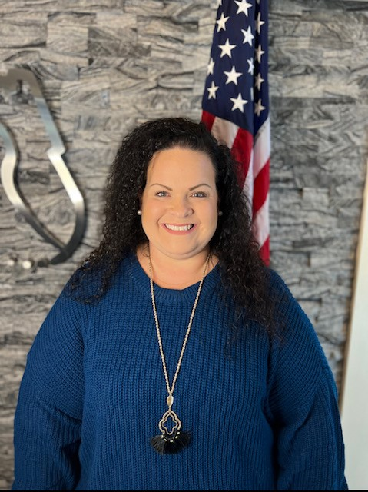
TRC: Marie Carvajal, Design Project Manager III
4 Years with FDOT
Procurement – 3 years
Project Management – 1 year
Contact Information:
863-519-2669
Marie.Carvajal@dot.state.fl.us

Slide 4
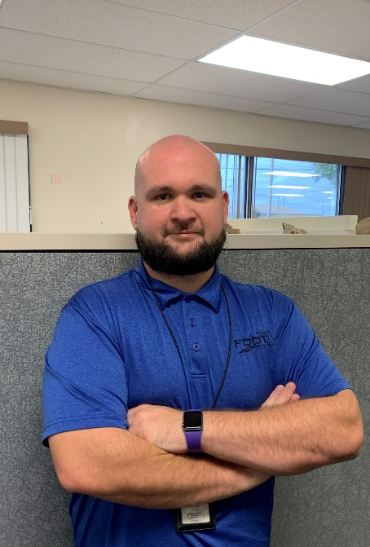
TRC: Davidge Turley, District 1/7 Materials Geotechnical Coordinator
7 years with FDOT
7 years in Materials
Contact Information:
(863) 519-4254
davidge.turley@dot.state.fl.us

Slide 5
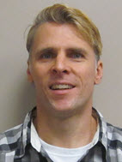
Design TRC: Randy Lachler, Roadway Engineer I
25 years with FDOT
P.E. Trainee Program – 4 years
Structures – 2 years
Roadway Design – 19 years
Contact Information:
863-519-2548
Randy.Lachler@dot.state.fl.us

Slide 6
Funding:
Design:
$916,164 funded in FY25
ROW:
No anticipated ROW required
Construction:
$4.8M funded in FY27

Slide 7
Consultant Responsibilities
Major Work Type: 3.1 Minor Highway Design
4.1.1 Miscellaneous Structures
7.1 Signing, Pavement Marking & Channelization
7.3 Signalization
8.1 Control Surveying
8.2 Design Right of Way & Construction Surveying

Slide 8
Major Scope Items
Milling and Resurfacing SR 45 (US 41) FROM N OF MAGELLAN DR TO N OF 63RD AVE W
Signing & Pavement Marking
Handrail Evaluation/Replacement
Guardrail
Drainage Inlet Replacement

Slide 9
TRC Considerations for LOR
Instead of listing specific topics we want you to cover, we ask you answer the following questions in your letter:
What are your team’s initial recommendations for pavement design?
Describe one low-cost/high-impact innovative idea your firm would suggest on this project or has implemented on a RRR past project?
Discuss your approach to coordination regarding the proposed projects within the same limits.

Slide 10
The Letter
Don’t:
Don’t use excessive graphics and pictures.
Don’t use multiple colors throughout the text. We print black and white.
Don’t assume just because the TRC has worked with you in the past that we will take your past work into consideration. The only way to be fair is to read every letter like we’ve never met you. If it’s not in the letter, it won’t be taken into consideration when shortlisting.
Don’t contact anyone regarding this project except FDOT. This project is “no call” until told otherwise.
Do:
Listen to your TRC.
This TRC prefers a two-column format.
Check for grammatical errors. If you can’t QC a letter, how do we expect you to QC plans?

Slide 11
Meetings are being held on: Monday May13th from 9:00 am-4:00pm Tuesday May 14th from 9:00 am-12:00pm Wednesday, May 15th from 9:00 am-3:00pm ***This time is for YOU to ask questions and get clarification, so information contained in this PowerPoint will not be repeated by the TRC.***
If you would like to schedule your 20-minute marketing meeting, please go to PDA for the booking link.

