Slide 1
FPID 420932-2-32-01 Ad # 25101 FDOT D1 Drainage Permits Review Consultant - Continuing Services Contract
In-House Design Project Manager
Caitlyn James
Caitlyn.James@dot.state.fl.us

Slide 2
If you have not done so, please email the project manager, Caitlyn James, directly at Caitlyn.James@dot.state.fl.us to book a marketing meeting. There are limited dates and times available.

Slide 3
Important CAP Dates
Advertisement: March 11, 2024
No contact with FDOT staff, other than the Professional Services Unit and Procurement, after this date.
Procurement Method: Interviews
Shortlist Selection
April 16, 2024
Interviews
May 1, 2024
Final Selection
May 14, 2024
No debriefs until 72 hours after final selection

Slide 4
Funding
$300,000 per year for this 5-year contract has been programmed with a 5 million dollar cap.

Slide 5
Common Tasks with this contract:
Assist FDOT staff in reviewing drainage connection permit applications and exemptions.
ERC reviews.
Preparing contract plans, storm water analysis and other documentation needed further for the design of a specific FDOT project.
Meet with agencies in the field for site visits.
Attend/assist with Agencies permit discussion and pre-application meetings.

Slide 6
Documents
Located on PSU’s FTP site
FDOT Scope
Additional items may be uploaded

Slide 7
Technical Review Committee (TRC)
Brent Setchell
Caitlyn James
Anthony Celani

Slide 8
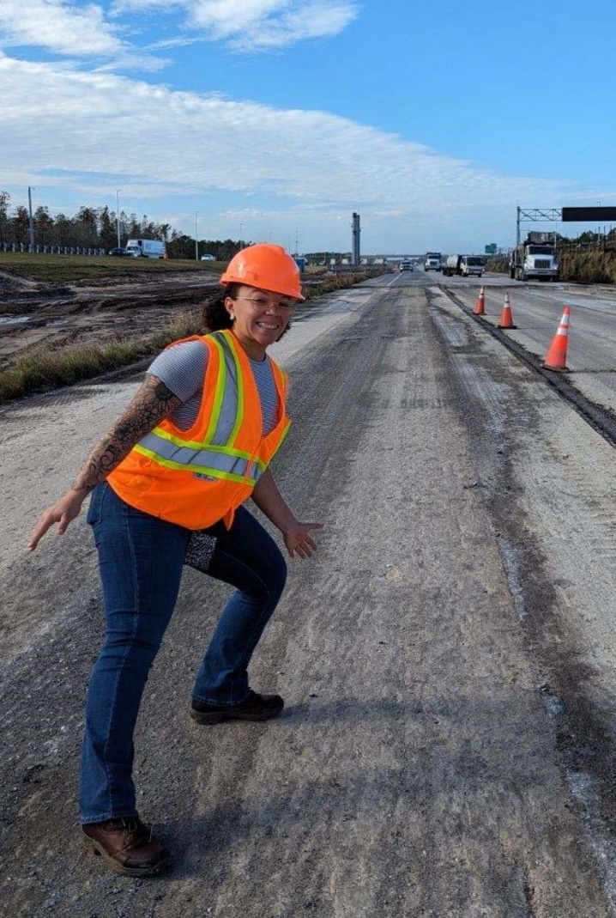
Design Project Manager: Caitlyn James District Drainage Permits Coordinator
4 years with FDOT
Drainage Permits Coordinator
Looking for
Well organized letter (including formatting).
The letter should be easy to go back & find information in.
Demonstrate you understand what is needed for this contract and have adequate/experienced staff. Team organization and communication.
Contact Information
Caitlyn.James@dot.state.fl.us
(863) 519-2586

Slide 9
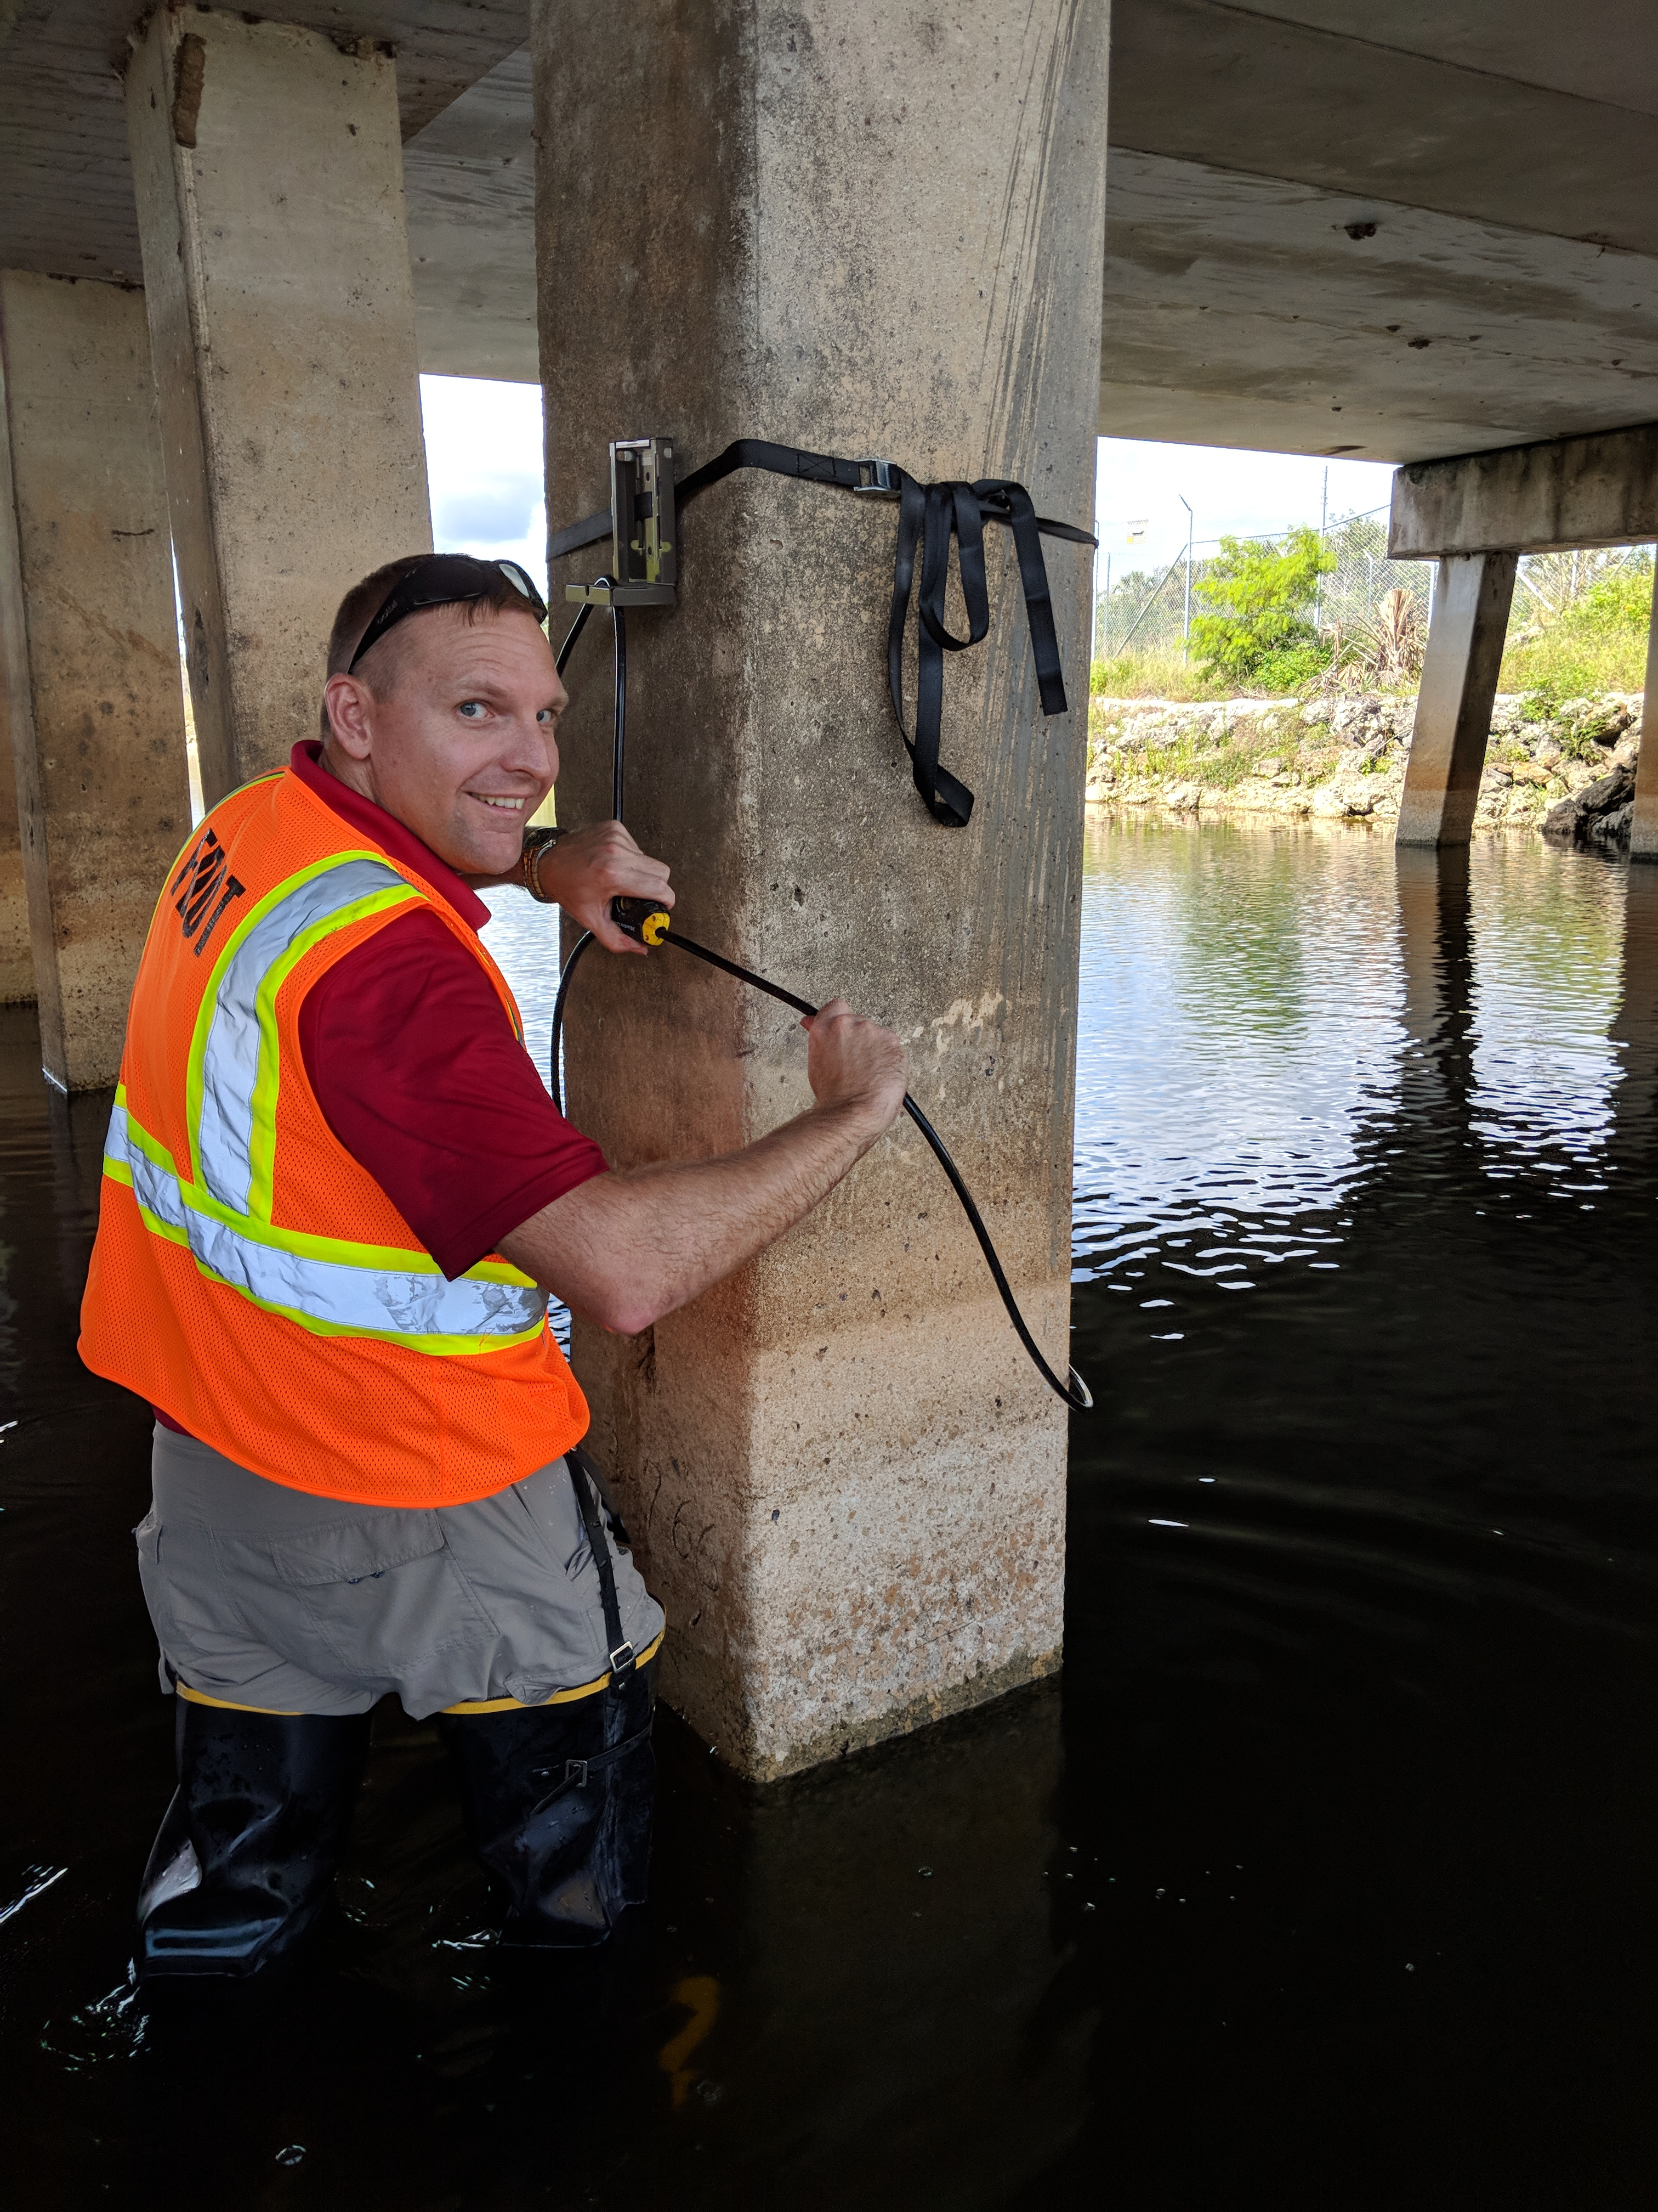
TRC Member: Brent Setchell, District Drainage Design Engineer
15 years with FDOT
8 Years as the District Drainage Design Engineer
Looking For
Approach to contract
Efficiency/Innovation
Contact Information
Brent.Setchell@dot.state.fl.us
(863) 519-2557

Slide 10
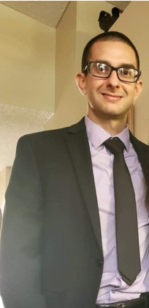
TRC Member: Anthony (Tony) Celani, PE Assistant District Drainage Design Engineer
4 years with FDOT (12 additional years as a consultant)
Lead EOR Drainage Design (In-House Projects)
Drainage Flooding Investigations
Looking For
Experienced Staff
Ability to handle difficult applicants
Contact Information
Anthony.Celani@dot.state.fl.us
(863) 519-2839

Slide 11
Suggestions for the Letter of Interest
Do:
Ask questions and listen to your TRC.
This TRC prefers a two-column format letter.
If you reference a specific project or work with an agency or other District, please include contact information.
Check for grammatical errors. It is a direct reflection of your QC abilities.
Include only key staff, their role in this contract, and years of experience.
PM & DPM listed
Avoid:
Be sure information is not duplicated.
Be conscious of what colors you use throughout the text that may not print well.
Don't assume just because the TRC has worked with you in the past that we will take your past work into consideration. The only way to be fair is to read every letter like we've never met you. If it's not in the letter, it will not be taken into consideration when shortlisting.

