Slide 1
TRAFFIC OPERATIONS ITS CONSULTANT
CONTINUING SERVICES CONTRACT
AD 26131
417470-2-32-02
Project Manager
Cassie Lee

Slide 2
Important CAP Dates
Advertisement – 1/5/2026
  District's Cone of Silence begins at 4 pm on 1/2/2026
  Contact ceases with all FDOT staff (except PSU)
Letter of Response deadline – 1/20/2026
Shortlist Selection – 2/10/2026
Abbreviated Technical Proposals deadline – 2/25/2026
Final Selection – 3/10/2026

Slide 3
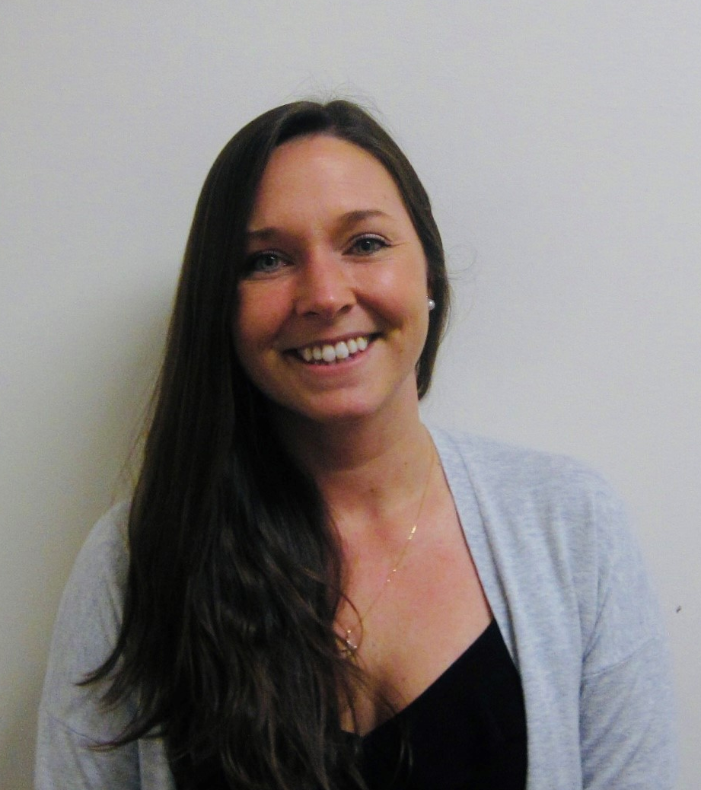
TRC (PM): Cassie Lee, FMS/AMS Specialist IV
FDOT
  Traffic Design – 4 years
  Traffic Operations – 7 years
Contact Information
  863-519-2342
  Cassie.Lee@dot.state.fl.us
Project Focus Areas
  Experience with CSC in other Districts
  Lessons Learned with Design Tasks/Projects
  Any Interesting/Notable Project Related Tasks Around the State

Slide 4
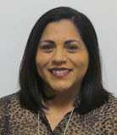
TRC: Belinda Thomas, FMS/AMS Specialist IV
FDOT
  Procurement – 13 years
  Traffic Operations – 4 years
Contact Information
  863-519-2726
  Belinda.Thomas@dot.state.fl.us
Project Focus Areas
  Schedule Management with Multiple Tasks
  Process Improvements
  Innovation, Research & Pilot Projects

Slide 5
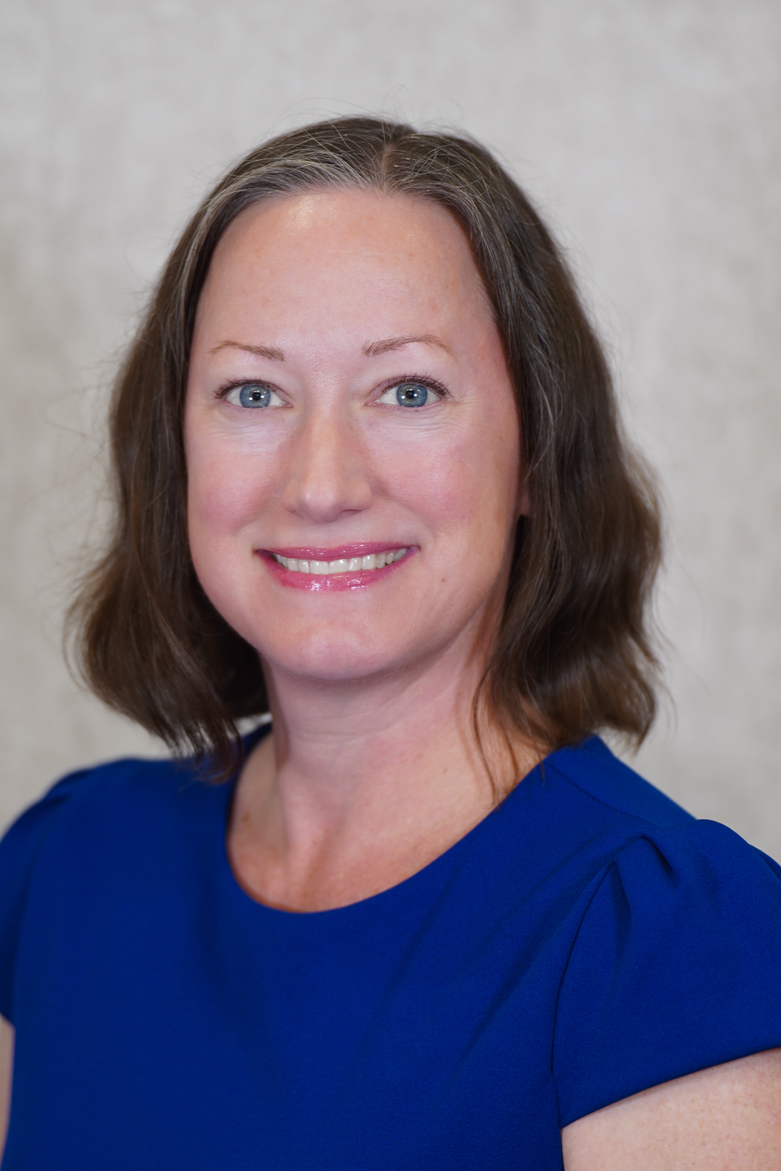
TRC: Katherine Chinault, TSM&O Development Manager
FDOT
  Traffic Operations – 17 years
  M-CORES – 2 years
  Special Projects – 2 years
Contact Information
  863-519-2511
  Katherine.Chinault@dot.state.fl.us
Project Focus Areas
  Innovation and Emerging Trends
  ITS Solutions for Diverse Communities
  Leveraging AI for ITS Capabilities

Slide 6
Anticipated Funding
FY 26 – $20,000
FY 27 – $500,000
FY 28 – $500,000
FY 29 – $500,000
FY 30 – $500,000
FY 31 – $500,000
Total funding available - $2,520,000

Slide 7
Consultant Responsibilities
Major Work Type
6.3.1 - Intelligent Trans Systems Analysis & Design
6.3.2 - Intelligent Trans Systems Implementation
6.3.3 - Intelligent Trans Systems Traffic Engineering Systems Communications
Minor Work Types
3.1 - Minor Highway Design
4.1.1 - Miscellaneous Structures
6.1 - Traffic Engineering Studies
6.2 - Traffic Signal Timing
6.3.4 - Intelligent Trans Software Development
7.1 - Signing, Pavement Marking & Channelization
7.3 – Signalization
10.1 – Roadway CEI
Notes:
Consultant Responsibilities for this project will include:

Slide 8
TRC Considerations for LOR
Desired Experience
Systems Engineering
ATMS Master Plans
Design Plans
Connected & Autonomous Vehicle
Truck Parking Availability System
Support for Various Contracting methods
Communication
Quality Products
Notes:
Here are the TRC Consideration for the LOR’s

Slide 9
The Letter
  Use of graphics should add value to the letter.
  TRC prints in black and white, so colors may not be correctly represented.
  Shortlisting will be based on information in the letter and not previous experience with the TRC or the Department.
  Ask questions of and listen to your TRC.
  This TRC prefers a two-column format.
  Check for grammatical errors and edit for clarity. It is a direct reflection on your QC abilities and written communication skills.
  Include key staff and years of experience, but don’t overload with resume information.
  The letters are your chance to stand out, so make it count.

Slide 10
Anticipated Tasks
  Stakeholder Engagement and Presentations
  Concepts of Operations
  Systems Engineering Documentation –
  Low & High Risk
  Post Design Services for ITS Projects
  Concepts & Full Design Plans
  Creating ITB & RFP Documents
  Ramp Metering (Analysis & Modeling)
  Interstate Diversion Route Planning
  Examples of Unique Tasks Previously Assigned:
  New Procedure White Paper & Magazine Article Writing
  Reverberation Time Measurements (SWIFT Center RTMC)
  511 Sign Inventory with GPS Location

Slide 11
If you would like to schedule a 20-minute marketing meeting,
please contact Cassie Lee at
Cassie.Lee@dot.state.fl.us or 863-519-2342.
Marketing meetings can be in-person or virtual
In-person meetings will be located at 801 N. Broadway Ave, Bartow, FL 33830
Meetings are being held on:
Monday, December 15th and Tuesday, December 16th
This time is for you to ask questions and get clarification.

Slide 12

Notes:
All motorists should use extra caution when driving around bicyclists, motorcyclists and commercial motor vehicles (CMV). The Florida Department of Highway Safety and Motor Vehicles reminds everyone to Share the Road, so all road users can Arrive Alive!
In Florida, the bicycle is legally defined as a vehicle and has all of the privileges, rights and responsibilities on public roads (except for expressways) that a motor vehicle operator does.
Bicyclists may ride out of the bike lane in the travel lane for their own safety on narrow roads to avoid obstacles or pavement hazards, or to prepare for a left turn.
A bicyclist may use the full lane even while traveling substantially below the speed of traffic if the lane is too narrow for both a car and bicycle to share.
To share the road, motorists can:
Slow down! Speed is the cause of 27% of all fatal crashes.
Avoid distractions while driving. Focus on the road. Always watch for pedestrians.
Pass bicyclists safely. Allow a minimum of three feet between your vehicle and the bicyclist.

