Slide 1
Ad # 26114 FPID 450671-1-32-01 SR 25 (US 27) AT FLAGHOLE RD
Design Project Manager:
Jennifer Freeman
863-519-2543

Slide 2
Important CAP Dates:
Advertisement: May 12, 2025
Contact ceases with all FDOT staff (except PSU)
Procurement Method: ELOR
Response Deadline: May 27, 2025
Shortlist Selection: June 24, 2025
Final Selection: July 15, 2025
No debriefs until 72 hours after final selection

Slide 3
Anticipated Work Groups
Major Work Type: 3.1 Minor Highway Design
4.1.1 Miscellaneous Structures
7.1 Signing, Pavement Marking, and Channelization
8.1 Control Surveying
8.2 Design, Right of Way, and Construction Surveying

Slide 4
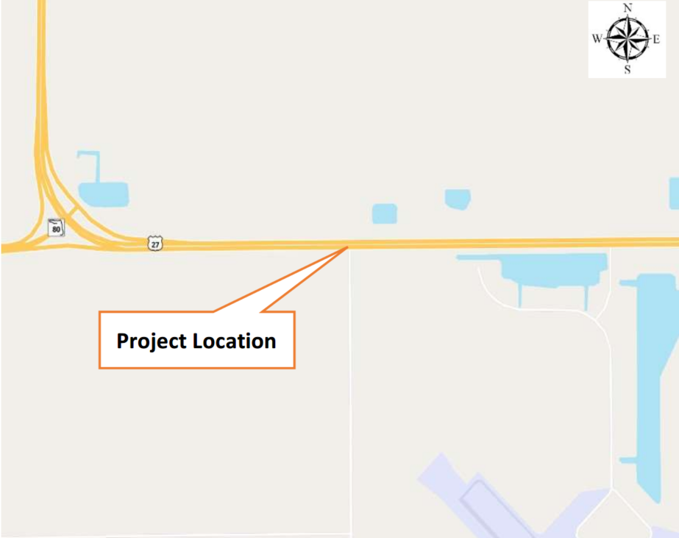
Project Overview FM 450671-1

Slide 5
Project Overview
Project Scope
Rigid pavement reconstructon
Signing/Pavement Marking
Survey
3D
Design Variations
No keyhole
Utility Coordination
SUE

Slide 6
Funding
Design
450671-1-32-01 $850,000 in FY 2026
Right-of-Way
No Right-of-Way Anticipated
Construction
450671-1-52-01 $5,089,676 in FY 2028

Slide 7
Technical Review Committee (TRC)
Jennifer
Freeman
David Henderson
Randy Lachler

Slide 8
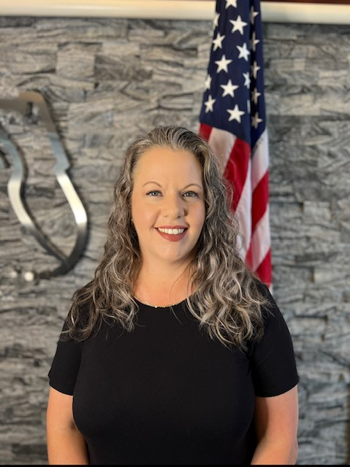
PM/TRC: Jennifer Freeman, Consultant Project Manager
11 years with FDOT
4 Years in Financial Services
4 Years in Materials
3.5 years in Project Management
Hot Button: QA/QC
Contact Information:
(863) 519-2543
Jennifer.Freeman@dot.state.fl.us

Slide 10
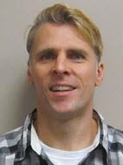
Design TRC: Randy Lachler, Roadway Engineer I
26 years with FDOT
P.E. Trainee Program – 4 years
Structures – 2 years
Roadway Design – 20 years
Contact Information:
863-519-2548
Randy.Lachler@dot.state.fl.us

Slide 11
Documents on PSU’s FTP site:
4P Technical Scope
Typical Sections
As-Builts
LRE

Slide 12
TRC Considerations for your ELOR – This is what we want to see in your letter.
Project approach: understanding scope, unique project issues, safety and context.
Relevant staff experience and knowledge of rigid pavement design processes.
Approach to constructability of concrete on the side road to allow access?
How will the MOT be phased so it is aligned with the concrete joints?
Quality of the letter.

Slide 13
Suggestions for the Letter of Interest
Listen to your TRC.
Use of graphics should add value to the letter.
TRC prints in black and white, so colors may not be correctly represented.
This TRC prefers a two-column format.
If you reference a specific project, please include contact information.
Check for grammatical errors. It is a direct reflection on your QC abilities.
Include key staff and years of experience, but don’t overload with resume information.
This letter is your chance to stand out, so make it count.
Be sure to check PSU’s marketing site for updates.

Slide 14
Meetings are being held on: 4/23/2025 4/30/2025 5/1/2025 This time is for you to ask questions and get clarification, so be prepared to ask the TRC questions. This is not the time to market yourself, that is what your letter is for.
If you would like to schedule your 20-minute marketing meeting, please follow this link:
https://outlook.office365.com/owa/calendar/D1TRCMarketingMeetings@fldot.onmicrosoft.com/bookings/s/VWRM6UfB3EibnendUi7PbQ2

