Slide 1

454941-1-32-01
Ad # 26106
RRR Project:
SR 544 from SR 600 (US 92) to W of 8th Street NW (US 17)
Polk County
Project Manager:
Amber Albritton
863-519-2668

Slide 2
Important CAP Dates:
Advertisement: February 21, 2025
  Contact ceases with all FDOT staff (except PSU)
Interviews: April 23, 2025
Final Selection: May 6, 2025

Slide 3
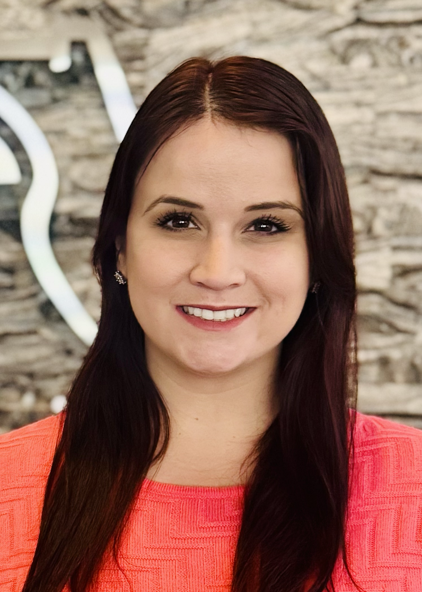
TRC: Amber Albritton, Project Manager III
9 Months with FDOT
  Project Management – 9 Months
Contact Information:
  863-519-2668
  Amber.Albritton@dot.state.fl.us

Slide 4
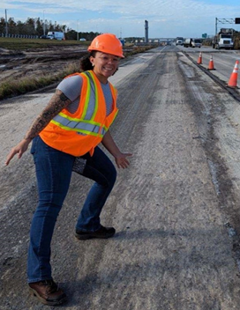
TRC: Caitlyn James, District Drainage Permits Coordinator
4.5 years with FDOT
  Drainage Permits Coordinator – 1.5 years
  Procurement – 3 years
Contact Information:
  (863) 519-2586
  Caitlyn.James@dot.state.fl.us

Slide 5
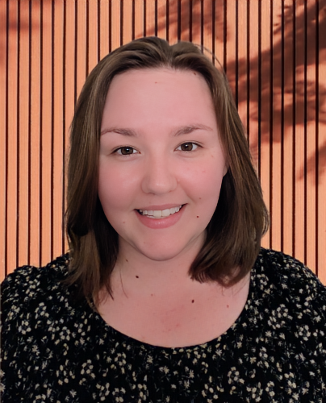
TRC: Sherry Mitchem, Traffic Designer IV
3 Years with FDOT
  Traffic Design – 3 years
Contact Information:
  863-519-2583
  Sherry.Mitchem@dot.state.fl.us

Slide 6
Funding:
Design:
  $1.2M funded in FY26
  Programmed design estimates were based on the full 4P scope. Please note the removal of scope items will affect the estimate fee.
  ROW:
  No ROW required
Construction:
  $15.1M funded in FY28

Slide 7
Consultant Responsibilities
Major Work Type: 3.1 Minor Highway Design
  4.1.1 Miscellaneous Structures
  6.1 Traffic Engineering Studies
  6.2 Traffic Signal Timing
  7.1 Signing, Pavement Marking & Channelization
  7.2 Lighting
  7.3 Signalization
  8.1 Control Surveying
  8.2 Design, Right of Way, & Construction Surveying

Slide 8
Major Scope Items
Milling and resurfacing SR 544 from SR 600 (US 92) to W of 8th St NW (US 17)
  Milling depth of 3 1/2”
  Subject to change based on pavement cores
Signing & pavement marking
Signalization
Concrete Traffic Separators/Median
Utility Coordination
Sidewalk
  Fill in the gap along the south side of the roadway from MP 0.140 to MP 0.490
Intersection Improvements

Slide 9
TRC Considerations for LOR
Instead of listing specific topics we want you to cover, we ask you answer the following questions in your letter:
Describe the experience you and your proposed team have on this type of project. Please give examples as well as provide PM contact information.
Discuss the challenges you expect to face when designing the Derby intersection and how you plan to overcome those challenges.

Slide 10
The Letter
Don’t:
  Don’t use excessive graphics and pictures.
  Don’t use multiple colors throughout the text. We print black and white.
  Don’t assume just because the TRC has worked with you in the past that we will take your past work into consideration. The only way to be fair is to read every letter like we’ve never met you. If it’s not in the letter, it won’t be taken into consideration when shortlisting.
  Don’t contact anyone regarding this project except FDOT. This project is “no call” until told otherwise.
Do:
  Listen to your TRC.
  This TRC prefers a two-column format.
  Check for grammatical errors. If you can’t QC a letter, how do we expect you to QC plans?

Slide 11
Meetings are being held on:
Tuesday, February 11th from 8:30am-4:30pm
Wednesday, February 12th from 8:30am-4:30pm
Thursday, February 20th from 10:00am-3:00pm
This time is for you to ask questions and get clarification, so information contained in this presentation will not be repeated by the TRC.
If you would like to schedule your
20-minute marketing meeting, please go to PDA for the booking link.

