Slide 1
ISD PLANNING - CORRIDOR PLANS & COMPLETE STREETS ANALYSES AD 26104 439029-1
Project Manager
Erica McCaughey

Slide 2
Important CAP Dates:
Advertisement – 3/3/25
District's Cone of Silence begins at 4 pm on 2/28/25
Contact ceases with all FDOT staff (except PSU)
Letter of Response deadline – 3/17/25
Interviews – 4/24/25
Final Selection – 5/6/25

Slide 3
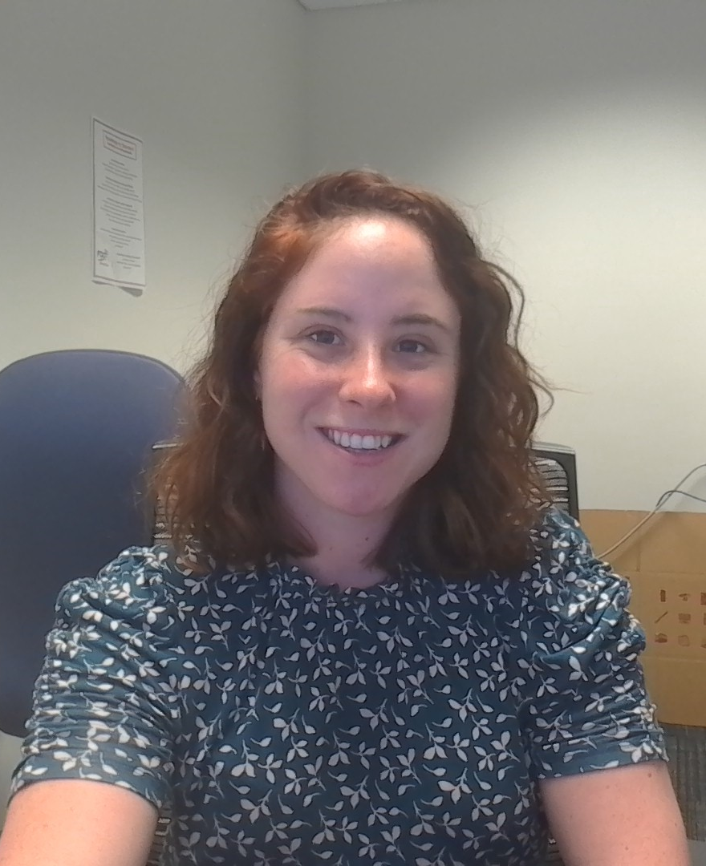
TRC (PM): Erica McCaughey, Complete Street Coordinator
FDOT
Planning Studio – 1.5 years
Contact Information
239-225-1914
erica.mccaughey@dot.state.fl.us
Concerns
Understanding of Context Classification
Consistent Communication
Innovation

Slide 4
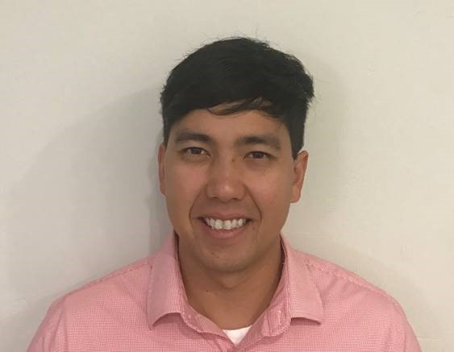
TRC: Vitor Suguri, Planning Studio Manager
FDOT
Planning Studio – 5 years
Contact Information
863-221-1707
Vitor.suguri@dot.state.fl.us
Concerns
Implementing Complete Streets
Ability to focus on people
Innovation

Slide 5
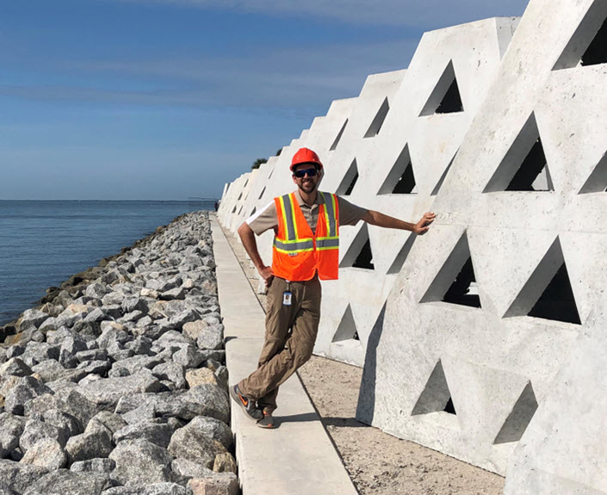
TRC: Sergio Figueroa, District Roadway Design Engineer
FDOT
Drainage – 9 years
Roadway – 2 years
Contact Information
863-519-2839
Sergio.figueroa2@dot.state.fl.us
Concerns
Innovation
Context Classification
Design Elements/Criteria

Slide 6
Anticipated Funding
FY 26
$100,000 ​
FY 27
$50,000​
FY 28
$300,000​
FY 29
$300,000
Total
$750,000

Slide 7
Consultant Responsibilities
Major Work Type
13.5 Subarea/ Corridor Planning
Minor Work Types
6.3.1 ITS Analysis and Design
13.3 Policy Planning
13.4 Systems Planning
13.6 Land Planning / Engineering
Notes:
Consultant Responsibilities for this project will include:

Slide 8
TRC Considerations for LOR
People’s perspective on connection between Land Use and Transportation
GIS experience
Communication
Context-sensitive design
Quality Products
Notes:
Here are the TRC Consideration for the LOR’s

Slide 9
The Letter
Ask questions of and listen to your TRC.
Use of graphics should add value to the letter.
TRC prints in black and white, so colors may not be correctly represented.
This TRC prefers a two-column format.
If you reference a specific project, include contact information.
Check for grammatical errors and edit for clarity. It is a direct reflection on your QC abilities and written communication skills.
Review CAP presentation if you have not pursued work in District One recently.
Include only key staff and years of experience.

Slide 10
If you would like to schedule your 20-minute marketing meeting, please contact Erica McCaughey at erica.mccaughey@dot.state.fl.us.
Marketing Meetings can be in-person or virtual. In-person meetings will be located at 801 N. Broadway Ave Bartow, FL 33830
Meetings are being held on:
2/14, 2/20, and 2/25.
This time is for you to ask questions and get clarification.

Slide 11
Notes:
All motorists should use extra caution when driving around bicyclists, motorcyclists and commercial motor vehicles (CMV). The Florida Department of Highway Safety and Motor Vehicles reminds everyone to Share the Road, so all road users can Arrive Alive!
In Florida, the bicycle is legally defined as a vehicle and has all of the privileges, rights and responsibilities on public roads (except for expressways) that a motor vehicle operator does.
Bicyclists may ride out of the bike lane in the travel lane for their own safety on narrow roads to avoid obstacles or pavement hazards, or to prepare for a left turn.
A bicyclist may use the full lane even while traveling substantially below the speed of traffic if the lane is too narrow for both a car and bicycle to share.
To share the road, motorists can:
Slow down! Speed is the cause of 27% of all fatal crashes.
Avoid distractions while driving. Focus on the road. Always watch for pedestrians.
Pass bicyclists safely. Allow a minimum of three feet between your vehicle and the bicyclist.

